Slide 1
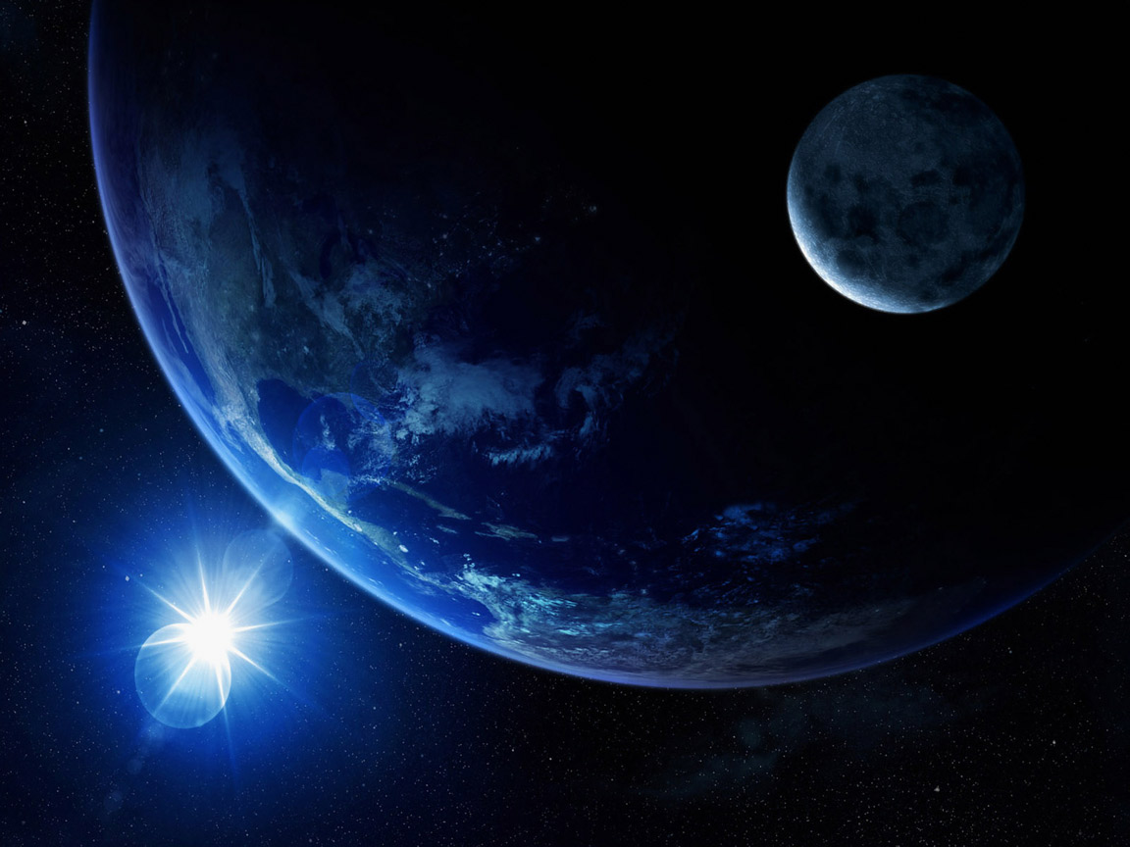
The Revelation
Of Jesus Christ
To John The Beloved … And Us

Slide 2
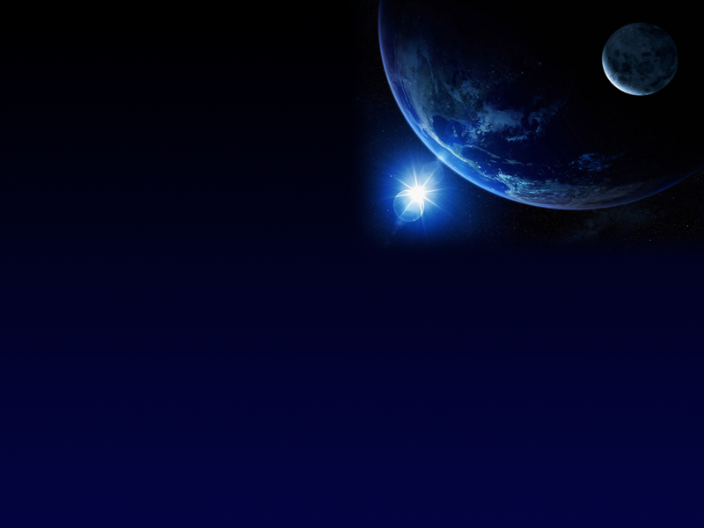
Apocalyptic (to reveal) Literature
Nature:
Filled with images drawn from both contemporary
culture (to John) and the Old Testament
It has a component of future telling, but does not
ignore contemporary events
- It was given often through angelic beings

Slide 3
Apocalyptic (to reveal) Literature
Purposes:
- Bring hope to those who suffer in persecution
- To remind us that God is ultimately in control
- To challenge us to fight deception
What It Is Not:
A perfect road map of events from now to the
Second Coming!

Slide 4
Apocalyptic (to reveal) Literature
Examples:
O.T.
- Ezekiel, last six chapters of Daniel, Zechariah
N.T.
- Revelation, Snippets from 2Peter, Jude
Non-Canonical
- 1Enoch, 4Ezra

Slide 5
Ways To View Revelation:
1) Preterist
a. The belief that all material was fulfilled within Israel’s history
b. The Tribulation, for example, took place in AD 70
2) Historicist
a. Prophecies can be literally linked to historical events and
people
3) Futurist
a. The prophecies given are mostly or completely meant to
describe the future, typically at the return of Christ
4) Idealist
a. General struggles of good and evil
b. Symbols cannot be taken literally
c. Virtually none of the prophetic statements will come to pass

Slide 6
One Possible View …
An Eclectic Approach …

Slide 7
Overarching:
No one will fully understand all that is in this book until it becomes
history for us. Be humble.
Do not ignore the material. It is given for a reason.
Your goal will be an overarching theology that encompasses
all of Scripture.
Revelation is not meant to be completely linear in time.
Use care to determine what can be taken as literal and what is
figurative.
The Old Testament is your best friend in interpreting symbols.

Slide 8

A Possible Scenario
Church Age
Bema Seat
Approx. 483 Years
7 Years
1000 Years
New Heaven & New Earth
Tribulation
Millennium
Nehemiah returns to Israel (445 BCE)
Great White
Throne Judgment
Babylon invades Israel (approx. 587 BCE)
(Time Of The Gentiles begins)

Slide 9
A Possible Scenario
3.5 Years
1260 Days, 42 Months
7 Years
1000 Years
Tribulation
Millennium
Great White
Throne Judgment
The Rapture?
1 Thess. 4
1 Cor. 15
The Abomination
Of Desolation
Matthew 24, Daniel 9
Return Of Christ

Slide 10
Bookends:
Where | What |  | Where | What
Gen. 1 | Creation |  | Rev. 21-22 | New Heaven and Earth
Gen. 2 | Marriage |  | Rev. 19 | Marriage supper
Gen. 3 | Sin |  | Rev. 19 | Clothed in righteousness
Gen. 9-11 | First government |  | Rev. 17-18 | Government falls
Gen 10 | The rise of Babylon |  | Rev. 17-18 | The fall of Babylon
Daniel 1-2 | “Time Of The Gentiles” Begins |  | Rev. 19 | “Time Of The Gentiles” ends
Daniel 2-3 | A statue is envisioned and created |  | Rev. 13:14 | Another image is set up
Misc. | God’s exists as Trinity |  | Rev. 13 | The “Dragon”, “Little Horn”, False Prophet
A small percentage of the parallels that exist

Slide 11
Outline:
Chapters 1-3 General introduction and letters to seven churches
Chapters 4-5 John’s vision of heaven
Chapter 6 The Seal Judgments
Chapter 7 Parenthetical – The 144,000 Jews
Chapters 8-9 The Trumpet Judgments
Chapter 10 The little scroll
Chapter 11 The two witnesses
Chapter 12 War in heaven and on earth
Chapter 13 The beast and the false prophet
Chapter 14 The 144,000 and judgment of the earth
Chapter 15-16 The Bowl Judgments
Chapter 17-18 The judgment of Babylon, Ecclesiastical and Economic
Chapter 19 The return of Jesus Christ
Chapter 20-22 Life in the Millennium and beyond

Slide 12
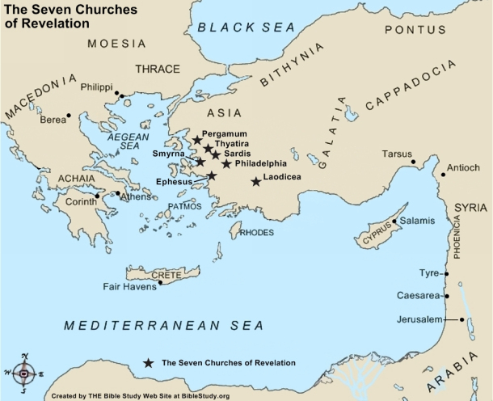
Chapters 1 -3

Slide 13
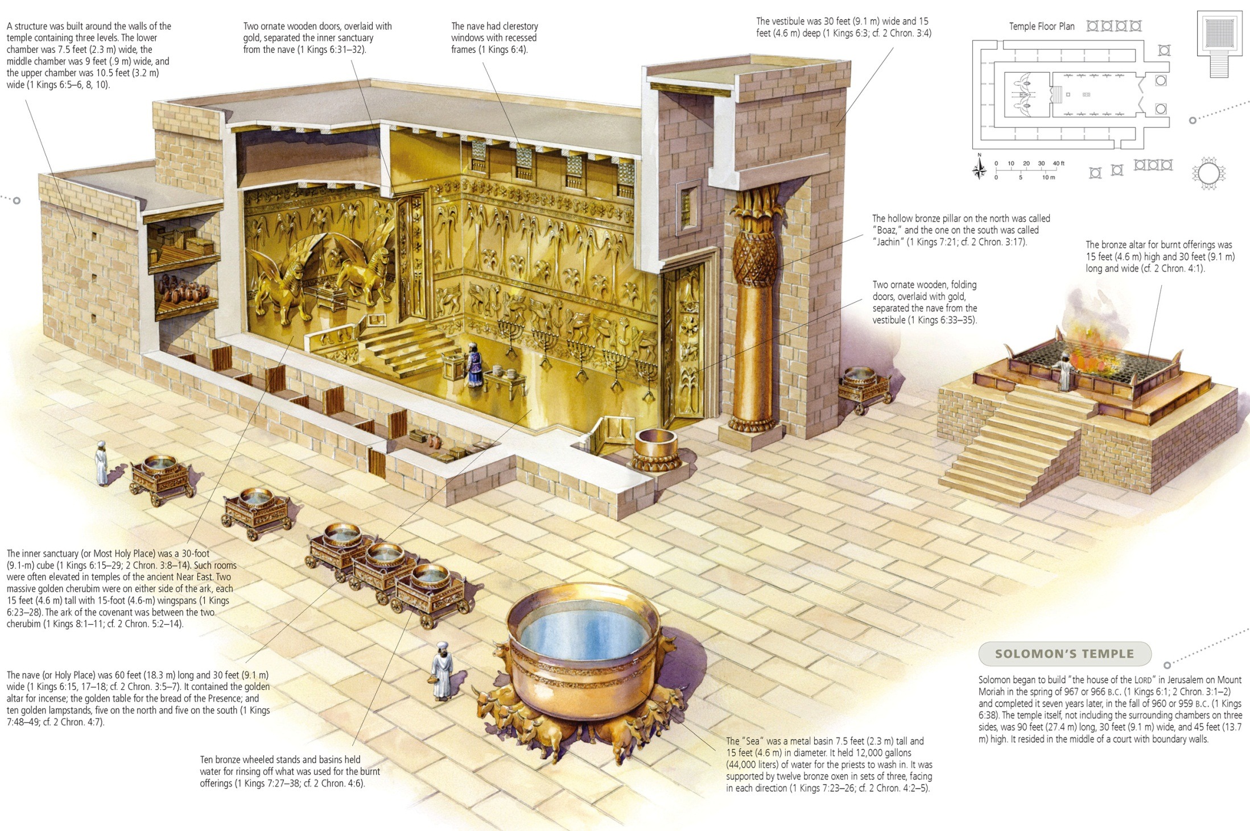
Chapter 4

Slide 14
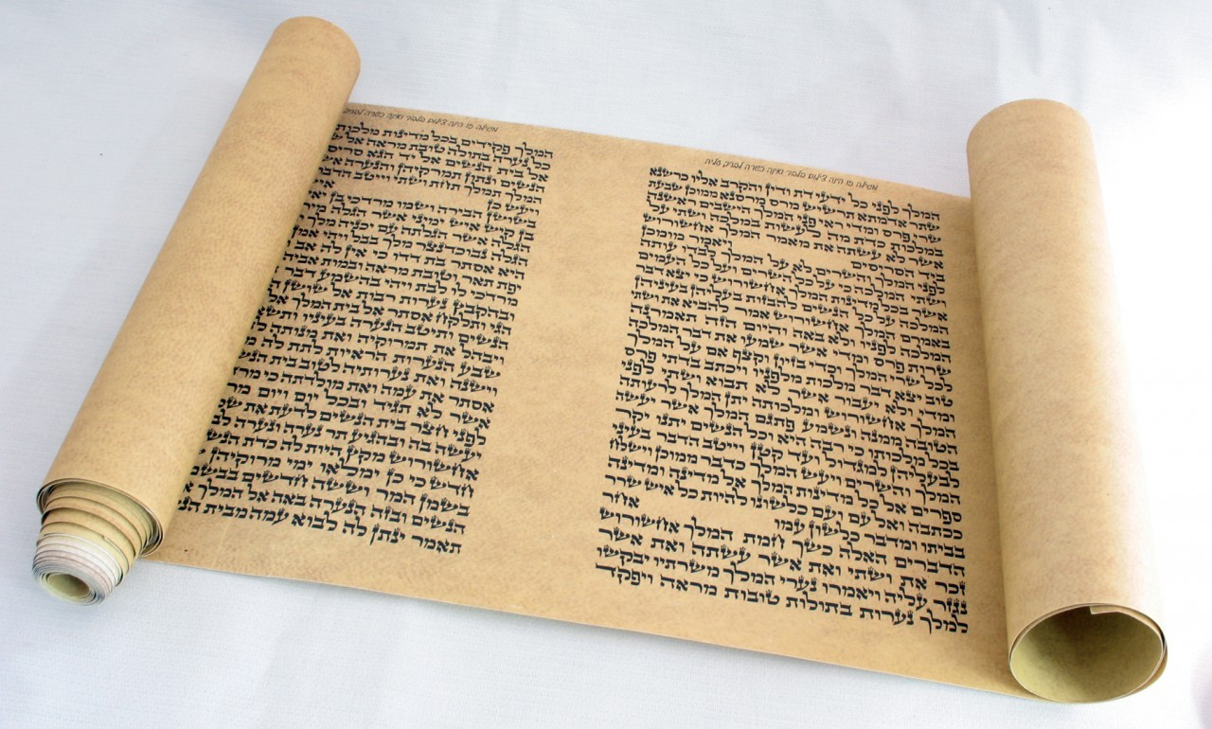
Chapter 5

Slide 15
Chapter 6
The Seal Judgments
1. A White Horse | Deception; Anti-Christ ?
2. A Red Horse | War
3. A Black Horse | Economic Chaos
4. A Pale Horse | Death (physical) & Hades (soul) The sword Famine Plague Beasts
5. Martyrdom
6. A Great Earthquake
7. The release of the next set of plagues

Slide 16
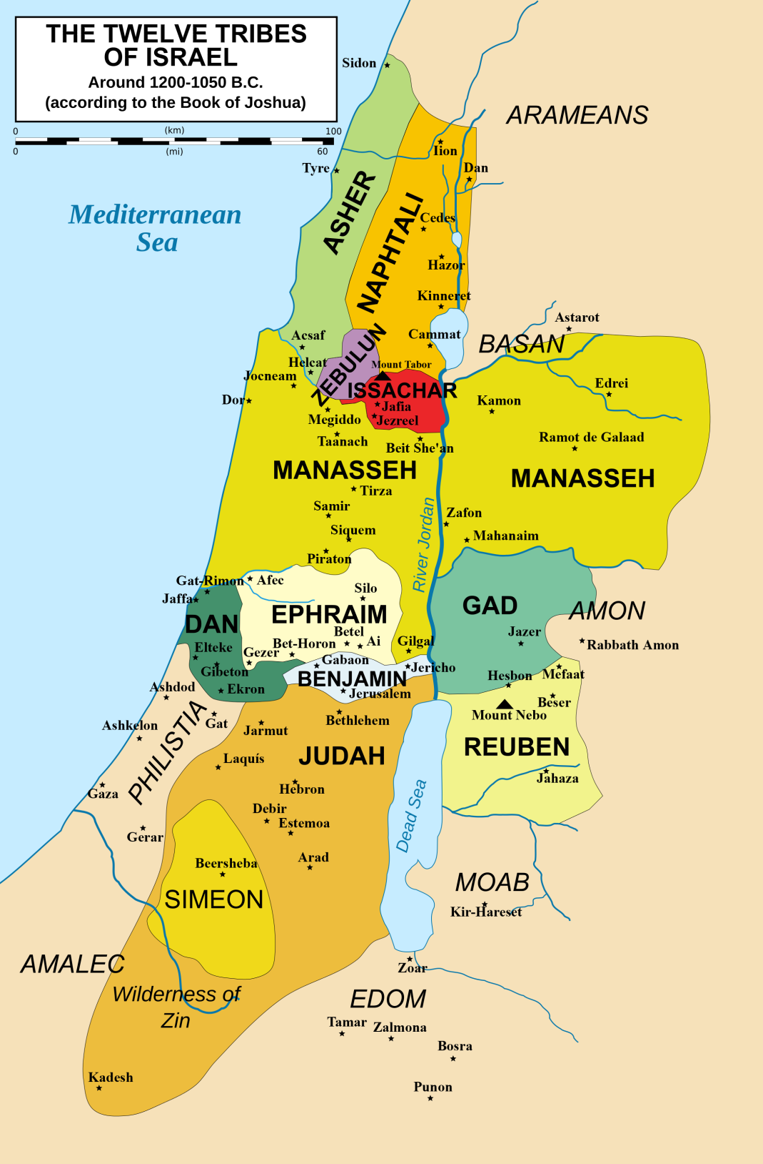
Chapter 7

Slide 17
ChapterS 8-9
The Trumpet Judgments
1. Third of the trees and grass were burned up
2. A third of the sea died (life and ships)
3. A third of the drinking water is left unusable
4. Light from above is reduced by a third
5. Locusts … apparently demonic … apparently bringing delusion
6. A third of humanity killed in war
7. A release of further judgments

Slide 18
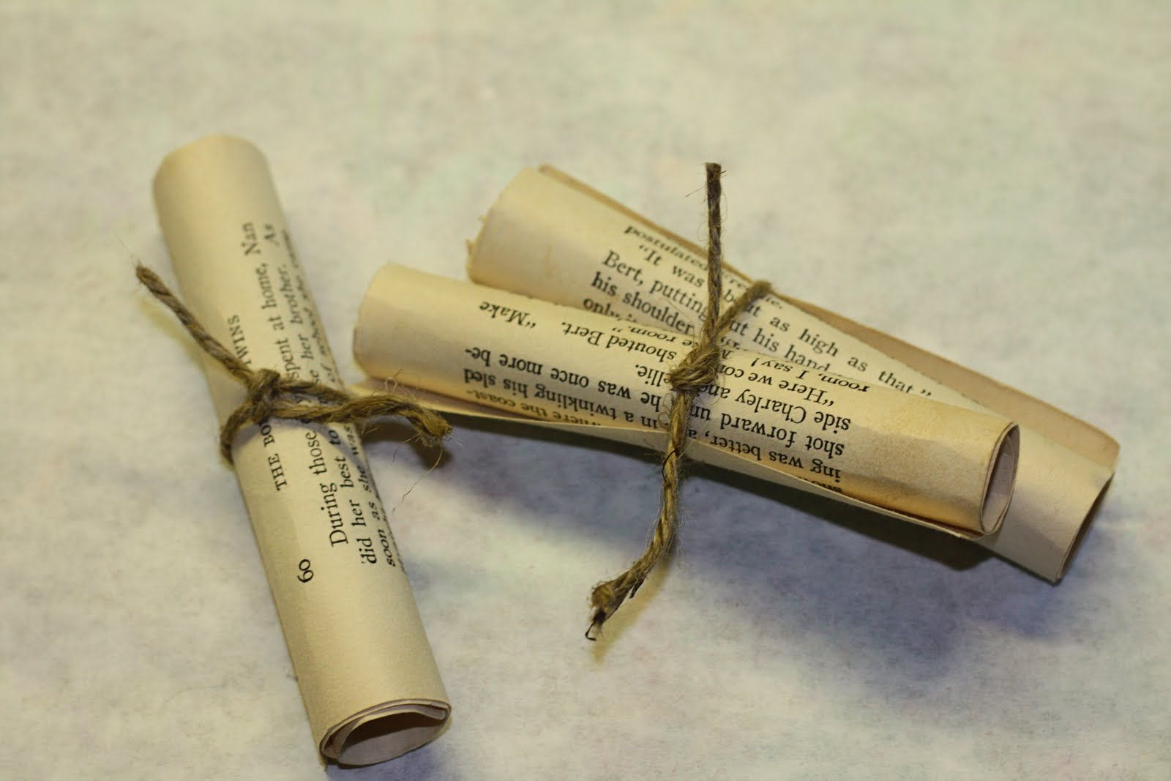
Chapter 10

Slide 19
Chapter 11
The Two Witnesses
Will prophecy for 1260 days (v. 3)
Related to Zechariah 3-4, where they are identified as Zerubbabel (Civil leader) and Joshua (high priest) (v. 4)
Their miracles will include: supernatural protection from enemies, withholding rain, water to blood and other plagues (v. 5-6)
They are killed in Jerusalem (v. 7) and the world watches
They are bodily resurrected (v. 11-12)
They are … who ??

Slide 20
Chapter 12
Symbol | Possible Understanding
A woman | Israel
Red Dragon | Satan
Stars | Fallen angels
A Male Child | Christ
Michael | An Archangel
The woman flees | Abomination Of Desolation

Slide 21
Chapter 13: The Beast
He will rule over all nations (Rev. 13:8)
He is a Gentile, as he rises from the sea (Rev. 13:1)
C) He is like a leopard, bear and lion –
like the empires before him (Rev. 13:2). Therefore
he is a political leader as well
D) One of the kingdoms (or leader) over which he
has authority will have been revived (Rev. 17:10)
E) His rise will have come through a peace program
(Dan. 8:25)

Slide 22
Chapter 13
F) He will receive power from Satan (Rev. 13:4)
- note that the quote here is from Exodus 15:11,
where it is attributed to God
- now it will be used of a man!
G) He will be empowered by Satan for 42 months
(Rev. 13: 5)
H) He will be elevated to his position through the
actions of the “harlot”, a corrupted religious system
(Rev. 17)
I) He will make war with the saints (7-9)

Slide 23
The Practical Lessons
1. Stop looking for the Anti-Christ
2. Watch for persuasive leadership
3. What the world loves … question deeply
4. Be sensitive to blasphemy
5. Retaliation is never the Christian way

Slide 24
The Practical Lessons
False Leaders
Issues Of Control
- The Tongue
- Actions
- Manipulation

Slide 25
The False Prophet
A. He is called the Second Beast
B. He appears to be a Jew
C. He appears to be religious
D. He derives his power from Satan
E. He causes people to worship the Beast
F. He performs signs and wonders

Slide 26
The False Prophet
G. His control will include economic means
Imperial Cult
‘charagma’ … Imperial Seal
H. Creates a statue to be worshipped
Does this remind you of Nebuchadnezzar?
Domitian build his statue in Ephesus (20’ tall!)

Slide 27
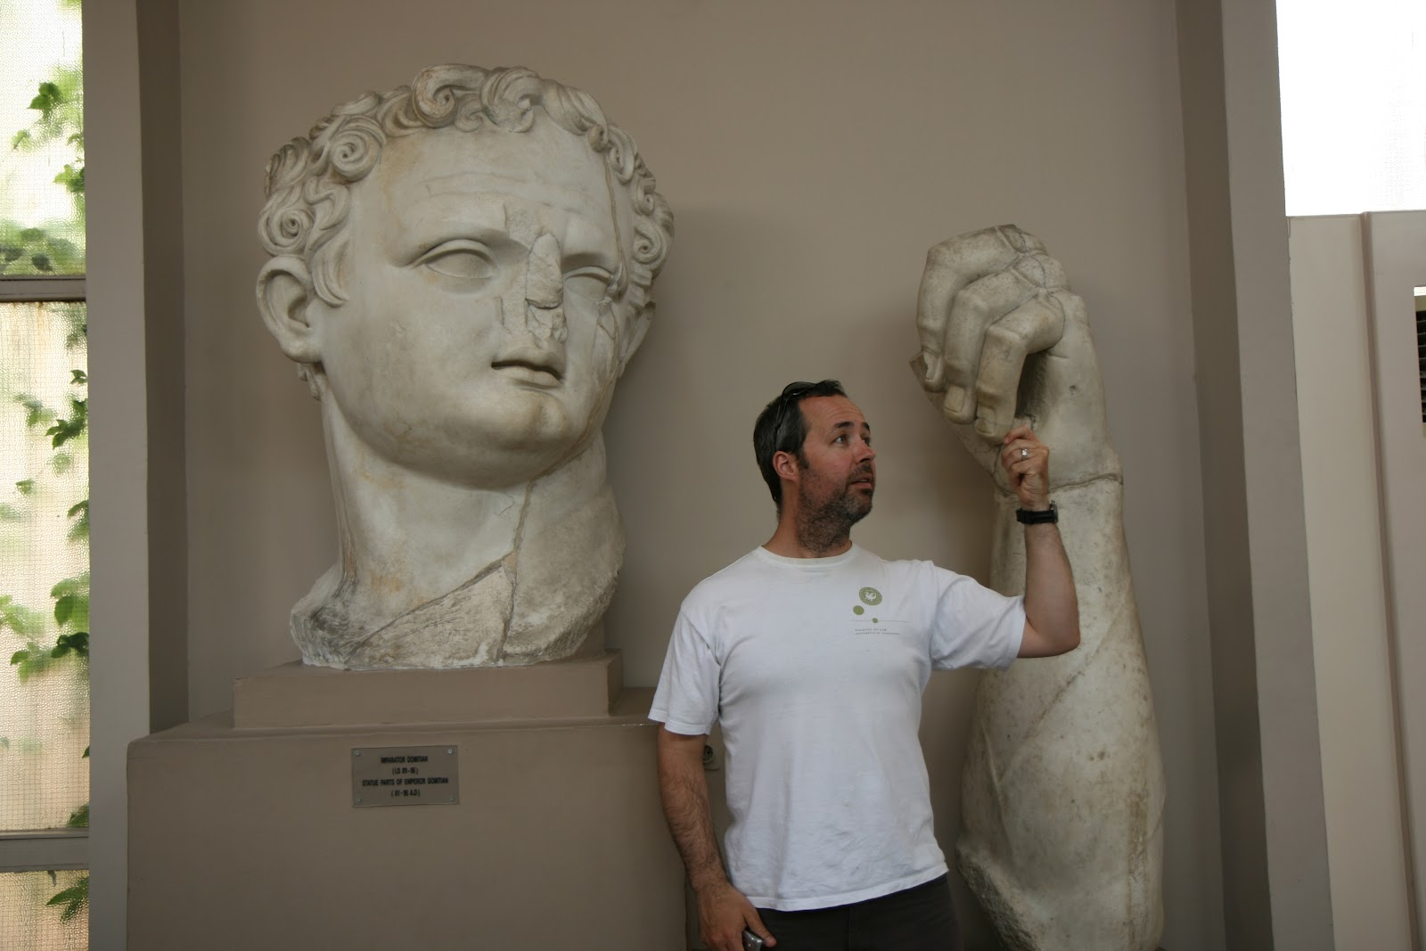
Domitian @ Ephesus

Slide 28
The Practical Lessons
False Prophet
1. Beware of a religion that looks and feels alluring
2. Remember that commerce controls
3. There really is a clear line of demarcation
4. Discernment is a gift best practiced

Slide 29
Revelation 14

Slide 34
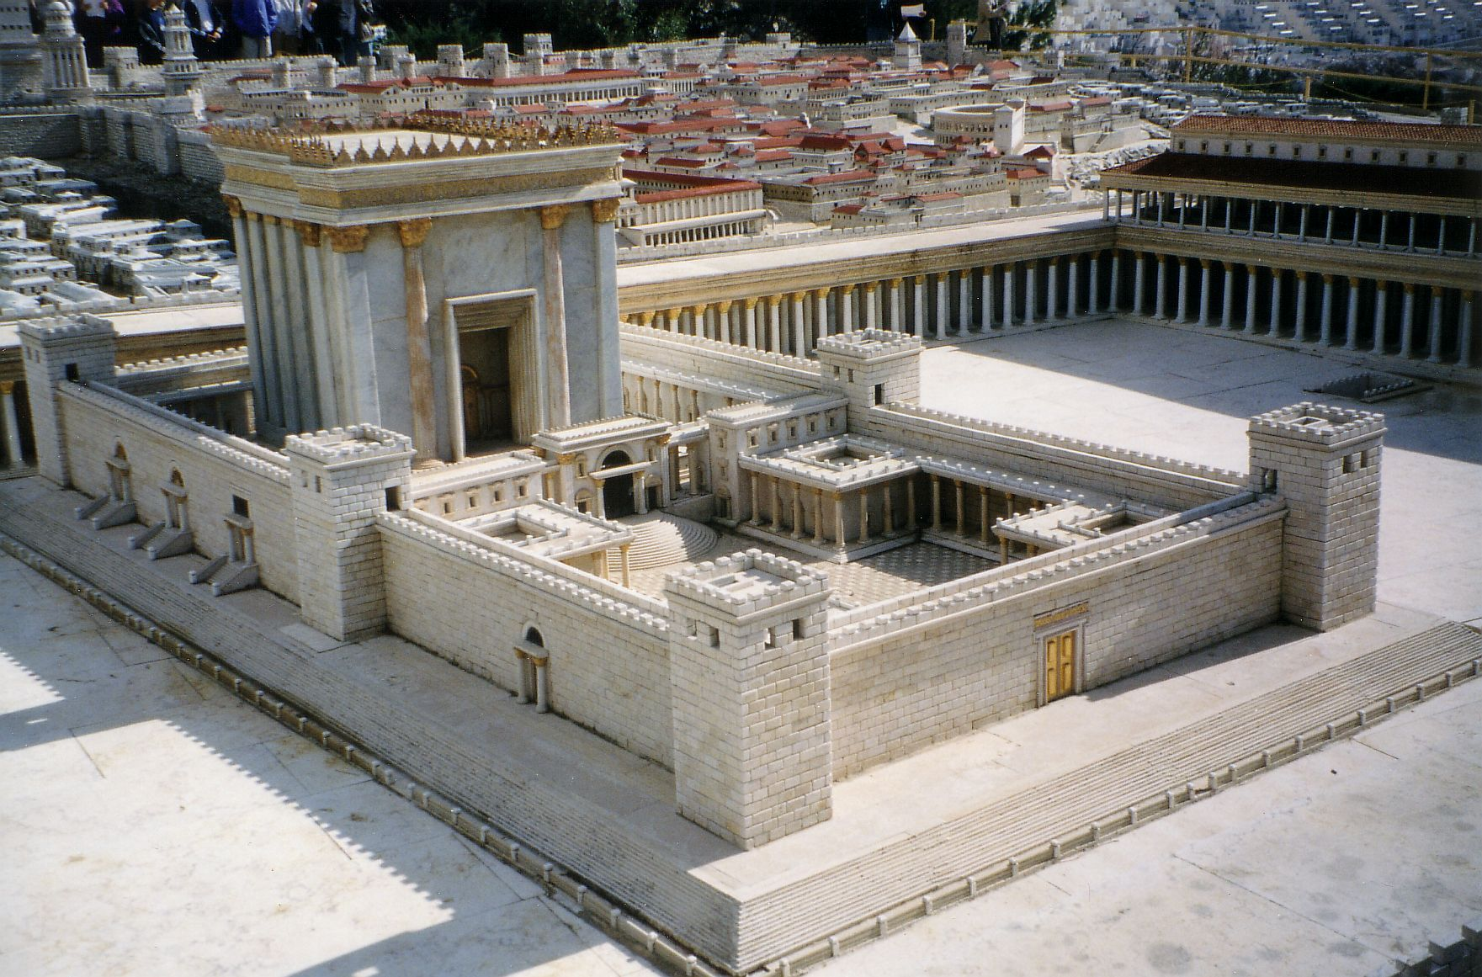
Herod’s Temple

Slide 35
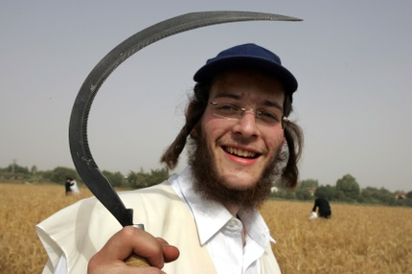
The Sickle

Slide 36
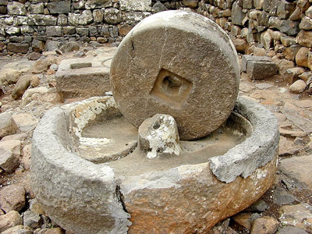
The Olive Press

Slide 37
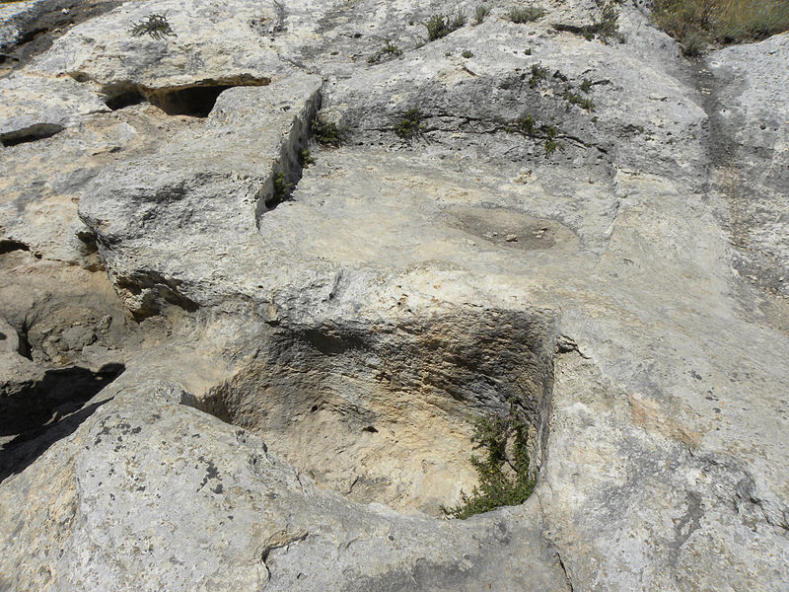
The WIne Press
First Century Wine Press In Nazareth

Slide 38
The Practical Lessons
Chapter 14
Be flexible and ready for change
Be open to receive the message of the Lord
Remember … tribulation does not mean God
  has abandoned you!
4. There truly is a choice … and a Kingdom to serve

Slide 39
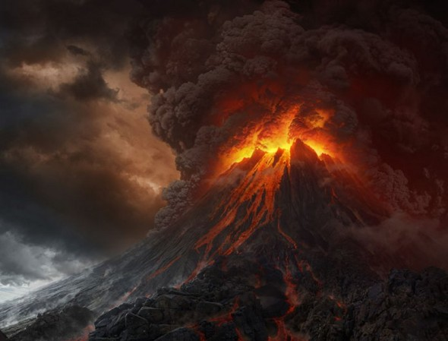
Revelation 15

Slide 40
Revelation 16
Plagues Of Egypt | Plagues of Revelation 16
1. Water To Blood | 1. Sores upon the people
2. Frogs | 2. Seas turned to blood
3. Gnats | 3. Fresh water to blood
4. Flies | 4. Scorching heat (sun)
5. Death of livestock | 5. Darkness
6. Boils upon people | 6. Euphrates dried; armies
7. Hail | 7. Earthquake; Hail, destruction
8. Locusts
9. Darkness upon all
10. Death of the firstborn son
Note: Like Pharaoh, these people refused to repent!

Slide 41
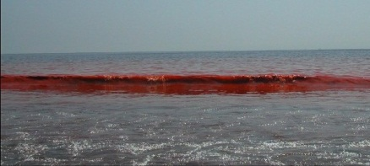
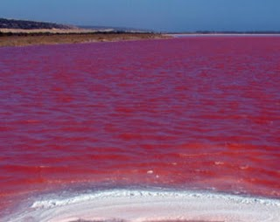
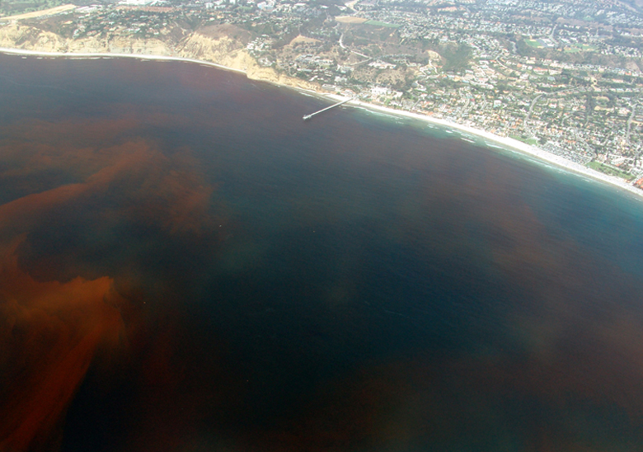
The Red Tide

Slide 42
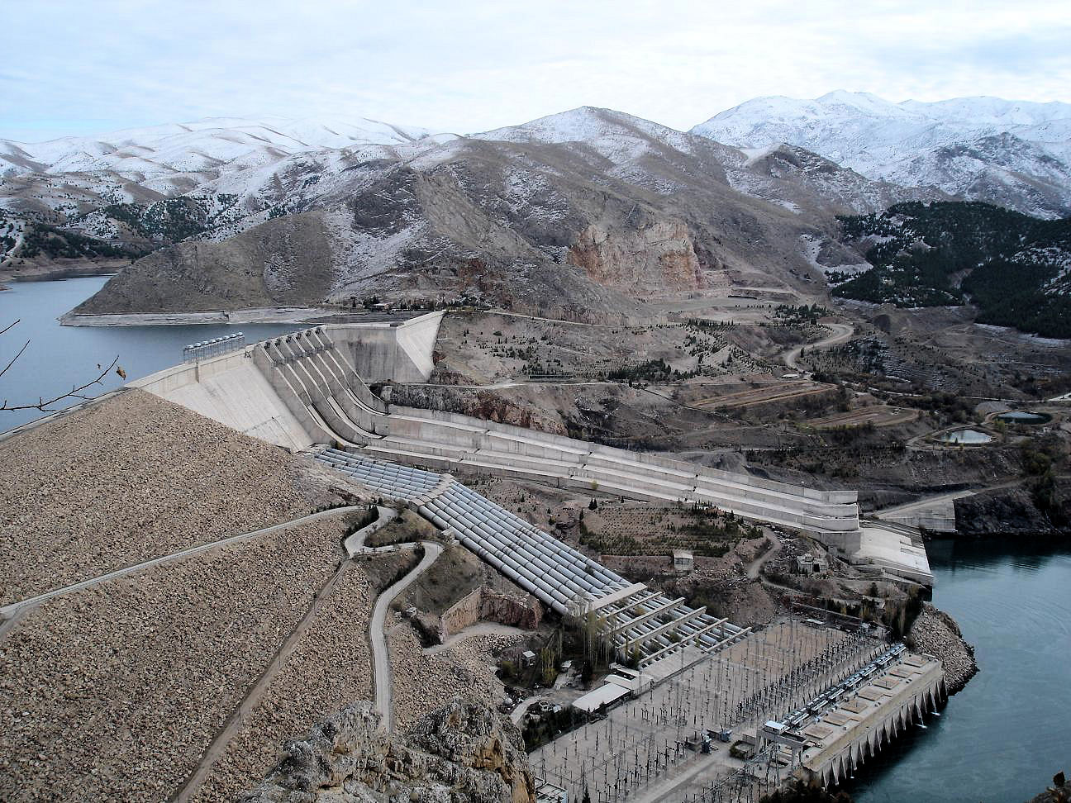
Keban Dam: Euphrates

Slide 43
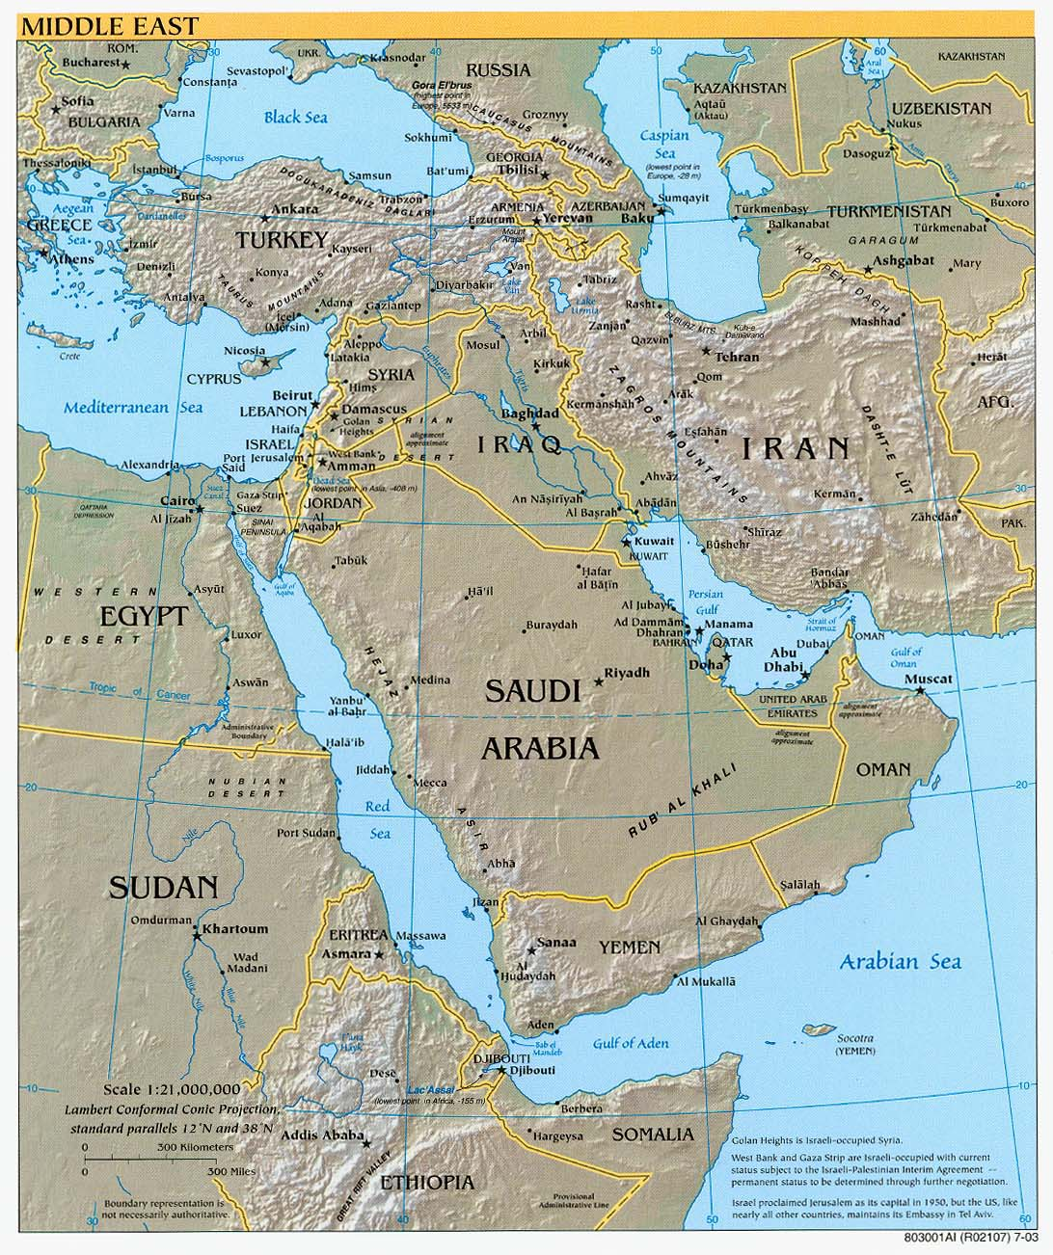

Slide 44
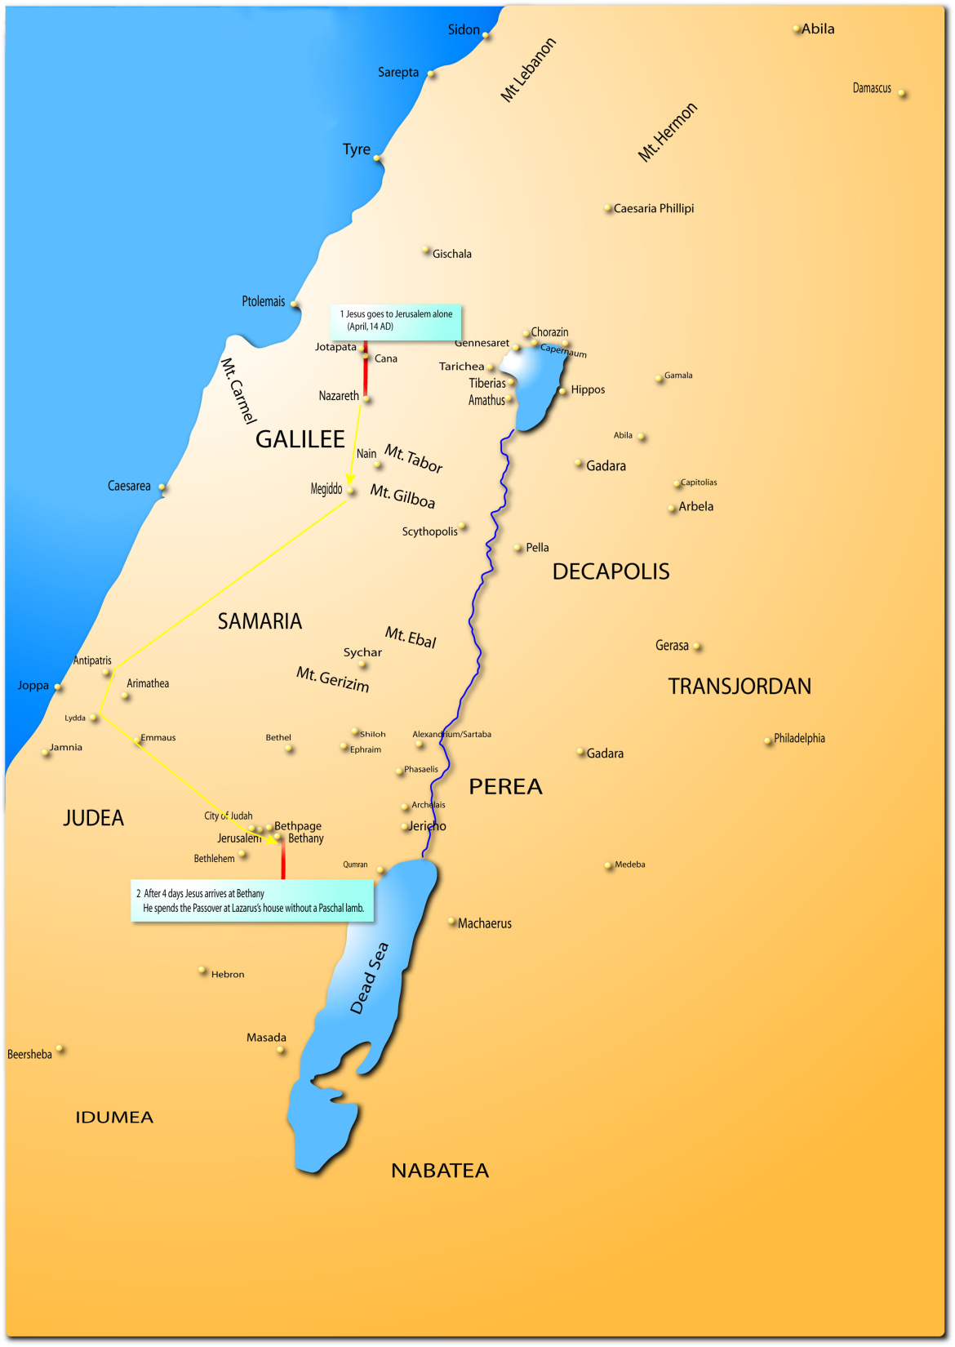
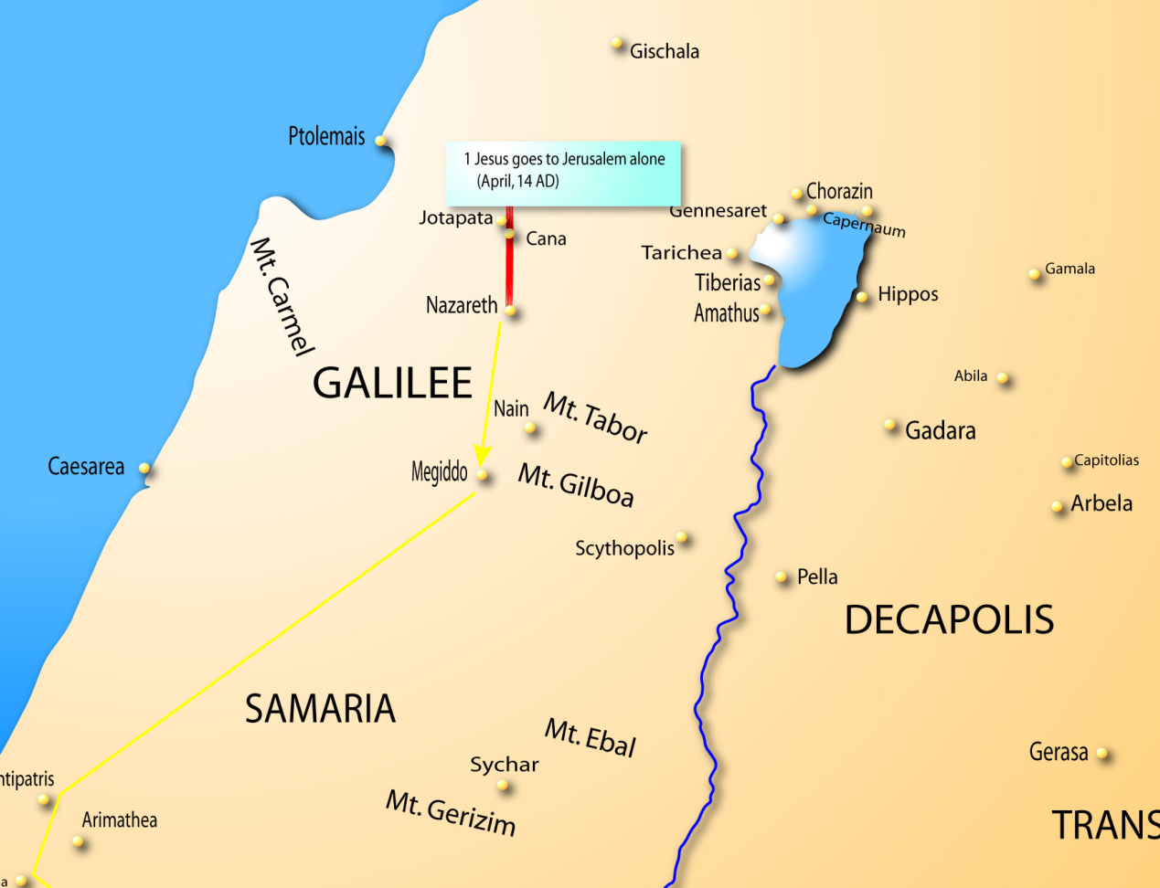

Slide 45
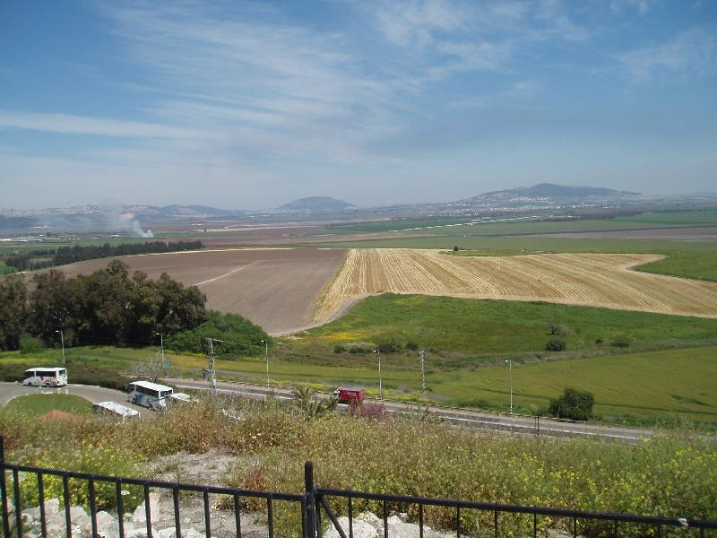
From The Mount Of Megiddo

Slide 46
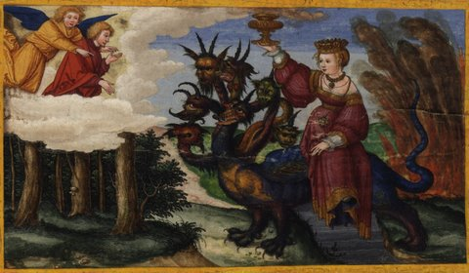
Revelation 17

Slide 47
Religious Babylon
The Great Prostitute
- Sits on many waters (v1)
- Peoples, nations,
languages (v15)
- Rides the Beast (v3)
- 7 heads, 10 horns
- Dressed purple, scarlet
gold, stones, pearls with a
golden cup
- Rich, powerful, ‘spiritual’
(holding a supposed
Communion cup)
- Is a city (v18)
- Rules over the earth

Slide 48
Religious Babylon
The Great Prostitute
- Drunk on the blood
of the saints (v6)
- Wars against the saints
- John is astonished
(awed) (v6)
- Could John be tempted?
(he admired it greatly)

Slide 49
Religious Babylon
The Beast
Who once was, now is not , and will come up
out of the abyss
One possibility:
  Since the beast is seen in part as an ultimate
  false unity against God, this could be a reference
  back to the Tower Of Babel
  - This appears to be a parody of the Lord’s attribute!

Slide 50
Seven Heads (v9)
Egypt, Assyrian, Babylonian,
Medes-Persians, Greek (Five have fallen)
Rome (One is)
New empire to come (one is yet to come)
Seven Hills (v9)
Rome?
Seven Kings (v10)
Five fallen, One is
The other is not yet come
The Eighth King (v11)
The Beast

Slide 51
The Ten Horns (v12)
Ten Kings (v12)
The Beast
Power
Seven Kings (v10)
Subdued
See Daniel 7:24

Slide 52
The Practical Lessons
Chapter 17
What facets of our faith, could the enemy
deceive us over?
Are we ever deceived by the sights we see?
Does the term ‘ecumenical’ bother you?
Power is never shared … but servant-hood is.
Any comments, based on the words of Christ?

Slide 53
WhAt Are Our ‘Non-Negotiables’?
The nature of God
  Personal
    He is capable of relationship
  Intelligent
  Creative
  Redeemer
  Triune

Slide 54
WhAt Are Our ‘Non-Negotiables’?
The nature of Christ
- Fully man and fully God (same substance)
- Historical
- Co-equal with the Father and Spirit
- Sinless
- Virgin birth

Slide 55
WhAt Are Our ‘Non-Negotiables’?
The nature of man
- Sinful
- In need of redemption
- Created in the image of God

Slide 56
WhAt Are Our ‘Non-Negotiables’?
The nature of salvation
- Outside of ourselves … we need a redeemer
- It is not earnable – no work will achieve it
- It is accessible through the work of Christ
The nature of revelation
- Through the Word Of God
- Through the Person of Christ

Slide 57
First Council of Nicea (325)
We believe in one God, the Father Almighty, Maker of all things visible and invisible.
And in one Lord Jesus Christ, the Son of God, begotten of the Father [the only-begotten; that is, of the essence of the Father, God of God], Light of Light, very God of very God, begotten, not made, being of one substance with the Father;
By whom all things were made [both in heaven and on earth];
Who for us men, and for our salvation, came down and was incarnate and was made man;
He suffered, and the third day he rose again, ascended into heaven;
From thence he shall come to judge the quick and the dead.
And in the Holy Ghost.

Slide 58
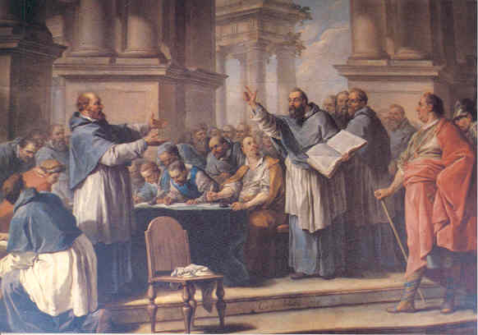
Saint Augustine (354-430) And The Donatists

Slide 59
The Donatists
Started around 311AD
Named for the Christian bishop Donatus Magnus
Outcome of Diocletian's (244-311) persecutions
The church must be a church of "saints," not "sinners,“
Sacraments administered by traditores were invalid
Could a traditore be brought to full repentance again?
traditores ("people who had handed over")
  Either other Christians or the Word of God
Were the sacraments offered by priests and bishops
who had been apostates under the persecution still valid?

Slide 60
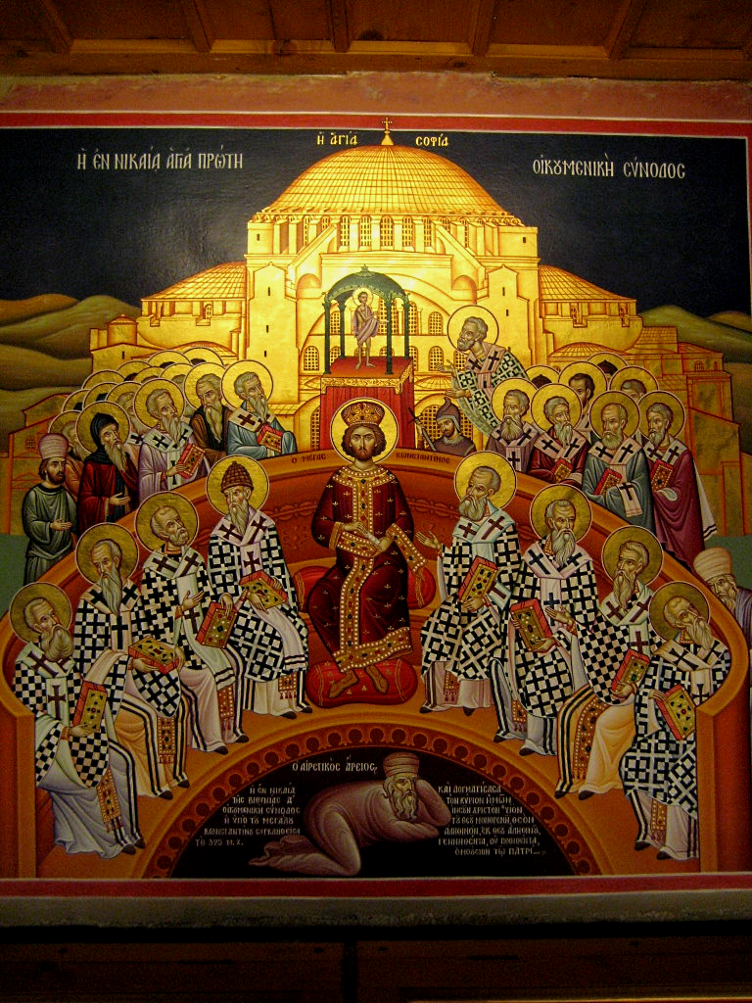
Arian
Controversy
Constantine
22 Bishops
Arius

Slide 61
Arian Controversy
Started before 325 and continued through 381
Arius stated that … “there was a time when the Son
was not”
Constantine legalizes the Church with the ‘Edict Of Milan’
in 313, then calls the first council in 325
- Athanasius stood on the side of Trinitarian doctrine
The Nicene Council lasted 2 months
Homoousios, meaning "one in essence“
Arius was exiled to Illyricum

Slide 62
Is The holy Spirit God?
Council Of Constantinople (May – July 381)
Theodosius is emperor
By 327 Constantine had begun to allow Arianism again
There was a schism that Theodosius wanted to heal
Further … was the Spirit God?
This council condemned all shades of Arianism and
is believed to have modified the “Nicene Creed”

Slide 63
First Council of Constantinople (381)
We believe in one God, the Father Almighty, Maker of heaven and earth, and of all things visible and invisible.
And in one Lord Jesus Christ, the only-begotten Son of God, begotten of the Father before all worlds (æons), Light of Light, very God of very God, begotten, not made, being of one substance with the Father;
by whom all things were made;
who for us men, and for our salvation, came down from heaven, and was incarnate by the Holy Ghost of the Virgin Mary, and was made man;
he was crucified for us under Pontius Pilate, and suffered, and was buried, and the third day he rose again, according to the Scriptures, and ascended into heaven, and sitteth on the right hand of the Father;
from thence he shall come again, with glory, to judge the quick and the dead;
whose kingdom shall have no end.
And in the Holy Ghost, the Lord and Giver of life, who proceedeth from the Father, who with the Father and the Son together is worshiped and glorified, who spake by the prophets.
In one holy catholic and apostolic Church; we acknowledge one baptism for the remission of sins; we look for the resurrection of the dead, and the life of the world to come. Amen.

Slide 64
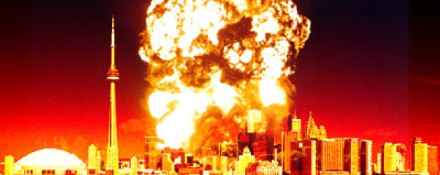
Revelation 18

Slide 65
Commercial Babylon
Represents the best that man can offer?
The splendor of one angel outshines our best!
Destroyed by God Himself (verse 8)
Her sin includes overindulgent commerce
Why do we find God’s people part of this city?
Kings of the earth … mourn (v.9)
Merchants of the earth … mourn (v.11, 14)
Sailors … mourn (v.17)
The saints, apostles and prophet, the heavens rejoice
(v. 20)

Slide 66
The Practical Lessons
Chapter 18
In our culture today, does the power of commerce
conflict with the Kingdom of God?
2. How should we understand the command to come out
from among the inhabitants of this city?

Slide 67
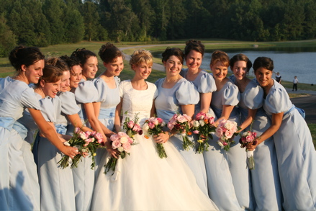
Revelation 19

Slide 68
Two Different Suppers
The Marriage Supper Of The Lamb (19:1-16)
  Based on the marriage celebration of the 1st Cent.
  The Rapture of the church can be pictured
  Remember His ascension was private
  In between:
      The Bema Seat
      The marriage supper
The Supper Of The Great God

Slide 69
After Death
Abode Of God
Bema Seat
New Heaven & New Earth
Great White
Throne Judgment
Abraham’s Bosom
Tartarus
(2Peter 2:4)
Hell
Lake Of Fire

Slide 70
In Between:
Bema Seat
  See 2 Corinth 5:10
  See 1 Corinth 3:10-23
Marriage Supper
  Matt. 22:2-14
  Matt. 25:1-13
  Matt. 26:27

Slide 71
A New Body
Typically associated with the Rapture
1 John 3:2
Flesh and bone, but not flesh and blood
  Luke 24:39 & 1 Corinth. 15:50
1 Corinth. 15:3-8 (Visible to all / Historical)
The fact that the tomb was empty, argues to the
idea that the resurrection somehow relates to it
  2 Corinth. 5:1
1 Corinthians 15:12-58

Slide 72
A New Body (con’t)
1 Corinthians 15:12-34
The foundation of the Gospel is the resurrection
When He comes, we see resurrection bodies (v.23)
Then the “End” comes (v.24)
“Death” is defeated last (v.26)
“They” are baptizing for the dead … not us
Epicureans … “eat, drink and be merry”
The nature of the resurrected body (v.35-50
  Same essence (seed to plant relationship)
  Imperishable (does not decay)
  Glorious (reflecting the image of God)
  Powerful
  Spiritual

Slide 73
A New Body (con’t)
Paul fights against Dualism. Why?
God’s create universe is not evil
God still calls us to care for this world and the
creatures in it
What is to come is still physical
Beauty still has incredible value

Slide 74
A New Body (con’t)
1 Corinthians 15:35-58
Many kids of flesh … Why can’t God create one more??
We are all changed … quickly, not over time
The trumpet is not that of Revelation, but that of Moses
(Number 10:1)
Stand firm!!
1) The resurrected body is required to partake of the new life
2) It comes to us when Christ does
3) It will be more glorious than anything we have known

Slide 75
The Last Campaign
The nations gather at Megiddo … but there are
many battles
that take place
in the end
See Joel 3:9-11
See Psalm 2:1-6

Slide 76
The Return
It appears to be in two separate parts:
a) Invisible, time undetermined
- 1Thess 4:16-18, 5:1-4
- 2Thess 2:1-4
- Matthew 24:36, 25:13
b) Visible and with great power, accompanied
- 2Thess 2:8-9
- Rev. 12:6, 13:5
- Zech. 14, Jude 14
- Col. 3:4

Slide 77
The Return
In the sky, light will be affected (Zech. 14:6-7, Joel 3:14-17)
A great earthquake (Rev. 16:18-20)
Great hail (Rev. 16:21)
A valley of protection formed (Zech. 14:3-5)
Anti-Christ and False Prophet condemned (Rev. 19:20)
A great slaughter (Rev. 19:21)

Slide 78
Jerusalem Campaign
2) Zech. 12:1-3
Zech. 14:1-2
The battle is fierce,
Israel fights with strength (Micah 4-11 to 5:1), but Jerusalem is finally lost.

Slide 79
A Possible Scenario
3.5 Years
1260 Days, 42 Months
7 Years
1000 Years
Tribulation
Millennium
Great White
Throne Judgment
The Rapture?
1 Thess. 4
1 Cor. 15
The Abomination
Of Desolation
Matthew 24, Daniel 9
Return Of Christ

Slide 80
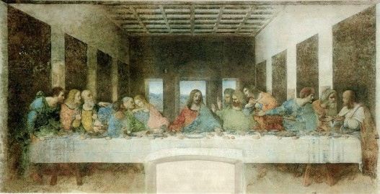
Revelation 20

Slide 81
The Nature Of The Millennium
Christ bodily reigns on earth (Matthew 25:31-41)
Both glorified and unglorified saints seem to coexist
  2Tim. 2:12, Rev. 20:4, 6
  Isa. 65:17-25, 11:6-9
    Some die; sin still exists
    Children at 100 (extended life)
    Nature of animals restored?
    God immediately responds
    The world moves from an evil dictator to
    Christ, the perfect ruler

Slide 82
The Nature Of The Millennium
3) An increase in light ??
- see Isa. 30:26
4) Purified language, worship, unity
- see Zech. 3:8
5) Satan can no longer deceive (Rev. 20:1-3)
- Less clear: status of demonic forces (Isa. 24:21)
6) Saints seem to reign in this time (Rev. 20:4-6)
- Also, they seem to act as priests

Slide 83
The Nature Of The Millennium
7) In essence, life appears to mimic that in the Garden
Purposes:
1) To declare forever, that in spite of humanity receiving God‘s
best, and Satan being removed, we will still choose to rebel against
God. The Millennium will remove the ability for us to blame anyone
but ourselves!
2) To visibly vindicate Christ
3) To usher in the time where God is found to be ALL IN ALL!
(1 Cor. 15:28)
4) Even the length (1000 years) > the age of the oldest
human (969); No one can claim they had insufficient time.

Slide 84
Satan’s End
Note that Satan’s tactics never change
Gog is deemed a leader and his land … Magog
(This is not the same as Ezekiel 38-39)
The camp of God’s people – Palestine
The City that He loves – Jerusalem
The world is remade:
Matthew 24:35, Hebrews 1:10-12, 2Peter 3:10-13
Rev. 20:11, 21:1

Slide 85
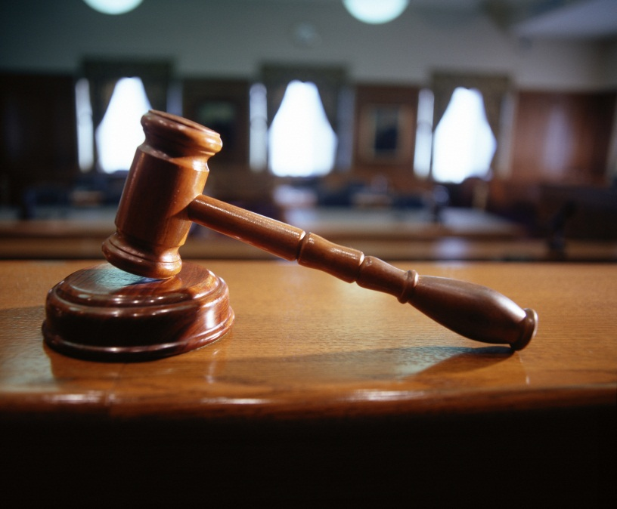
The great White Throne Judgment
The Body of Christ does not
participate in this event.
The Books
a) Book Of Life
b) The Word Of God?
c) The books detailing their actions in life
These are the legal proceedings that detail why a soul is
outside the Kingdom of God.

Slide 86
Gleanings From Chapter 20
If we are to judge angels … can we judge righteously now?
Is there any value in the claims that “The devil made me do it”?
Is an “external” righteousness enough?
How important is it for parents and the church to
pass on their faith to the next generation?

Slide 87
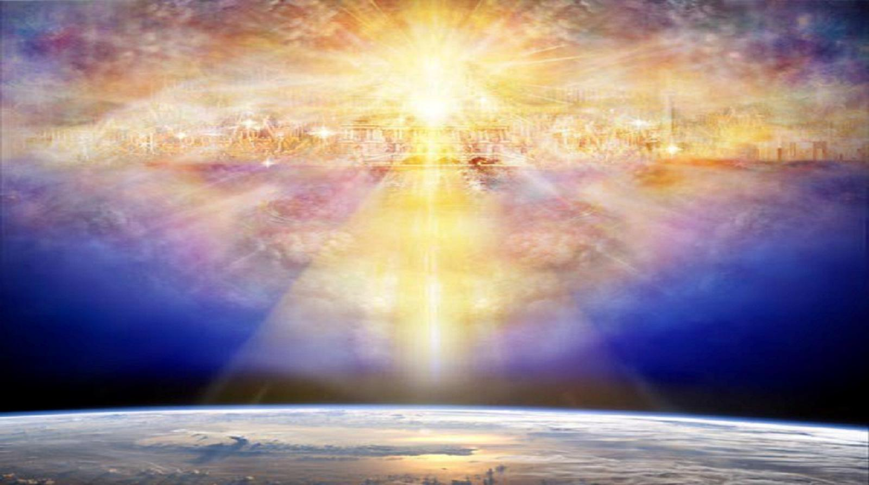
Revelation 21 - 22

Slide 88
Four Views Of Eternity
Eternal life with God / Eternal life without God (Lake Of Fire)
- Eternal punishment
2) “Second Chance” doctrine
- After death, there is a second chance to accept
3) “Annihilation” doctrine
- The undegenerated cease to exist
4) “Conditional Immortality”
- We are not immortal by nature, but this is a gift

Slide 89
The Eternal State
This appears to deal with the “Eternal State”
There is a new heaven, a new earth and a new Jerusalem
(Matthew 24:35, Hebrews 1:10-12, 2Peter 3:10-13
Rev. 20:11, 21:1)
The word “heaven” refers to the expanse of sky and all that is in it … not the abode of God.
It is amazing that in the eternal state, the Father lives with creation …. Not the other way around.

Slide 90
The Eternal State
Unanswered: What happens to the unglorified people?
Note that the sources of tears (pain, suffering) are taken
away.
Why do you think that we move from a garden (in Genesis)
to a city (in Revelation)?

Slide 91
The Eternal State
The city is literal:
Dimensions: 1500 miles square and high.
- The land surface of the world today is about 57 million square miles … the city could be considered 60 times larger.
- 200 foot walls (high or thick?) with three gates per side
- the walls had 12 foundations
There was no temple (v.22)
There will be no night there (v.25)

Slide 92
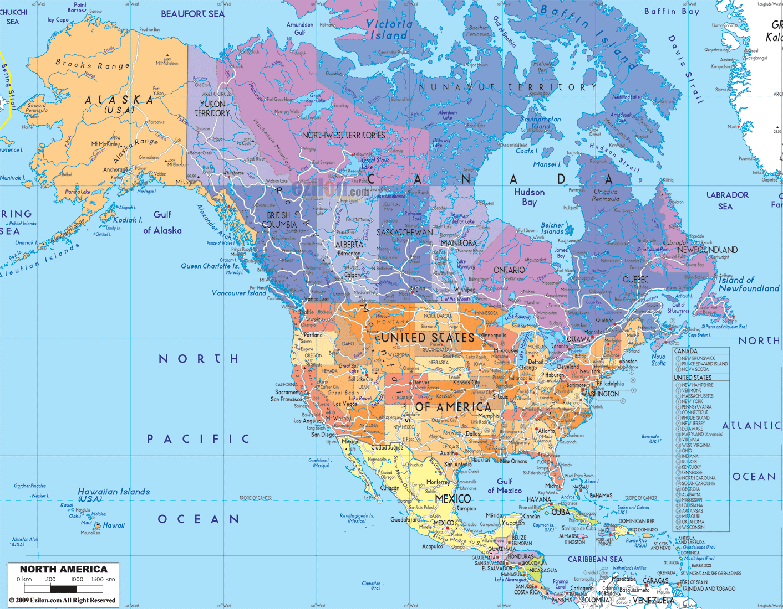
The New Jerusalem Footprint

Slide 93
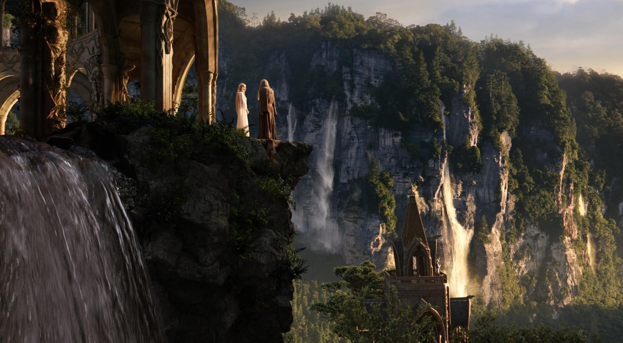

Slide 94
The Eternal State
Other Characteristics:
- No death or crying (v.4)
No wickedness (v.8)
No longer are there seas (v.1)
The city seems to light the world (v. 24)
There continues to be nations (v.24, 26)
  - see Hebrews 12:22-29
  Both Christians and Jews (spirits of righteous men)
No night there (v.25)

Slide 95
The Eternal State
There is a river and trees (vrs. 22:1-5)
See Genesis 2:10 for the first example of a river that flows from the throne of God
Water carries many contexts
  Requirement of life for desert people (John 4:14)
  Cleansing (Ezekiel 47:1-12)
  Justice (Psalm 46:4, Amos 5:24)

Slide 96
Gleanings From ChapterS 21-22
What does it mean to keep the words of this prophecy
(Rev. 22:7)
Was it fair of the Lord to say that these events were
“coming soon”?
3) What do you think it means to “add” or “subtract”
words away from this prophecy?

