Slide 1
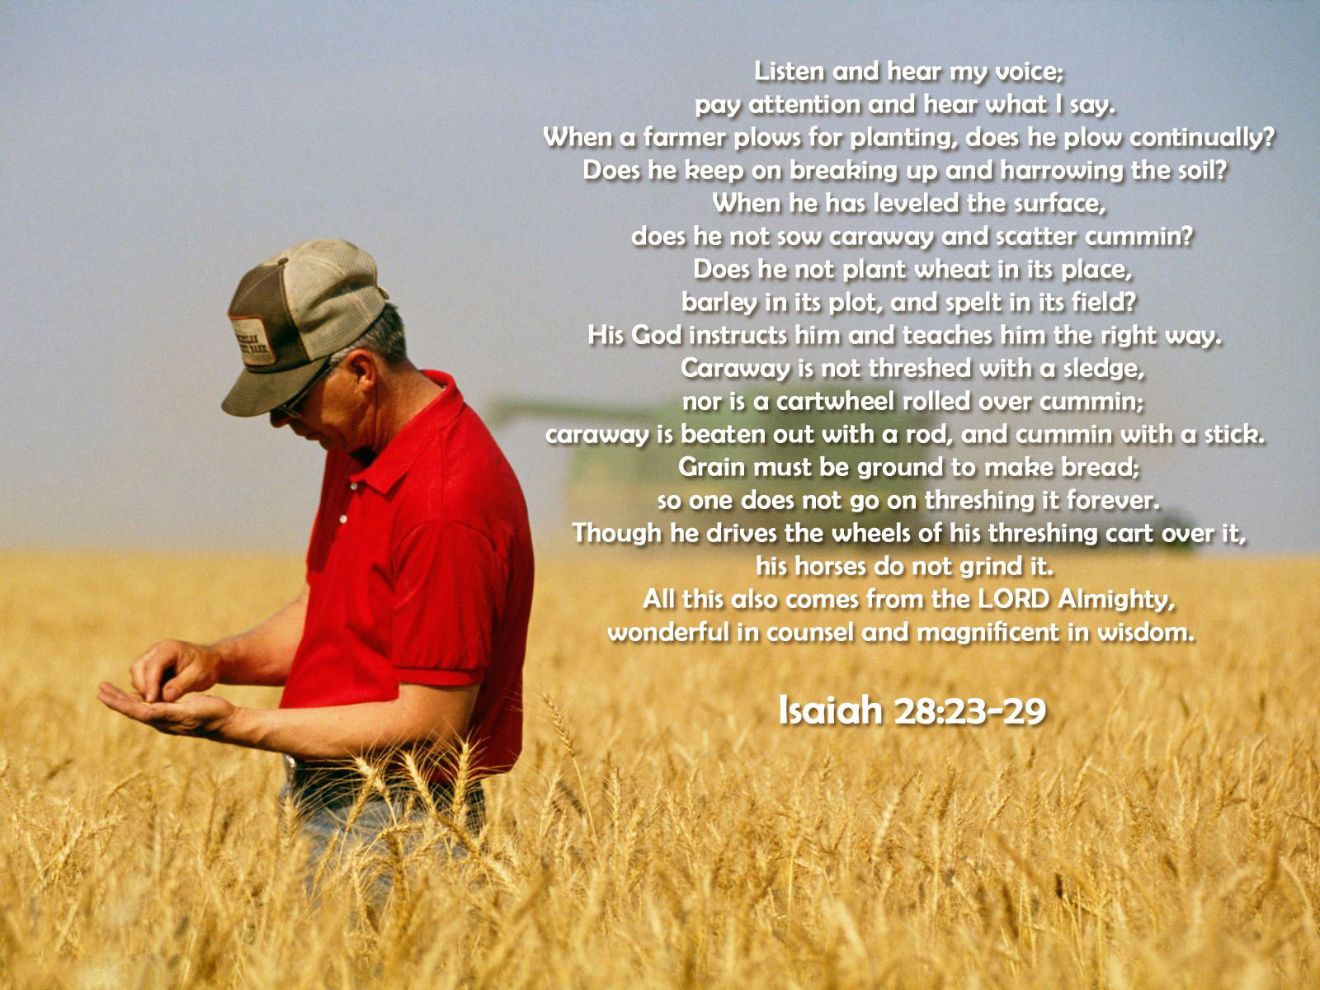

Slide 2

A Possible Scenario
Church Age
Bema Seat
Approx. 483 Years
7 Years
1000 Years
New Heaven & New Earth
Tribulation
Millennium
Nehemiah returns to Israel (445 BCE)
Great White
Throne Judgment
Babylon invades Israel (approx. 587 BCE)
(Time Of The Gentiles begins)

Slide 3
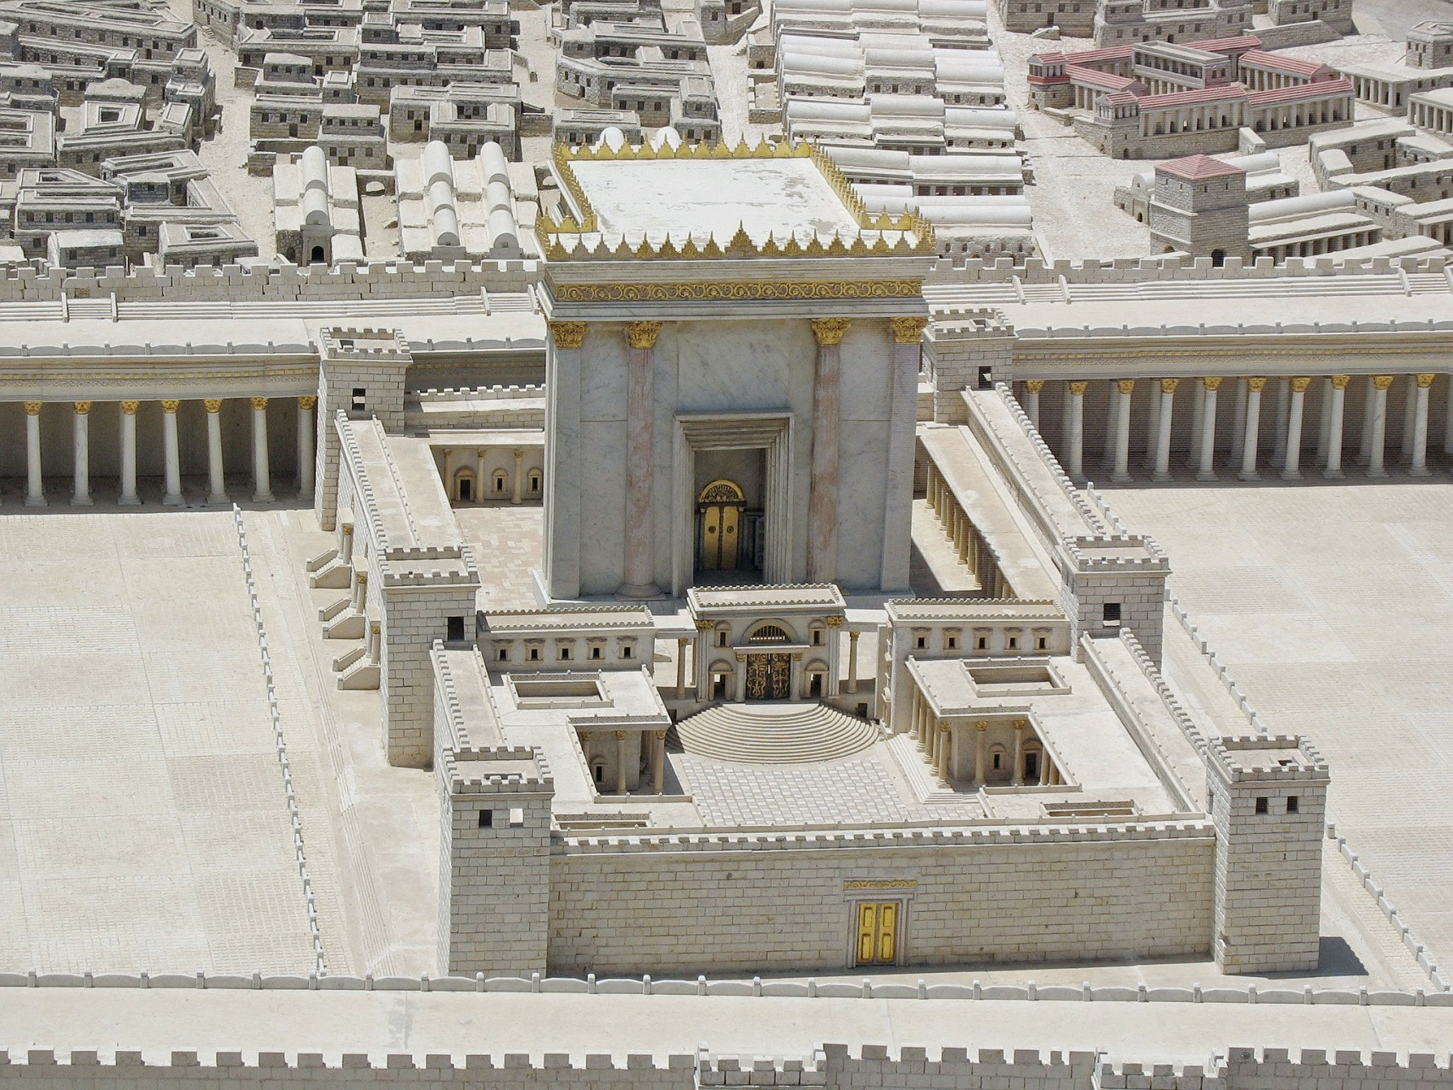
Isaiah 52
Herod’s Temple
Jachin (God will establish) And Boaz (Redeemer)
The “Legs Of God”

Slide 4
Revelation: Chiasm
Prologue (Rev 1:1-8)
Seven Churches (1:10-3:22)
Seven Seals (4:1 – 8:1)
Seven Trumpets (8:2 – 11:18)
Satan attacks (11:19-14:20)
Fall Of Babylon (17:1-19:10)
Bowl Judgments 15:1 – 16:21
Millennium (19:11 – 21:8)
New Jerusalem (21:9 – 22:9)
Epilogue (Rev 22:8-17)

Slide 5
Revelation: Chiasm
Christ walks among the 7 lamps (2:1)
Tree Of Life (2:1)
Open Door (3:8)
Christ sits on the Father’s throne (3:21)
New Jerusalem comes down from heaven (3:12)
I am coming soon (3:11)
Seven Churches (1:10-3:22)
Christ is the eternal lamp (21:23)
Tree Of Life (22:2)
Gates never close (21:25)
Throne of God and the Lamb (22:1,3)
New Jerusalem comes down from heaven (21:10)
I am coming soon (22:7)
New Jerusalem (21:9 – 22:9)

Slide 6
Revelation: Chiasm
Heaven opens (4:1)
Riders on colored horses (6:2-8)
Souls of martyrs under alter ask for judgment (6:9-10)
White robes (6:11, 7:9-14)
Kings ask to be killed (6:15-16)
Seven Seals (4:1 – 8:1)
Heaven opens (19:11)
Rider on white horse and others (19:11-16)
Souls of martyrs resurrected and made judges (20:4-6)
White robes (19:14)
Kings are killed (19:17-21)
Millennium (19:11 – 21:8)

Slide 7
The Nature Of The Millennium
Christ bodily reigns on earth (Matthew 25:31-41)
Both glorified and unglorified saints seem to coexist
  2Tim. 2:12, Rev. 20:4, 6
  Isa. 65:17-25, 11:6-9
    Some die; sin still exists
    Children at 100 (extended life)
    Nature of animals restored?
    God immediately responds
    The world moves from an evil dictator to
    Christ, the perfect ruler

Slide 8
The Nature Of The Millennium
3) An increase in light ??
- see Isa. 30:26
4) Purified language, worship, unity
- see Zech. 3:8
5) Satan can no longer deceive (Rev. 20:1-3)
- Less clear: status of demonic forces (Isa. 24:21)
6) Saints seem to reign in this time (Rev. 20:4-6)
- Also, they seem to act as priests

Slide 9
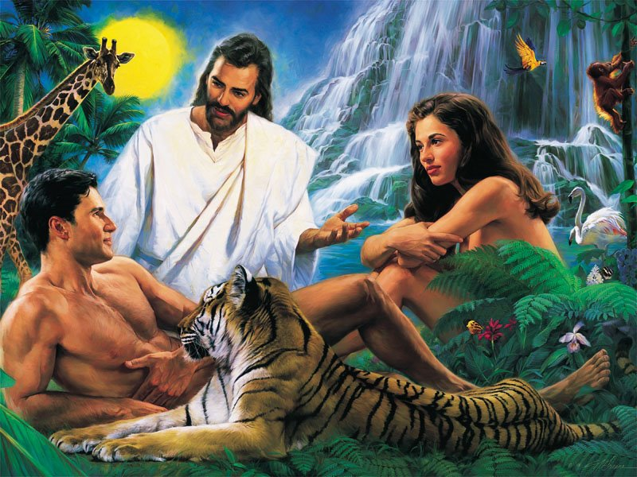
The Nature Of The Millennium
7) In essence, life appears to mimic that in the Garden
Right Relationships
Human to God
Male to female
Human to animal
Human to nature

Slide 10
The Nature Of The Millennium
Purposes:
1) To declare forever, that in spite of humanity receiving God‘s
best, and Satan being removed, we will still choose to rebel against
God. The Millennium will remove the ability for us to blame anyone
but ourselves!
2) To visibly vindicate Christ
3) To usher in the time where God is found to be ALL IN ALL!
(1 Cor. 15:28)
4) Even the length (1000 years) > the age of the oldest
human (969); No one can claim they had insufficient time.

Slide 11
Literal Prophetic Fulfillment
The Messiah must... | Prophecy | Fulfillment by Jesus
Bear the reproaches and sin of others | Isaiah 53:12 | Romans 15:3
Be a priest | Psalms 110:4 | Hebrews 5:5‑6, 6:20, 7:15‑17
Enter Jerusalem on a donkey | Zechariah 9:9 | Matthew 21:1‑11; Mark 11:1‑11; John 12:12‑16
Enter the Temple with authority | Malachi 3:1 | Matthew 21:12; John 2:13‑22
Born of a virgin | Isaiah 7:14 | Matthew 1:23
Proceeded by a messenger | Isaiah 40:3 5, Malachi 3:1 | Matthew 3:1‑3, Luke 3:2‑6
Be born in Bethlehem | Micah 5:2 | Matthew 2:1; Luke 2:4‑7
Be adored by great persons | Psalms 72:10‑11 | Matthew 2:1‑11
Be anointed with the Spirit of God | Isaiah 11:2, 61:1 | Matthew 3:16; John 3:34; Acts 10:38
Be hated without cause | Isaiah 49:7; Psalms 69:4 | John 15:24‑25
Be undesired, rejected by His own people | Isaiah 53:2, 63:3; Psalms 69:8 | Mark 6:3; Luke 9:58; John 1:11
Be plotted against by Jews, Gentiles | Psalms 2:1‑2 | Acts 4:27
Be betrayed by a friend | Psalms 41:9, 55:12‑24 | Matthew 26:21‑25, 47‑50; John 13:18‑21; Acts 1:16‑18
Be betrayed for 30 pieces of silver | Zechariah 11:12 | Matthew 26:16
Have his price given for a potter’s field | Zechariah 11:13 | Matthew 27:7
Be forsaken by His disciples | Zechariah 13:7 | Matthew 26:31, 56
Be struck on the cheek | Micah 5:1 | Matthew 27:30
Be spat on | Isaiah 50:6 | Matthew 26:67, 27:30
Be mocked | Psalms 22:7‑8 | Matthew 27:31, 39‑44
Be beaten | Isaiah 50:6 | Matthew 26:67, 27:26, 30
Be thirsty during His execution | Psalms 22:15 | John 19:28
Be given vinegar to quench that thirst | Psalms 69:21 | Matthew 27:34
Be considered a transgressor | Isaiah 53:12 | Matthew 27:38
Be buried with the rich when dead | Isaiah 53:9 | Matthew 27:57‑60
Be sought after by Gentiles as well as Jews | Isaiah 11:10, 42:1 | Acts 10:45
Be accepted by the Gentiles | Isaiah 11:10, 42:1‑4, 49:1‑12 | Matthew 12:21; Acts 10:45; Romans 15:9‑12
Resurrection | Psalm 16:10, 2, 7, Isaiah 53:9‑10 | Matthew 28:1‑20, Acts 13:33-37
To the right hand of the Father | Psalms 16:11, 68:18 and 110:1 | Luke 24:51, Acts 1:9‑11 and 7:55 and Hebrews 1:3

Slide 12
Isaiah 61
He went to Nazareth, where he had been brought up, and on the Sabbath day he went
into the synagogue, as was his custom. And he stood up to read. The scroll of the prophet
Isaiah was handed to him. Unrolling it, he found the place where it is written:
"The Spirit of the Lord is on me, because he has anointed me to preach good news to the
poor. He has sent me to proclaim freedom for the prisoners and recovery of sight for the
blind, to release the oppressed, to proclaim the year of the Lord’s favour.“
Then he rolled up the scroll, gave it back to the attendant and sat down. The eyes of
everyone in the synagogue were fastened on him, and he began by saying to them, "Today
this scripture is fulfilled in your hearing.“ All spoke well of him and were amazed at the
gracious words that came from his lips. "Isn’t this Joseph’s son?" they asked.
Luke 4:16-30

Slide 13
Isaiah 61
Jesus said to them, "Surely you will quote this proverb to me: ‘Physician, heal yourself!
Do here in your home town what we have heard that you did in Capernaum.’“ "I tell you
the truth," he continued, "no prophet is accepted in his home town. I assure you that there
were many widows in Israel in Elijah’s time, when the sky was shut for three and a half
years and there was a severe famine throughout the land. Yet Elijah was not sent to any
of them, but to a widow in Zarephath in the region of Sidon. And there were many in
Israel with leprosy in the time of Elisha the prophet, yet not one of them was cleansed—
only Naaman the Syrian.“ All the people in the synagogue were furious when they heard this.
They got up, drove him out of the town, and took him to the brow of the hill on which
the town was built, in order to throw him down the cliff. But he walked right through
the crowd and went on his way.

Slide 14
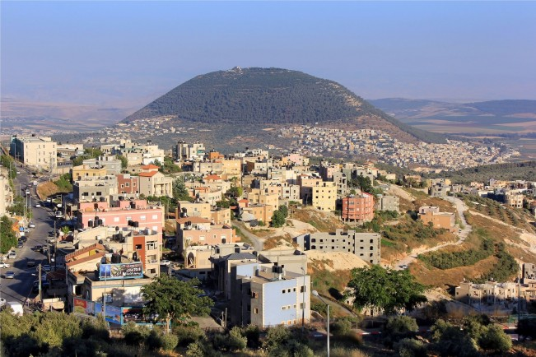
Isaiah 61
Mount Tabor And Nazareth today

Slide 15

Isaiah 61
Husbands, love your wives, just as Christ loved
the church and gave himself up for her to make
her holy, cleansing her by the washing with
water through the word, and to present her
to himself as a radiant church, without stain
or wrinkle or any other blemish, but holy and
blameless. (Eph. 5:25-27)
Let us rejoice and be glad and give him glory!
For the wedding of the Lamb has come, and
his bride has made herself ready. Fine linen,
bright and clean, was given her to wear."
(Fine linen stands for the righteous acts of
the saints.) (Rev. 19:7-8)
Jewish Wedding Dress (Modern)

Slide 16
Isaiah 61
There IS such a thing as right living!
For the grace of God that brings salvation has appeared to all men. It teaches us to
say "No" to ungodliness and worldly passions, and to live self-controlled, upright and
godly lives in this present age,
while we wait for the blessed hope—the glorious appearing of our great God and
Saviour, Jesus Christ,
who gave himself for us to redeem us from all wickedness and to purify for himself a
people that are his very own, eager to do what is good.
(Titus 2:11-14)
What good is it, my brothers, if a man claims to have faith but has no deeds? Can such
faith save him? (James 2:14)
This is love for God: to obey his commands. And his commands are not burdensome,
for everyone born of God overcomes the world. This is the victory that has overcome
the world, even our faith. (1John 5:3-4)

Slide 17
Isaiah 62: The Chapter Of Names
English | Hebrew, definition, times used | Text
God | Elohim (Mighty Ones) 2606x | Genesis 1:1
God | El (Might, Power) 245x | Genesis 14:18
God | Eloah (Mighty One) 57x | Nehemiah 9:17
God | Elah (Aramaic form) 95x | Daniel 2:18
Yahweh (Jehovah), God, LORD | YHWH (Yahweh) 6519x | Gen 2:4; 15:2; Ex 6:3
Lord | YH (Yah) (abbreviated form of Yahweh) 49x | Psalm 68:4
Lord | Adon (Lord, Ruler) 335x | Joshua 3:11
Lord | Adonai (Lords, Rulers) 434x | Genesis 15:2
I Am That I Am | Eheyeh asher Eheyeh 1x | Exodus 3:14
I Am | Eheyeh 19x | Exodus 3:14
Most High God | El-Elyon (Supreme Might) | Genesis 14:18
The God Of Sight | El-Roiy | Genesis 16:13
Almighty God | El-Shaddai (Might of the Powerful Ones) | Genesis 17:1
Everlasting God | El-Olam | Genesis 21:33
Rock | Cela (craig) Tzur (rock or strength) | Ps 18:2 (used interchangeably)

Slide 18
Isaiah 62: The Chapter Of Names
English | Hebrew, definition, times used | Text
YHWH of Hosts | YHWH-sabaoth (Lord of Armies) 285x | 1 Samuel 1:3
YHWH will provide | YHWH-jireh: will see or provide | Genesis 22:14
I, YHWH, am your healer. | YHWH-rapha: heals | Exodus 15:26
YHWH is my banner | YHWH-nissi: our banner or victory | Exodus 17:15
YHWH who sanctifies you | YHWH-m'kaddesh: sanctifies | Exodus 31:13
YHWH is peace | YHWH-shalom: peace | Judges 6:24
YHWH is my shepherd | YHWH-raah: my shepherd | Psalm 23:1
YHWH our maker | YHWH-hoseenu: creator | Psalm 95:6
YHWH our righteousness | YHWH-tsidkenu: righteousness | Jeremiah 23:6
YHWH who is there | YHWH-shammah: Present and available when needed | Ezekiel 48:35

Slide 19
Isaiah 62: The Chapter Of Names
Other Names Of Significance:
Abraham The father of many
Absalom My father is peace
Achan Trouble
Barnabas Son of encouragement
Boaz Swiftness
Cephas Rock
Daniel God is my judge
David Beloved
Delilah Weak
Gabriel Strong man of God
Gethsemane Olive press
Isaiah Yahweh is salvation
Israel God contended
Jacob Deceiver
Jesus (=Joshua) Yahweh is salvation
Judah Praise
Methuselah When he is gone it shall come
Moses Deliver
Peter Stone
Philemon Affectionate
Satan Adversary
Solomon Peace
Stephen Crown

Slide 20
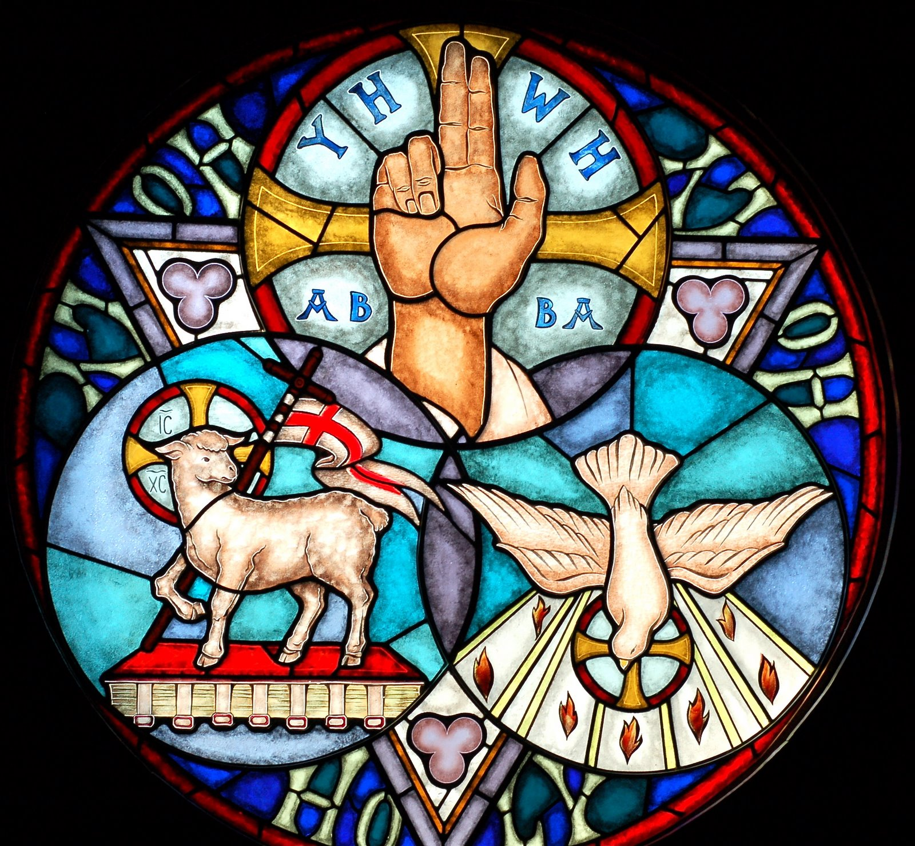
Isaiah 62: The Chapter Of Names
Within Trinitarian doctrine,
the three members of the
trinity exist in mutually
dependent relationship with
each other and the identity
of each is dependent on the
others. There is no Father
without Son and no Son
without Father. The Spirit
proceeds from both the
Father and the Son.

Slide 21
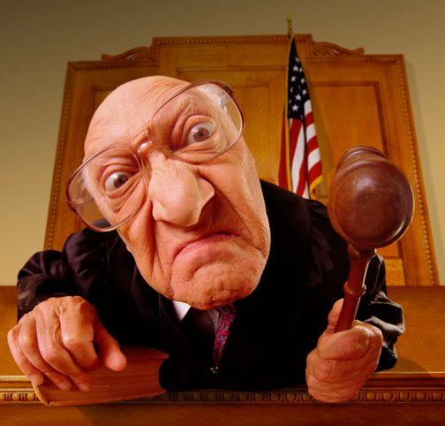
Isaiah 62: The Chapter Of Names
Then Jesus told his disciples a parable to show them that they should always pray and not
give up. He said: "In a certain town there was a judge who neither feared God nor cared
about men. And there was a widow in that town who kept coming to him with the plea,
‘Grant me justice against my adversary.’ "For some time he refused. But finally he said to
himself, ‘Even though I don’t fear God or care about men, yet because this widow keeps
bothering me, I will see that she gets justice, so that she won’t eventually wear me out with
her coming!’“ And the Lord said, "Listen to
what the unjust judge says. And will not God
bring about justice for his chosen ones, who
cry out to him day and night? Will he keep
putting them off? I tell you, he will see that
they get justice, and quickly. However, when
the Son of Man comes, will he find faith on the
earth?"
Luke 18:1-8

Slide 22
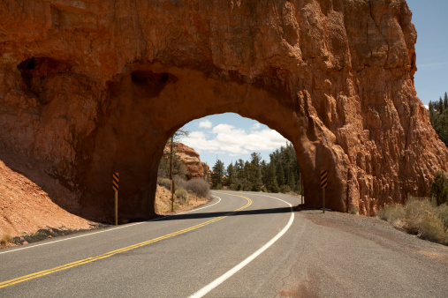
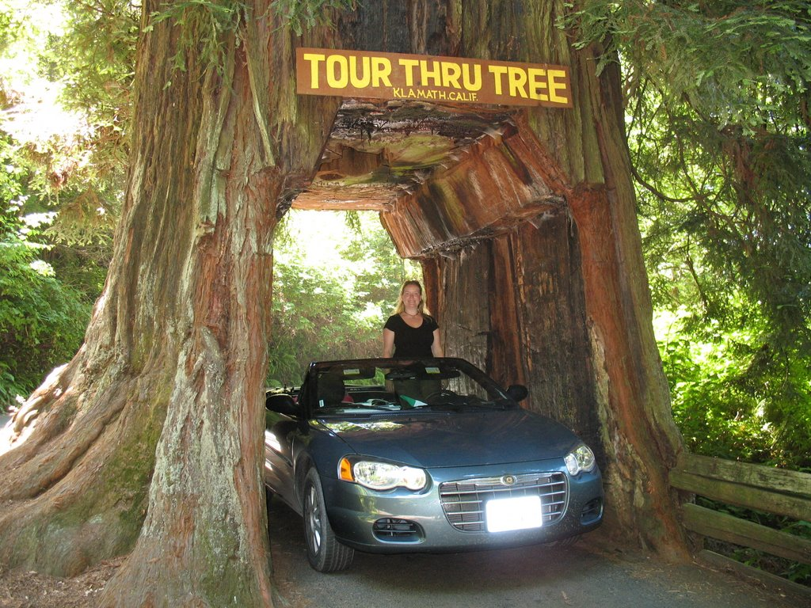
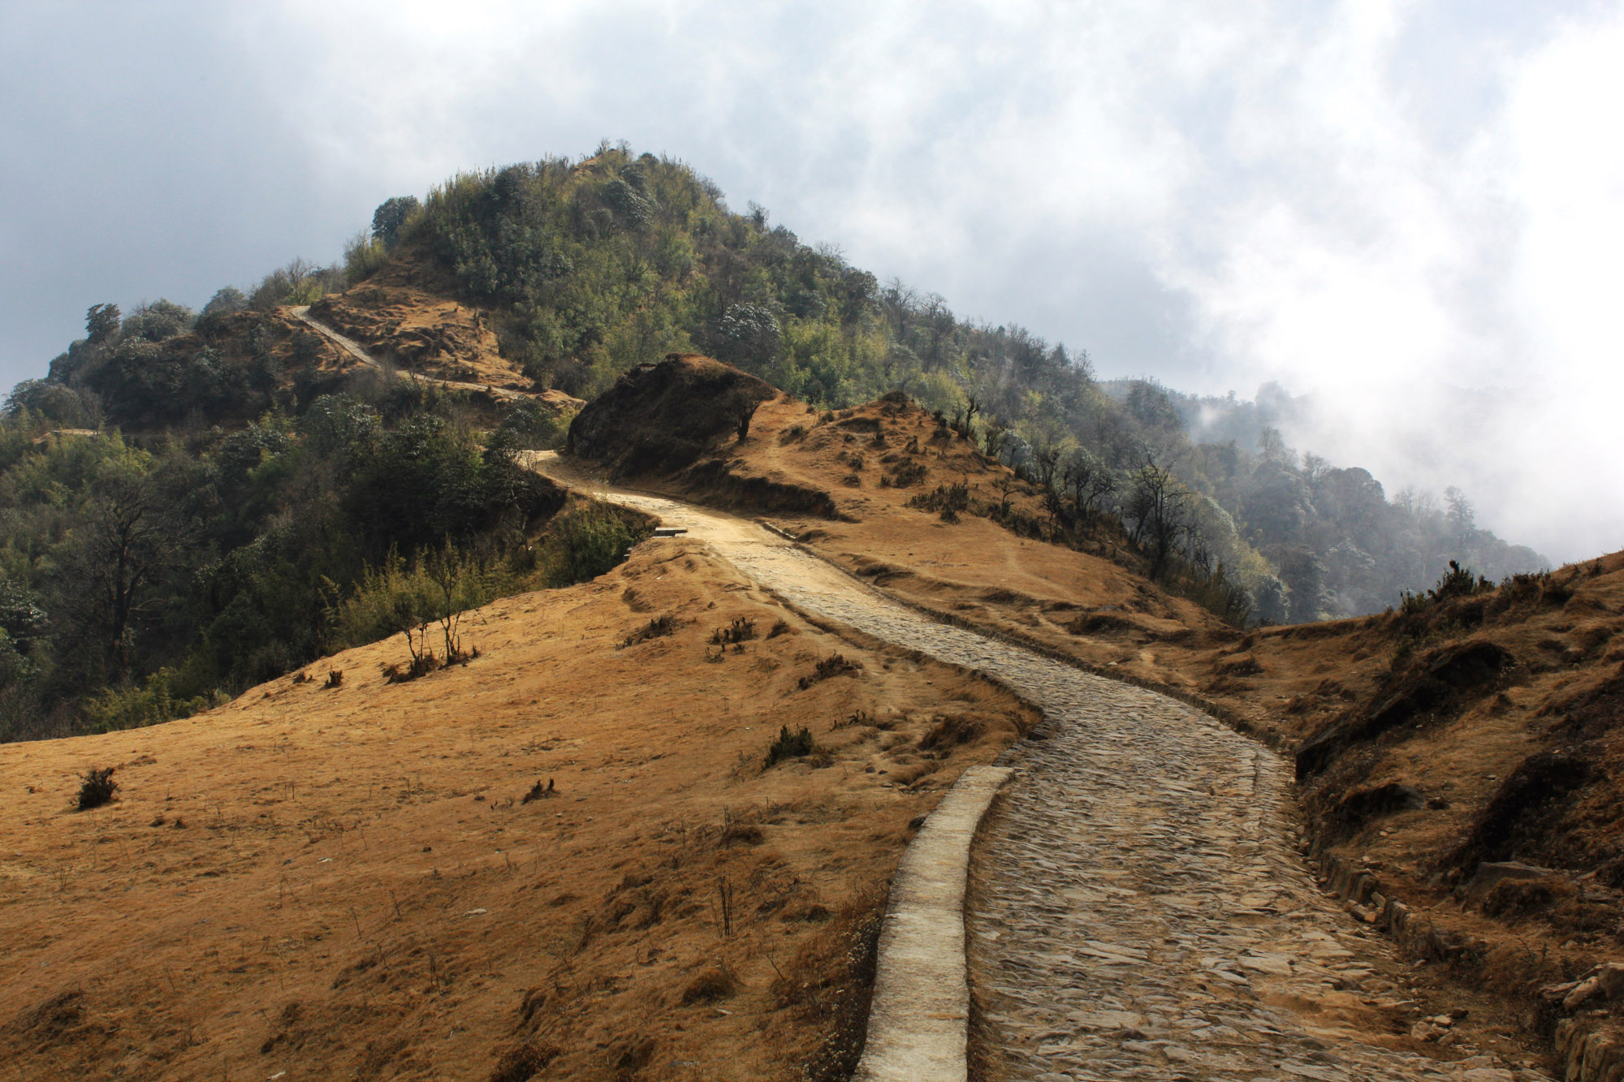
Isaiah 62: The Chapter Of Names
Make A Way …

Slide 23
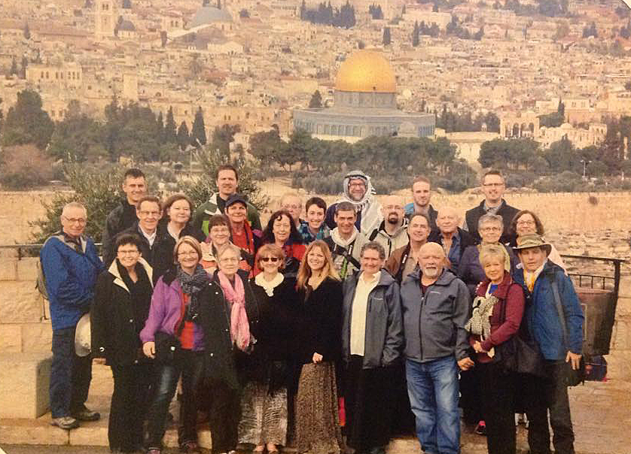

Slide 24
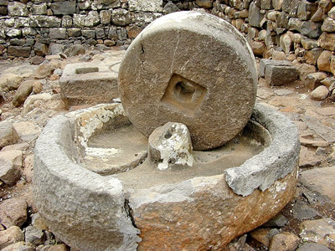
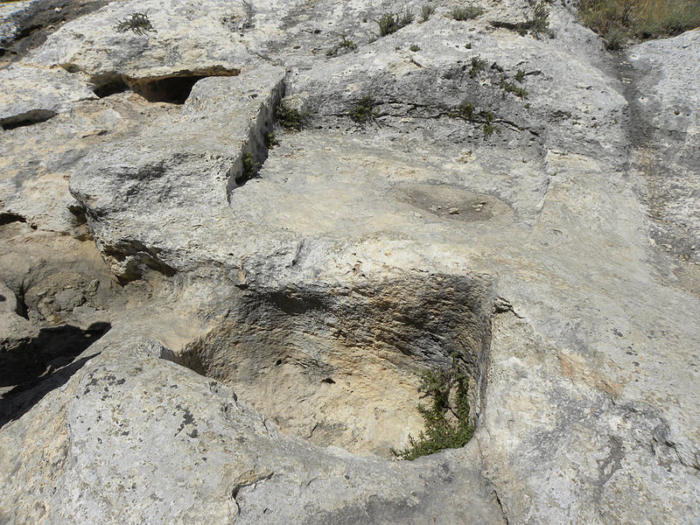
Isaiah 63
The Olive Press
The WIne Press
First Century Wine Press In Nazareth

Slide 25
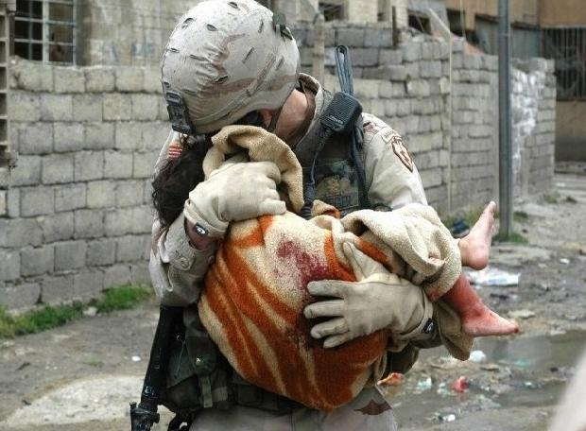
Isaiah 63
We may find the picture of a blood stained Messiah somehow distasteful … but to those
in our world who are suffering terribly, I doubt that they would see their liberators as such:

Slide 26
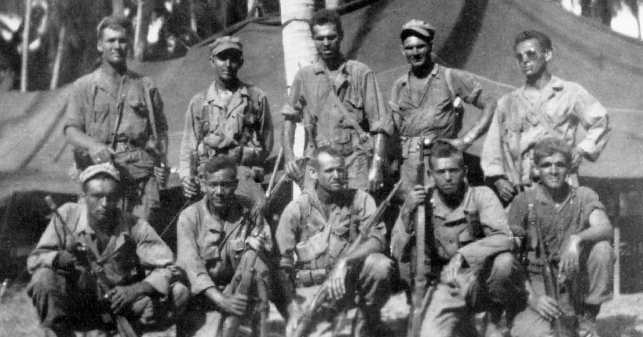
Isaiah 63
The Cabanatuan POW camp was where up to 8,000 soldiers, mostly American, were kept by
the Japanese. By 1945, there were less than 1,000 left, with most being shipped to slave
labor camps and others being murdered. On January 30, a group of 120 US Army Rangers
and 300 Filipino guerrilla fighters raided the camp, rescuing all of the 512 prisoners who
still remained in the camp.:

Slide 27
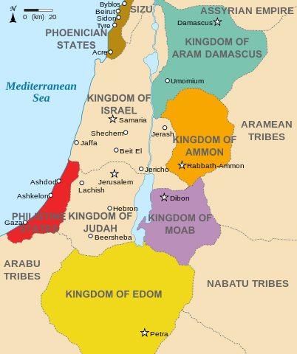
Isaiah 63
Edom’s capital is called Bozrah

Slide 28
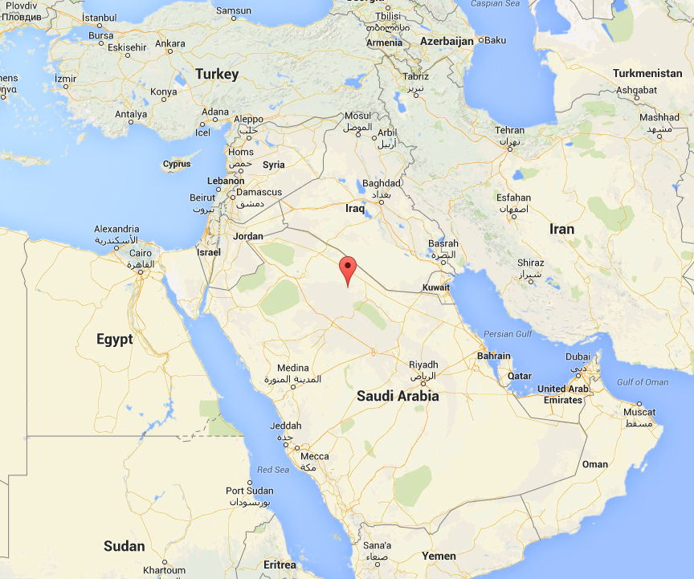
Isaiah 63
The Middle East Today

Slide 29
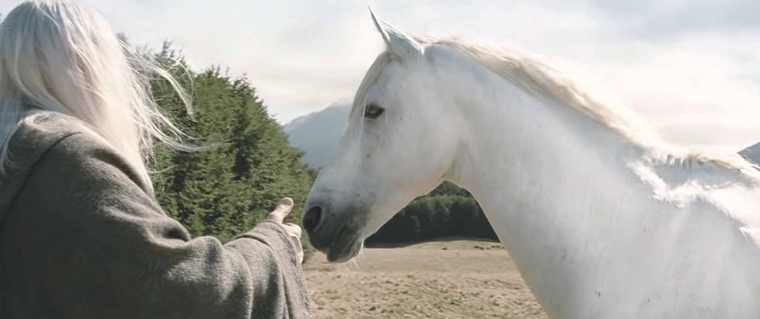
Isaiah 63
Shadowfax … The Horse That Does Not Stumble (v.13)

Slide 30

Isaiah 64

Slide 31



Isaiah 64
Do you not know that in a race all the runners run, but only one gets the prize? Run in
such a way as to get the prize. Everyone who competes in the games goes into strict
training. They do it to get a crown that will not last; but we do it to get a crown that will last
for ever. Therefore I do not run like a man running aimlessly; I do not fight like a man beating
the air. No, I beat my body and make it my slave so that after I have preached to others, I
myself will not be disqualified for the prize. 1 Corinth. 9:25-27

Slide 32
Isaiah 64
The Four Women Of Christmas
Who | Where | Details
Tamar | Gen. 38 | Judah … refuses Kinsman Redeemer; She is gentile, strong, one who is forced to get her justice in a poor way. Scarlet thread around her baby. Judah realizes his sin and spares her life (like Joseph would). Tragic marriage situation.
Rahab | Joshua 2 | Gentile. Strong willed. Has found God’s grace and understanding. Her family is spared the slaughter by a scarlet rope. Tragic marriage situation.
Ruth | Ruth | Tragic marriage situation. A gentile, strong. Willing to glean. Willing to serve God despite bad circumstances. Is lead to Boaz. A blessed marriage results. The Kinsman Redeemer made real.
Bathsheba | 2 Samuel 11 | Tragic marriage situation. Note she is not even named in this genealogy, and is identified by her gentile husband. Strong woman, who would later stand with her son as he becomes king.

Slide 33
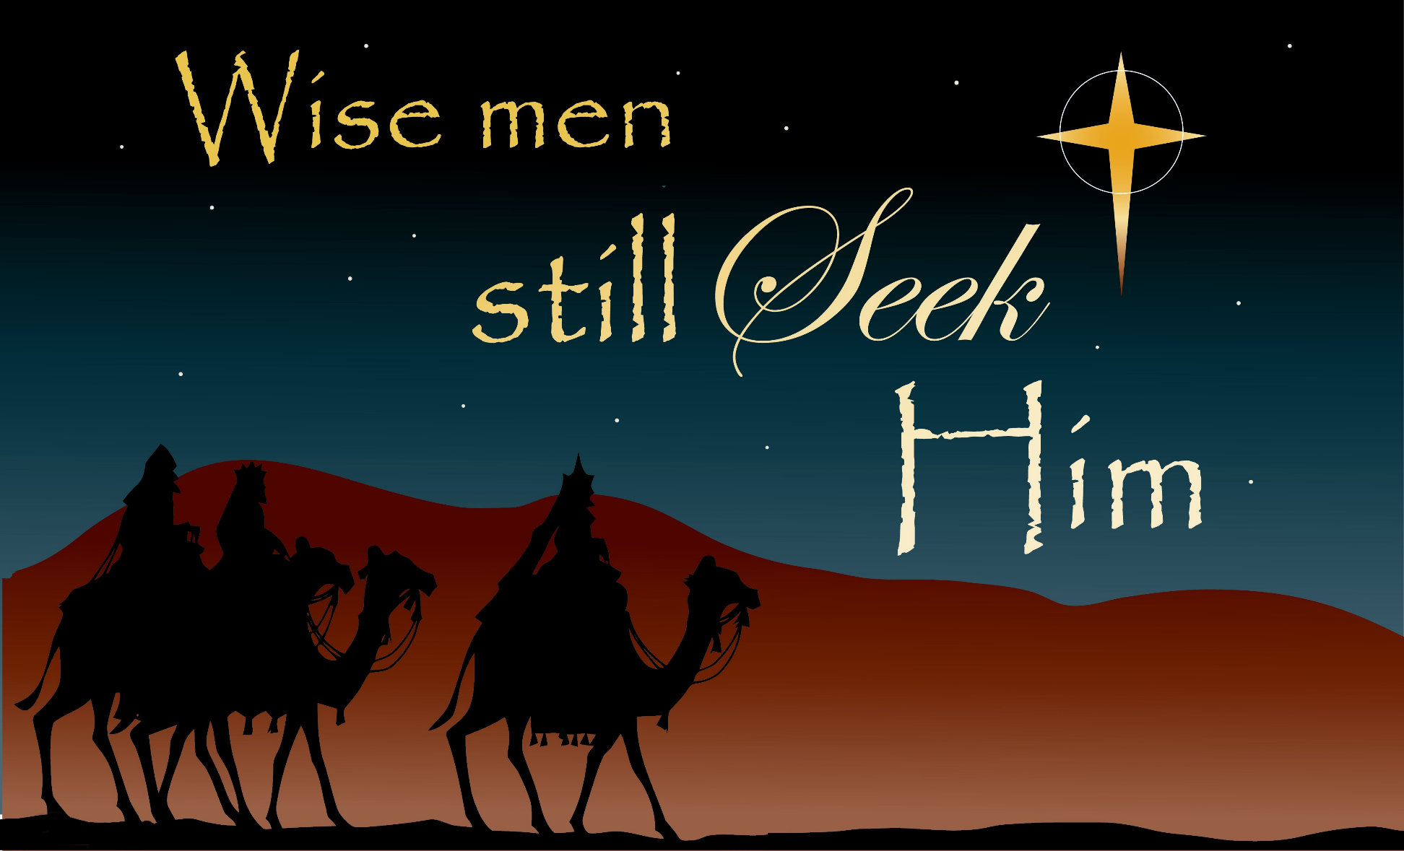
Isaiah 65
Deut. 4:29 But if from there you seek the LORD your God, you will find him if you
look for him with all your heart and with all your soul.

Slide 34
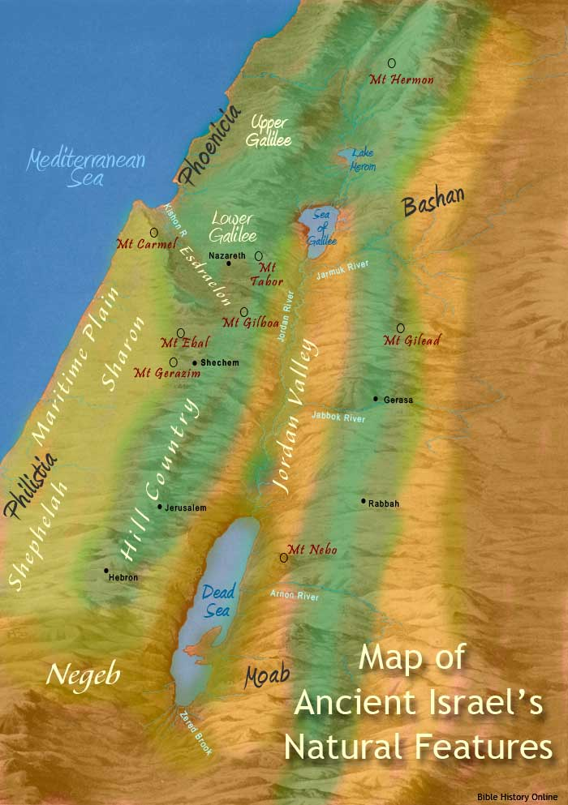
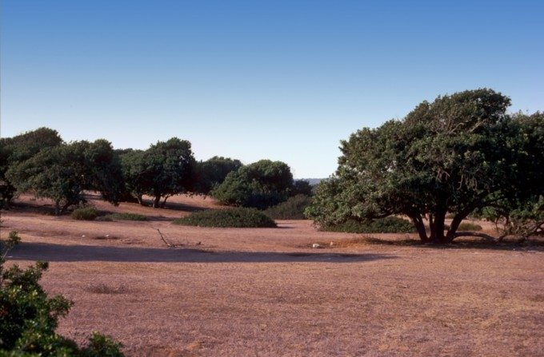
Isaiah 65
Verse 10 … Plains of Sharon …

Slide 35
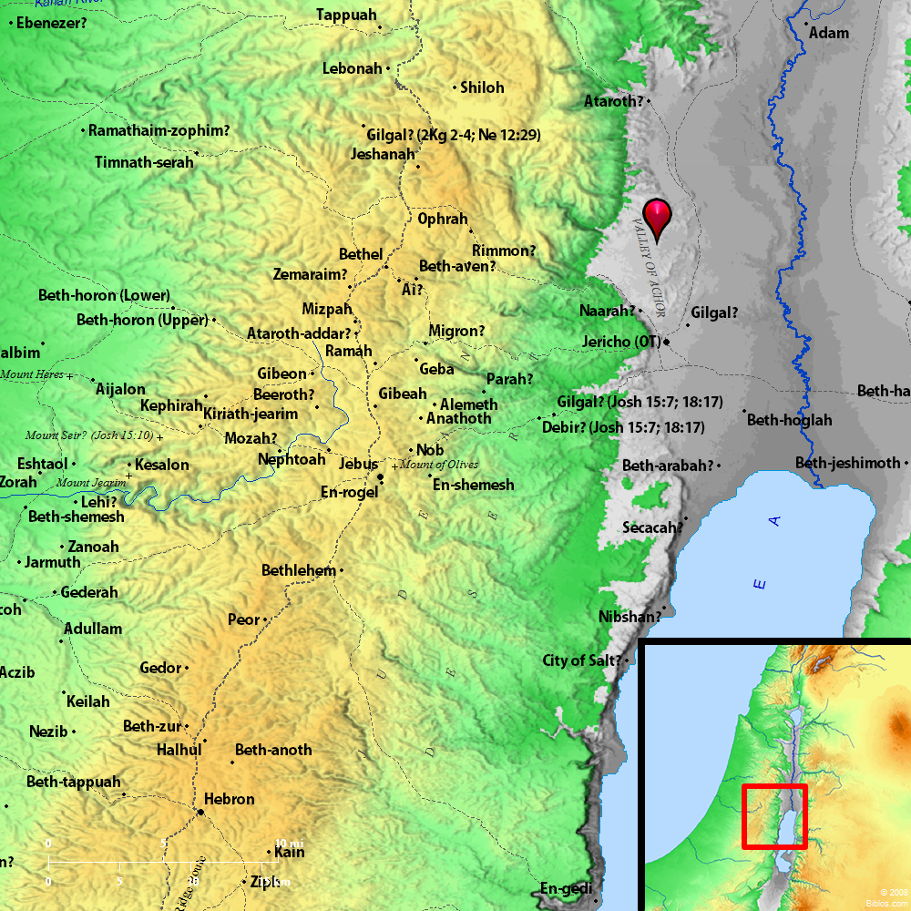
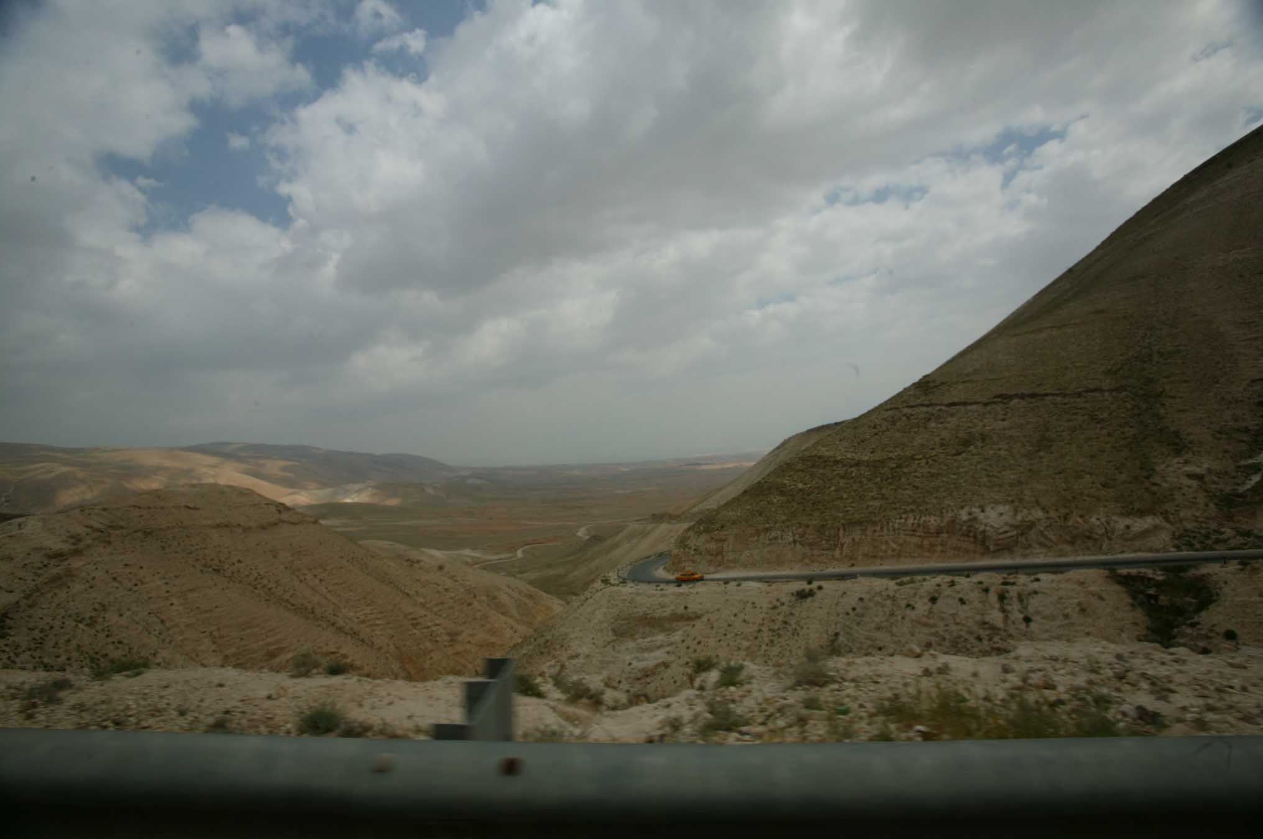
Isaiah 65
and Valley Of Achor

Slide 36
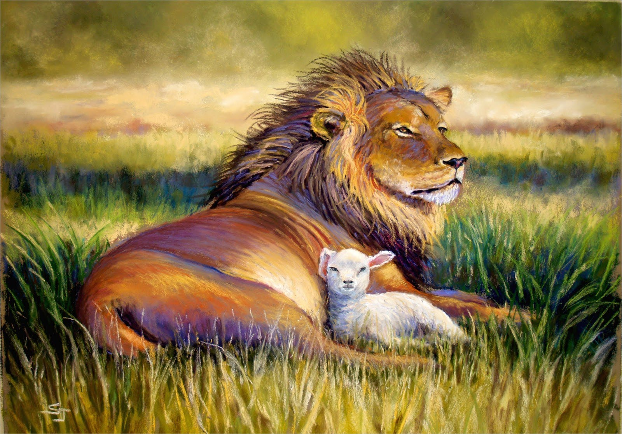
Isaiah 65
The Millennium

Slide 37
Isaiah 65
Garden Of Eden
Right Relationships
Human to God
Male to female
Human to animal
Human to nature

Slide 38
A Possible Scenario
3.5 Years
1260 Days, 42 Months
7 Years
1000 Years
Tribulation
Millennium
Great White
Throne Judgment
The Rapture?
1 Thess. 4
1 Cor. 15
The Abomination
Of Desolation
Matthew 24, Daniel 9
Return Of Christ

Slide 39
Isaiah 65
Characteristics:
It is new (v. 17)
  Is this an event that happens at the beginning or the end of
  the period?
Former things are not remembered.
Joy will be the character that will mark this Kingdom (v. 18-19)
Age is greatly extended again (as it was in the Garden).
Some still die (they are unglorified).
Sin still seems to reign (v. 20).
People build and enjoy the fruit of their own labour (v. 21-22).
Children are born and there is every expectation of a wonderful
future (v.23)
9. Prayer is answered without delay (v.24)
10. The nature of animals is restored as it was in the Garden (v.25)

Slide 40
Isaiah 65
The Nature Of The Millennium
Christ bodily reigns on earth (Matthew 25:31-41)
Both glorified and unglorified saints seem to coexist
  2Tim. 2:12, Rev. 20:4, 6
  Isa. 65:17-25, 11:6-9
    Some die; sin still exists
    Children at 100 (extended life)
    Nature of animals restored?
    God immediately responds
    The world moves from an evil dictator to
    Christ, the perfect ruler

Slide 41
Isaiah 65
The Nature Of The Millennium
3) An increase in light ??
- see Isa. 30:26
4) Purified language, worship, unity
- see Zech. 3:8
5) Satan can no longer deceive (Rev. 20:1-3)
- Less clear: status of demonic forces (Isa. 24:21)
6) Saints seem to reign in this time (Rev. 20:4-6)
- Also, they seem to act as priests

Slide 42
Isaiah 65
The Nature Of The Millennium
7) In essence, life appears to mimic that in the Garden
Purposes:
1) To declare forever, that in spite of humanity receiving God‘s
best, and Satan being removed, we will still choose to rebel against
God. The Millennium will remove the ability for us to blame anyone
but ourselves!
2) To visibly vindicate Christ
3) To usher in the time where God is found to be ALL IN ALL!
(1 Cor. 15:28)
4) Even the length (1000 years) > the age of the oldest
human (969); No one can claim they had insufficient time.

Slide 43
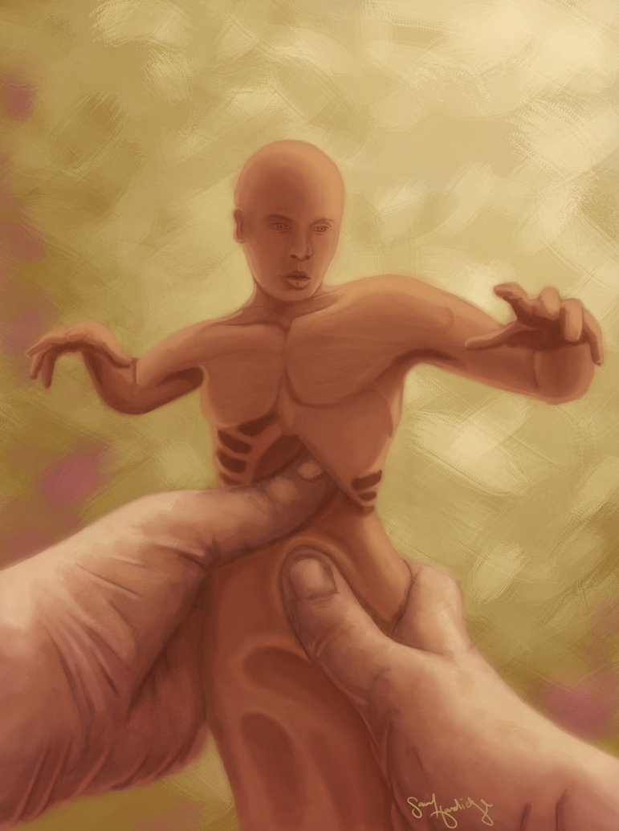
Isaiah 66
Creation
Samuel Hardidge

Slide 44
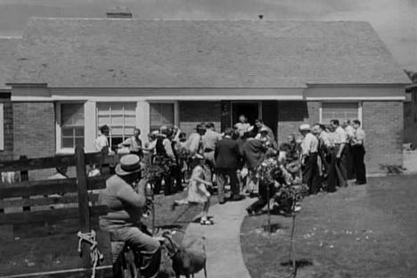
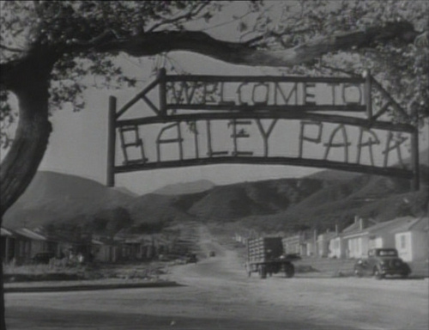
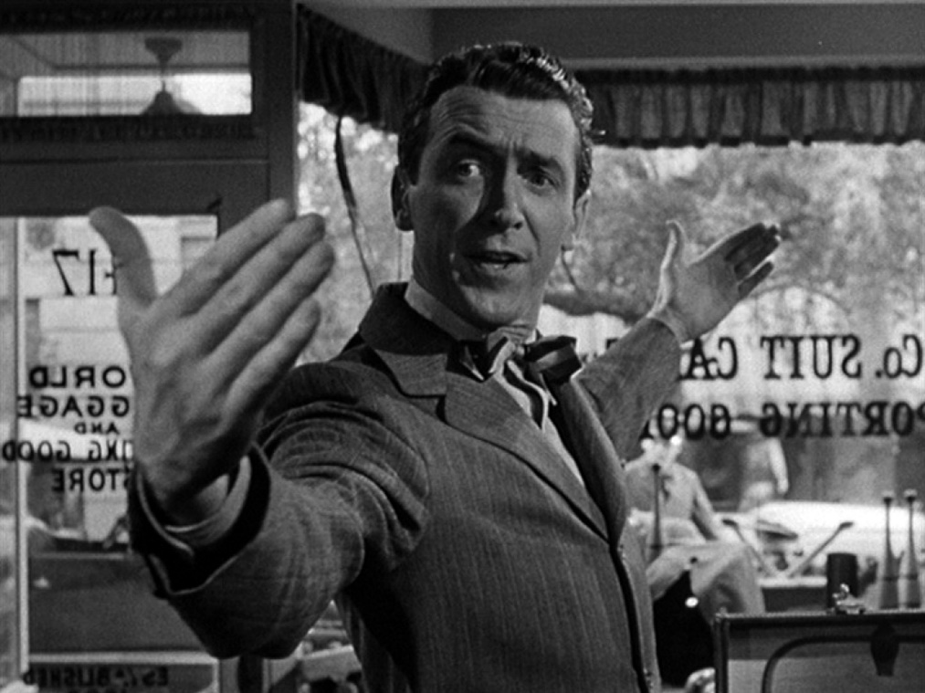
Isaiah 66
Which Of My “Buildings” Count?

Slide 45
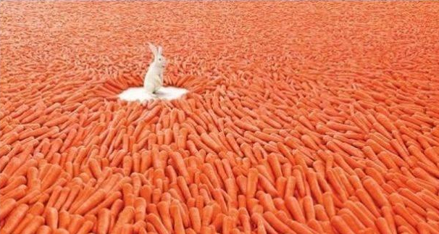
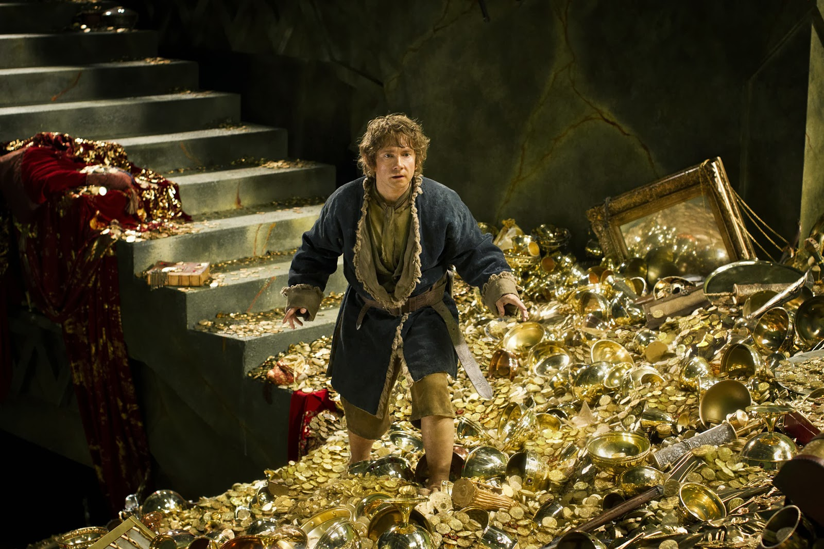
Isaiah 66
What is the source of abundance?

Slide 46

Isaiah 66
To grab is to lose …

Slide 47
Isaiah 66
Isaiah 66:3-17 is organized in a modified chiasm:
A. Fourfold abominations, 3 (“blood of swine”).
B. Punishment of enemies, 4-6 (begins with “hear the word of Yahweh”).
C. Zion gives birth, 7-9 (“says your God” at end).
D. Jerusalem’s joy, 10-11.
E. Peace like a river, 12a (begins with “thus says Yahweh”)
C’. Comforted like a child with mother, 12b-13.
D’. Joy, 14a.
B’. Indignation toward enemies, 14b-16
A’. Abominations, 17 (“swine’s flesh”; ends with “declares Yahweh”).

Slide 48
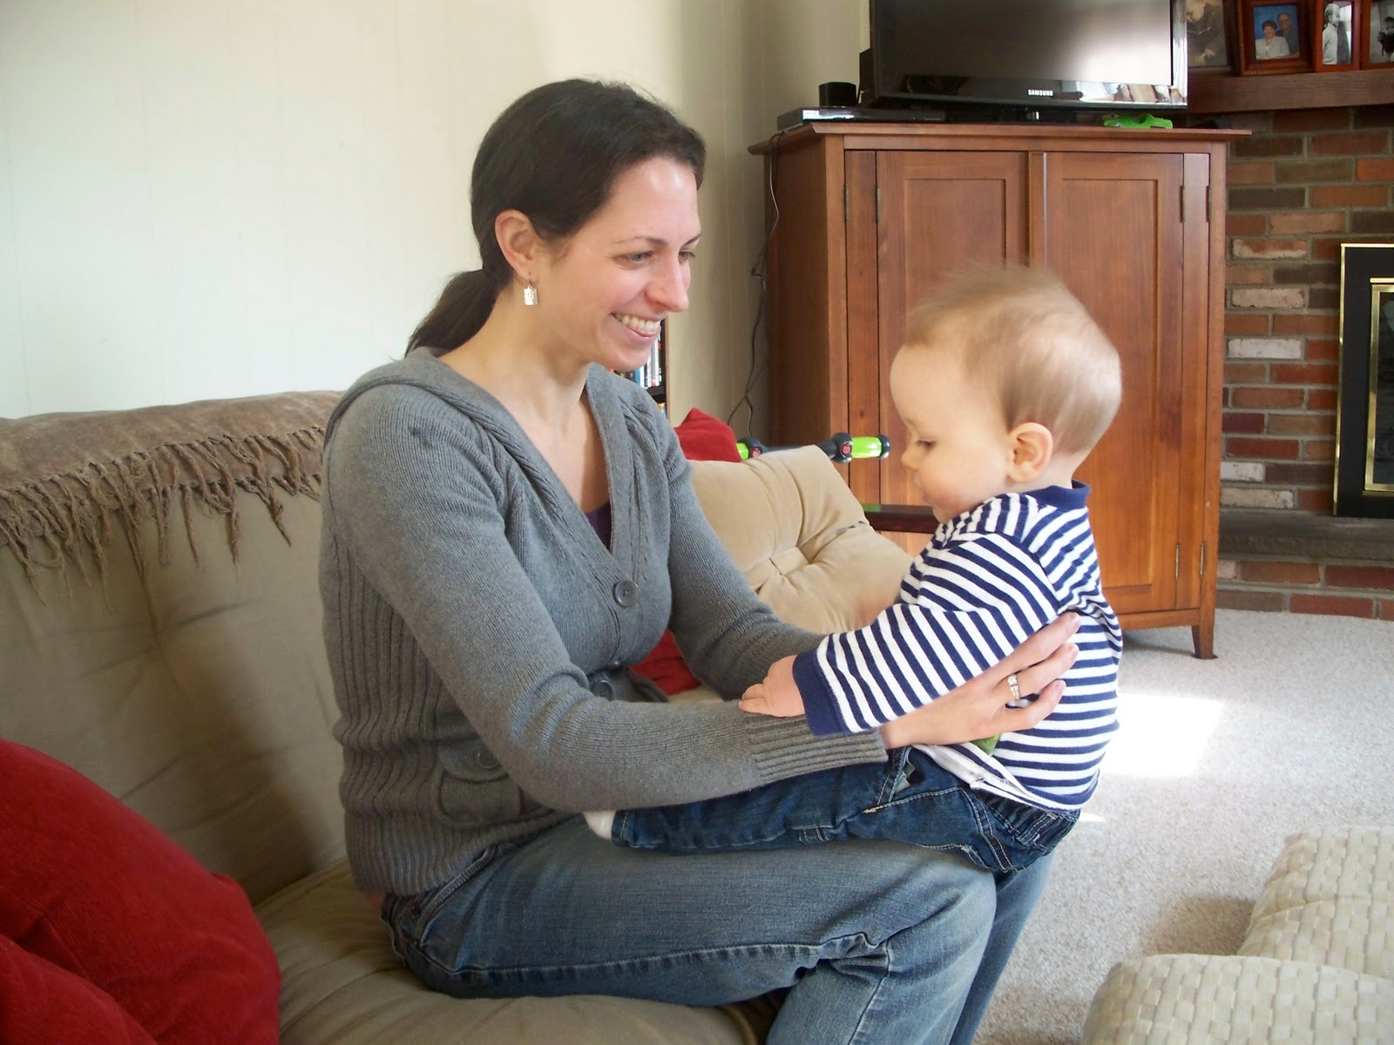
Isaiah 66
Dandling

