Slide 2
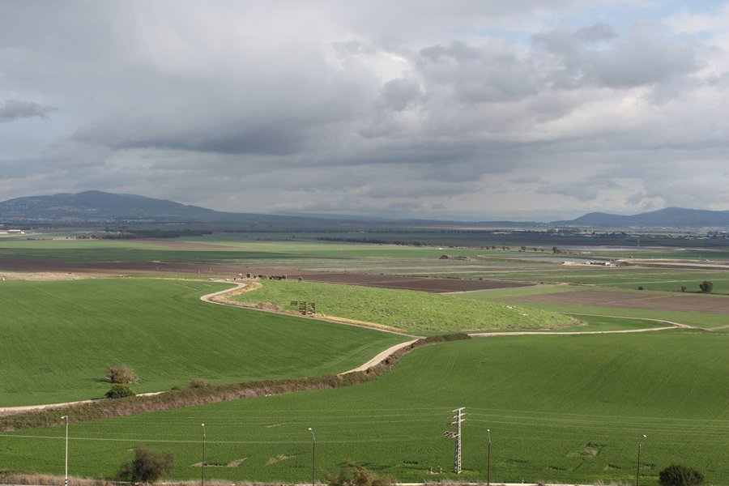
Isaiah 34
Armageddon
Megiddo

Slide 3
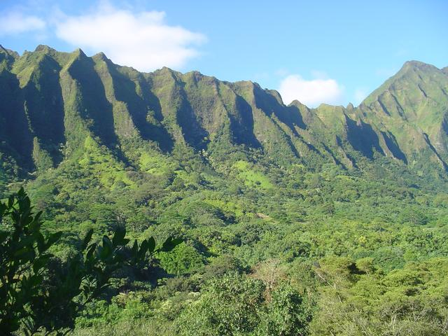
Isaiah 35
The New Kingdom

Slide 4
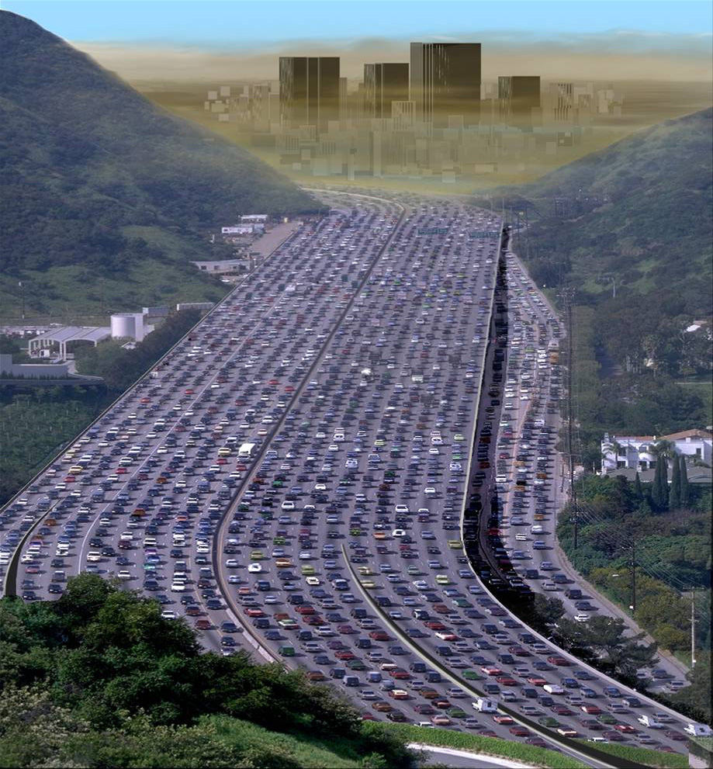
Isaiah 35
The Way Of Holiness

Slide 5
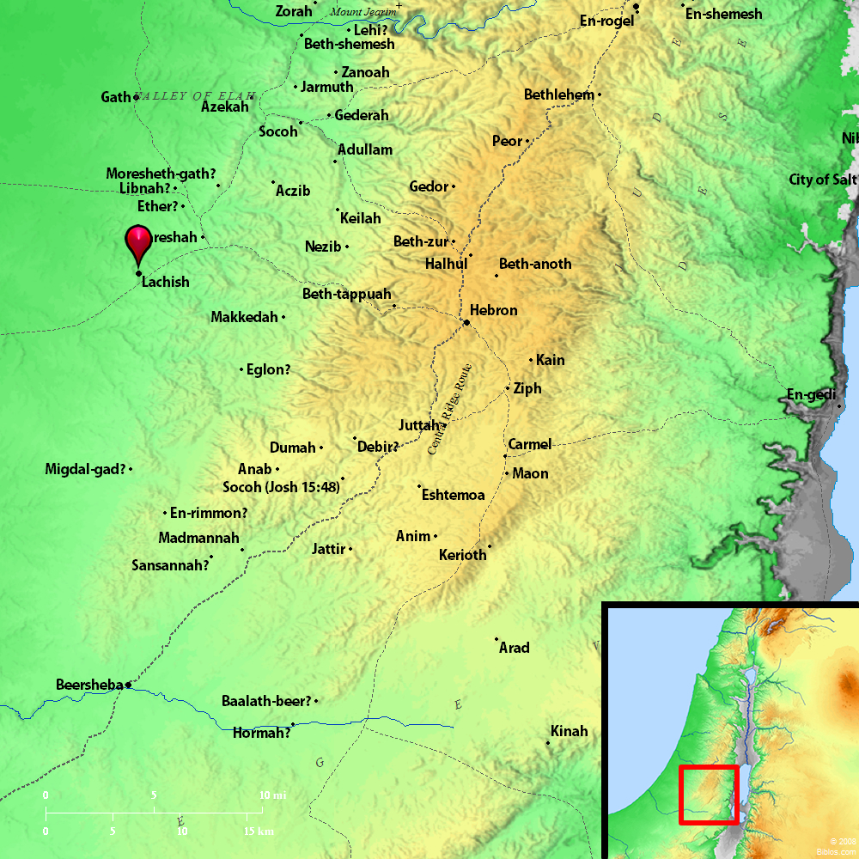
Isaiah 36
Lachish

Slide 6
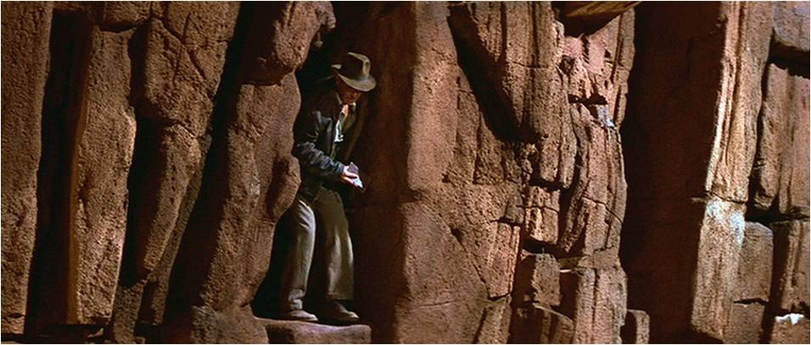
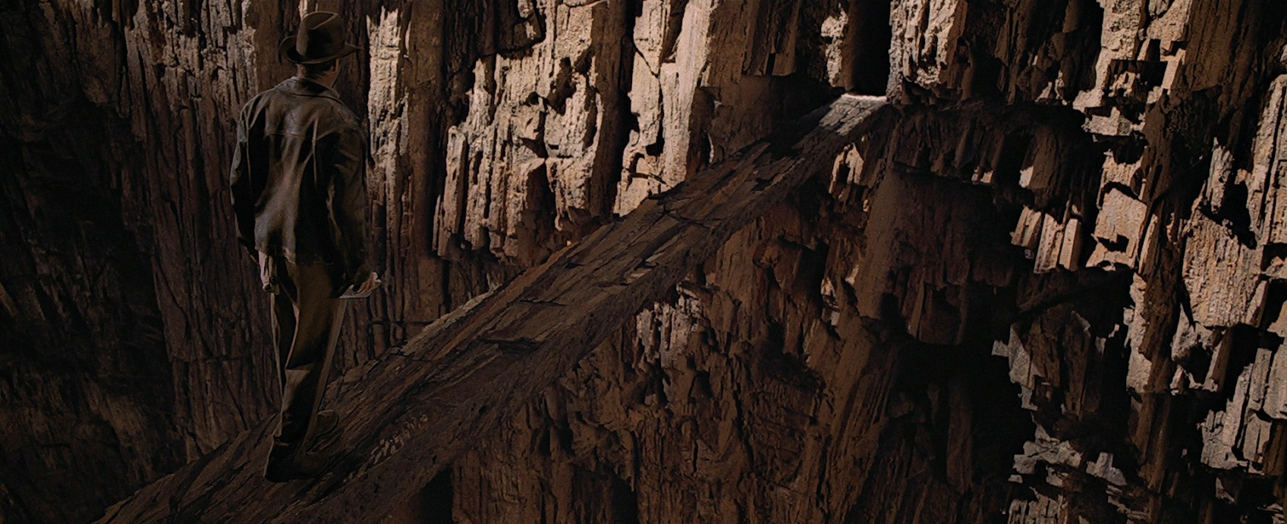
Isaiah 37

Slide 7
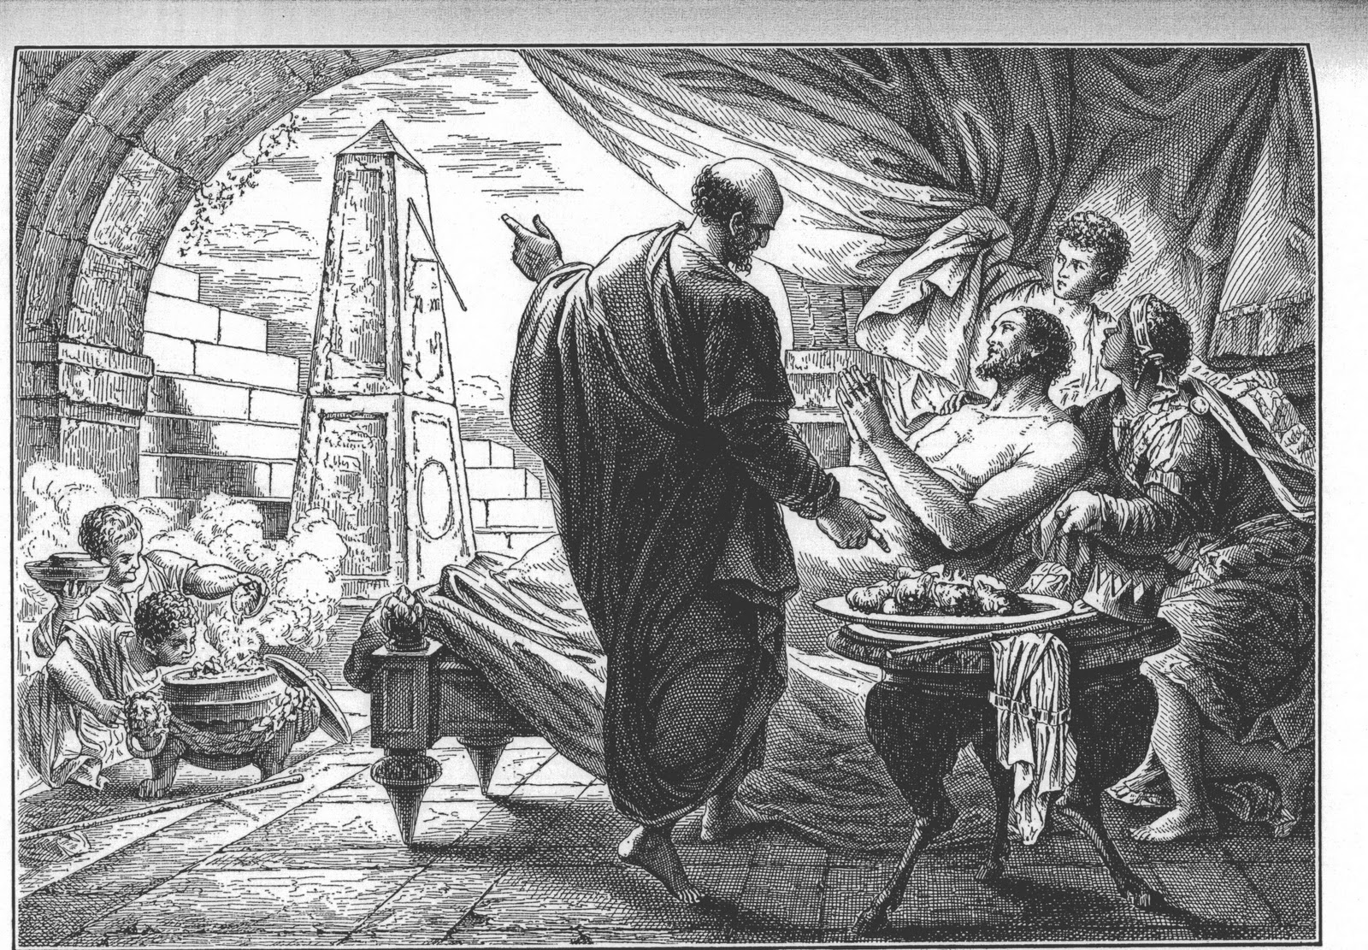
Isaiah 38

Slide 8
Isaiah 38
Does God change His mind?
Powerless
Robotic

Slide 9
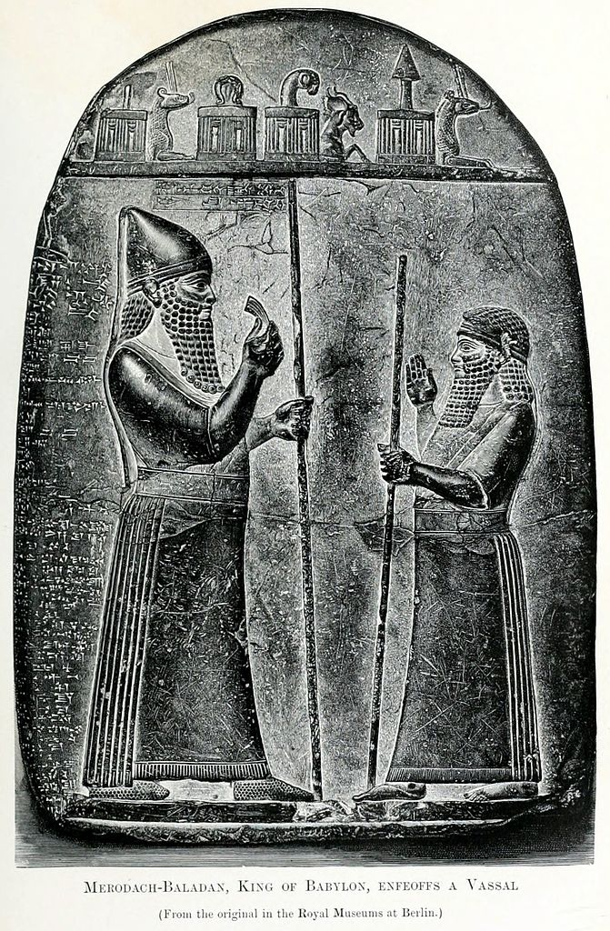
Isaiah 39

Slide 10
Isaiah 39
What I do matters!

Slide 11
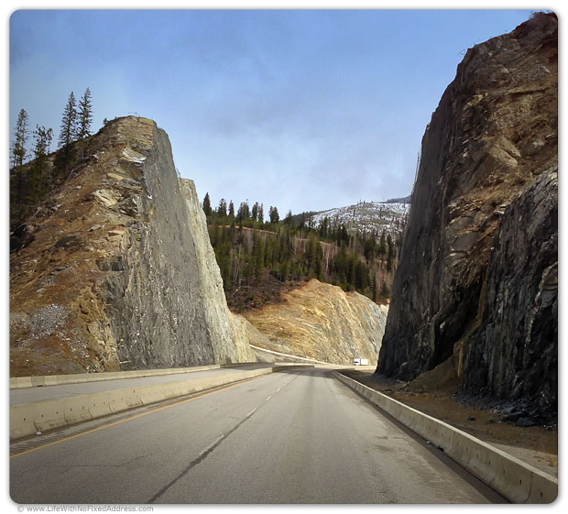
Isaiah 40
Making Straight Paths

Slide 12
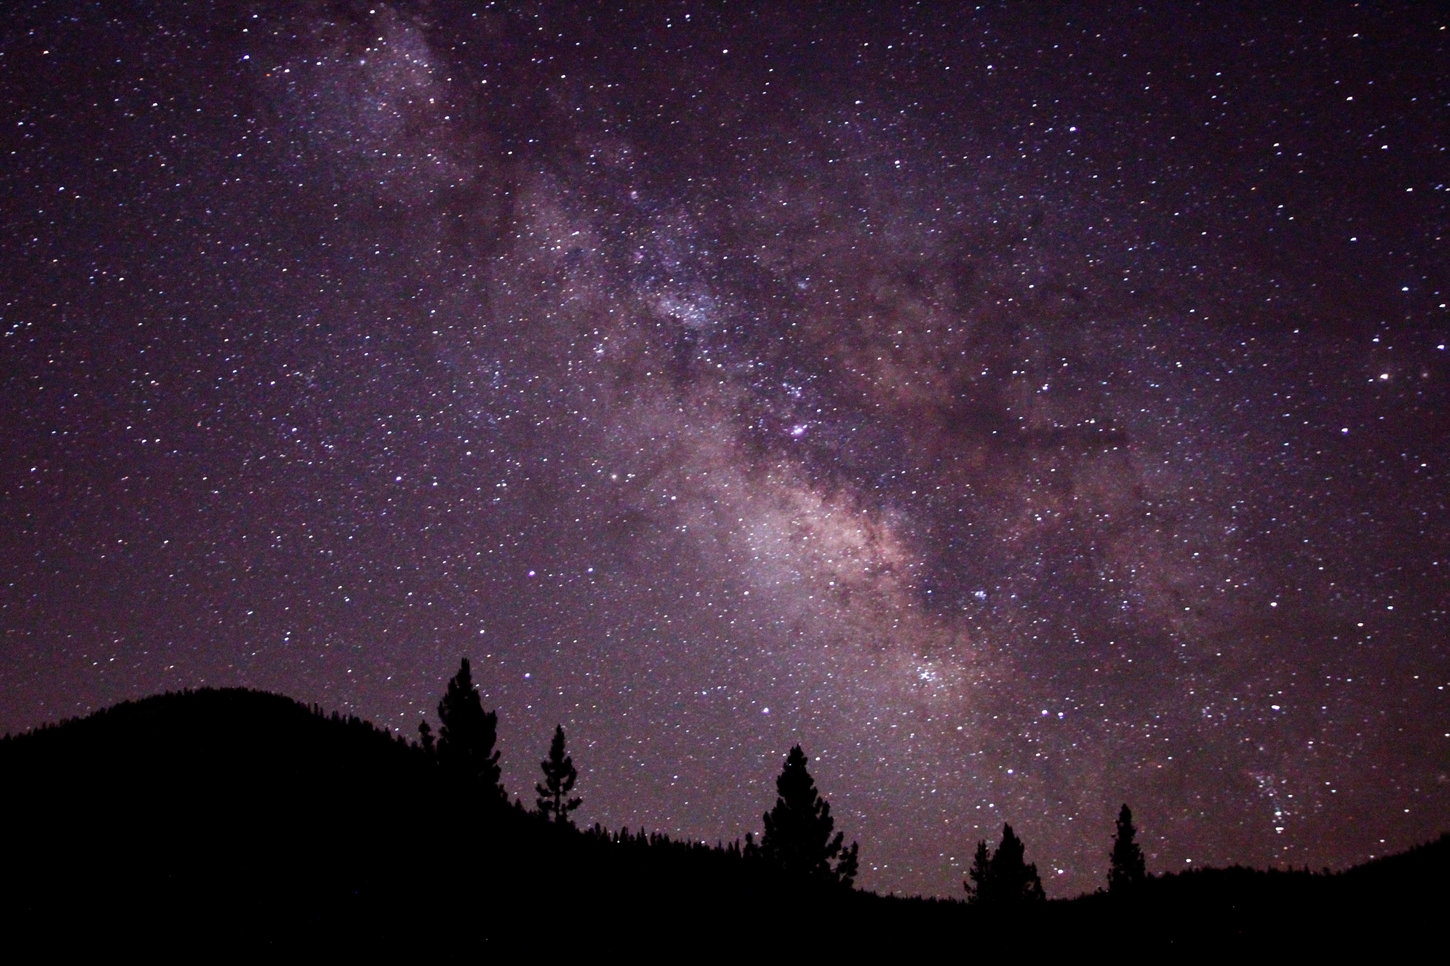
Isaiah 40
In Awe Of God

Slide 13
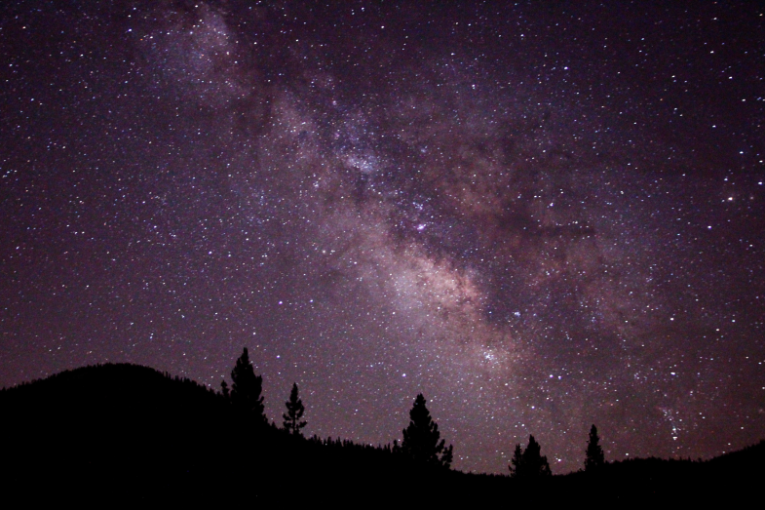
Isaiah 40
Without Divine Creation:
a) If matter precedes spirit, then our nature is accidental and without significance
b) If all things happened by chance, then life is without meaning and purpose.
c) There is no thing as good and evil, and no overriding ethic.
d) Our lives are nothing more than deterministic evolution

Slide 14
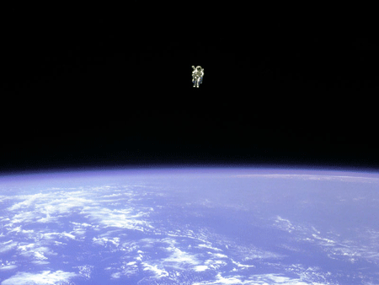
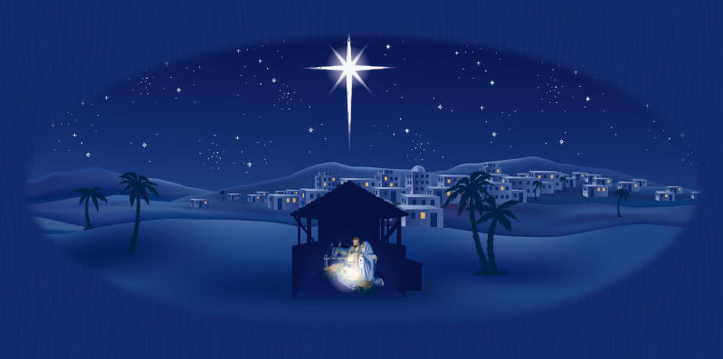
Isaiah 40
Transcendence
and
Immanence

Slide 15
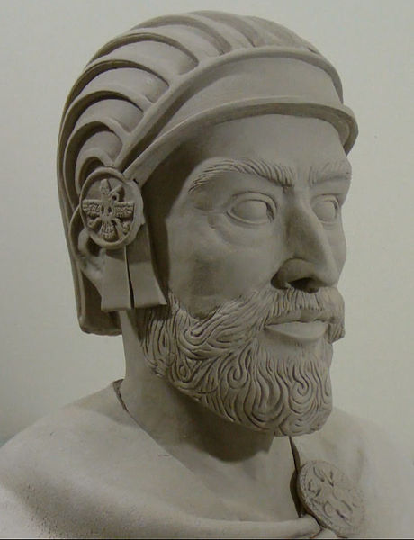
Isaiah 41
Cyrus The Great

Slide 16
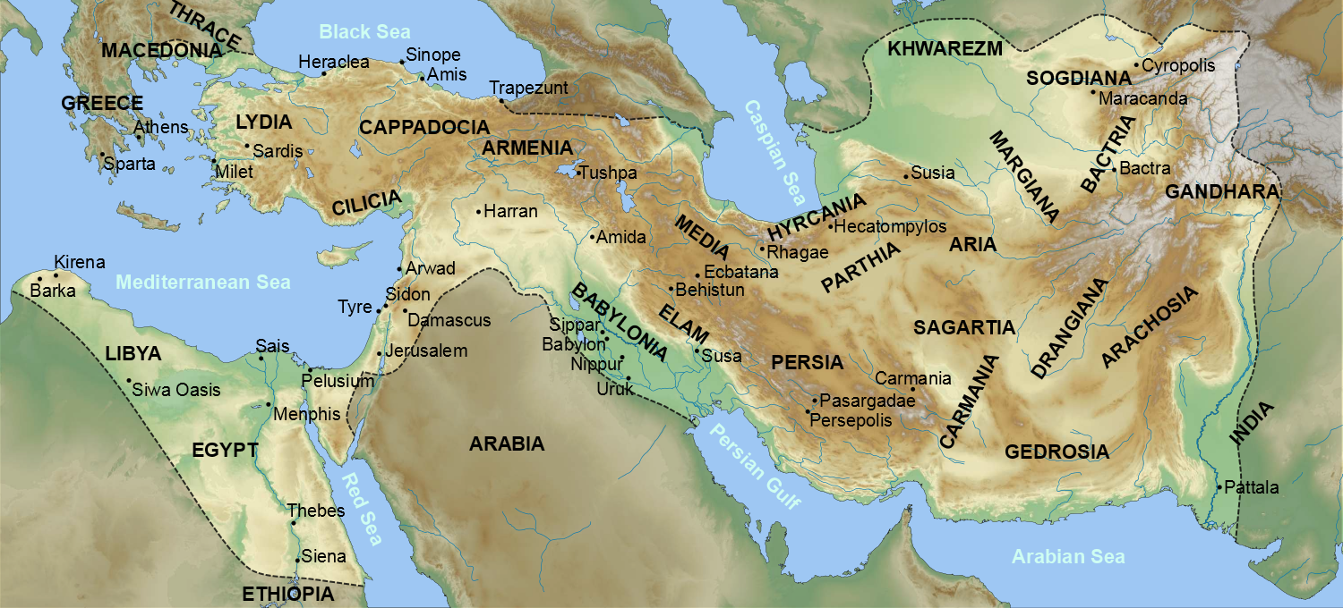
Isaiah 41
Persian Or Achaemenid Empire
In 540, Cyrus defeats Babylon
Alexander the Great invades in 334 BC

Slide 17
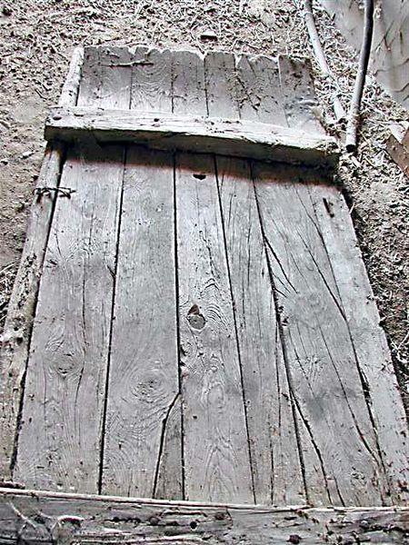
Isaiah 41
Curved front with
notched “teeth”
Used to separate the
kernels of grain.
The Threshing Sledge

Slide 18
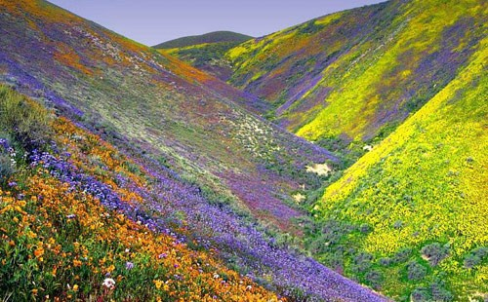
Isaiah 41
The Desert Blooms

Slide 19
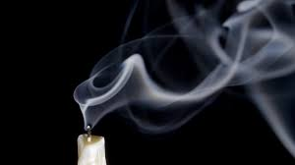
Isaiah 42

Slide 20
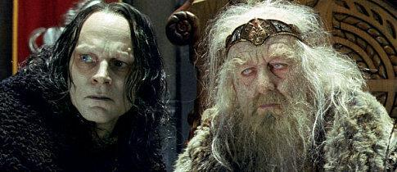
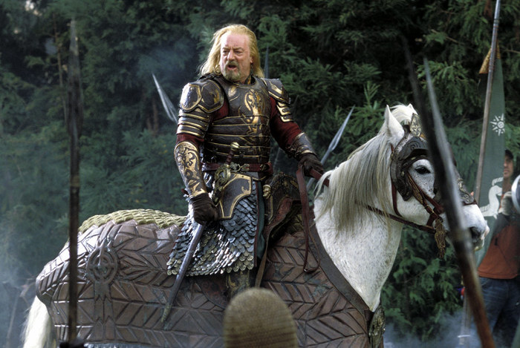
Isaiah 43
Captivity Of Fear

Slide 21
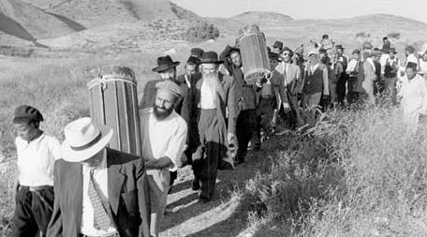
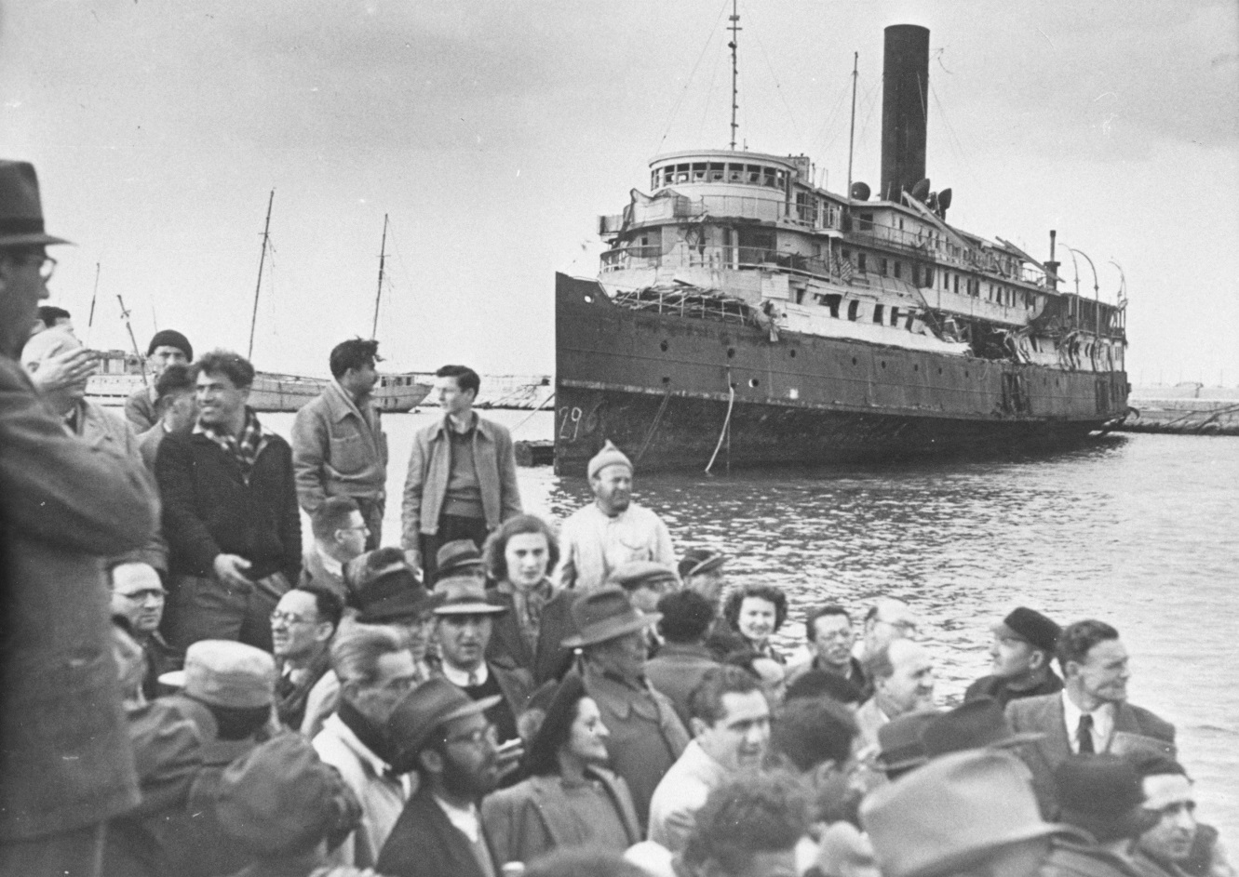
Isaiah 43
Israel comes home

Slide 22
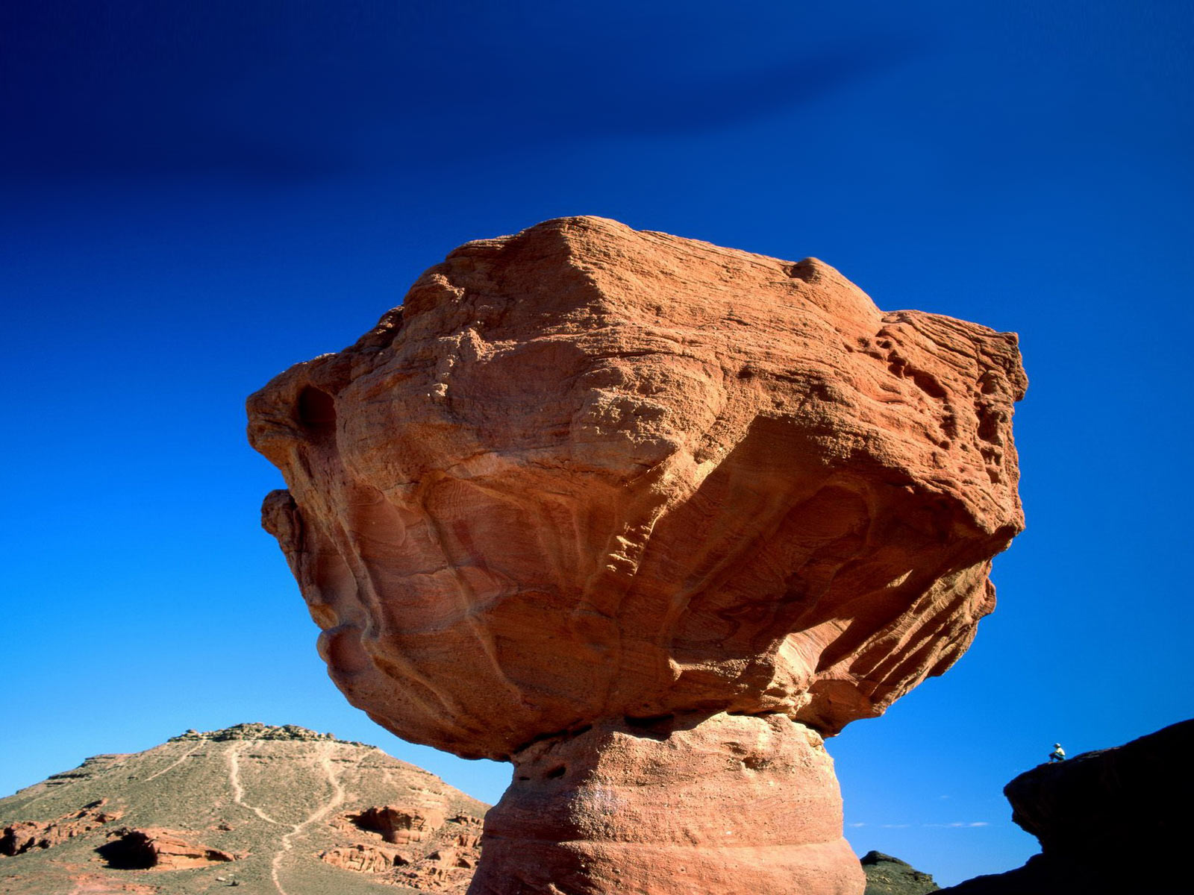
Isaiah 44
Mushroom Rock, Israel

Slide 23
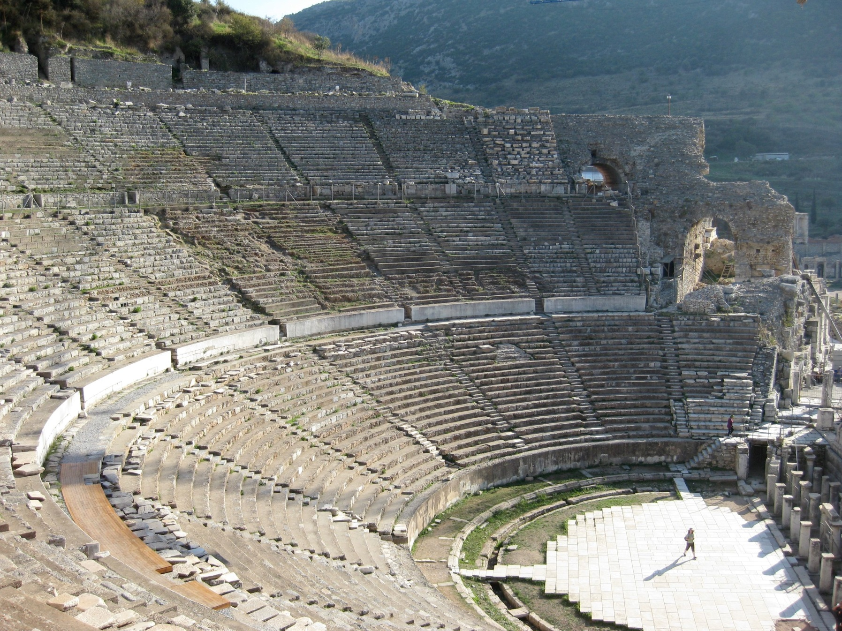
Isaiah 44
Ephesus Today

Slide 24
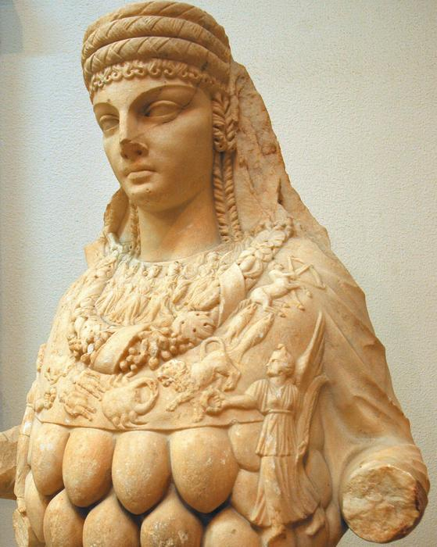
Isaiah 44
Artemis (Greek) or Diana (Roman)

Slide 25
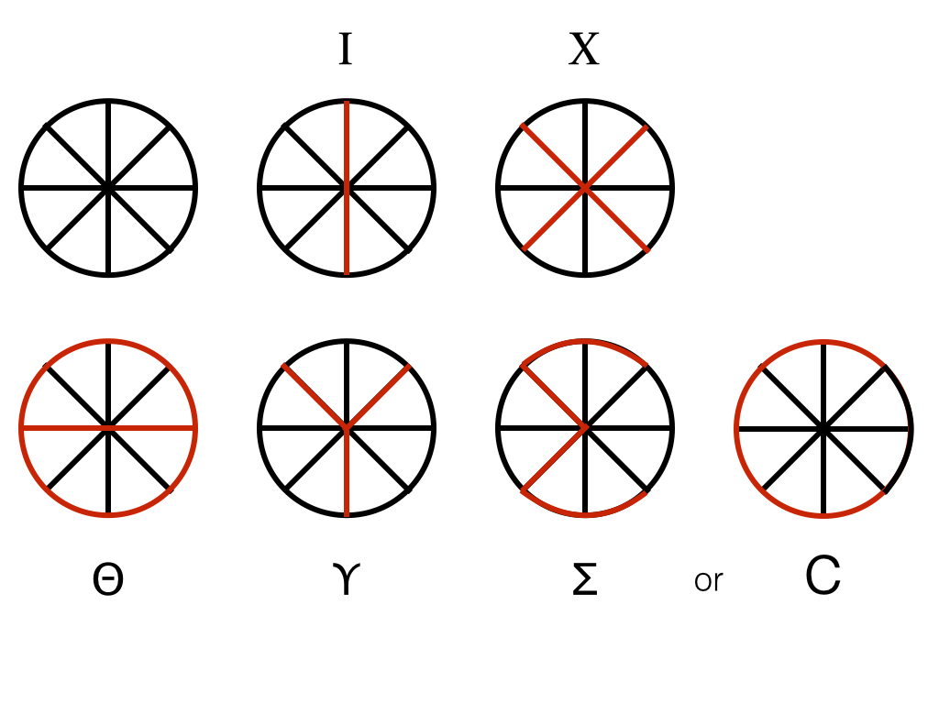
Isaiah 44
The earliest Christians generally did not use the cross as a symbols of the faith.
One of the earliest Christian symbols was, in fact, the fish, in Greek
“ichthus” (ΙΧΘΥΣ), which formed an acronym for “Jesus Christ, God’s Son, Savior”
Ίησοῦς = Iēsous = Jesus
Χριστός = Christos = Christ
Θεοῦ = Theou = “of God”
Υἱός = (H)uios = Son
Σωτήρ = Sōtēr = Savior

Slide 26
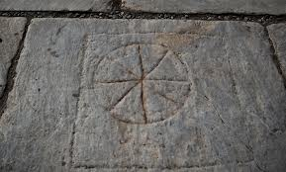
Isaiah 44

Slide 27
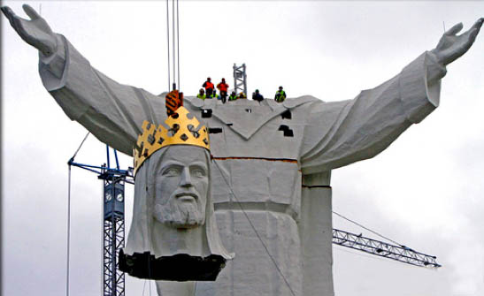
Isaiah 44
Anatomy Of An Idol
Equating an idol to a lie! Lies are powerful and they lead us to INSANE notions!

Slide 28
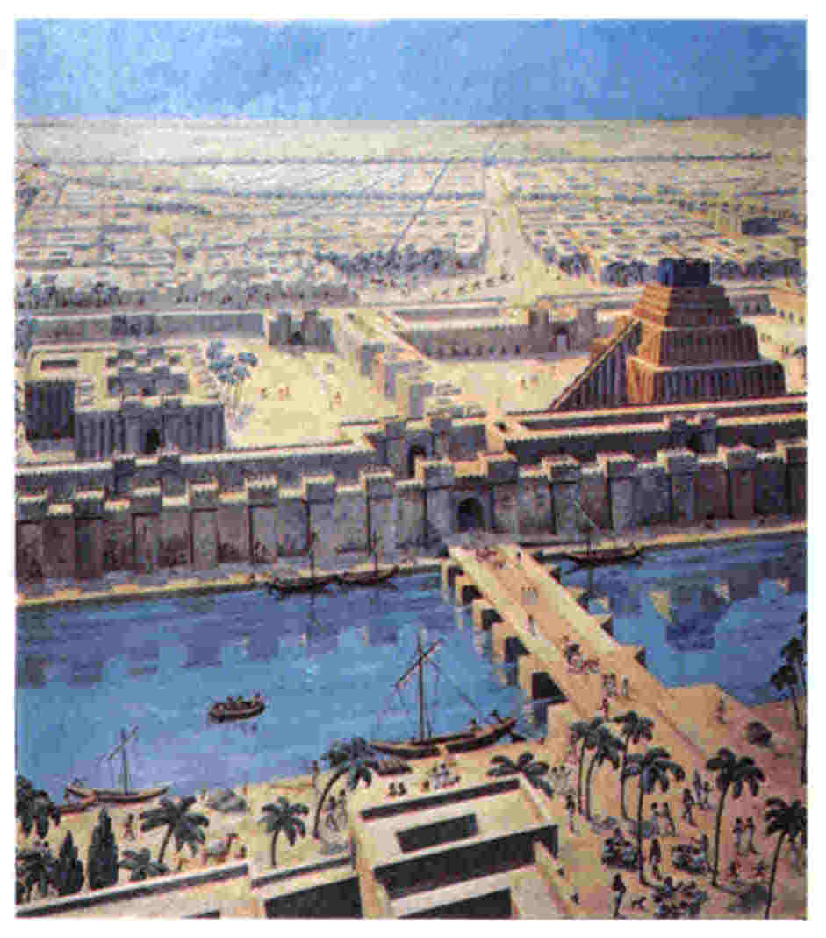
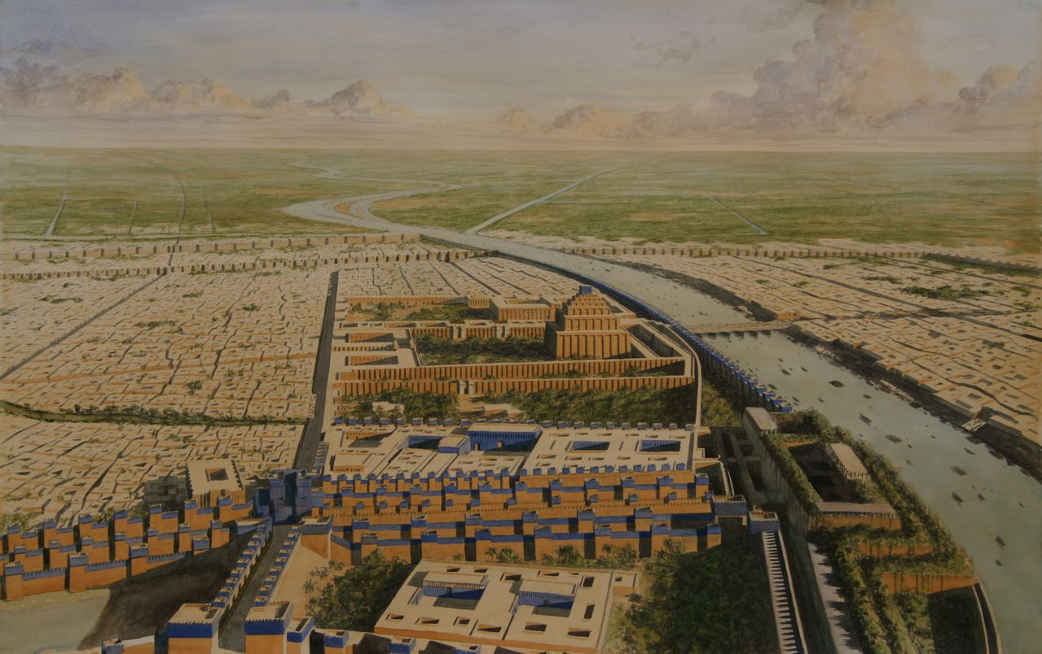
Isaiah 45
Gates Of Babylon

Slide 29
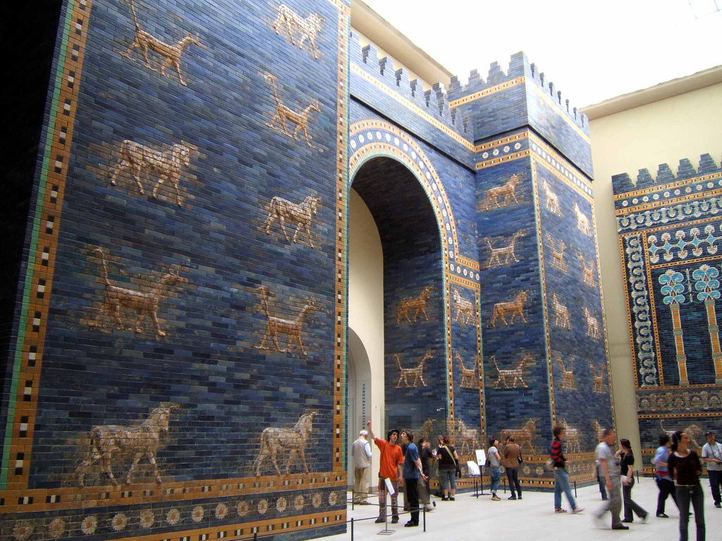
Isaiah 45
Gates Of Babylon

Slide 30
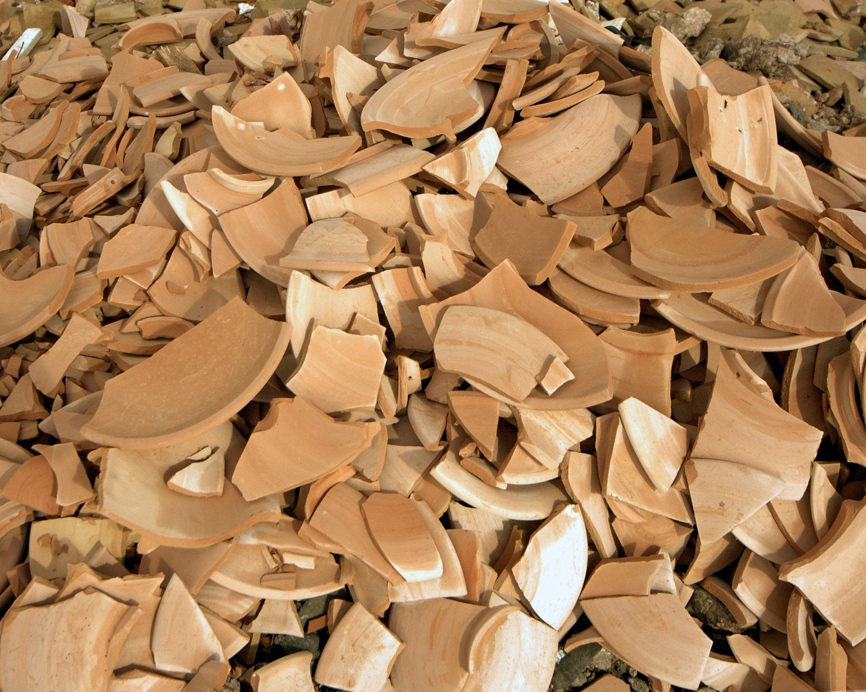
Isaiah 45
Potsherds

Slide 31
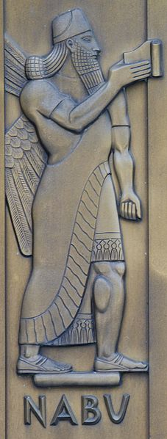
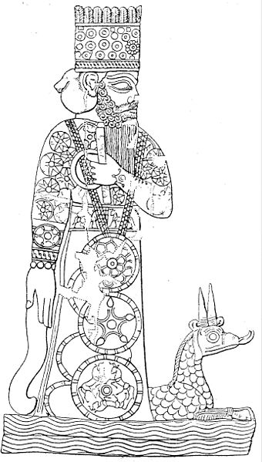
Isaiah 46
Babylonian “God’s”
Marduk & his
dragon

Slide 32
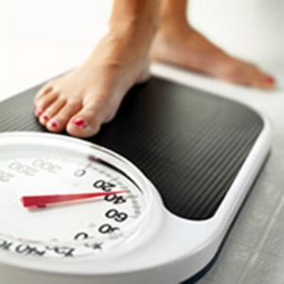
Isaiah 46
The root of all fear is the belief that we will lose something we treasure.

Slide 33
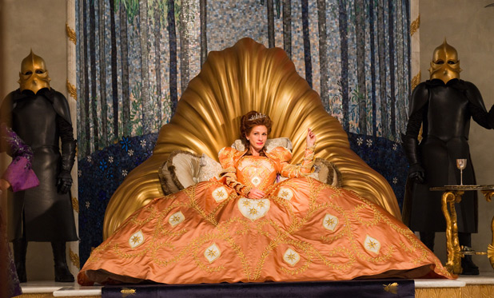
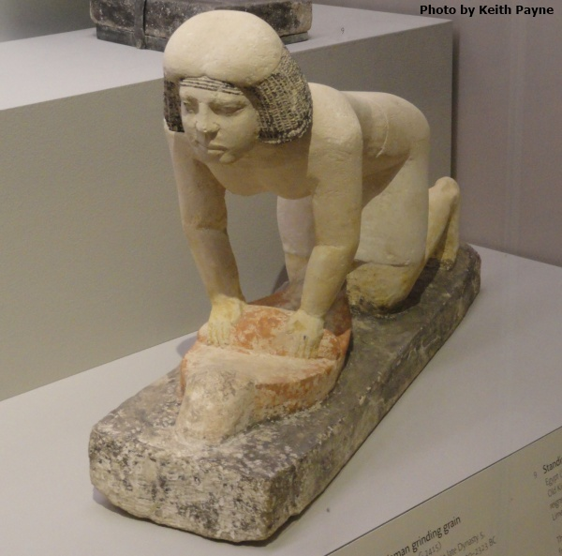
Isaiah 47
Babylon The Queen

Slide 34
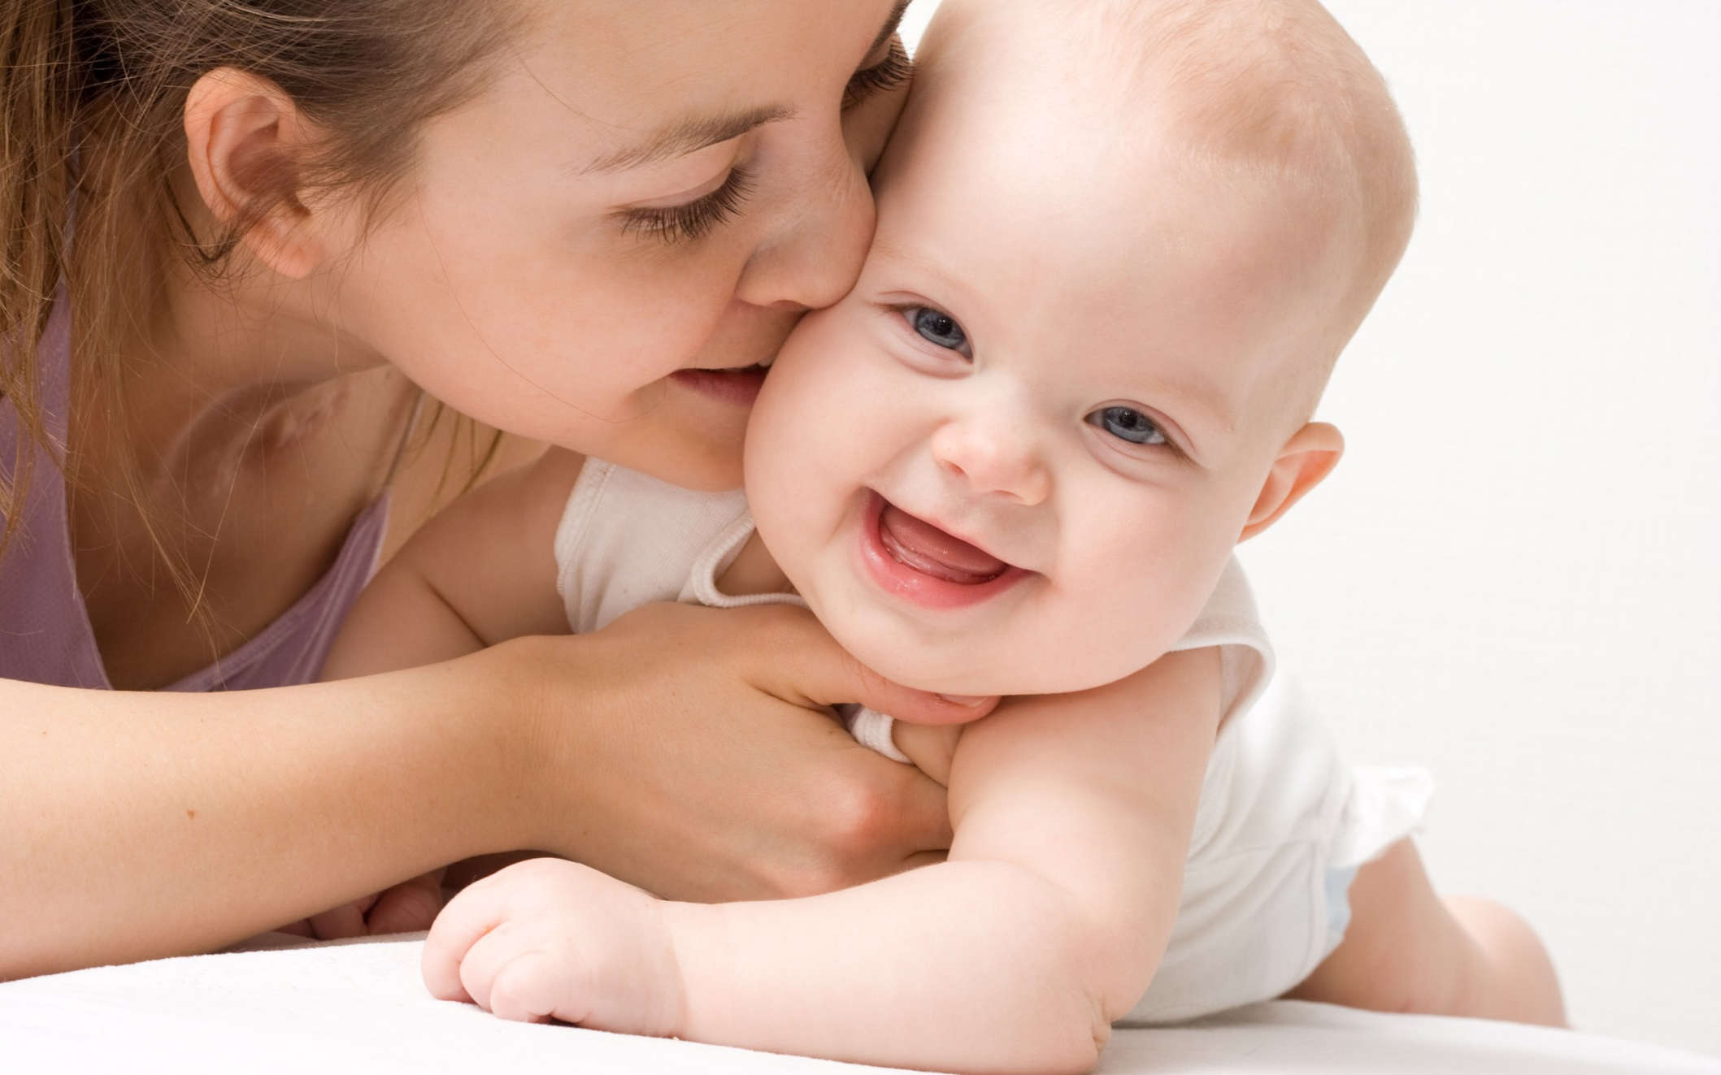
Isaiah 47
Do You Think It Will Stay This Way Forever?

Slide 35
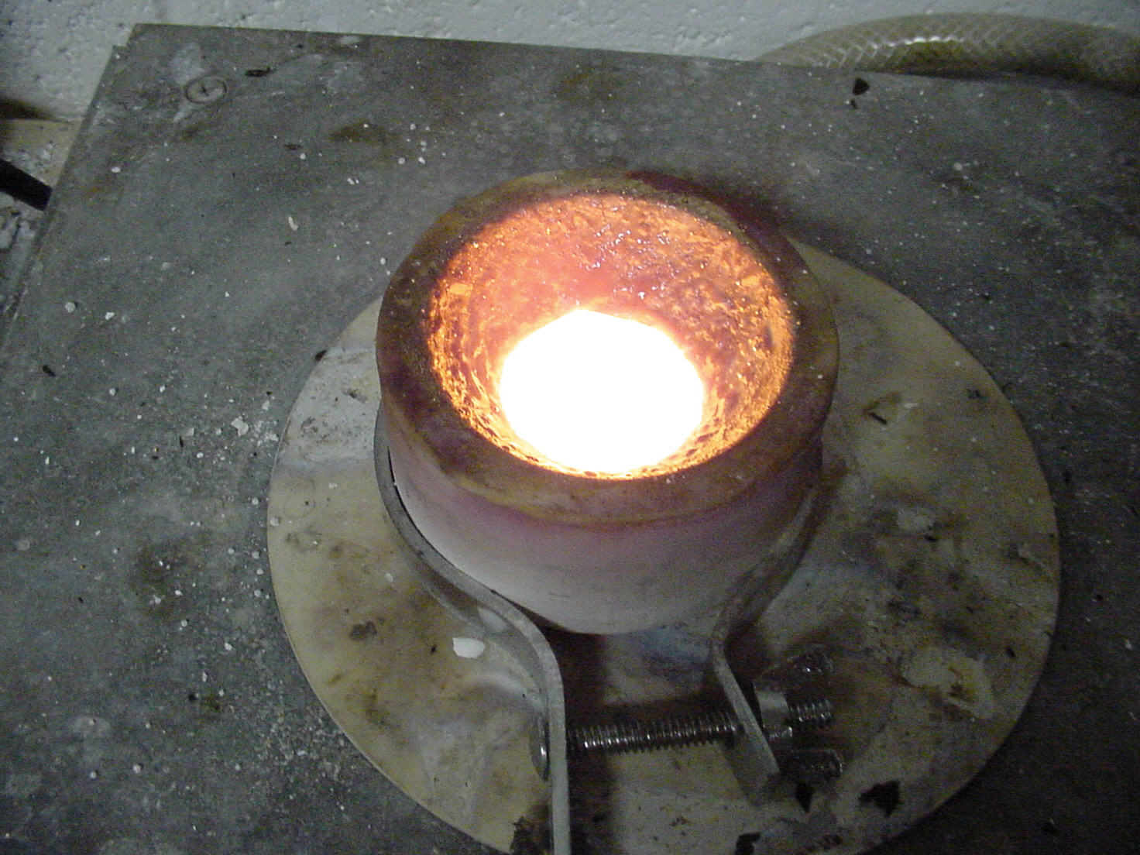
Isaiah 48
Why might the purification process of the Lord not “take”?
Purify Sliver

Slide 36
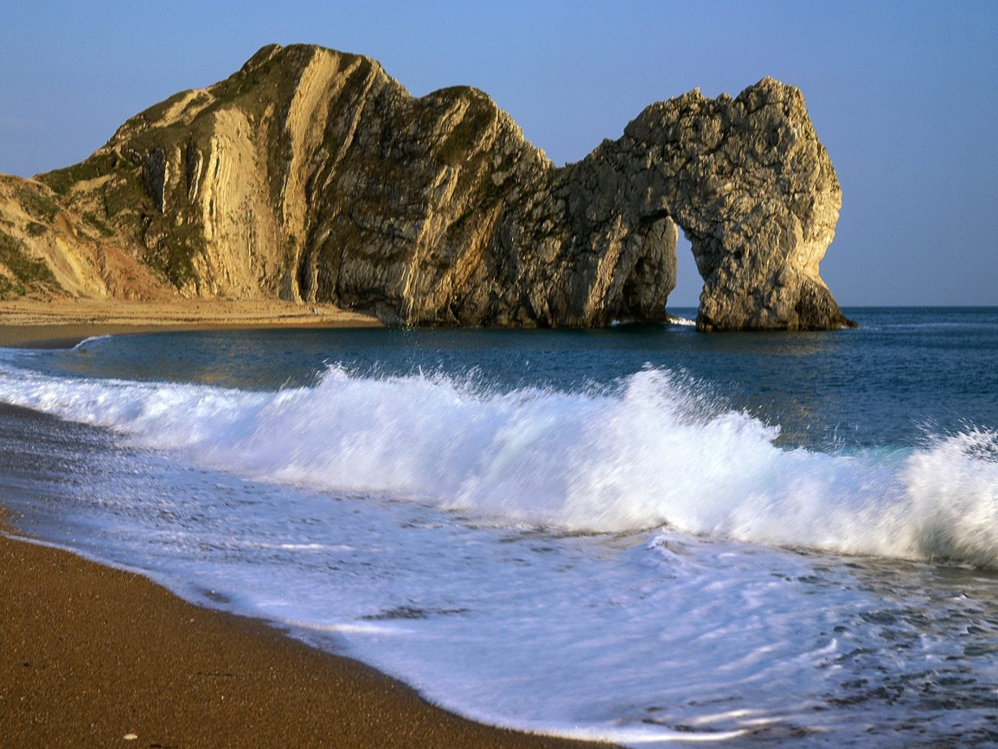
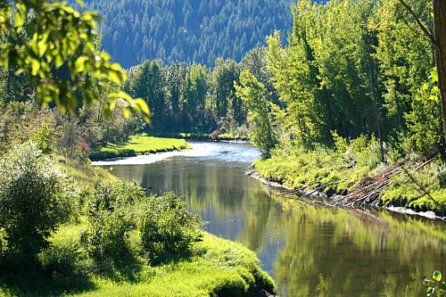
Isaiah 48
Peace like a river … waves of righteousness

Slide 37
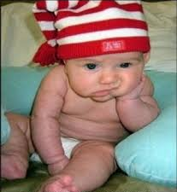
Isaiah 49
Dealing With Disappointment
(verse 4-6)
a) What is due to me comes from the Lord … not my circumstances.
b) God often has larger plans in mind – though the Jews would reject,
the Gentile would not.
c) His time table is different than mine. He WILL redeem the
Jews as well.

Slide 38
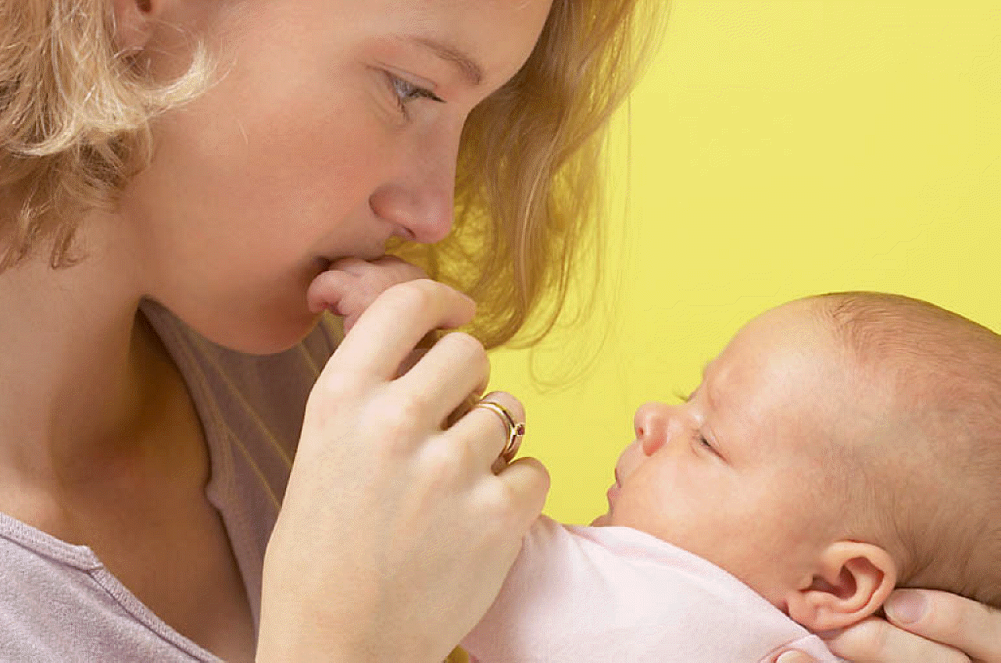
Isaiah 49
Could I ever forget you …?

Slide 39
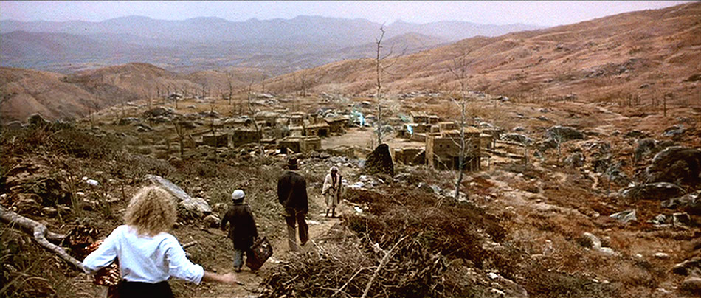
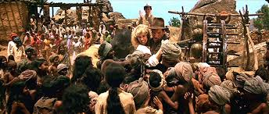
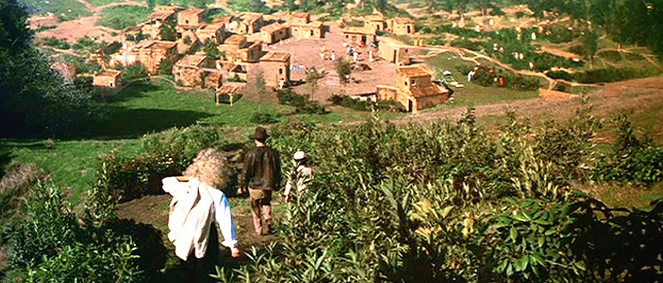
Isaiah 49
Children Return …

Slide 40
Isaiah 49
Chiastic Structure
Verses | Theme
12-13 | The people return and celebrate
14a | God has turned his back (outward abandonment)
14b | God has forgotten us (inner abandonment)
15 | God DOES remember us
16 | God knows my ways
17-18 | The children return and celebrate

Slide 41
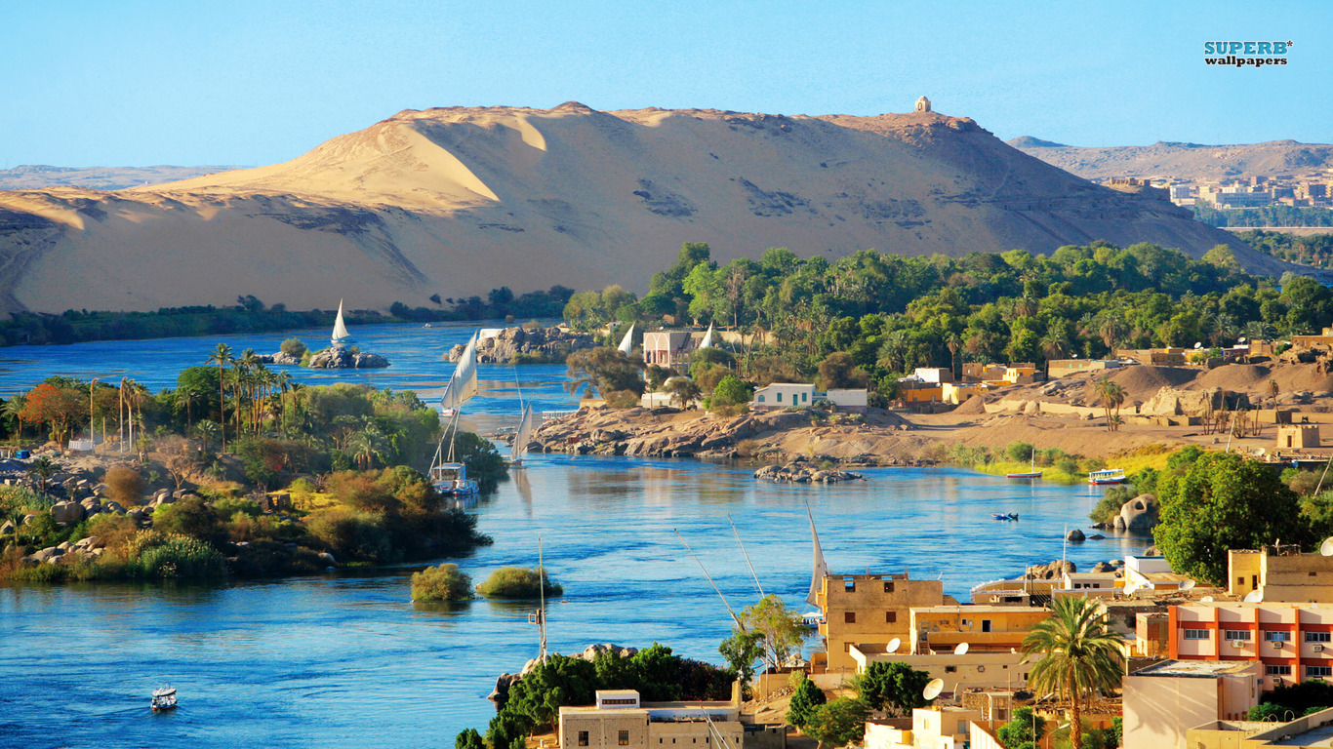
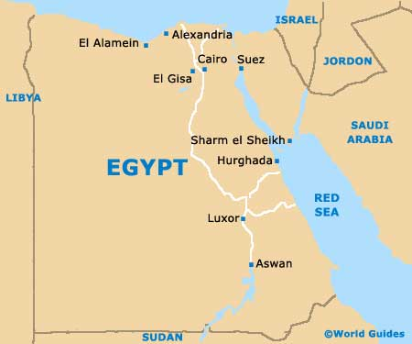
Isaiah 49
Aswan, Epypt

Slide 42
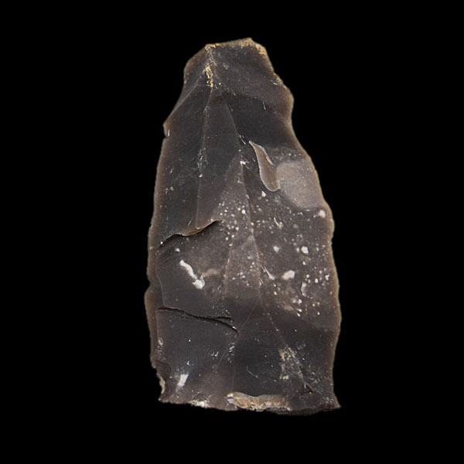
Isaiah 50
Flint

Slide 43
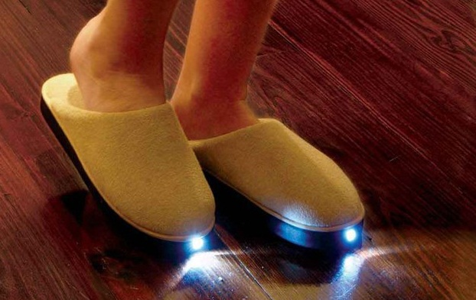
Isaiah 50
Which Light To Follow?

Slide 44
Isaiah 51
Garden Of Eden
Right Relationships
Human to God
Male to female
Human to animal
Human to nature

Slide 45
Isaiah 51
Focus on God
How might we daily focus on God better?

Slide 46
Isaiah 51
The root of fear is the belief that I will “lose”
something. Yet hear, God reminds us that:
a) Most of my fear revolves around other people
b) Other people are every bit under the control of God as I am
c) God’s power can and does manifest in all circumstances

Slide 47
Isaiah 51
The Cup Of God’s Wrath

Slide 48
Isaiah 52

Slide 49
Isaiah 52
After the unification of Spain in 1492, the Dominican friar Torquemada insisted on the
expulsion of the Jews and he finally won his case before the Catholic kings Ferdinand
and Isabella. Torquemada himself came from a family of conversos, or converted Jews.

Slide 50
Isaiah 52
Unequally yoked??

Slide 51
Isaiah 52
Unequally yoked??

Slide 52
Isaiah 52
Herod’s Temple
Jachin (God will establish) And Boaz (Redeemer)
The “Legs Of God”

Slide 53
Isaiah 52
Tabernacle

Slide 54
Isaiah 52
Solomon’s Temple

Slide 55
Isaiah 53
Which one is the “super hero”?
Chris Evans

Slide 56
Isaiah 53
Rhetoric: Ring Composition (v. 3-4)
He was despised and rejected by men, DESPISED by others
a man of sorrows, and familiar with suffering. ACQUAINTED WITH
Sorrow and grief
Like one from whom men hide their PARABLE OF
faces he was despised, and we A person despised
esteemed him not.
Surely he took up our infirmities and HAS BORNE OUR
carried our sorrows, Grief and sorrow
yet we considered him stricken by God, smitten ESTEEMED NOT
by him, and afflicted. Smitten by God

Slide 57
Isaiah 53
Rhetoric: Ring Composition (v. 5-6)
But he was pierced for our transgressions, HE SUFFERED
he was crushed for our iniquities; the punishment For us
that brought us peace was upon him, and by his
wounds we are healed.
We all, like sheep, have gone astray, each PARABLE
of us has turned to his own way; Of the lost sheep
and the LORD has laid on him the iniquity of us all. HE SUFFERED
For us

Slide 58
Isaiah 53
Rhetoric: Ring Composition (v. 7-8)
He was oppressed and afflicted, HE WAS OPPRESSED
yet he did not open his mouth; He was silent
he was led like a lamb to the slaughter, PARABLE OF THE
and as a sheep before her shearers is silent, Suffering Lamb
so he did not open his mouth. He was silent
By oppression and judgment he was taken away. HE WAS OPPRESSED
In all three, Isaiah climaxes with a concrete image.
The man no one can look at
We are like sheep
He is like us

Slide 59
Isaiah 53
Verse 10 Analysis
Guilt has two distinct aspects: legal and emotional.
Legal guilt is the outcome of a legal or a moral violation. If I break the law or a moral code, I am “guilty” of breaking it. Put another way, the breaking of law or code imparts guilt to the law breaker.
Emotional guilt is the outcome of the conscience that God has given us. It is the spiritual organ that causes us to feel pain when we do wrong. Hebrews 5:14 says, “But solid food is for the mature, who because of practice have their senses trained to discern good and evil.”

Slide 60
Isaiah 53
Verse 10 Analysis
Legal and emotional guilt may be paired in any one of four ways:
1. No legal guilt with no guilt feelings. This, of course, is where we would like to be all the time. I have neither broken a law nor do have any sense of conviction.
2. No legal guilt with guilt feelings. This can come about by a misunderstanding of the intent of a law, or it can be a sign of an overly sensitive conscience. A girl, raised with the teaching that make-up is of the devil, who tries a little blush, may feel guilty.

Slide 61
Isaiah 53
Verse 10 Analysis
Legal and emotional guilt may be paired in any one of four ways:
3. Legal guilt with no guilt feelings. On the good side, this comes from convicting an innocent person. On the serious side, this comes from the reprobate who feels bad for being caught in his or her law breaking, but has no sense of wrongdoing. As Proverbs 30:20 says, “This is the way of an adulterous woman: She eats and wipes her mouth, and says, ‘I have done no wrong.’”
4. Legal guilt with guilt feelings. Not the best place to be but it certainly presents cause for hope. It’s the stuff from which repentance comes.

Slide 62
Isaiah 53
Verse 10 Analysis
The Guilt Offering and the Sin Offering
Leviticus chapters 4 through 7 present the Sin and Guilt offerings. The two themes intermingle throughout.
Leviticus 5:5-6 When anyone is guilty in any of these ways, he must confess in what way he has sinned and, as a penalty for the sin he has committed, he must bring to the Lord a female lamb or goat from the flock as a sin offering; and the priest shall make atonement for him for his sin.
Leviticus 5:15 When a person commits a violation and sins unintentionally in regard to any of the Lord’s holy things, he is to bring to the Lord as a penalty a ram from the flock, one without defect and of the proper value in silver, according to the sanctuary shekel. It is a guilt offering.
On the one hand, if a person is guilty he may need to bring a sin offering. On the other hand, if a person sins, he may need to bring a guilt offering. The two concepts are seemingly inseparable.

Slide 63
Isaiah 53
Verse 10 Analysis
Here are some concrete ideas for handling guilt:
1. Our conscience must be correctly trained. It must alert us when we have failed to do, as we ought. This requires faithful teaching:
1 Timothy 1:3, 5 As I urged you when I went into Macedonia, stay there in Ephesus so that you may command certain men not to teach false doctrines any longer … The goal of this command is love, which comes from a pure heart and a good conscience and a sincere faith.

Slide 64
Isaiah 53
Verse 10 Analysis
2. Not all of our sin will be known to us. This is really an extension of the first point, but it also covers those times when we just feel unworthy. The sin nature is a deep, festering pool. Now that we know the Lord instituted an offering for this, we may have confidence that this is normal and covered by the cross.
3. Confession is better than denial. First John 1:9 validates the role confession has in the life of the believer. It contains the promise of cleansing, and by faith, we know that our known failings will eventually be behind us, and our unknown failings brought to light and cleansed. Confessing unknown sinfulness is appropriate.

Slide 65
Isaiah 53
Verse 10 Analysis
4. When restitution is possible, make it. When restitution is offered, accept it. Restitution is what uniquely distinguishes the guilt offering from the sin offering. Restitution brings healing, and cancels the legal and moral debt on the horizontal level between men.
5. Learn the lesson, and leave it behind you. I suspect that it is here that we drop the ball. But consider the Israelite who appears before the priest with the property of his neighbor, plus 20 percent of its value in grain, plus the ram. When all has been offered, what else is there to do? The moral and legal debt is paid. What more can he do? Nothing. Continuing to carry it around as baggage is not faith and may violate the holiness of the guilt offering and the atonement of the priest.

Slide 66
Isaiah 53
Subject | Prophecy | Fulfillment
The Messiah would be God's servant. | Isaiah 52:13a | John 9:4
The Messiah would be highly exalted. | Isaiah 52:13b | Philippians 2:9-11
The Messiah's face would be disfigured from severe beatings. | Isaiah 52:14 | Matthew 26:67-68
The Messiah’s blood would be shed to make atonement for all. | Isaiah 52:15 | Revelation 1:5
The Messiah's own people would not believe he was the Christ. | Isaiah 53:1 | John 12:37-38
The Messiah would grow up in a poor family. | Isaiah 53:2a | Luke 2:7
The Messiah would have the appearance of an ordinary man. | Isaiah 53:2b | Philippians 2:7-8
The Messiah would be despised. | Isaiah 53:3a | Luke 4:28-29
42 Prophetic Realities

Slide 67
Isaiah 53
The Messiah would be rejected. | Isaiah 53:3b | Matthew 27:21-23
The Messiah would have great sorrow and grief. | Isaiah 53:3c | Luke 19:41-42
Men would hide from being associated with the Messiah. | Isaiah 53:3d | Mark 14:50-52
The Messiah would have a healing ministry. | Isaiah 53:4a | Luke 6:17-19
The Messiah would bear and carry upon himself the sins of the world. | Isaiah 53:4b | 1 Peter 2:24
The Messiah would be thought to be cursed by God. | Isaiah 53:4c | Matthew 27:41-43
The Messiah would bear the penalty for mankind's transgressions. | Isaiah 53:5a | Luke 23:33
The Messiah's sacrifice would provide peace between man and God. | Isaiah 53:5b | Colossians 1:20

Slide 68
Isaiah 53
The Messiah's back would be whipped. | Isaiah 53:5c | Matthew 27:26
The Messiah would be the sin-bearer for all mankind. | Isaiah 53:6a | Galatians 1:4
It was God's will that the Messiah would be the sin-bearer for all mankind. | Isaiah 53:6b | 1 John 4:10
The Messiah would be oppressed and afflicted. | Isaiah 53:7a | Matthew 27:27-31
The Messiah would be silent before his accusers. | Isaiah 53:7b | Matthew 27:12-14
The Messiah would be as a sacrificial lamb. | Isaiah 53:7c | John 1:29
The Messiah would be confined and persecuted. | Isaiah 53:8a | Matthew 26:47-27:31
The Messiah would be judged. | Isaiah 53:8b | John 18:13-22
The Messiah would be killed. | Isaiah 53:8c | Matthew 27:35
The Messiah would die for the sins of the world. | Isaiah 53:8d | 1 John 2:2

Slide 69
Isaiah 53
The Messiah would be buried in a rich man's grave. | Isaiah 53:9a | Matthew 27:57
The Messiah would be innocent and had done no violence. | Isaiah 53:9b | Mark 15:3
The Messiah would have no deceit in his mouth. | Isaiah 53:9c | John 18:38
It was God's will that the Messiah would die for all mankind. | Isaiah 53:10a | John 18:11
The Messiah would be an offering for sin. | Isaiah 53:10b | Matthew 20:28
The Messiah would be resurrected and live forever. | Isaiah 53:10c | Mark 16:16
The Messiah would prosper. | Isaiah 53:10d | John 17:1-5
God would be fully satisfied with the suffering of the Messiah. | Isaiah 53:11a | John 12:27
The Messiah would be God's servant. | Isaiah 53:11b | Romans 5:18-19

Slide 70
Isaiah 53
The Messiah would justify man before God. | Isaiah 53:11c | Romans 5:8-9
The Messiah would be the sin-bearer for all mankind. | Isaiah 53:11d | Hebrews 9:28
Because of his sacrifice, the Messiah would be greatly exalted by God. | Isaiah 53:12a | Matthew 28:18
The Messiah would give up his life to save mankind. | Isaiah 53:12b | Luke 23:46
The Messiah would be grouped with criminals. | Isaiah 53:12c | Luke 23:32
The Messiah would be the sin-bearer for all mankind. | Isaiah 53:12d | 2 Corinthians 5:21
The Messiah would intercede to God in behalf of mankind. | Isaiah 53:12e | Luke 23:34

Slide 71
Isaiah 53

Slide 72
Isaiah 54
Unqualified?

Slide 73
Isaiah 54
v. 2 God still has plans for all His people. Look for it!
v. 4 Do not fear to be used. Do not give into the idea that you are no good!
v. 4 Don’t let shame be the brakes on moving forward!
v. 5 God is big!

Slide 74
Isaiah 54
A City Destroyed (Aleppo, Syria on October 3, 2012)
O Absalom, O Absalom …

Slide 75
Isaiah 54
Turquoise
Sapphire

Slide 76
Isaiah 54
Ruby

Slide 77
The New Jerusalem Footprint

Slide 78
The New Jerusalem

Slide 79
Isaiah 55
Luke 14:15-23

Slide 80
Isaiah 55
Luke 14:15-23 … A more happy scene filled with loving community!

Slide 81
Isaiah 55
Satisfaction?

Slide 82
Isaiah 55
Irvin D. YaloIrvin D. Yalom, M.D:
- A rearrangement of life's priorities: what is trivial emerges as such, and can be ignored.
- A sense of liberation: being able to choose not to do those things you do not wish to do.
- An enhanced sense of living in the immediate present, rather than postponing life until
some point in the future.
- A vivid appreciation of the elemental facts of life: the changing seasons, the wind, falling
leaves, the last Christmas, and so forth.
- Deeper communication with loved ones than before the crisis.
- Fewer interpersonal fears, less concern about rejection, greater willingness to take risks
than before the crisis.

Slide 83
Isaiah 55
The Stoic …
Zeno of Citium

Slide 84
Isaiah 55
Contentment
Bathysphere (3,028 feet) vrs. the Blob Fish
James Cameron: Vertical Torpedo – 6.8 miles

Slide 85
Isaiah 55
Contentment

Slide 86
Isaiah 55
Not that I am speaking of being in need, for I have learned in whatever situation I am to be
content. I know how to be brought low, and I know how to abound. In any and every circumstance,
I have learned the secret of facing plenty and hunger, abundance and need. (Phil 4:11-12)
Keep your life free from love of money, and be content with what you have, for he has said, “I will
never leave you nor forsake you.” (Hebrews 13:5)
Now there is great gain in godliness with contentment, for we brought nothing into the world,
and we cannot take anything out of the world. But if we have food and clothing, with these we
will be content. (1Timothy 6:6-8)
You keep him in perfect peace whose mind is stayed on you, because he trusts in you.
(Isaiah 26:3)

Slide 87
Isaiah 55
Another Chiasm:
55:8-9 "For my thoughts are not your thoughts,
neither are your ways my ways," declares the LORD
.
"As the heavens are higher than the earth,
so are my ways higher than your ways
and my thoughts than your thoughts.

Slide 88
Isaiah 55 (v.10)

Slide 89
Isaiah 55
Do the trees block my path …

Slide 90
Isaiah 55
… or create the trail?

Slide 91
http://www.williamsonit.ca/ss/
RIGHT click on any link and
choose “Save Link As”.
When the file is downloaded,
double click it to play.

Slide 92
Isaiah 56
Chiasm
56:1-2 To all people
56:3 To the foreigner
56:4-5 To the eunuch
56:6a To the foreigner
56:6b-7 To all people

Slide 93
Isaiah 56
What Is The Purpose Of The Sabbath?
Regularly reminds us to reflect on the Lord
Reminds us of where true provision comes from
Gives our bodies an opportunity to rest
Remembers God as Creator
Israel was redeemed from slavery and rested. We too!
It is meant to “taste” of the future Kingdom

Slide 94
Isaiah 56
Acts 10:14-16

Slide 95
Court Of The Gentiles

Slide 96
Isaiah 56
Some Interesting Cultic Leaders …
Australia: Also known as A.J., Alan John Miller lives in Queensland,
Australia with his partner Mary Luck. Miller claims that he remembers
details from his “former life” as Jesus, and Luck says that she is the
reincarnation of Mary Magdalene. Both state that they were married
in their previous life and had a daughter together.
“I have very clear memories of the crucifixion, but it wasn’t as
harrowing for me as it was for others like Mary who was present,”
Miller told Sky News last year.
The two run the organization Divine Truth, and have appeared on
local and international television programs to speak of Miller’s claims
of being the Messiah. Crowds of generally 100 people or more gather
to hear him speak at his seminars, and some followers from across
the country have given up their possessions and families to be
nearer to Miller.

Slide 97
Isaiah 56
Some Interesting Cultic Leaders …
Siberia: Also known as Vissarion, Sergey Anatolyevitch Torop
began proclaiming himself as Jesus reincarnated after he was
fired as a traffic officer in Russia in 1990. He went on to found the
Church of the Last Testament, which combines various religions
together, including Buddhism, Hinduism and Christianity.
At the last report, Torop has over 5,000 followers, some of which
gather to listen to the self-proclaimed Messiah speak. His words
are often collected in a book, which spans 10 volumes.
Torop, also known as “Jesus of Siberia,” has long hair and
wears long, flowing gowns. He speaks from the side of a hill covered
by an umbrella. Approximately 2,000 of his followers live in a
settlement in Siberia dedicated to his worship.
Torop, 53, has six children from two marriages. He divorced his
first wife for a nineteen year old girl, who has reportedly lived with
him since she was seven years of age.
“I am not God. And it is a mistake to see Jesus as God,” he told
reporters in 2002. “But I am the living word of God the Father.
Everything that God wants to say, He says through me.”

Slide 98
Isaiah 56
Some Interesting Cultic Leaders …
Brazil: Also known as Inri Cristo, Alvarro Theiss has been
claiming since 1979 to be the reincarnation of Jesus Christ.
He runs Suprema Ordem Universal da Santmssima Trindade
in Brazil, where he also maintains a compound that houses
his followers, who are mostly women.
Theiss, 66, dresses in a white robe and wears a cloth “crown
of thorns.” His followers often wear a blue uniform with a
rope tied around their waist. Theiss and those who live with
him at his compound are vegans and grow their own fruits
and vegetables on the property.

Slide 99
Isaiah 56
Some Interesting Cultic Leaders …
The United States, Britain and Venezuela have banned Theiss because of his claims and
views, and the throne-sitting cult leader been arrested over 40 times. Theiss is an
abortion supporter, and also speaks against capitalism.
Theiss has his own 24-hour television internet channel, which airs messages from the
self-proclaimed Messiah around the clock. “My mission is to prepare the elect, the
survivors of the inevitable nuclear hecatomb that will culminate in the end of this chaotic
world, for the formation of the new earthly society, which will strive to fulfil the Creator’s
will,” he said.

Slide 100
Isaiah 56
Is my satisfaction my ultimate goal?

Slide 101
Isaiah 56
Is my satisfaction my ultimate goal?

Slide 102
Isaiah 56
Ecclesiastes 2:1-11
Pleasure (v.1)
Wine (v.3)
Projects (v.4)
Slaves (v.6)
Wealth (v.7)
Entertainment (v.8)
Results?
I denied myself nothing my eyes desired; I refused my heart no pleasure. My
heart took delight in all my work, and this was the reward for all my labour.
Yet when I surveyed all
that my hands had
done and what I had
toiled to achieve,
everything was
meaningless, a chasing
after the wind; nothing
was gained under the
sun.

Slide 103
Isaiah 57
Twilight Zone: “A Nice Place To Visit”
Pip & Rocky

Slide 104
Isaiah 57
Is there a value to death we do not yet understand?

Slide 105
Isaiah 57
Hinnom Valley Location

Slide 106
Isaiah 57
Valley Of Hinnom Today

Slide 107
Isaiah 57
Various Wadi’s

Slide 108
Isaiah 57
Various Wadi’s

Slide 109
Isaiah 57
Is shame dead in our culture today?
A Bed On High And Lofty Hills

Slide 110
Isaiah 57
Even if I caused you sorrow by my letter, I do not regret it. Though I did regret it—
I see that my letter hurt you, but only for a little while—
yet now I am happy, not because you were made sorry, but because your sorrow
led you to repentance. For you became sorrowful as God intended and so were not
harmed in any way by us.
Godly sorrow brings repentance that leads to salvation and leaves no regret, but
worldly sorrow brings death. (Remember Judas!)
See what this godly sorrow has produced in you: what earnestness, what eagerness
to clear yourselves, what indignation, what alarm, what longing, what concern,
what readiness to see justice done. At every point you have proved yourselves to be
innocent in this matter.
2 Corinthians 7:8-11

Slide 111
Isaiah 57
Mezuzah On A Door
Pylactery

Slide 112
Isaiah 57
Why Is God Silent?

Slide 113
Isaiah 57
Is God really silent??
Israel At Mount Sinai | Elijah At Horeb (Mnt. Of God) | Day Of Pentecost
Moses 40 days and nights to get the Law | Traveled 40 days and nights to get there | Jesus is with the disciples for 40 days, teaching them
Angels present | Angels present | Angels present (Acts 1)
Moses was on the mountain | Elijah was on the mountain | Upper room
Israel receives their commissioning | Elijah receives his re-commissioning | Church receives its commission
Moses speaks directly with God | Elijah speaks directly with God | God speaks through His church
Smoke & fire, earthquake, thunder & lightning, | Wind, earthquake, fire | Fire and wind
Law given | Small, still voice | Loud, boisterous worship
3000 people die | - | 3000 people born again

Slide 114
Isaiah 57
Larsson: Bound for Freedom The book of Exodus in Jewish and Christian Traditions
(Peabody 1999)

Slide 115
Isaiah 57
Beni’s Collection Of Idols
He uses: A Christian cross, an Islamic crescent
moon and sword, a Buddha, and a Jewish Star of David

Slide 116
Isaiah 58
Chiastic structure of verse 2:
For day after day they seek me out; Come near
they seem eager to know my ways, Eager
as if they were a nation that does what is right Do right
and has not forsaken the commands of its God. Forsaken?
They ask me for just decisions and Do right
seem eager for Eager
God to come near them. Come near

Slide 117
Isaiah 58
Zechariah 9: 18-19
Israel was called to fast one day a year … on the Day Of Atonement
After Babylon, the number was increased:
Fourth Month Nebuchadnezzar enters Jerusalem 586 BC
Fifth Month The temple is burned in 586 BC
Seventh Month Gedaliah’s assassination
Tenth Month Siege of Jerusalem in 588
God promises that one day, these will all be turned into gladness

Slide 118
Isaiah 58
When does our faith make us a curse to people around us?

Slide 119
Isaiah 58
Scripture does not command Christians to fast
The Bible presents fasting as something that is good, profitable, and beneficial
Acts records believers fasting before they made important decisions (Acts 13:2; 14:23)
Fasting and prayer are often linked together (Luke 2:37; 5:33)
The purpose of fasting should be to take your eyes off the things of this world to
focus completely on God
Although fasting in Scripture is almost always a fasting from food, there are other ways to fast
Fasting is not intended to punish the flesh, but to redirect attention to God
Fasting should not be considered a “dieting method”
Fasting is not a way to get God to do what we want
Fasting is not a way to appear more spiritual than others
Fasting is to be done in a spirit of humility and a joyful attitude
Fasting may allow resources to be directed towards the poor

Slide 120
Isaiah 58
Chiastic structure of verse 8-10:
Then your light will break forth like the dawn, Light
and your healing will quickly appear; Your Healing
then your righteousness will go before you, God’s presence
and the glory of the LORD will be your rear guard.
(think here of the cloud/fire in the wanderings)
Then you will call, and the LORD will answer;
you will cry for help, and he will say:
Here am I. God’s presence
"If you do away with the yoke of oppression,
with the pointing finger and malicious talk,
and if you spend yourselves on behalf of the Their healing
hungry and satisfy the needs of the oppressed,
then your light will rise in the darkness, Light
and your night will become like the noonday.

Slide 121
Isaiah 58
The results:

Slide 122
Isaiah 59
Eggs Of Vipers … Spider Webs

Slide 123
Isaiah 59
Dr J Edwin Orr: History of revivals
His work has clearly revealed several distinct and successive 'great awakenings' or
'resurgences.' These progressive periods of revival are unquestionably the means
God has used to counteracts spiritual decline in the church and to promote
spiritual advance in the world. There have been six of these major periods or waves
from the Reformation to the turn of the 20th century, from 1727, 1792, 1830, 1857,
1882 and 1904.
1727 (George Whitefield and John Wesley)
Historically, the beginning of this awakening can be traced to the Moravian community
called "Herrnhut" (the Lord's watch), where a visitation from God was experienced after
a period of prayer, repentance and reconciliation in 1727. Nikolas Count Ludwig Von
Zinzendorf, a German, was the leader of the movement that began a 24 hour-a-day prayer
meeting, which lasted the next 100 years. In the next 65 years that small community sent
out 300 radical missionaries. Their revived German Pietism was destined to influence
two other harvest fields, which were on God's agenda for that time - England and America.

Slide 124
Isaiah 59
1792
This awakening began as a prayer-movement in 1784, when John Erskine of Edinburgh
re-published Jonathan Edward's earnest plea for revival prayer. It was entitled, 'An Humble
Attempt to Promote Explicit Agreement and Visible Union of God's People in Extraordinary
Prayer for the Revival of Religion and the Advancement of Christ's Kingdom".
Denomination after denomination devoted a monthly Monday evening to prayer,
first in Britain, then in the US.
1830 (Charles Finney)
Finney's well documented ministry began in 1830 and netted 100,000 souls within one
year! The Methodist Episcopal church steadily increased in the 1830's, especially through
camp-meetings. But their numbers doubled in 1840-1842. Other denominations flourished
too.

Slide 125
Isaiah 59
1857 (Dwight Moody and David Sankey, William & Catherine Booth
Hudson Taylor, Charles Haddon Spurgeon)
This Great Awakening (often called the 3rd) was the greatest to date in its extent,
effects and lasting impact. It began slowly in Canada, when 21 were saved, and grew
steadily until between 25 and forty were converted each day. Slowly reports of small
awakenings began to emerge from various states in America. Then, in September 1857
Jeremiah Lanphier, a businessman and convert of Finney's (a decade before), began a
noon day prayer meeting on Wednesdays in a New York church. The small but growing
numbers decided to meet daily in early October. Within six months over 10,000 business
men were meeting in similar meetings across America; confessing sins, being converted
and praying for revival. It was a lay-led movement that harvested a million souls in two
years. In 1858, from February to June, around 50,000 people a week were added to the
church - in a nation whose population was only 30,000,000.

Slide 126
Isaiah 59
Early 20th Century
On the day of prayer and fasting (according to Torrey) Evan Roberts received an anointing
of the Holy Spirit with great power, in a meeting conducted by Seth Joshua. Here the Welsh
Revival began. It was Sept 22nd 1904. However, the roots of the revival went back further.
Young Evan Roberts had been praying for revival and an outpouring of the Holy Spirit for
11 years. Through a vision he received, Roberts believed that God was going to win
100,000 souls. In response to a further vision, he returned home in Loughor from
Newcastle Emlyn where he had been enrolled in a Bible College.
During his first few meetings the heavens opened. God's presence seemed to fill the air.
Many were prostrated with conviction, others cried for mercy and many were so filled
with the Spirit they pleaded with the Lord to stay His hand.
Soon the revival spread to other places in South Wales. Teams of young people
assisted preachers like Roberts, Sydney Evans, Seth Joshua, Joseph Jenkins and R. B. Jones.
The revival then took hold in North Wales. Within six months 100,000 had come to Christ!

Slide 127
Isaiah 59
Early 20th Century
In 1906 the modern Pentecostal Movement was born in Azusa Street, in Los Angeles, after
a succession of local revivals through 1905. News of the Welsh Revival encouraged more
prayer and suddenly the Holy Spirit descended. Daily meetings were held for the next
three years. Visitors flocked there to catch the power of the Spirit and they were not
disappointed. No one could have imagined that this was the beginning of the greatest and
most effective missionary movement that the world had ever seen. It marked the birth of
what was once called 'the third force in Christendom.' Some would argue that, 100 years
later, it has grown into the largest and most powerful force.

Slide 128
Revelation: Chiasm
Prologue (Rev 1:1-8)
Seven Churches (1:10-3:22)
Seven Seals (4:1 – 8:1)
Seven Trumpets (8:2 – 11:18)
Satan attacks (11:19-14:20)
Fall Of Babylon (17:1-19:10)
Bowl Judgments 15:1 – 16:21
Millennium (19:11 – 21:8)
New Jerusalem (21:9 – 22:9)
Epilogue (Rev 22:8-17)

Slide 129
Revelation: Chiasm
Christ walks among the 7 lamps (2:1)
Tree Of Life (2:1)
Open Door (3:8)
Christ sits on the Father’s throne (3:21)
New Jerusalem comes down from heaven (3:12)
I am coming soon (3:11)
Seven Churches (1:10-3:22)
Christ is the eternal lamp (21:23)
Tree Of Life (22:2)
Gates never close (21:25)
Throne of God and the Lamb (22:1,3)
New Jerusalem comes down from heaven (21:10)
I am coming soon (22:7)
New Jerusalem (21:9 – 22:9)

Slide 130
Literal Prophetic Fulfillment
The Messiah must... | Prophecy | Fulfillment by Jesus
Bear the reproaches and sin of others | Isaiah 53:12 | Romans 15:3
Be a priest | Psalms 110:4 | Hebrews 5:5‑6, 6:20, 7:15‑17
Enter Jerusalem on a donkey | Zechariah 9:9 | Matthew 21:1‑11; Mark 11:1‑11; John 12:12‑16
Enter the Temple with authority | Malachi 3:1 | Matthew 21:12; John 2:13‑22
Born of a virgin | Isaiah 7:14 | Matthew 1:23
Proceeded by a messenger | Isaiah 40:3 5, Malachi 3:1 | Matthew 3:1‑3, Luke 3:2‑6
Be born in Bethlehem | Micah 5:2 | Matthew 2:1; Luke 2:4‑7
Be adored by great persons | Psalms 72:10‑11 | Matthew 2:1‑11
Be anointed with the Spirit of God | Isaiah 11:2, 61:1 | Matthew 3:16; John 3:34; Acts 10:38
Be hated without cause | Isaiah 49:7; Psalms 69:4 | John 15:24‑25
Be undesired, rejected by His own people | Isaiah 53:2, 63:3; Psalms 69:8 | Mark 6:3; Luke 9:58; John 1:11
Be plotted against by Jews, Gentiles | Psalms 2:1‑2 | Acts 4:27
Be betrayed by a friend | Psalms 41:9, 55:12‑24 | Matthew 26:21‑25, 47‑50; John 13:18‑21; Acts 1:16‑18
Be betrayed for 30 pieces of silver | Zechariah 11:12 | Matthew 26:16
Have his price given for a potter’s field | Zechariah 11:13 | Matthew 27:7
Be forsaken by His disciples | Zechariah 13:7 | Matthew 26:31, 56
Be struck on the cheek | Micah 5:1 | Matthew 27:30
Be spat on | Isaiah 50:6 | Matthew 26:67, 27:30
Be mocked | Psalms 22:7‑8 | Matthew 27:31, 39‑44
Be beaten | Isaiah 50:6 | Matthew 26:67, 27:26, 30
Be thirsty during His execution | Psalms 22:15 | John 19:28
Be given vinegar to quench that thirst | Psalms 69:21 | Matthew 27:34
Be considered a transgressor | Isaiah 53:12 | Matthew 27:38
Be buried with the rich when dead | Isaiah 53:9 | Matthew 27:57‑60
Be sought after by Gentiles as well as Jews | Isaiah 11:10, 42:1 | Acts 10:45
Be accepted by the Gentiles | Isaiah 11:10, 42:1‑4, 49:1‑12 | Matthew 12:21; Acts 10:45; Romans 15:9‑12
Resurrection | Psalm 16:10, 2, 7, Isaiah 53:9‑10 | Matthew 28:1‑20, Acts 13:33-37
To the right hand of the Father | Psalms 16:11, 68:18 and 110:1 | Luke 24:51, Acts 1:9‑11 and 7:55 and Hebrews 1:3

Slide 131
Isaiah 61
He went to Nazareth, where he had been brought up, and on the Sabbath day he went
into the synagogue, as was his custom. And he stood up to read. The scroll of the prophet
Isaiah was handed to him. Unrolling it, he found the place where it is written:
"The Spirit of the Lord is on me, because he has anointed me to preach good news to the
poor. He has sent me to proclaim freedom for the prisoners and recovery of sight for the
blind, to release the oppressed, to proclaim the year of the Lord’s favour.“
Then he rolled up the scroll, gave it back to the attendant and sat down. The eyes of
everyone in the synagogue were fastened on him, and he began by saying to them, "Today
this scripture is fulfilled in your hearing.“ All spoke well of him and were amazed at the
gracious words that came from his lips. "Isn’t this Joseph’s son?" they asked.
Luke 4:16-30

Slide 132
Isaiah 61
Jesus said to them, "Surely you will quote this proverb to me: ‘Physician, heal yourself!
Do here in your home town what we have heard that you did in Capernaum.’“ "I tell you
the truth," he continued, "no prophet is accepted in his home town. I assure you that there
were many widows in Israel in Elijah’s time, when the sky was shut for three and a half
years and there was a severe famine throughout the land. Yet Elijah was not sent to any
of them, but to a widow in Zarephath in the region of Sidon. And there were many in
Israel with leprosy in the time of Elisha the prophet, yet not one of them was cleansed—
only Naaman the Syrian.“ All the people in the synagogue were furious when they heard this.
They got up, drove him out of the town, and took him to the brow of the hill on which
the town was built, in order to throw him down the cliff. But he walked right through
the crowd and went on his way.

Slide 133
Isaiah 61
Mount Tabor And Nazareth today

