Slide 2
The Beginnings Of The Life Of Jesus
1:1-4 The introduction of the book.
1:5-25 The birth of John the Baptist is foretold
1:26-45 The birth of Jesus is foretold.
1:45-56 The song of praise that Mary dictates. This is similar to Hannah’s song.
1:57-80 The birth of John the Baptist, with Zachariah’s prophecy
2:1-3 Enrollment of Quirinius
2:4-20 The birth of Christ
2:21-38 Jesus is circumcised and presented to the priest Simeon. Anna also speaks.
2:39-52 The boyhood of Jesus; the visit to Jerusalem when He was twelve.
The Preparation For Ministry
3:1-14 The ministry of John the Baptist.
3:15-20 John testifies about the coming Christ.
3:21-22 The baptism of Jesus
3:23-38 The genealogy of Jesus
4:1-12 The temptation of Jesus
4:13 Satan is defeated and leaves temporarily.

Slide 3
The Galilean Ministry Begins
4:14-15 The beginning of His ministry.
4:16-30 Jesus is rejected at Nazareth, His home town. Note that He quotes from Isa. 61:1-2.
4:31-37 The demoniac is healed.
4:38-44 Peter’s mother-in-law is healed.
5:1-11 The call of Peter, James and John.
5:12-26 The leper and the paralytic are healed.
5:27-29 The call of Levi (also called Matthew)
5:30-39 The Pharisees and scribes attack: Jesus answers.
6:1-11 Jesus deals with the question of the Sabbath by healing an atrophied hand.
6:12-19 Jesus prays all night - then chooses the twelve.
6:20-49 Another teaching of the Beatitudes (similar to Matthew 5-7).
7:1-10 The Centurion’s servant is healed.
7:11-18 The widow’s son is raised from the dead
at Nain.
7:19-35 Jesus testifies about John the Baptist.
7:36-50 Jesus is anointed by the sinful woman.

Slide 4
8:1-3 The women who ministered to Christ are listed.
8:4-15 The parable of the sower
8:16-18 The parable of the lighted candle.
8:19-21 The new relationship is defined.
8:22-25 Jesus stills the storm
8:26-39 The demoniac of Gadara is healed
8:40-56 A woman is healed and Jarius’s daughter is raised from the dead.
9:1-9 The twelve are sent out to minister on their own (and are given power)
9:10-17 The feeding of the 5000.
9:18-26 The confession of Peter
9:27-36 The transfiguration of Jesus before the disciples.
9:37-50 Why the disciples had no power: Jesus again casts of the demon.

Slide 5
On The Way To Jerusalem
9:51-62 Jesus now turns towards Jerusalem (and the cross).
10:1-24 The seventy disciples are sent out to minister.
10:25-29 The lawyer asks, “Who is my neighbour”?
10:30-37 The good Samaritan story.
10:38-42 The contrasts between Mary and Martha.
11:1 Jesus praying.
11:2-4 Jesus’ instructions on prayer.
11:5-13 A parable on prayer
11:14-28 Jesus teaches on Demonism
11:29-32 The sign of Jonah
11:33-38 The parable of the candle.
11:39-44 The Pharisees are denounced.
11:45-54 The lawyers are denounced.
12:1-12 The warning about false doctrine.
12:13-34 The warnings against greediness.
12:35-48 The warning about watching for
the second coming.
12:49-59 Christ “divides” people.

Slide 6
13:1-5 Jesus teaches on repentance and being ready.
13:6-9 The barren fig tree (this represents Israel).
13:10-17 The healing of another woman.
13:18-21 The parables of the mustard seed and leaven.
13:22-30 How many will be saved?
13:31-33 Jesus warns about Herod.
13:34-35 Jesus weeps over Jerusalem
14:1-6 The healing on the Sabbath.
14:7-15 The parable of the over-zealous guest.
14:16-24 The parable of the great supper.
14:25-35 The cost of discipleship.
15:1-7 The parable of the lost sheep.
15:8-10 The parable of the lost coin.
15:11-32 The parable of the lost (prodigal) son.
16:1-18 The parable of the dishonest steward.
16:19-31 The story (not parable) of the rich man
and Lazarus.
17:1-10 The teaching on forgiveness and service.
17:11-19 The cleansing of the ten lepers.
17:20-37 The question of “when the Kingdom of God”
should come.

Slide 7
18:1-8 The parable of the Unjust Judge.
18:9-14 The parable of the Pharisee and the Publican.
18:15-17 Jesus blesses the little children.
18:18-30 The story of the rich young ruler.
18:31-34 Jesus predicts His death.
18:35-43 Jesus heals the blind man near Jericho.
19:1-10 The conversion of Zacchaeus.
19:11-27 The parable of the pounds.
19:28-40 The triumphal entry into Jerusalem.
19:41-44 Jesus weeps over Jerusalem.
19:45-48 Again, Jesus cleanses the Temple court.
Temple Teachings
20:1-8 The authority of Jesus is questioned.
20:9-18 The parable of the vineyard.
20:19-26 The question about tax money.
20:27-38 The Sadducees are silenced.
20:39-47 The scribes are interrogated.
21:1-4 Jesus observes the widow’s mite offering.
21:5-38 Jesus discusses the end-times issues.

Slide 8
The Suffering And Resurrection Of The Lord
22:1-2 The plot to kill Jesus
22:3-6 The treachery of Judas
22:7-13 The preparations for the Passover.
22:14-18 The last Passover.
22:19-20 The Lord’s supper is instituted.
22:21-23 The announcement of the betrayal.
22:24-30 The Apostle’s place in the future kingdom.
22:31-34 Jesus predicts Peter’s denial.
22:35-38 Jesus predicts future conflicts.
22:39-46 Jesus prays in the Garden of Gethsemane.
22:47-53 Jesus is betrayed.
22:54-65 Jesus is arrested
22:66 - 23:26 The various trials
23:27-38 The crucifixion
23:39-45 The thief that repents.
23:46-49 The death of Christ.
23:50-56 The burial of Christ
24:1-12 The resurrection of Christ
24:13-35 Jesus appears to the disciples on the
road to Emmaus
24:36-43 Jesus appears to the eleven.
24:44-49 Jesus gives the great commission.
24:50-53 The ascension of Christ

Slide 9
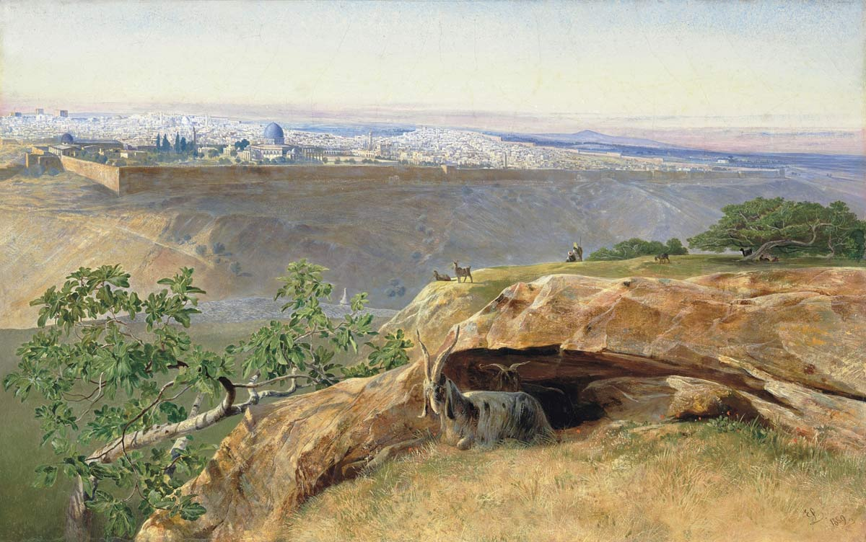
The Triumphal Entry
- See Psalm 118
See also Zech 9:9
Luke 19:28-44
From The Mount Of Olives To Jerusalem
(across the Kidron Valley) … looking west.

Slide 10
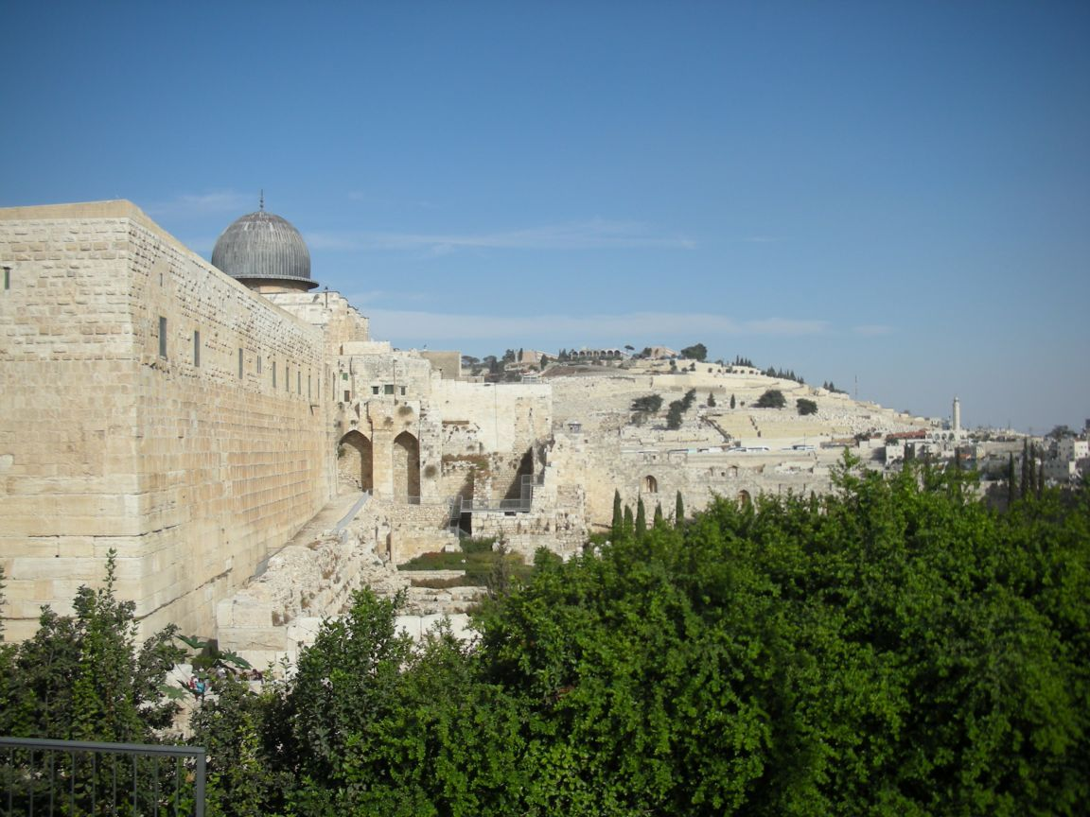
Luke 19:28-44
From The Mount Of Olives To The Temple

Slide 11
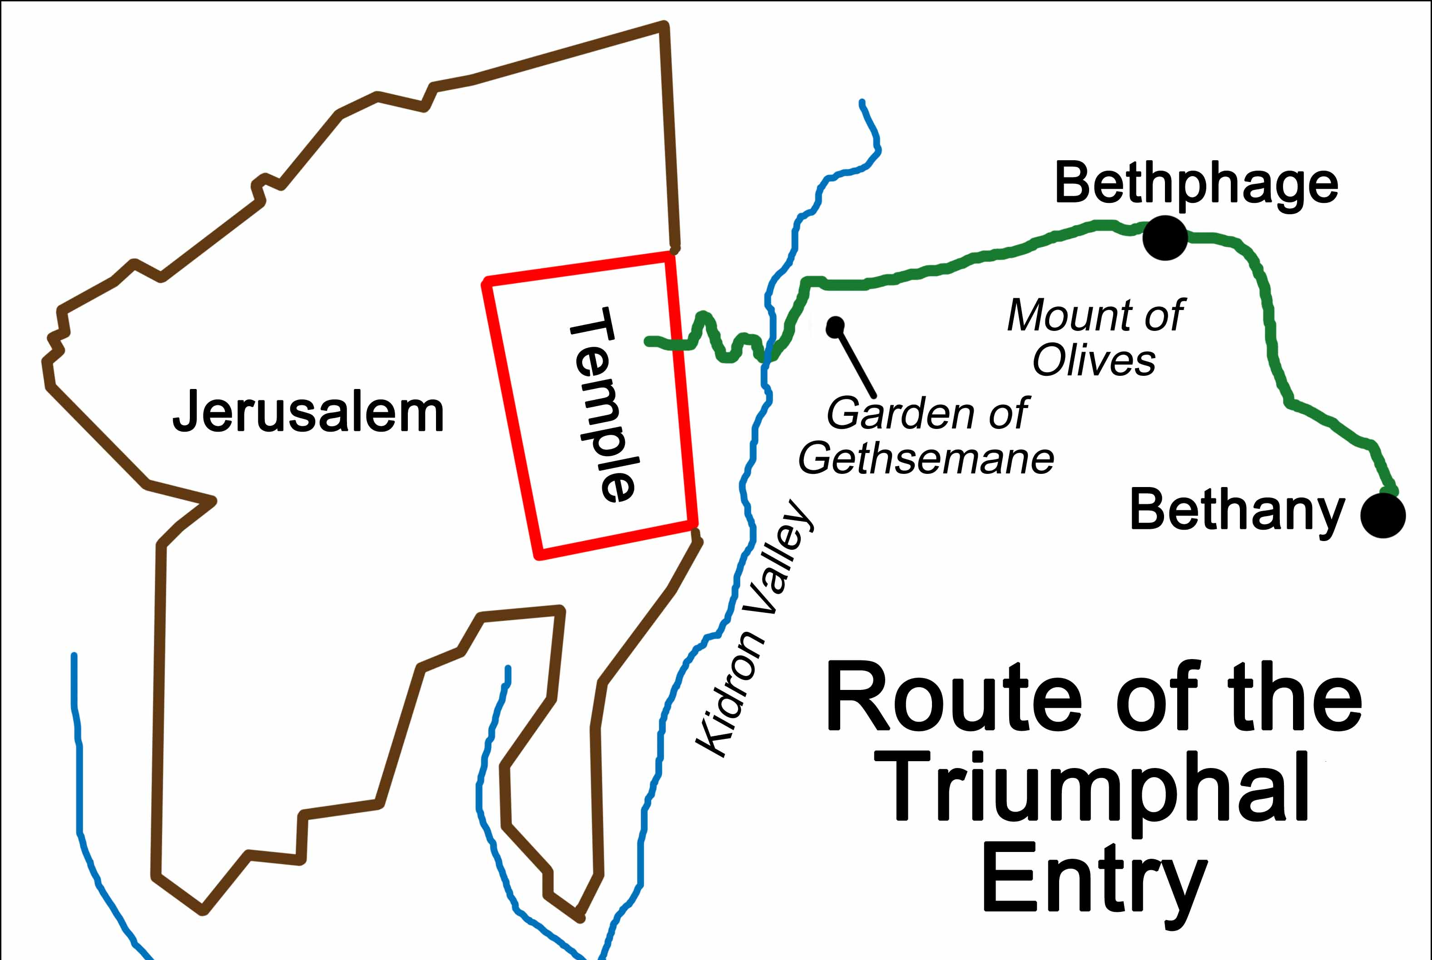
Luke 19:28-44
From The Mount Of Olives To The Temple

Slide 12
Luke 19:28-44
Some Further Notes:
The Mount Of Olives is significant as the ascension location and the return of Christ
Five times is the loosing of the colt mentioned! See Gen 49:11
The irony is that in Genesis, the rider is rich and here the colt must be borrowed!
The colt was never ridden before … it was unbroken
The palm branches waved were a political reference to Israel … like the maple leaf
Is it possible to get caught up in a "crowd" mentality and lose sight of truth??

Slide 13
Luke 19:28-44
Some Further Notes:
In v. 42ff, Jesus weeps at the fact that they missed the recipe for peace (him) and
instead chose a recipe for war … which brought destruction. The enemy so often
lies to us with promises of cheap substitutes

Slide 14
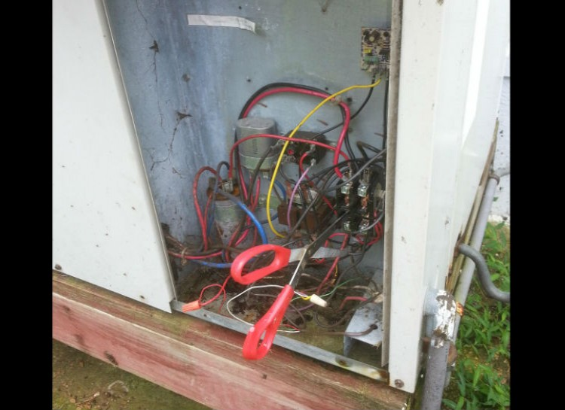
Luke 19:28-44

Slide 15
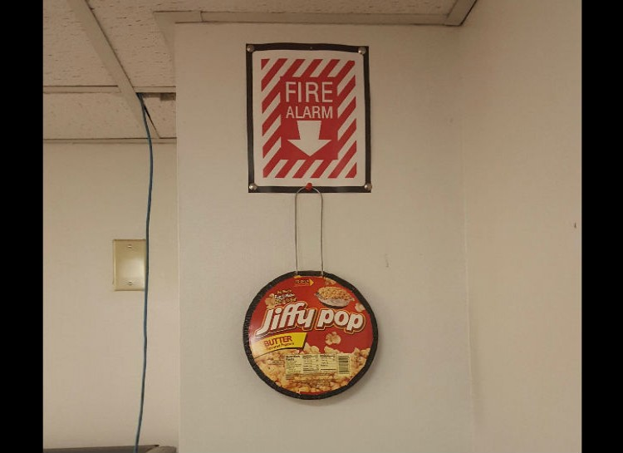
Luke 19:28-44

Slide 16
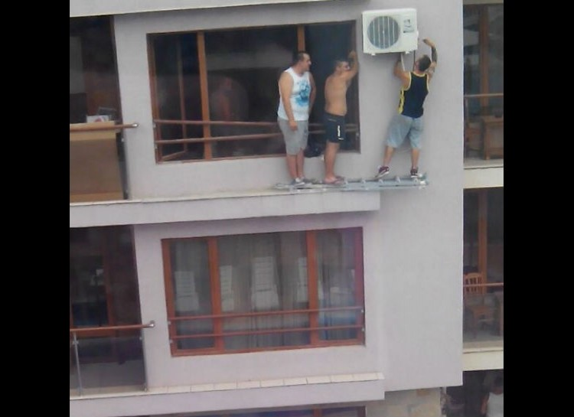
Luke 19:28-44

Slide 17
Luke 19:28-44
Lamb Selection Day (Palm Sunday)
Tell the whole community of Israel that on the tenth day of this month each man is to take a
lamb for his family, one for each household. If any household is too small for a whole lamb,
they must share one with their nearest neighbor, having taken into account the number of
people there are. You are to determine the amount of lamb needed in accordance with
what each person will eat. The animals you choose must be year-old males without defect,
and you may take them from the sheep or the goats.
Take care of them until the fourteenth day of the month, when all the people of the
community of Israel must slaughter them at twilight. (Exodus 12:3-6)

Slide 18
Luke 19:28-44
Lamb Selection Day (Palm Sunday)
1 Kings 1:38-40 So Zadok the priest, and Nathan the prophet, and Benaiah the son of Jehoiada,
and the Cherethites, and the Pelethites, went down, and caused Solomon to ride upon king
David’s mule, and brought him to Gihon. And Zadok the priest took an horn of oil out of the
tabernacle, and anointed Solomon. And they blew the trumpet; and all the people said,
God save king Solomon. And all the people came up after him, and the people piped with
pipes, and rejoiced with great joy, so that the earth rent with the sound of them.
2Kings 9:12-13 "That’s not true!" they said. "Tell us." Jehu said, "Here is what he told me: ‘
This is what the LORD says: I anoint you king over
Israel.’" They hurried and took their cloaks and spread
them under him on the bare steps. Then they blew
the trumpet and shouted, "Jehu is king!"
Zechariah 9:9-10 9 ¶ Rejoice greatly, O Daughter of
Zion! Shout, Daughter of Jerusalem! See, your king
comes to you, righteous and having salvation, gentle
and riding on a donkey, on a colt, the foal of a donkey. I will take
away the chariots from Ephraim and the war-horses from Jerusalem,
and the battle-bow will be broken. He will proclaim peace to the nations.
His rule will extend from sea to sea and from the River to the ends of the earth.

Slide 19
Luke 19:28-44
Lamb Selection Day (Palm Sunday)
Regarding the Mount Of Olives:
Zechariah 14: 3-4 Then the LORD will go out and fight against those nations, as he fights in the day of
battle. On that day his feet will stand on the Mount of Olives, east of Jerusalem, and the Mount of
Olives will be split in two from east to west, forming a great valley, with half of the mountain moving
north and half moving south.
Acts 1:9-12 9 After he said this, he was taken up before their very eyes, and a cloud hid him from their
sight. They were looking intently up into the sky as he was going, when suddenly two men dressed
in white stood beside them. "Men of Galilee," they said,
"why do you stand here looking into the sky? This same
Jesus, who has been taken from you into heaven, will come
back in the same way you have seen him go into heaven."
Then they returned to Jerusalem from the hill called the
Mount of Olives, a Sabbath day’s walk from the city.
Matthew 24:3 As Jesus was sitting on the Mount of Olives,
the disciples came to him privately. "Tell us," they said, "when
will this happen, and what will be the sign of your coming and
of the end of the age?"

Slide 20
Luke 19:28-44
A Very Specific Prophecy
Daniel’s 70 weeks of years: Dan. 9:24-27
A year to the Israelite was 360 days (lunar calendar), not 365.25 as it is measured today.
A week = 7 years ... See Rev. 12:6, 1260 days , Verse 14 as a time, times and half a times,
and 42 months (13:5)
The command to rebuild Jerusalem was given by Artaxerxes (Neh. 2:1)
- The first of Nisan, was calculated by the Royal Observatory, Greenwich UK as
March 14, 445BC, according to Sir Robert Anderson (1895), leader of Scotland Yard and
renowned Biblical scholar.
- According to the Talmud, the first of Nisan is the appropriate date for calculating the
reign of kings
so: 7 weeks + 62 weeks = 69 and 7 x 69 = 483 years
then: 483 years x 360 days = 173880 days
This works out to 10th day of Nisan, April 6, AD32, which MAY be the Palm Sunday that Jesus
entered Jerusalem.

Slide 21
Luke 19:28-44
A Very Specific Prophecy
Daniel’s 70 weeks of years: Dan. 9:24-27
If you perform this calculation, don’t forget to subtract one year (moving from BC to AD, there
is no 0 year) and don’t forget to add 116 leap days
- Therefore:
March 14, 445BC – March 14 AD32 = 476 years x 365 days + 116 leap days = 173,856 days
From March 14 AD32 – April 6 AD32= 24 days
173,856 + 24 = 173880 days, exactly as prophesized
It is ironic that Jesus seems to indicate that the Jews should know the time of the coming
of the Christ (see Luke 19:41-44)
In AD 70, under General Titus of Rome, Israel was captured and the temple burned to the
ground
- the Jews would be scattered until May of 1948.
- Josephus reported the hills around Jerusalem were studded with thousands of crosses
during this awful time

Slide 22
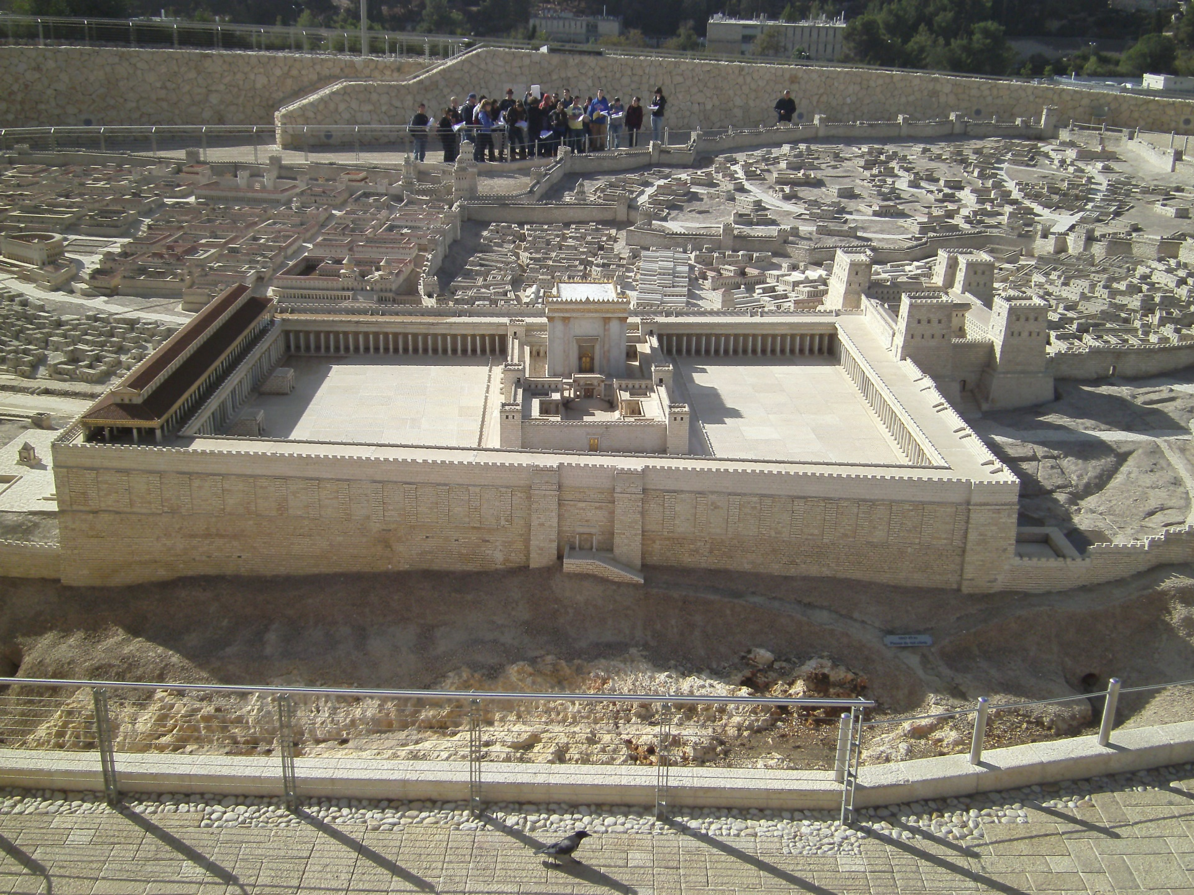
Luke 19:45-48

Slide 23
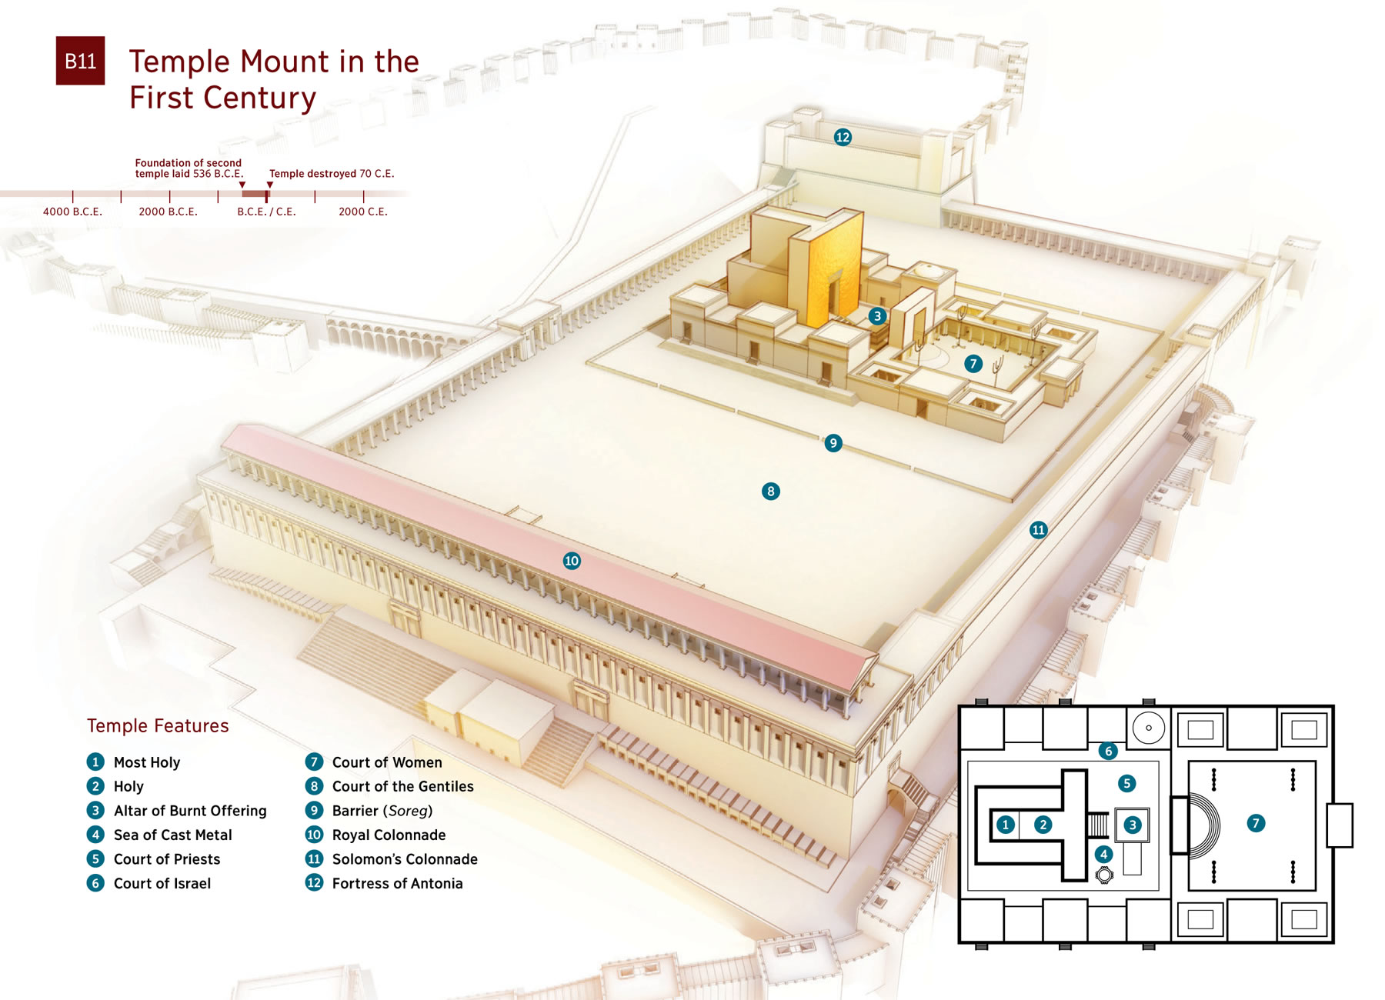
Luke 19:45-48

Slide 24
Worship
Luke 19:45-48
God Himself is a continuous outpourer. His love, grace, mercy, forgiveness, creativity, power
are all made manifest in creation. This act never ceases. God loves us with exactly the same
love that He exhibits between the Trinity. His outpouring there is identical to His outpouring
here.
We are made in His image and so we too are outpourers.
Worship is the continuous outpouring of all that I am, all that I do and all that I can become in
light of my chosen God. (Harold Best, modified by Bob Williamson)
This definition:
Includes everyone, sinner and saint.
Carries the idea that we have all chosen a god
There are none that do not worship as it is what we were created doing
Is continuous. When I sin, worship does not stop … it changes direction. It may
ebb and flow, but it does not cease when then drummer stops or the amplifier
shut off.

Slide 25
Worship
Luke 19:45-48
It is not music. We cannot equate the power of the music to the nearness of the Lord.
There is no on or off switch. We are all bowing down right now, to someone or something;
an idea or a spirit.
Outpouring implies generosity and lavishness. I give it up, I let it go. It surpasses
measuring out or some form of quota.
Out .. implies direction – it moves from me to a destination. It implies a transfer
of energies; an active not passive motion.
Because it is all that I do, my work, my vacation time, my golf can all be acts of worship as
they are done to the glory of the Lord.
Further, this process changes me. Any outpouring must and it will be for good or
ill. In worship, I am transformed.

Slide 26
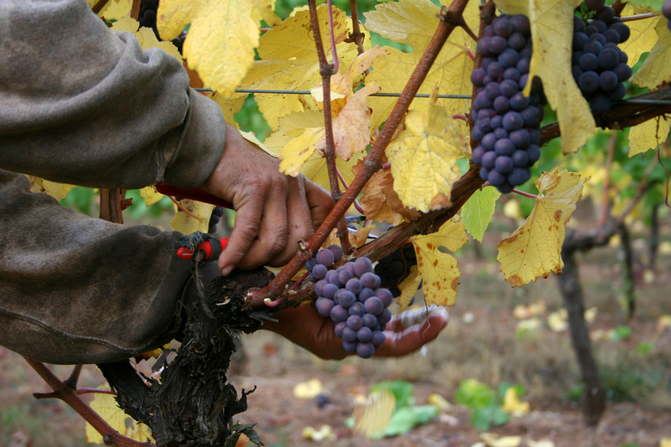
Luke 20:1-18
Luke 20:9 …"A man planted a vineyard, rented it to some farmers
and went away for a long time. At harvest time he sent a servant
to the tenants so they would give him some of the fruit of the
vineyard. But the tenants beat him and sent him away empty-handed.
He sent another servant, but that one also they beat and treated
shamefully and sent away empty-handed. He sent still a third,
and they wounded him and threw him out.
"Then the owner of the vineyard said, ‘What shall I do? I will send my son,
whom I love; perhaps they will respect him.’
"But when the tenants saw him, they talked the matter over. ‘This is the
heir,’ they said. ‘Let’s kill him, and the inheritance will be ours.’
So they threw him out of the vineyard and killed him. "What then will
the owner of the vineyard do to them? He will come and kill those tenants
and give the vineyard to others." When the people
heard this, they said, "May this never be!"
Vineyard rented
Servants sent and
rejected
Son sent
Son rejected
Vineyard transferred

Slide 27
Luke 20:19-26

Slide 28
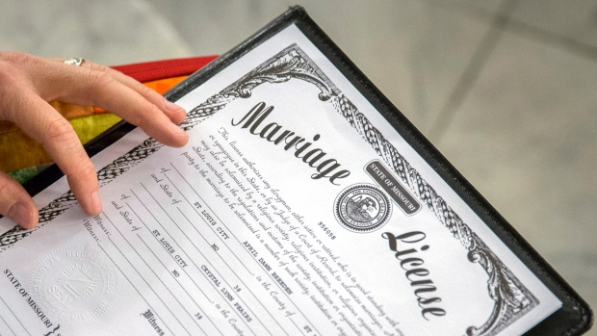
Luke 20:27-40
The levirate marriage …
There is no marriage in the kingdom to come
No procreation necessary
Known even as we are known
No death, no separation …

Slide 29
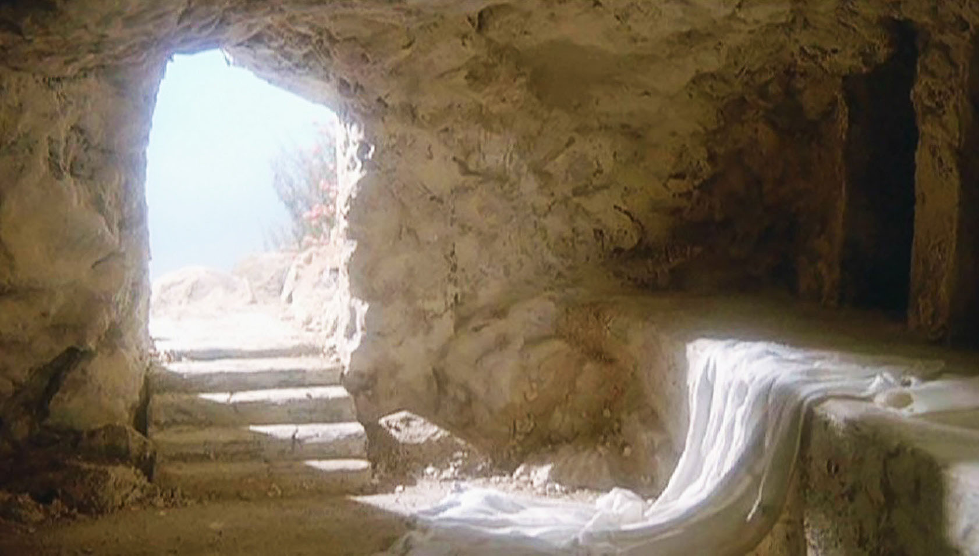
Luke 20:27-40
Resurrection. Is it important?

Slide 30
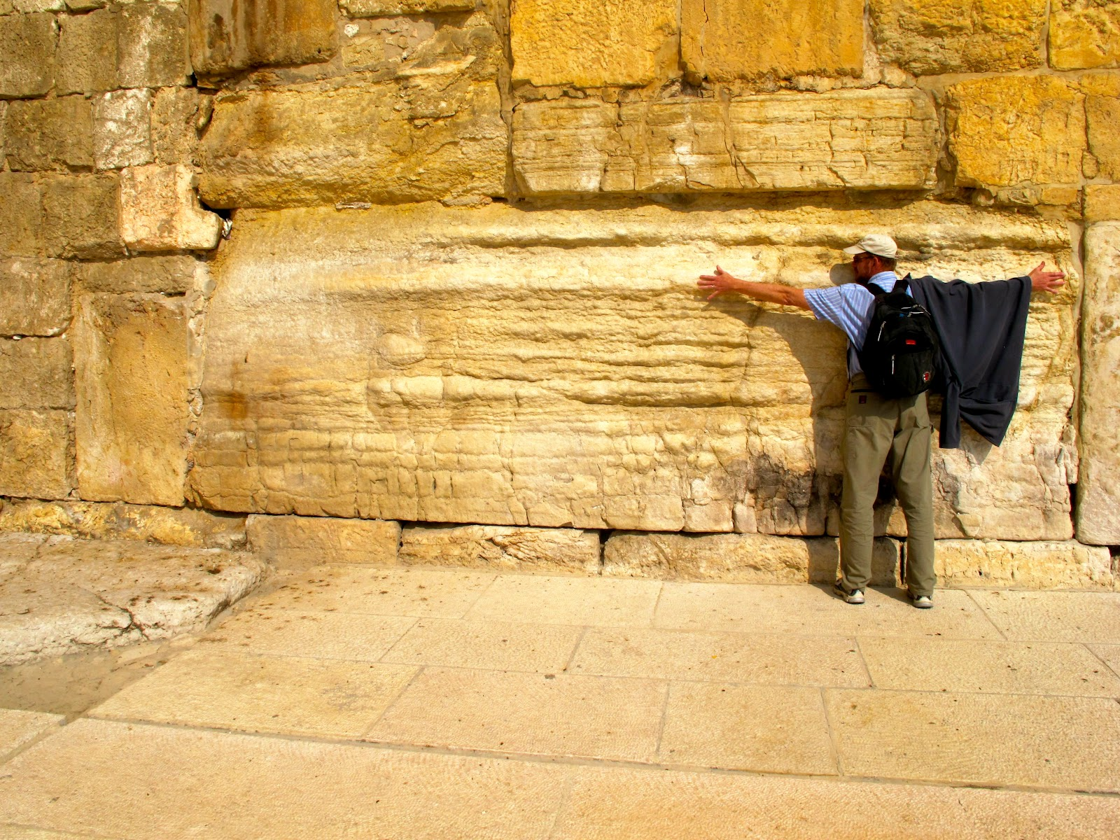
Luke 21:5-38
The Awe Of Construction
Herodian Temple Foundation Stones

Slide 31
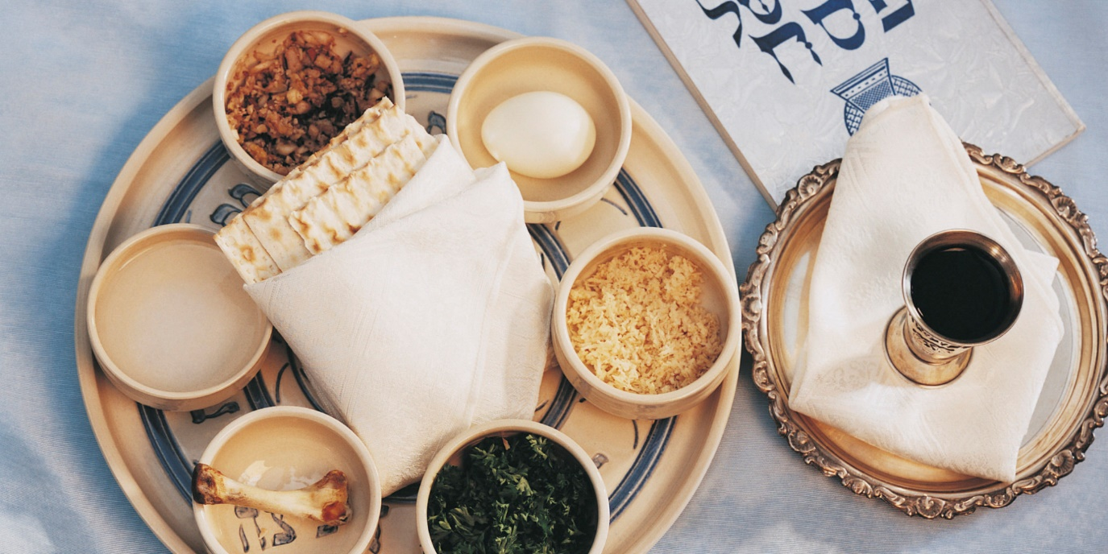
Luke 21:5-38
Israel's Feasts
God seems willing and able to speak to Israel very specifically in regards to the events
to unfold in their future. We wish to take some time to examine the Feasts Of Israel found
in Leviticus 23. These feasts were celebrated annually and commemorated certain events.
We should study them because of an intriguing verse found in Col. 2:16-17.
Therefore do not let anyone judge you by what you eat or drink, or with regard to a
religious festival, a New Moon celebration or a Sabbath day. These are a shadow of
the things that were to come; the reality, however, is found in Christ.

Slide 32
Israel's Feasts
Luke 21:5-38
Exodus 12:1-3; The LORD said to Moses and Aaron in Egypt, "This month is to be for you
the first month, the first month of your year. Tell the whole community of Israel that on the
tenth day of this month each man is to take a lamb for his family, one for each household …
The Biblical Calendar
Order | Jewish Name | Our Name
1 | Nisan, or Abib | March - April
2 | Ziv, or Iyyar | April - May
3 | Sivan or Siwan | May - June
4 | Tammuz | June - July
5 | Ab, or Av | July - August
6 | Elul | August - September
7 | Tishri or Ethanim | September - October
8 | Bul or Kheshvan or Heshvan | October - November
9 | Chisleu or Kislev | November - December
10 | Tebeth or Tevet | December - January
11 | Sebat or Shevat | January - February
12 | Adar | February - March
13 | Adar II | (Intercalary month) (7 of these every 19 years)
Passover
Unleavened Bread
Firstfruits
Pentecost
Trumpets
Day Of Atonement
Tabernacles

Slide 33
Luke 21:5-38
Israel's Feasts
New Years Day (first day of Nisan)
- the purpose of this day was a time of ritual cleansing and new beginnings for the Jewish people.
- note that God had shifted their calendar six months at the Exodus (See Exodus 12:1)
What Else Happened On This Day?
a) The dedication of the Tabernacle in the wilderness (Exodus 40:17)
- some two years after fleeing from Egypt
b) Hezekiah cleanses and rebuilds the Temple
(2 Chronicles 29:2-3, 17)
c) Ezra begins his journey to Jerusalem to rebuild
the city (Ezra 7:9, 25)
- Nehemiah joins him 13 years later
d) Some future cleansing of a future
temple (Ezekiel 45:18)

Slide 34
Luke 21:5-38
Israel's Feasts
Lamb Selection Day (10th Of Nisan)
- this was a day of sanctification (See Zech. 9:9)
What Else Happened On This Day?
a) Lamb selected for the first Passover (Ex. 12:3-6)
- Paul calls Jesus our Passover Lamb (1 Corinthians 5:7)
b) Israel crosses the Jordan and enters the Promised Land (Joshua
3:5, 4:19)
c) Christ our Lamb was cut off (Palm Sunday, 10th of Nisan AD32)
d) Ezekiel’s vision of the end time Temple is given
(Ezekiel 40:1-2)

Slide 35
Luke 21:5-38
Israel's Feasts
Passover (1 of 7 Levitical Feasts)
- see Lev. 23:4-5
this day always falls on a full moon - the first full moon of spring
All Jewish males were required to go to Jerusalem three times a year - Feasts of Passover, Pentecost and Tabernacles
- the new day started from evening and concluded at the end of the day (see Gen 1:5)
- this feast started at sun down, on the 14th of Nisan
it is interesting to note that when the Jews placed the blood on the doorframe sides
and top of their door, they were painting the Hebrew letter chet (rhymes with mate);
it has the meaning of life or light!

Slide 36
Luke 21:5-38
Israel's Feasts
Passover (1 of 7 Levitical Feasts)
the location for the lambs raised for Passover … was Bethlehem … about 5 miles south of Jerusalem. The high priest would go down each year to select a lamb. Keep in mind, however, that both Zacharias and Elizabeth were from the tribe of Levi … which makes John the Baptizer of the Levitical tribe … which would allow him to
also select a Lamb … which he did at the baptism of Jesus!
What Else Happened On This Day?

Slide 37
Luke 21:5-38
Israel's Feasts
- in each of these cases, we see either a new covenant being offered or re-confirmed
Passover: The Covenant Relationship With God
1. God makes a covenant with Abraham - The Promised Land
2. The Passover supper eaten in preparation for the Exodus
3. The First Passover in Canaan
4. The Book Of The Law found and reaffirmed under Josiah
5. The dedication of the second temple under Ezra
6. The Last Supper - A new covenant offered by Christ
We can confirm this with a comparison between
Gen. 15:18 and Ex. 12:41 (Rabbinic tradition)
2) We can see this in Exodus 12:41
3) See Joshua 5:3, 8, 11-12
4) Compare 2Kings 23:23 (18th year of Josiah) with
2Chr. 34 and 35:1
5) See Ezra 6:19
6) See Luke 22:19-20

Slide 38
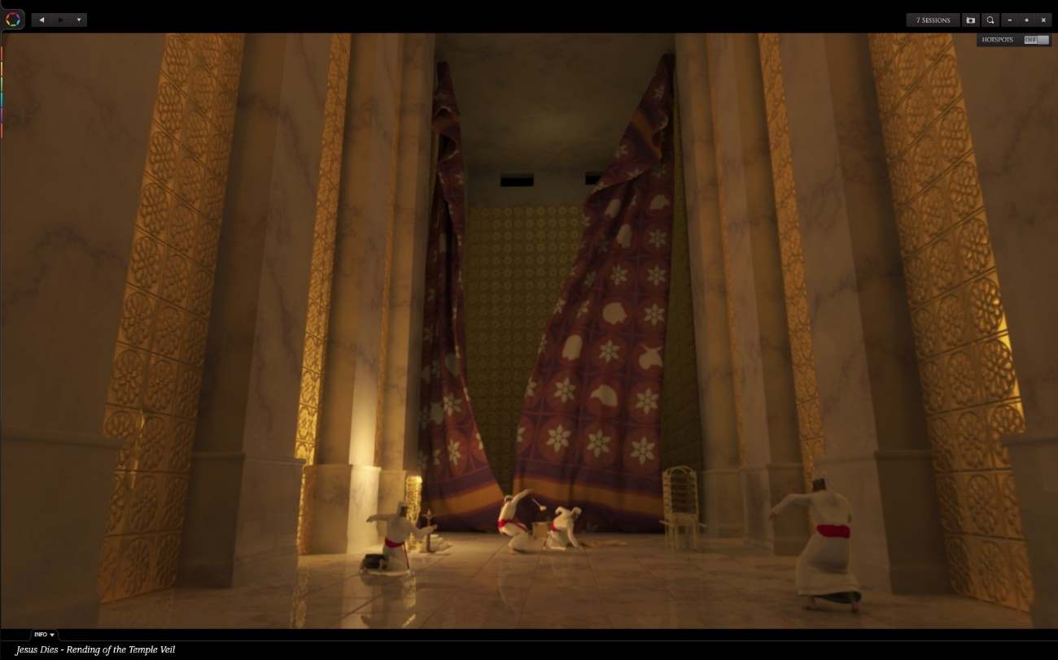
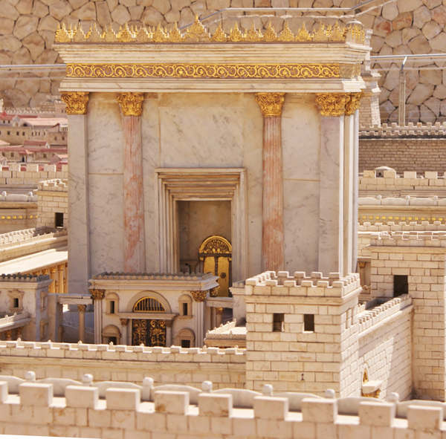
Luke 21:5-38
Israel's Feasts
Other thoughts:
- remember that the Passover lamb was slain on this day at 3:00pm. After its
death, a priest would climb the steps to the temple wall and blow the shofar
… announcing the end of the Passover. This was representative of the voice of
God declaring that the sin sacrifice was received.
- remember that the place of crucifixion had another name … Mount Moriah
- if a Jewish father lost his son to death … he would tear his robe. What other
tearing took place at this time? The temple pillars were often called the legs
of God.

Slide 39
Luke 21:5-38
Israel's Feasts
Unleavened Bread (2 of 7 Levitical Feasts)
- See Leviticus 23:6-7, 10-11 AND Exodus 12:14-20
this feast occurs from 15 Nisan to 21 Nisan (seven days) and begins that day after
Passover
Israel was to eat bread with no leaven in it (separation from sin) and SPEED at which
salvation came (see Exodus 12:34)
the Matzah bread (unleavened) was to remind them of the night that they would eat
the Passover lamb, then be ready to make a hasty exit from Egypt (see Ex. 12:8, 14-20, 39)
Christ is called our Passover (1Cor. 5:7-8)
What else happened on this day?

Slide 40
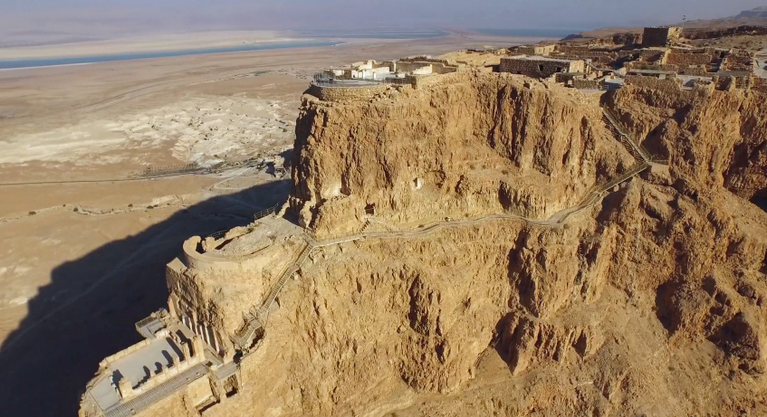
Luke 21:5-38
Israel's Feasts
15th Day Of Nisan (The Feast Of Unleavened Bread): The Purging Of Sin
1) The Exodus journey from the bondage of Egypt begins
2) The crucifixion Of Christ
3) The final fall of the Jewish resistance at Masada
Notes:
Exodus 12:41 states that they left the country that day. In Deut. 16:3, it is called
the Bread of Affliction (think of Jesus in the Garden!)
2) Jesus calls Himself the Bread Of Life (John 6:35)
The place where the 960
freedom fighters finally fell
to defeat at the hands of
the Romans. We are given
the date of the event from
Flavius Josephus.

Slide 41
Luke 21:5-38
Israel's Feasts
Note that there is some debate here as to how long Jesus was in the tomb. Consider:
Matthew 12:40 … after three days and three nights
Mark 8:31 … after three days
Matthew 16:21 … On the third day
Luke 24:21 … It is the third day
John 2:19 … Raise it in three days
Comp: Matthew 27:62 with 27:64 … after three days … until the third day
Comp: Genesis 42:17 with 42:18 … for three days … on the third day
Clearly, all of these phrases are idioms.
RULE: Do not let a text generate a controversy in
the 21 century that was not a controversy in the
first century!

Slide 42
Luke 21:5-38
Easter Time Line

Slide 43
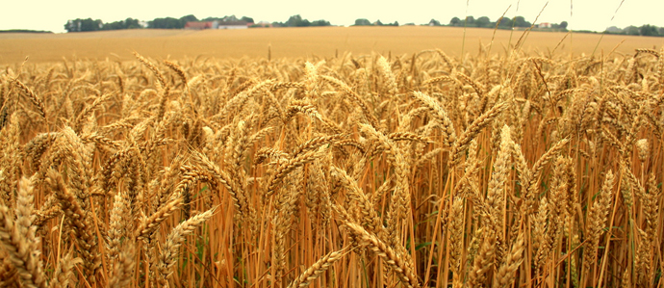
Luke 21:5-38
Israel's Feasts
The Feast Of First Fruits (3 of 7)
- See Lev. 23:9-14
- This feast was celebrated on the 16th day of Nisan (day after Sabbath).
This was a time of harvesting the early crops.
- Typically, this was barley which was sown in the winter. Note that it is possible that this
could be celebrated on the 17th of Nisan … if there were two Sabbath’s in a row
(regular Sabbath and the High Sabbath that occurs as the beginning of the Feast Of
Unleavened Bread – this is highly doubtful, however)
- God wanted the people to acknowledge Him as the provider of these good things
What else happened on
this day?

Slide 44
Luke 21:5-38
Israel's Feasts
Feast Of Firstfruits: Resurrection
1. Noah’s ark rests on Mount Ararat
2. Israel eats the first fruits the land
3. The resurrection of Jesus
Notes:
Compare Gen 8:4. This states that the event occurred in the seventh month. However,
one must remember that the Lord changed Israel’s calendar during the Exodus by
rotating it six months. See Exodus 12:1-2
2) See Joshua 5:10-12. They ate the last Passover (14th of Nisan), ate old stores from the
land (15th of Nisan), manna stopped falling on the 16th of Nisan and the new crops
were partaken
3) Paul calls Jesus our Firstfruits - 1Cor. 15:20-23

Slide 45
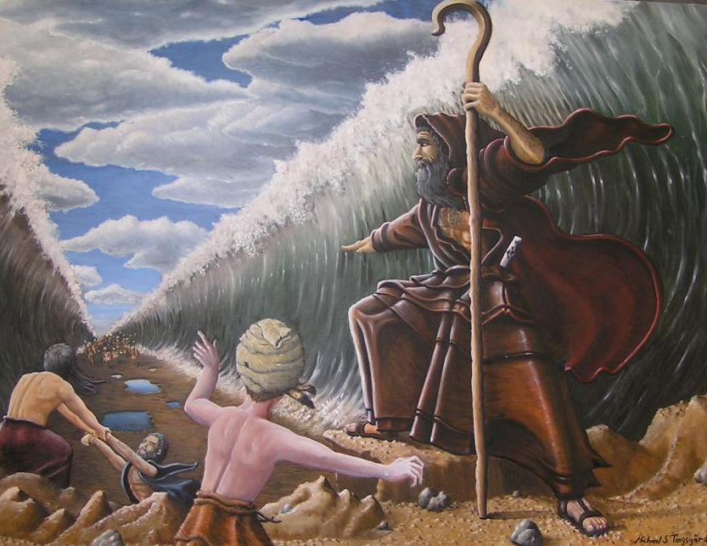
Luke 21:5-38
Israel's Feasts
Interestingly, Israel crossed the Red Sea on the 17th of Nisan
It is possible, with a comparison of Exodus 13 and 14 to trace the first few days of
Israel’s journey (see also Numbers 33:3-8):
- 15th of Nisan they left Egypt and camped the night at Succoth
- 16th of Nisan they camped at Etham
- 17th of Nisan Pi Hahiroth, by the sea
- that night, the Lord dried the sea
- the next day and evening they went
through the passage that the Lord made

Slide 46
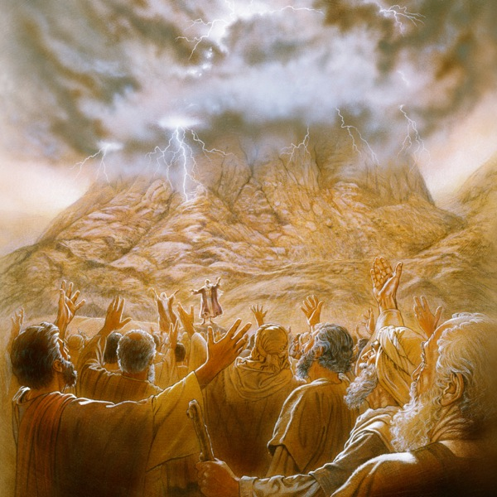
Luke 21:5-38
Israel's Feasts
The Feast Of Pentecost (4 Of 7)
- see Lev. 23:15-22
- note this is also called the Feast Of Weeks
- it was celebrated 50 days after Passover... a harvest festival
- it was considered 50 days after crossing the Red Sea
- this works out to the 6th Day Of Sivan
- Exodus 19:19 says that the voice of the Lord was like a trumpet
- Rabbi Yohanan ben Zakkai claimed, in the Midrash, that “God’s voice, as it was uttered,
split into 70 voices so that all the nations should understand”
- Further, Rabbi Moshe Weissman claimed that the people actually saw the voice waves
emanate from the mouth of God (the trumpet) as fiery breathes (Exodus 20:18 … the
people perceived the thunders)
- wind, fire … different languages … sound familiar?
- typically, the Book of Ruth is read at Pentecost each year (our Redeemer!)
- according to Jewish legend, Enoch was raptured on this day, as well
- note that Jesus taught His disciples during this time (Acts 1:3)
- See Jeremiah 31:31-33 … where God promises to write His laws in our hearts by His Spirit
What else happened on this day?

Slide 47
Luke 21:5-38
Israel's Feasts
Feast Of Pentecost: The Revelation Of God’s Will
1. The giving of the law to Moses on Mount Sinai
2. The giving of the Holy Spirit to the Church
Notes:
1) See Exodus 19:1 ... the third day on the third month. Then compare with verses 10 and 11
2) See Acts 2:1
- It is important to note that in Christ there has been a prophetic fulfillment of the first
four feasts. Although we can only offer conjecture as to the last three, it is possible that
they will indeed be anniversaries of things Christ yet will do.
- It is interesting to note that at the giving of the Law, 3000 died (Exodus 32:28) and at the
giving of the Spirit, 3000 “lived” (Acts 2:41)

Slide 48
Israel's Feasts
Luke 21:5-38
Exodus 12:1-3; The LORD said to Moses and Aaron in Egypt, "This month is to be for you
the first month, the first month of your year. Tell the whole community of Israel that on the
tenth day of this month each man is to take a lamb for his family, one for each household …
The Biblical Calendar
Order | Jewish Name | Our Name
1 | Nisan, or Abib | March - April
2 | Ziv, or Iyyar | April - May
3 | Sivan or Siwan | May - June
4 | Tammuz | June - July
5 | Ab, or Av | July - August
6 | Elul | August - September
7 | Tishri or Ethanim | September - October
8 | Bul or Kheshvan or Heshvan | October - November
9 | Chisleu or Kislev | November - December
10 | Tebeth or Tevet | December - January
11 | Sebat or Shevat | January - February
12 | Adar | February - March
13 | Adar II | (Intercalary month) (7 of these every 19 years)
Passover
Unleavened Bread
Firstfruits
Pentecost
Trumpets
Day Of Atonement
Tabernacles

Slide 49
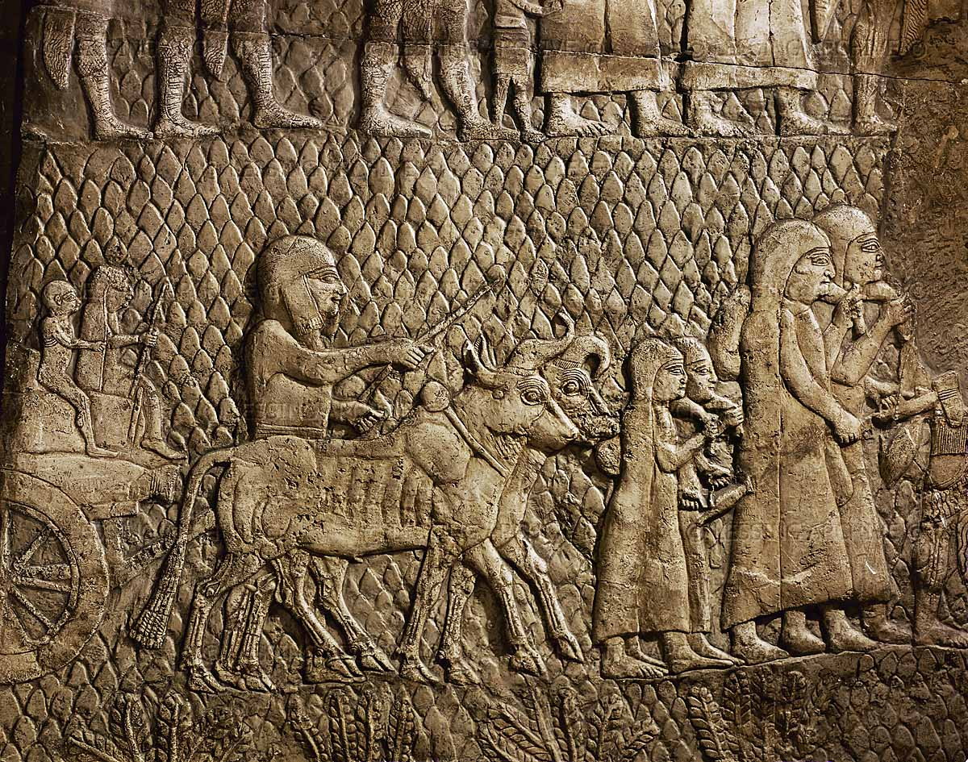
Luke 21:5-38
Israel's Feasts
A Fast Of Mourning (9th Day Of Av)
- see Zechariah 7:5
- called Tisha Be-Av
- mourning for the loss of the Temple
- Israel have witnessed 8 of their greatest disasters on this day
- This feast was not commanded
by God. Had Israel stayed close to the
Lord, this would never have had to
be observed.
- We must all be careful to not make
feast something more than what the
Lord wanted.
What else happened on this day?

Slide 50
Luke 21:5-38
Israel's Feasts
1) The 12 spies return with their report (from the Mishna)
2) Solomon’s Temple is destroyed (Babylon) Jeremiah 52:6
3) The second temple is destroyed by the Romans (Josephus)
- the original Roman attack came on the Feast Of Passover, where over 1.25 million
Jews were inside the city
- the Jews had been in revolt since AD 66
- Titus entered the city and reached the temple on Av 9
- soldiers burned the temple
- see also Luke 19:43-44
4) The destruction of Bar Kockba’s army
- this was a charismatic leader who rebelled against Rome in AD 132
- although he succeeded in repelling the Romans for two years, things did not go well
- the Romans began a “scorched earth policy to demoralize the Jews
- 580,000 Jews were killed, and 50 fortified towns and 985 villages razed
- Emperor Hadrian again made it illegal to perform any Jewish rites

Slide 51
Luke 21:5-38
Israel's Feasts
Bar Kochba was very successful in battle and managed to hold the Romans back for three
and 1/2 years.
- At the end, the Talmud reports that:
numbers slain (Jews) were enormous, that the Romans "went on killing until their horses
were submerged in blood to their nostrils"
The Gemora tells us that we know Betar was conquered on the ninth of Av because we have
a tradition that this is so. The Medrash explains the events surrounding the fall of Betar.
Fifty two years after the second Temple was destroyed, a large Jewish army massed in the
city of Betar. The leader of this army was Bar Koziva, also known as Bar Kochba. The sage
Rabbi Akiva became Bar Kochba's armor bearer and regarded him as the Moshiach (Messiah).

Slide 52
Luke 21:5-38
Israel's Feasts
5) The Roman army plowed Jerusalem in prep. for a new city
this took place exactly one year later (see Micah 3:12)
According to a text in the Gemara - a collection of ancient Jewish writings - the Romans
ran a plow over Zion on the 9th day of the Jewish month of Ab. The Gemara said that
Turnus Rufus, a Roman officer, plowed the area of the Temple. This prophecy was fulfilled in
literal detail.
Incidentally, there was a Roman coin minted during that era that shows an image of a man
using a plow. The coin was intended to commemorate the founding of the pagan Roman city
called Aelia Capitolina on the site of Jerusalem. The Romans sometimes minted coins
showing the plowing motif as a symbol of the establishment of a new Roman city.
Further, the Ta’anit 4:26b also records this event as a preparation for a Roman colony
… on the 9th of Abh it was decreed that our ancestors should not enter the Holy Land; on
that day the first and second Temples were destroyed, the city of Bethar was taken, and the
site (of Jerusalem) was ploughed up (like a field) …

Slide 53
Luke 21:5-38
Israel's Feasts
6) England expels all Jews (1290 AD)
- July 18, 1290 AD, under King Edward the first … all Jews were forced to leave
- in was under Oliver Cromwell, 400 years later, that Jews were allowed to return (1657)
- this is when Britain became a huge world power and is directly traced to Lord Cromwell
- by 1914, they controlled one fourth of the planet
- Nov. 2, 1917, Lord Balfour gave his speech re: setting up a homeland for the Jews
The Balfour Declaration of 1917 (dated 2 November 1917) was a letter from the United
Kingdom's Foreign Secretary Arthur James Balfour to Baron Rothschild (Walter Rothschild,
2nd Baron Rothschild), a leader of the British Jewish community, for transmission to the
Zionist Federation of Great Britain and Ireland.

Slide 54
Luke 21:5-38
Israel's Feasts
His Majesty's government view with favour the establishment in Palestine of a national
home for the Jewish people, and will use their best endeavours to facilitate the achievement
of this object, it being clearly understood that nothing shall be done which may prejudice
the civil and religious rights of existing non-Jewish communities in Palestine, or the rights
and political status enjoyed by Jews in any other country.
- however, the Arabs were granted most of the territory because of their help in defeating
the Turks and Germany (Under Lawrence Of Arabia, who helped Arabs against the Turks
during WWI)
- until 1948, Britain continued to renege on their promise to Israel
- Jews could not immigrate there before this and this lead to the slaughter of many during
WW2
- it was at this time that England lost ALL of its outer colonies
7) Spain expels all Jews (1492 AD)
- 800,000 Jews were forced to leave the country

Slide 55
Luke 21:5-38
Israel's Feasts
… an Edict of Expulsion was issued against the Jews of Spain by Ferdinand and
Isabella (March 31, 1492). It ordered all Jews of whatever age to leave the kingdom by the
last day of July (one day before Tisha B'Av)
- from this point forward, the power of Spain began to decrease
- It was also on August 3, 1942 day that Christopher Columbus began his historic trip to
discover a new world
8) World War 1 is declared (Germany against Russia) (August 1, 1914)
- Russia began a persecution of their Jews in eastern Russia, forcing many of them to flee
Other events that occur on/around this date:
- The First Crusade was declared by Pope Urban II on July 20, 1095 (Av 9), killing 10,000
Jews in its first month and destroying Jewish communities in France and the Rhineland
- On the eve of Tisha B'Av 5702 (July 23, 1942), the mass deportation began of Jews from
the Warsaw Ghetto to Treblinka (death camp)

Slide 56
Luke 21:5-38
Israel's Feasts
On 22 July, 1306 King Philip IV of France expelled all Jews from his kingdom.
- Jews living in England had been expelled by King Edward I, many of them moving to France.
- They had to wear a special garment to differentiate them from Christians.
- Historians believed that this was ease the king's poor economy
- 100,000 Jews were arrested on the 9th of Av, given one month to leave the country
- They were required to leave everything behind but the clothes on their backs.
- The king auctioned it all off, kept the profits and took over the receipt of all debts owed
to the Jews.
On August 2, 1941 (Av 9, AM 5701), SS commander
Heinrich Himmler formally received approval from
the Nazi Party for "The Final Solution." As a result,
the Holocaust began during which almost one third
of the world's Jewish population perished.
Anno Mundi

Slide 57
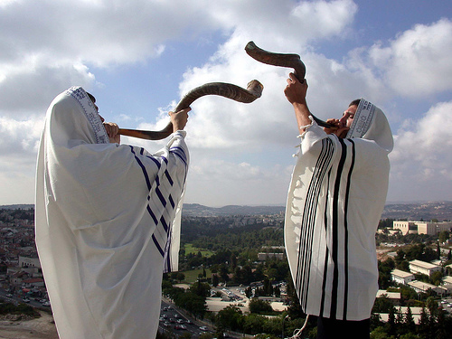
Luke 21:5-38
Israel's Feasts
The Feast Of Trumpets (5 Of 7) (Rosh Hashanah)
- see Lev. 23:23-25
- no one really knows what the trumpet really commemorates
- However, Isa. 27:13 – the Messiah is seen here as blowing the shofar (also Zech. 9:14)
- note that the Lev 23 passage calls people to a holy assembly … and a holy rest
- to the Jew, it was reminiscent of Abraham’s faithfulness in sacrificing Isaac
- Lev 25:9 – the shofar was blown at the
beginning of the year of Jubilee
- 1 Kings 34:39 – a shofar was used to
announce a new king

Slide 58
Luke 21:5-38
Israel's Feasts
The Feast Of Trumpets (5 Of 7) (Rosh Hashanah)
- this feast was celebrated on the first of Tishri (7th month of the calendar)
- the trumpet was blown three times, followed by the blowing of the silver trumpets
(to mark the new month)
- most of the middle eastern cultures considered this to be the first day of the new year,
although we remember that Israel’s calendar was shifted six months by the Lord.
- it was a time of self examination
- this is viewed as the day that the Messiah would begin to rule
- this feast was declared to occur at the sighting of the new moon … by two witnesses
- this day (perhaps celebrated for two days) was considered to be the civil new year
What else happened on this day?

Slide 59
Luke 21:5-38
Israel's Feasts
Feast Of Trumpets: New Beginnings
1. Joshua brings the first offerings to the rebuilt alter
2. Ezra reads the law to the returned exiles to affirm the covenant
3. ?? End of the Battle of Armageddon
Notes:
1. Read Ezra 3:1-6. Even before the foundations of the temple were laid, the sacrifices
were re-started
2. See Neh. 8:2-3. Some years later, when the walls were rebuilt, the law was read to
re-affirm the covenant with the Lord. Note that the people were then sent away to
rejoice (10)
3. Joel 1:14-15, 2:1-2, Jer. 4:5-6 all seem to link the blowing of a trumpet with the coming
of the Lord during the Battle of Armageddon. It is intriguing to note that Rev. 12:6,
Dan. 9:27 and Matt. 24 all talk of the Abomination of Desolation that occurs and the
fact that 1260 days later, the Antichrist is destroyed. If you count back 1260 days from
the Feast Of Trumpets you fall on the Passover.

Slide 60
Luke 21:5-38
Israel's Feasts
Feast Of Trumpets: New Beginnings
1. Joshua brings the first offerings to the rebuilt alter
2. Ezra reads the law to the returned exiles to affirm the covenant
3. ?? End of the Battle of Armageddon
Notes:
Other Jewish traditions that are said to occur on this day:
- Creation of Adam and Eve … their expulsion from the Garden
- Noah removes the covering from the Ark
- Sarah, Rachel and Hannah apparently all received the answers to their prayers for children
- Joseph released from jail

Slide 61
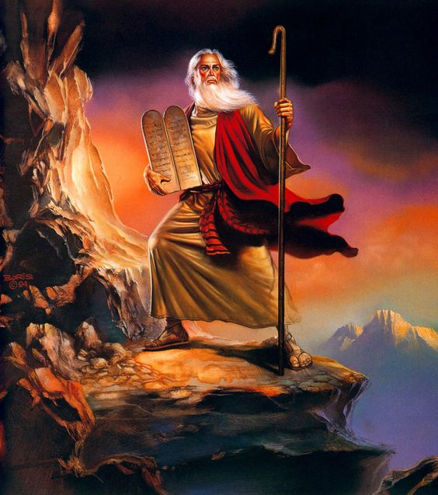
Luke 21:5-38
Israel's Feasts
The Day Of Atonement (6 of 7)
- see Lev. 23:26-32
- this feast was celebrated on the 10th day of Tishri
- it is also called Yom Kippur, the holiest day of the Jewish calendar (from Kapper, meaning to
cover over) … related is kopher … a ransom of money
- Israel was to mourn for their sin, the high priest would enter the Holy of Holies and offer a
sacrifice for the nation.
According to the Jewish writers, on the 6th of Sivan,
seven weeks after the Exodus (49 days!), Moses first
ascended Sinai to receive the Torah. Forty days later,
on the 17th of Tammuz, the tablets were broken. Moses
intercedes for Israel for another 40 days until he was
called back up to Sinai on Elul 1. Here, he was given a
second set of tablets and returned on Tishri 10.

Slide 62
Luke 21:5-38
Israel's Feasts
The Day Of Atonement (6 of 7)
- the two animals would be marked … one for sacrifice and one to be lead into the desert
and set free (as a sign that sin had been removed); Lev 16:21-22 – Also John 1:29, see also
Hebrews 9:12-14
- every 50th year, was a year of Jubilee (see Lev. 25:9-10) that was celebrated on this feast
day
- on this day, all debts were cancelled, all slaves set free, family lands that had been sold
(including slaves) were returned (or set free)
- it was a day of fasting; no work was done
- this was the one day of the year that the “face of the Lord” could be seen and the man live
- the high priest was not required to where the Urim and Thummim on this day –
communication with the Lord was face-to-face
- incense was offered this day … as a sweet savor to the Lord
- it is interesting that repentance (10 days prior) must come before redemption
- the ten days recall the 10 commandments
- Jesus has accomplished all of this for us (Romans 5:8-9)
What else happened on this day?

Slide 63
Luke 21:5-38
Israel's Feasts
Day Of Atonement: Mourning and Atonement For Sin
1. Aaron, the high priest, makes atonement for Israel first
2. Israel saved from annihilation in 1973 during Yom Kippur War
3. The possible date when Israel will mourn as they see their Messiah
Notes:
1. Read Lev. 16:1-28
2. It was on this date that Arabs attacked Israel without warning. Over 100 000
Egyptian and Syrian soldiers entered Sinai against 3000 Jewish defenders and
captured the Sinai Peninsula and Golan Heights
3. See Zech. 12:10-11, Ezek. 36:26, 33

Slide 64
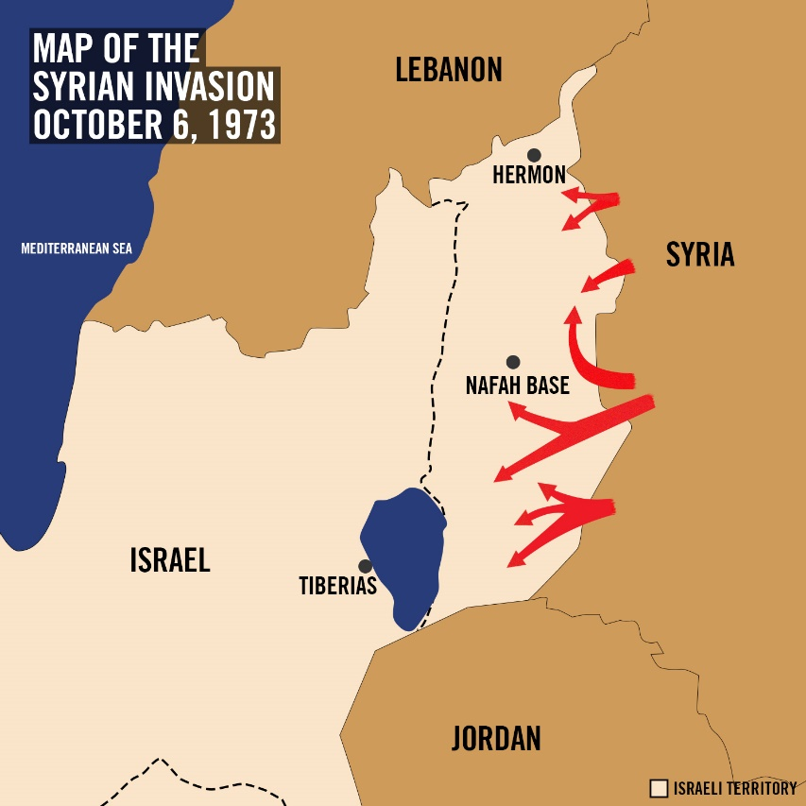
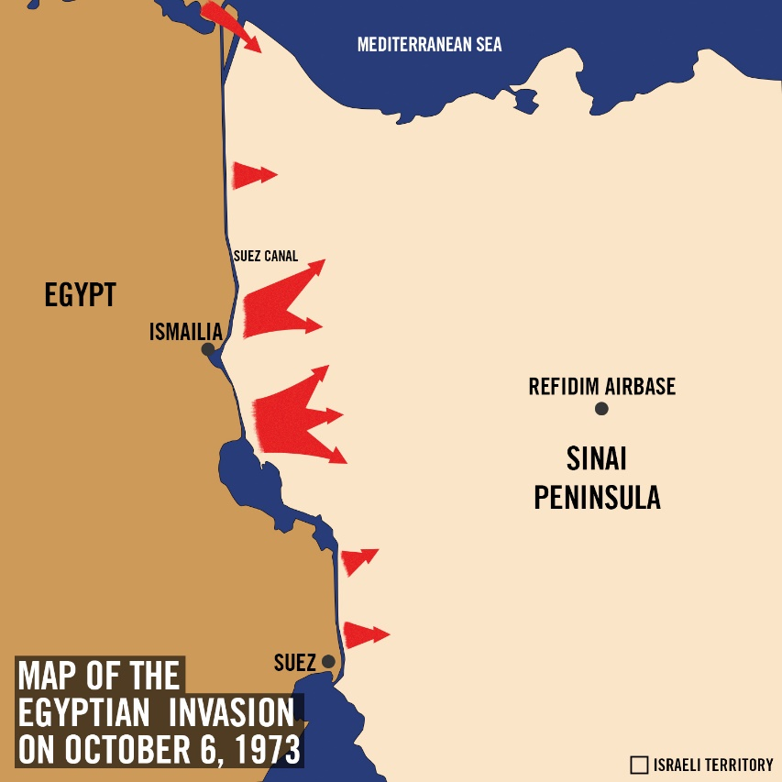
Luke 21:5-38
Israel's Feasts
October 6 – 25, 1973

Slide 65
Luke 21:5-38
Israel's Feasts
The Feast Of Tabernacles (7 Of 7)
- see Lev. 23:33-44
- this is the rejoicing after the mourning … it was later called “The Season Of Our Joy”
- it is also called Sukkot
- it begins five days after the Day of Atonement and lasts for one week.
- there is a huge list of sacrifices offered on this day – no matter how you group them, their number is ALWAYS divisible by seven. The seventh month, the seventh feast … seven days of feasting
- the people were to live in tents made with branches, to remind them of 40 years of wandering and how God cared for them, supplied for them and lead them
- it is possible that Christ was born on this day (see John 1:14 for the use of tabernacled)
- we know that Christ’s ministry lasted about three and one half years, and if He was indeed 33 and ½ years old at His death, then there is an exact agreement between this birthdate and the Feast Of Passover
What else happened on this day?

Slide 66
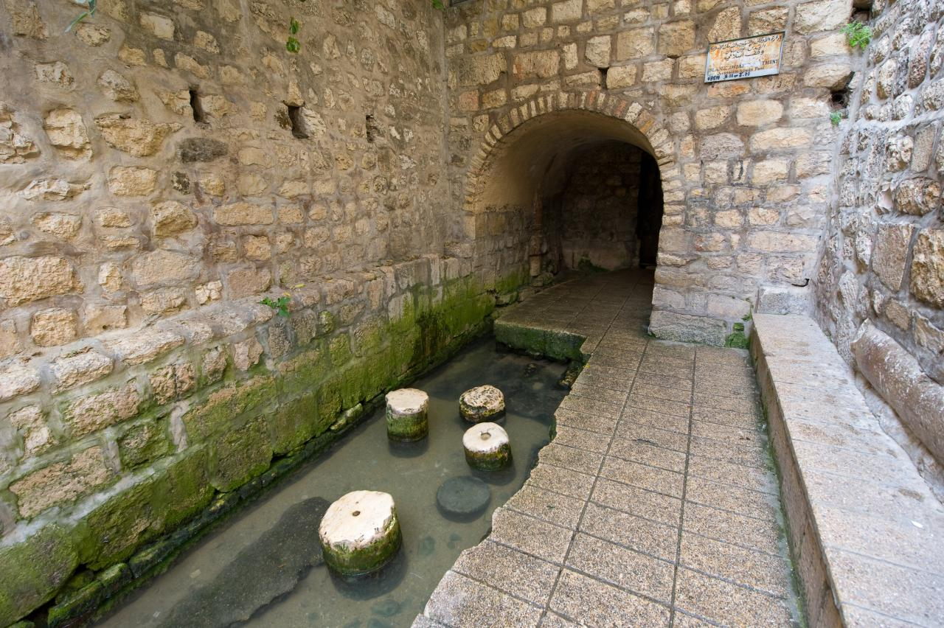
Luke 21:5-38
Israel's Feasts
The 15th Day Of Tishri: The Coming Of The Presence Of God
1. The dedication of Solomon’s Temple
2. The dedication of Ezra’s temple
3. The possible ushering in of the Messiah
Notes:
1. Read 2Chron. 5:2-3, 12-14, 1Kings 8:1-2 remembering that this was one of the three
feasts that God commanded all Israelite men to respond to.
2. See Neh. 8:2, 13-17
3. See Zech. 14:9, 16. Why would God
command all men everywhere to
celebrate this Jewish feast? See
Rev. 21:1-3

Slide 67
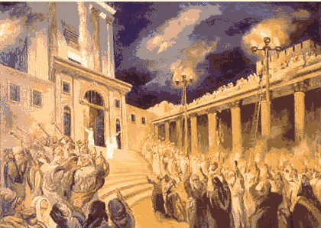
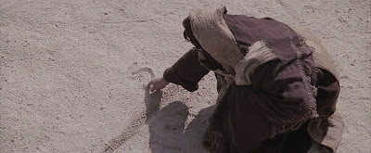
Luke 21:5-38
Israel's Feasts
Note John 7 takes place during this feast. On the last day of the Feast Of Tabernacles,
He makes the claim to be living water (John 7:37). Remember that on this day, the High
Priest would descend from the temple to the Pool Of Siloam … and take water (spring fed,
making it living water) in two pitchers back to the temple … and then pour the water on the
alter. He would ask God for the rains that the people needed.
- after the first day of the festival, four giant candle sticks, with pots crowning them, would
be placed in the Court Of The Women … four lads would pour oil into them from atop
ladders – created a very bright light; choirs would sing, many played instruments and all
danced to the Lord. John 8:12 … Jesus said that He was the Light Of The World.
- Consider that this day’s theme was communion with the Lord … Jesus in John 8 illustrates
this. What is the writing in the sand? Read Jeremiah 17:13

Slide 68
Luke 21:8 He replied: "Watch out that you are not deceived. For many will come in my
name, claiming, ‘I am he,’ and ‘The time is near.’ Do not follow them.
9 When you hear of wars and revolutions, do not be frightened. These things must
happen first, but the end will not come right away."
10 Then he said to them: "Nation will rise against nation, and kingdom against kingdom.
11 There will be great earthquakes, famines and pestilences in various places,
and fearful events and great signs from heaven.
12 "But before all this, they will lay hands on you and persecute you. They will deliver
you to synagogues and prisons, and you will be brought
before kings and governors, and all on account of my name.
13 This will result in your being witnesses to them.
14 But make up your mind not to worry beforehand
how you will defend yourselves.
15 For I will give you words and wisdom that none of
your adversaries will be able to resist or contradict.

Slide 69
16 You will be betrayed even by parents, brothers, relatives and friends, and they will
put some of you to death.
17 All men will hate you because of me.
18 But not a hair of your head will perish.
19 By standing firm you will gain life.
20 ¶ "When you see Jerusalem being surrounded by armies, you will know that its
desolation is near.
21 Then let those who are in Judea flee to the mountains,
let those in the city get out, and let those in the
country not enter the city.
22 For this is the time of punishment in fulfilment
of all that has been written.
23 How dreadful it will be in those days for pregnant
women and nursing mothers! There will be great distress in
the land and wrath against this people.

Slide 70
24 They will fall by the sword and will be taken as prisoners to all the nations. Jerusalem
will be trampled on by the Gentiles until the times of the Gentiles are fulfilled.
25 "There will be signs in the sun, moon and stars. On the earth, nations will be in
anguish and perplexity at the roaring and tossing of the sea.
26 Men will faint from terror, apprehensive of what is coming on the world, for the
heavenly bodies will be shaken.
27 At that time they will see the Son of Man coming in a cloud with power and great glory.
28 When these things begin to take place, stand up and lift up your heads,
because your redemption is drawing near."
29 ¶ He told them this parable: "Look at the
fig-tree and all the trees.
30 When they sprout leaves, you can see for
yourselves and know that summer is near.
31 Even so, when you see these things happening,
you know that the kingdom of God is near.

Slide 71
32 "I tell you the truth, this generation will certainly not pass away until all these things
have happened.
33 Heaven and earth will pass away, but my words will never pass away.
34 "Be careful, or your hearts will be weighed down with dissipation, drunkenness and
the anxieties of life, and that day will close on you unexpectedly like a trap.
35 For it will come upon all those who live on the face of the whole earth.
36 Be always on the watch, and pray that you may be able to escape all that is about
to happen, and that you may be able to stand before the Son of Man."

Slide 72
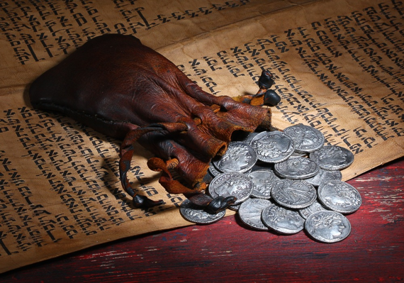
The words of Judas …
Mt 26:25 Then Judas, the one who would betray him, said, "Surely not I, Rabbi?" Jesus answered,
"Yes, it is you."
Mt 26:49 Going at once to Jesus, Judas said, "Greetings, Rabbi!" and kissed him.
Mt 27:3 When Judas, who had betrayed him, saw that Jesus was condemned, he was seized
with remorse and returned the thirty silver coins to the chief priests and the elders.
John 12: 4-7 But one of his disciples, Judas
Iscariot, who was later to betray him,
objected, "Why wasn’t this perfume sold
and the money given to the poor? It was
worth a year’s wages." He did not say this
because he cared about the poor but because
he was a thief; as keeper of the money bag,
he used to help himself to what was put into
it. "Leave her alone," Jesus replied. "It was
intended that she should save this perfume for
the day of my burial.
Mt 27:5 So Judas threw the money into the
temple and left. Then he went away and
hanged himself.
.

Slide 73
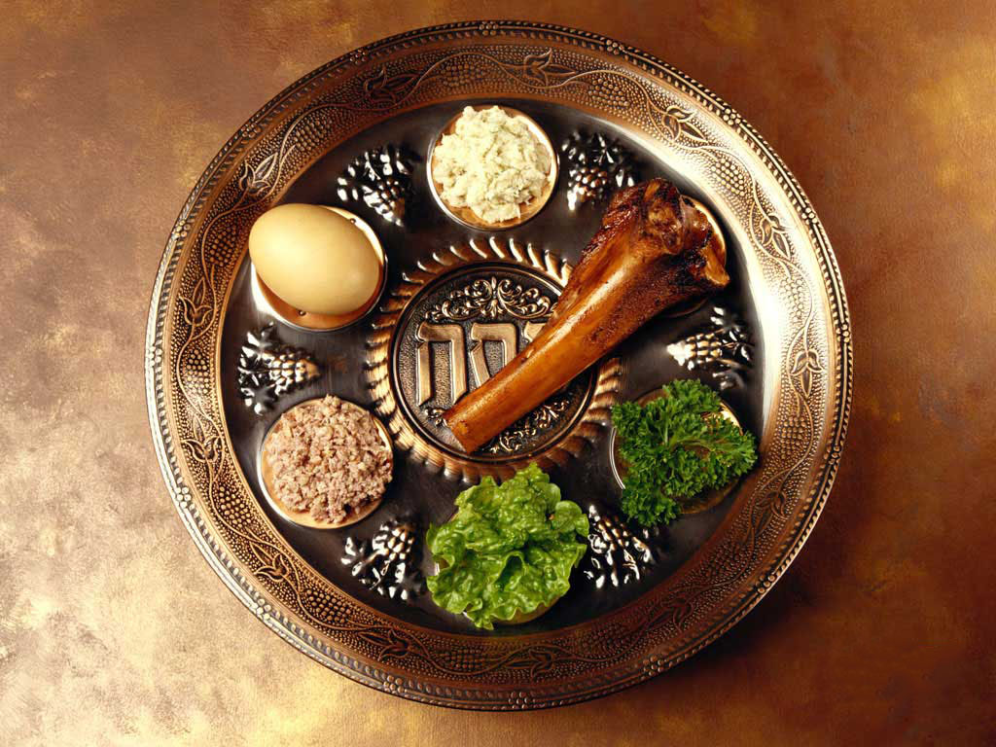
Seder Meal

Slide 74
Luke 22:1-38
The Passover (Last Supper, Communion,
Eucharist [thanksgiving])
When receiving communion, some of the thoughts that I hang on to …
- The matzoth is pierced … like the body of the Lord
- It is jagged like His broken body
- It is a part of a whole … as I am a part of the Body.
- It will be taken again one day with the Lord
- It is my nourishment
- It is made without yeast (sin)
- It was made quickly with haste … I am not to put down roots in this world. Always ready to move.
- My God supplies my needs as He did in the desert with Israel
- This is a lingering taste … meant to
be dessert and the last thing I remember
- The juice is red, as His precious blood
- It was the cup of salvation.
- It was used of a bride to say, “I do”.
- I am to abide in the vine.
- There is life in the blood and it was shed as
a sacrifice for me.
- Communion is a shared meal. It is serious
but also joyful. These are not polar opposites.

Slide 75
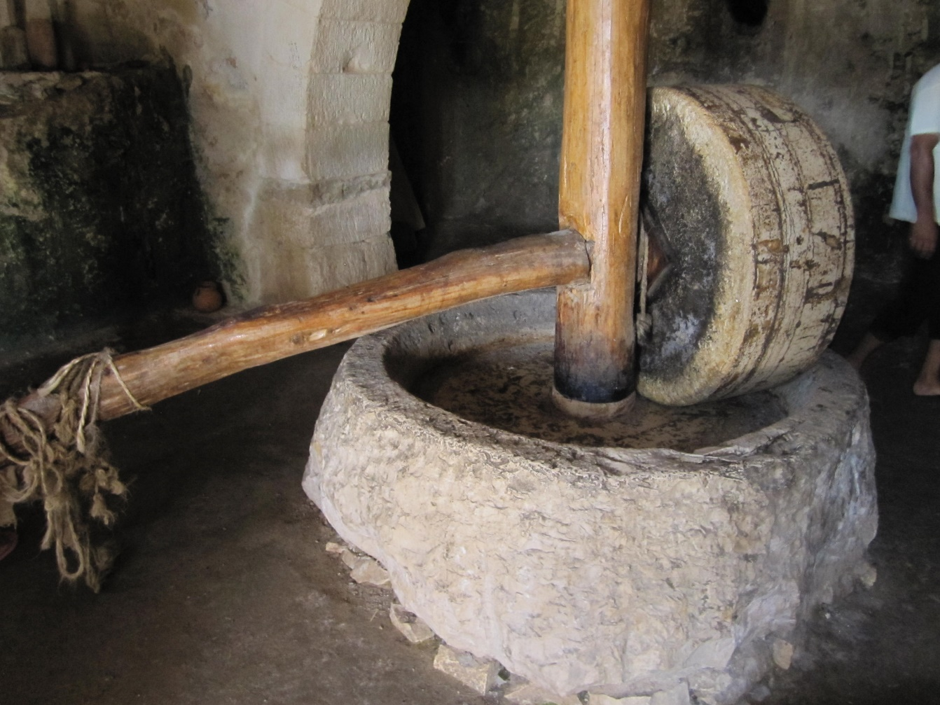
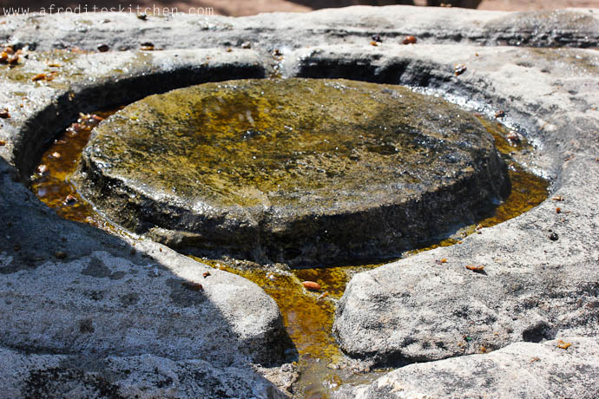
Luke 22:39-46
Gethsemane

Slide 76
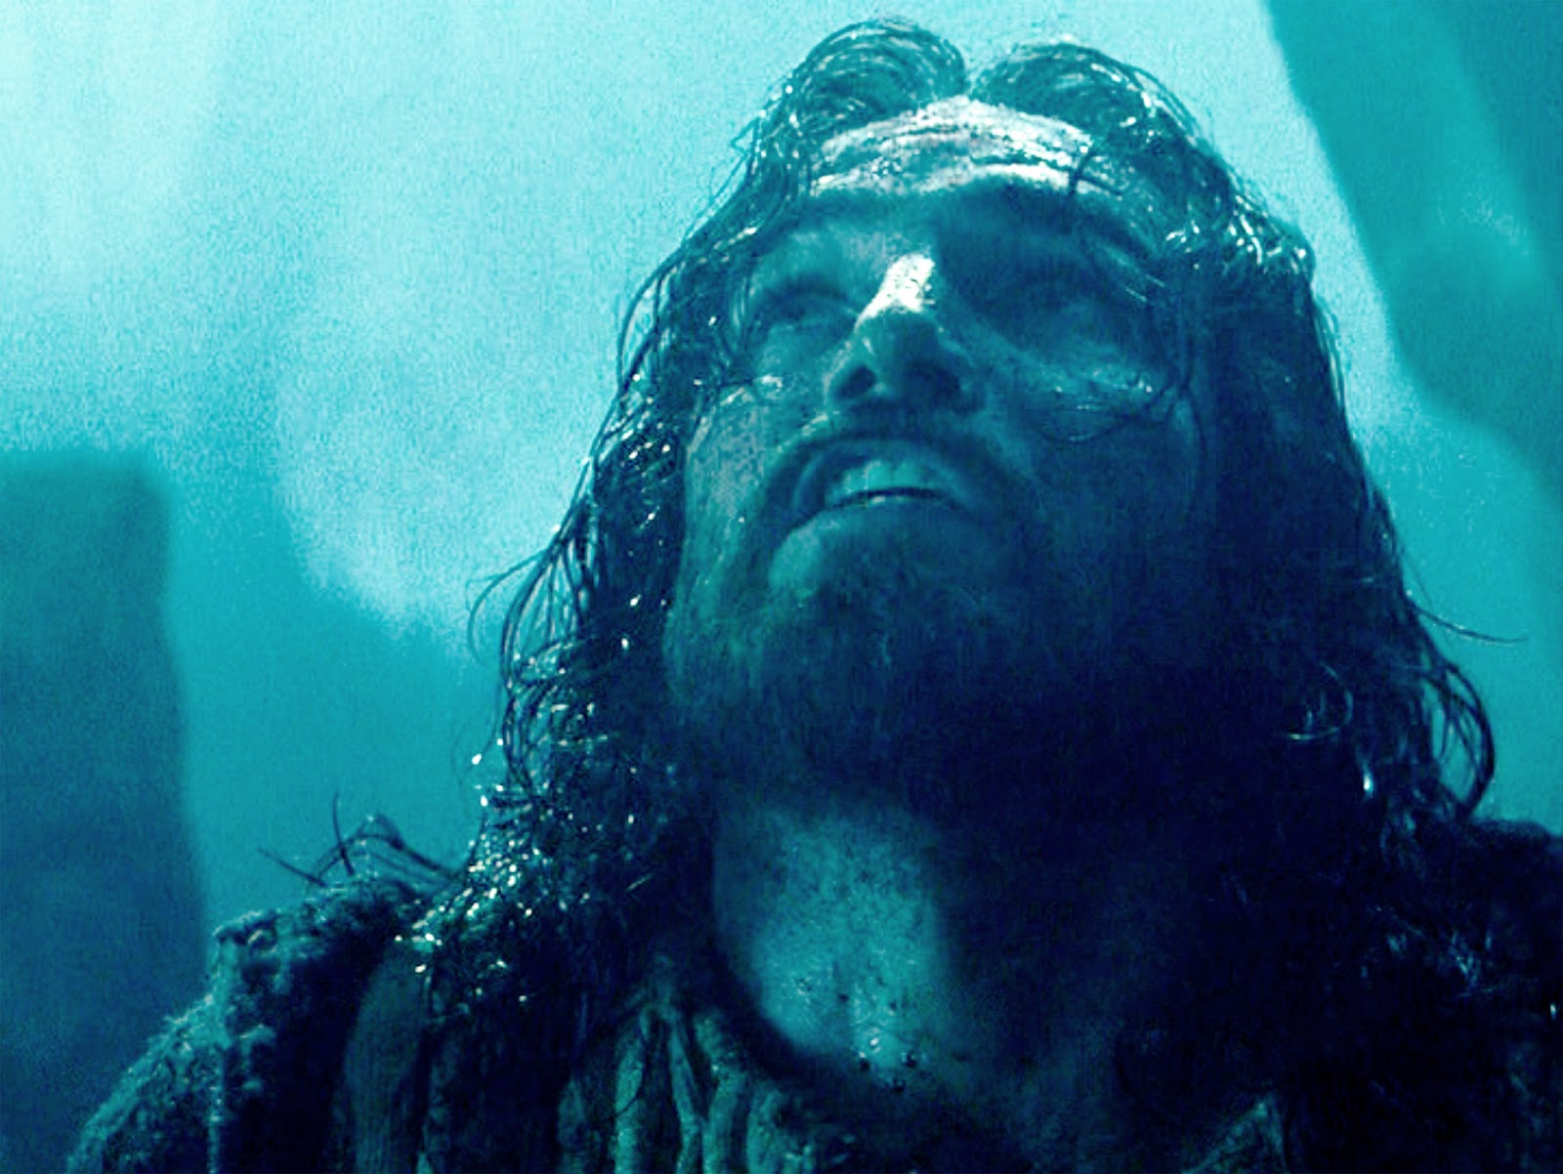
Luke 22:39-46
Gethsemane And Prayer
- There is a time to pray that is not convenient but imperative. Would the apostles have
scattered had they prayed? Would Peter’s outcome have been different?
We do not know.
- We pray as we know best to pray … in honesty and humility. Jesus sought for a different
way to accomplish what He needed to. There was no other way. When God said NO,
Jesus submitted to the plan.
- Prayer should be emotional as well as rational.
- We should not expect others to fully
understand our burden. Show grace when
they do not and gratitude when they do.
- An angel strengthened him. Though we have
no idea how, it was apparently necessary.
God comforts all who mourn.

Slide 77
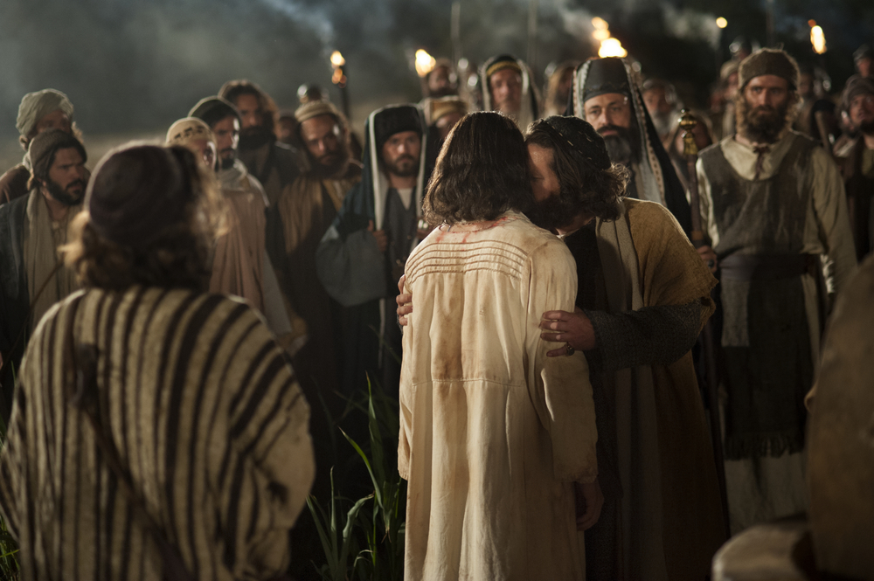
Luke 22:47-62
The Arrest
It is interesting that Peter does not wait for instructions from the Lord regarding fighting.
He just jumps right in.
Note that the healing of the ear, nor the knocking down of the guards stops them
from arresting Jesus.
How often do I attempt to control a situation with power tactics?

Slide 78
Luke 22:47-62
Silence and Solitude
- these ancient practices are often lost today.
- We need to silence all of the extraneous noises and LISTEN for God to speak
- Not all prayer must be spoken.
- It forces us to come to grips with ourselves, our own pattern and thought
- It allows for God to intrude into our lives and speak loudly and shockingly
- It reminds us that our lives and value do not consist of what we produce!

Slide 79
Luke 22:47-62
Silence and Solitude

Slide 80
Luke 22:47-62
Redefining
“People use the word ‘depression’ if they can’t find their keys, or if they've had a fight with
their mother or father, or if they’ve had an argument with their boyfriend or girlfriend, if
they didn’t make the school team or didn’t do well on an exam,” Kutcher says. “When we
use the word ‘depression’ for every negative emotional state, the word loses its meaning.”
Kutcher says this over-diagnosis of normal human experience is indeed a social trend.
“There is more interest in the topic and more self-identification,” says Dr. Stan Kutcher, an
adolescent psychiatry expert and the Sun Life Financial Chair in Adolescent Mental Health,
who says he sees a trend of romanticized depression, of self-victimization. “I see that on
lots of social media.

Slide 81
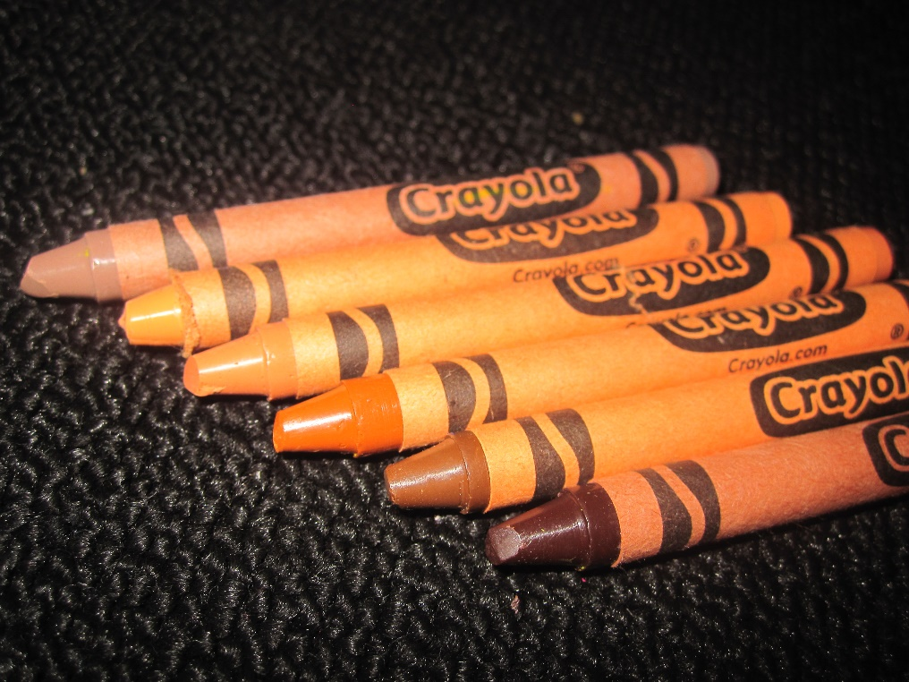
Luke 22:47-62
Redefining
Consider a student union diversity officer at Goldsmith University, who banned white people
and men from an event promoting equality. After accusations of what was obvious racism
and sexism, the woman denied the allegations, stating that,
“I, an ethnic minority woman, cannot be racist or sexist towards white men, because racism
and sexism describe structures of privilege based on race and gender.”
You may be thinking, “that’s not the definition of racism,” and you’d be correct. Racism, by
definition, is the belief that some races are naturally superior to others and that race is the
primary determinant of human traits. Racial discrimination is treating people differently
solely on the basis of their race, and has
nothing to do with “structures or privilege.”
Social justice extremists like this woman
have literally redefined what racism is in
order to justify their own racism. In their
view, their actions are justified as they
are a natural response to oppression.

Slide 82
Luke 22:47-62
Redefining
Love ….
Hate ….
Tolerance …
Grace …

Slide 83
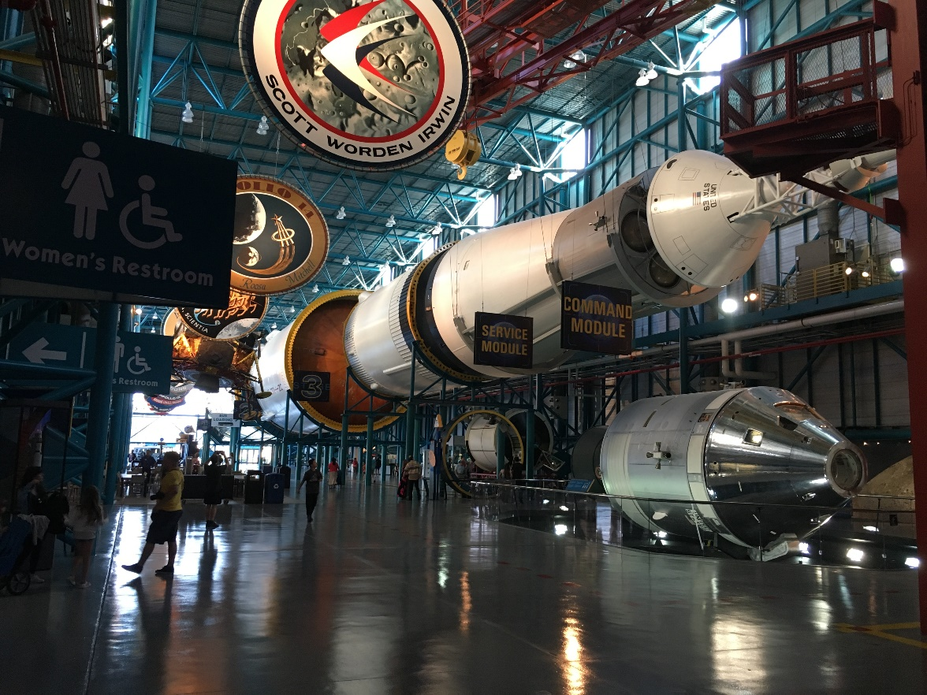
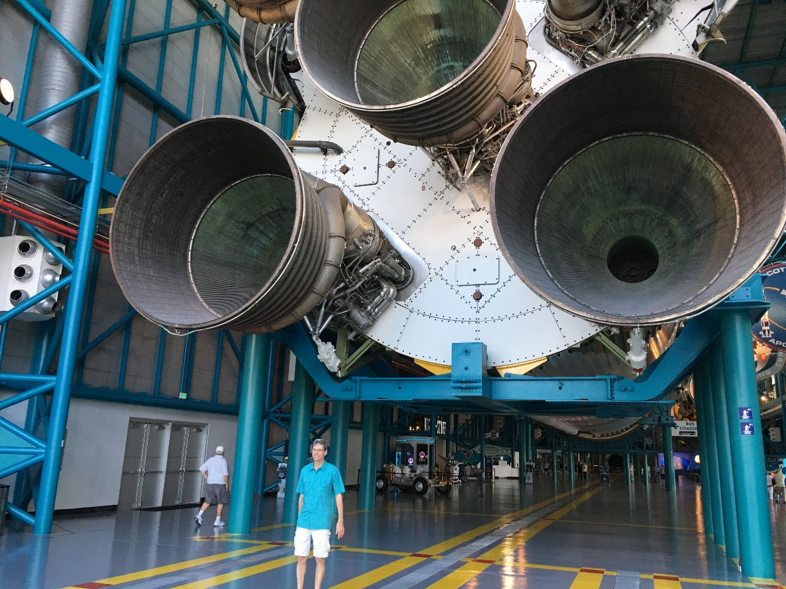
Luke 22:47-62
Binding

Slide 84
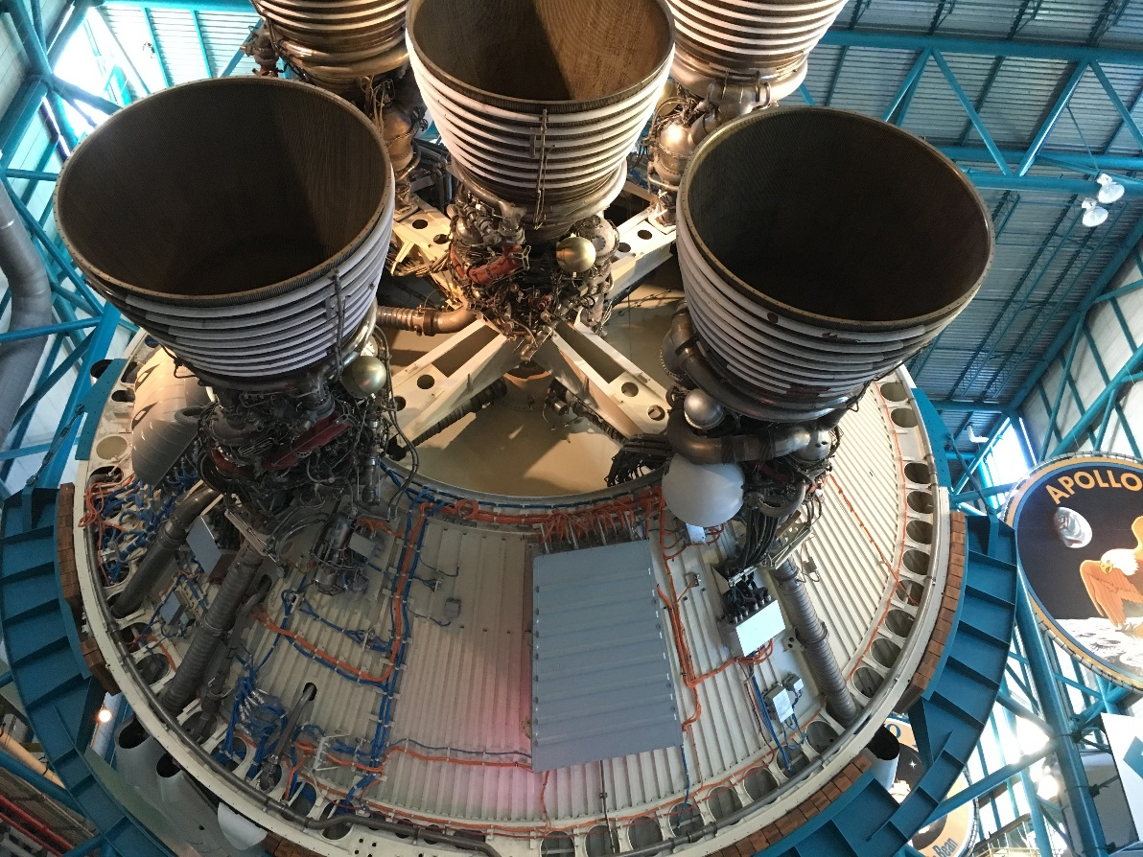
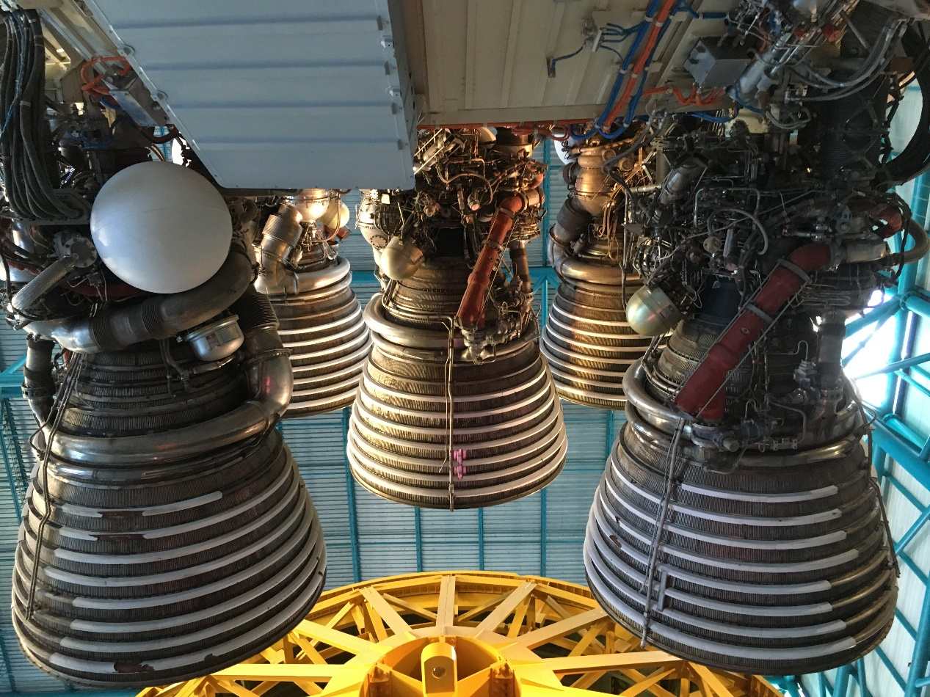
Luke 22:47-62
Binding

Slide 85
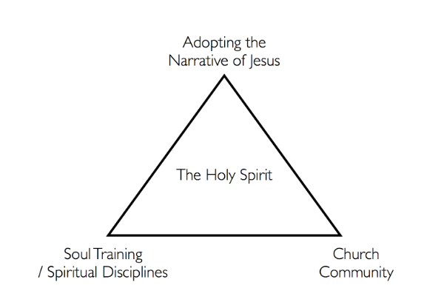
Luke 2:6-12
Before Herod
Spiritual Growth

Slide 86
Luke 2:6-12
Before Herod
What truly binds us together?
Christ died for each of us and we are redeemed, adopted into a family together
A common goal of making Christ known
A common future together
An understanding that Christ uses us together to encourage, rebuke, transform

Slide 87
Luke 23:13-25
Before Herod
Authority?
a) The ability to redeem back portions of creation towards God’s order
b) The ability to model righteousness
c) The ability to influence people towards the love of God
d) The ability tot treat all people, even the oppressed, as valued

Slide 88
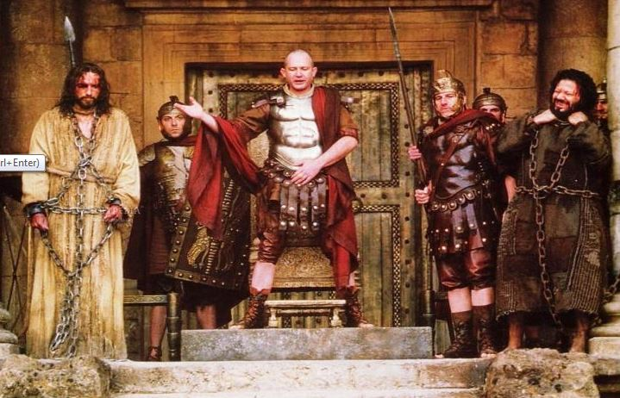
Luke 23:13-25
Before Herod
Barabbas?

Slide 89
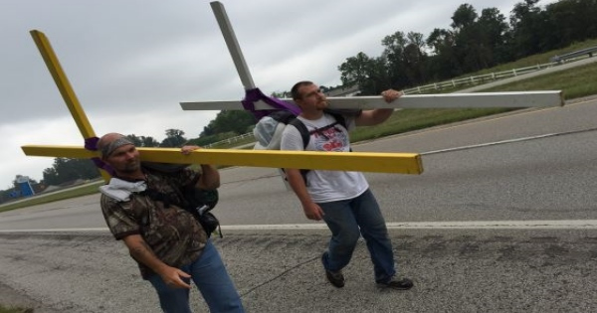
Luke 23:13-25
Carrying my cross?
What it does NOT mean
- that there is some burden that I am required to suffer with
In the first century, this phrase had only one meaning
- You were about to die.
- I surrender my life, plans, dreams to Christ
- The call is tough, the rewards are without measure

Slide 90
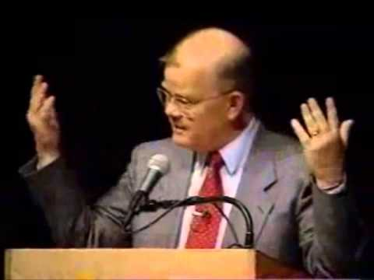
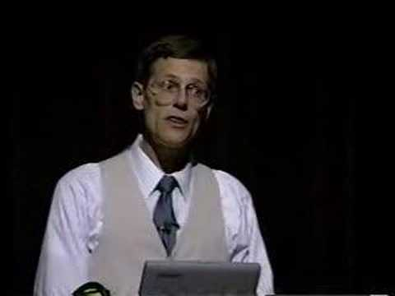
Phil Johnson
William Provine
Who made absolute truth claims?
Can you really have a robust ethic outside of divinity?
Did Williamson Provine try to convince you?
- Why is this counter intuitive to his argument?

Slide 91
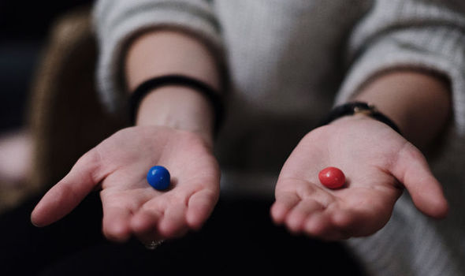
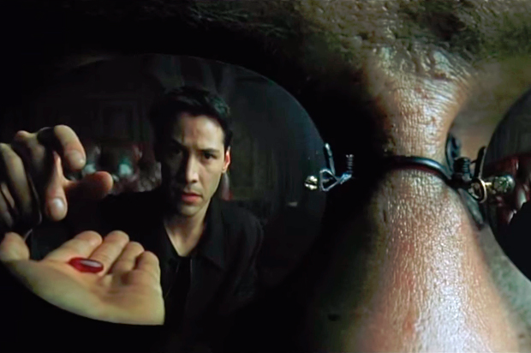
Free Will?
Does it exist?

Slide 92
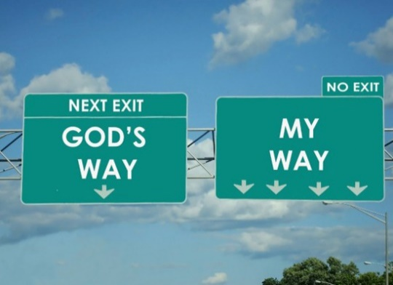
The Principle of Reaping
and Sowing

Slide 93
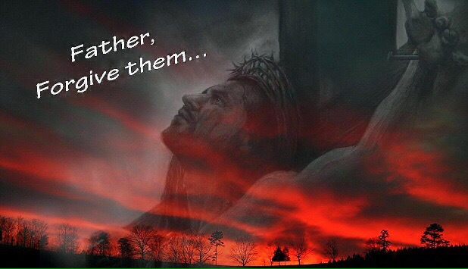
Luke 23:13-25
1) Father, forgive them for they do not know what they are doing
2) I tell you the truth. Today you will be with me in paradise.
3) Father, into your hands to I commit my spirit.
4) Dear woman, here is your son. Here is your mother (John 19:26-27)
5) I am thirsty (John 19:28) … see Psalm 69:21
6) It is finished (John 19:30)
7) My God, my God, why have you forsaken me (Matt. 27:46)

Slide 94
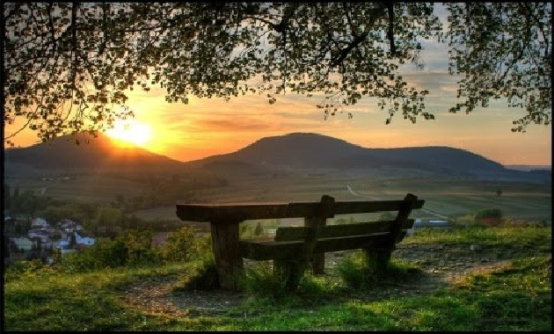
Luke 23:13-25
General Reflections For Us On Death
1) Being ready to die well
- how we each view and handle death speaks to the next generation
powerfully. I want to be ready and to have a heart at ease with all
- No unfinished business
2) As a Christian, I must view death as a path, a door, a transition
3) Trust in the will of the Lord. It is often not easy nor painless,
but trustworthy.

Slide 95
Luke 23:13-25
4) How do we help others face the losses in their own lives?
- Death of a parent - Death of a sibling
- Loss of a friend - Death of a pet
What do we do?
Remember that about 2-3 months after a loss is most critical.
Get people to talk about their grief and be willing to let them express it.
They may be angry, they may cry … get comfortable with it.
Talk about/ask questions about the past. Do not avoid talking to them
about the lost person.
They do not need sermon.
Also remember the
practical … loss typically
can last for 2 years
(or more).
They may need help
making decisions …
especially financial ones
Help them to not make
crucial decisions for the
next year, if possible.

Slide 96
Luke 23:13-25
5) Making people comfortable at death
- See Proverbs 31:4-7
6) Reminds me that there is something that the Lord wants me to do
and to become. Death does not end that process, but it is clear that there
is a part in this life that does come to an end.
7) Reminds me that ALL through my life, there is a need for those to
speak truth into my hearts because in the stressors of living, I too can
forget or become confused. I need people around me to help me
remember truth. This is the day to continue to build meaningful
relationships where you can.

Slide 97
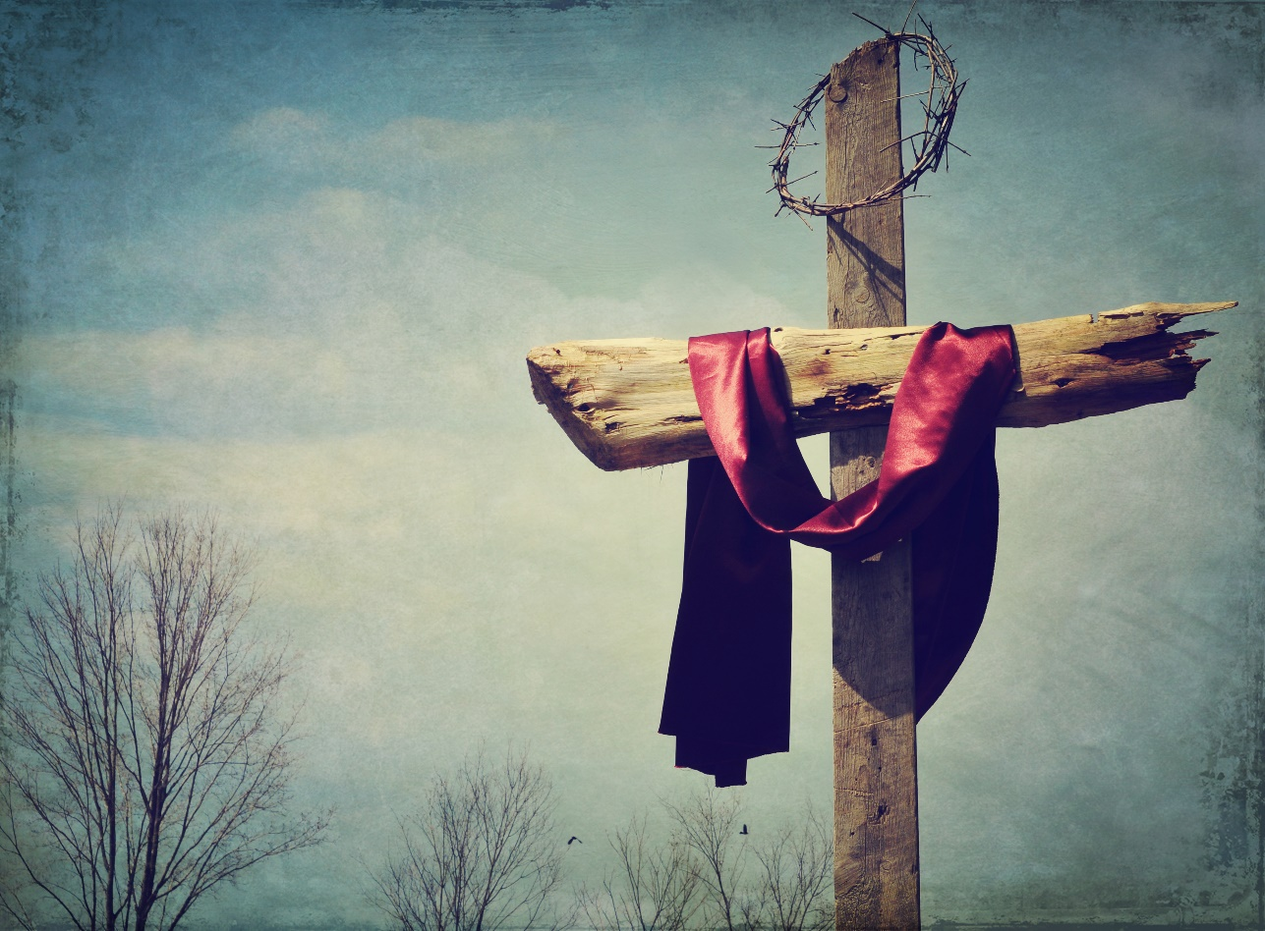
Luke 23:13-25
Ways of looking at the cross:
1) Ransom
2) Substitutionary
3) Propitiation (satisfying the justice of God)
4) The lifting up of Jesus (and the lowering of Satan)
5) It is the sacrifice that causes to cease all other sacrifices for sin

Slide 98
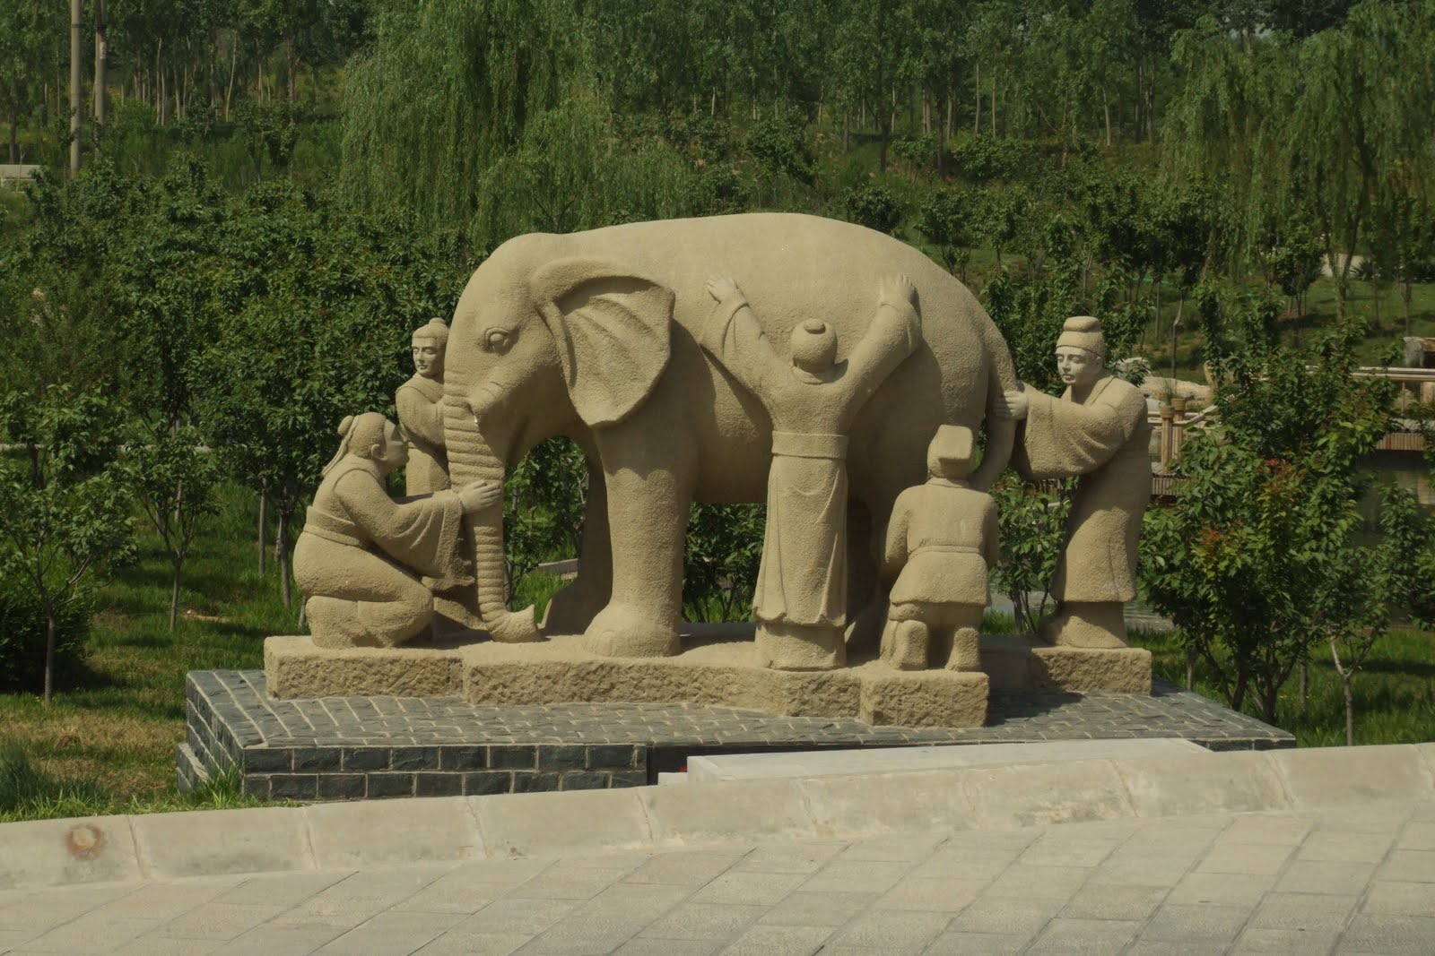
Luke 23:13-25
Often times, we can ALL observe the SAME facts
and arrive at DIFFERENT conclusions

Slide 99
First Century Tombs

Slide 100
Luke 23:13-25
On The Road To Emmaus
The journey from Jerusalem vv. 14-15
Appearance … Obstructed eyes v. 16
Interaction vv. 17-18
Summary of things vv. 19-21
Empty tomb and vision vv. 22-23a
Jesus is ALIVE v. 23b
Empty tomb but no vision v. 24
Interpretation of "the things" vv. 25-27
Interaction vv. 28-30
Opened eyes, Recognition vv. 31-32
The journey to Jerusalem vv. 33-35

