Slide 2
The Beginnings Of The Life Of Jesus
1:1-4 The introduction of the book.
1:5-25 The birth of John the Baptist is foretold
1:26-45 The birth of Jesus is foretold.
1:45-56 The song of praise that Mary dictates. This is similar to Hannah’s song.
1:57-80 The birth of John the Baptist, with Zachariah’s prophecy
2:1-3 Enrollment of Quirinius
2:4-20 The birth of Christ
2:21-38 Jesus is circumcised and presented to the priest Simeon. Anna also speaks.
2:39-52 The boyhood of Jesus; the visit to Jerusalem when He was twelve.
The Preparation For Ministry
3:1-14 The ministry of John the Baptist.
3:15-20 John testifies about the coming Christ.
3:21-22 The baptism of Jesus
3:23-38 The genealogy of Jesus
4:1-12 The temptation of Jesus
4:13 Satan is defeated and leaves temporarily.

Slide 3
The Galilean Ministry Begins
4:14-15 The beginning of His ministry.
4:16-30 Jesus is rejected at Nazareth, His home town. Note that He quotes from Isa. 61:1-2.
4:31-37 The demoniac is healed.
4:38-44 Peter’s mother-in-law is healed.
5:1-11 The call of Peter, James and John.
5:12-26 The leper and the paralytic are healed.
5:27-29 The call of Levi (also called Matthew)
5:30-39 The Pharisees and scribes attack: Jesus answers.
6:1-11 Jesus deals with the question of the Sabbath by healing an atrophied hand.
6:12-19 Jesus prays all night - then chooses the twelve.
6:20-49 Another teaching of the Beatitudes (similar to Matthew 5-7).
7:1-10 The Centurion’s servant is healed.
7:11-18 The widow’s son is raised from the dead
at Nain.
7:19-35 Jesus testifies about John the Baptist.
7:36-50 Jesus is anointed by the sinful woman.

Slide 4
8:1-3 The women who ministered to Christ are listed.
8:4-15 The parable of the sower
8:16-18 The parable of the lighted candle.
8:19-21 The new relationship is defined.
8:22-25 Jesus stills the storm
8:26-39 The demoniac of Gadara is healed
8:40-56 A woman is healed and Jarius’s daughter is raised from the dead.
9:1-9 The twelve are sent out to minister on their own (and are given power)
9:10-17 The feeding of the 5000.
9:18-26 The confession of Peter
9:27-36 The transfiguration of Jesus before the disciples.
9:37-50 Why the disciples had no power: Jesus again casts of the demon.

Slide 5
On The Way To Jerusalem
9:51-62 Jesus now turns towards Jerusalem (and the cross).
10:1-24 The seventy disciples are sent out to minister.
10:25-29 The lawyer asks, “Who is my neighbour”?
10:30-37 The good Samaritan story.
10:38-42 The contrasts between Mary and Martha.
11:1 Jesus praying.
11:2-4 Jesus’ instructions on prayer.
11:5-13 A parable on prayer
11:14-28 Jesus teaches on Demonism
11:29-32 The sign of Jonah
11:33-38 The parable of the candle.
11:39-44 The Pharisees are denounced.
11:45-54 The lawyers are denounced.
12:1-12 The warning about false doctrine.
12:13-34 The warnings against greediness.
12:35-48 The warning about watching for
the second coming.
12:49-59 Christ “divides” people.

Slide 6
13:1-5 Jesus teaches on repentance and being ready.
13:6-9 The barren fig tree (this represents Israel).
13:10-17 The healing of another woman.
13:18-21 The parables of the mustard seed and leaven.
13:22-30 How many will be saved?
13:31-33 Jesus warns about Herod.
13:34-35 Jesus weeps over Jerusalem
14:1-6 The healing on the Sabbath.
14:7-15 The parable of the over-zealous guest.
14:16-24 The parable of the great supper.
14:25-35 The cost of discipleship.
15:1-7 The parable of the lost sheep.
15:8-10 The parable of the lost coin.
15:11-32 The parable of the lost (prodigal) son.
16:1-18 The parable of the dishonest steward.
16:19-31 The story (not parable) of the rich man
and Lazarus.
17:1-10 The teaching on forgiveness and service.
17:11-19 The cleansing of the ten lepers.
17:20-37 The question of “when the Kingdom of God”
should come.

Slide 7
18:1-8 The parable of the Unjust Judge.
18:9-14 The parable of the Pharisee and the Publican.
18:15-17 Jesus blesses the little children.
18:18-30 The story of the rich young ruler.
18:31-34 Jesus predicts His death.
18:35-43 Jesus heals the blind man near Jericho.
19:1-10 The conversion of Zacchaeus.
19:11-27 The parable of the pounds.
19:28-40 The triumphal entry into Jerusalem.
19:41-44 Jesus weeps over Jerusalem.
19:45-48 Again, Jesus cleanses the Temple court.
Temple Teachings
20:1-8 The authority of Jesus is questioned.
20:9-18 The parable of the vineyard.
20:19-26 The question about tax money.
20:27-38 The Sadducees are silenced.
20:39-47 The scribes are interrogated.
21:1-4 Jesus observes the widow’s mite offering.
21:5-38 Jesus discusses the end-times issues.

Slide 8
The Suffering And Resurrection Of The Lord
22:1-2 The plot to kill Jesus
22:3-6 The treachery of Judas
22:7-13 The preparations for the Passover.
22:14-18 The last Passover.
22:19-20 The Lord’s supper is instituted.
22:21-23 The announcement of the betrayal.
22:24-30 The Apostle’s place in the future kingdom.
22:31-34 Jesus predicts Peter’s denial.
22:35-38 Jesus predicts future conflicts.
22:39-46 Jesus prays in the Garden of Gethsemane.
22:47-53 Jesus is betrayed.
22:54-65 Jesus is arrested
22:66 - 23:26 The various trials
23:27-38 The crucifixion
23:39-45 The thief that repents.
23:46-49 The death of Christ.
23:50-56 The burial of Christ
24:1-12 The resurrection of Christ
24:13-35 Jesus appears to the disciples on the
road to Emmaus
24:36-43 Jesus appears to the eleven.
24:44-49 Jesus gives the great commission.
24:50-53 The ascension of Christ

Slide 9
Lost And Found
Luke 15:1-32
Idea | The Lost Sheep | The Lost Coin | The Lost Son
Increasing value | 1 in a hundred | 1 in ten | 1 in two
Focus (increasing surprise) | On a man | On a woman | On a family
Increasing response | Rejoicing in heaven | Angels rejoice | Father rejoices
Increasing Effort | Seeks the sheep | Sweeps, lamp, careful | Seeking greatly
Final Disposition | Rejoice with friends | Rejoice with friends | Huge banquet
It is interesting to note that the first parable
involves a sheep and the second involves money.
The third involves wasted money and ends with
the killing of a fatted calf.
WHY?

Slide 10
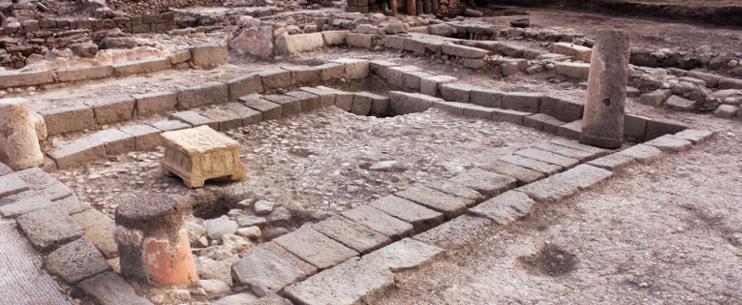
Lost And Found
Luke 15:1-32
First century floor of a synagogue in Magdala
WHY?

Slide 11
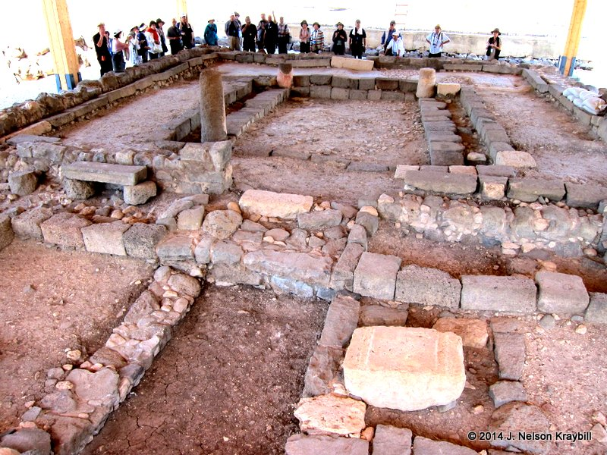
Lost And Found
Luke 15:1-32
WHY?
First century floor of a synagogue in Magdala

Slide 12
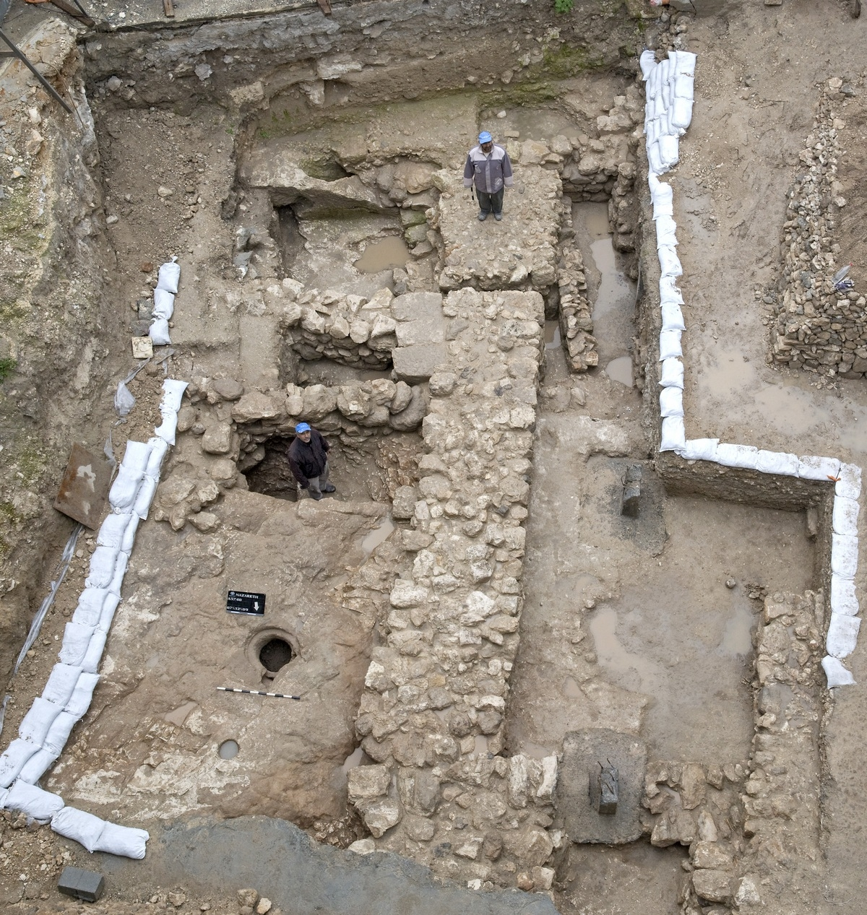
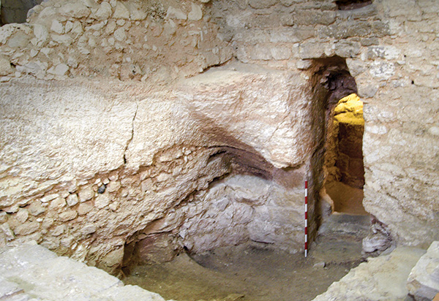
Lost And Found
Luke 15:1-32
WHY?
Excavation of a first century home in Nazareth

Slide 13
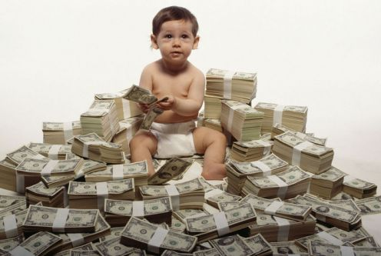
Lost And Found
Luke 15:1-32
Judaism had advice about this kind of a request. Sirach 33:19 – 23 begins with the
statement: “To son or wife, to brother or friend, give no power over yourself while
you live; and give not your goods to another so as to have to ask for them again.”
To distribute the estate too soon was to risk having to fall into another’s care.
Nevertheless, the father in the parable grants the request. This detail pictures a
father who is letting a sinner go his own way.
WHY?

Slide 14
What do you value most?
Luke 15:1-32
WHY?

Slide 15
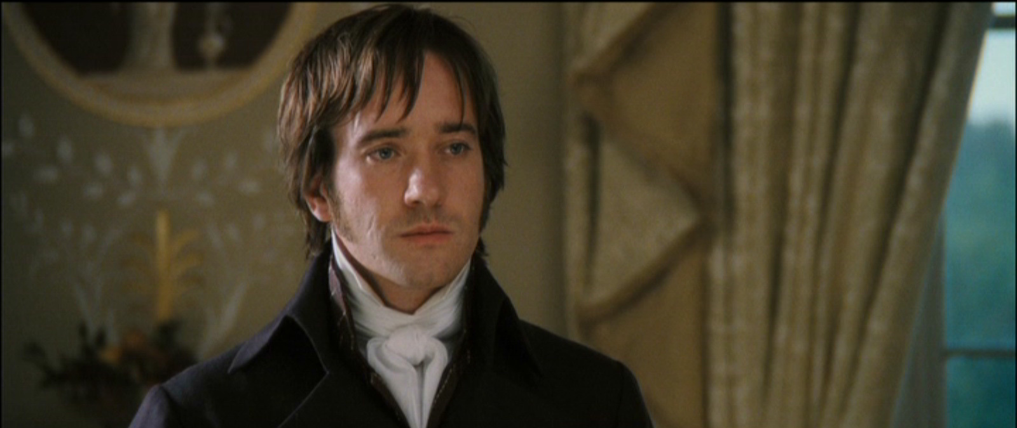
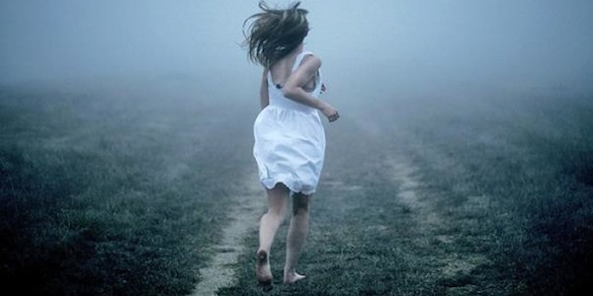
Am I running from … or standing aloof?
Luke 15:1-32
WHY?

Slide 16
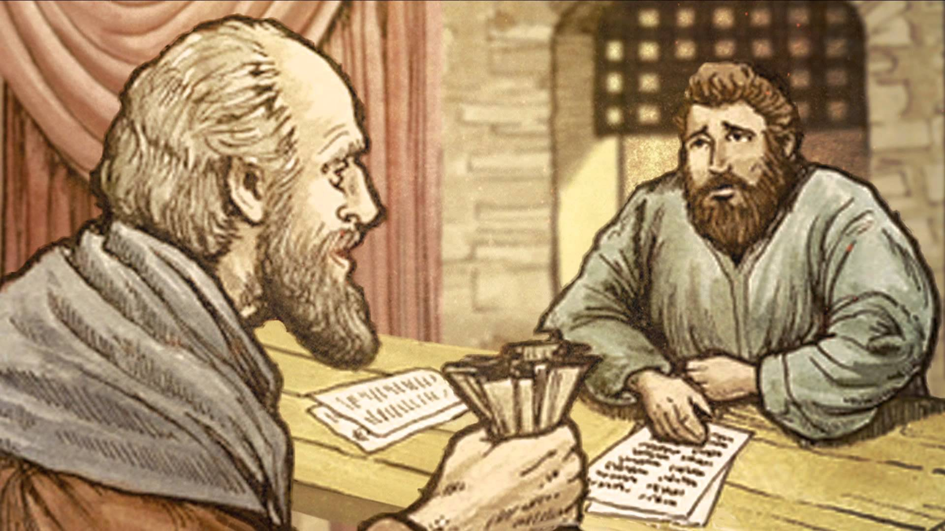
Dishonest Steward
Luke 16:1-9
WHY?

Slide 17
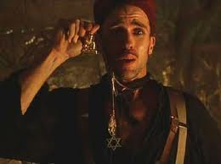
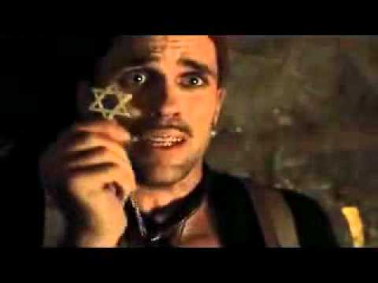
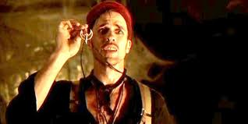
Doing What It Takes To Survive
Luke 16:1-9
Beni’s Collection Of Idols
He uses: A Christian cross, an Islamic crescent
moon and sword, a Buddha, and a Jewish Star of David

Slide 18
Serving who?
Luke 16:10-14
It is interesting that God links the way we handle little with the way we handle much.
Size does not indicate the level of integrity. Little things matter
WHY?

Slide 19
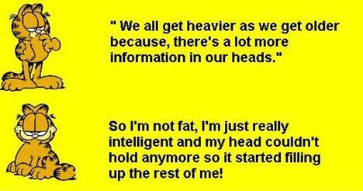
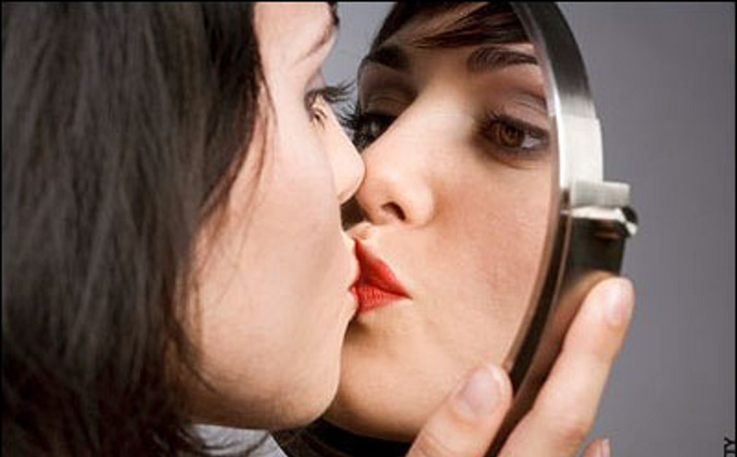
Self Justification
Luke 16:10-14
- Who am I trying to please?
- Will I invite Christ to examine me and my motives?
Can I see another perspective
(especially a Biblical one)?
- Do I always have to be right?
- Does grace flow freely from me?
WHY?

Slide 20
Luke 16:19-30
A Trilogy ...
The Prodigal Son wastes his dad's possessions (Luke 15: 11-32)
The Unjust Steward wastes his master's possessions (16:1-12)
No servant can serve two masters. Either he will hate the one and love the other, or he will be devoted to the one and despise the other. You cannot serve both God and Money.“ (Luke 16:13)

Slide 21
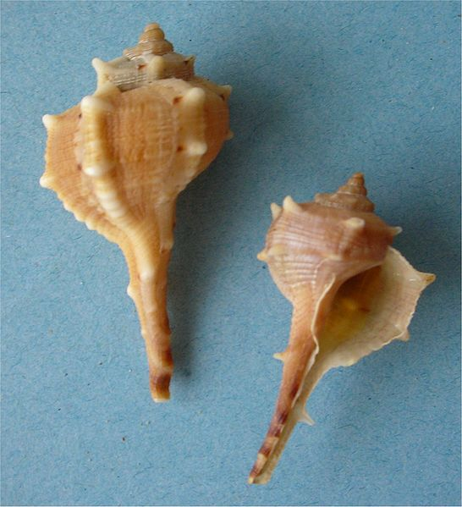
3) The Rich Man wastes his life
Luke 16:19-30
Murex
(Rock Snail)
"There was a rich man who was dressed in purple and fine linen and
lived in luxury every day. At his gate was laid a beggar named Lazarus, covered with sores and longing to eat what fell from the rich man’s table. Even the dogs came and licked his sores. (Luke 16:19-21)

Slide 22
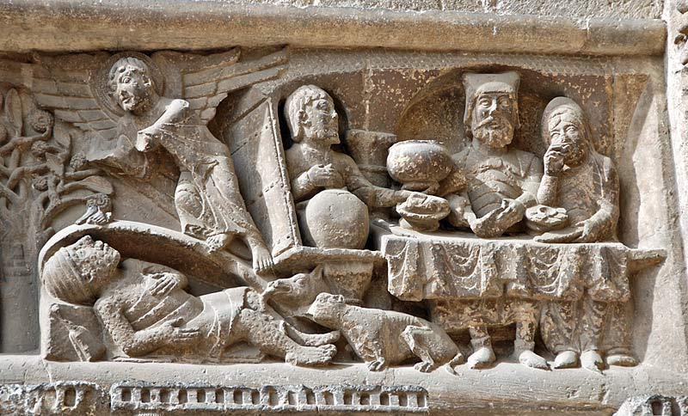
Luke 16:19-30

Slide 23
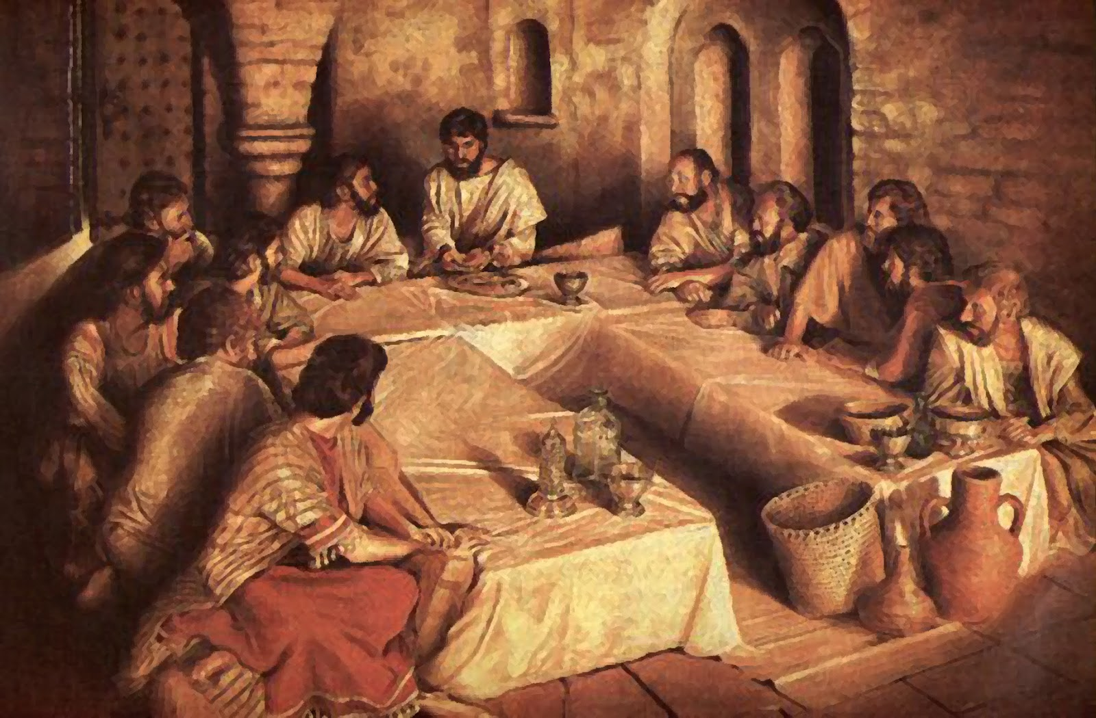
Luke 16:19-30
The Triclinium

Slide 24
Luke 16:19-30

Slide 25
Luke 16:19-30

Slide 26
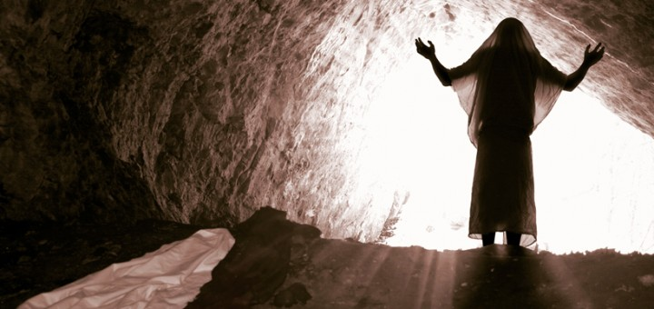
Luke 16:19-30
Interesting Questions From The Text:
Are miracles enough to sustain a life time of faith?
What "close by" person is God calling me to love?
Do I make my resources count for the Kingdom?
Is there a reservoir of anger or peace inside of me? What am I adding to the tank?
Can I ask the Lord to move me towards possessing a forgiving spirit?
- Lazarus' silence is impressive to me!
How important is community to me?
How do I sense or see divine help in my life?
Do I flirt with racial pride?
Does wealth = blessing?

Slide 27
Luke 17:1-10
Acts 11:19 ¶ Now those who had been scattered by the persecution in connection with Stephen travelled as far as Phoenicia, Cyprus and Antioch, telling the message only to Jews.
20 Some of them, however, men from Cyprus and Cyrene, went to Antioch and began to speak to Greeks also, telling them the good news about the Lord Jesus.
21 The Lord’s hand was with them, and a great number of people believed and turned to the Lord.
22 News of this reached the ears of the church at Jerusalem, and they sent Barnabas to Antioch.
23 When he arrived and saw the evidence of the grace of God, he was glad and encouraged them all to remain true to the Lord with all their hearts.
24 He was a good man, full of the Holy Spirit and faith, and a great number of people were brought to the Lord.
Galatian 2:11 ¶ When Peter came to Antioch, I opposed him to his face, because he was clearly in the wrong.
12 Before certain men came from James, he used to eat with the Gentiles. But when they arrived, he began to draw back and separate himself from the Gentiles because he was afraid of those who belonged to the circumcision group.
13 The other Jews joined him in his hypocrisy, so that by their hypocrisy even Barnabas was led astray.
14 When I saw that they were not acting in line with the truth of the gospel, I said to Peter in front of them all, "You are a Jew, yet you live like a Gentile and not like a Jew. How is it, then, that you force Gentiles to follow Jewish customs?
15 "We who are Jews by birth and not ‘Gentile sinners’
16 know that a man is not justified by observing the law, but by faith in Jesus Christ. So we, too, have put our faith in Christ Jesus that we may be justified by faith in Christ and not by observing the law, because by observing the law no-one will be justified.

Slide 28
www.williamsonit.ca/ss

Slide 29
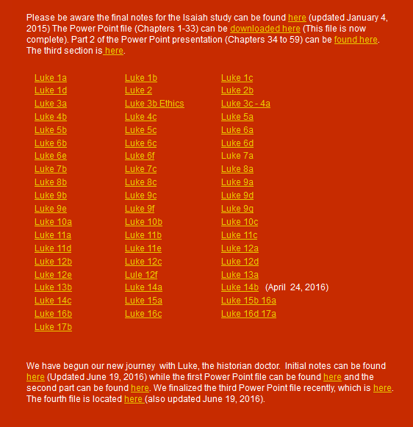
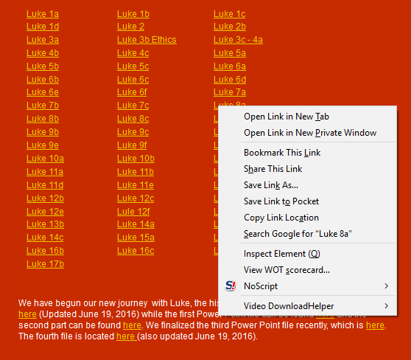
www.williamsonit.ca/ss

Slide 30
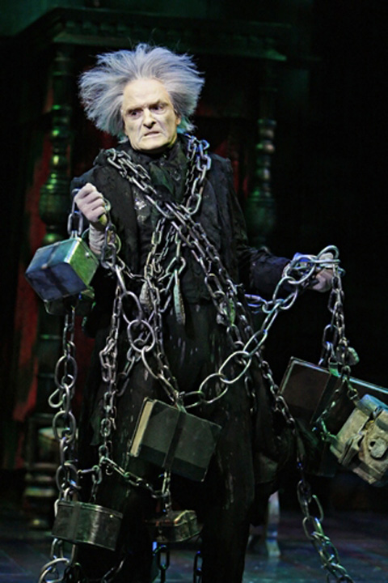
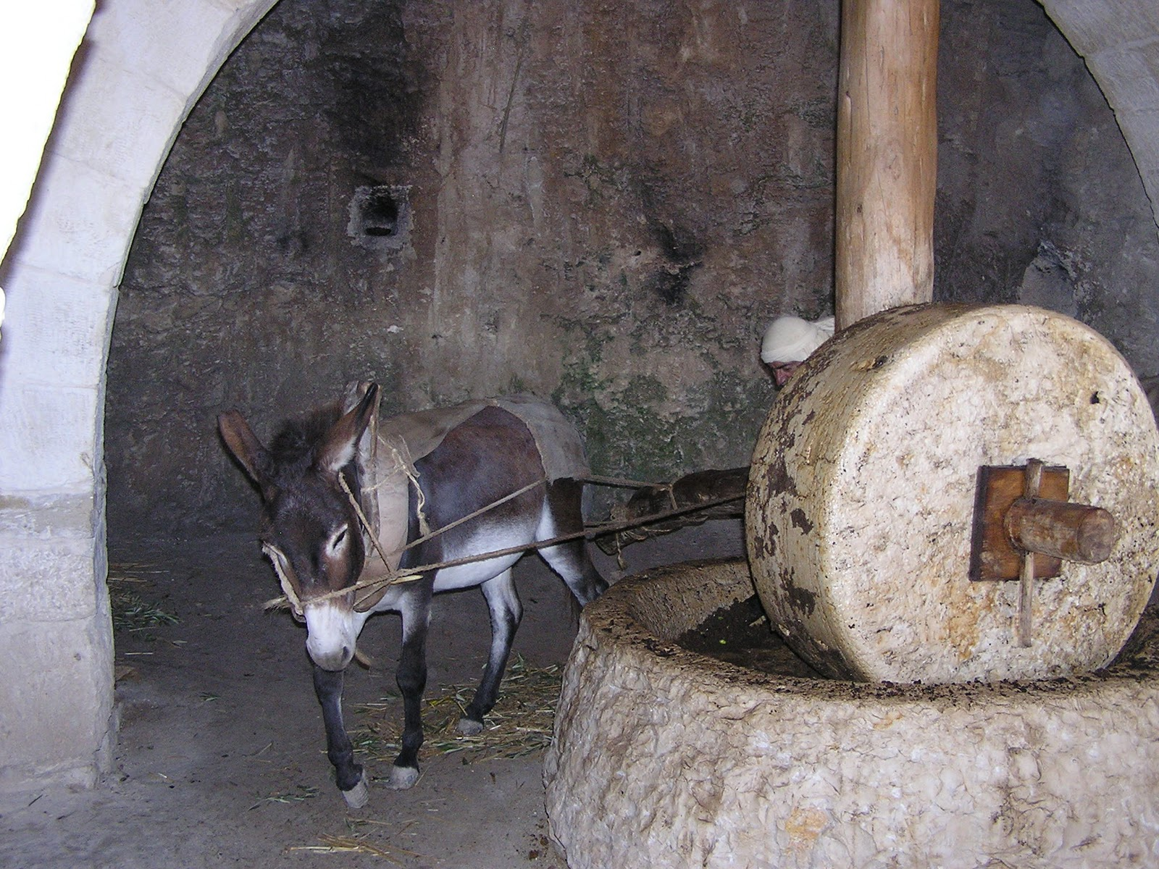
Luke 17:1-10

Slide 31
Luke 17:1-10

Slide 32
Luke 17:1-10
When you must have this kind of conversation …
What is the real goal? What do I want for me, the other person and the relationship?
When others move to silence (withdrawing, masking, avoiding) or violence (controlling,
labeling, verbal attacking), these are signs that others don't feel safe. Learn to look for
silence or violence - signs that safety is at risk. When crucial conversations turn ugly, the
problem is not too much candor, it's too little safety. With enough safety, you can talk
about anything.
People don't get defensive because of the content of what you're saying.
They get defensive because of the intent they perceive behind it. When others become
defensive, stop talking about the issue and clarify your purpose.
Master your own emotions
Be willing to really listen to the other person. Get
curious
Plan appropriate actions to resolve the problem.

Slide 33
Luke 17:1-10

Slide 34
Luke 17:1-10
If we put ourselves out there and love with our whole hearts, we ARE going to experience
heartbreak.
When I hurt, I often tell myself a story about the situation. My version of the story allows
me to be the victim and the hero and often ends with me getting my just reward. The truth
problem: My version of the story is almost always a lie.
Vulnerability, can lead to hurt. As a result, we turn to self-protection- choosing certainty
over curiosity, armour over vulnerability, knowing over learning.
Often when I am angry, I am really hurt, feeling uncomfortable, vulnerable and even shame.
Often, we make up the story that we are unlovable … unworthy of love. This is perhaps
the most dangerous lie of all.
Healing begins when I exhaust every comfortable way of solving my problem, finally giving
into truth and owning my story. Seeking God to intervene.
Brene Brown, "Rising Strong"

Slide 35
Luke 17:1-10
Forgiveness: I desire to give up my right to hurt you for hurting me.
Who do I need to forgive?
a) My parents?
b) My friends and acquaintances?
c) Church leaders (youth pastors), teachers?
d) Myself?
e) God?
It does not mean that they are “off
the hook”. Just that they are now
on God’s hook and not yours.
You are asking God to take control
and you relinquish it. You want His
best for them.

Slide 36
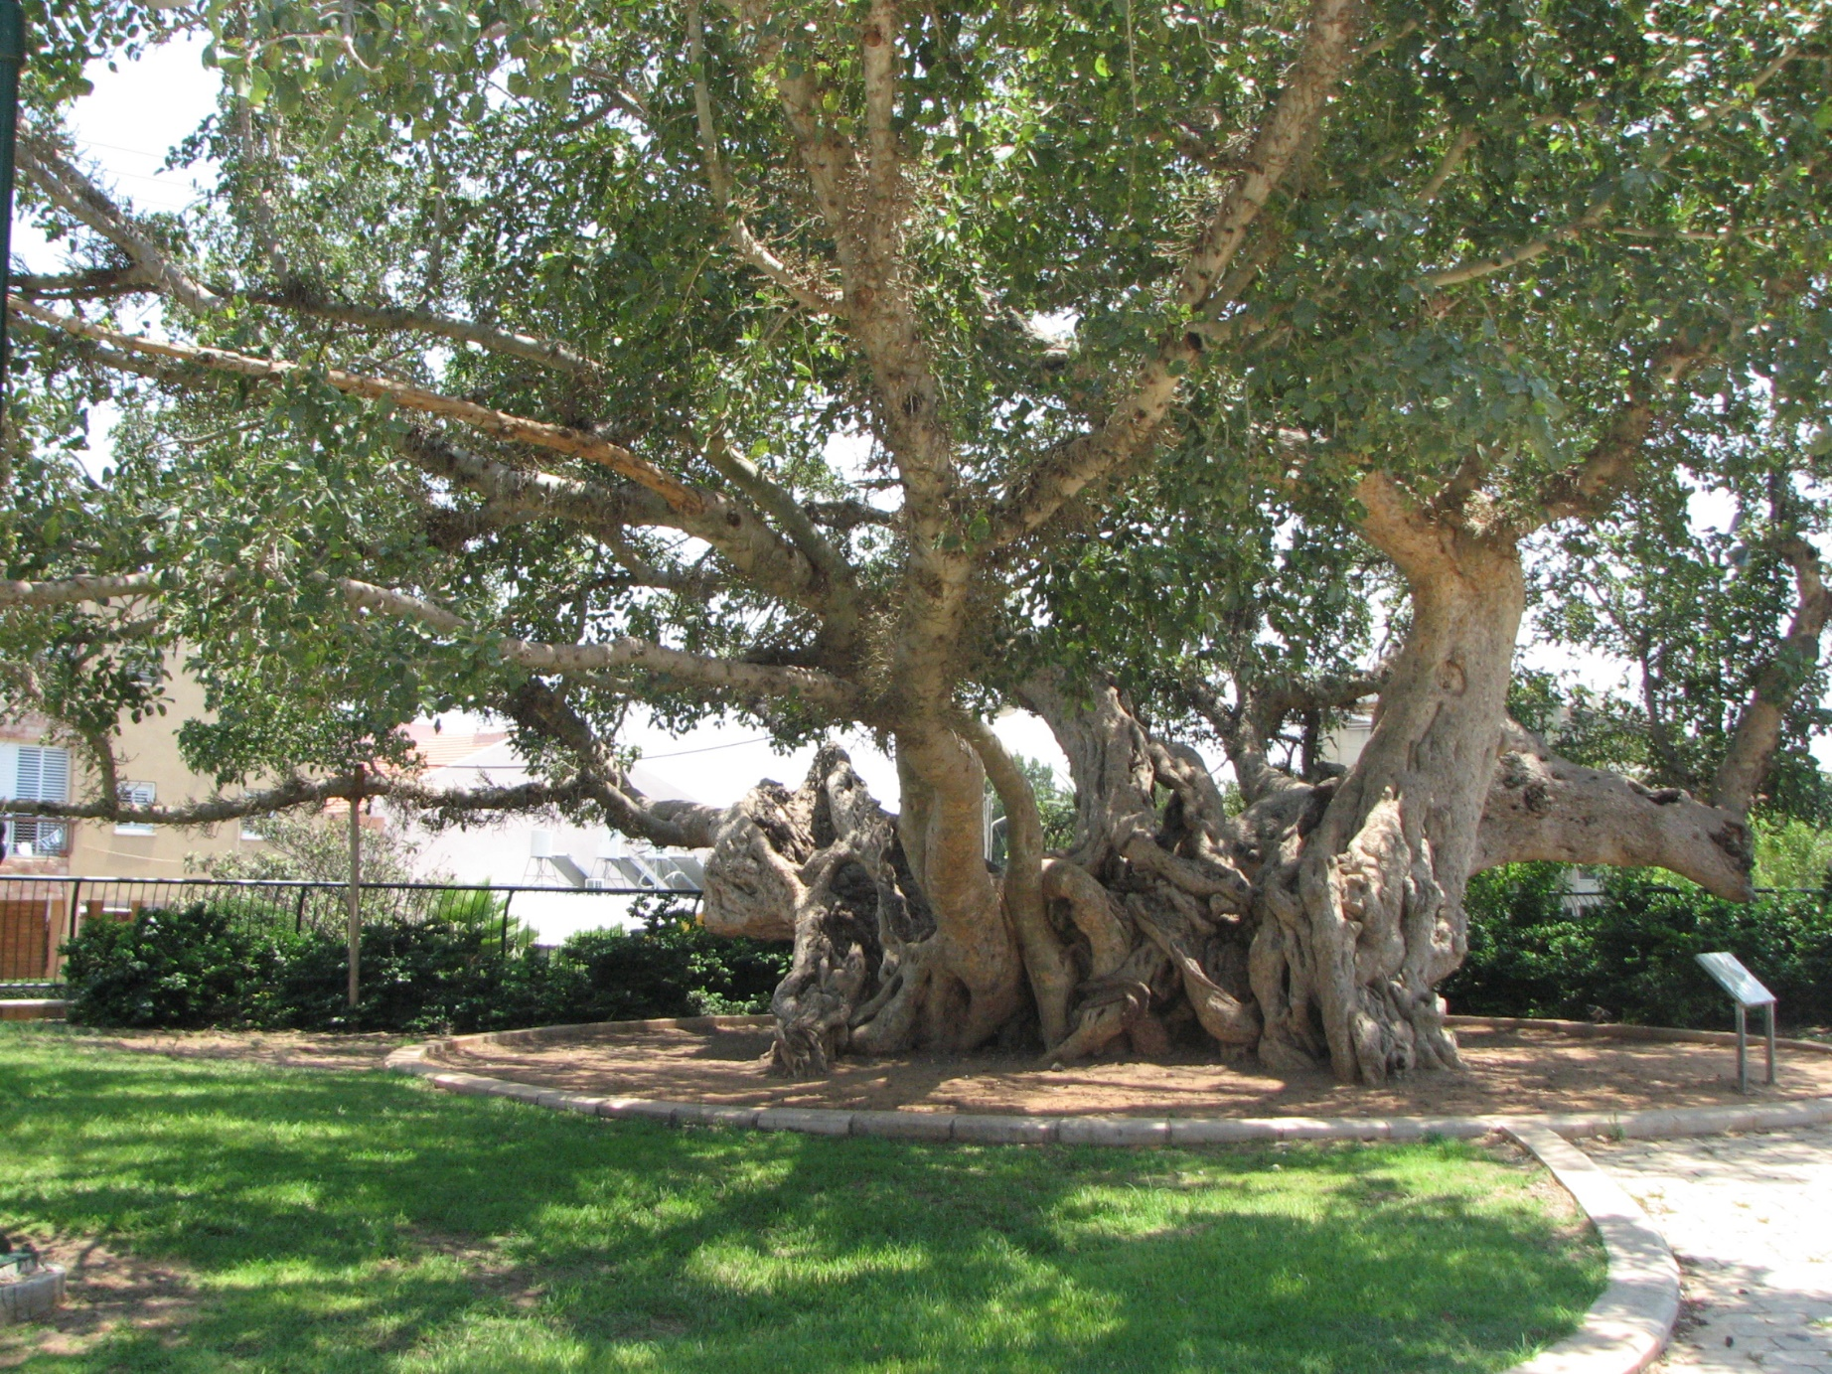
Sycamore Garden in Netanya –
Thousand year old sycamore tree
Luke 17:6

Slide 37
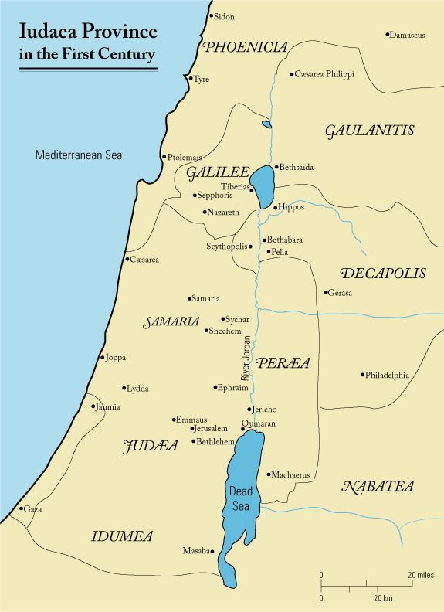
Luke 17:11-19

Slide 38
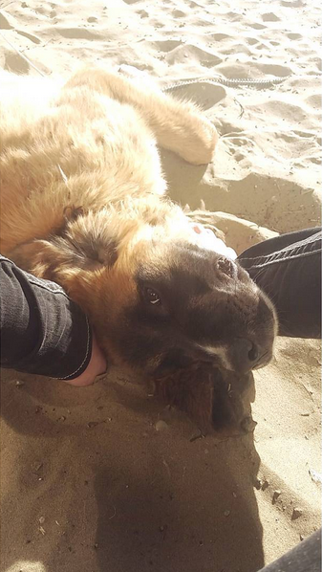
Luke 17:11-19
Roots Of Thankfulness
God is
God is imminent
God cares
God moves on my behalf
God's gifts often APPEAR small
or not important
- but are huge
God's gifts appear ill-timed
- But are not
God's gifts produce fruit

Slide 39
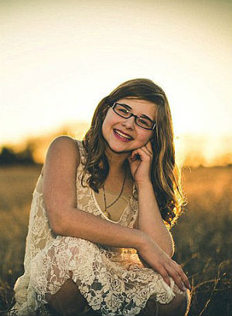
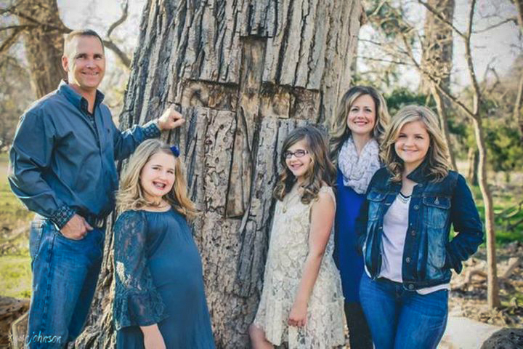
Luke 17:11-19
Annabel Beam was five years old she was diagnosed with two rare
life-threatening digestive disorders, pseudo-obstruction motility
disorder and antral hypomotility disorder. In December 2011 (age 9),
Annabel Beam fell 30 feet headfirst down into the rotted-out trunk
of a cottonwood tree. Several hours passed before emergency
personnel were able to harness Annabel to safety. -FoxNews.com
Miracles From Heaven
Anabel Beam
Christy Beam

Slide 40
Luke 17:11-19
What is a Univocal Term?
A term that has only one meaning. That is, it signifies only one
thought, and therefore corresponds to only one definition. Words
mean the same thing even when applied in different contexts, for
example, black shoes, black hair, black car. Such a term invariably
has an equivalent import where it’s used.
What is an Equivocal Term?
A term that has a variety of different meanings. An associate equivocal
term has completely different intentions once it’s used. For instance, the
term “Chihuahua” will signify (a) a breed of dog; (b) a state of Mexico.
The term ‘bat’ could also be seen as an equivocal term. You could be talking
about a ‘cricket bat’ or a ‘flying bat’ (the animal).

Slide 41
Luke 17:11-19
Thomas Aquinas on Religious Language as Analogous
Aquinas argued that our positive talk about God is analogical, and neither
univocal or equivocal. He argues that we do not speak of God univocally,
because words when applied to God do not have the same meaning as when
they are applied to a person. He also argued that we do not speak equivocally
about God because there must be some connection of the creature and the
creator. We therefore speak about God analogically.
What is an Analogous Term?
Analogous Term: A term that is supposed to convey one or additional similar
characteristics that exist between two ideas.

Slide 42
Luke 17:20-37
The Kingdom is where the rule and reign of Christ is recognized and obeyed.
Principle #1: How far does the Kingdom of God enter into your life, your family, your
home? It is meant to be clearly evident and daily lived out.
Principle #2: The Kingdom of God is not found in a book, or place or charismatic
leader. It is not just a future thing.
Principle #3 The Kingdom cannot be manifested before the suffering of Christ.
Principle #4 People will seek the Kingdom by following humans. When Christ returns,
no one will doubt it as it will not be hidden from anyone.

Slide 43
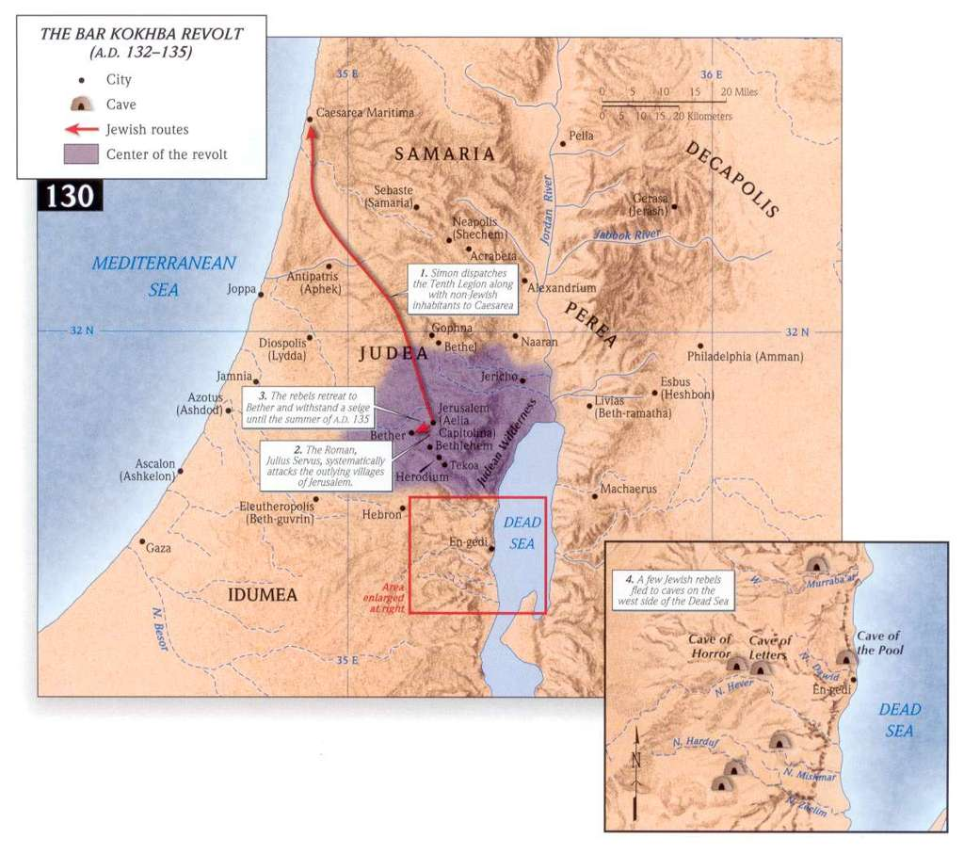
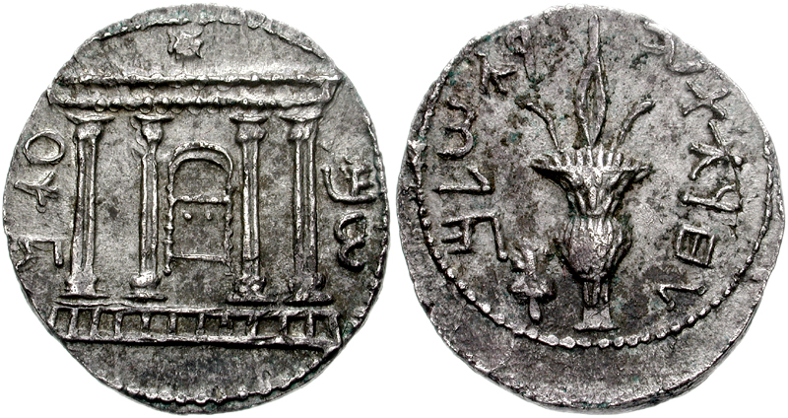
Luke 17:20-37
To The Freedom
Of Jerusalem …

Slide 44
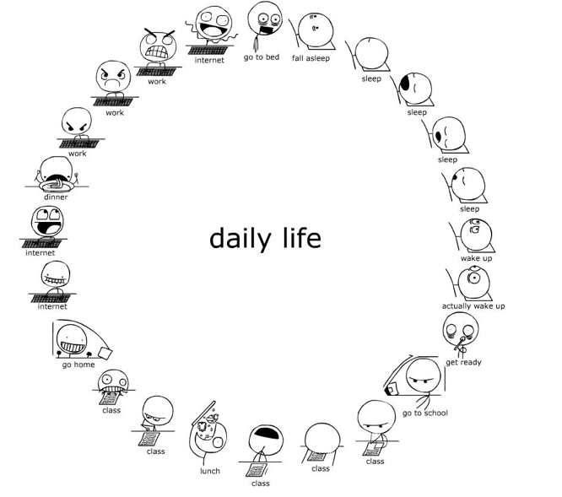
Luke 17:28-37
In life, can I maintain a specific
orientation towards God?

Slide 45
Luke 17:28-37
How should I avoid the entanglements of this world?
a) I must be a student of what motivates me, what triggers me to act in certain ways
“1Ch 12:32 men of Issachar, who understood the times and knew what Israel should do—”
- What drove me to Friday night walks?
- When I am tired, do I want to buy something to help me feel better?
- Do I need the approval of others to feel good about myself?
b) I must chose to surrender those
aspects to God that He finds unsavory
Continue to surround myself and
propel myself towards those things
that bring life
WHAT ELSE??

Slide 46
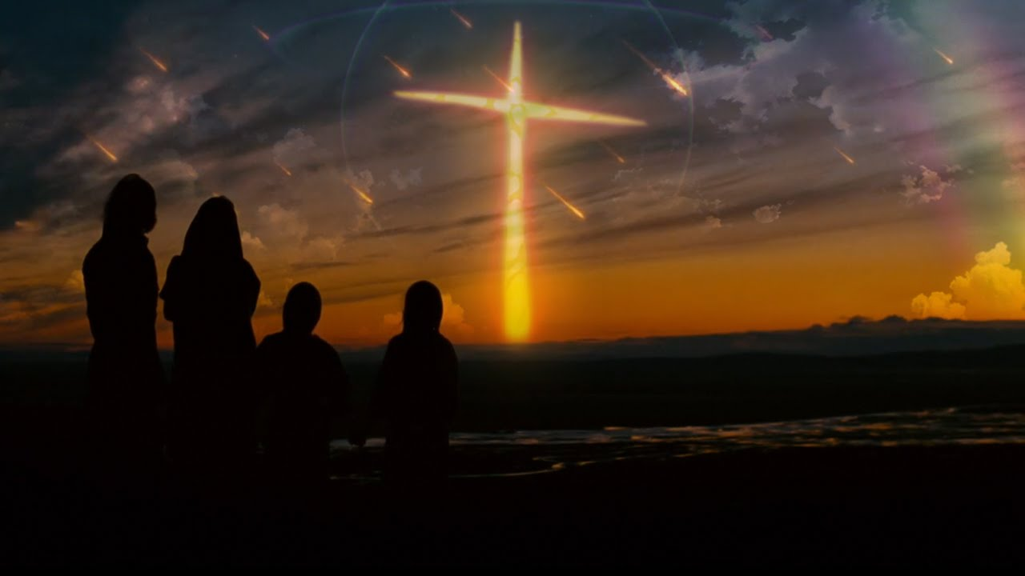
Luke 17:28-37
To what "Day" is Jesus warning us?
The "Day" is spoken of in context as when Christ is revealed
It appears to be a day in which there is a separation of that which is within the
Kingdom and that which is without.
There seems to be specific warning … don't look to the things of this world
It appears to be sudden
There could be a link here to Matthew 25 and Revelation 14
I align these events at the
bodily return of Christ, at the
end of the Battle of
Armageddon.

Slide 47
Luke 18:1-8
The Art Of Persistence

Slide 48
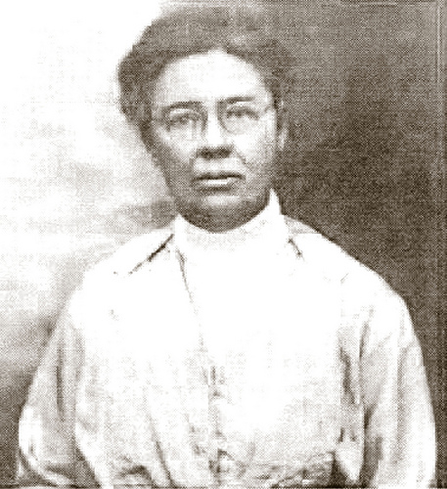
Luke 18:1-8
The Art Of Persistence
Notes:
Doctor June McCarroll … Road History

Slide 49
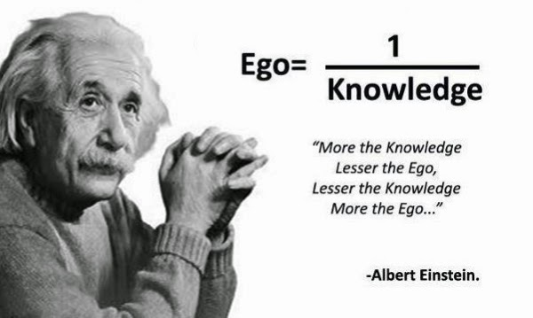
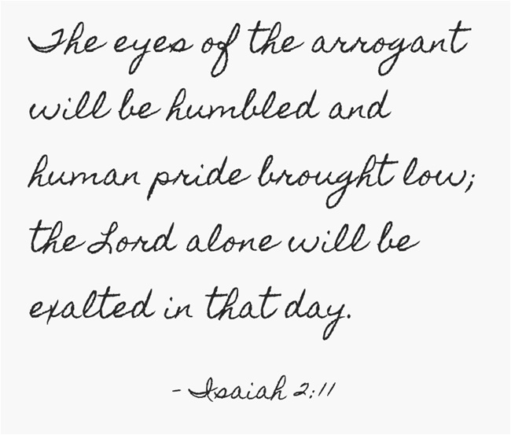
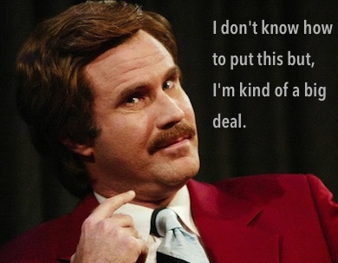
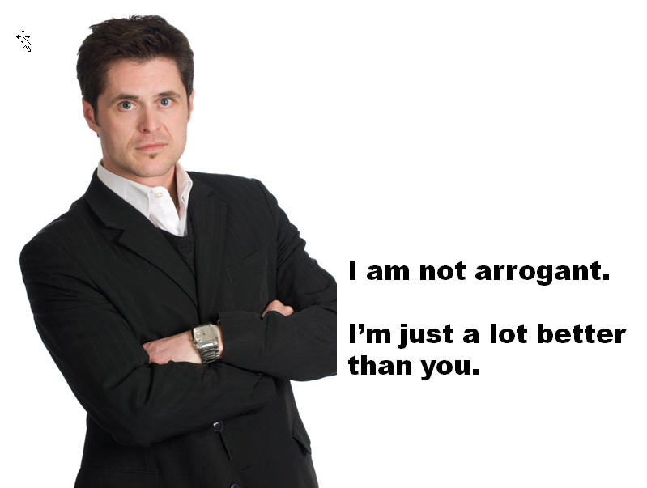
Luke 18:9-17

Slide 50
Luke 18:9-17
What does it mean to be a righteous person? In the Greek world, the word dikaios was used
of a person who was cultured, and observed customs and legal norms. This kind of person
would generally be viewed well, would obey the law and would be seen as decent.
Yet, the NT draws its understanding of the word from the OT.
“There is absolutely no concept in the Old Testament with so central a significance for
all relationships of human life as that of sadaqa (righteousness). It is the standard not only
for man’s relationship with God, but also for his relationships with others … even to his
relationship to the animals and to his natural environment.”
The righteous is not one who observes a particular
code of ethics, but rather a person or community
granted a special relationship of acceptance in the
presence of God. That relationship is maintained by
acting in loyalty to the giver of the unearned status.
God’s righteousness means His saving acts in history.
Kenneth Baily

Slide 51
Luke 18:9-17
Micah 6:3-5,8 "My people, what have I done to you? How have I burdened you? Answer me.
I brought you up out of Egypt and redeemed you from the land of slavery. I sent Moses to
lead you, also Aaron and Miriam. My people, remember what Balak king of Moab
counselled and what Balaam son of Beor answered. Remember your journey from
Shittim to Gilgal, that you may know the righteous acts of the LORD."
He has showed you, O man, what is good. And what does the LORD require of you?
To act justly and to love mercy and to walk humbly with your God.

Slide 52
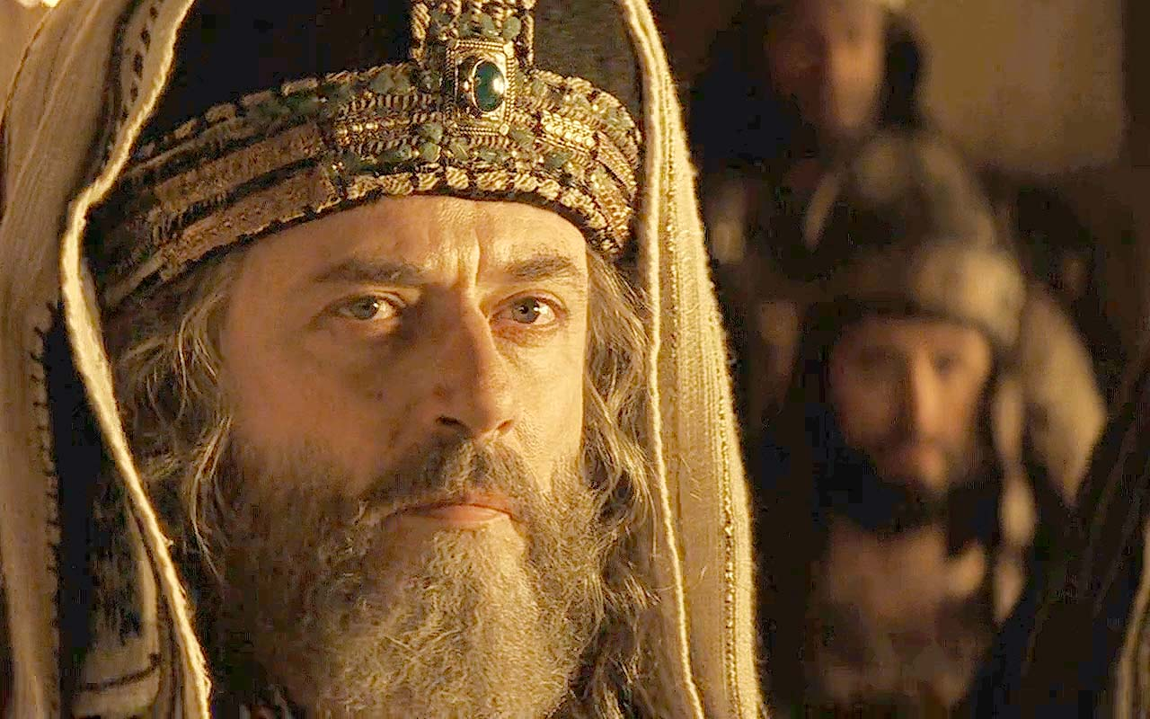
Luke 18:9-17
Self-righteousness distorts my vison of myself, my God and my neighbour!

Slide 53
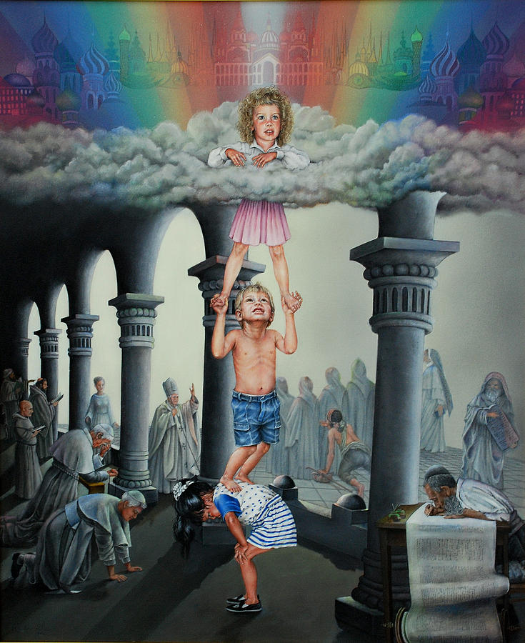
Luke 18:15-17
Faith Like A Child
When was the last time you
took a step of faith?

Slide 54
Luke 18:18-30

Slide 55
Luke 18:18-30
The Ten Commandments
Do not commit adultery
Do not murder
Do not steal
Do not give false testimony
Honor your father and mother
No other gods before me
No idols
Not take the Lord's name in vain
Remember the Sabbath
Towards people
Towards God
Do not covet

Slide 56
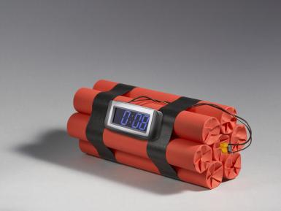
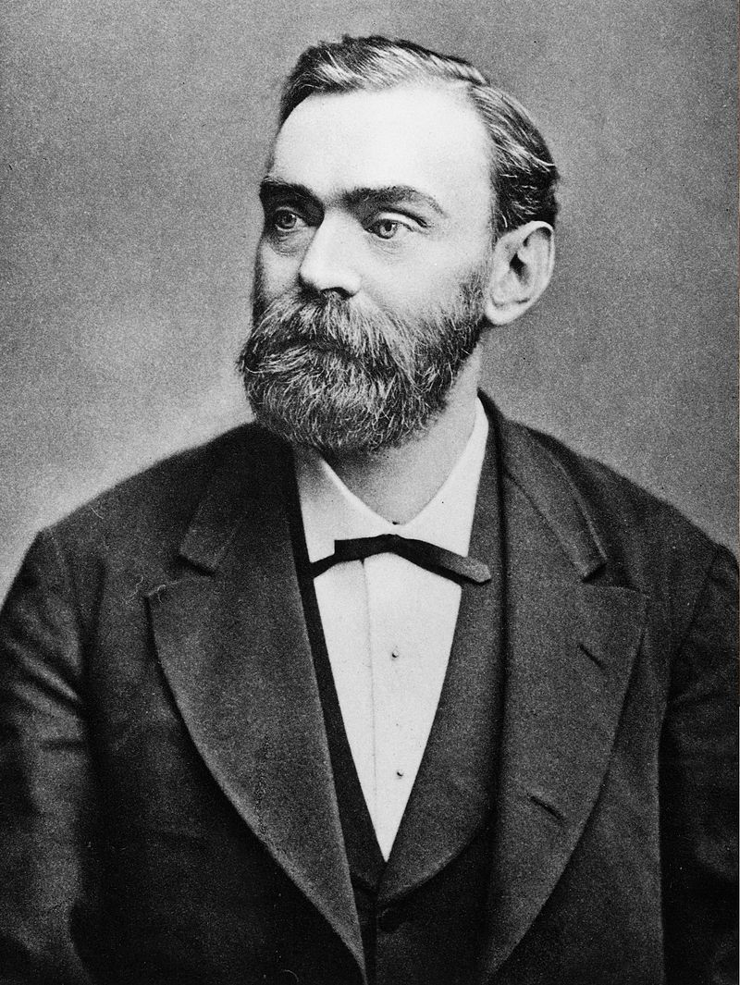
Luke 18:18-30
Alfred Nobel 1833 - 1896
In 1888 Alfred's brother Ludvig died while visiting
Cannes and a French newspaper erroneously
published Alfred's obituary. It condemned him for
his invention of dynamite and is said to have
brought about his decision to leave a better legacy
after his death. The obituary stated, Le marchand
de la mort est mort ("The merchant of death is
dead") and went on to say, "Dr. Alfred Nobel, who
became rich by finding ways to kill more people
faster than ever before, died yesterday." Alfred
(who never had a wife or children) was
disappointed with what he read and concerned
with how he would be remembered.

Slide 57
Luke 18:31-34
Blindness

Slide 58
Luke 18:31-34
Literal Prophetic Fulfillment
The Messiah must... | Prophecy | Fulfillment by Jesus
Bear the reproaches and sin of others | Isaiah 53:12 | Romans 15:3
Be a priest | Psalms 110:4 | Hebrews 5:5‑6, 6:20, 7:15‑17
Enter Jerusalem on a donkey | Zechariah 9:9 | Matthew 21:1‑11; Mark 11:1‑11; John 12:12‑16
Enter the Temple with authority | Malachi 3:1 | Matthew 21:12; John 2:13‑22
Born of a virgin | Isaiah 7:14 | Matthew 1:23
Proceeded by a messenger | Isaiah 40:3 5, Malachi 3:1 | Matthew 3:1‑3, Luke 3:2‑6
Be born in Bethlehem | Micah 5:2 | Matthew 2:1; Luke 2:4‑7
Be adored by great persons | Psalms 72:10‑11 | Matthew 2:1‑11
Be anointed with the Spirit of God | Isaiah 11:2, 61:1 | Matthew 3:16; John 3:34; Acts 10:38
Be hated without cause | Isaiah 49:7; Psalms 69:4 | John 15:24‑25
Be undesired, rejected by His own people | Isaiah 53:2, 63:3; Psalms 69:8 | Mark 6:3; Luke 9:58; John 1:11
Be plotted against by Jews, Gentiles | Psalms 2:1‑2 | Acts 4:27
Be betrayed by a friend | Psalms 41:9, 55:12‑24 | Matthew 26:21‑25, 47‑50; John 13:18‑21; Acts 1:16‑18
Be betrayed for 30 pieces of silver | Zechariah 11:12 | Matthew 26:16
Have his price given for a potter’s field | Zechariah 11:13 | Matthew 27:7
Be forsaken by His disciples | Zechariah 13:7 | Matthew 26:31, 56
Be struck on the cheek | Micah 5:1 | Matthew 27:30
Be spat on | Isaiah 50:6 | Matthew 26:67, 27:30
Be mocked | Psalms 22:7‑8 | Matthew 27:31, 39‑44
Be beaten | Isaiah 50:6 | Matthew 26:67, 27:26, 30
Be thirsty during His execution | Psalms 22:15 | John 19:28
Be given vinegar to quench that thirst | Psalms 69:21 | Matthew 27:34
Be considered a transgressor | Isaiah 53:12 | Matthew 27:38
Be buried with the rich when dead | Isaiah 53:9 | Matthew 27:57‑60
Be sought after by Gentiles as well as Jews | Isaiah 11:10, 42:1 | Acts 10:45
Be accepted by the Gentiles | Isaiah 11:10, 42:1‑4, 49:1‑12 | Matthew 12:21; Acts 10:45; Romans 15:9‑12
Resurrection | Psalm 16:10, 2, 7, Isaiah 53:9‑10 | Matthew 28:1‑20, Acts 13:33-37
To the right hand of the Father | Psalms 16:11, 68:18 and 110:1 | Luke 24:51, Acts 1:9‑11 and 7:55 and Hebrews 1:3

Slide 59
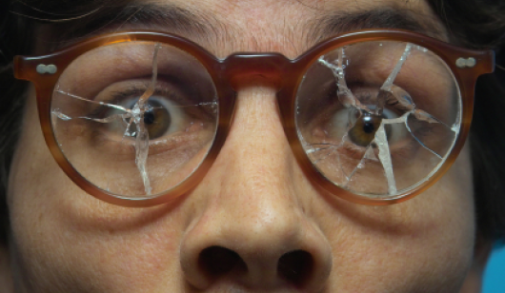
Luke 18:31-34
I cannot help but wonder if Luke has an intentional purpose in this way he has aligned
this material around the theme of blindness. For example:
Pharisee and the publican: The Pharisee was blind to his own self-righteousness
Parents and children see, the disciples are blind to the Kingdom
Rich ruler is blind to his covetousness
The disciples cannot perceive the death of Christ
Blind man on the side of the road can see … the crowds are blind
Zacchaeus … came to see his own need of salvation, but not the others.
Is there value in praying to the Lord
for eyes to see?

Slide 60
Luke 19:1-10
Luke 19
¹Jesus entered Jericho and was passing through.
² A man was there by the name of Zacchaeus; he was
a chief tax collector and was wealthy.
³ He wanted to see who Jesus was, but because he
was short he could not see over the crowd.
⁴ So he ran ahead and climbed a sycamore-fig tree to
see him, since Jesus was coming that way.
⁵ When Jesus reached the spot, he looked up and said to
him, “Zacchaeus, come down immediately. I must stay at
your house today.”
⁶ So he came down at once and welcomed him gladly.
⁷ All the people saw this and began to mutter, “He
has gone to be the guest of a sinner.”
⁸ But Zacchaeus stood up and said to the Lord, “Look, Lord!
Here and now I give half of my possessions to the poor,
and if I have cheated anybody out of anything, I will pay
back four times the amount.”
⁹ Jesus said to him, “Today salvation has come to this
house, because this man, too, is a son of Abraham.
JESUS ENTERS
ZACCHAUS; Keeps his wealth
CROWD: Hostile
UP THE TREE
UNEXPECTED LOVE
MAIN POINT!!!
DOWN THE TREE
CROWD: Hostile
ZACCHAUS: Gives his wealth
JESUS’FINAL WORDS

Slide 61
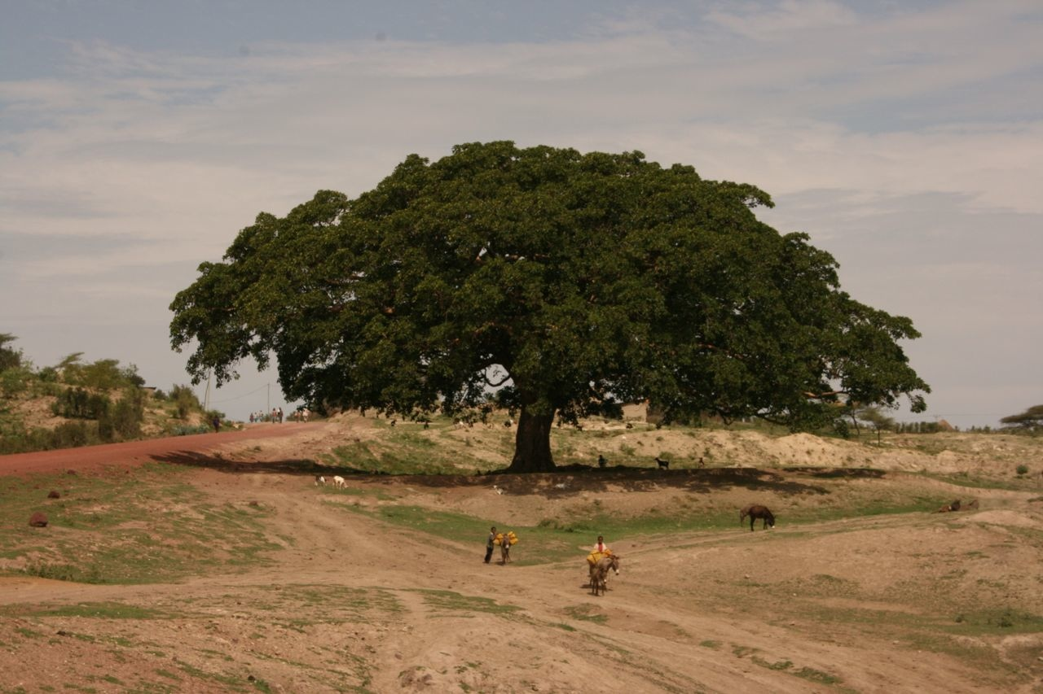
Luke 19:1-10
Sycamore fig tree

Slide 62
Luke 19:11-27

Slide 63
Luke 19:11-27
And having received the kingdom and returned,
he spake to call to him those servants to whom
he had given the silver, that he might know how
every one of them had traded.
(Luke 19:15 Syriac)

Slide 64
Luke 19:11-27
I planted the seed, Apollos watered it, but God made it grow … The man who plants and
the man who waters have one purpose, and each will be rewarded according to his own
labour. (1 Corinthians 3:6,8)
To the faithful you show yourself faithful, to the blameless you show yourself blameless,
to the pure you show yourself pure, but to the crooked you show yourself shrewd.
(Psalm 18: 25-26)

Slide 65
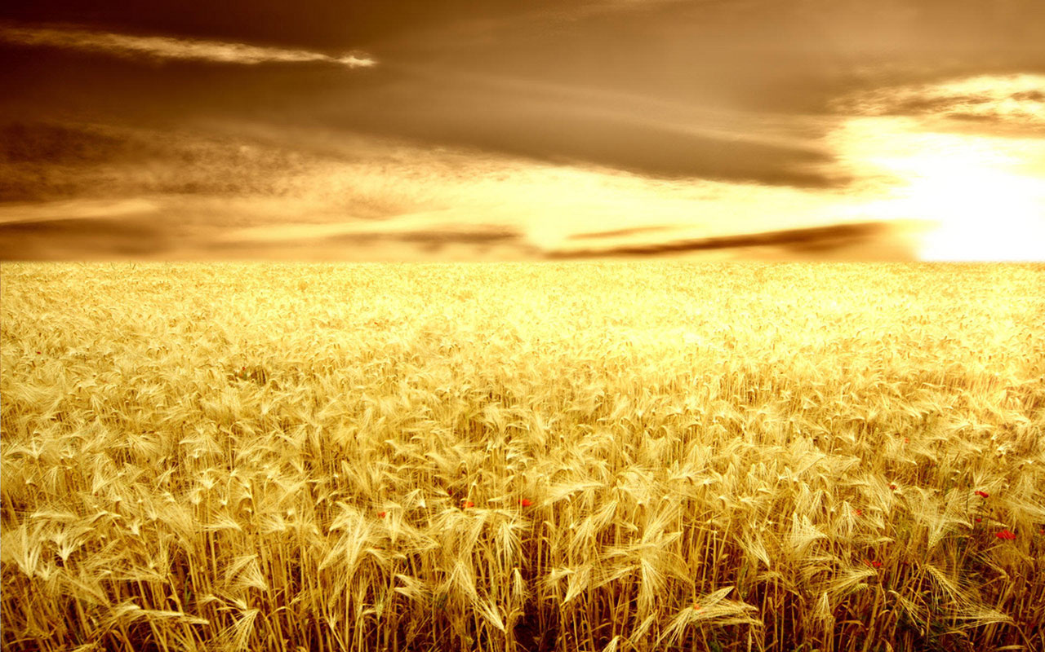
Luke 19:11-27
If my understanding of these verses is correct, I would draw the following conclusions:
1) Different people will have different opportunities, skills, placements
2) The Lord asks us to be FAITHFUL not fruitful (quality verses quantity)
3) The Lord’s reward is further responsibilities, but with responsibilities comes the
ability to impact and bless more greatly
4) There will be those that are opposed to our kingdom … be steady and faithful in spite
of this opposition.

Slide 66
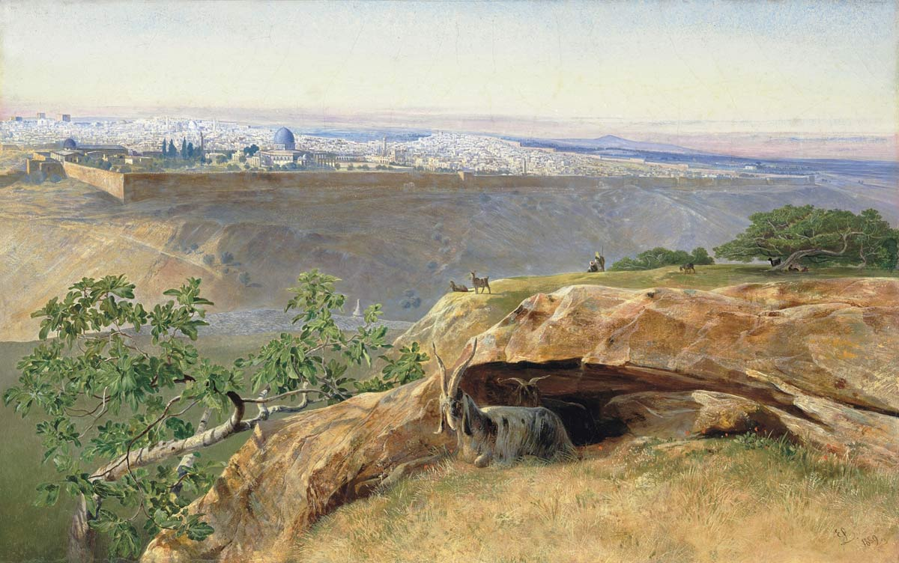
The Triumphal Entry
- See Psalm 118
See also Zech 9:9
Luke 19:28-44
From The Mount Of Olives To Jerusalem
(across the Kidron Valley) … looking west.

Slide 67
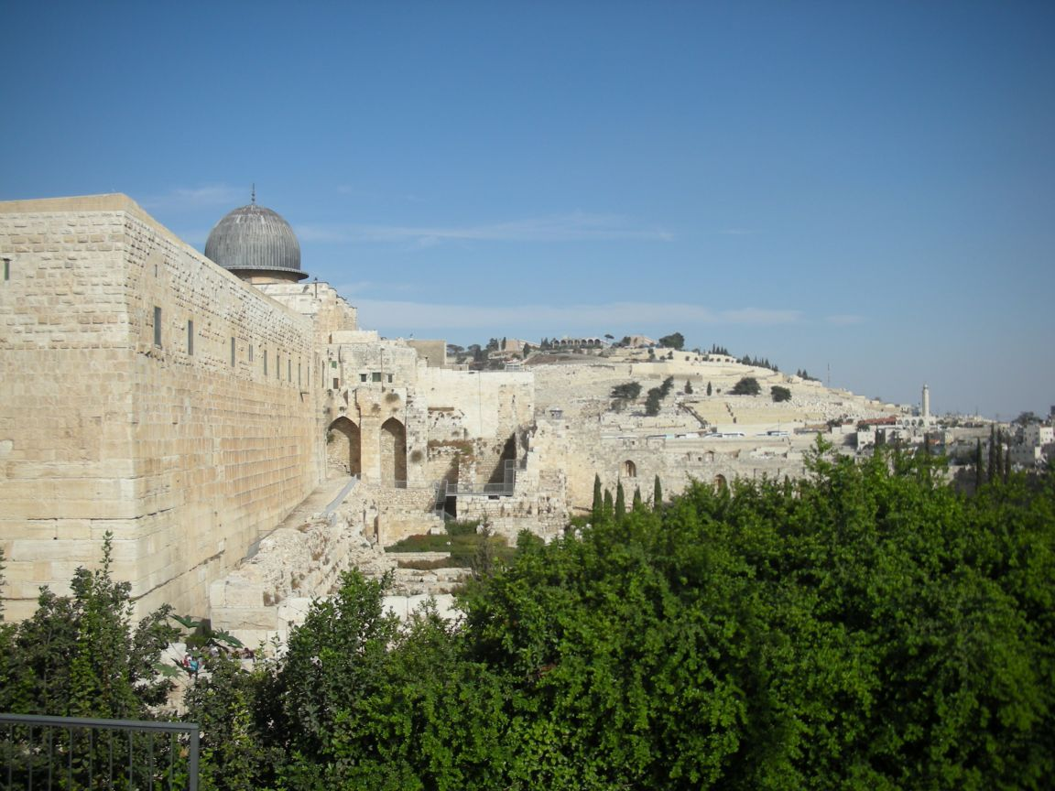
Luke 19:28-44
From The Mount Of Olives To The Temple

Slide 68
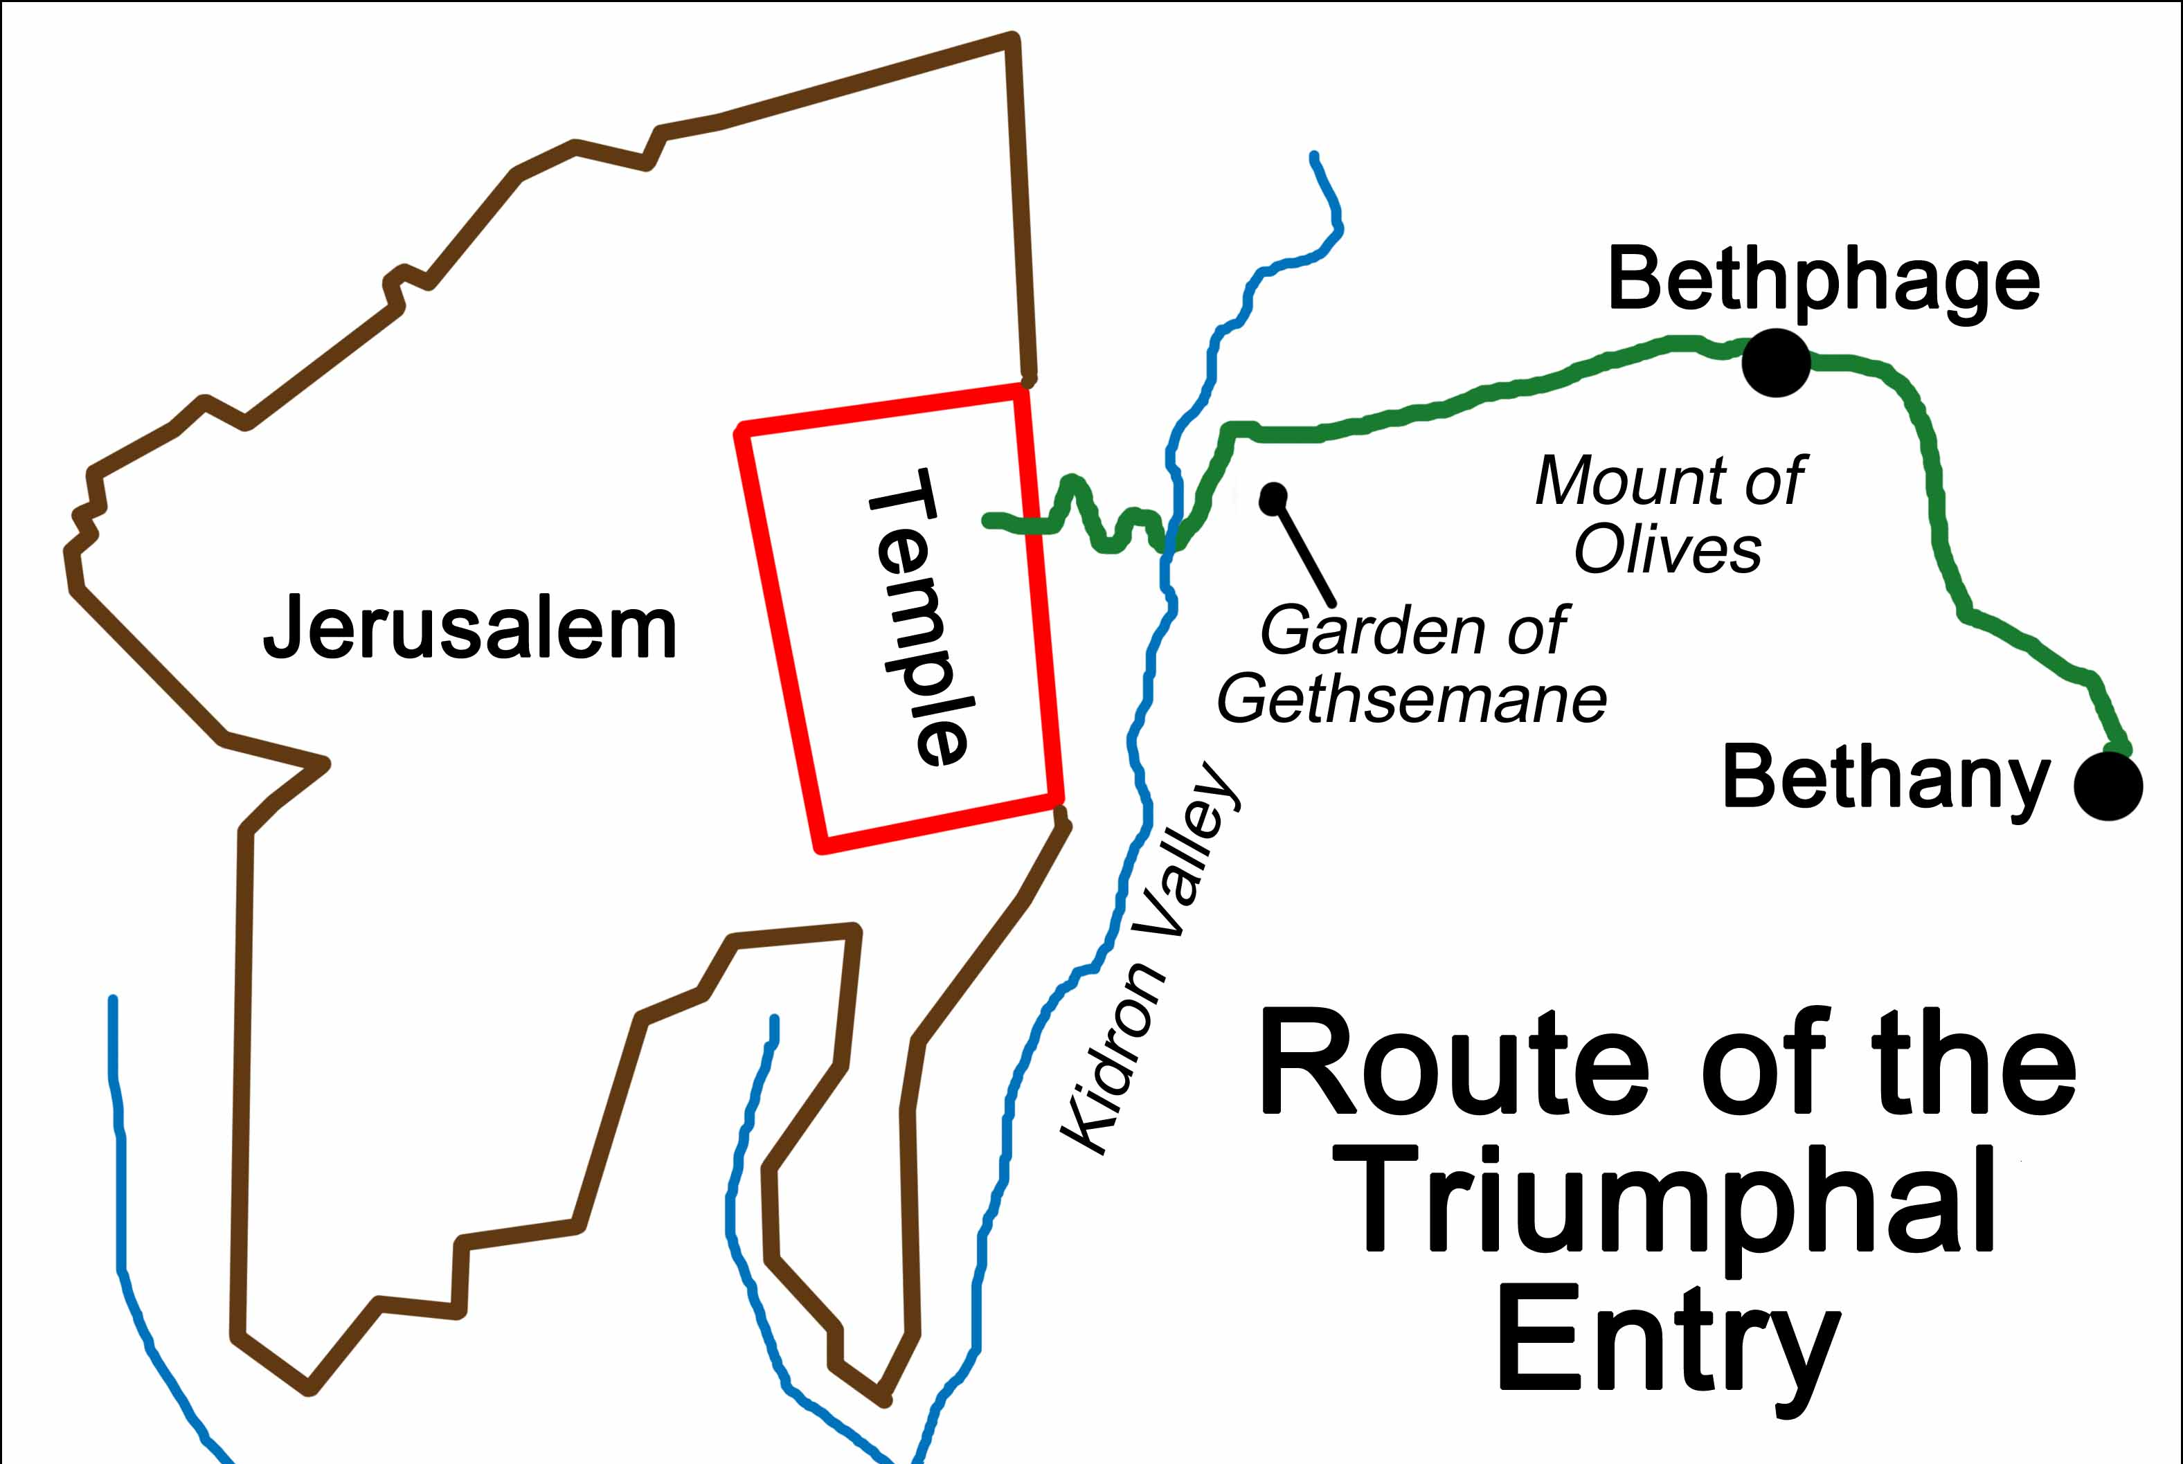
Luke 19:28-44
From The Mount Of Olives To The Temple

Slide 69
Luke 19:28-44
Some Further Notes:
The Mount Of Olives is significant as the ascension location and the return of Christ
Five times is the loosing of the colt mentioned! See Gen 49:11
The irony is that in Genesis, the rider is rich and here the colt must be borrowed!
The colt was never ridden before … it was unbroken
The palm branches waved were a political reference to Israel … like the maple leaf
Is it possible to get caught up in a "crowd" mentality and lose sight of truth??

Slide 70
Luke 19:28-44
Some Further Notes:
In v. 42ff, Jesus weeps at the fact that they missed the recipe for peace (him) and
instead chose a recipe for war … which brought destruction. The enemy so often
lies to us with promises of cheap substitutes

Slide 71
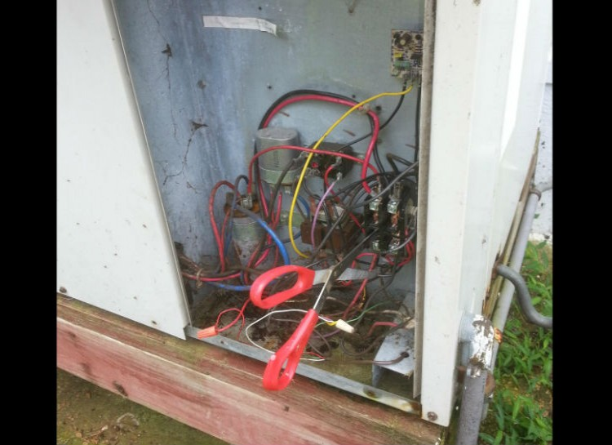
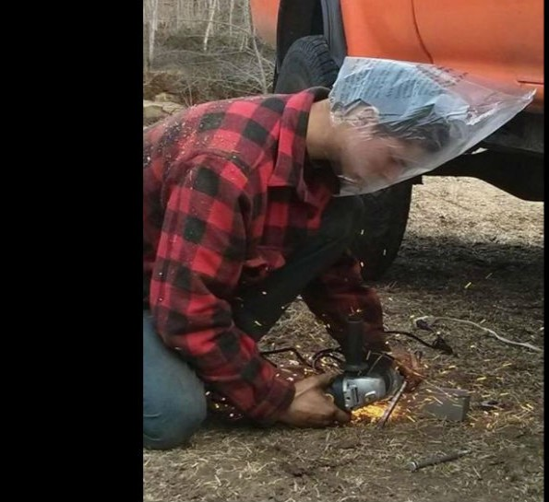
Luke 19:28-44

Slide 72
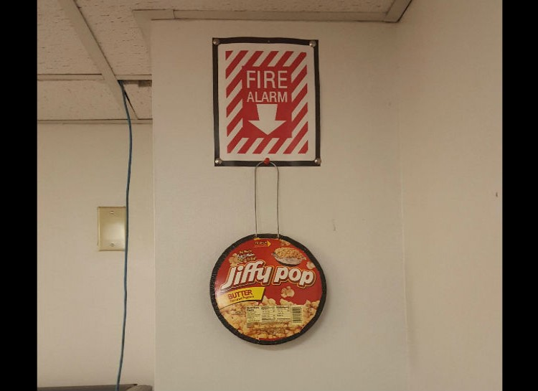
Luke 19:28-44

Slide 73
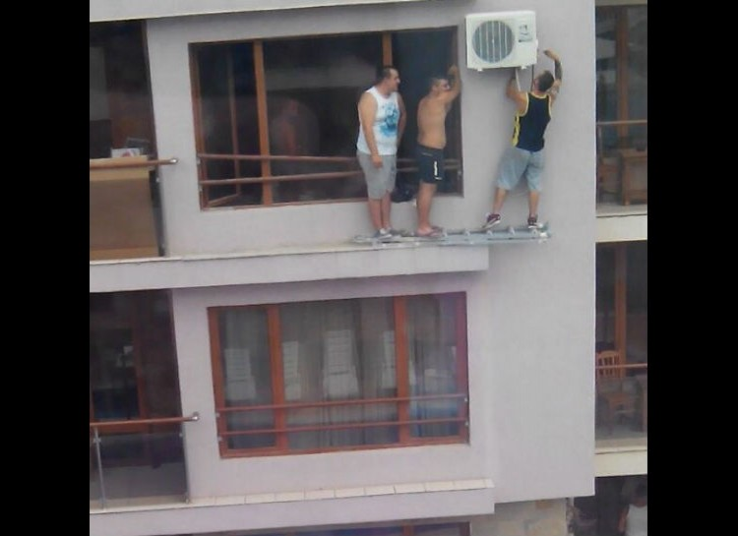
Luke 19:28-44

Slide 74
Luke 19:28-44
Lamb Selection Day (Palm Sunday)
Tell the whole community of Israel that on the tenth day of this month each man is to take a
lamb for his family, one for each household. If any household is too small for a whole lamb,
they must share one with their nearest neighbor, having taken into account the number of
people there are. You are to determine the amount of lamb needed in accordance with
what each person will eat. The animals you choose must be year-old males without defect,
and you may take them from the sheep or the goats.
Take care of them until the fourteenth day of the month, when all the people of the
community of Israel must slaughter them at twilight. (Exodus 12:3-6)

Slide 75
Luke 19:28-44
Lamb Selection Day (Palm Sunday)
1 Kings 1:38-40 So Zadok the priest, and Nathan the prophet, and Benaiah the son of Jehoiada,
and the Cherethites, and the Pelethites, went down, and caused Solomon to ride upon king
David’s mule, and brought him to Gihon. And Zadok the priest took an horn of oil out of the
tabernacle, and anointed Solomon. And they blew the trumpet; and all the people said,
God save king Solomon. And all the people came up after him, and the people piped with
pipes, and rejoiced with great joy, so that the earth rent with the sound of them.
2Kings 9:12-13 "That’s not true!" they said. "Tell us." Jehu said, "Here is what he told me: ‘
This is what the LORD says: I anoint you king over
Israel.’" They hurried and took their cloaks and spread
them under him on the bare steps. Then they blew
the trumpet and shouted, "Jehu is king!"
Zechariah 9:9-10 9 ¶ Rejoice greatly, O Daughter of
Zion! Shout, Daughter of Jerusalem! See, your king
comes to you, righteous and having salvation, gentle
and riding on a donkey, on a colt, the foal of a donkey. I will take
away the chariots from Ephraim and the war-horses from Jerusalem,
and the battle-bow will be broken. He will proclaim peace to the nations.
His rule will extend from sea to sea and from the River to the ends of the earth.

Slide 76
Luke 19:28-44
Lamb Selection Day (Palm Sunday)
Regarding the Mount Of Olives:
Zechariah 14: 3-4 Then the LORD will go out and fight against those nations, as he fights in the day of
battle. On that day his feet will stand on the Mount of Olives, east of Jerusalem, and the Mount of
Olives will be split in two from east to west, forming a great valley, with half of the mountain moving
north and half moving south.
Acts 1:9-12 9 After he said this, he was taken up before their very eyes, and a cloud hid him from their
sight. They were looking intently up into the sky as he was going, when suddenly two men dressed
in white stood beside them. "Men of Galilee," they said,
"why do you stand here looking into the sky? This same
Jesus, who has been taken from you into heaven, will come
back in the same way you have seen him go into heaven."
Then they returned to Jerusalem from the hill called the
Mount of Olives, a Sabbath day’s walk from the city.
Matthew 24:3 As Jesus was sitting on the Mount of Olives,
the disciples came to him privately. "Tell us," they said, "when
will this happen, and what will be the sign of your coming and
of the end of the age?"

Slide 77
Luke 19:28-44
A Very Specific Prophecy
Daniel’s 70 weeks of years: Dan. 9:24-27
A year to the Israelite was 360 days (lunar calendar), not 365.25 as it is measured today.
A week = 7 years ... See Rev. 12:6, 1260 days , Verse 14 as a time, times and half a times,
and 42 months (13:5)
The command to rebuild Jerusalem was given by Artaxerxes (Neh. 2:1)
- The first of Nisan, was calculated by the Royal Observatory, Greenwich UK as
March 14, 445BC, according to Sir Robert Anderson (1895), leader of Scotland Yard and
renowned Biblical scholar.
- According to the Talmud, the first of Nisan is the appropriate date for calculating the
reign of kings
so: 7 weeks + 62 weeks = 69 and 7 x 69 = 483 years
then: 483 years x 360 days = 173880 days
This works out to 10th day of Nisan, April 6, AD32, which MAY be the Palm Sunday that Jesus
entered Jerusalem.

Slide 78
Luke 19:28-44
A Very Specific Prophecy
Daniel’s 70 weeks of years: Dan. 9:24-27
If you perform this calculation, don’t forget to subtract one year (moving from BC to AD, there
is no 0 year) and don’t forget to add 116 leap days
- Therefore:
March 14, 445BC – March 14 AD32 = 476 years x 365 days + 116 leap days = 173,856 days
From March 14 AD32 – April 6 AD32= 24 days
173,856 + 24 = 173880 days, exactly as prophesized
It is ironic that Jesus seems to indicate that the Jews should know the time of the coming
of the Christ (see Luke 19:41-44)
In AD 70, under General Titus of Rome, Israel was captured and the temple burned to the
ground
- the Jews would be scattered until May of 1948.
- Josephus reported the hills around Jerusalem were studded with thousands of crosses
during this awful time

Slide 79
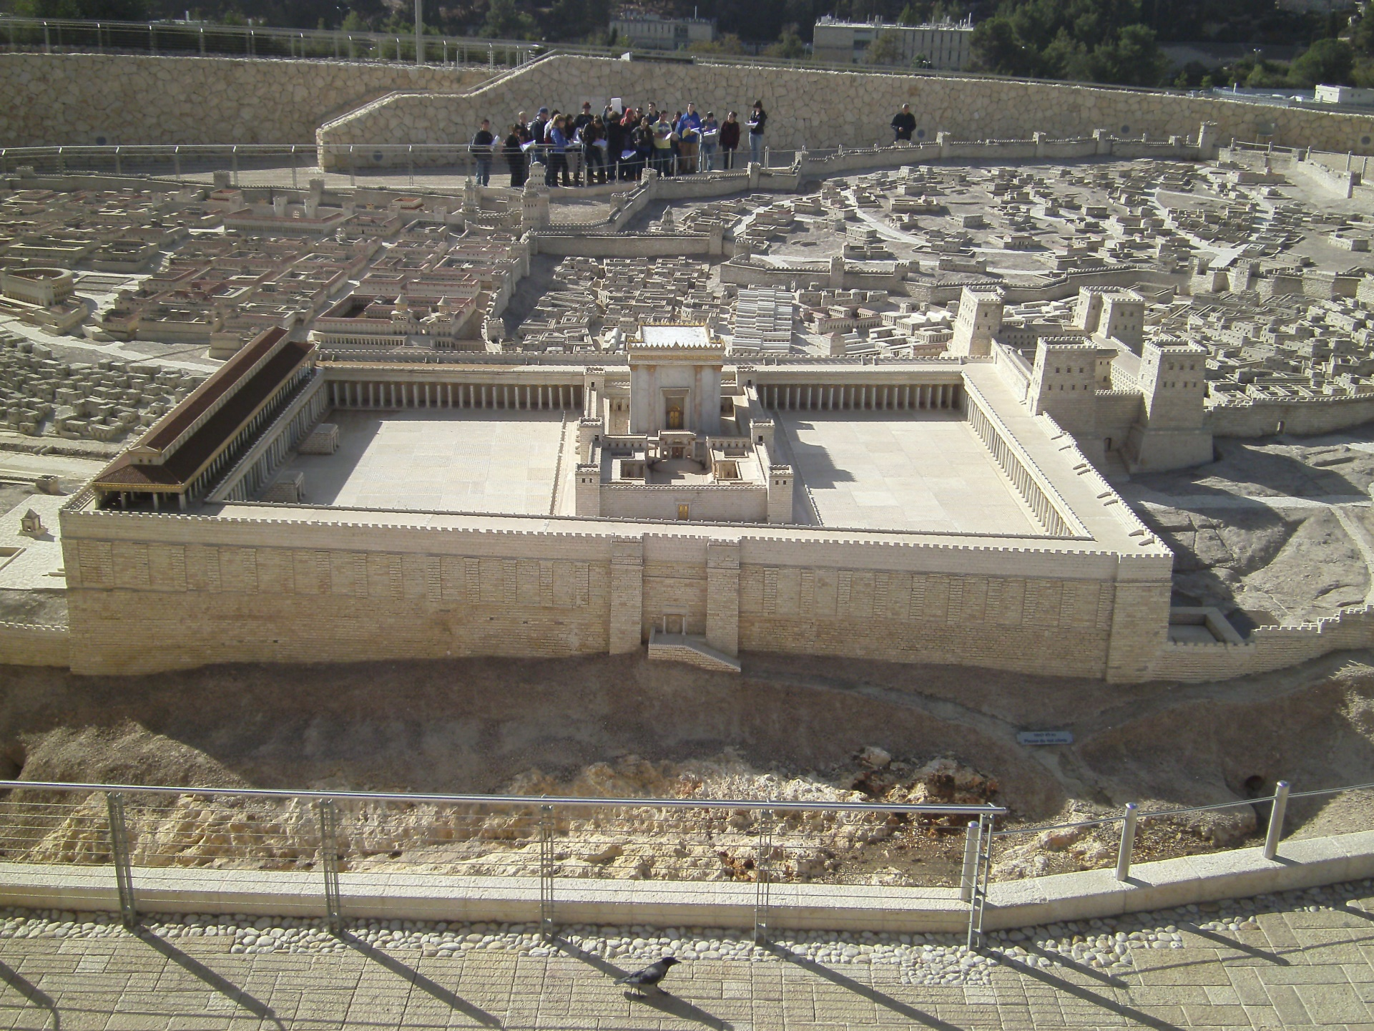
Luke 19:45-48

Slide 80
Luke 19:45-48

Slide 81
Worship
Luke 19:45-48
God Himself is a continuous outpourer. His love, grace, mercy, forgiveness, creativity, power
are all made manifest in creation. This act never ceases. God loves us with exactly the same
love that He exhibits between the Trinity. His outpouring there is identical to His outpouring
here.
We are made in His image and so we too are outpourers.
Worship is the continuous outpouring of all that I am, all that I do and all that I can become in
light of my chosen God. (Harold Best, modified by Bob Williamson)
This definition:
Includes everyone, sinner and saint.
Carries the idea that we have all chosen a god
There are none that do not worship as it is what we were created doing
Is continuous. When I sin, worship does not stop … it changes direction. It may
ebb and flow, but it does not cease when then drummer stops or the amplifier
shut off.

Slide 82
Worship
Luke 19:45-48
It is not music. We cannot equate the power of the music to the nearness of the Lord.
There is no on or off switch. We are all bowing down right now, to someone or something;
an idea or a spirit.
Outpouring implies generosity and lavishness. I give it up, I let it go. It surpasses
measuring out or some form of quota.
Out .. implies direction – it moves from me to a destination. It implies a transfer
of energies; an active not passive motion.
Because it is all that I do, my work, my vacation time, my golf can all be acts of worship as
they are done to the glory of the Lord.
Further, this process changes me. Any outpouring must and it will be for good or
ill. In worship, I am transformed.

Slide 83
Luke 20:1-18
Luke 20:9 …"A man planted a vineyard, rented it to some farmers
and went away for a long time. At harvest time he sent a servant
to the tenants so they would give him some of the fruit of the
vineyard. But the tenants beat him and sent him away empty-handed.
He sent another servant, but that one also they beat and treated
shamefully and sent away empty-handed. He sent still a third,
and they wounded him and threw him out.
"Then the owner of the vineyard said, ‘What shall I do? I will send my son,
whom I love; perhaps they will respect him.’
"But when the tenants saw him, they talked the matter over. ‘This is the
heir,’ they said. ‘Let’s kill him, and the inheritance will be ours.’
So they threw him out of the vineyard and killed him. "What then will
the owner of the vineyard do to them? He will come and kill those tenants
and give the vineyard to others." When the people
heard this, they said, "May this never be!"
Vineyard rented
Servants sent and
rejected
Son sent
Son rejected
Vineyard transferred

Slide 84
Luke 20:19-26

Slide 85
Luke 20:27-40
The levirate marriage …
There is no marriage in the kingdom to come
No procreation necessary
Known even as we are known
No death, no separation …

Slide 86
Luke 20:27-40

Slide 87
Luke 21:5-38
Herodian Temple Foundation Stones

