Slide 2
The Beginnings Of The Life Of Jesus
1:1-4 The introduction of the book.
1:5-25 The birth of John the Baptist is foretold
1:26-45 The birth of Jesus is foretold.
1:45-56 The song of praise that Mary dictates. This is similar to Hannah’s song.
1:57-80 The birth of John the Baptist, with Zachariah’s prophecy
2:1-3 Enrollment of Quirinius
2:4-20 The birth of Christ
2:21-38 Jesus is circumcised and presented to the priest Simeon. Anna also speaks.
2:39-52 The boyhood of Jesus; the visit to Jerusalem when He was twelve.
The Preparation For Ministry
3:1-14 The ministry of John the Baptist.
3:15-20 John testifies about the coming Christ.
3:21-22 The baptism of Jesus
3:23-38 The genealogy of Jesus
4:1-12 The temptation of Jesus
4:13 Satan is defeated and leaves temporarily.

Slide 3
The Galilean Ministry Begins
4:14-15 The beginning of His ministry.
4:16-30 Jesus is rejected at Nazareth, His home town. Note that He quotes from Isa. 61:1-2.
4:31-37 The demoniac is healed.
4:38-44 Peter’s mother-in-law is healed.
5:1-11 The call of Peter, James and John.
5:12-26 The leper and the paralytic are healed.
5:27-29 The call of Levi (also called Matthew)
5:30-39 The Pharisees and scribes attack: Jesus answers.
6:1-11 Jesus deals with the question of the Sabbath by healing an atrophied hand.
6:12-19 Jesus prays all night - then chooses the twelve.
6:20-49 Another teaching of the Beatitudes (similar to Matthew 5-7).
7:1-10 The Centurion’s servant is healed.
7:11-18 The widow’s son is raised from the dead
at Nain.
7:19-35 Jesus testifies about John the Baptist.
7:36-50 Jesus is anointed by the sinful woman.

Slide 4
8:1-3 The women who ministered to Christ are listed.
8:4-15 The parable of the sower
8:16-18 The parable of the lighted candle.
8:19-21 The new relationship is defined.
8:22-25 Jesus stills the storm
8:26-39 The demoniac of Gadara is healed
8:40-56 A woman is healed and Jarius’s daughter is raised from the dead.
9:1-9 The twelve are sent out to minister on their own (and are given power)
9:10-17 The feeding of the 5000.
9:18-26 The confession of Peter
9:27-36 The transfiguration of Jesus before the disciples.
9:37-50 Why the disciples had no power: Jesus again casts of the demon.

Slide 5
On The Way To Jerusalem
9:51-62 Jesus now turns towards Jerusalem (and the cross).
10:1-24 The seventy disciples are sent out to minister.
10:25-29 The lawyer asks, “Who is my neighbour”?
10:30-37 The good Samaritan story.
10:38-42 The contrasts between Mary and Martha.
11:1 Jesus praying.
11:2-4 Jesus’ instructions on prayer.
11:5-13 A parable on prayer
11:14-28 Jesus teaches on Demonism
11:29-32 The sign of Jonah
11:33-38 The parable of the candle.
11:39-44 The Pharisees are denounced.
11:45-54 The lawyers are denounced.
12:1-12 The warning about false doctrine.
12:13-34 The warnings against greediness.
12:35-48 The warning about watching for
the second coming.
12:49-59 Christ “divides” people.

Slide 6
13:1-5 Jesus teaches on repentance and being ready.
13:6-9 The barren fig tree (this represents Israel).
13:10-17 The healing of another woman.
13:18-21 The parables of the mustard seed and leaven.
13:22-30 How many will be saved?
13:31-33 Jesus warns about Herod.
13:34-35 Jesus weeps over Jerusalem
14:1-6 The healing on the Sabbath.
14:7-15 The parable of the over-zealous guest.
14:16-24 The parable of the great supper.
14:25-35 The cost of discipleship.
15:1-7 The parable of the lost sheep.
15:8-10 The parable of the lost coin.
15:11-32 The parable of the lost (prodigal) son.
16:1-18 The parable of the dishonest steward.
16:19-31 The story (not parable) of the rich man
and Lazarus.
17:1-10 The teaching on forgiveness and service.
17:11-19 The cleansing of the ten lepers.
17:20-37 The question of “when the Kingdom of God”
should come.

Slide 7
18:1-8 The parable of the Unjust Judge.
18:9-14 The parable of the Pharisee and the Publican.
18:15-17 Jesus blesses the little children.
18:18-30 The story of the rich young ruler.
18:31-34 Jesus predicts His death.
18:35-43 Jesus heals the blind man near Jericho.
19:1-10 The conversion of Zacchaeus.
19:11-27 The parable of the pounds.
19:28-40 The triumphal entry into Jerusalem.
19:41-44 Jesus weeps over Jerusalem.
19:45-48 Again, Jesus cleanses the Temple court.
Temple Teachings
20:1-8 The authority of Jesus is questioned.
20:9-18 The parable of the vineyard.
20:19-26 The question about tax money.
20:27-38 The Sadducees are silenced.
20:39-47 The scribes are interrogated.
21:1-4 Jesus observes the widow’s mite offering.
21:5-38 Jesus discusses the end-times issues.

Slide 8
The Suffering And Resurrection Of The Lord
22:1-2 The plot to kill Jesus
22:3-6 The treachery of Judas
22:7-13 The preparations for the Passover.
22:14-18 The last Passover.
22:19-20 The Lord’s supper is instituted.
22:21-23 The announcement of the betrayal.
22:24-30 The Apostle’s place in the future kingdom.
22:31-34 Jesus predicts Peter’s denial.
22:35-38 Jesus predicts future conflicts.
22:39-46 Jesus prays in the Garden of Gethsemane.
22:47-53 Jesus is betrayed.
22:54-65 Jesus is arrested
22:66 - 23:26 The various trials
23:27-38 The crucifixion
23:39-45 The thief that repents.
23:46-49 The death of Christ.
23:50-56 The burial of Christ
24:1-12 The resurrection of Christ
24:13-35 Jesus appears to the disciples on the
road to Emmaus
24:36-43 Jesus appears to the eleven.
24:44-49 Jesus gives the great commission.
24:50-53 The ascension of Christ

Slide 9
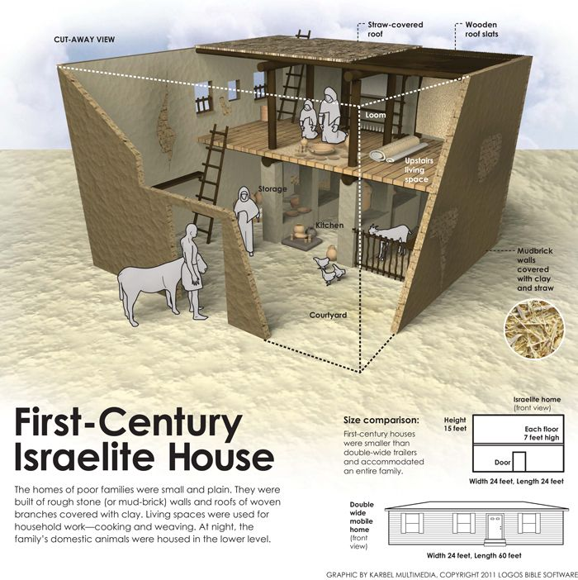
Luke 11:5-13
First Century
Jewish Home

Slide 10
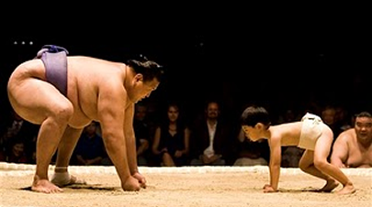
Luke 11:5-13
Don’t Quit Seeking
Having therefore, brethren, boldness to enter into the holiest by the blood of Jesus, By a
new and living way, which he hath consecrated for us, through the veil, that is to say, his
flesh; And having an high priest over the house of God; Let us draw near with a true heart
in full assurance of faith, having our hearts sprinkled from an evil conscience, and our
bodies washed with pure water.
Hebrews 10:19-22
Ask
Seek
Knock
Increasing Familiarity
WHY?

Slide 11
What heroes of the faith have acted in incredibly bold ways?
What boldnesses have you committed lately?
WHY?

Slide 12
WHY?

Slide 13
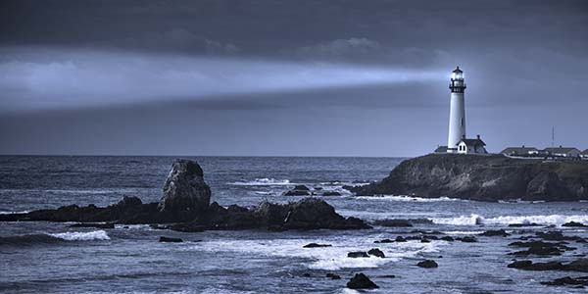
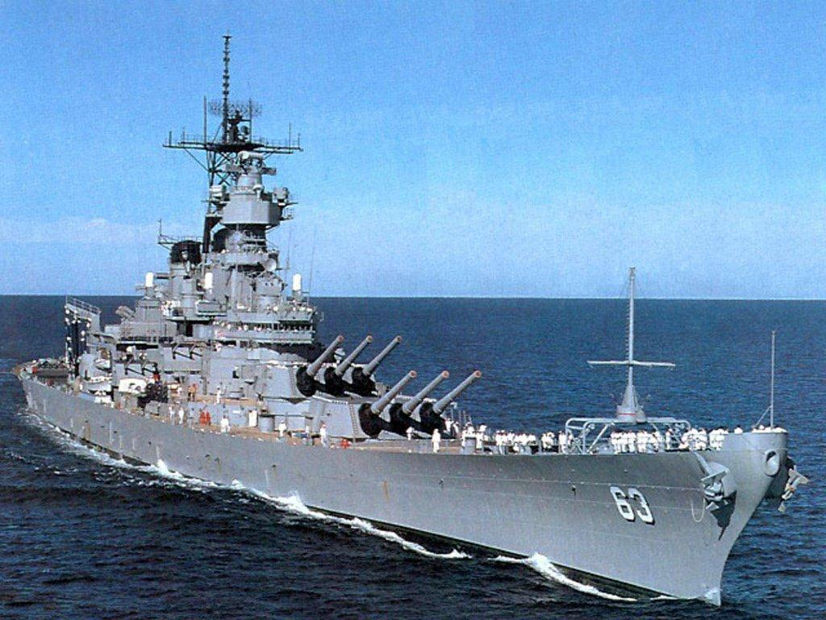
Luke 11:14-23
Authority
WHY?

Slide 14
Luke 11:14-23
Slander …
Meaning: False accuser, malicious gossiper, purveyors of intrigue or scandal
34 out of 38 times it is used in the NT, it is used as a name of Satan (diabolos))
Legally, slander is an untruthful statement about a person that harms or defames
their reputation.
It can be spreading a false report about someone.
It can be spreading harmful information about another, which is what the
Scripture calls “tale bearing.”
It can be reporting the truth with the intent to harm.
It will:
Break relationships
Create division
Create a generally negative spirit
A reverent heart produces a change in the tongue.
- There will be a renewed sensitivity to what we say
WHY?

Slide 15
Luke 11:14-23
Slander …
It is easiest to slander:
People in authority
People we disagree with
People we are angry with or have chosen to not forgive
People to whom we have no vested interest
When I speak:
What’s my tone?
What’s my spirit?
What’s my motive?
Why am I saying what I’m saying?
Am I trying to edify and build up?
Is it necessary?
WHY?

Slide 16
What fills your heart?
Luke 11:24-26
WHY?

Slide 17
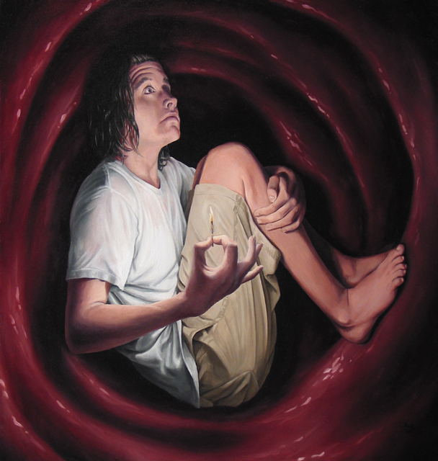
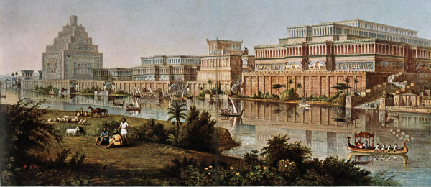
Luke 11:27-36
Sign of Jonah?
WHY?

Slide 18
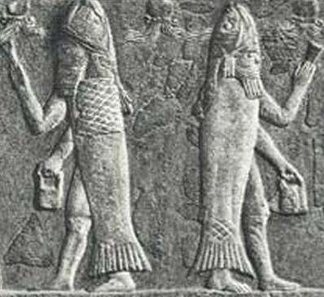
Luke 11:27-36
By tradition, Joppa appears to be the home of a sea creature who consumes men
(the myths of Perseus and Heracles (Cetus) as examples). Meanwhile, the name Nineveh
translates as “The House of the Fish.” The city is sometimes signified by a glyph of a
fish in a basin. The tutelar goddess of Nineveh was Nînâ, a fish goddess, and a leading
god of Nineveh, Ea (Enki) was often depicted with a fish robe. Of even greater import
is the fact that priests in Nineveh (and throughout Assyria) often donned fish robes in
imitation to the deity who had power over the deep. On one cuneiform tablet we are
also told that individuals being initiated into the priesthood of these deities would
“ritually” descend into the underworld where
they would behold the “altars amid the
waters” belonging to Anu, Bel, and Ea (the
gods of heaven, earth, and underworld).
WHY?

Slide 19
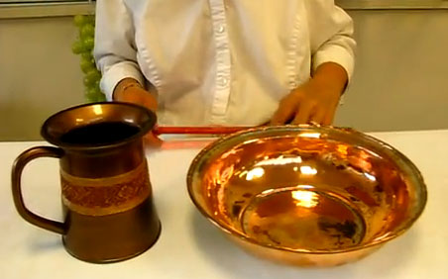
Legalism: Hand Cleaning
Luke 11:37-54
Special hand washing pots were used (ordinary water may have become tainted).
You must use enough water to fill one and one-half eggs shells.
3) Water poured from the tips of the fingers to the wrists.
The palm must be then cleaned by running the opposite fist into it.
Water must be poured again, this time from the wrist to the finger tips.
because you build tombs for the prophets –
your forefathers who killed them.
So you testify that you approve of what your forefathers did;
they killed the prophets,
and you build their tombs.
WHY?

Slide 20
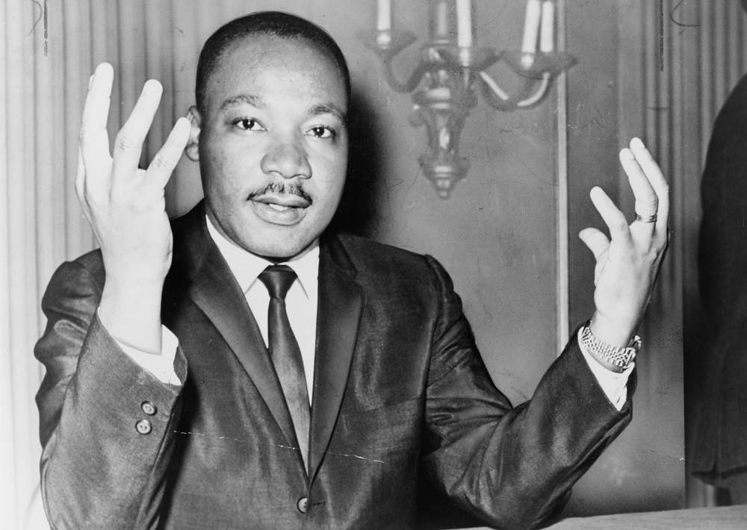
Luke 11:37-54
Prophets
The Blood of Abel …
- How is Abel like a prophet?
The blood of Zachariah …
- 2 Chron. 24:20-22
WHY?

Slide 21
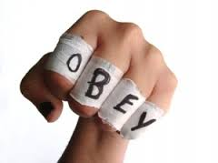
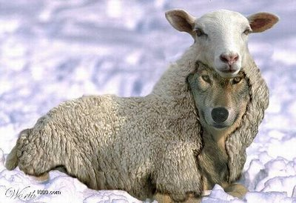
Legalism
Luke 11:37-54
Frequently legalists refuse to speak directly to those whose behavior bothers them.
The Pharisees disagree here about what Jesus is doing, but they discuss it only
privately, in their own inner circle.
(2) Legalists major in minors and ignore the major relational requirements God asks of
his followers. Jesus’ major complaint is that in keeping such close tabs on what is on
the outside, the inner heart is ignored, and along with that, justice and God’s love.
What he does condemn is a pretense of being so self-focused on spiritual matters
that one ignores the condition of the heart and fails to notice those who are truly
hurting.
Bock, Darrell L. “Contemporary Significance” In The NIV Application
Commentary: Luke. By Darrell L. Bock, 334-335. Grand Rapids:
Zondervan, © 1996.
WHY?

Slide 22
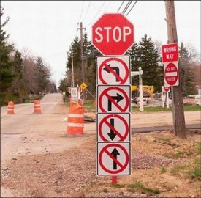
Legalism
Luke 11:37-54
(3) The close association of pride with this condition is no accident. Pride tends to make
us into nonlisteners. We can speak, but we cannot hear. We think no one has anything
to tell us. If so, we are slipping into a legalistic, prideful mind-set, which is death to
genuine spirituality. We should criticize only with the attitude that we too are tempted
and might fall into sin (cf. Gal. 6:1).
(4) A legalist is often quick to criticize but slow to help. In making sure others know their
spiritual responsibilities, they often are the last in line to encourage others in the
pursuit of those goals. The absence of relational commitment is a symptom of a
deeper problem. If there was one thing Jesus’ ministry shows us, it is a commitment
to people.
Bock, Darrell L. “Contemporary Significance” In The NIV Application
Commentary: Luke. By Darrell L. Bock, 334-335. Grand Rapids: Zondervan, © 1996.
WHY?

Slide 23
Lessons From Pharisees
Luke 11:37-54
My self-willed, personal acts of devotion to God should be invisible to all but Christ
My own "list" should be between me and the Lord … alone
A major tension in my life will be between being seen by others as "good" as opposed to
people seeing the goodness of Christ in me.
To get legalism wrong will DRAW people FROM Christ.
I am successful ONLY when those I lead are successful.
To honour something requires that I be identified
with it personally.
WHY?

Slide 24
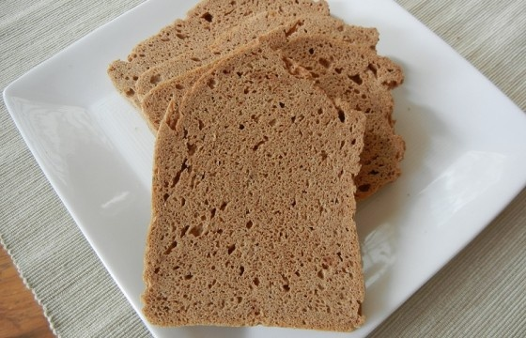
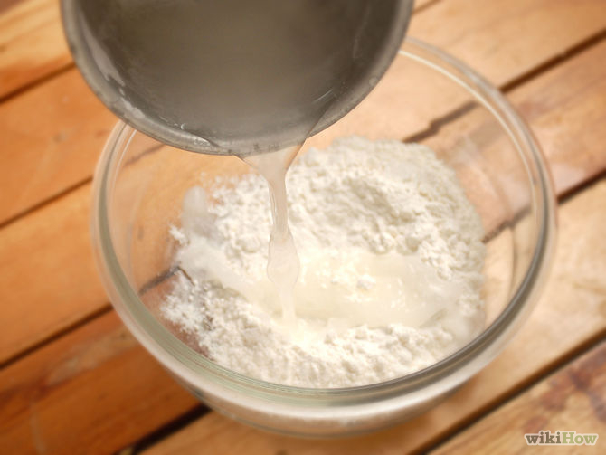
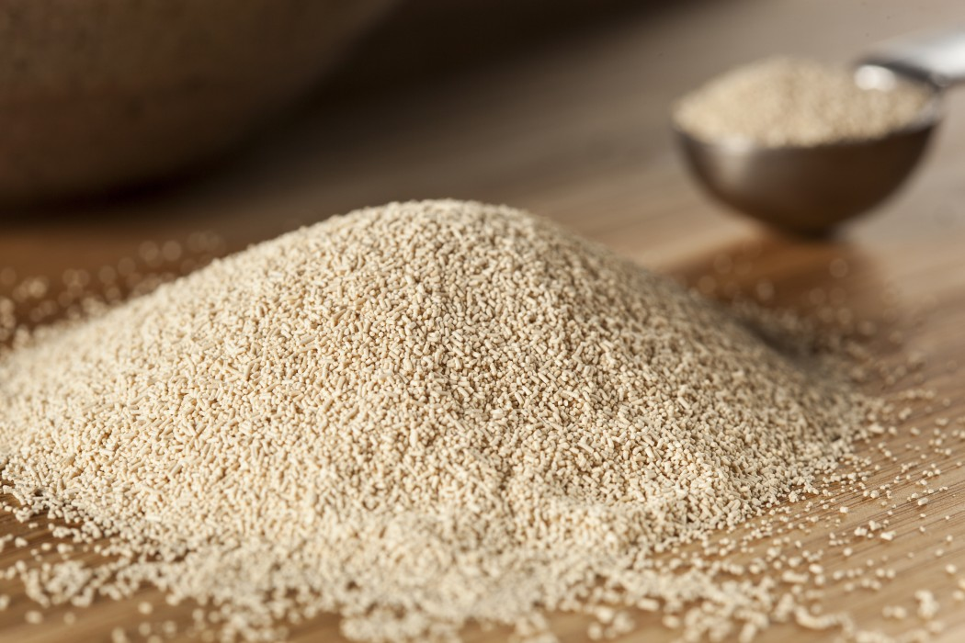
Yeast?
Luke 12:1-2
What's so bad about yeast?
WHY?

Slide 25
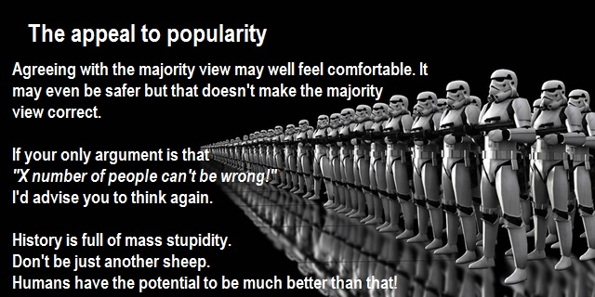
The Importance Of Popularity
Luke 12:1-2
How many people need to be on "my side" before I am comfortable and secure?
What is the connection between me and those people?
WHY?

Slide 26
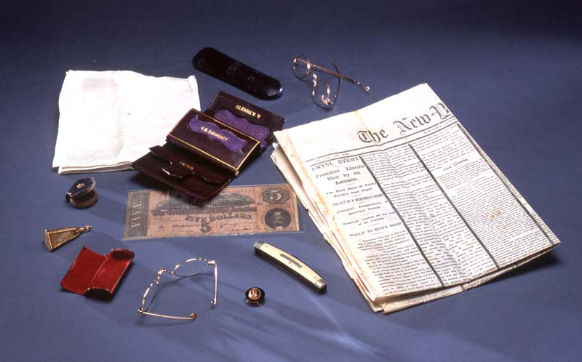
The Importance Of Popularity
Luke 12:1-2
When Abraham Lincoln was shot at Ford's Theatre in Washington, D.C. on April 14,
1865, he was carrying two pairs of spectacles and a lens polisher, a pocketknife,
a watch fob, a linen handkerchief, and a brown leather wallet containing a five-dollar
Confederate note and nine newspaper clippings, including several favorable to the
president and his policies.
WHY?

Slide 27
My Affirmation?
Luke 12:1-12
WHY?

Slide 28
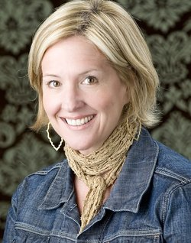
My Affirmation?
Luke 12:1-12
When I hurt, I often tell myself a story about the situation. My version of the story
allows me to be the victim and the hero and often ends with me getting my just reward.
The truth problem: My version of the story is almost always a lie.
Often when I am angry, I am really hurt, feeling uncomfortable, vulnerable and even shame.
Healing begins when I exhaust every comfortable way of solving my problem, finally giving
into truth and owning my story.
Without feeling, we seek emotional intensity vicariously.
We are numb and we need stimulation. Where will it
come from?
Vulnerability, can lead to hurt. As a result, we turn to
self-protection- choosing certainty over curiosity,
armour over vulnerability, knowing over learning.
Rising Strong, Brene Brown, chapters 2-4
WHY?

Slide 29
My Affirmation?
Luke 12:1-12
WHY?

Slide 30
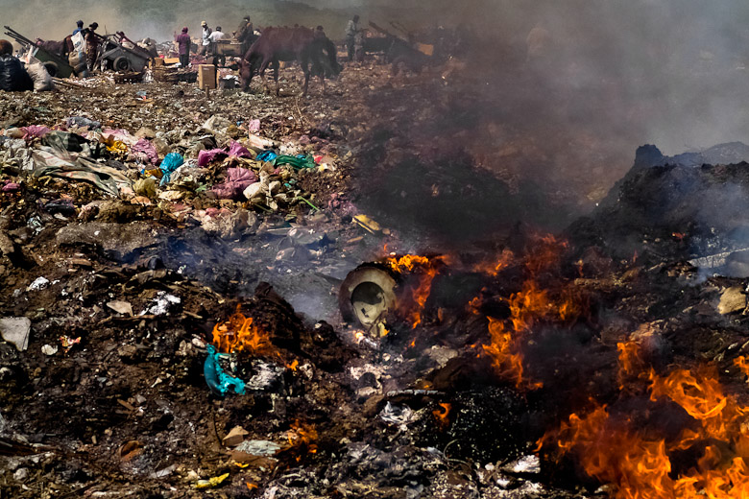
Gehenna (Valley Of Hinnom)
Luke 12:3-12

Slide 31
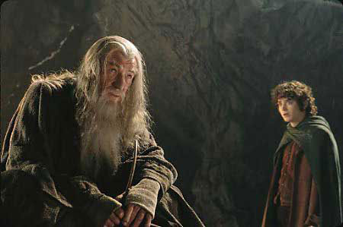
The Importance Of Popularity
Luke 12:1-2
In the Mines of Moria, Gandalf and Frodo have a critical conversation. Frodo reflects
on the “evil” one that follows behind them in the darkness. “It would have been better
had Bilbo had killed him.” Gandalf responds with wisdom and passion, as he speaks of
pity and mercy. Frodo is transformed.
Bilbo shows mercy to Gollum. Frodo shows mercy (that he learns from Gandalf) to
Gollum. Gollum survives to the end, and it is his actions that determine the fate of all.
Paul argues in 1 Corinthians 13 that “now we know in part, but then we will know fully
even as we are known.” In the Kingdom to come, I will be known completely … and will still
be loved. I will know others fully … and still
fully love. I cannot wait for this new reality.
Until then, it is my prayer that I learn to speak
words of love and life everywhere. Words of
encouragement and hope. Less sarcasm and
more mercy. Less vengeful and more forgiving.
I honestly want to leave every soul I encounter
feeling valued and important. Because they are.
Will anyone join me?
WHY?

Slide 32
Luke 12:1-12
When Christianity was made the official religion of Rome in the fourth century, the church
became socially and politically acceptable. People with halfhearted faith flocked to churches
that could no longer disciple them. Soon the word “Christian” became meaningless. And
when the empire that sanctioned it collapsed, the church nearly went down too.
In the Middle Ages, the unholy alliance of church and state resulted in bloody crusades
and scandalous inquisitions. And in our own day, one of the most inglorious examples
can be found in the church’s failure to stand solidly against Hitler in Germany during the
1930s.
The church must stand apart from the state. Independence from a culture is what gives
the church its reforming capacity and enables it to
point society toward the truth. The church must be
free to address issues biblically across the spectrum
and to speak prophetically, regardless of who is in
power. Ironically, political flirtations and dalliances
have threatened the church’s independence in the
West even more than the direct oppression of the
Communists in the East.
- Charles Colson
WHY?

Slide 33
Luke 12:13-21
The brother’s request here is not really to
arbitrate (choose wisely), but really to
advocate (be a cheerleader for me).
What is Jesus' role in my life?
WHY?

Slide 34
Then he said to them, "Watch out! Be on your
guard against all kinds of greed; a man’s life does Principle
not consist in the abundance of his possessions."
And he told them this parable: "The ground of a certain Goods Given
rich man produced a good crop.
He thought to himself, ‘What shall I do? I have no Dialog with self
place to store my crops.’
"Then he said, ‘This is what I’ll do. I will tear down
my barns and build bigger ones, and there I will Solution?
store all my grain and my goods.
And I’ll say to myself, "You have plenty of good Dialog with self
things laid up for many years. Take life easy; eat,
drink and be merry."’
"But God said to him, ‘You fool! This very night your life
will be demanded from you. Then who will get what you Goods taken
have prepared for yourself?’
"This is how it will be with anyone who stores up things for Principle
himself but is not rich towards God."
WHY?

Slide 35
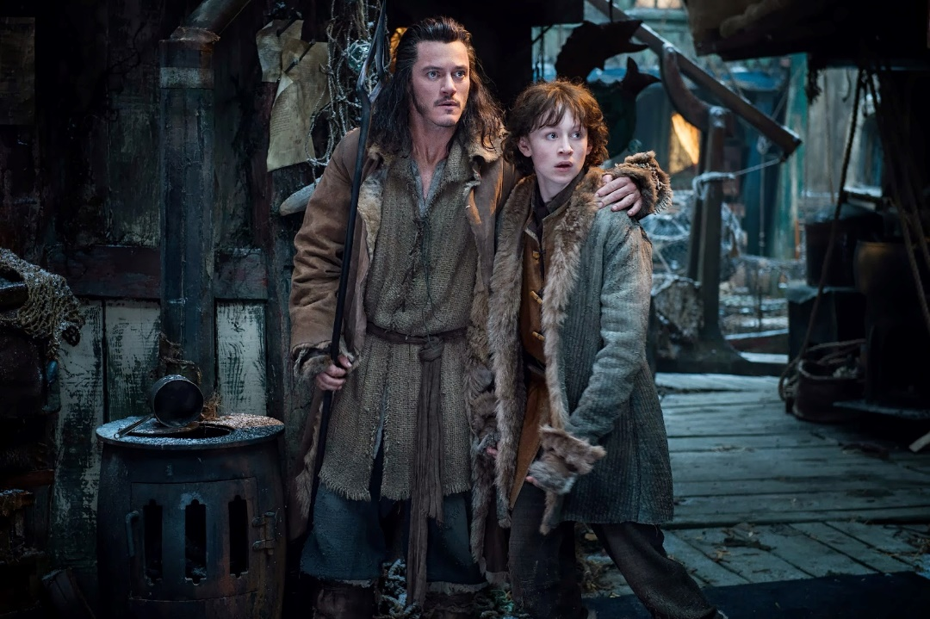
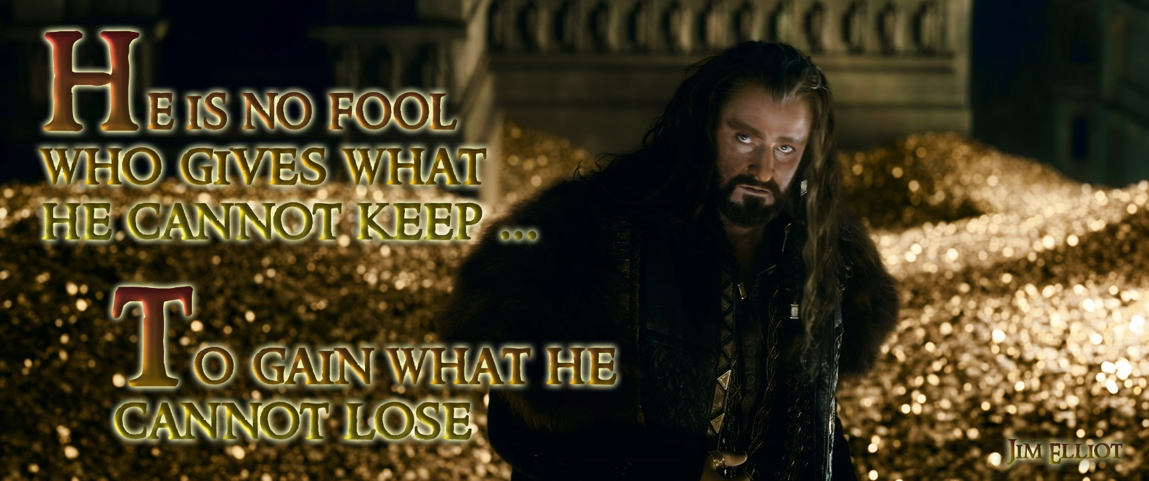
Luke 12:13-21
Who was richer, Thorin or Bard? As one
multiplied his net worth, the other lost all.
Yet I would chose Bard’s lot over Thorin’s
every time. It’s not what we have that
counts, but why. Because his heart was filled
with love for his family and kinfolk, there
was no room left in it for power or gold or
ease. Giving came easy. If we are truly
“richer than we think”, then it is not found
in bigger barns, but in the people we love.
WHY?

Slide 36
Luke 12:13-21
Wealth brings choices. Who or what guides those choices? Is what I control really mine?
Is it possible that after reaching a “certain amount”, the resources that we current have
INCREASE our worry and stress (because of the need to sustain it or perhaps hang onto it)?
Note he dialogs with himself. Yet our decisions affect many??
I am accountable to God for my actions. Now what?
- If married, talk about it. How are our resources being used?
- Tax time is a good time to reflect on this?
- What is the purpose of my current financial
plans? To retire early? More vacations?
WHY?

Slide 37
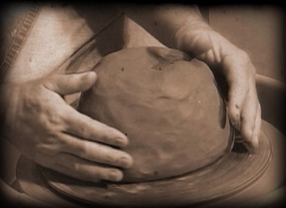
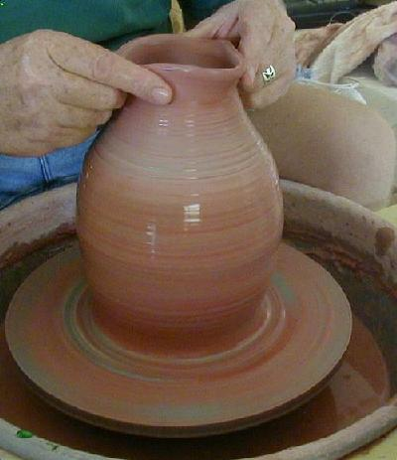
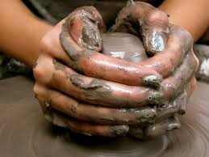
Nothing changes until
something moves!
Luke 12:22-34
WHY?

Slide 38
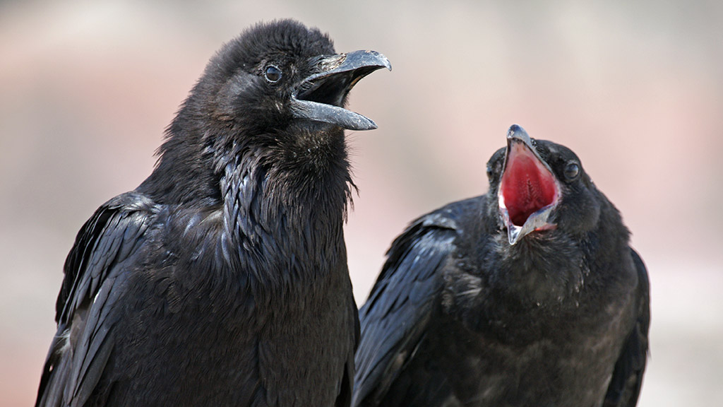
Ravens
Luke 12:22-34
Job 38:41 Who provides food for the raven when its young cry out to God and
wander about for lack of food?
Gen 8:6-7 ¶ After forty days Noah opened the window he had made in the ark and sent
out a raven, and it kept flying back and forth until the water had dried up from
the earth.
Psalm 147:9 He provides food for the cattle and for the young ravens when they call.
WHY?

Slide 39
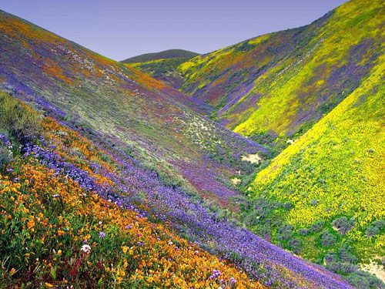
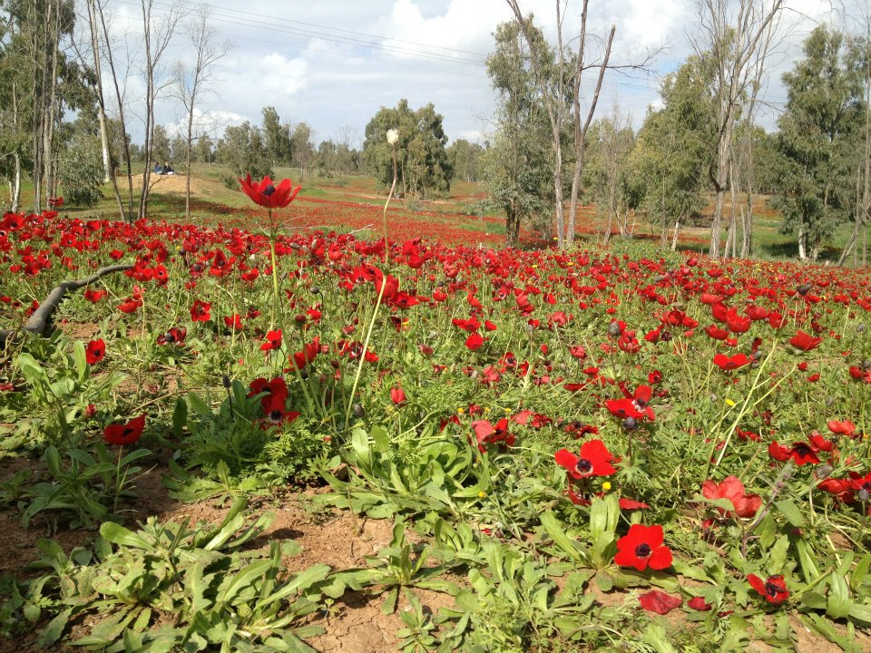
Spring Flowers (Israel)
Luke 12:22-34
WHY?

Slide 40
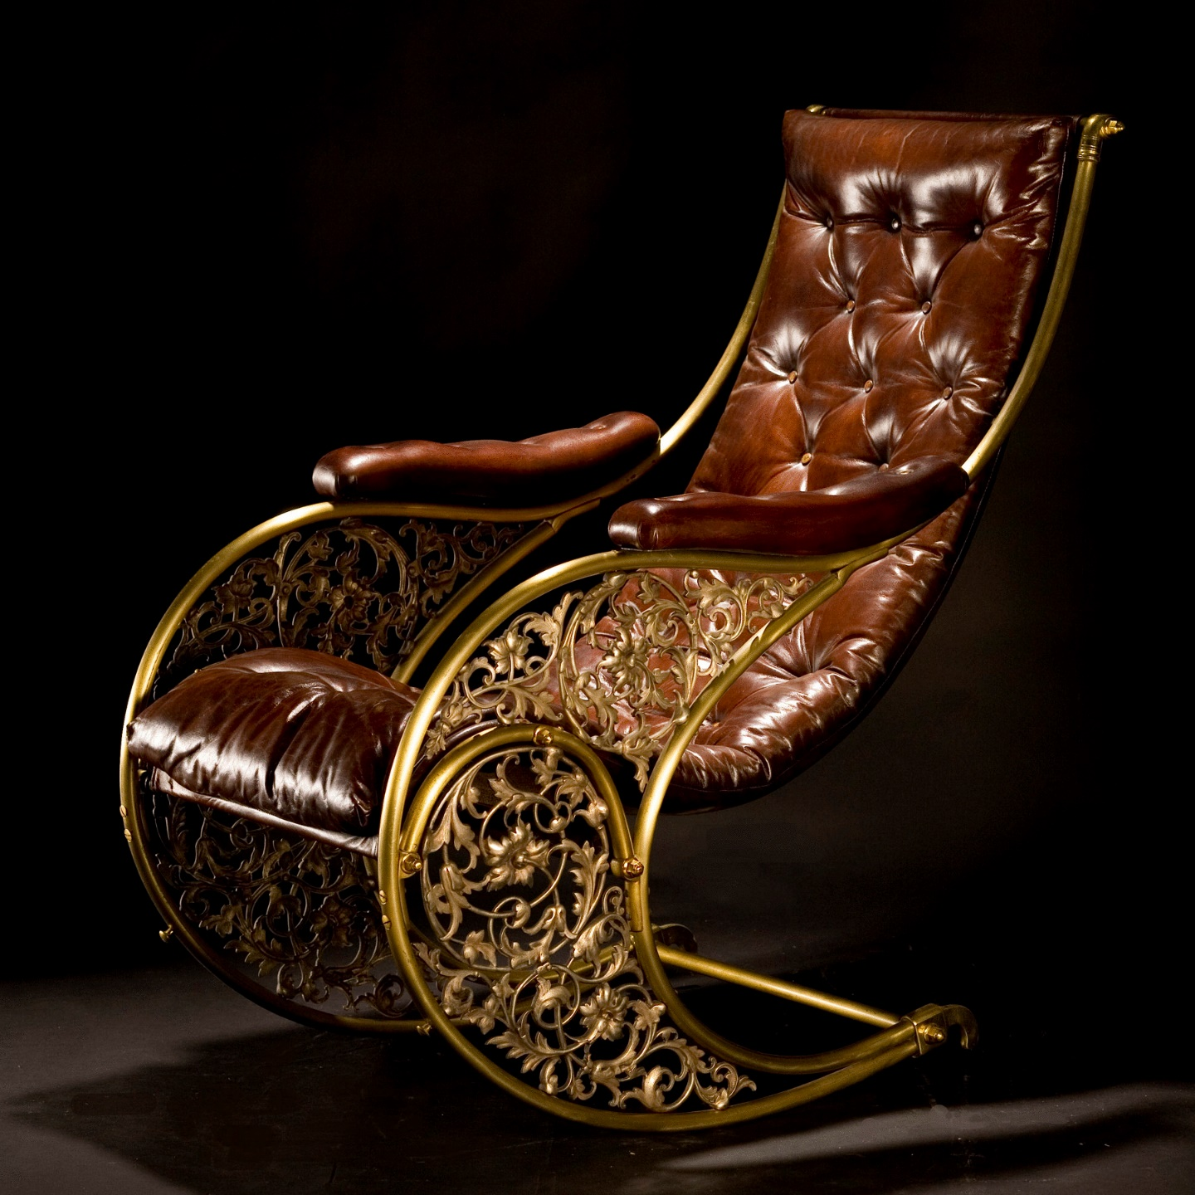
Worry
Luke 12:22-34
… Like a rocking chair constantly in
motion but never getting somewhere!
WHY?

Slide 41
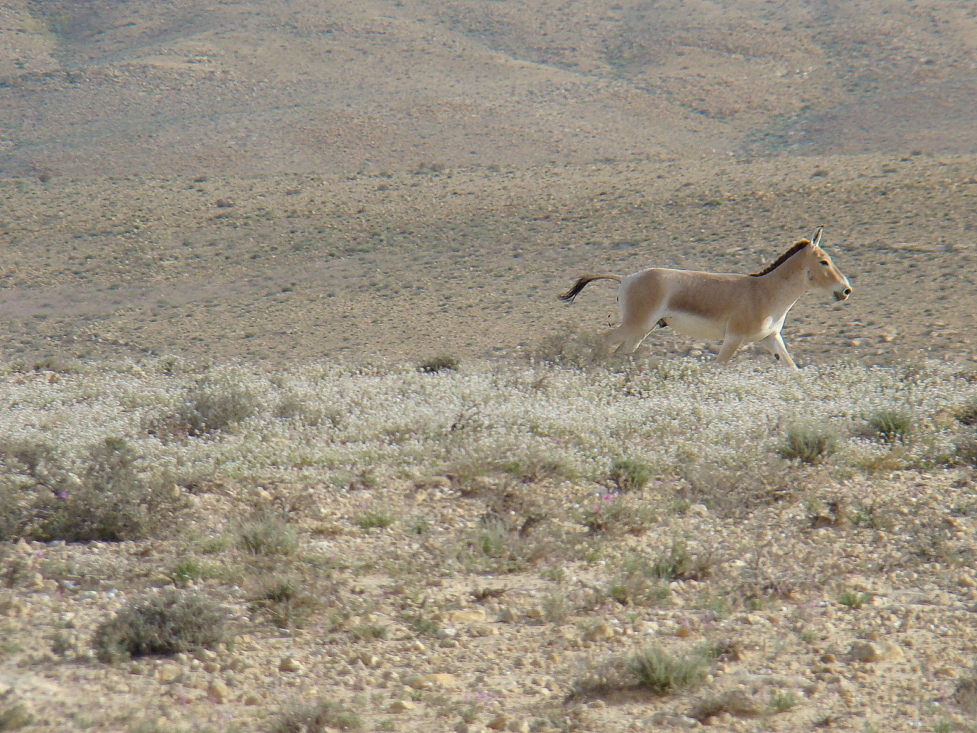
The Negev
Luke 12:22-34
WHY?

Slide 42
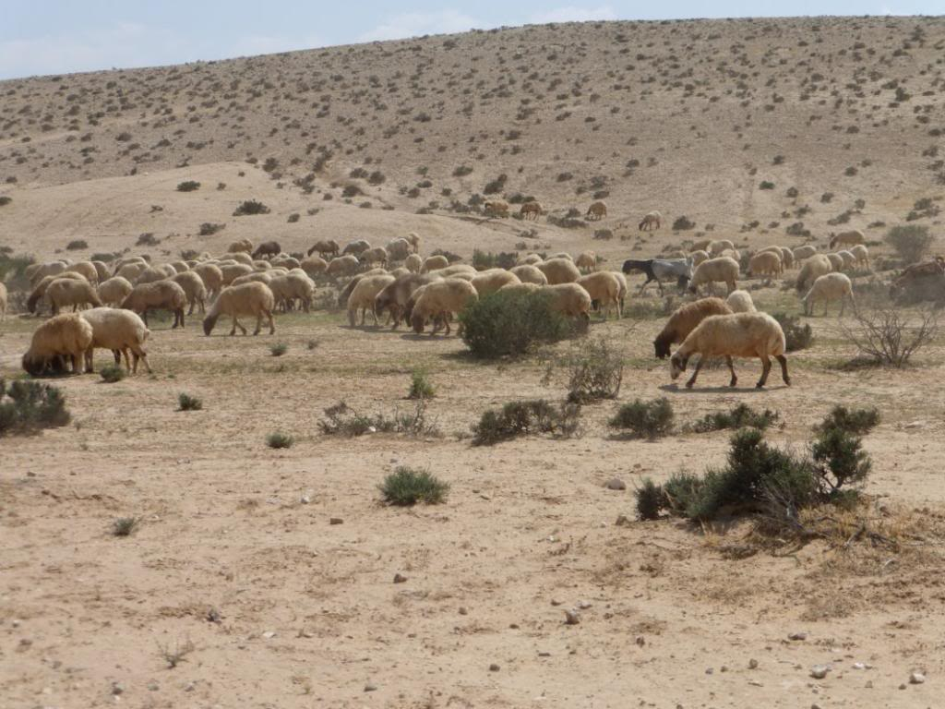
The Negev
Luke 12:22-34
WHY?

Slide 43
Luke 12:35-48
Stanza 1
"Be dressed ready for service Servants prepared
and keep your lamps burning, Servants prepared
Stanza 2
like men waiting (expecting) for their master Servants alert
to return (withdraw) from a wedding banquet, Master comes
so that when he comes and knocks Master comes
they can immediately open the door for him. Servants alert
Stanza 3
It will be good for those servants Servants blessed
whose master finds them watching when he comes. Master comes/finds
I tell you the truth, he will dress himself to serve,
will have them recline at the table and will come Master serves servants
and wait on them.
… whose master finds them ready, even if he comes Master comes/finds
in the second or third watch of the night.
It will be good for those servants Servants blessed
WHY?

Slide 44
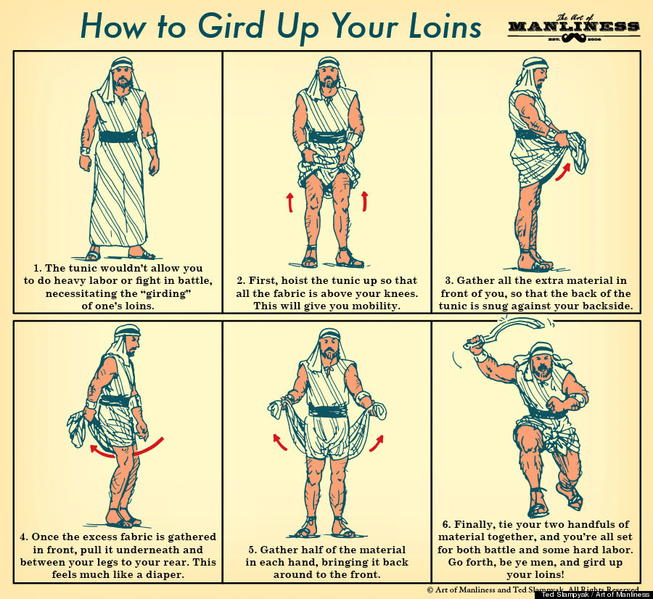
Luke 12:35-48
Being
prepared
to battle!
WHY?

Slide 45
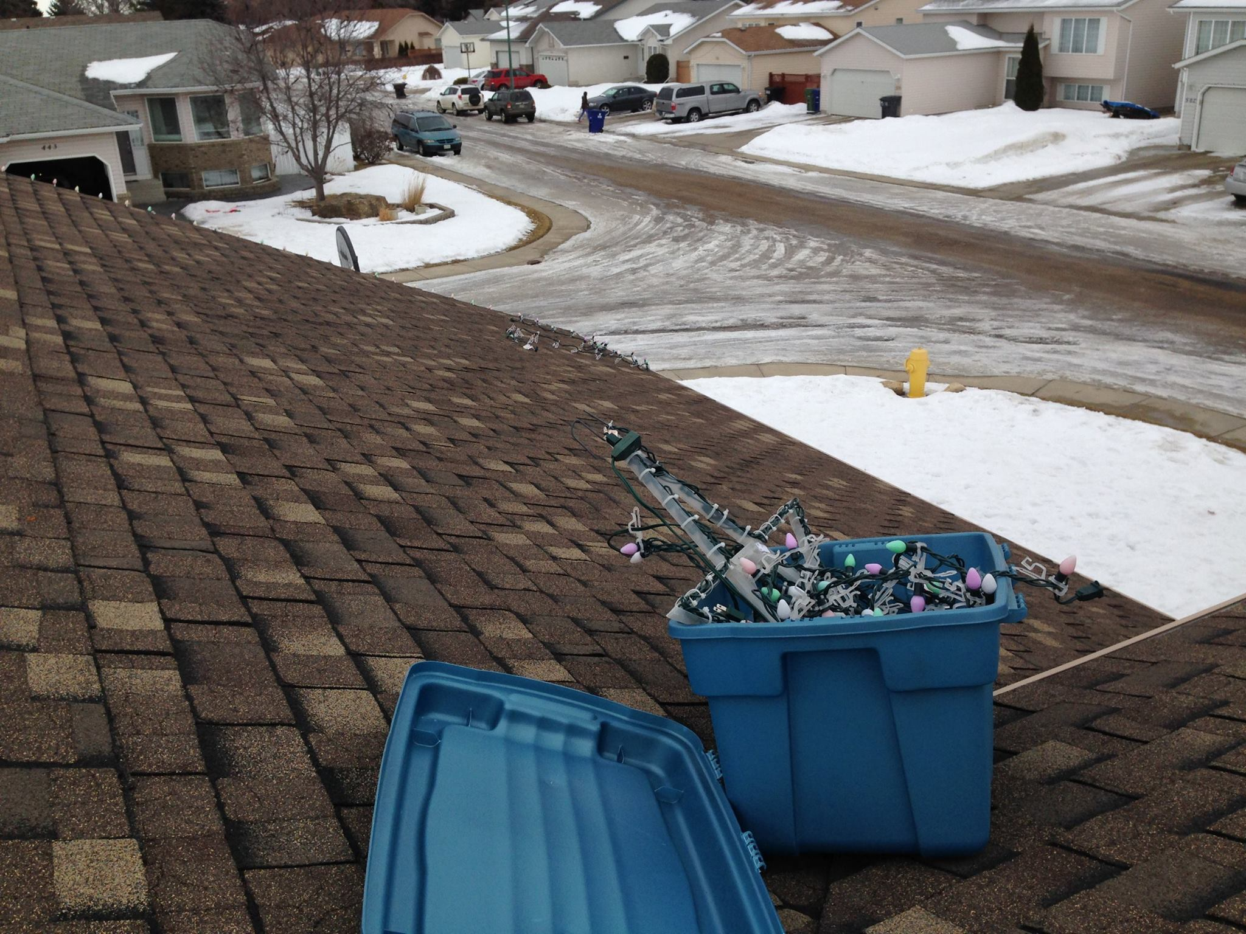
Servant Leadership
Luke 12:35-48
People ask me why I put up with the hassles of Christmas lights. Yes, I know that Jesus is the
light of the world, but that isn’t why I do it. In Saskatchewan, winters are harsh and though
beauty is there, it is often hidden. I put up lights because I think they add a splash of
technicolor beauty to a barren season. They have always brightened my evening and morning
trips. The cost of beauty? Pulling them down at the end of the season.
Adding beauty into lives, is an attainable goal for all of us. Maybe not with lights, but as
Peter suggests, through a gentle spirit.
Compassion and forgiveness, a kind
word instead of a sarcastic bite, a
smile of acknowledgment can go a
long way to lifting someone up and
instilling a hypodermic of hope.
There is always a cost to beautifying
something, but it is worth every penny.
In the meantime, I will remember that
the greens and oranges of Christmas
lights will soon give way to lush grass
and crackling campfires. Isn’t God
good, who paints us so much beauty
in life?
WHY?

Slide 46
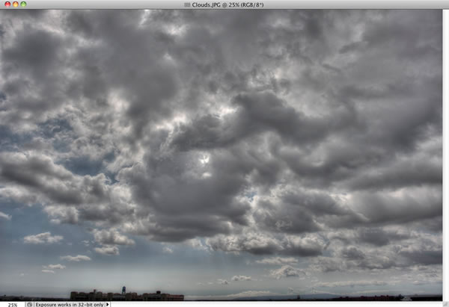
Luke 12:42-48
Attention To Detail
WHY?

Slide 47
Luke 12:35-48
Attention To Detail
WHY?

Slide 48
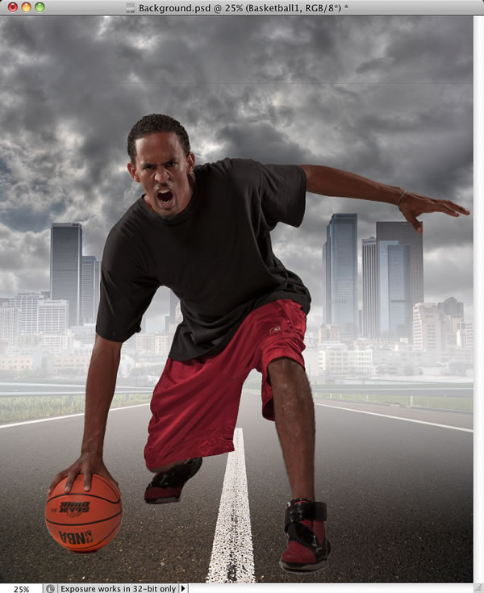
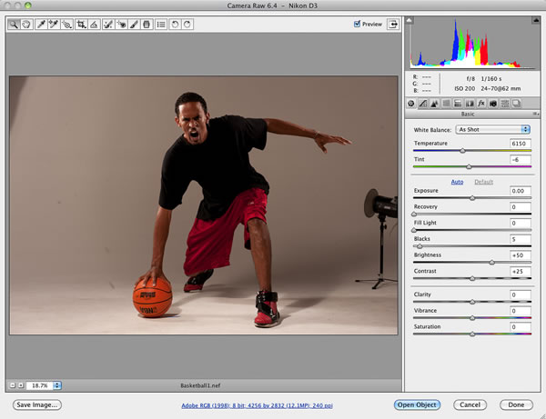
Luke 12:35-48
Attention To Detail
WHY?

Slide 49
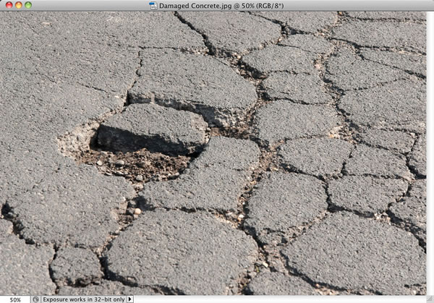
Luke 12:35-48
Attention To Detail
WHY?

Slide 50
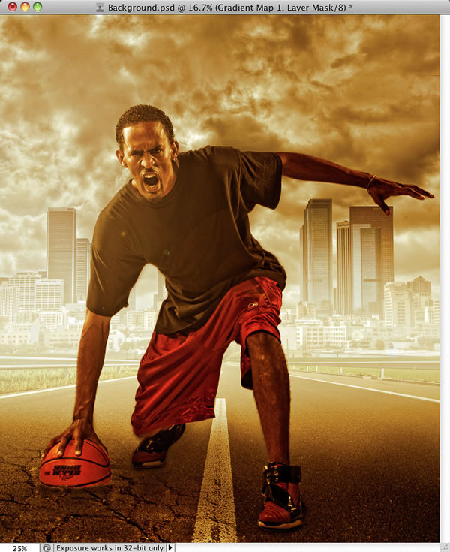
Luke 12:35-48
Attention To Detail
WHY?

Slide 51
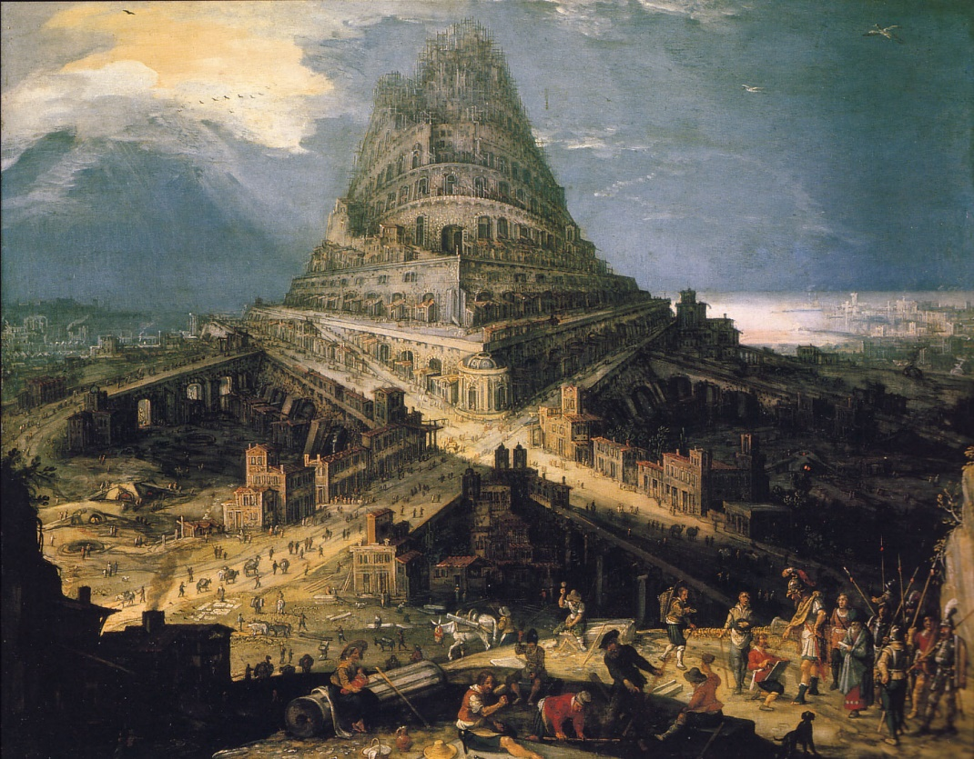
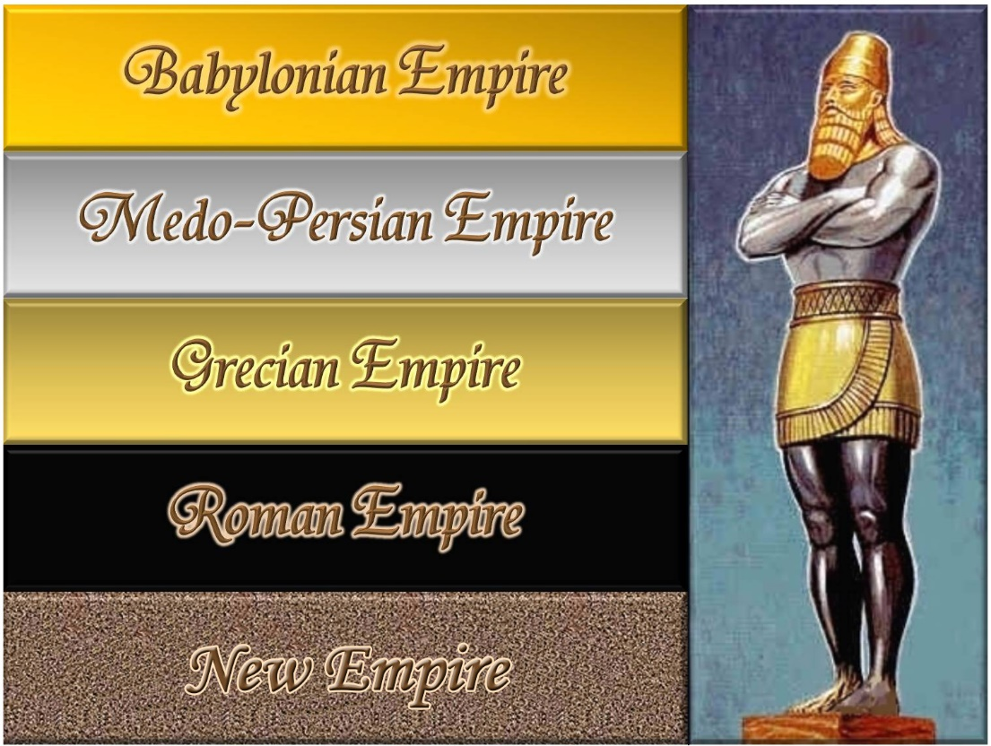
The Problem Of Unity
Luke 12:49-53
When is unity right and when is it wrong?
WHY?

Slide 52
The Problem Of Unity
Luke 12:49-53
Organization unity is not the same thing as spiritual unity.
What is the unifying principle or things? Does unity become the end goal?
Do I derive power and influence from unity?
What does this unity require me to surrender? (What are my non-negotiables [Galatians 1]?)
Can I discern between the essentials of my faith and the secondary issues?
- Indeed, are their secondary issues?
Conformity requires sameness and agreement. It requires
obedience to socially accepted standards and conventions.
It means, to me, to act, think, speak and feel “the same.”
Conformity is not unity.
WHY?

Slide 53
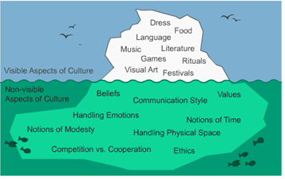
Discernment
Luke 12:54-56
What kind of issues should we be watching today?
o Education and tech and science will solve our woes
o Tech further eroding relationships
o The heart to consume rather than create
o The belief that politics will solve problems
- The more we refuse to self-regulate, the more laws are required to
force regulation
o The belief that faith has no public place
- What then informs our ethic?
Others ?
WHY?

Slide 54
Getting Right With God
Luke 12:57-59
WHY?

Slide 55
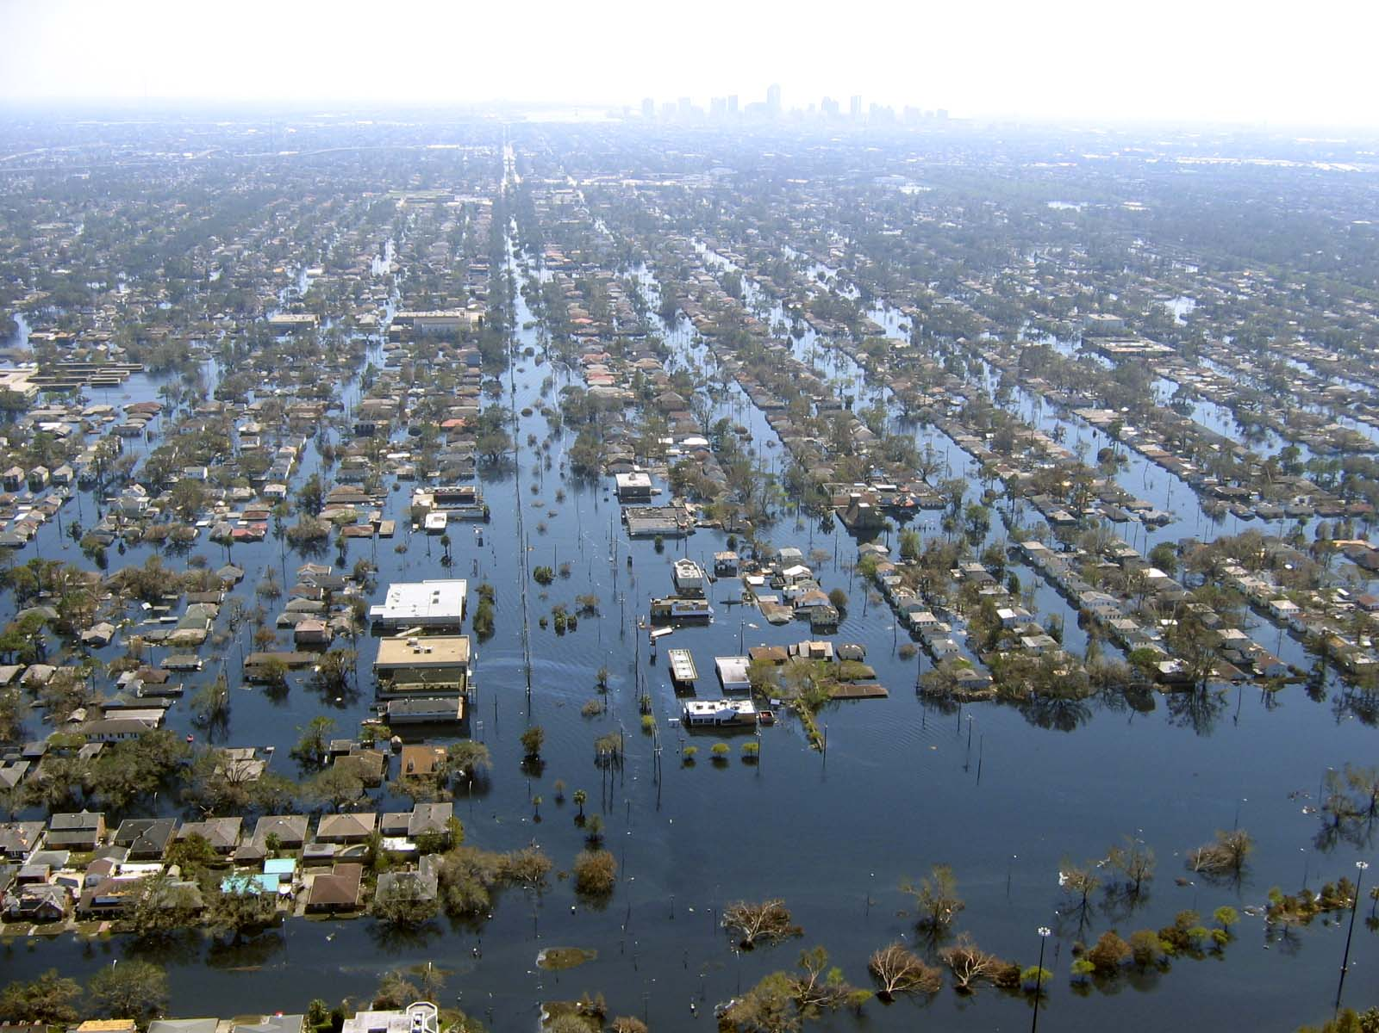
Worse Sinners?
Luke 13:1-5
WHY?

Slide 56
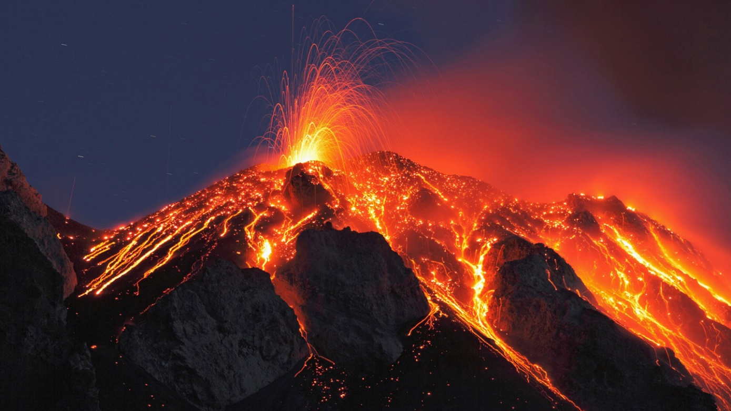
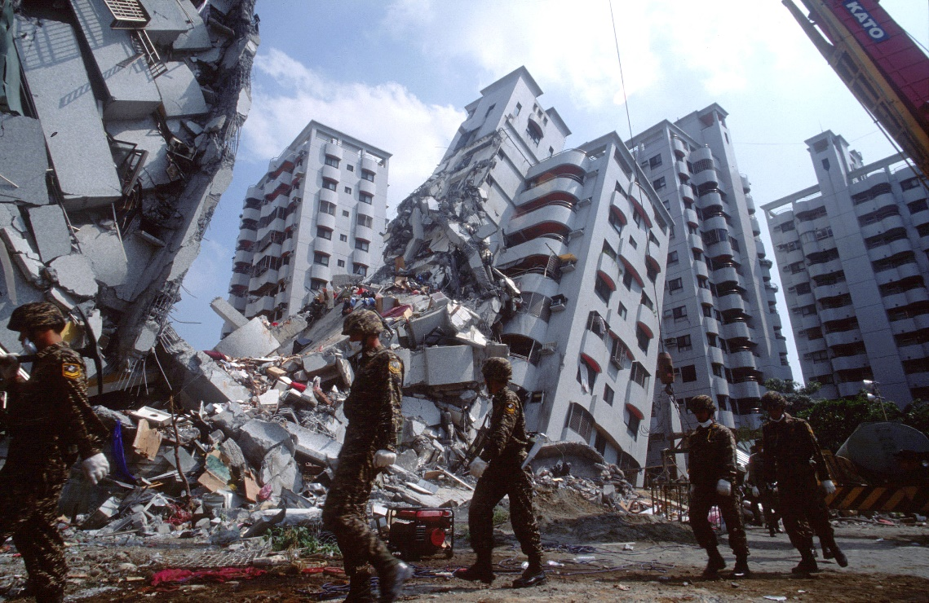
Worse Sinners?
Luke 13:1-5
WHY?

Slide 57
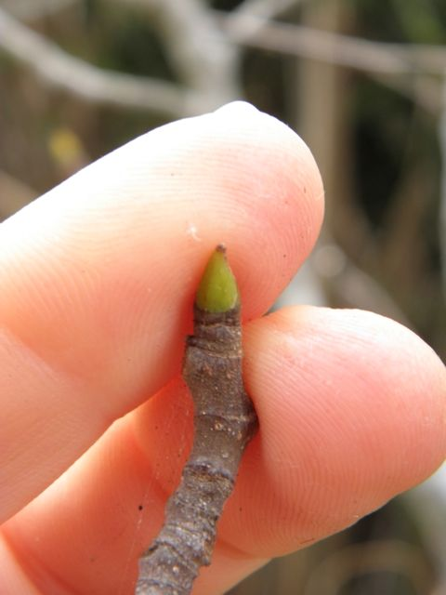
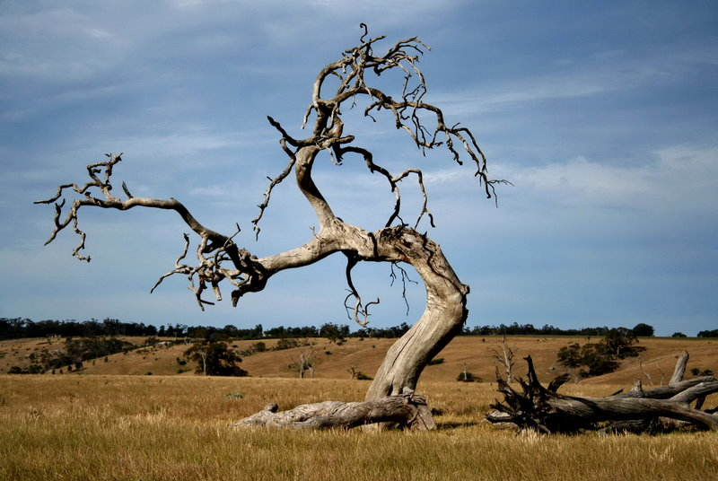
Luke 13:1-9
WHY?

Slide 58
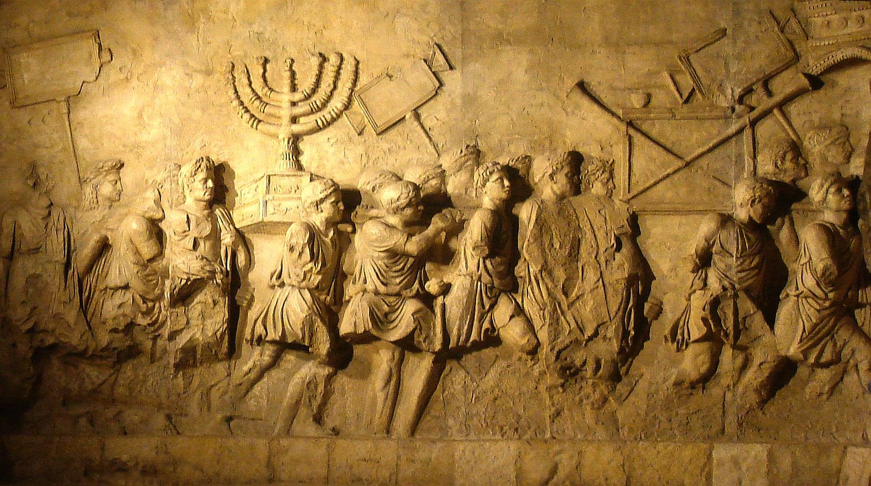
Luke 13:1-9
WHY?

Slide 59
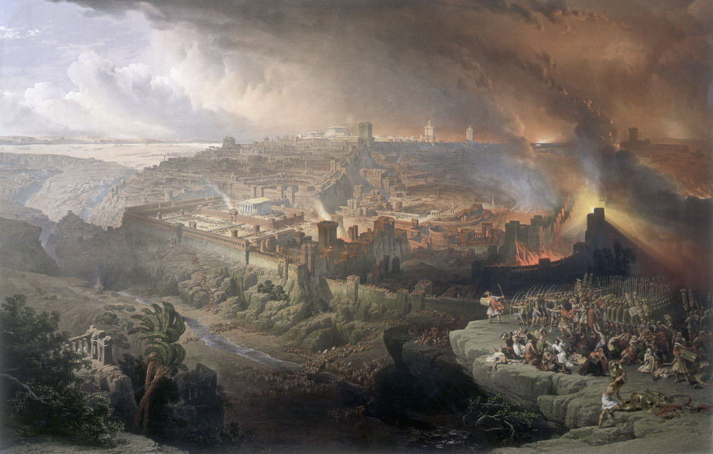
Luke 13:1-9
WHY?

Slide 60
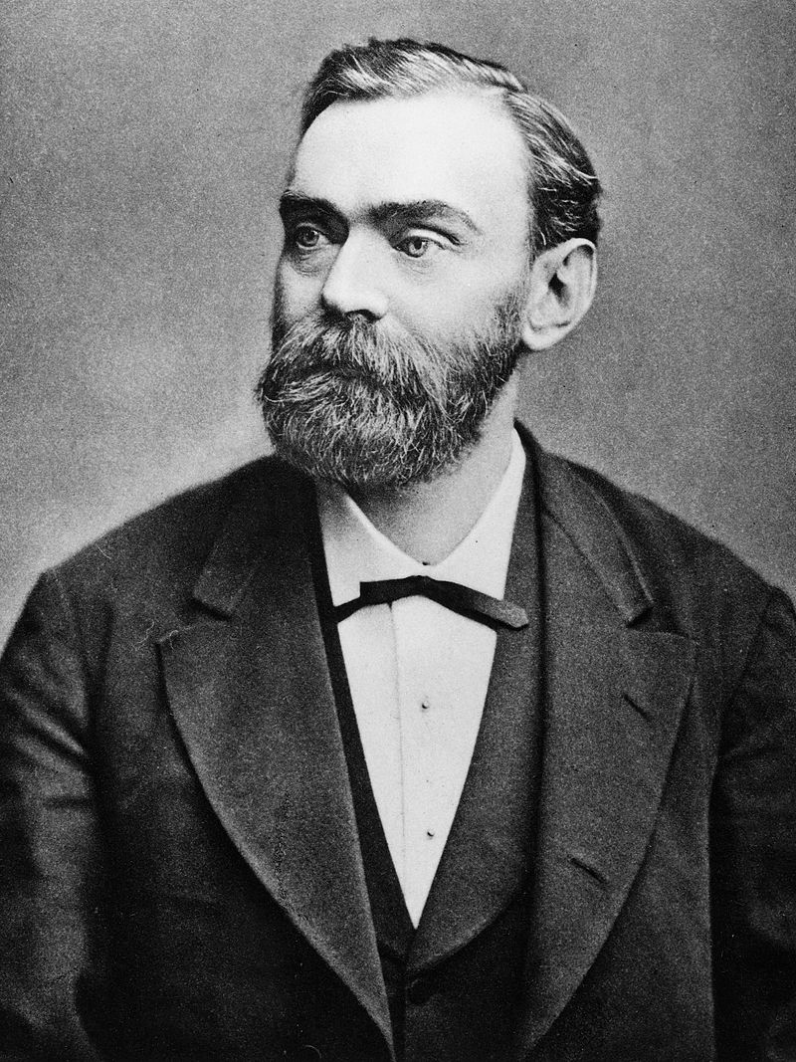
Alfred Nobel
October 21 1833 (Stockholm, Sweden)
Died: December 10 1896
Known for inventing dynamite, Nobel also
owned Bofors, which he had redirected from
its previous role as primarily an iron and
steel producer to a major manufacturer of
cannon and other armaments. Nobel held
355 different patents, dynamite being the
most famous.
Luke 13:1-9
WHY?

Slide 61
Luke 13:1-9
Alfred Nobel
In 1888 Alfred's brother Ludvig died while visiting Cannes and a
French newspaper erroneously published Alfred's obituary. It
condemned him for his invention of dynamite and is said to have
brought about his decision to leave a better legacy after his death.
The obituary stated, "The merchant of death is dead"
and went on to say, "Dr. Alfred Nobel, who
became rich by finding ways to kill more people
faster than ever before, died yesterday."
Alfred (who never had a wife or children) was
disappointed with what he read and concerned
with how he would be remembered.
WHY?

Slide 62
Luke 13:1-9
Alfred Nobel
On 27 November 1895, at the Swedish-Norwegian Club in Paris,
Nobel signed his last will and testament and set aside the bulk of his
estate to establish the Nobel Prizes, to be awarded annually without
distinction of nationality.
The first three of these prizes are awarded for
eminence in physical science, in chemistry and
in medical science or physiology; the fourth is for
literary work "in an ideal direction" and the fifth
prize is to be given to the person or society that
renders the greatest service to the cause of
international fraternity, in the suppression or
reduction of standing armies, or in the
establishment or furtherance of peace congresses.
WHY?

Slide 63
Repentance
Luke 13:10-14
When it comes to the demonic, no one has spoken more eloquently that C. S. Lewis in
The Screwtape Letters. The whole book is worth reading and reflecting on, especially in
an era that has seen an increase in interest in Satan. Here are a few key citations:
There are two equal and opposite errors into which our race can fall about the devils.
One is to disbelieve in their existence. The other is to believe, and feel an excessive and
unhealthy interest in them. They themselves are equally pleased by both errors, and hail
a materialist or a magician with the same delight.
[Screwtape to his devil assistant]: It is funny how mortals always picture us [devils] as putting
things into their minds: in reality our best work in done by keeping things out.
[Screwtape to his devil assistant]: Our policy, for the
moment, is to conceal ourselves.
WHY?

Slide 64
Change??
Luke 13:15-17
What is the Lord speaking to you about?
What does He desire to change?
If the answer is nothing, you are not listening
close enough.
What is making you angry these day? Defensive?
What themes are constantly bombarding you?
What are your mentors saying to you?
What aspects of your life are in need of
the Lord's touch?
What next????
WHY?

Slide 65
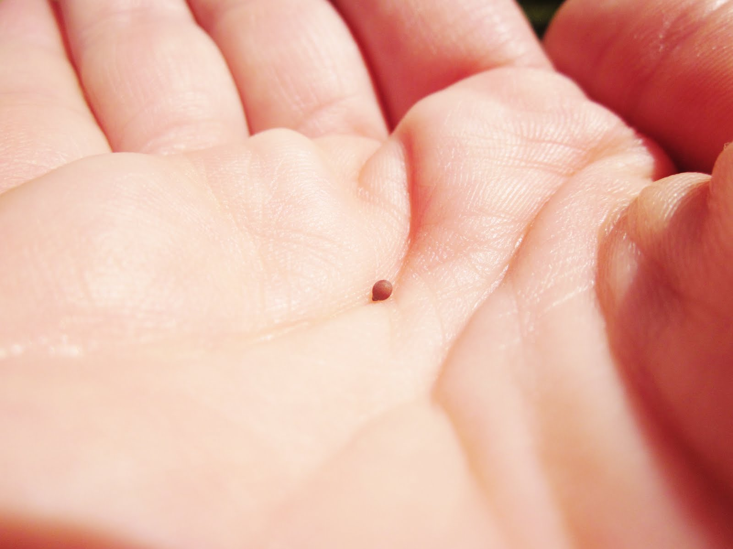
The Kingdom
Luke 13:18-30
WHY?
The Kingdom grows.

Slide 66
The Kingdom
Luke 13:18-30
WHY?
Mustard

Slide 67
The Kingdom
Luke 13:18-30
Leaven
WHY?
Wheat and tares

Slide 68
What Does "Pressing In" look Like?
Luke 13:18-30
WHY?

Slide 69
What Does "Pressing In" look Like?
Luke 13:18-30
WHY?

Slide 70
What Does "Pressing In" look Like?
Luke 13:18-30
WHY?

Slide 71
What Does "Pressing In" look Like?
Luke 13:18-30
WHY?

Slide 72
That Fox …
Luke 13:32-35
WHY?

Slide 73
Unrequited Love
Luke 13:32-35
- Not all people that we care about will respond the way we want them to.
- Don’t withdraw or holdback. Remain in a state of being ready to accept them.
- Understand they are on a different journey. Keep to the moral high grounds.
WHY?

Slide 74
Triclinium
Luke 14:7-11
WHY?

Slide 75
The Kingdom
Luke 14:15-20
Isaiah 25:6-9
And in this mountain shall the LORD of hosts make unto all people a feast of fat things, a
feast of wines on the lees, of fat things full of marrow, of wines on the lees well refined.
And he will destroy in this mountain the face of the covering cast over all people, and the
vail that is spread over all nations.
He will swallow up death in victory; and the Lord GOD will wipe away tears from off
all faces; and the rebuke of his people shall he take
away from off all the earth: for the LORD hath spoken it.
And it shall be said in that day, Lo, this is our God;
we have waited for him, and he will save us: this is
the LORD; we have waited for him, we will be glad
and rejoice in his salvation.
WHY?

Slide 76
The Kingdom
Luke 14:15-20
The Targum
Yahweh of hosts will make for all the people in this mountain a meal. And although they
suppose it is an honor, it will be a shame for them and great plagues, plagues from which
they will be unable to escape, plagues thereby they will come to their end.
1 Book Of Enoch 62
Nevertheless that Lord of Spirits will so press them
That they shall hastily go forth from His presence,
And their faces shall be filled with shame,
And the darkness grow deeper on their faces.
And He will deliver them to the angels for punishment,
To execute vengeance on them because they have oppressed His children and His elect
WHY?

Slide 77
The Kingdom
Luke 14:15-20
WHY?

Slide 78
Excuses
Luke 14:15-20
WHY?

Slide 79
Excuses
Luke 14:15-20
WHY?

Slide 80
Response To Sorrow
Luke 14:15-20
WHY?

Slide 81
Indifference
Luke 14:15-20
WHY?

Slide 82
The Cost of Being A Disciple
Luke 14:25-35
WHY?

Slide 83
The Cost of Being A Disciple
Luke 14:25-35
Common salt comprises a very stable, simple chemical compound called sodium chloride,
which has a salty flavour. As table salt, it typically also contains minor amounts of additives
to keep it free-flowing.
As it is so chemically stable, sodium chloride will not lose its saltiness, even after being
stored dry for many years. However, there are ways in which salt may appear to lose its
saltiness.
Historically, salt has been
obtained from crude sources
such as salt marshes, and
minerals such as rock salt.
This contains the stable
sodium chloride plus other
components. Sodium chloride
is readily water-soluble, so if
this crude salt were exposed
to condensation or rain water,
the sodium chloride could be
dissolved and removed, and
the salt could in effect lose its saltiness.
WHY?

Slide 84
The Cost of Being A Disciple
Luke 14:25-35
John Wesley’s Small Group Questions
Am I consciously or unconsciously creating the impression that I am better than I am? In other words,
am I a hypocrite?
Am I honest in all my acts and words, or do I exaggerate?
Do I confidentially pass on to another what was told me in confidence?
Am I a slave to dress, friends, work, or habits?
Am I self-conscious, self-pitying, or self-justifying?
Did the Bible live in me today?
Do I give it time to speak to me everyday?
Am I enjoying prayer?
When did I last speak to someone about my faith?
Do I pray about the money I spend?
Do I get to bed on time and get up on time?
Do I disobey God in anything?
Do I insist upon doing something about which my conscience is uneasy?
Am I defeated in any part of my life?
Am I jealous, impure, critical, irritable, touchy or distrustful?
How do I spend my spare time?
Am I proud?
Do I thank God that I am not as other people, especially as the Pharisee who despised the publican?
Is there anyone whom I fear, dislike, disown, criticize, hold resentment toward or disregard?
If so, what am I going to do about it?
Do I grumble and complain constantly?
Is Christ real to me?
WHY?

Slide 85
The Cost of Being A Disciple
Luke 14:25-35
Chuck Swindoll’s Pastoral Accountability Questions
Have you been with a woman anywhere this past week that might be seen as compromising?
Have any of your financial dealings lacked integrity?
Have you exposed yourself to any sexually explicit material?
Have you spent adequate time in Bible study and prayer?
Have you given priority time to your family?
Have you fulfilled the mandates of your calling?
Have you just lied to me?
Phil Helfer’s Questions
How have you experienced God in your life this week?
What is God teaching you?
How are you responding to His prompting?
Do you have a need to confess any sin?
How did you do with your reading this week?
WHY?

Slide 86
The Cost of Being A Disciple
Luke 14:25-35
The Highway Community in Palo Alto
Did I invest the proper quality/quantity of time in my most important relationships?
Did my life reflect verbal integrity?
Did I express a forgiving attitude toward others?
Did I practice undisciplined or addictive behavior?
Was I honorable in my financial dealings?
Was I sexually pure?
Did I spend time with the Lord this week, completing the Bible reading for the week?
Did I pray for my pre-Christian friends? Did I talk with someone about Christ?
Neil Cole’s Basic Questions
What is God telling you to do?
What are you going to do about it?
WHY?

