Slide 2
The Beginnings Of The Life Of Jesus
1:1-4 The introduction of the book.
1:5-25 The birth of John the Baptist is foretold
1:26-45 The birth of Jesus is foretold.
1:45-56 The song of praise that Mary dictates. This is similar to Hannah’s song.
1:57-80 The birth of John the Baptist, with Zachariah’s prophecy
2:1-3 Enrollment of Quirinius
2:4-20 The birth of Christ
2:21-38 Jesus is circumcised and presented to the priest Simeon. Anna also speaks.
2:39-52 The boyhood of Jesus; the visit to Jerusalem when He was twelve.
The Preparation For Ministry
3:1-14 The ministry of John the Baptist.
3:15-20 John testifies about the coming Christ.
3:21-22 The baptism of Jesus
3:23-38 The genealogy of Jesus
4:1-12 The temptation of Jesus
4:13 Satan is defeated and leaves temporarily.

Slide 3
The Galilean Ministry Begins
4:14-15 The beginning of His ministry.
4:16-30 Jesus is rejected at Nazareth, His home town. Note that He quotes from Isa. 61:1-2.
4:31-37 The demoniac is healed.
4:38-44 Peter’s mother-in-law is healed.
5:1-11 The call of Peter, James and John.
5:12-26 The leper and the paralytic are healed.
5:27-29 The call of Levi (also called Matthew)
5:30-39 The Pharisees and scribes attack: Jesus answers.
6:1-11 Jesus deals with the question of the Sabbath by healing an atrophied hand.
6:12-19 Jesus prays all night - then chooses the twelve.
6:20-49 Another teaching of the Beatitudes (similar to Matthew 5-7).
7:1-10 The Centurion’s servant is healed.
7:11-18 The widow’s son is raised from the dead
at Nain.
7:19-35 Jesus testifies about John the Baptist.
7:36-50 Jesus is anointed by the sinful woman.

Slide 4
8:1-3 The women who ministered to Christ are listed.
8:4-15 The parable of the sower
8:16-18 The parable of the lighted candle.
8:19-21 The new relationship is defined.
8:22-25 Jesus stills the storm
8:26-39 The demoniac of Gadara is healed
8:40-56 A woman is healed and Jarius’s daughter is raised from the dead.
9:1-9 The twelve are sent out to minister on their own (and are given power)
9:10-17 The feeding of the 5000.
9:18-26 The confession of Peter
9:27-36 The transfiguration of Jesus before the disciples.
9:37-50 Why the disciples had no power: Jesus again casts of the demon.

Slide 5
On The Way To Jerusalem
9:51-62 Jesus now turns towards Jerusalem (and the cross).
10:1-24 The seventy disciples are sent out to minister.
10:25-29 The lawyer asks, “Who is my neighbour”?
10:30-37 The good Samaritan story.
10:38-42 The contrasts between Mary and Martha.
11:1 Jesus praying.
11:2-4 Jesus’ instructions on prayer.
11:5-13 A parable on prayer
11:14-28 Jesus teaches on Demonism
11:29-32 The sign of Jonah
11:33-38 The parable of the candle.
11:39-44 The Pharisees are denounced.
11:45-54 The lawyers are denounced.
12:1-12 The warning about false doctrine.
12:13-34 The warnings against greediness.
12:35-48 The warning about watching for
the second coming.
12:49-59 Christ “divides” people.

Slide 6
13:1-5 Jesus teaches on repentance and being ready.
13:6-9 The barren fig tree (this represents Israel).
13:10-17 The healing of another woman.
13:18-21 The parables of the mustard seed and leaven.
13:22-30 How many will be saved?
13:31-33 Jesus warns about Herod.
13:34-35 Jesus weeps over Jerusalem
14:1-6 The healing on the Sabbath.
14:7-15 The parable of the over-zealous guest.
14:16-24 The parable of the great supper.
14:25-35 The cost of discipleship.
15:1-7 The parable of the lost sheep.
15:8-10 The parable of the lost coin.
15:11-32 The parable of the lost (prodigal) son.
16:1-18 The parable of the dishonest steward.
16:19-31 The story (not parable) of the rich man
and Lazarus.
17:1-10 The teaching on forgiveness and service.
17:11-19 The cleansing of the ten lepers.
17:20-37 The question of “when the Kingdom of God”
should come.

Slide 7
18:1-8 The parable of the Unjust Judge.
18:9-14 The parable of the Pharisee and the Publican.
18:15-17 Jesus blesses the little children.
18:18-30 The story of the rich young ruler.
18:31-34 Jesus predicts His death.
18:35-43 Jesus heals the blind man near Jericho.
19:1-10 The conversion of Zacchaeus.
19:11-27 The parable of the pounds.
19:28-40 The triumphal entry into Jerusalem.
19:41-44 Jesus weeps over Jerusalem.
19:45-48 Again, Jesus cleanses the Temple court.
Temple Teachings
20:1-8 The authority of Jesus is questioned.
20:9-18 The parable of the vineyard.
20:19-26 The question about tax money.
20:27-38 The Sadducees are silenced.
20:39-47 The scribes are interrogated.
21:1-4 Jesus observes the widow’s mite offering.
21:5-38 Jesus discusses the end-times issues.

Slide 8
The Suffering And Resurrection Of The Lord
22:1-2 The plot to kill Jesus
22:3-6 The treachery of Judas
22:7-13 The preparations for the Passover.
22:14-18 The last Passover.
22:19-20 The Lord’s supper is instituted.
22:21-23 The announcement of the betrayal.
22:24-30 The Apostle’s place in the future kingdom.
22:31-34 Jesus predicts Peter’s denial.
22:35-38 Jesus predicts future conflicts.
22:39-46 Jesus prays in the Garden of Gethsemane.
22:47-53 Jesus is betrayed.
22:54-65 Jesus is arrested
22:66 - 23:26 The various trials
23:27-38 The crucifixion
23:39-45 The thief that repents.
23:46-49 The death of Christ.
23:50-56 The burial of Christ
24:1-12 The resurrection of Christ
24:13-35 Jesus appears to the disciples on the
road to Emmaus
24:36-43 Jesus appears to the eleven.
24:44-49 Jesus gives the great commission.
24:50-53 The ascension of Christ

Slide 9
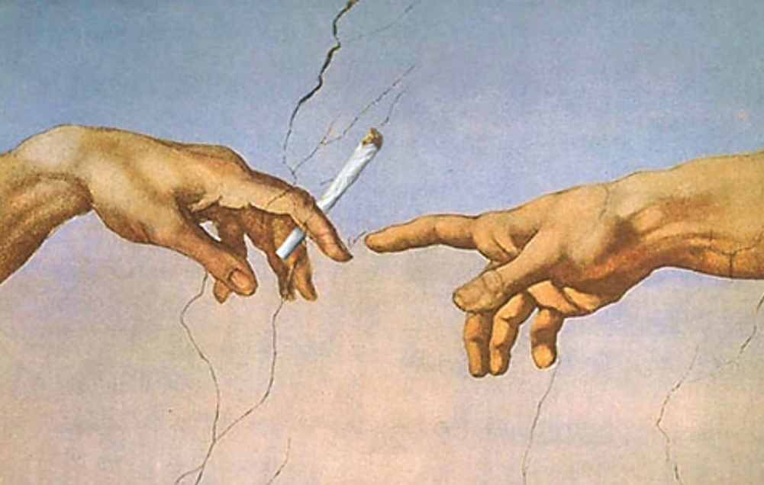
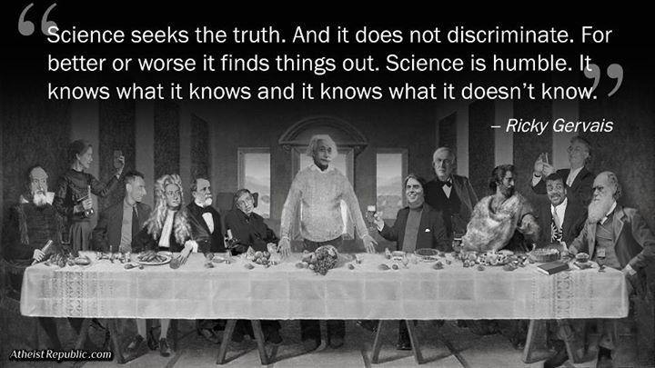
Luke 6:11
The chain of hatred moves from:
caricaturization to
marginalization to
vilification to
villainization to
criminalization to
elimination.

Slide 10
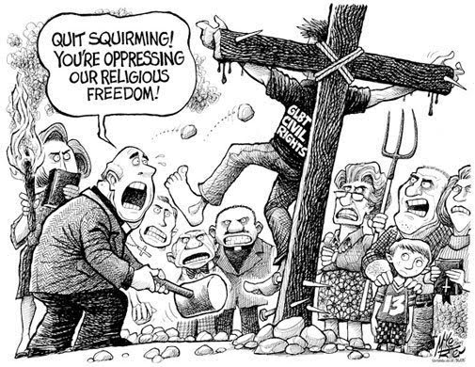
Luke 6:11
The chain of hatred moves from:
caricaturization to
marginalization to
vilification to
villainization to
criminalization to
elimination.

Slide 11
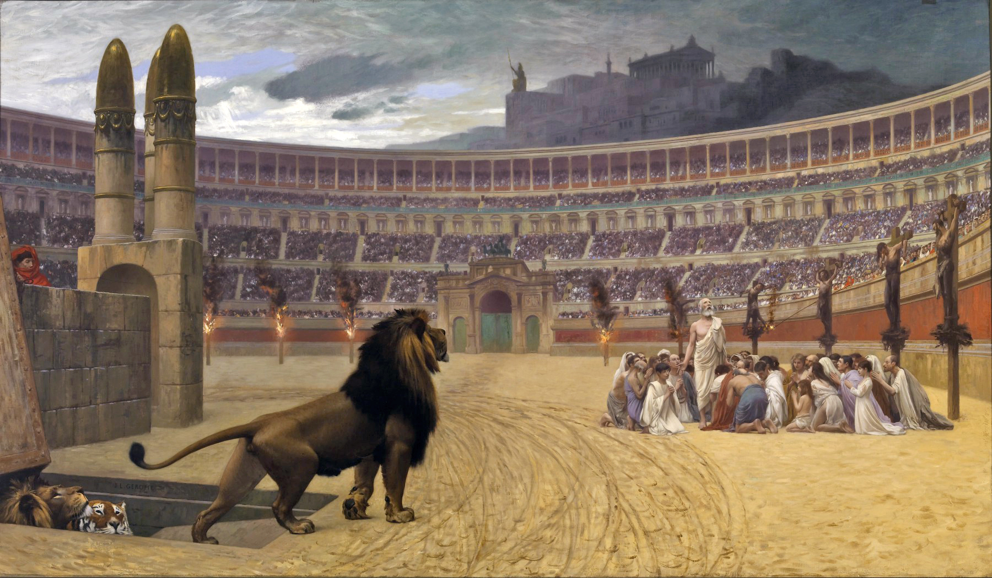
Luke 6:11
The chain of hatred moves from:
criminalization to
elimination.

Slide 12
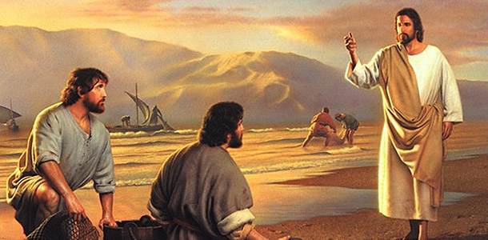
Luke 6:12
- Jesus spends all night in prayer. Why? In the mountains … why?
- One will betray Him. Did Jesus choose wrong?
- Why choose 12? Does this choosing of new leaders mean that Jesus has rejected the
current spiritual leadership? Is there anything to be made of the fact that these men
were of no repute and lived far from Jerusalem?
- In all the lists of the Apostles, Peter is always first, the first four are always Peter, Andrew,
James and John. Bartholomew = Nathanael; Matthew = Levi; Judas son of James =
Thaddeus
- Why would Jesus choose a Zealot, who would have hated someone like Matthew?
- Leadership is never restricted to the chosen, gifted few!

Slide 13
Luke 6:22, Matthew 5
Jesus’ Values Counter-values
Poor in spirit Self-confident, competent, self-reliant
Mourn Pleasure-seeking, hedonistic, “the beautiful people”
Meek Proud, powerful, important
Hunger and thirst Satisfied, “well adjusted,” practical
for righteousness
Merciful Self-righteous, “able to take care of themselves”
Pure in heart “Adult,” sophisticated, broad-minded
Peacemakers Competitive, aggressive
Persecuted because Adaptable, popular, “Don’t rock the boat”
of righteousness

Slide 14
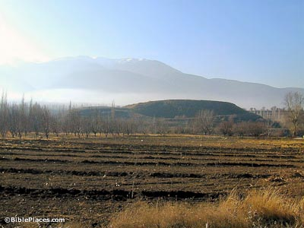
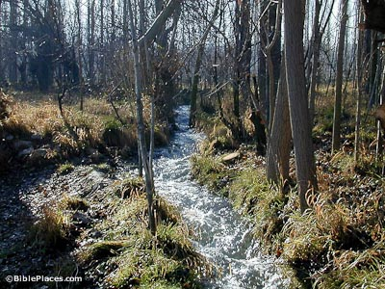
Luke 6 Making A Cultural Difference
Colossae Water: Cooling and refreshing
Colossae at the foot of Mount Cadmus

Slide 15
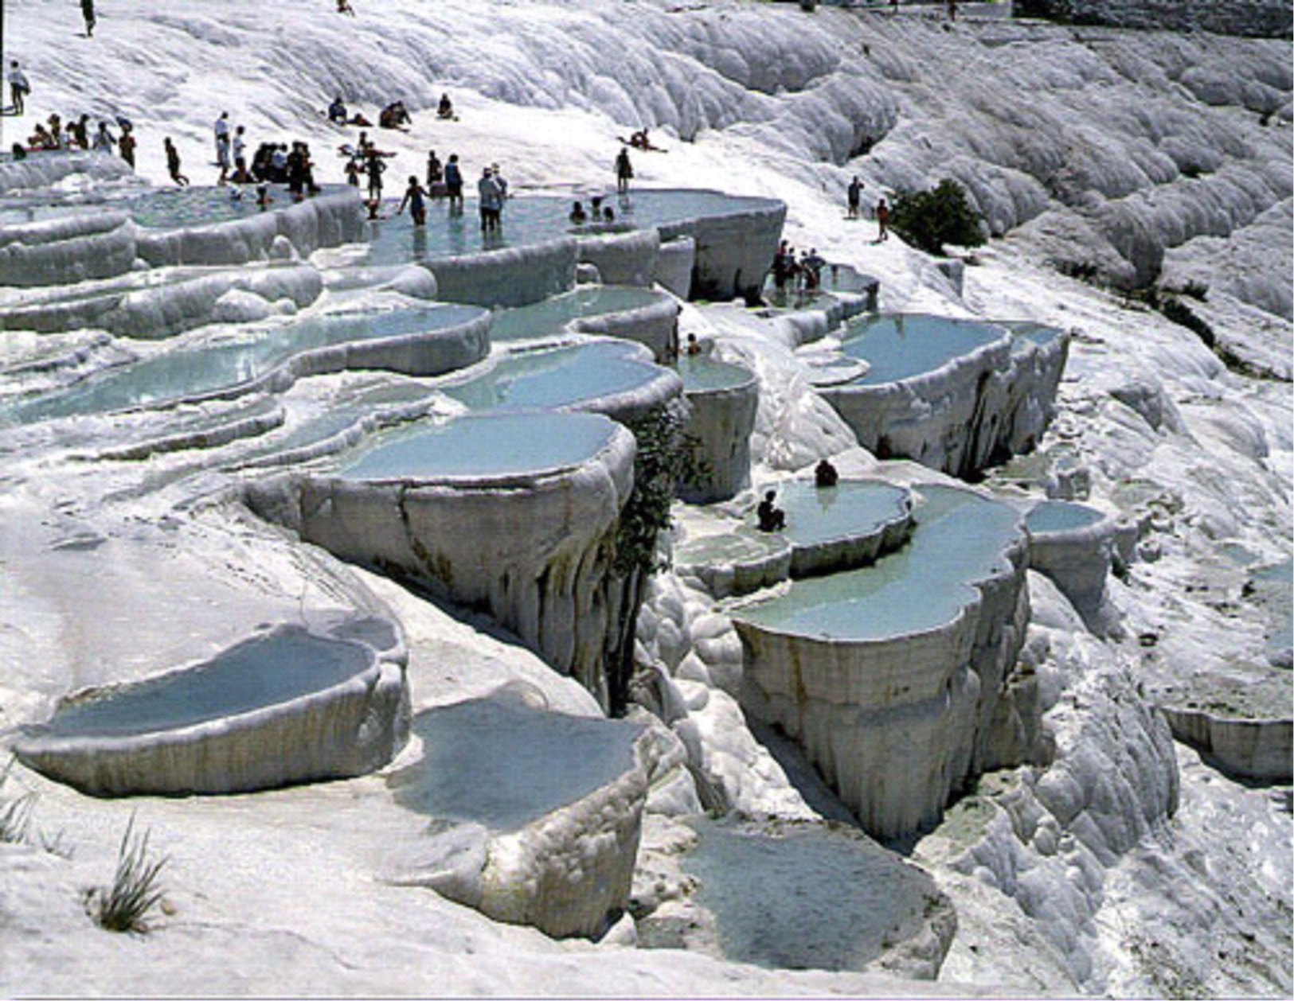
Luke 6 Making A Cultural Difference
Hierapolis Water: Medicinal

Slide 16
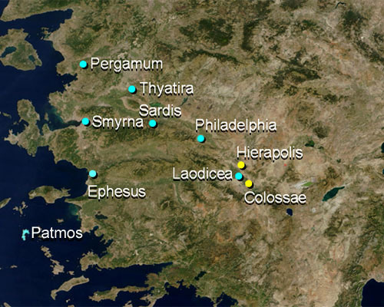
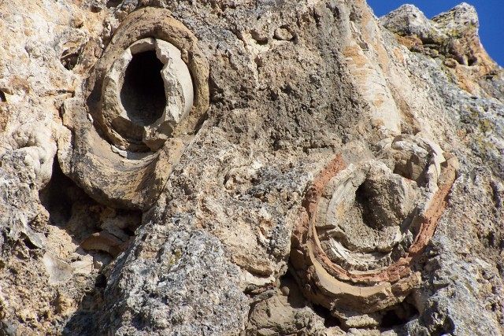
Luke 6 Making A Cultural Difference
Laodicean Water: Mixing The Waters

Slide 17
We will not obey’: Christian leaders threaten civil disobedience if Supreme Court
legalizes gay marriage
We will not obey.”
That’s the blunt warning a group of prominent religious leaders is sending to the Supreme
Court of the United States as they consider same-sex marriage. “We respectfully warn the
Supreme Court not to cross that line,” read a document titled, Pledge in Solidarity to
Defend Marriage. “We stand united together in defense of marriage. Make no mistake
about our resolve.”
“While there are many things we can endure, redefining
marriage is so fundamental to the natural order and
the common good that this is the line we must draw
and one we cannot and will not cross,” the pledge
states.
The signees are a who’s who of religious leaders
including former Arkansas Gov. Mike Huckabee, former
U.S. Senator Rick Santorum, National Religious Broadcasters
president Jerry Johnson, Pastor John Hagee, and Franklin Graham,
president and CEO of the Billy Graham Evangelistic Association and Samaritan’s Purse.

Slide 18
The pledge was co-drafted by Deacon Keith Fournier, a Catholic deacon, and Mat Staver,
the founder of Liberty Counsel. Also involved in the document were Rick Scarborough, the
president of Vision America Action and James Dobson, the founder of Family Talk Radio.
“We’re sending a warning to the Supreme Court and frankly any court that crosses the line
on the issue of marriage,” Staver told me. He said that once same-sex marriage is elevated
to the level of protected status – it will transform the face of society and will result in
the “beginning of the end of Western Civilization.”
“You are essentially saying that boys and girls don’t need moms and dads – that moms
and dads are irrelevant,” Staver said. “Gender becomes pointless when government
adopts same-sex marriage. It creates a genderless relationship
out of a very gender-specific relationship. It says that it
doesn’t matter and that two moms or two dads are
absolutely equivalent to a mom and a dad.”
Dobson said the legalization of same-sex marriage
could fracture the nation. “The institution of marriage
is fundamental and it must be defended,” he told me.
“It’s the foundation for the entire culture. It’s been in
existence for 5,000 years. If you weaken it or if you undermine
it – the entire superstructure can come down. We see it as that important.”

Slide 19
And that means the possibility of Christians – people of faith – engaging in acts of civil
disobedience. “Yes, I’m talking about civil disobedience,” Staver said. “I’m talking about
resistance and I’m talking about peaceful resistance against unjust laws and unjust rulings.”
That’s quite a shocking statement. So I asked Mr. Staver to clarify his remarks. “I’m calling
for people to not recognize the legitimacy of that ruling because it’s not grounded in the
Rule of Law,” he told me. “They need to resist that ruling in every way possible. In a peaceful
way – they need to resist it as much as Martin Luther King, Jr. resisted unjust laws in his time.”
Scarborough said the pledge was meant to be forthright and clear.
We’re facing a real Constitutional crisis if the Supreme Court rules adversely
from our perspective on same-sex marriage,” he told
me. For me there’s no option. I’m going to choose to
serve the Lord. And I think that thousands of other
pastors will take that position and hundreds of
thousands – if not millions of Christians.”
Scarborough is urging pastors across the nation
to sign the pledge.

Slide 20
He referenced the “outrageous penalties” being assessed against people of faith simply
because they don’t want to participate in a same-sex union.
An Oregon bakery is facing a $135,000 fine for refusing to make a cake for a lesbian wedding
and a Washington State florist faces fines for refusing to participate in a gay wedding.
“Christians are being declared the lawbreakers when we are simply living by what we have
always believed, and by a set of laws that the culture historically has agreed to,” he said.
“Right now the courts are changing the playing field and declaring that what the natural
eye can see and natural law reveals is not truth. ... What will we do, and how will we
respond?”
Dobson said there’s no doubt that LGBT activists are targeting Christian business owners.
“For about 50 years the homosexual community has
had as its goal to change the culture, to change the
ideology and if necessary – to force people who don’t
agree by use of the courts,” Dobson told me. “I think
there’s a collision here and we can all see it and
where it’s going to go is anybody’s guess – but it is
serious.” To be clear – the men and women who
courageously signed this pledge did so knowing the hell
storm that is about to be unleashed on them – and their families.
“We have no choice,” Staver told me. “We cannot compromise our clear
biblical convictions, our religious convictions. Fox News …

Slide 21
Luke 6:33
Note that much of this message is aimed at those facing religious persecution!
27 ¶ "But I tell you who hear me: Love your enemies, do good to those who hate you,
28 bless those who curse you, pray for those who ill-treat you.
If someone strikes you on one cheek, turn to him the other also. (Acts of rejection)
If someone takes your cloak, do not stop him from taking your tunic. (Economic loss)
Give to everyone who asks you, and if anyone takes what belongs to you,
do not demand it back. (Helping the needy without indebting them to yourself)
31 Do to others as you would have them do to you.
"If you love those who love you, what credit is that to you?
Even ‘sinners’ love those who love them.
And if you do good to those who are good to you,
what credit is that to you? Even ‘sinners’ do that.

Slide 22
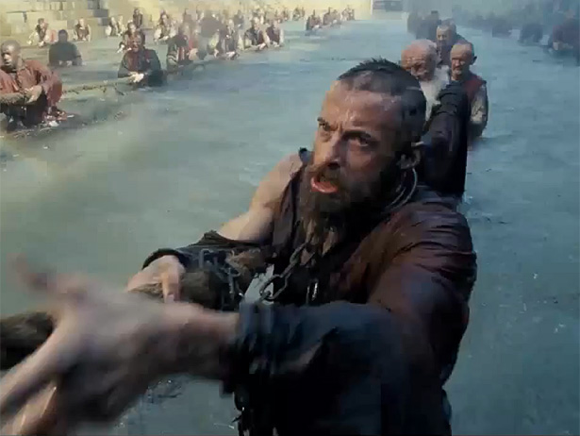
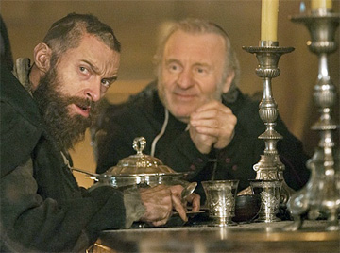
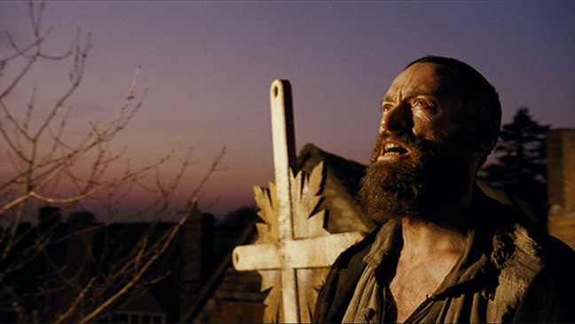
Luke 6:39
Treatment Of Enemies …
Jean Valjean
Moral likeness proves parentage!

Slide 23
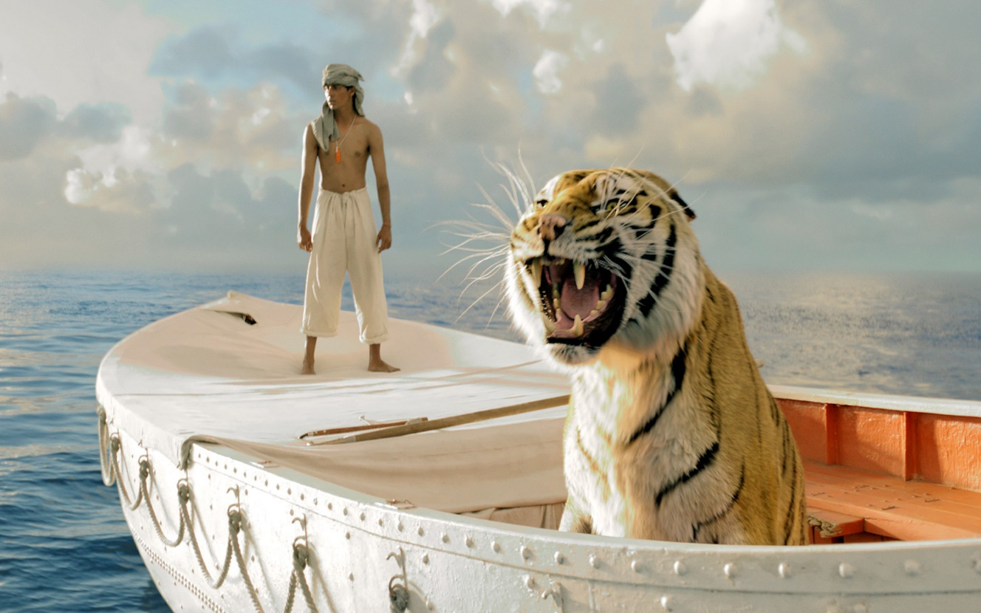
Luke 6:39
Why should we love our enemies?
i. Because God loved us when we were His enemies
ii. Because this builds godly community (remember that there are
many ‘degrees’ of hatred … at what point do I start hating and stop loving?
iii. I am easily persuaded to withhold good from those viewed as
enemies
iv. It reminds us all of a redemptive eschatology

Slide 24
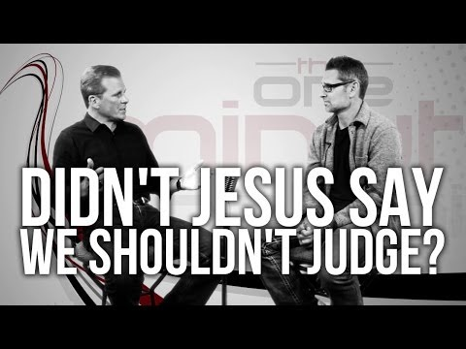
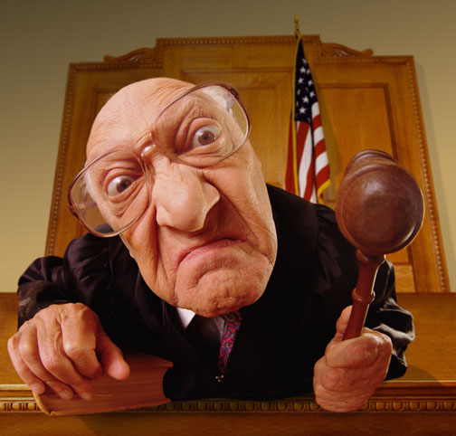
Luke 6:39
In What Way Should Christians Judge?
We live in a world that increasingly strives to promote the idea of tolerance, but actually
becomes intolerant of Christian absolutes as it does so.
Ultimately, built into this “tolerance” is the concept that truth is determined by each
individual, not by God. (John 14:6, 17:17, 18:37)
Those who reject the notion of God or the credibility of the Bible often attempt to use
God’s Word (e.g., by quoting verses out of context) to excuse their actions.
EVERY HUMAN BEING
makes moral judgements
about right and wrong
every day!

Slide 25
Luke 6:39
Does God ‘Judge’?
"“For the Father judges no one, but has committed all judgment to the Son.”" (John 5:22)
"“I have come as a light into the world, that whoever believes in Me should not abide in darkness. And if anyone hears My words and does not believe, I do not judge him; for I did not come to judge the world but to save the world. He who rejects Me, and does not receive My words, has that which judges him—the word that I have spoken will judge him in the last day.”" (John 12:46–48)
"Because He has appointed a day on which He will judge the world in righteousness by the Man whom He has ordained. He has given assurance of this to all by raising Him from the dead." (Acts 17:31)

Slide 26
Luke 6:39
Scriptural Understanding:
What is the full context of Matthew 7:1-5.?
- Does it teach to not discern or to discern in wisdom?
- Is it possible to bear witness to the Truth without condemnation?
Was Paul wrong in Galatians 2:11-14? What about in Acts 15:37-40?
How does one make sense of 1 Corinthians 5:3-7?

Slide 27
Luke 6:39
1Co 5:12 What business is it of mine to judge those outside the church? Are you not to
judge those inside?
1Co 5:13 God will judge those outside. "Expel the wicked man from among you."
1Co 6:2 Do you not know that the saints will judge the world? And if you are to judge
the world, are you not competent to judge trivial cases?
1Co 6:3 Do you not know that we will judge angels? How much more the things of this life!

Slide 28
Luke 6:39
Joh 7:24 Stop judging by mere appearances, and make a right judgment."
Ro 14:4 Who are you to judge someone else’s servant? To his own master he stands or falls.
And he will stand, for the Lord is able to make him stand.
Ro 14:10 You, then, why do you judge your brother? Or why do you look down on your
brother? For we will all stand before God’s judgment seat.
1Co 4:3 I care very little if I am judged by you or by any human court; indeed, I do not even
judge myself.
1Co 4:5 Therefore judge nothing before the appointed time; wait till the Lord comes.
He will bring to light what is hidden in darkness and will expose the motives of
men’s hearts. At that time each will receive his praise from God.

Slide 29
Luke 6:39
What Do We Do With All This?
1) No one wants to be told that what they do indicates a depraved heart.
2) By the definition of culture, to “judge” means to be told that what I am doing is wrong.
3) We see this all the way back to the Garden story … “you will know good and evil”
4) The New Testament is filled with commands to us as believers to govern our actions.
A consistent violation of those commands indicates a problem and that problem must be
addressed.
5) We are specifically command to NOT judge “non-sin” issues that are hidden in the
heart or matters of Christian conscience. We may discuss and debate and disagree but
we are commanded to not break fellowship over them.
6) We are never to condemn (i.e. declare Hell bound, without redemptive hope), for that is
in the purview of God … not us. We are dispensers of grace and hope and truth. We do
not declare judgment upon the world now because
that belongs to Christ.

Slide 30
Luke 6:39
What Do We Do With All This?
7) As you study the Word, remember that the word “to judge” may have several different
shades of meaning depending upon the context:
To discern the truth or fairness of a legal or moral issue
To condemn to hell (or other punishment)
To be in leadership or authority over another.
8) Especially since the Enlightenment Period, humanity has continued down the path of
belief that there is no Absolute Truth and therefore no such thing as a morality.
Therefore to modern thinking, there is no such thing as right and wrong. Expect supreme
opposition here but do not fall into the trap of the world’s definitions and conclusions.
Know the difference between bearing witness to the truth and Hate!
9) Always be ready to pour forgiveness into the
shattered lives of people around you.

Slide 31
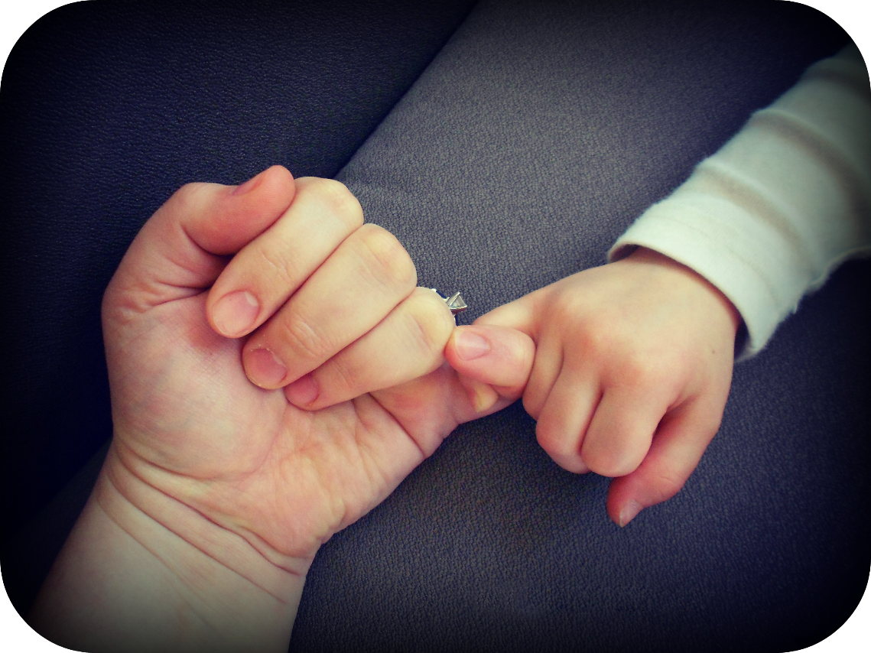
Jesus promised His disciples three things:
- that they would be completely fearless,
- absurdly happy and …
- in constant trouble.
F.R. Maltby

Slide 32
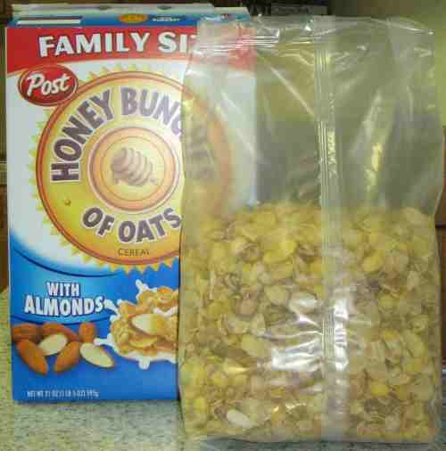
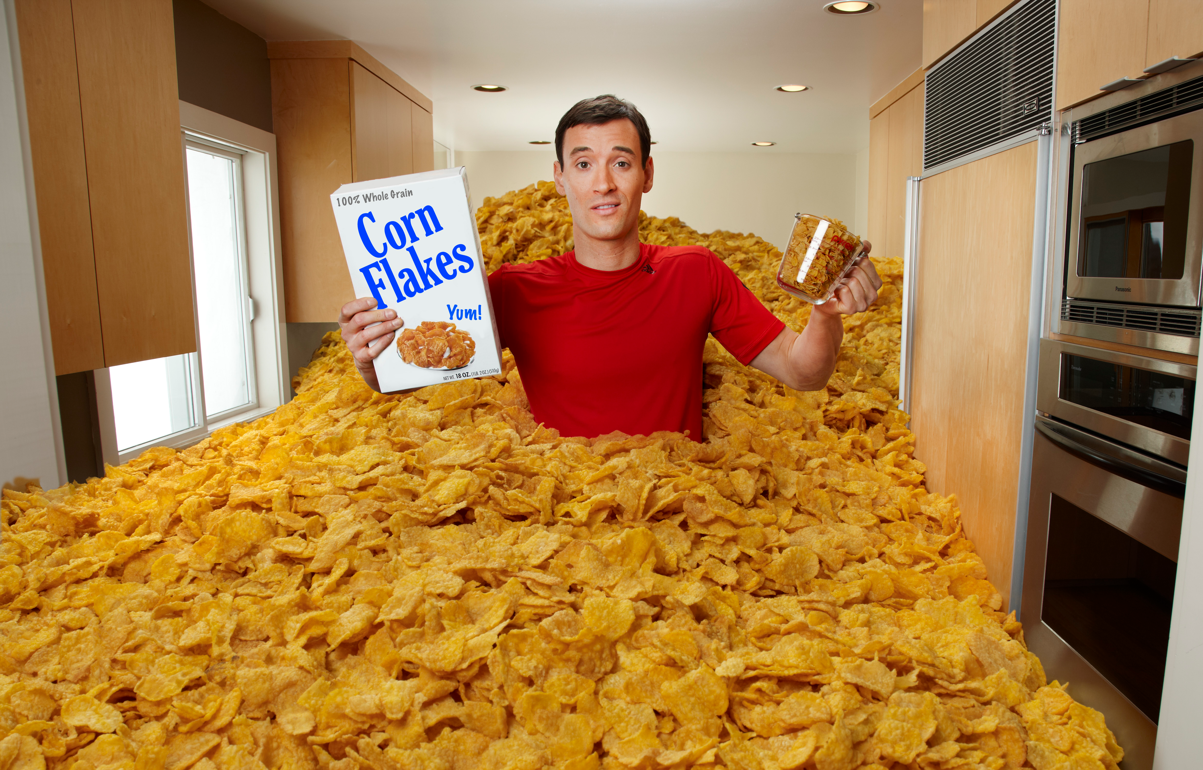
Luke 6:39
Exhibit grace & forgiveness … pressed down,
shaken together, running over!

Slide 33
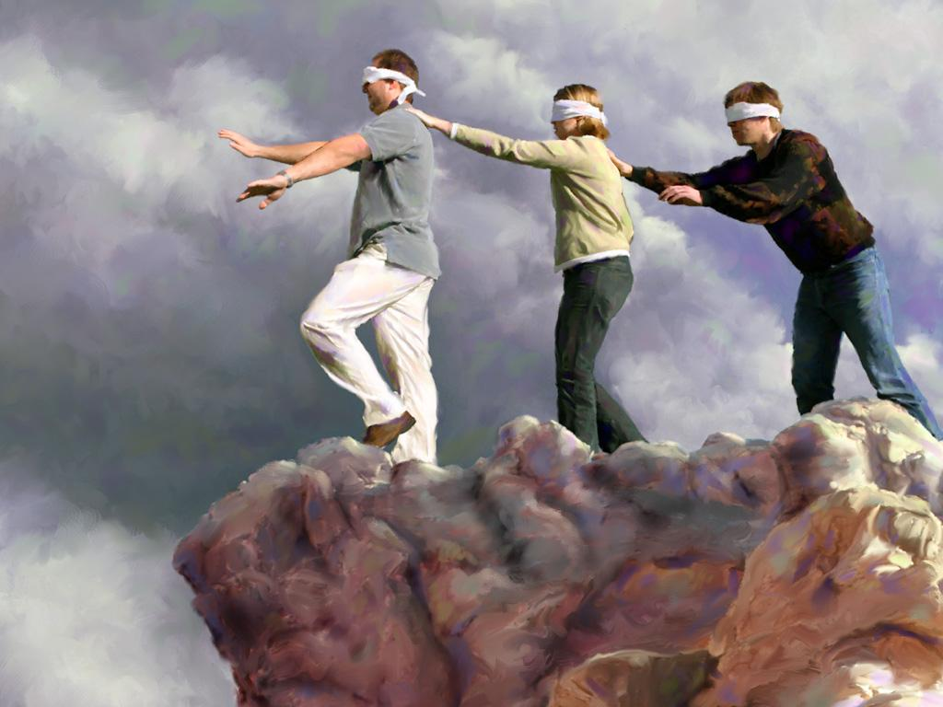
Luke 6:39-45
Can the blind lead the blind … ?

Slide 34
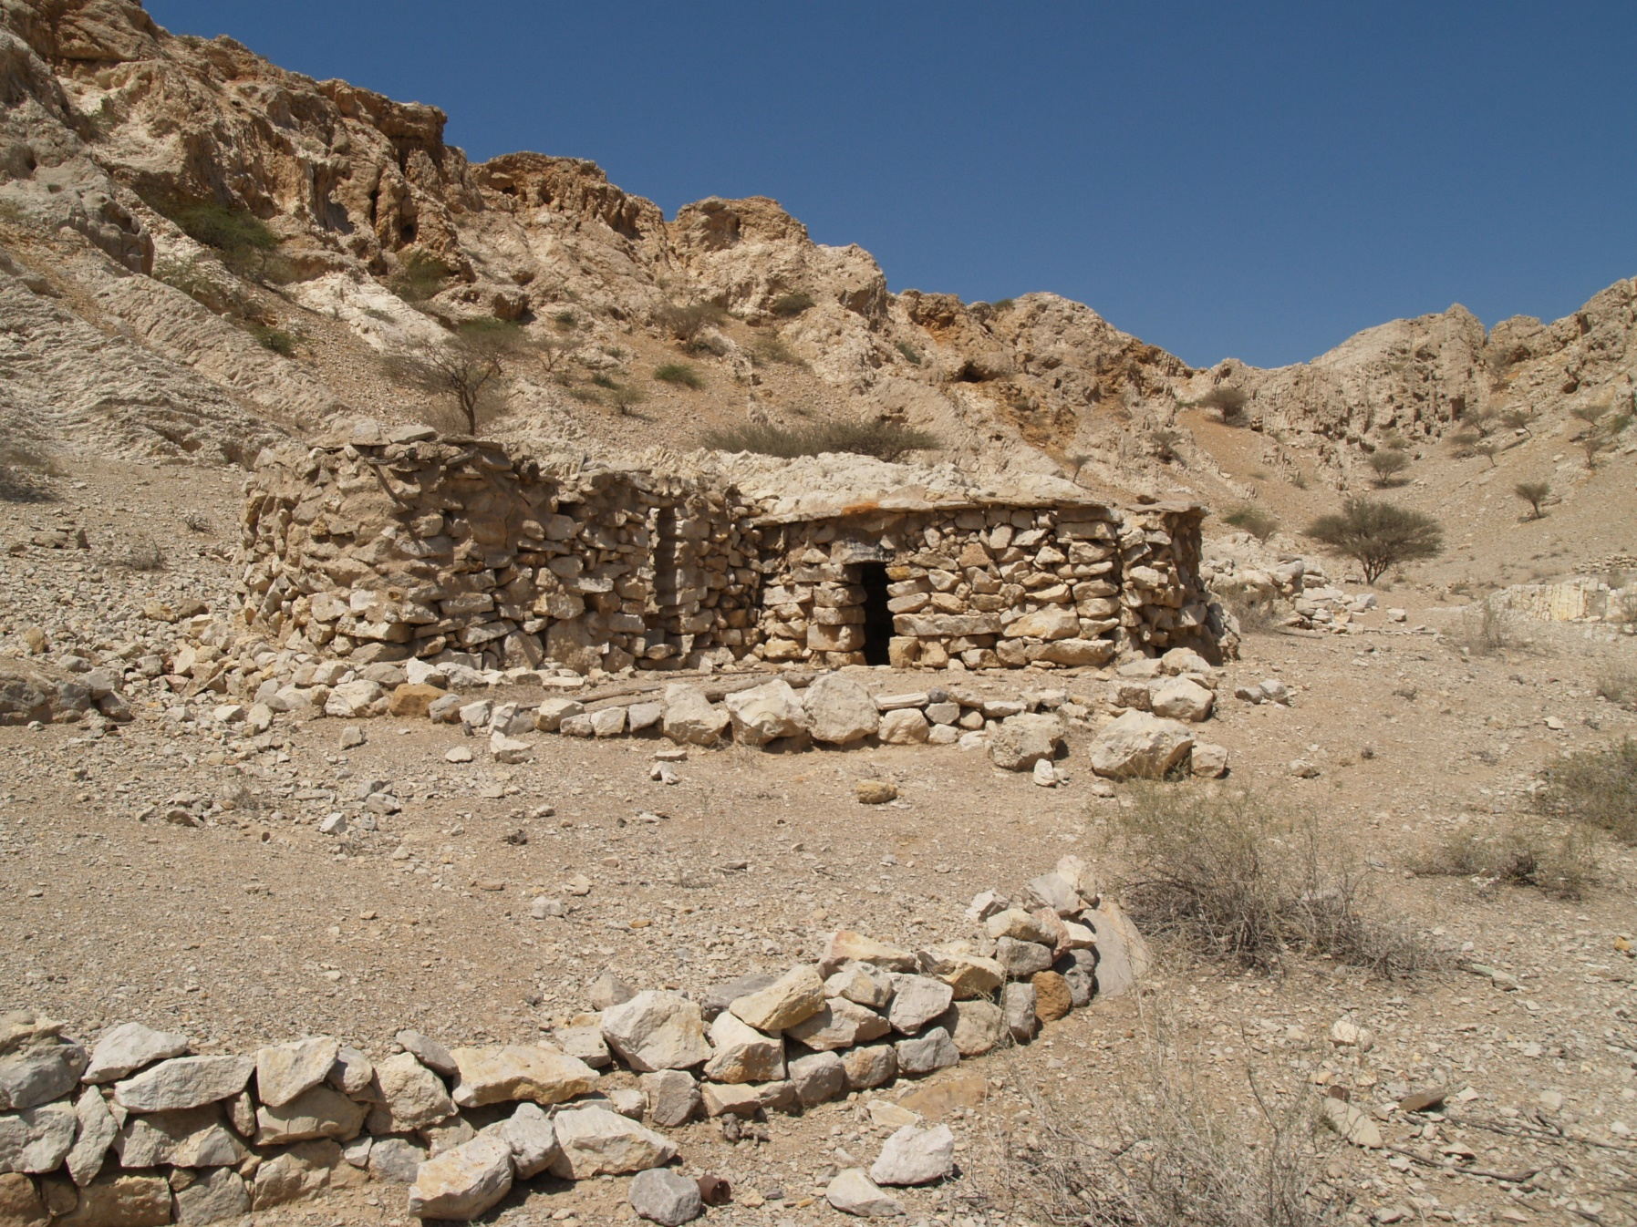
Luke 6:48
House In A Wadi

Slide 35
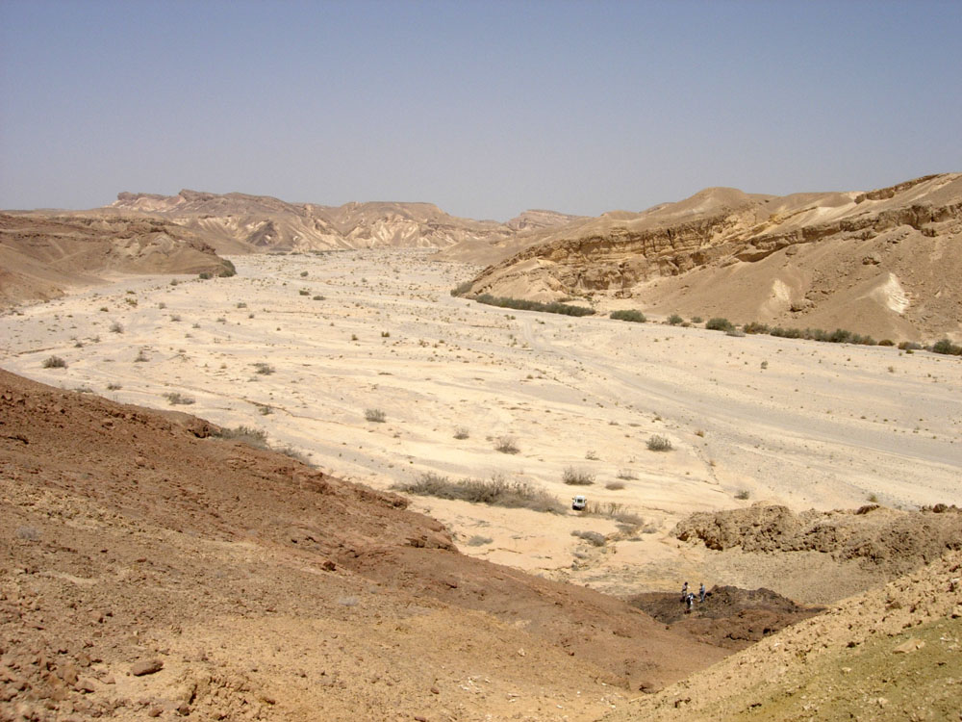
Luke 6:48
House In A Wadi

Slide 36
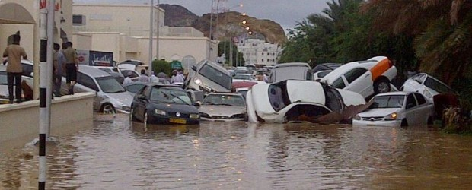
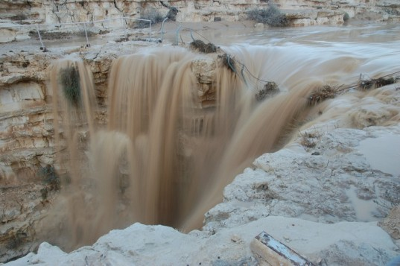
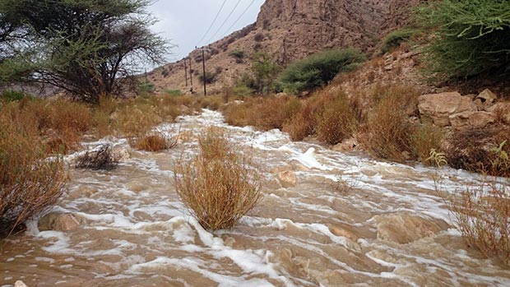
Luke 6:48

Slide 37
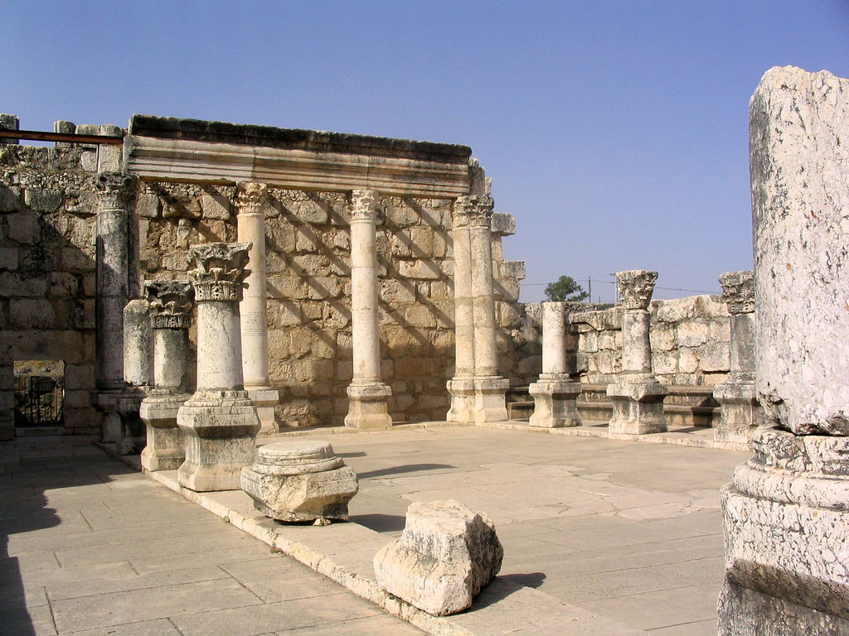
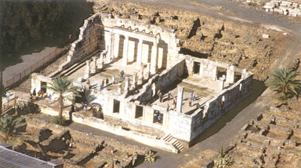
Luke 7:1
Capernaum Synagogue

Slide 38
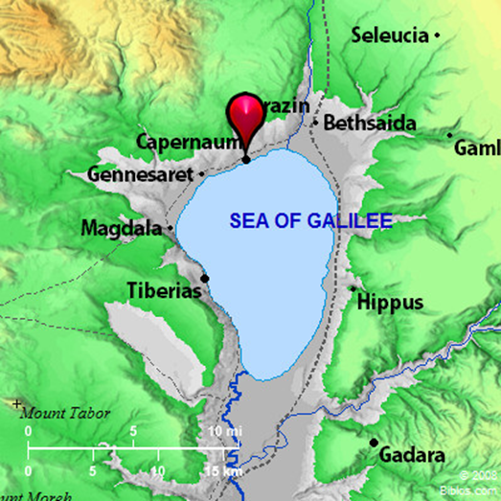
Luke 7:1
Capernaum Synagogue
Luke 7 | 2Kings 5
The centurion is well respected (v. 2, 4-5) | Naaman: Was well respected (v. 1)
The Jewish elders intercede for him (3-5) | The Jewish girl intercedes for him (2-3)
The centurion does not meet Jesus (6-9) | Naaman does not meet Elisha (5-10)
The healing takes place from afar (10) | The healing takes place far away (v. 14)

Slide 39
Luke 7:11
Healing At Nain
Luke 7 | 1Kings 17
A widow loses her son (v. 12) | A widow loses her son (1 Kings 17:17)
He is an only son (young) (v. 12) | He is an only son (young)
Jesus commands healing (v. 14) | Elijah cries to the Father (17:20)
Jesus touches the coffin (v. 14) | Elijah must exert physical energy (17:19-21)
The boy is healed (v. 15) | The boy is healed (17:22)

Slide 40
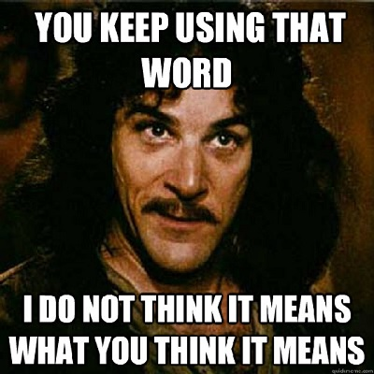
Luke 7:19
John The Baptizer Doubts
Is it possible to be disillusioned with Jesus because we have false expectations?
What are the sources of these
false expectations?

Slide 41
Luke 7:25
Selfies
- What are we drawn to today?

Slide 42
Luke 7:31
Group Of Children
(This Generation,
Religious Leaders)
John and Jesus refuse to play
the role dictated to them by
the culture of the day.
Funeral Song
Wedding Song
Group Of Children
(Jesus, John
the Baptizer)

Slide 43
Luke 7:35
We played a flute – You did not dance (v.32)
We sang a dirge – You did not cry
John came (neither eating nor drinking) – He has a demon (v.33)
Son of Man (ate and drank) – He is a glutton/drunkard (v.34)
All the people justified God (v.29)
The religious leaders reject God (v.30)
The people of this generation reject God (v.31-34)
Wisdom is justified by her children (v.35)
Inverted Parallelism

Slide 44
Luke 7:35
How do we response to the Word of God?

Slide 45
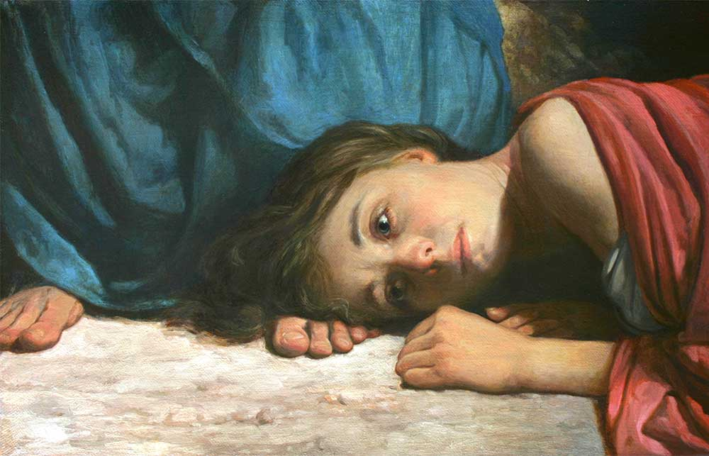
Luke 7:36
At the feet of Christ

Slide 46
Luke 7:36
At the feet of Christ
Introduction (36) Pharisee, Jesus, woman
The outpouring of love (37) Action
A dialog (40) Simon judges poorly
A parable (41)
A dialog (43) Simon judges rightly
The outpouring of love (44) In retrospect
Conclusion (49) Pharisee, Jesus, woman
Babylonian Talmud: The absence of oil is a bar
to the saying of grace!

Slide 47
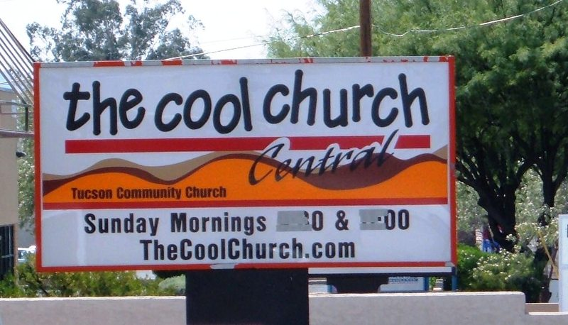
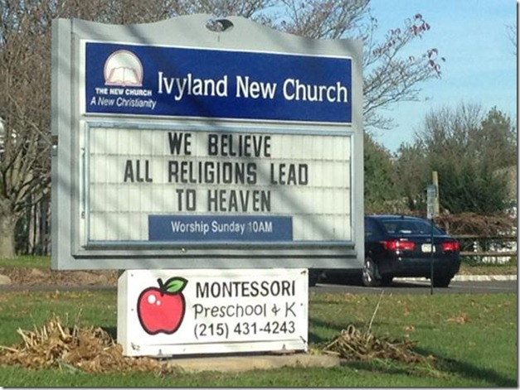
Should Church Be Seeker Sensitive?
Luke 7:36

Slide 48
Luke 7:36
Seeker Sensitive Churches?
The Good:
o People can investigate the claims of Christianity
o One can understand grace (Come as you are)
o Less concern with exterior attributes (clothes, building)
o More community focused
o Willing to challenge and ask hard questions
The Struggles:
o Is the whole Word of God preached fearlessly
o Do we become too worried about being offensive?
o Attendance now is tied to the correct “formula” and not the presences of God. Marketing??
o Music is chosen for cultural
relevance and not theological
correctness
o Me focused? My comfort,
my self-actualization?

Slide 49
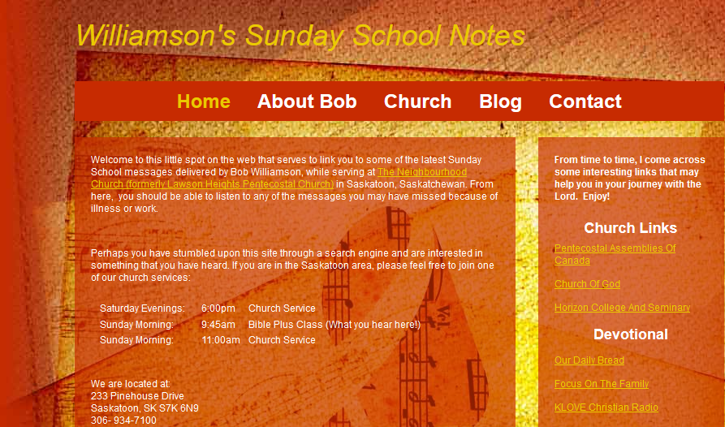
www.williamsonit.ca/ss

Slide 50
Luke 8:1-3
Why does giving have such a bad rap today?

Slide 51
Luke 8:4-18
The Sower And The Seed: The Theme
"He who has ears to hear, let him hear.“ (Verse 8)
I speak in parables, so that, "‘though seeing, they
may not see; though hearing, they may not
understand.’ (Verse 10)
Those along the path are the ones who hear, (Verses 12,13,14,15)
Therefore consider carefully how you listen. (Verse 18)
He replied, "My mother and brothers are those
who hear God’s word.” (Verse 21)

Slide 52
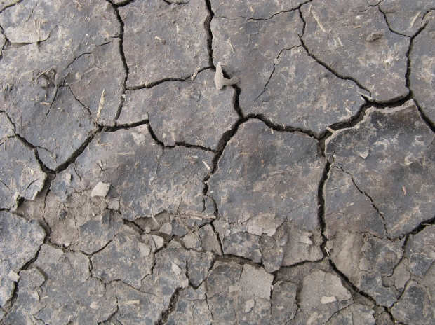
Luke 8:4-18
How does Satan snatch the Word away?
No time to even attend an event in which the Word is preached?
Don’t believe I have a need?
Procrastination?
Other voices speaking more loudly than the Spirit?

Slide 53
Luke 8:4-18
Times Of Testing … reveal
Most growth comes from times of testing
Testing reveals my rough spots … and allows God to shine through
Do not believe the lie that God is gone, distant or uncaring.

Slide 54
Luke 8:4-18
Times Of Substitution (Hiding the face of God!)
Worries (substituting my power for God’s)
Riches (Substituting the power of money for the power of God)
Pleasures (substituting emotional happiness for the presence of God)

Slide 55
Luke 8:4-18
The Sower And The Seed: The Theme
HEAR + Believe (12-13)
HEAR + Chocked (14)
HEAR + Produce Fruit (14-15)
HEAR + Hold Fast (15)
HEAR + Do (21)
Remember that the ground that produces good
fruit still can face hardness, poor roots and weeds,
but it overcomes to produce a harvest!
To HEAR implies the receiving of TRUTH
Truth is displayed for us in the Word of God
The Word illuminates reality.

Slide 56
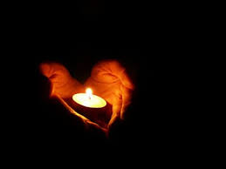
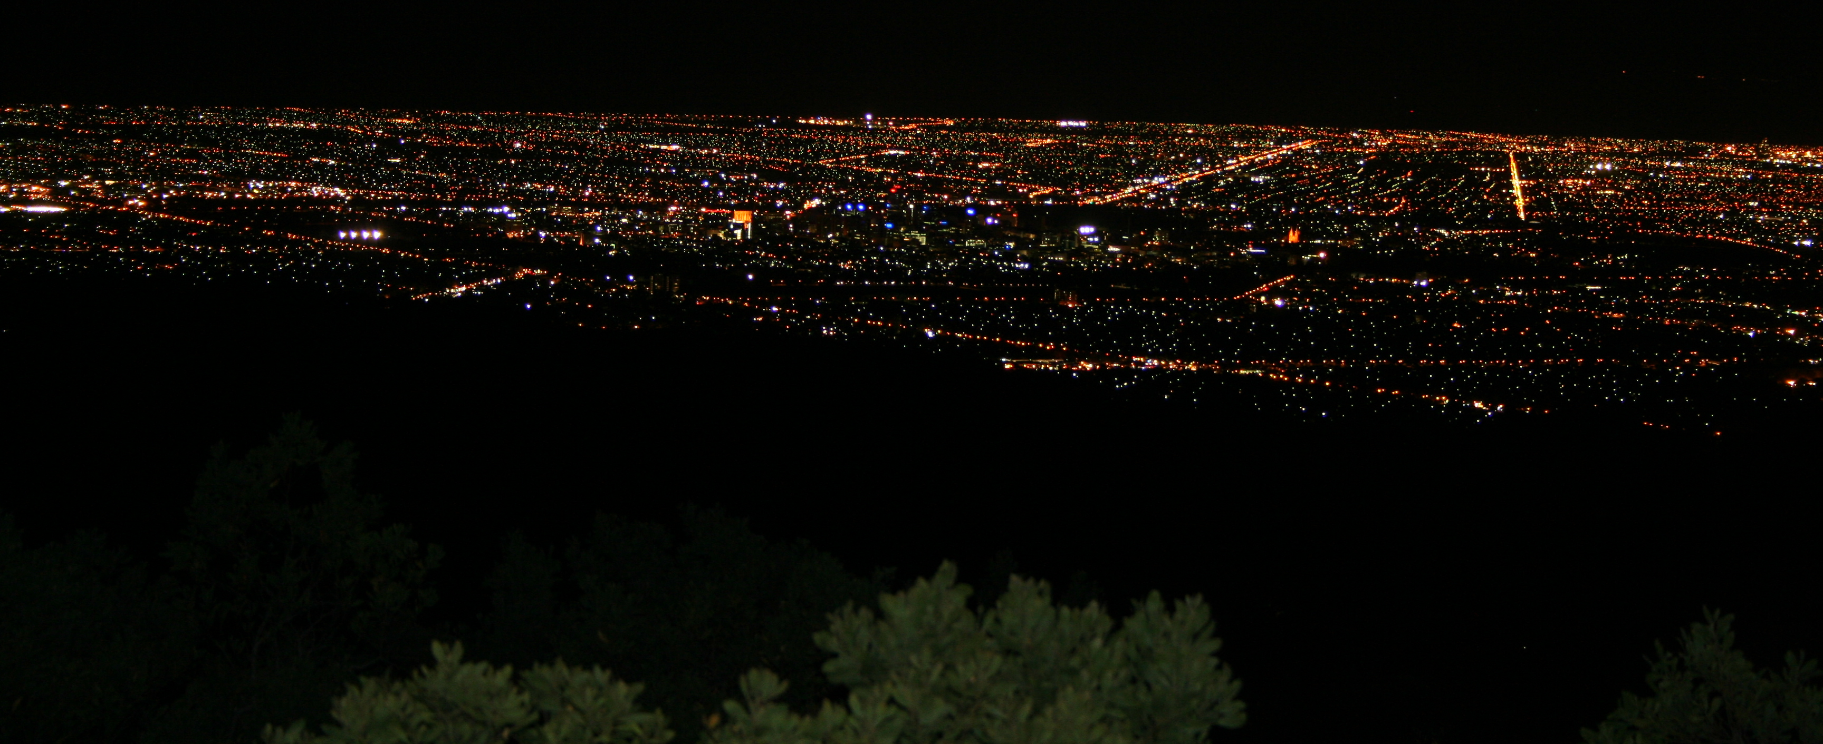
Luke 8:16-18
Light cannot be hid, no matter how much the darkness pushes back!

Slide 57
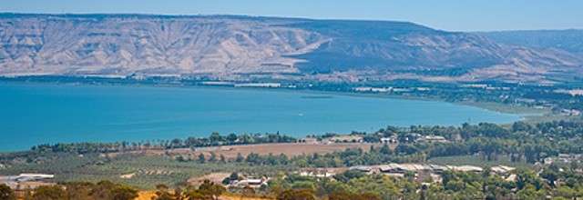
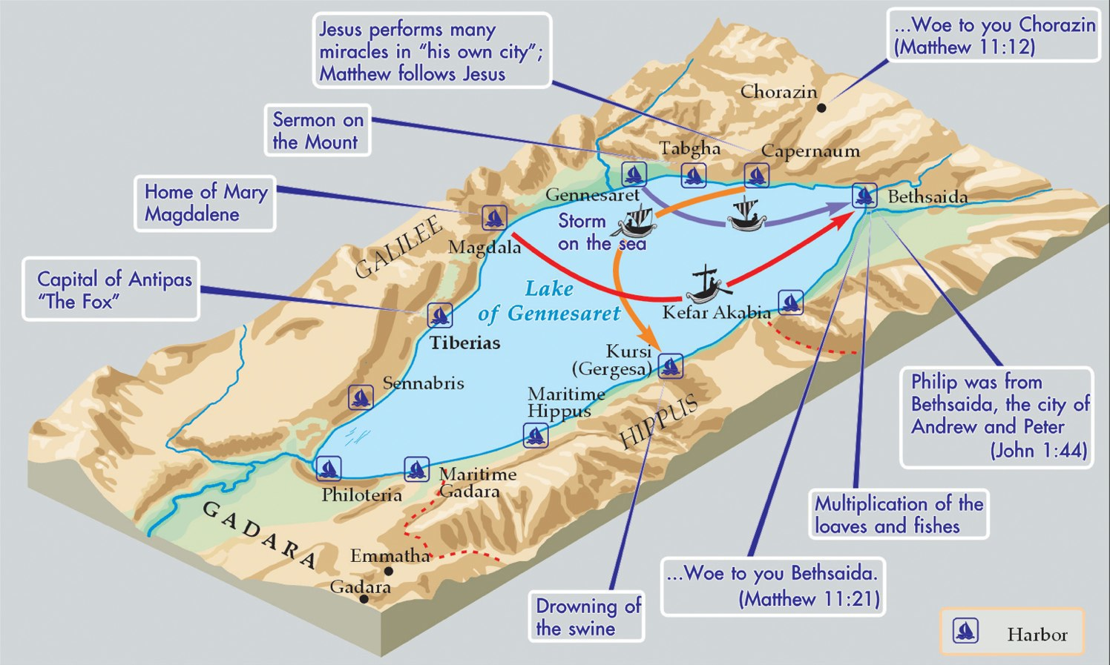
Luke 8:22-25

Slide 58
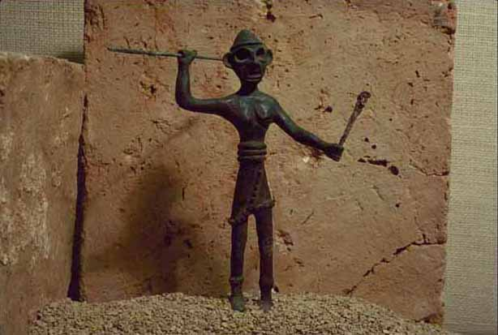
Luke 8:22-25
Baal was known to be a rider of clouds,
most active during storms but was also
considered to be a "lord of heaven and earth",
even controlling earth's fertility. He was the
god of thunderstorms, the most vigorous and
aggressive of the gods and the one on whom
mortals most depended.
Some of his other common epithets include " Most
High Prince/Master", " Conqueror of Warriors",
Mightiest, Most High, Supreme, Powerful, Puissant",
" Warrior", and " Prince, Master of the Earth". He is
also sometimes called Re'ammin, meanign "Thunderer",
as well as Aleyin, meaning "Most High", Mightiest",
"Most Powerful", or Supreme and he has many, many
other epithets.

Slide 59
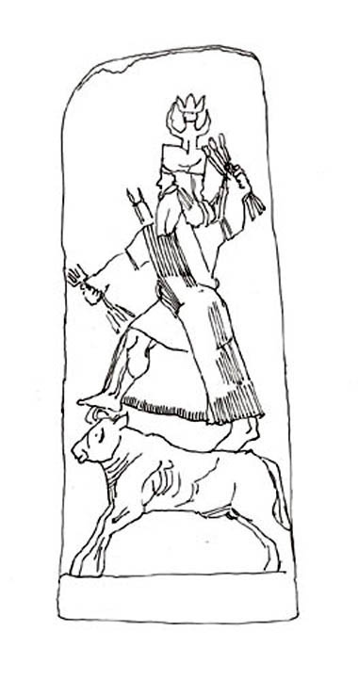
Luke 8:22-25
Baal's cult animal was the bull, which symbolized his
power and fertility, though at times and in different
places he was also associated with goats and even
flies. He is sometimes shown in Near Eastern art
standing on the back of a bull.

Slide 60
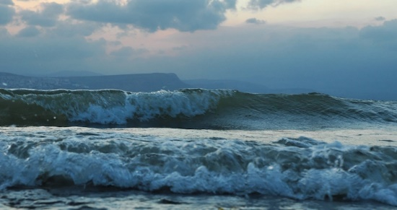
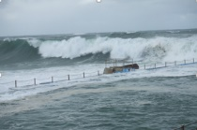
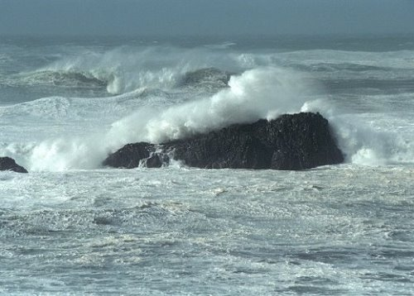
Luke 8:25-39
Storms On The Sea Of Galilee
8 miles wide and 13 miles long

Slide 61
Luke 8:25-39
A man had many demon (v27)
He wore no clothes (v27)
He lived among the tombs, not in a home (v27)
He fell down before Him and shouted (v28)
The demon seized him and he was out of control (v29)
The demons had gone from the man (v35)
He was fully clothed (v35)
Return to your home … (v39)
Sitting at the feet of Jesus (v35)
He was in his right mind (v35)

Slide 62
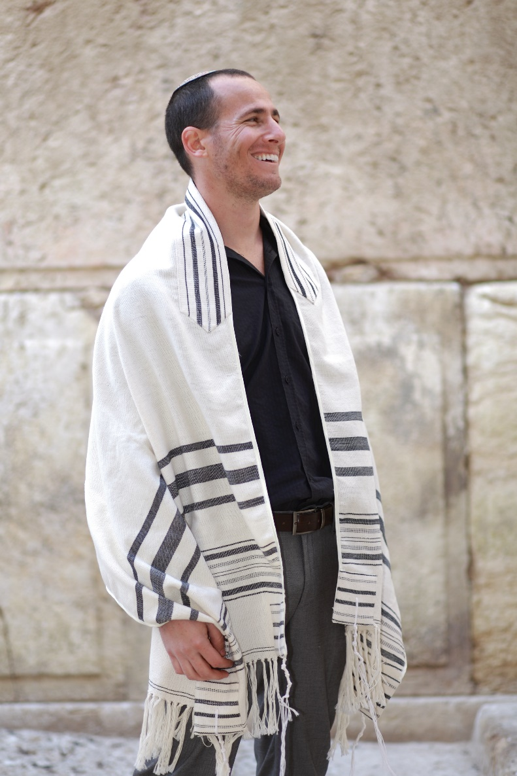
Luke 8:40-53
Nu 15:38 "Speak to the Israelites and say to them:
‘Throughout the generations to come you are to make
tassels on the corners of your garments, with a blue
cord on each tassel.
Nu 15:39 You will have these tassels to look at and
so you will remember all the commands of the LORD,
that you may obey them and not prostitute yourselves
by going after the lusts of your own hearts and eyes.
De 22:12 Make tassels on the four corners of the
cloak you wear.
Mt 23:5 "Everything they do is done for men to
see: They make their phylacteries wide and the
tassels on their garments long;
Shema
Tallit
Tzitzit

Slide 63
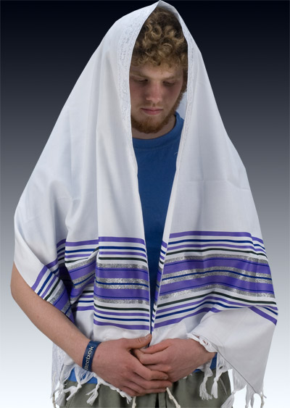
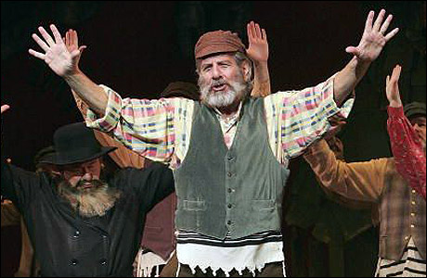
Luke 8:40-53
Mal 4:2 But for you who revere my name, the sun
of righteousness will rise with healing in its wings.
And you will go out and leap like calves released
from the stall.
Matthew 6: 6 But when you pray, go into your
room, close the door and pray to your Father,
who is unseen. Then your Father, who sees what
is done in secret, will reward you.
Tetragrammaton: YHWH
Common substitutions for Hebrew forms are hakadosh baruch hu ("The Holy One,
Blessed Be He"), Adonai ("The Lord"),[6] or HaShem ("The Name").

Slide 64
Luke 8:40-53
How are these two healings related?
Jairus | Woman
Falls at Jesus feet (v41) | Falls at His feet (v47)
His daughter (v42) | A daughter (v48)
Girl was 12 years old (v42) | Her disease was for 12 years (v43)
Desperate – no one could help (v.42) | Desperate – no one could help (v.43)
He touched her (v54) | She touched Him (v44)
Impurity (touch a corpse) (v54) | Impurity (flow of blood) (v45)
Healing immediate (v.54) | Healing immediate (v.44)
Both exhibit great faith!

Slide 65
Luke 8:40-53
Because these two stories are so related,
we should see common themes:
- Great faith exhibited by the woman and Jairus; Moved them to action!
- Salvation, faith and resurrection are intimately tied together.
- Note the speed that the crowd turns from praise to laughter. THEY did not have the
faith of these two heroes of our story.
- We are reminded that even synagogue leaders (usually portrayed negatively) can come
to see Christ as Lord.
- This woman lived outside of the normal social
community, just like the demon possessed man did
(as we just read about above).
- Both Jairus and this woman are caused great
potential public humiliation.
- Timing is ALWAYS in the hands of the Lord.

Slide 66
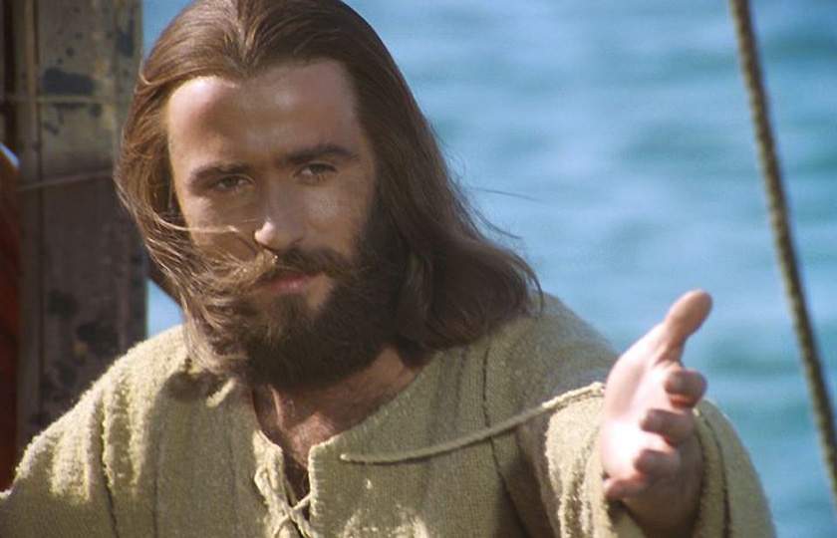
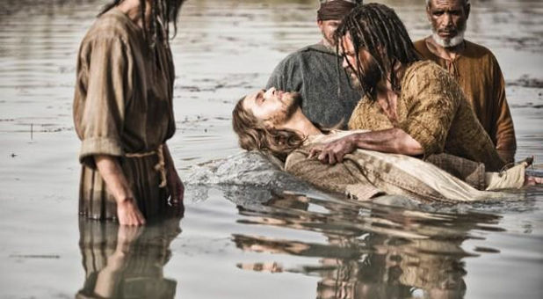
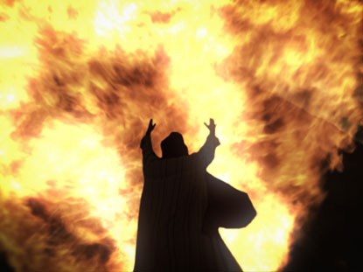
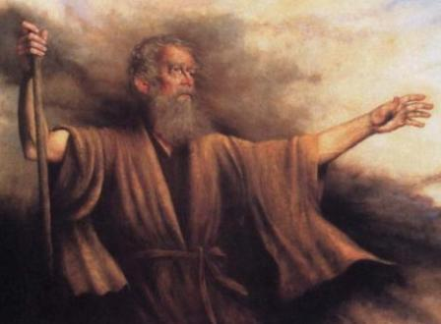
Luke 9:1-9
John the Baptizer
Great prophet (Deut. 18:15, 18)
Elijah (Malachi 4:5)

Slide 67
Luke 9:10-17
It is interesting to note that this meal is absolutely ceremoniously unclean!
o Some of these people are ceremoniously clean, others not
o Some more faithful to the Law and others less so
o Is the food itself clean? Has it been prepared in a kosher way?
o Has tithes been paid on in?
o Where is the water for washing?

Slide 68
Luke 9:18-22
Caesarea Philippi: The Gates Of Hell

Slide 69
Luke 9:18-22
Who really IS Jesus?
o He is fully God and full human
o He is historical (He is and He said what the Gospel writers
recorded)
o He is a revealer of reality and truth
o He is the only mechanism of salvation (The Way, The Truth
and the Life)
o He is the fulfillment of the OT Scriptures

Slide 70
Luke 9:23-27
Accusations We Face …
o Accused of cannibalism
(Doctrines misunderstood)
o Accused of atheism
(Against cultural norms & values)
o Accused of sedition (seeing a greater kingdom than Roman)
(Interfering with politics)
o Starting fires (in Roman)
(When things go wrong)

Slide 71
Luke 9:23-27
Sports Fans …
… Invest money in purchasing tickets and gear that represent their teams
… are not afraid to broadcast their beliefs
… will drive for miles through any weather to see their teams
… will memorize statistics on their favourite players
… read the newspaper every day to ensure they know the standings
… will sit in cold bleachers forever just to catch a glimpse … and yearn for the front row seats
… will support their team no matter how bad they are nor what scandal they face
… spend hours talking about their sport
… will do anything to get THAT autograph … or THAT selfie

Slide 72
Luke 9:28-36

Slide 73
Course Correction
Luke 9:28-36
There are a number of sharp corrections the Lord needs to make in the
disciples lives at this juncture.
Source of spiritual power is not in ME! (Prayer & fasting)
The true purpose of Jesus’s coming. (Redemption)
What does greatness really
means (Service)
Living with those that have not
yet reached spiritual life. (Grace)
What does it REALLY means to
be a disciple. (Discipleship)

Slide 74
Luke 9:37-45
Nuggets from other Gospels
Matthew 17:9 Jesus tells the disciples to tell no one until after the resurrection
Matthew 17:11 Elijah must yet come AND he has already come …
Matthew 17:19-20 Why were the disciples unable to cast it out?
- Lack of faith
- Lack of prayer (Mark 9:29)
Mark 9:14 The teachers of the law were arguing with the disciples
Mark 9:21 The boy had been oppressed since childhood
Mark 9:22 “If you can”? Did the man have faith?
- ‘Help my unbelief’
Mark 9:25 Jesus dealt with the demon as
a crowd was running to Him
Mark 9:26 The boy appeared to be dead

Slide 75
Luke 9:37-45
Nuggets from other Gospels
What were the nine apostles feeling right now?
They had just come from a successful ministry of casting out demons
Jesus had left them to go up the mountain
They had publically failed to cast out this demon
Jesus had taken the “special” three with Him. What about the rest of them?
Now they were arguing with the religious leaders regarding their allegiance to Christ

Slide 76
Luke 9:37-45
Nuggets from other Gospels
Thomas Edison: microphone, phonograph, incandescent light, the storage battery,
talking movies (plus over 1000 other devices)
December 1914 he had worked for 10 years on a storage battery.
This had greatly strained his finances. This particular evening spontaneous combustion had
broken out in the film room. Within minutes all the packing compounds, celluloid for records
and film, and other flammable goods were in flames. Fire companies from eight surrounding
towns arrived, but the heat was so intense and the water pressure so low that the attempt to
douse the flames was futile. Everything was destroyed. Edison was 67.

Slide 77
Luke 9:37-45
Nuggets from other Gospels
With all his assets going up in a whoosh (although the damage exceeded two million dollars,
the buildings were only insured for $238,000 because they were made of concrete and
thought to be fireproof), would his spirit be broken?
The inventor’s 24-year old son, Charles, searched frantically for his father. He finally found
him, calmly watching the fire, his face glowing in the reflection, his white hair blowing in the
wind. “My heart ached for him,” said Charles. “He was 67—no longer a young man—and
everything was going up in flames. When
he saw me, he shouted, ‘Charles, where’s
your mother?’ When I told him I didn’t
know, he said, ‘Find her. Bring her here.
She will never see anything like this as
long as she lives.’”

Slide 78
Luke 9:37-45
Nuggets from other Gospels
The next morning, Edison looked at the ruins and said, “There is great value in disaster.
All our mistakes are burned up. Thank God we can start anew.” Three weeks after the fire,
Edison managed to deliver the first phonograph.

Slide 79
Luke 9:46-48
The Least Of These …
What is so important about welcoming the least?
o They cannot repay? This purifies my motive.
o They cannot provide for themselves. We become a dispenser of grace.
- God honors us when He burdens our hearts
o This mirrors the character of God (grace) and allows Him to be revealed.
o We should not be able to bear the thought of someone hurting when we can
help.
o To do these simple, quiet, unassuming acts for others (that the world considers unimportant) keeps our own hearts
from seeking prestige and fame.

Slide 80
Luke 9:57-62
What IS a Disciple?

Slide 81
Luke 9:57-62
What IS a Disciple?
So Moses went out and told the people what the LORD had said. He brought together
seventy of their elders and made them stand round the Tent. Then the LORD came down
in the cloud and spoke with him, and he took of the Spirit that was on him and put the
Spirit on the seventy elders. When the Spirit rested on them, they prophesied, but they
did not do so again. However, two men, whose names were Eldad and Medad, had
remained in the camp. They were listed among the elders, but did not go out to the Tent.
Yet the Spirit also rested on them, and they prophesied in the camp.
A young man ran and told Moses, "Eldad and Medad are prophesying in the camp."
Joshua son of Nun, who had been Moses’ assistant since
youth, spoke up and said, "Moses, my lord, stop them!“
But Moses replied, "Are you jealous for my sake?
I wish that all the LORD’s people were prophets
and that the LORD would put his Spirit on them!"
Numbers 11:24-30

Slide 82
Luke 9:57-62
Counting The Cost

Slide 83
Luke 9:57-62
Counting The Cost

Slide 84
Luke 9:57-62
Counting The Cost

Slide 85
Luke 9:57-62
Counting The Cost
The Church must deal with the world’s rejection. The world often sees our commitment
to Jesus as a blind, arrogant exclusivism, when in reality it represents an invitation to
share in the rich blessings of God. How should the church respond to such hostility?
Many people in the world react strongly against the church’s
concern for the moral character of our culture and
see it as a dogmatic attempt to control other people.
That reading could not be more
wrong. In warning against immoral
behavior, the church is warning
against that which is ultimately
self-destructive not only to the
individual who engages in it, but
also to the society at large.

Slide 86
Luke 9:57-62
Counting The Cost
William Barclay put it well:
“Jesus did not say discuss me; He said follow me. We do not make terms with Christ;
we surrender to Christ. We do not compromise with Christ; we submit to Christ.
Christianity does not mean being interested in Jesus Christ; it means taking the same
oath as princes take to the king or queen in a coronation ceremony.... The very word
sacrament comes from the Latin word sacramentum which means a soldier's oath of
loyalty. The Christian is the one who has a sworn loyalty and who keeps loyalty to
Christ, the King.”

Slide 87
Luke 10:1-17
Calling The 72
And over them are SEVENTY-TWO PRINCES OF KINGDOMS on high
corresponding to the 72 tongues of the world. And all of them are crowned
with royal crowns and clad in royal garments and wrapped in royal cloaks.
And all of them are riding on royal horses and they are holding royal
sceptres in their hands. 3 Enoch 17:8*
According to the LXX, Genesis 10 claims that there were
72 nations in the world.
*Note that this is a non-canonical source

Slide 88
Luke 10:1-17
The Didache (11:12 – 12:5)*
And whosoever shall say in the Spirit, Give me silver or anything else, ye shall not listen to him; but if he tell you to give on behalf of others that are in want, let no man judge him.
But let every one that cometh in the name of the Lord be received; and then when ye have tested him ye shall know him, for ye shall have understanding on the right
hand and on the left.
If the comer is a traveler, assist him, so far as ye are able; but he shall not stay with you more than two or three days, if it be necessary.
But if he wishes to settle with you, being a craftsman, let him work for and eat his bread. But if he has no craft, according to your
wisdom provide how he shall live as a Christian
among you, but not in idleness.
If he will not do this, he is trafficking
upon Christ. Beware of such men.
*Written late in the first century

Slide 89
Luke 10:1-17
Don’t live here!

Slide 90
Luke 10:1-17
Is It Fair?
 | Hidden / Do Not See |  | Disclosed / See
v. 21 | Wise and Intelligent | versus | Infants
v. 22 |  |  | Whoever the Son wishes
v. 23-24 | Prophets | versus | You (disciples)

Slide 91
Luke 10:25-37
Who Is My Neighbour?
The road from Jericho to Jerusalem
- Jerusalem: 2500ft above sea level
Jericho: 800ft below sea level
Over 20 miles, this road drops
3300 ft.

Slide 92
Luke 10:25-37
Good Samaritan: Rhetoric
Robbers: Steal and Injure
Priest: Sees and does nothing
Levite: Sees and does nothing
Samaritan: Sees and has compassion
Samaritan: Treats wounds
(The Levite’s failure)
Samaritan: Transports the man
(The priest’s failure)
Samaritan: Spends money on the man
(Compensation for the thieves)

Slide 93
Luke 10:25-37
Who Do I Help?
Sirach 12:1-4
(New Revised Standard Version Catholic Edition (NRSVCE))
12 If you do good, know to whom you do it, and you will be thanked for your good deeds. ² Do good to the devout, and you will be repaid— if not by them, certainly by the Most High. ³ No good comes to one who persists in evil or to one who does not give alms. ⁴ Give to the devout, but do not help the sinner.

Slide 94
Luke 10:25-37
Who Do I Help?
Mishnah Nazir Chapter 7
A High Priest and a nazir may not become impure for their relatives,
but may for an abandoned dead body. [If] they were walking on the
road and found an abandoned dead body, Rabbi Eliezer says: "A High
Priest shall become impure but the nazir shall not become impure."
The Sages say: "The nazir shall become impure and the High Priest shall
not become impure." Rabbi Eliezer said to them: "A High Priest shall
become impure, as he does not bring a sacrifice for his impurity.
And the nazir shall not become impure, as he
brings a sacrifice for his impurity." They said to
him: "The nazir shall become impure, for his
holiness is not eternal holiness. And a High
Priest shall not become impure, for his holiness
is eternal holiness."

Slide 95
Luke 10:25-37
The Cost Of Love
How does this Samaritan man put himself at risk?
- He stops on the road (he too is alone and subject to attack)
- He pays his own money
- He goes into a Jewish inn, placing himself at risk
- He may be accused of actually hurting the Jew himself
- He enters into a financial agreement that lends itself to the possibility of abuse and
extortion.
- Without this pledge, the
beaten man (who had NOTHING)
could be sold as a slave when he
returned to health to settle his
bill with the inn keeper.

Slide 96
Luke 10:38-42
At Bethany
Service
Reflection
WHY?

Slide 97
Luke 11:1-4
The Lord’s Prayer
Father … Hallowed be Your Name …
a. Elohim
- Creator, carries authority and sovereignty (Gen 1:1)
b. El Roi (EL raw-ee)
- The god who sees me (Gen. 16:13-14)
c. El Shadday
- God almighty (Gen. 17:1-2)
d. El Olam (EL o–LAM)
- God who has no beginning and no end (Gen 21:32-33)
e. Yahweh Yireh
- The Lord will provide (Gen 22:13-14)
f. Yahweh
- I am that I am (Ex. 3:14-15)
- Self-existent and always present
g. Adonay
- Lord (Psalm 16:2); owner, master,
superior
WHY?

Slide 98
Luke 11:1-4
The Lord’s Prayer
h. Yahweh Rophe (ro-FEH)
- Heal, cure, restore, make whole (Ex. 15:26)
i. Yahweh Nissi
- The Lord my banner (Ex. 17:15-16)
- A banner was seen from a distance and was a rallying point for the troops
j. Esh Oklah (Consuming Fire) or El Kanna (Jealous God)
- Exodus 34:14 and Deut. 4:23-24
- Why is it apt that God uses the image of fire to describe Himself?
k. Qedosh Yisrael
- Holy One of Israel (Lev. 19:1-2)
- Holy is to be separated
l. Yahweh Shalom
- Judge 6:24
- Peace = complete, whole, finished,
perfection
m. Yahweh Tsebaoth
- The Lord of Hosts (1Samuel 17:45-46)
- To be under God’s rule and reign
WHY?

Slide 99
Luke 11:1-4
The Lord’s Prayer
n. Yahweh Tsuri (sure-REE)
- The Lord is my Rock (Psalm 144:1)
- Provides shade, shelter, safety; used for alters, homes, temples and walls
o. Yahweh Roi (row-EE)
- The Lord is my shepherd (Psalm 23)
p. Ish
- Husband (Hosea 2:16)
q. El Chay
- The Lord who is living (2Kings 19:15-16)
r. Shopeht (sho-PHAIT)
- Judge (Psalm 94:15)
s. Miqweh Yisrael (MIK-weh)
- The Hope of Israel (Jer. 17:7-8)
t. Yahweh Tsidqenu
- The Lord our righteousness (Jer. 23:6)
WHY?

Slide 100
Luke 11:5-13
Don’t Quit Seeking
Having therefore, brethren, boldness to enter into the holiest by the blood of Jesus, By a
new and living way, which he hath consecrated for us, through the veil, that is to say, his
flesh; And having an high priest over the house of God; Let us draw near with a true heart
in full assurance of faith, having our hearts sprinkled from an evil conscience, and our
bodies washed with pure water.
Hebrews 10:19-22
WHY?

Slide 101
Luke 11:14-23
Authority
WHY?

