Slide 2
The Beginnings Of The Life Of Jesus
1:1-4 The introduction of the book.
1:5-25 The birth of John the Baptist is foretold
1:26-45 The birth of Jesus is foretold.
1:45-56 The song of praise that Mary dictates. This is similar to Hannah’s song.
1:57-80 The birth of John the Baptist, with Zachariah’s prophecy
2:1-3 Enrollment of Quirinius
2:4-20 The birth of Christ
2:21-38 Jesus is circumcised and presented to the priest Simeon. Anna also speaks.
2:39-52 The boyhood of Jesus; the visit to Jerusalem when He was twelve.
The Preparation For Ministry
3:1-14 The ministry of John the Baptist.
3:15-20 John testifies about the coming Christ.
3:21-22 The baptism of Jesus
3:23-38 The genealogy of Jesus
4:1-12 The temptation of Jesus
4:13 Satan is defeated and leaves temporarily.

Slide 3
The Galilean Ministry Begins
4:14-15 The beginning of His ministry.
4:16-30 Jesus is rejected at Nazareth, His home town. Note that He quotes from Isa. 61:1-2.
4:31-37 The demoniac is healed.
4:38-44 Peter’s mother-in-law is healed.
5:1-11 The call of Peter, James and John.
5:12-26 The leper and the paralytic are healed.
5:27-29 The call of Levi (also called Matthew)
5:30-39 The Pharisees and scribes attack: Jesus answers.
6:1-11 Jesus deals with the question of the Sabbath by healing an atrophied hand.
6:12-19 Jesus prays all night - then chooses the twelve.
6:20-49 Another teaching of the Beatitudes (similar to Matthew 5-7).
7:1-10 The Centurion’s servant is healed.
7:11-18 The widow’s son is raised from the dead
at Nain.
7:19-35 Jesus testifies about John the Baptist.
7:36-50 Jesus is anointed by the sinful woman.

Slide 4
8:1-3 The women who ministered to Christ are listed.
8:4-15 The parable of the sower
8:16-18 The parable of the lighted candle.
8:19-21 The new relationship is defined.
8:22-25 Jesus stills the storm
8:26-39 The demoniac of Gadara is healed
8:40-56 A woman is healed and Jarius’s daughter is raised from the dead.
9:1-9 The twelve are sent out to minister on their own (and are given power)
9:10-17 The feeding of the 5000.
9:18-26 The confession of Peter
9:27-36 The transfiguration of Jesus before the disciples.
9:37-50 Why the disciples had no power: Jesus again casts of the demon.

Slide 5
On The Way To Jerusalem
9:51-62 Jesus now turns towards Jerusalem (and the cross).
10:1-24 The seventy disciples are sent out to minister.
10:25-29 The lawyer asks, “Who is my neighbour”?
10:30-37 The good Samaritan story.
10:38-42 The contrasts between Mary and Martha.
11:1 Jesus praying.
11:2-4 Jesus’ instructions on prayer.
11:5-13 A parable on prayer
11:14-28 Jesus teaches on Demonism
11:29-32 The sign of Jonah
11:33-38 The parable of the candle.
11:39-44 The Pharisees are denounced.
11:45-54 The lawyers are denounced.
12:1-12 The warning about false doctrine.
12:13-34 The warnings against greediness.
12:35-48 The warning about watching for
the second coming.
12:49-59 Christ “divides” people.

Slide 6
13:1-5 Jesus teaches on repentance and being ready.
13:6-9 The barren fig tree (this represents Israel).
13:10-17 The healing of another woman.
13:18-21 The parables of the mustard seed and leaven.
13:22-30 How many will be saved?
13:31-33 Jesus warns about Herod.
13:34-35 Jesus weeps over Jerusalem
14:1-6 The healing on the Sabbath.
14:7-15 The parable of the over-zealous guest.
14:16-24 The parable of the great supper.
14:25-35 The cost of discipleship.
15:1-7 The parable of the lost sheep.
15:8-10 The parable of the lost coin.
15:11-32 The parable of the lost (prodigal) son.
16:1-18 The parable of the dishonest steward.
16:19-31 The story (not parable) of the rich man
and Lazarus.
17:1-10 The teaching on forgiveness and service.
17:11-19 The cleansing of the ten lepers.
17:20-37 The question of “when the Kingdom of God”
should come.

Slide 7
18:1-8 The parable of the Unjust Judge.
18:9-14 The parable of the Pharisee and the Publican.
18:15-17 Jesus blesses the little children.
18:18-30 The story of the rich young ruler.
18:31-34 Jesus predicts His death.
18:35-43 Jesus heals the blind man near Jericho.
19:1-10 The conversion of Zacchaeus.
19:11-27 The parable of the pounds.
19:28-40 The triumphal entry into Jerusalem.
19:41-44 Jesus weeps over Jerusalem.
19:45-48 Again, Jesus cleanses the Temple court.
Temple Teachings
20:1-8 The authority of Jesus is questioned.
20:9-18 The parable of the vineyard.
20:19-26 The question about tax money.
20:27-38 The Sadducees are silenced.
20:39-47 The scribes are interrogated.
21:1-4 Jesus observes the widow’s mite offering.
21:5-38 Jesus discusses the end-times issues.

Slide 8
The Suffering And Resurrection Of The Lord
22:1-2 The plot to kill Jesus
22:3-6 The treachery of Judas
22:7-13 The preparations for the Passover.
22:14-18 The last Passover.
22:19-20 The Lord’s supper is instituted.
22:21-23 The announcement of the betrayal.
22:24-30 The Apostle’s place in the future kingdom.
22:31-34 Jesus predicts Peter’s denial.
22:35-38 Jesus predicts future conflicts.
22:39-46 Jesus prays in the Garden of Gethsemane.
22:47-53 Jesus is betrayed.
22:54-65 Jesus is arrested
22:66 - 23:26 The various trials
23:27-38 The crucifixion
23:39-45 The thief that repents.
23:46-49 The death of Christ.
23:50-56 The burial of Christ
24:1-12 The resurrection of Christ
24:13-35 Jesus appears to the disciples on the
road to Emmaus
24:36-43 Jesus appears to the eleven.
24:44-49 Jesus gives the great commission.
24:50-53 The ascension of Christ

Slide 9
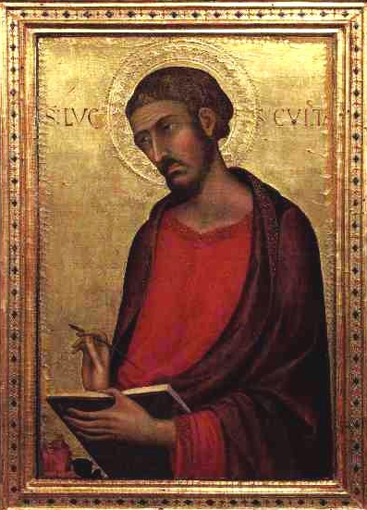
Introduction
Luke was a gentile physician who joined Paul on his missionary journeys.
It is interesting that this narrative will detail no less than 20 miraculous healings by
Christ … more than any other writer.
o There is a strong tie from the author of Acts to Luke (see Acts 1:1-2)
o The eye witness nature of Acts is testified to in the “We” sections of
the book.
o He was a gentile based on Col. 4:9-11, where those of the circumcision
were greeted and then was Luke and Demas … the inference being
that they were not circumcised.
o At the end of Paul’s life, Luke can be found (2Timothy 4:11)

Slide 10
Introduction
Ancient Traditions Support Luke As The Writer Of His Gospel And The Book Of Acts:
Irenaeus (A.D. 115-190) wrote in his book against heresy that Luke was a follower of
Paul, who had preserved in a book the gospel which Paul preached. Irenaeus was referring
to the book we know as the Gospel of Luke.
Justin Martyr, about A.D. 150, quoted frequently from the Gospel of Luke.
Tatian, sometime after A.D. 150, included the Gospel of Luke in his Diatessaron,
which was a harmony of the four gospels.

Slide 11
Introduction
The Anti-Marcionite Prologue, written between A.D. 160 and 180, which was an
introduction to Luke's gospel, stated Luke accompanied Paul until Paul's martyrdom, and
that while the gospels of Matthew and Mark had already been written, Luke was moved
by the Spirit to compose his gospel in Achaia.
The pagan Celsus attacked the Gospel of Luke around A.D. 178.
The Muratorian Canon, dated around A.D. 175, attested to Luke's having written the
gospel bearing his name.
Eusebius (A.D. 270-340) in his Church History spoke of
both the Gospel and the Book of Acts as having been written by Luke.
The caption “According to Luke” is an ancient
attestation to Luke's having written his gospel. Each
of the four gospel rolls was marked on the outside
of its roll with the phrase “according to” and the writer's
name to distinguish one gospel account from another in the
holder or drawer in which they were stored. These captions date
back to a very early date in the history of the church.

Slide 12
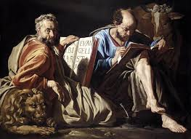
Introduction
The Themes Of This Book
- The work is theological in that it centres on the work of God in salvation
- God’s divine purposes are clearly revealed.
- God is seen, through Christ, as the divine healer.
- Matthew spends more time on the Old Testament fulfillments of the Messiah
- Mark spends more time showing the actions of Christ as a servant
- John spends his gospel showing the divine character of Christ
Jesus is seen as redeeming not just Jews, but ALL people.
- It was written to a Gentile audience.
- Jesus is pictured in this Gospel in a more intimate, homey way.
His humanity is on display.

Slide 13
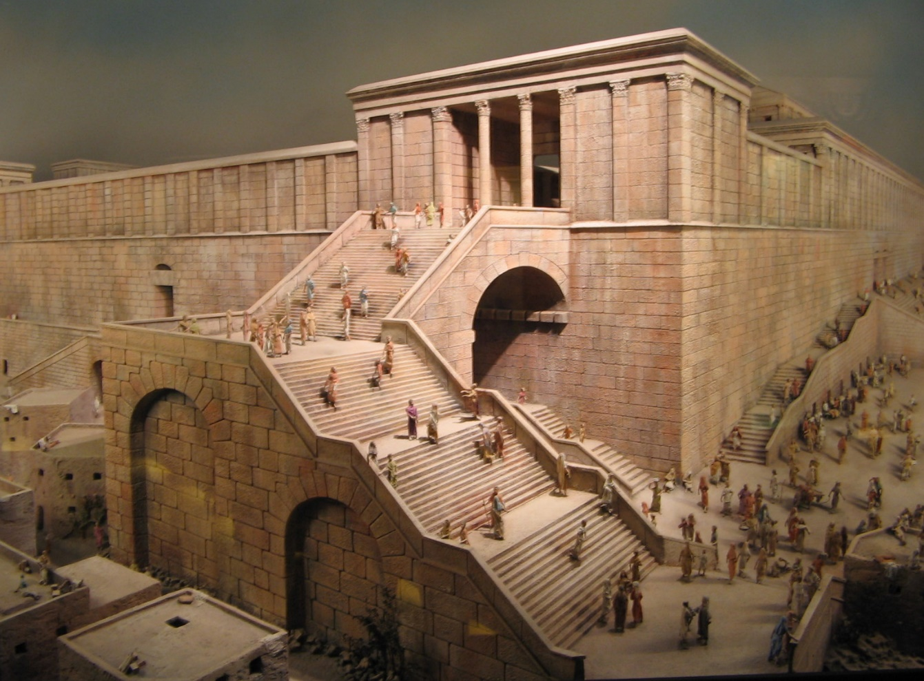
Priestly Order
There were 24 orders or courses of priests, who would minister 2 separate weeks each year.
A week would extend from Sabbath to Sabbath.
Incense was burned before the morning sacrifice and after the evening sacrifice.
Only those who had never done the job before were allowed to cast lots for the honor.
Afterwards, those involved in burning the incense would stand on the steps of the temple
and bless the people.

Slide 14
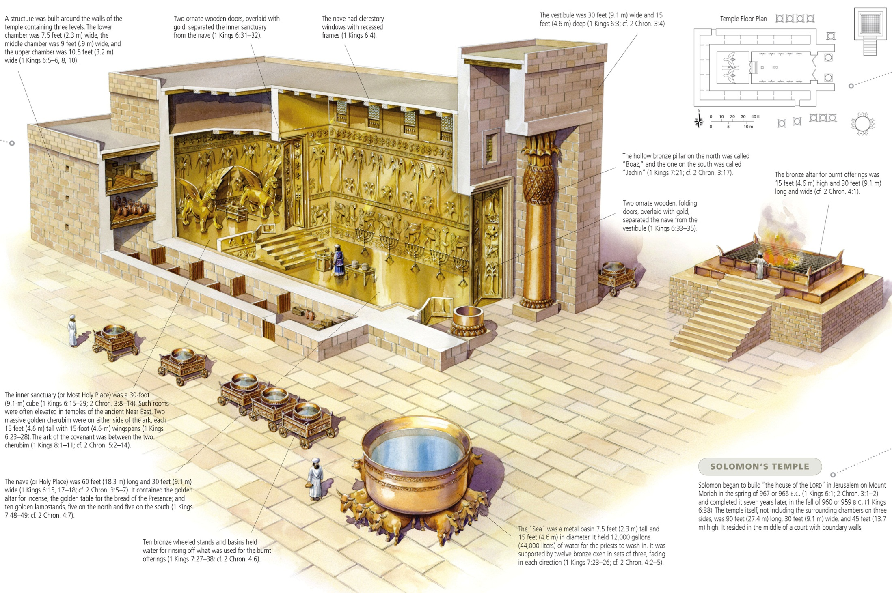

Slide 15
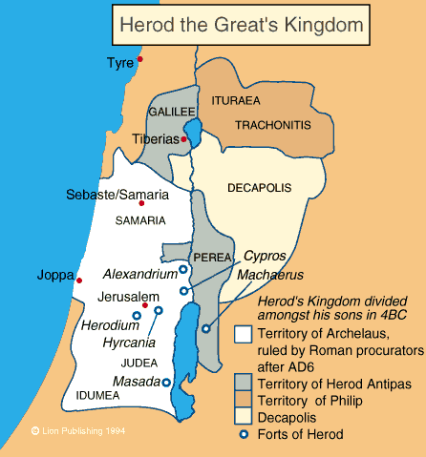
Herod
He reigned from 37 – 4 BC

Slide 16
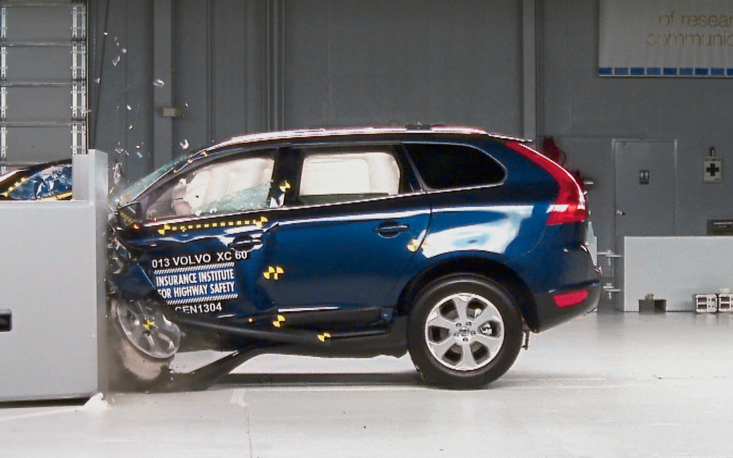
Testing
God test us … (James 1:2)

Slide 17
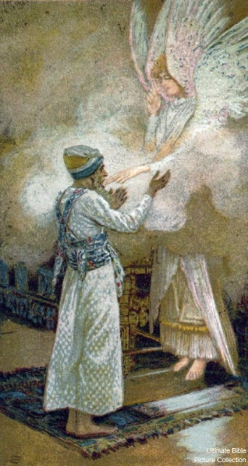
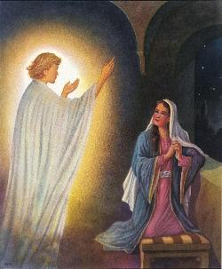
The Two Visits
Luke 1:11-20 | Luke 1:28-38
He was troubled (v12) | She was much troubled (v28)
The angel said to him (v13) | The angel said to her (v30)
Do not be afraid (v13) | Do not be afraid (v30)
Will bear you a son (v13) | You will … bear a son (v31)
And you will name him (v13) | And you will name him (v31)
He will be great (v15) | He will be great (v32)
Said to the angel (v18) | Said to the angel (v34)
And replying, the angel (v19) | And replying, the angel (v35)
Gabriel … God … sent (v19) | Gabriel … send … God (v26)
And now (v20) | And now (v36)

Slide 18
Revelation: Chiasm
Prologue (Rev 1:1-8)
Seven Churches (1:10-3:22)
Seven Seals (4:1 – 8:1)
Seven Trumpets (8:2 – 11:18)
Satan attacks (11:19-14:20)
Fall Of Babylon (17:1-19:10)
Bowl Judgments 15:1 – 16:21
Millennium (19:11 – 21:8)
New Jerusalem (21:9 – 22:9)
Epilogue (Rev 22:8-17)

Slide 19
Revelation: Chiasm
True mother dressed in white (12:1-2)
Her child keeps the commandments (12:17)
Woman in the wilderness (12:14)
Beast with 7 heads and 10 horns (12:3, 13:1)
Fallen is Babylon (14:8)
Testimony of Jesus (12:17)
Satan attacks (11:19-14:20)
False mother, dressed in purple (17:4)
Her children are harlots (17:5)
Woman in the wilderness (17:3)
Beast with 7 heads and 10 horns (17:3)
Fallen is Babylon (18:2)
Testimony of Jesus (19:10)
Fall Of Babylon (17:1-19:10)

Slide 20
Zechariah’s Song
"Praise be to the Lord, the God of Israel, He has come
because he has come
and has redeemed his people. He has raised up Salvation
a horn of salvation for us in the house of his
servant David
(as he said through his holy prophets of long ago), Prophets
salvation from our enemies and from the Enemies
hand of all who hate us—
to show mercy to our fathers Mercy
and to remember his holy
covenant, the oath he swore
to our father Abraham:
to rescue us from the hand of our enemies, Enemies
and to enable us to serve him without fear
in holiness and righteousness before him all
our days.
And you, my child, will be called a prophet of Prophet
the Most High; for you will go on before the Lord
to prepare the way for him,
to give his people the knowledge of salvation through the Salvation
forgiveness of their sins,
because of the tender mercy of our God, by which the rising sun will come to us He has come
from heaven to shine on those living in darkness and in the shadow of death, to
guide our feet into the path of peace."

Slide 21
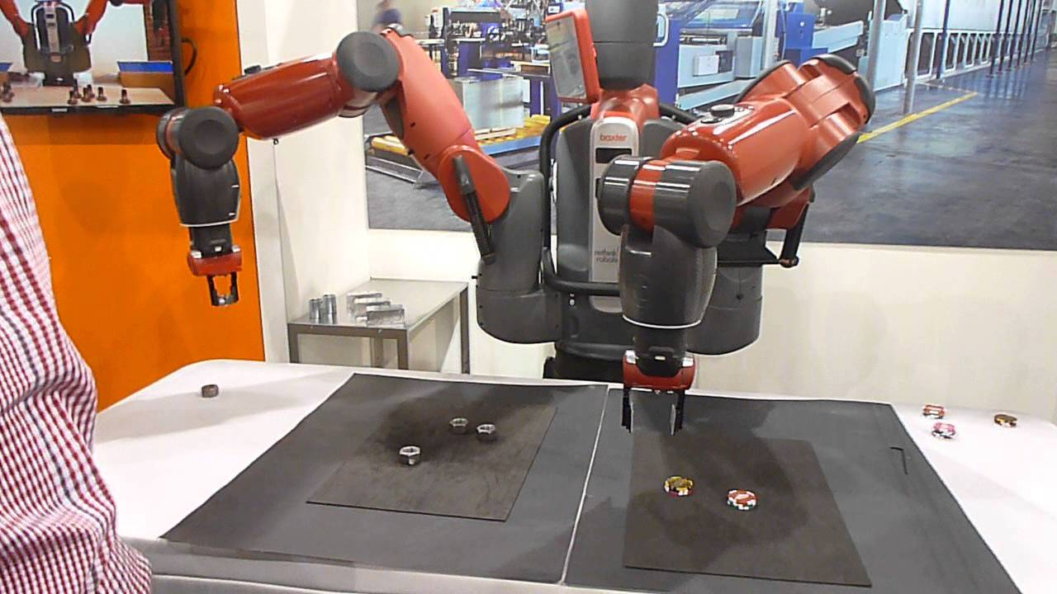
John’s Birth (1:57-80)
Teachable?

Slide 22
John’s Birth (1:57-80)
Teachable Traits:
I open to other people’s ideas?
Do I listen more than I talk?
Am I open to changing my opinion based on new information?
Do I readily admit when I am wrong?
Do I observe before acting on a situation?
Do I ask questions?
Am I willing to ask a question that will expose my ignorance?
Am I open to doing things in a way I haven’t done before?
Am I willing to ask for directions?
Do I act defensive when criticized, or do I listen openly for truth?
John Maxwell

Slide 23
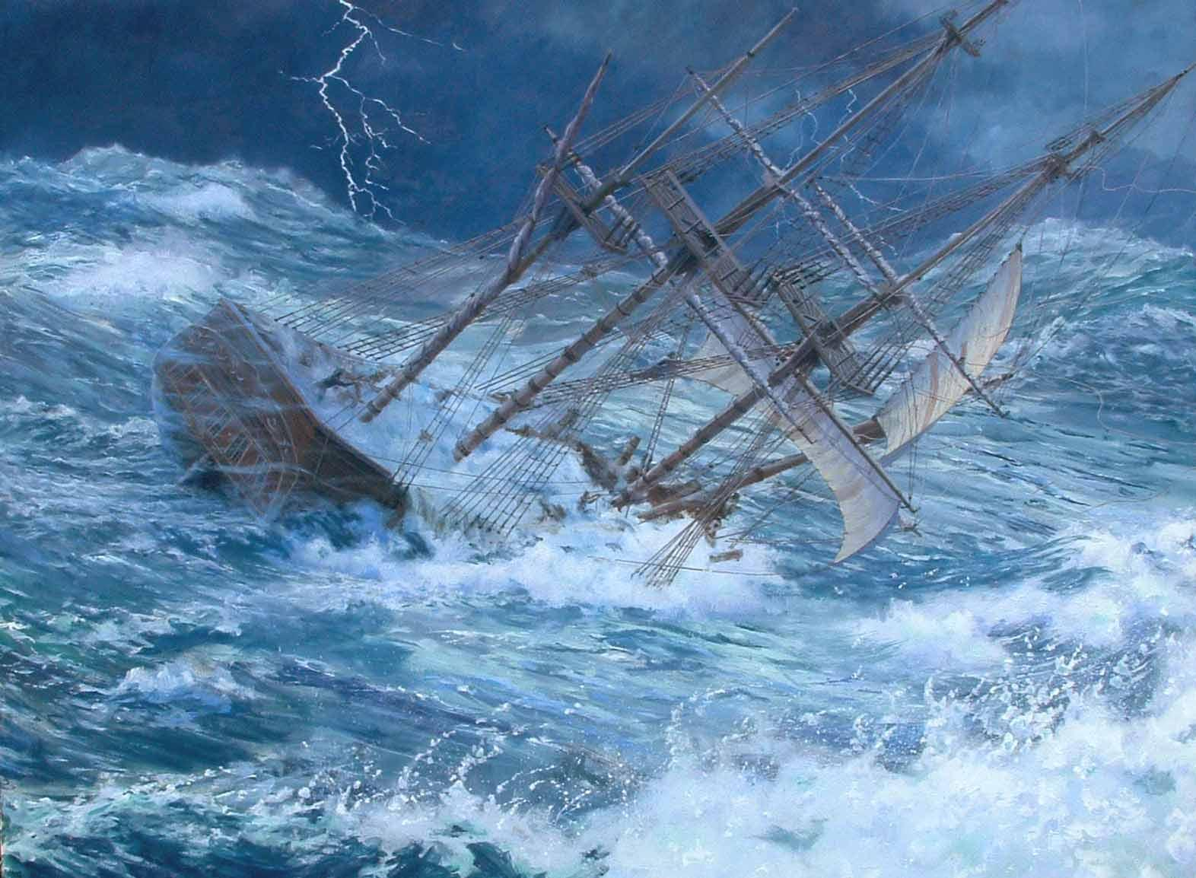
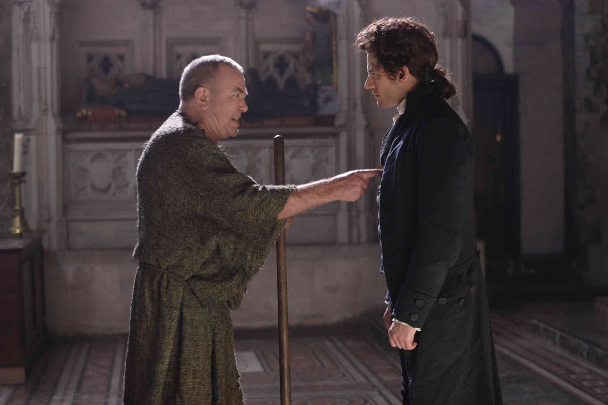
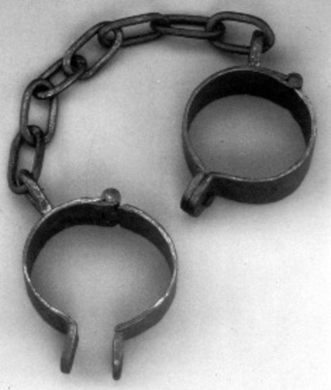
Why Am I Blessed?
John Newton & William Wilberforce

Slide 24
Why Am I Blessed?
To: William Wilberforce
Some of his people may be emphatically said, Not to live to themselves. May it not be said of you?
Would you not be glad to have more command of your time, and more choice of your company,
than your situation will admit? You meet with many things which weary and disgust you, which you
would avoid in a more private life. But then they are inseparably connected with your path of duty.
And though you cannot do all the good you wish for, some good is done, and some evil is probably
prevented, by your influence and that of a few gentlemen in the House of Commons, like-minded
with yourself. It costs you something, many hours, which you could employ more to your own personal
satisfaction, and exposes you to many impertinencies from which you would gladly be exempted; but if
upon the whole you are thereby instrumental in
promoting the cause of God and the public good,
you will have no reason to regret, that you had not
so much leisure for more retired exercises than
some of us are favoured with. Nor is it possible at
present to calculate all the advantages that may result
from your having a seat in the house, at such a time as
this. The example, and even the presence of a
consistent character may have a powerful, though
unobserved, effect upon others. You are not only a
Representative for Yorkshire. You have the far greater
honour of being a Representative for the Lord, in a place
where many know him not, and an opportunity of showing them
what are the genuine fruits of that religion which you are known to profess. John Newton

Slide 25
Mary’s Song (1:46-55)
Personal Section:
And Mary said: "My soul glorifies the Lord Praise
and my spirit rejoices in God my Savior, Salvation
for he has been mindful of the humble state Lowly
of his servant. From now on all generations
will call me blessed, Exalted
for the Mighty One has done great
things for me Salvation
—holy is his name. Praise

Slide 26
Mary’s Song (1:46-55)
Communal Section:
His mercy extends to those who fear him, Mercy (to all who fear Him)
from generation to generation.
He has performed mighty deeds with Salvation
his arm; he has scattered those who are (with judgment)
proud in their inmost thoughts.
He has brought down rulers from Humiliation
their thrones
but has lifted up the humble. Exaltation
He has filled the hungry with Exaltation
good things
but has sent the rich away empty. Humiliation
He has helped his servant Israel, Salvation
remembering to be merciful Mercy
to Abraham and his descendants for ever,
even as he said to our fathers."

Slide 27
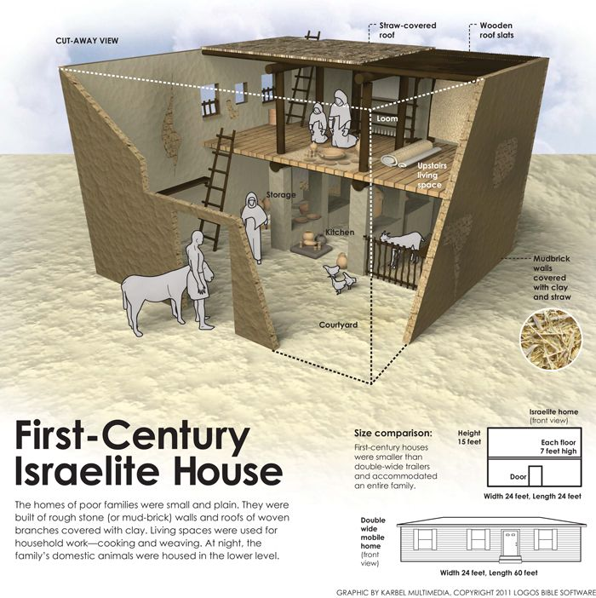
Jesus’ Birth (1:57-80)
First Century Jewish Homes

Slide 28
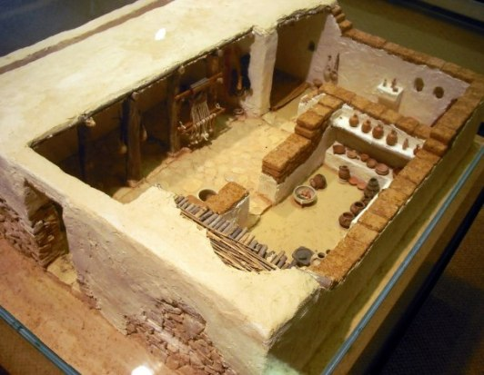
Jesus’ Birth (1:57-80)
First Century Jewish Homes

Slide 29
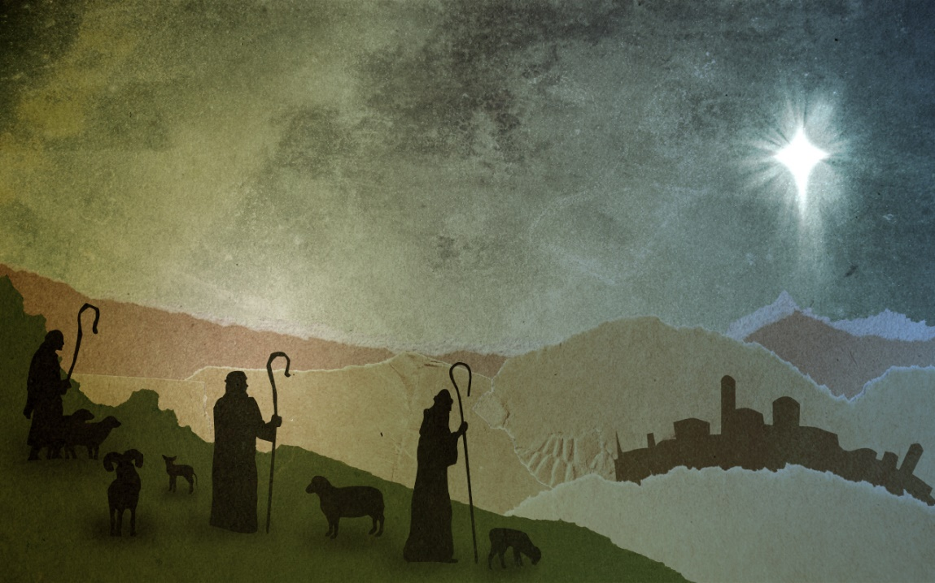
Jesus’ Birth (1:57-80)
It is interesting that these lowly citizens of the culture were among the
first to have this news revealed.
The sheep that these men watched over may indeed have been those
that were used in the priestly sacrifices in Jerusalem
These shepherds could hardly contain themselves once they understood
the good news.
The reception of the angel is the same as the last two times:
- The angel appears
- The angel proclaims to “Fear not”
- There is a birth announcement
- There is a sign
In the first two cases, the angel
makes his claims in the context of
a family. The shepherds are clearly
not family. Yet, Jesus would
enlarge the meaning of family to
include ALL who would come!

Slide 30
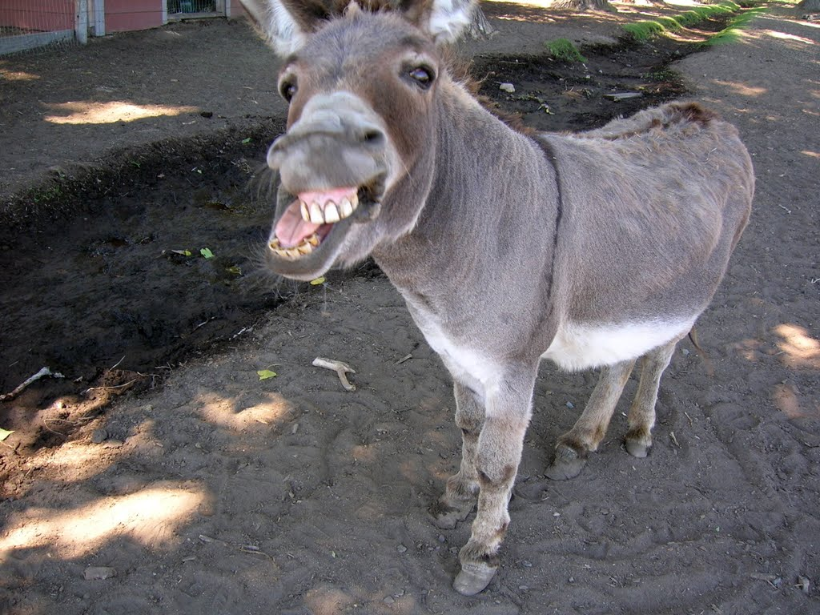
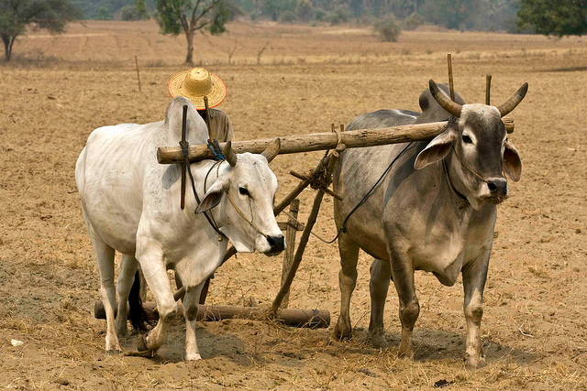
Jesus’ Birth (1:57-80)
Isaiah 1:2-3 ¶ Hear, O heavens! Listen, O earth! For the LORD has
spoken: "I reared children and brought them up, but they have
rebelled against me. The ox knows his master, the donkey his
owner’s manger, but Israel does not know, my people do
not understand."

Slide 31
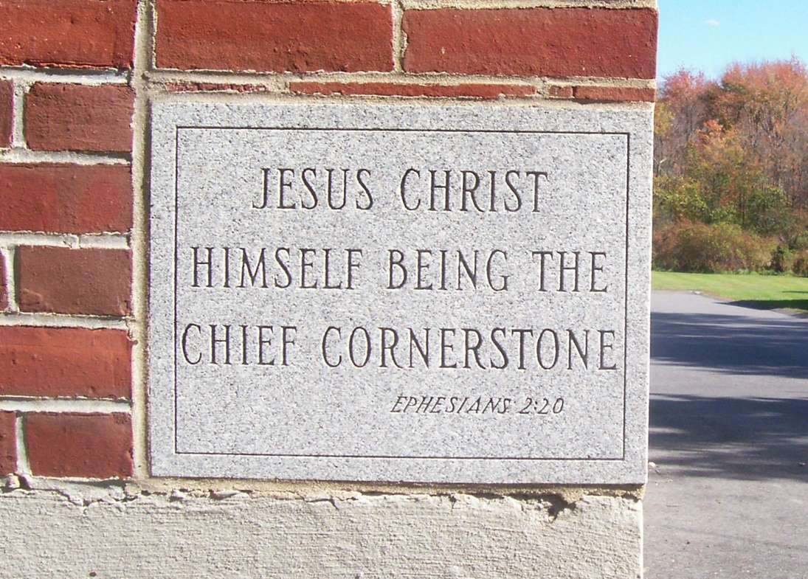
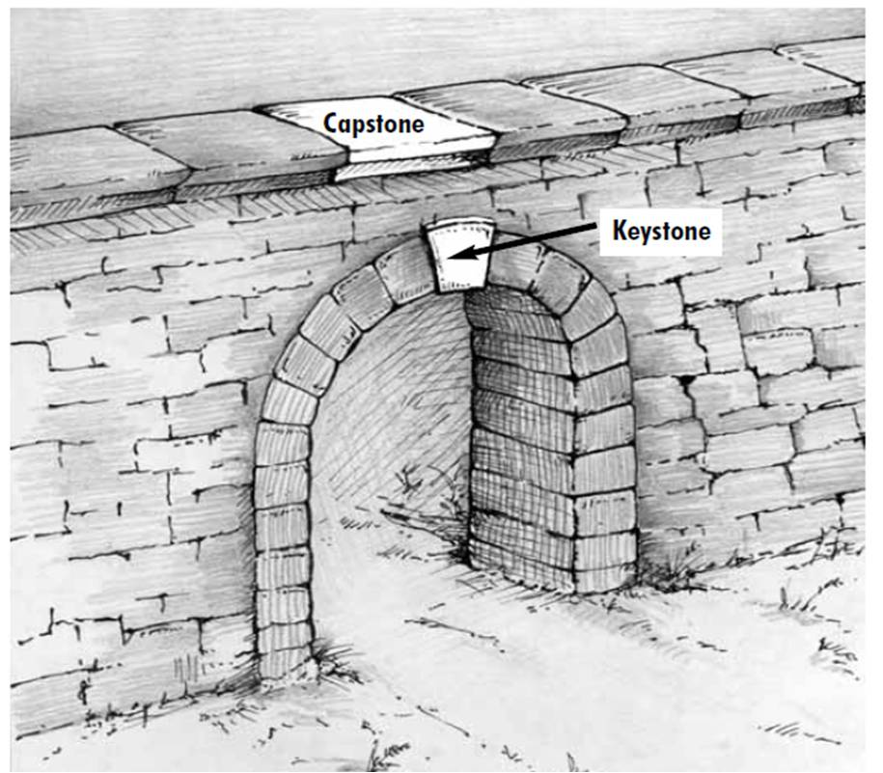
Simeon and Anna 2:21-28
1Peter 2:4-8 ¶ As you come to him, the living Stone—rejected by men but chosen by God
and precious to him—you also, like living stones, are being built into a spiritual house to
be a holy priesthood, offering spiritual sacrifices acceptable to God through Jesus Christ.
For in Scripture it says: "See, I lay a stone in Zion, a chosen and precious cornerstone, and
the one who trusts in him will never be put to shame.“ Now to you who believe, this stone
is precious. But to those who do not believe, "The stone the builders rejected has become
the capstone,“ and, "A stone that causes men to stumble and a rock that makes them fall."
They stumble because they disobey the message—

Slide 32
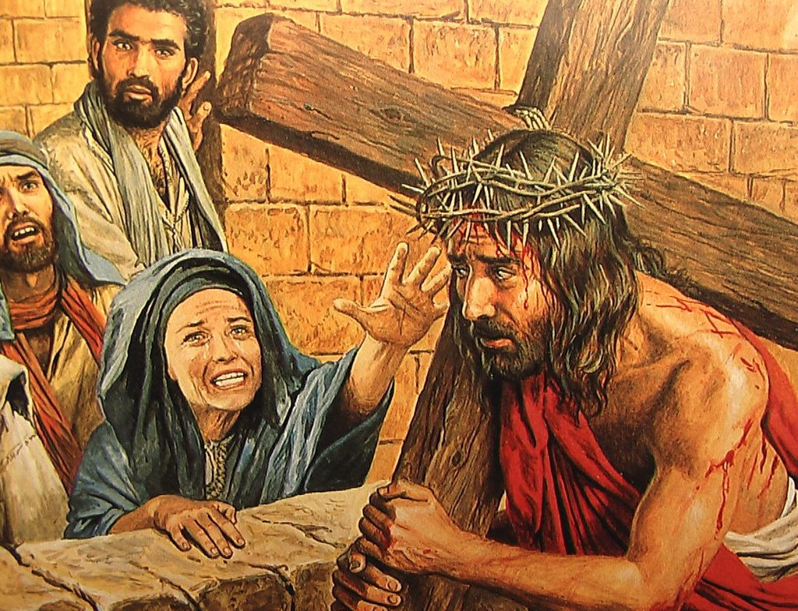
Simeon and Anna 2:21-28
Think about what is revealed at the cross:
Peter says one thing and then does another (denial)
All the apostles run away
Pilate violates his own conscience as he condemns an innocent man
The high priest condemns one who perfectly fulfills the OT definition of the Messiah
The soldiers follow orders even though those orders contravene Roman law
Mary, on the other hand, stayed until the bitter end. She aligned herself with her son.
Her testimony was a stinging rebuke to everyone around her. She could not argue to
get Jesus freed, and so her only choice was to remain.

Slide 33
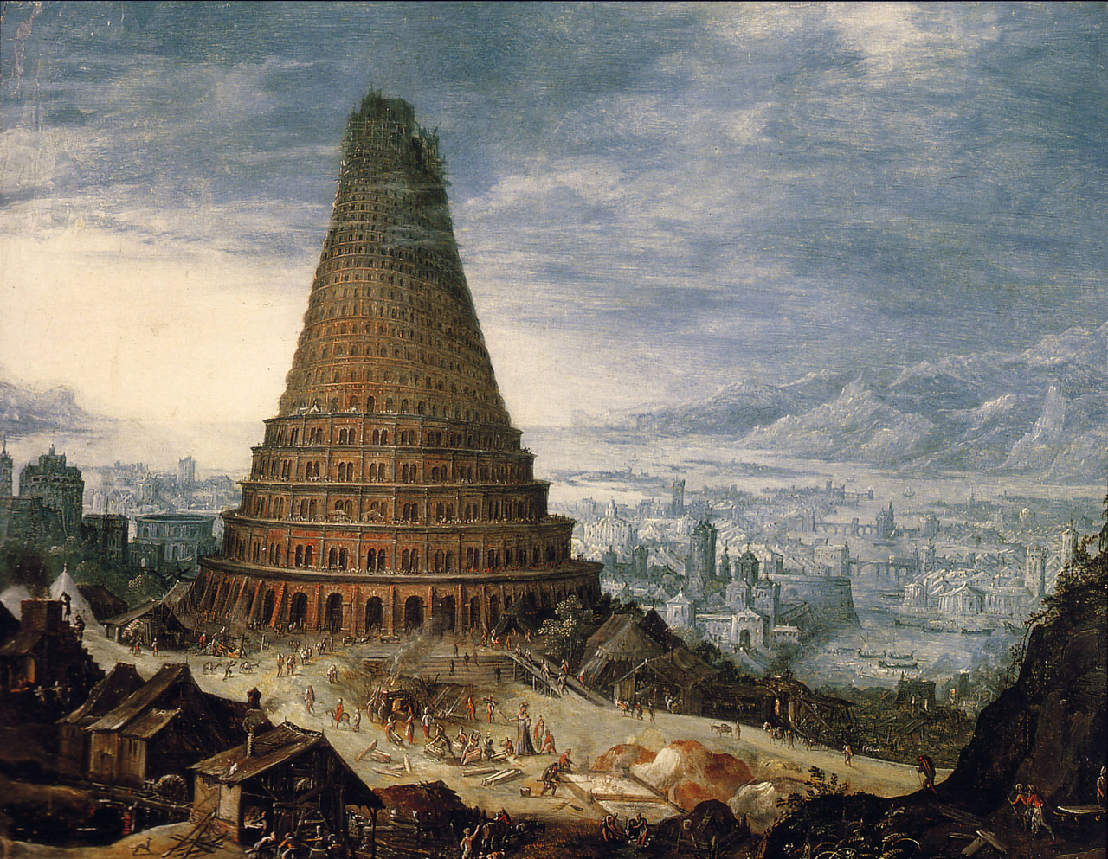
Simeon and Anna 2:21-28
Note that Simeon says that Jesus will cause division … split the nation in two (Luke 12:51)
o Why is there such a push today for unity?
o Is unity ever NOT in God’s will?
o What does an unholy unity look like? (2Corinth. 6:14)
o Christ of course, comes to reveal hearts!

Slide 34
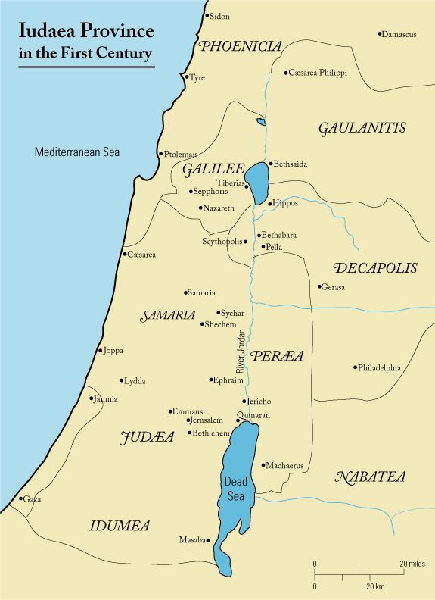
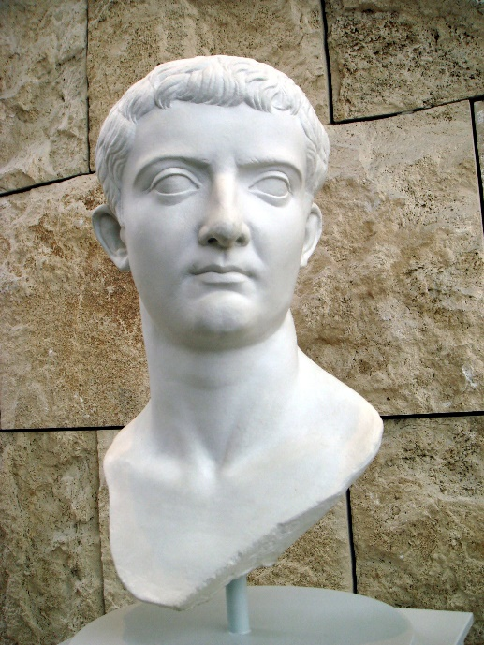
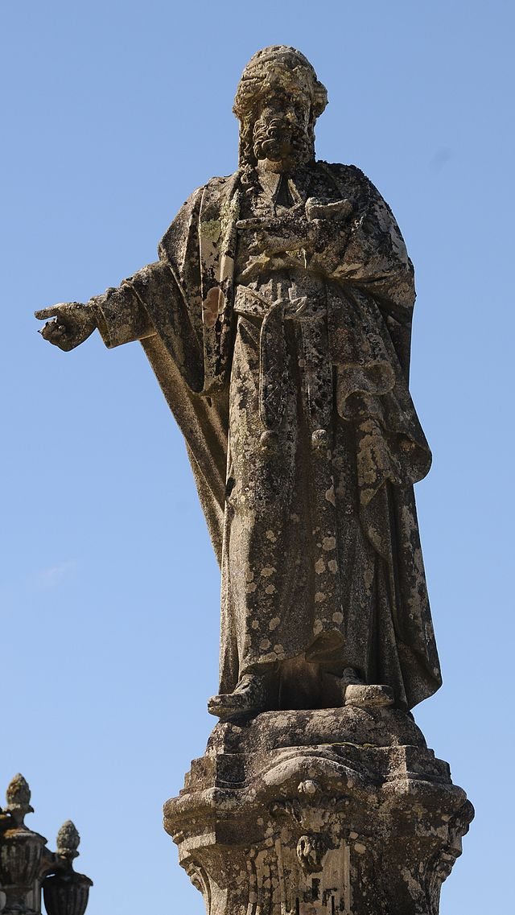
Luke 3 John The Baptizer
Tiberius Caesar
Annas

Slide 35
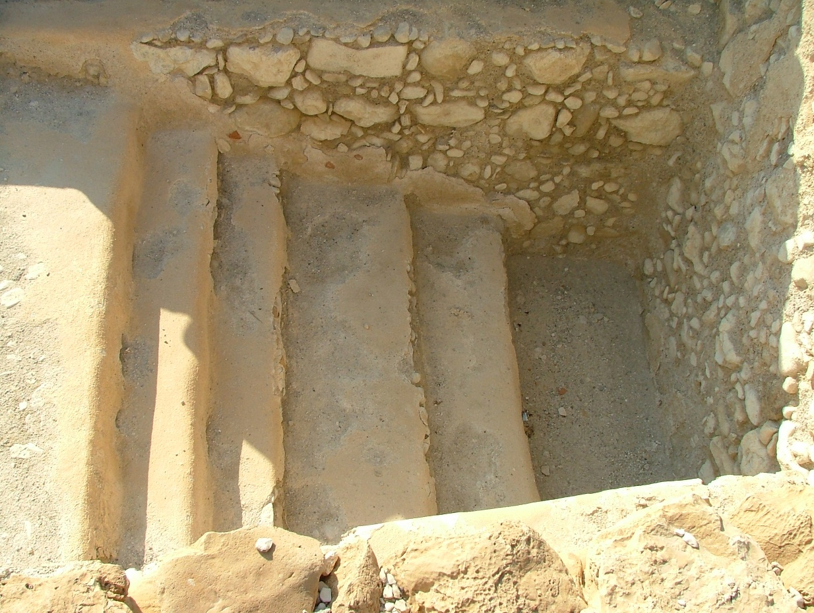
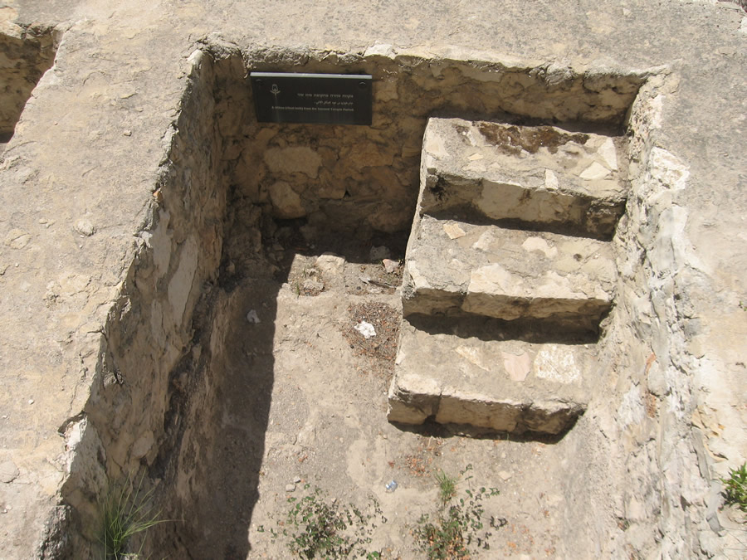
Luke 3 John The Baptizer
Qumran Mikveh

Slide 36
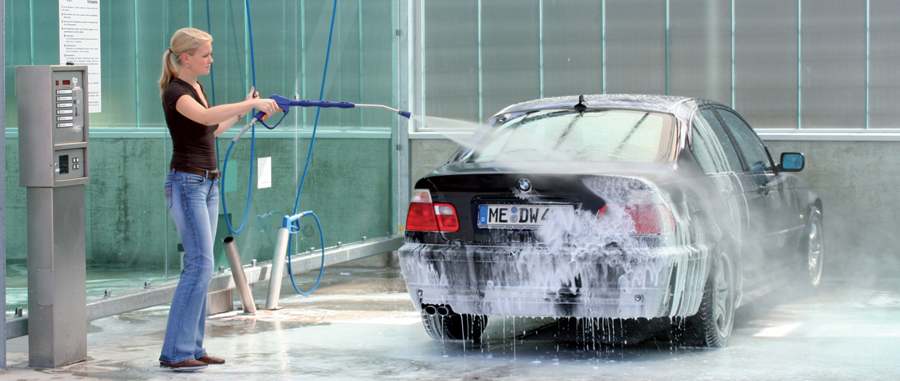
Luke 3 John The Baptizer
Ezekiel 36: 25 - 26 ¶ I will sprinkle clean water on you, and you will be clean; I
will cleanse you from all your impurities and from all your idols. I will give you a new
heart and put a new spirit in you; I will remove from you your heart of stone and give
you a heart of flesh.

Slide 37
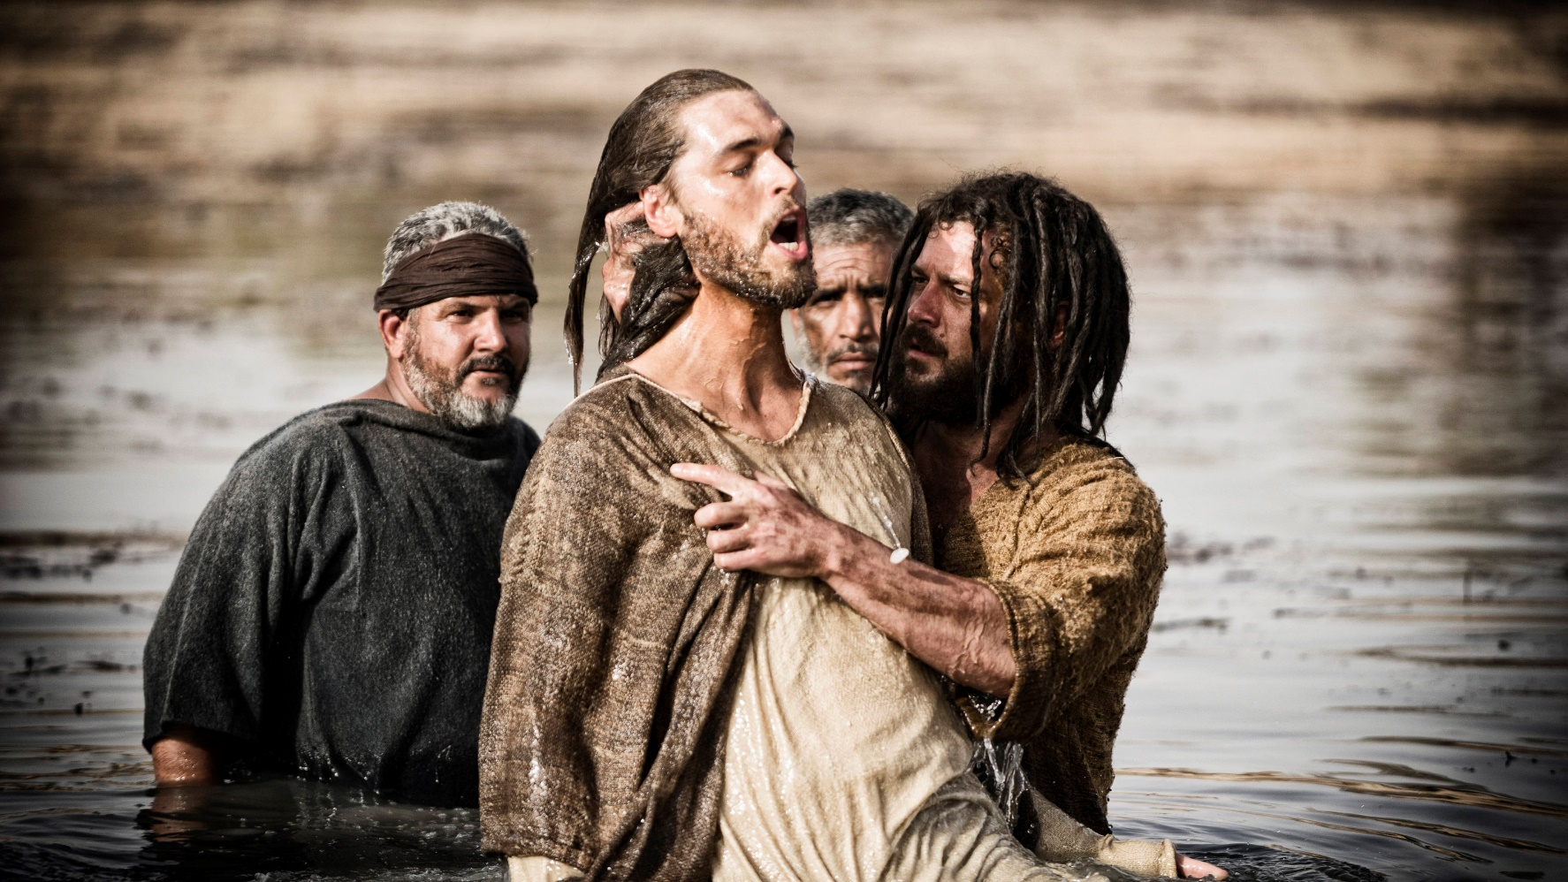
Luke 3 John The Baptizer
Isaiah 40: 3-5 A voice of one calling: "In the desert prepare the way for the LORD;
make straight in the wilderness a highway for our God. Every valley shall be raised up,
every mountain and hill made low; the rough ground shall become level, the rugged
places a plain. And the glory of the LORD will be revealed, and all mankind together
will see it. For the mouth of the LORD has spoken."

Slide 38
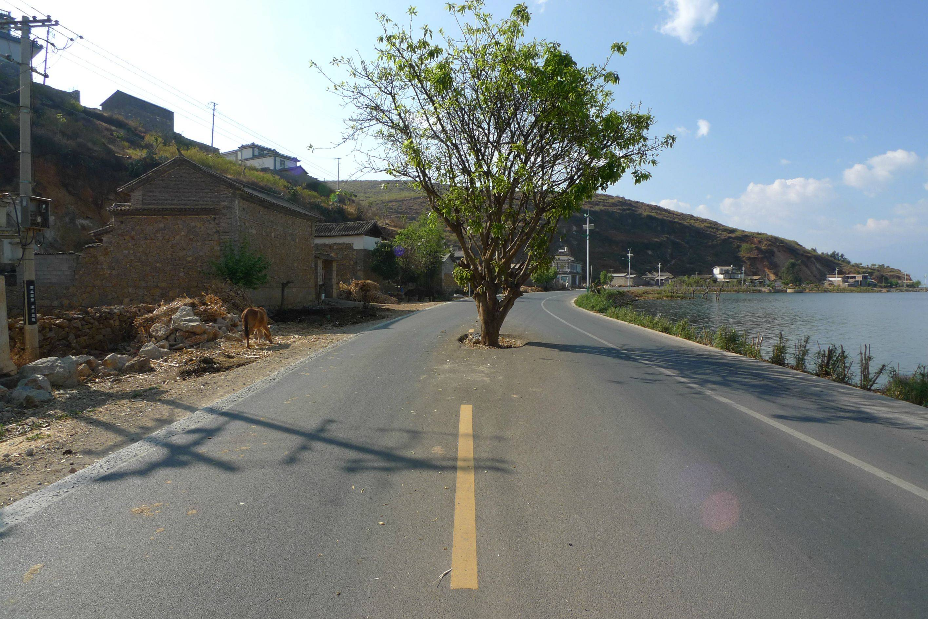
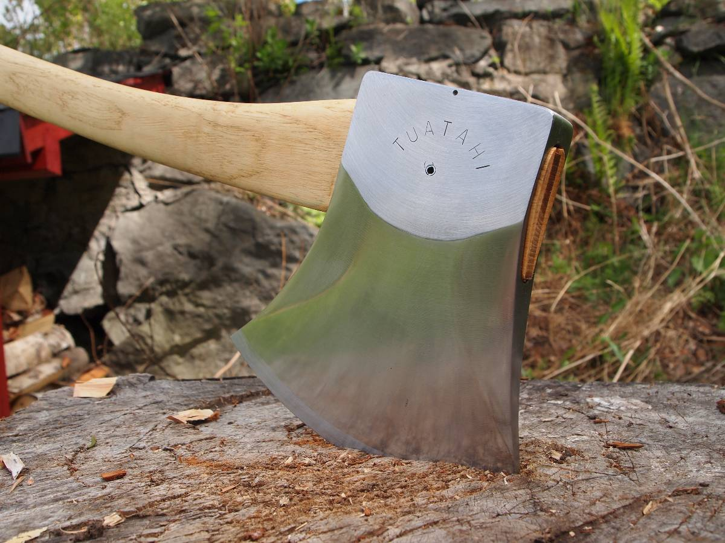
Luke 3 John The Baptizer
Trees in the way get cut down!

Slide 39
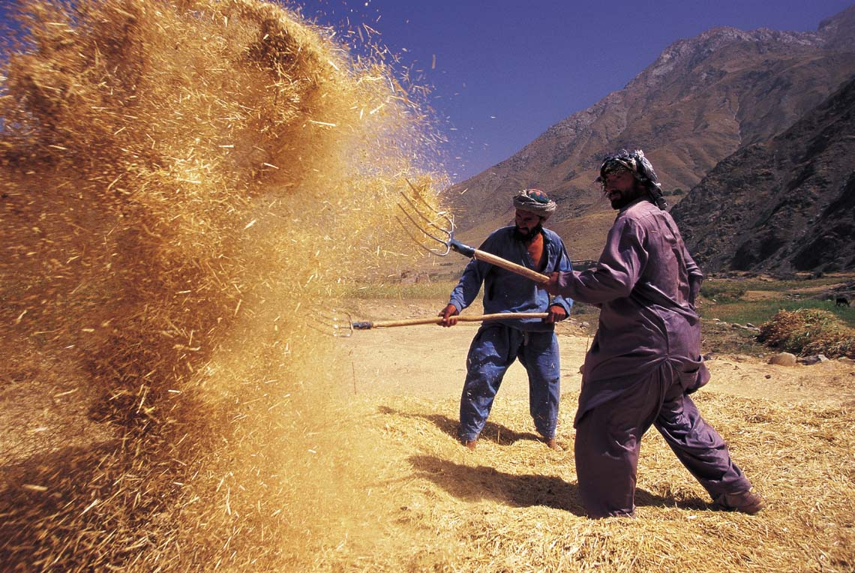
Luke 3:17
Baptism in the Spirit Or With Fire

Slide 40
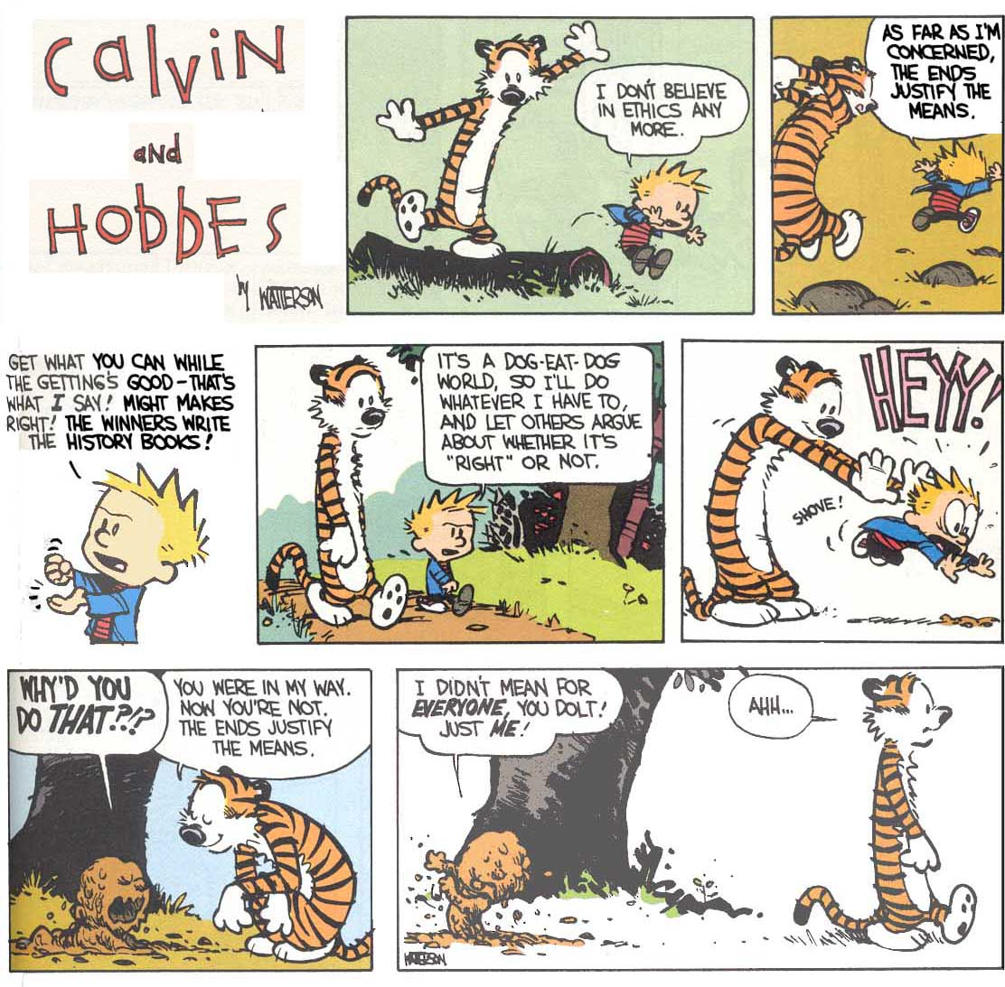
Luke 3
Ethics

Slide 41
Luke 3
Ethics
Comparison chart
 | Ethics | Morals
What are they? | The rules of conduct recognized in respect to a particular class of human actions or a particular group or culture. | Principles or habits with respect to right or wrong conduct. While morals also prescribe dos and don'ts, morality is ultimately a personal compass of right and wrong.
Where do they come from? | Social system - External | Individual - Internal
Why we do it? | Because society says it is the right thing to do. | Because we believe in something being right or wrong.
Flexibility | Ethics are dependent on others for definition. They tend to be consistent within a certain context, but can vary between contexts. | Usually consistent, although can change if an individual’s beliefs change.
Origin | Greek word "ethos" meaning"character" | Latin word "mos" meaning "custom"
Acceptability | Ethics are governed by professional and legal guidelines within a particular time and place | Morality transcends cultural norms

Slide 42
Luke 3: Ethics
1) Purely Biblical Ethic
This revealed morality is understood to give quite specific information. While admitting
that the moral information of Scripture is not always explicit, followers contends
that "there is actually no ethical decision in life which the biblical revelation leaves
wholly untouched and for which, if carefully interpreted and applied, it cannot afford
some concrete guidance.“ The Bible does not merely provide principles but embraces
the particularities of life, giving specific guidelines for ethical decision. In light of this
specific guidance there is never, according to followers,
a conflict of Christian duty.
Not only does Scripture reveal a clear, unambiguous
Christian duty; there is also a distinctive Christian
virtue that is attained only by Christians.

Slide 43
Luke 3: Ethics
1) Purely Biblical Ethic: Difficulties
Bioethics?
Beginning and ending of life issues?
Allocation of scarce resources?
Ecology?
In other words, how do we deal with issues not spoken of
directly in the Bible?
Is there ever a place where the LAW should be superseded
By Love?
i.e. Joseph’s treatment of Mary
Jesus’ treatment of the adulterous woman

Slide 44
Luke 3: Ethics
2) God Is Free to Command (Antinomianism or “against law”)
The concept that "God is free to command" is primarily the position of neo-orthodox
theologians, especially those such as Karl Barth and Dietrich Bonhoeffer.
It places strong emphasis on the all-sufficiency of grace and the inadequacy of human
effort. Because the sinner can only respond, and because God's act of justification rules
out all self-justification, ethical reflection that seeks to justify certain acts is considered
suspect. Christians are called to respond in obedience to God's grace, not to reflect on
good and evil.
Bonhoeffer also emphasizes obedience to the concrete
command. He stresses that it does not come by some
direct inspiration to the individual, but through the
church family, labor, and government.
In other words, God will tell us specifically what
to do. Will we obey?

Slide 45
Luke 3: Ethics
2) God Is Free to Command: Difficulties
How exactly are we to determine the “voice of God” and with what criteria
will we measure its authenticity?
Could God command something contrary to His Word or His nature?

Slide 46
Luke 3: Ethics
3) Duty (Deontological) – Immanuel Kant
Gives priority to what is right … not what has a good outcome.
You must act from a good will. The motive of an action determines whether it is
right or wrong.
Categorical Imperative:
Act only according to that maxim by which you can at the same time will that it
should become a universal law. i.e borrowing money with no intent to repay
Act in such a way that you treat humanity, whether
in your own person or in the person of another,
always at the same time as an end and never simply
as a means.

Slide 47
Luke 3: Ethics
3) Duty (Deontological) – Kant: Difficulties
What deontology does right is that it takes the standard of morality out of humanity's
hands and places it in something with absolute authority. Unfortunately, deontologists
then argue about the source of that authority.
a)Natural Law - Natural law theory is the philosophy that everything in nature is subject to a
particular way of acting that will best enable it to fulfill that nature. The law as it applies to
humanity is based on human nature and can be determined by carefully considering that
universal nature of mankind which is independent of culture and era. Ironically, although
natural law is supposedly derived from the universality
of human nature, philosophers can't agree on what
the key points of natural law should be. They usually
include life, procreation, and some kind of personal
fulfillment.

Slide 48
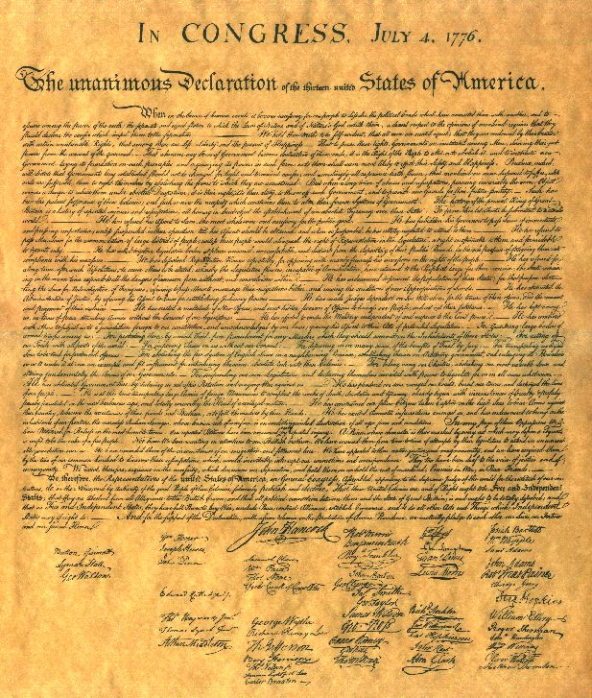
When in the course of human events, it becomes necessary for one people to dissolve the
political bands which have connected them with another, and to assume among the powers
of the earth, the separate and equal station to which the Laws of Nature and of Nature's
God entitle them, a decent respect to the opinions of mankind requires that they should
declare the causes which impel them to the separation.
We hold these truths to be self-evident, that all men are created equal, that they are
endowed by their Creator with certain inalienable rights, that among these are life, liberty
and the pursuit of happiness.
That to secure these rights, governments are
instituted among men, deriving their just
powers from the consent of the governed. That
whenever any form of government becomes
destructive of these ends, it is the right of the
people to alter or abolish it, and to institute new
government, laying its foundation on such
principles and organizing its powers in such form,
as to them shall seem most likely to effect their
safety and happiness.
US Declaration Of Independence, 1776

Slide 49
Luke 3: Ethics
3) Duty (Deontological) – Kant: Difficulties
b) Contractual Agreements - Two of the most basic rules in society are that individuals
will not harm each other and individuals will not lie. Contractarianism is the belief that
a contract or promise automatically gives moral weight to the actions necessary to fulfill
that contract. The "contract" may be a voluntarily agreed-upon list of obligations or the
assumed responsibilities of a citizen in a society.
c) Divine Command - The divine command theory states that an action's morality is
based on its adherence to the command of God.
An act can only be ethical if it obeys God’s law,
and the word of God overrides any other law,
custom, or inclination.

Slide 50
Luke 3: Ethics
3) Duty (Deontological) – Kant: Difficulties
The Bible doesn't give duty as the motivation for right behavior.
Exodus 20:6; Deuteronomy 5:10; Joshua 22:5; John 14:15; 2 John 1:6 and eleven
other verses associate love for God with obedience. Righteousness, then, isn't about
duty or obligation; it's an expression of our love for God.
What do we do when duties come into conflict?
If I enjoy an act, it cannot be morally good
(because I enjoy, that is my motivation)

Slide 51
Luke 3: Ethics
4) Utilitarianism – What brings the greatest good
- Also Egoism (What brings the greatest benefit to me)
- A teleological theory: Goal Oriented
The ultimate aim of all humanity is happiness. Our moral choices should bring
the greatest amount of happiness to the greatest number of people.
Or another way, any behavior may be justified if it will achieve the most good for the
most people. Popularly, it is summed up as "the ends justify the means".
Calculus:
Should I take my niece, Erika to the circus?
It gives her pleasure: +5
It causes me distress -2
It helps the circus to survive +1
We may get hurt -1
It gives my sister joy +2
Quite expensive -4
NET: +1
- Let’s go (happily??)

Slide 52
Luke 3: Ethics
4) Utilitarianism: Difficulties
Its weakness falls in the need for "good" to have an objective standard
and the fact that the "end" is ambiguous (due to lack of omniscience of humans).
The responsibility to determine both of these then falls back on the individual making
the decision.
It really removes any objective, transcendence from our decision making.

Slide 53
Luke 3: Ethics
5) Situational Ethics: Joseph Fletcher
Situational Ethics was pioneered by Joseph Fletcher (1905-1991). His work,
Situation Ethics, founded the modern situational ethics movement. Since then, almost
every publication on situational ethics has referred to the model presented in Fletcher's
writings. Fletcher was an Episcopal priest, a member of the Euthanasia Educational
Counsel, and an advocate for Planned Parenthood. He was a supporter of both euthanasia
and abortion.
Situational Ethics, according to Fletcher's model, states
that decision-making should be based upon the
circumstances of a particular situation, and not
upon fixed Law. The only absolute is Love. Love
should be the motive behind every decision. As
long as Love is your intention, the end justifies the
means. Justice is not in the letter of the Law, it is in
the distribution of Love. Fletcher founded his model
upon a statement found in the New Testament of the
Bible that reads, "God is Love" (1 John 4:8).

Slide 54
Luke 3: Ethics
5) Situational Ethics: Joseph Fletcher: Difficulties
Fletcher's model of Situational Ethics appears reasonable upon a glance, yet given
careful consideration, its flaw becomes apparent. Situational Ethics is based upon
"God is Love" in I John 4:8. However, in the very next chapter we read, "This is the
love of God, that we keep His commandments. And His commandments are not
burdensome" (I John 5:3). While Fletcher holds that any commandment may be
broken in good conscience if Love is one's intention, the Bible states that the keeping
of God's commandments is loving God. To break any commandment, regardless of
your intentions, is to not love God. Therefore, logic
holds that the breaking of the commandment was
not done in Love.
Can flawed human beings truly choose to love?

Slide 55
Luke 3: Ethics
6) Virtue Ethics (Aristotle)
What sort of person do I want to be … or ought I to be?
Character is formed by past choices.
The virtue ethicist argues that what matters morally is not what we do at a time, but what
we become over time. To the virtue ethicist it is the acquisition of a good character that is
or should be our moral aim.
They do not: (a) follow rules
(b) try to produce certain
consequences
If you acquire the right habits you will,
over time, become a person with the
disposition to do certain things in certain
circumstances.

Slide 56
Luke 3: Ethics
6) Virtue Ethics (Aristotle)
Once you have become virtuous you will:
• know what the right action is;
• perform the right action;
• perform the right action because it is the right action.

Slide 57
Luke 3: Ethics
6) Virtue Ethics (Aristotle): Difficulties
There is no guidance on what to do!
The only way to learn what to do is to emulate someone already doing it.
How do we KNOW who is virtuous? Is anyone?

Slide 58
Luke 3: Ethics
A Useful Checklist:
What are my feelings towards the issue? Do I have assumptions and biases?
a. I must work hard to remain consistent!
Gather as much information about the issue as you can.
Scientific
Legal
Social
What are the Biblical traditions?
What are the traditions of the church on this subject?
Is there an ethical system that makes some sense?
What are current ethicists & theologians saying?
Pray for the wisdom to choose wisely.

Slide 59
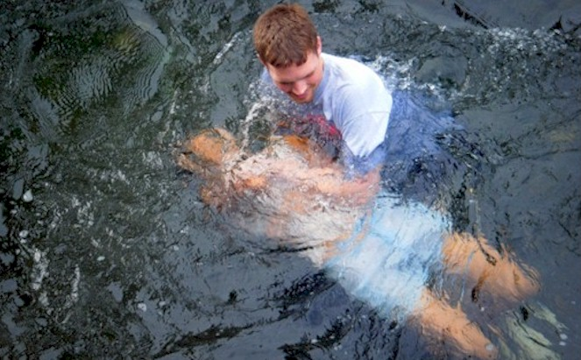
Luke 3:21
Genesis 1-3 | Jesus’ Baptism
Chaos in creation | Creation is chaos due to sin
The Father speaks | The Father testifies of the Son
The Spirit hovers | The Spirit descends upon Christ
Created order emerges | The New Kingdom emerges
Humanity created perfect | Humanity re-created (Born again)
The Father declares “It is good” | The Father declares: Well pleased
Humanity tempted by Satan: Fails | Christ tempted by Satan: Succeeds

Slide 60
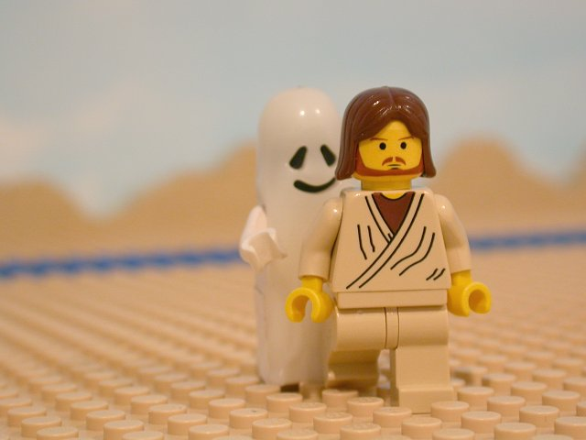
Luke 4:1-13
Christ’s Temptation
Israel | Christ
Divinely lead in the wilderness (Deut. 8:2) | Lead into the wilderness (Luke 4:1)
For 40 years (Ex. 16:35, Numbers 14:34) | Luke 4:2
The events of the wanderings brought the commands of Deut. | Jesus quotes Deut. 8:3, 6:13, 6:16)
Israel grieves the Spirit (Isa. 63:10) | Jesus is filled with the Spirit (Luke 4:1)

Slide 61
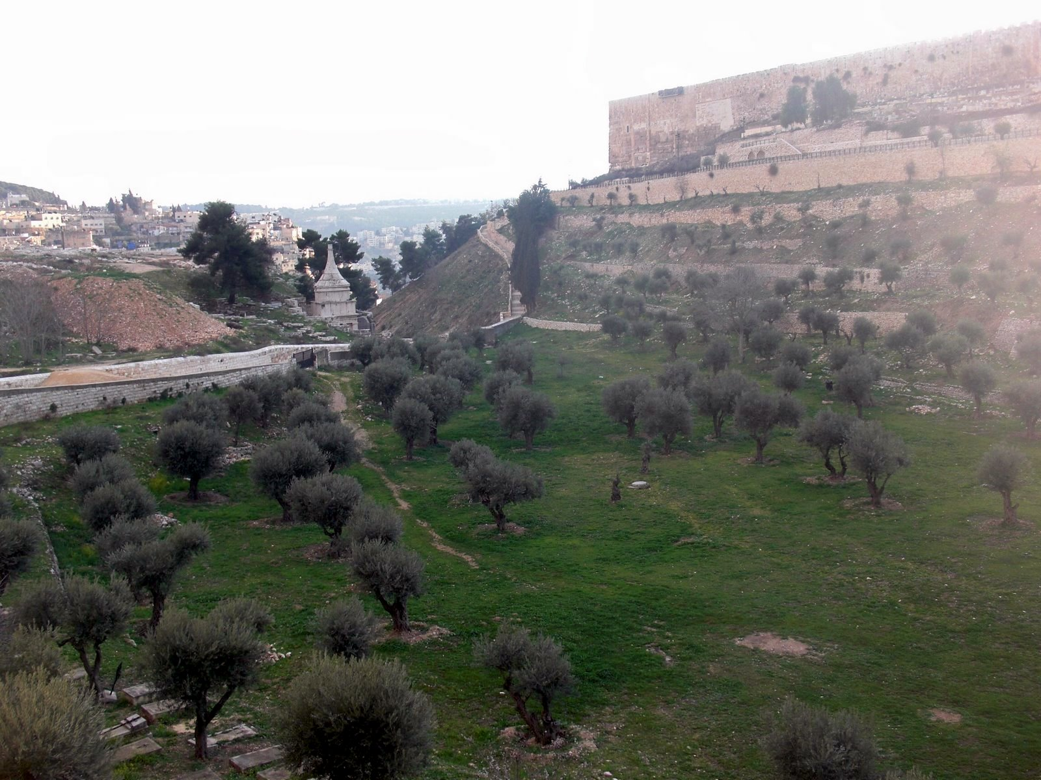
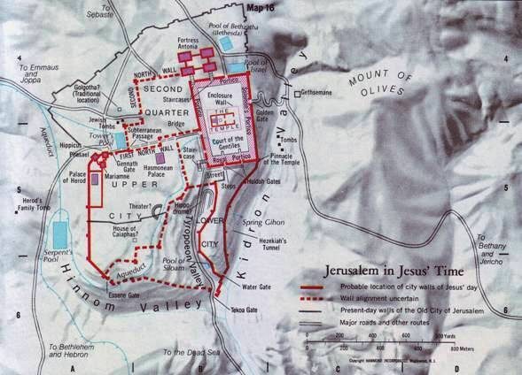
Luke 4:1-13
Kidron Valley

Slide 62
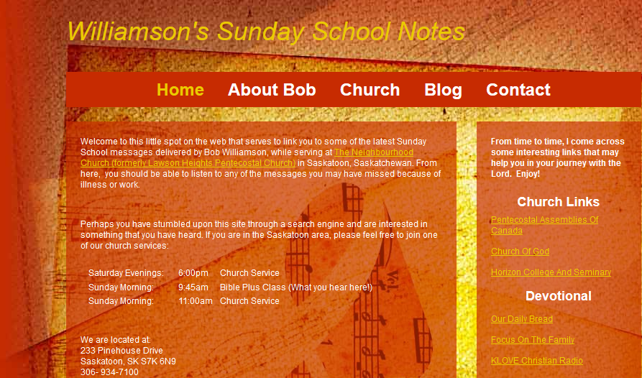
Luke
www.williamsonit.ca/ss

Slide 63
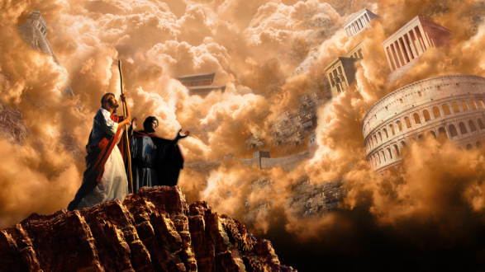
Luke 4:1-13
1John 2:15 Do not love the world or anything in the world. If anyone loves the world, the love of the Father is not in him.
For everything in the world—the cravings of sinful man, the lust
of his eyes and the boasting of what he has and does— comes not from the Father
but from the
world.
The world
and its desires
pass away, but
the man who
does the will of
God lives for
ever.

Slide 64
Luke 4:1-13
Gleanings:
Jesus has faced the same kind of temptations that we have and relying on nothing but the same power afforded to us, overcomes.
Before great giftings and opportunities, often come times of lonely trials. God is concerned greatly with the preparatory work His desires to accomplish.
Doubt in the faithfulness of God has satanic roots.
It is not the mere speaking of the Word of God that has magical power (Satan can speak it) but a trust in what it says and means that avails great things.
The path to Christian maturity at times takes time
and may involve difficulty. But it is always best.
Trust the artist who sees the finished product!
f) Tests are part of God’s divine plan. Our reaction
to them says much about our character. We must
fight the temptation to “force” God to act to
prove His love for us.
Elizabeth Elliot’s testing time …

Slide 65
Jesus’ Inauguration
The stones into bread (4:1-4)
Use power to provide food for self? Jesus refuses.
The kingdoms of this world (4:5-8)
- Worship the devil and receive authority? Jesus refuses.
From the pinnacle of the temple (4:9-13)
Thrown yourself down – stones will not hurt you? Jesus refuses.
4. Jesus in Nazareth (4:16-28)
From the brow of the hill (4:29-30)
The people seek to thrown Him down. They cannot.
With authority and power, Jesus commands unclean spirits (4:31-41)
The demons submit and cry out
Jesus’ popularity grows
The miraculous catch of fish (5:1-11)
- Jesus uses His power to feed others

Slide 66
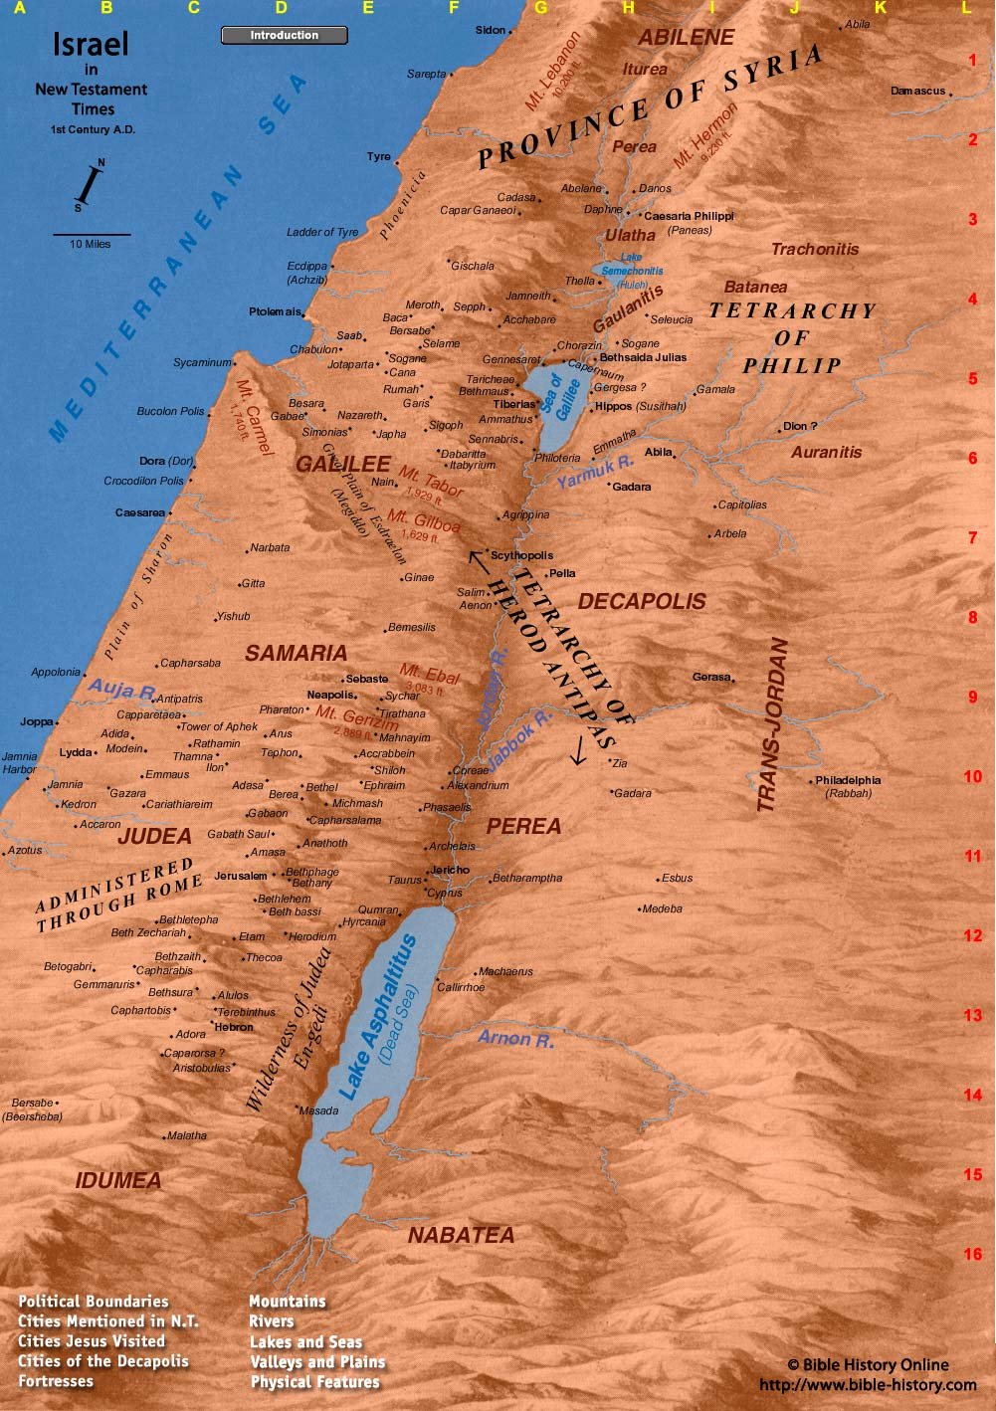
Luke 4:14-30

Slide 67
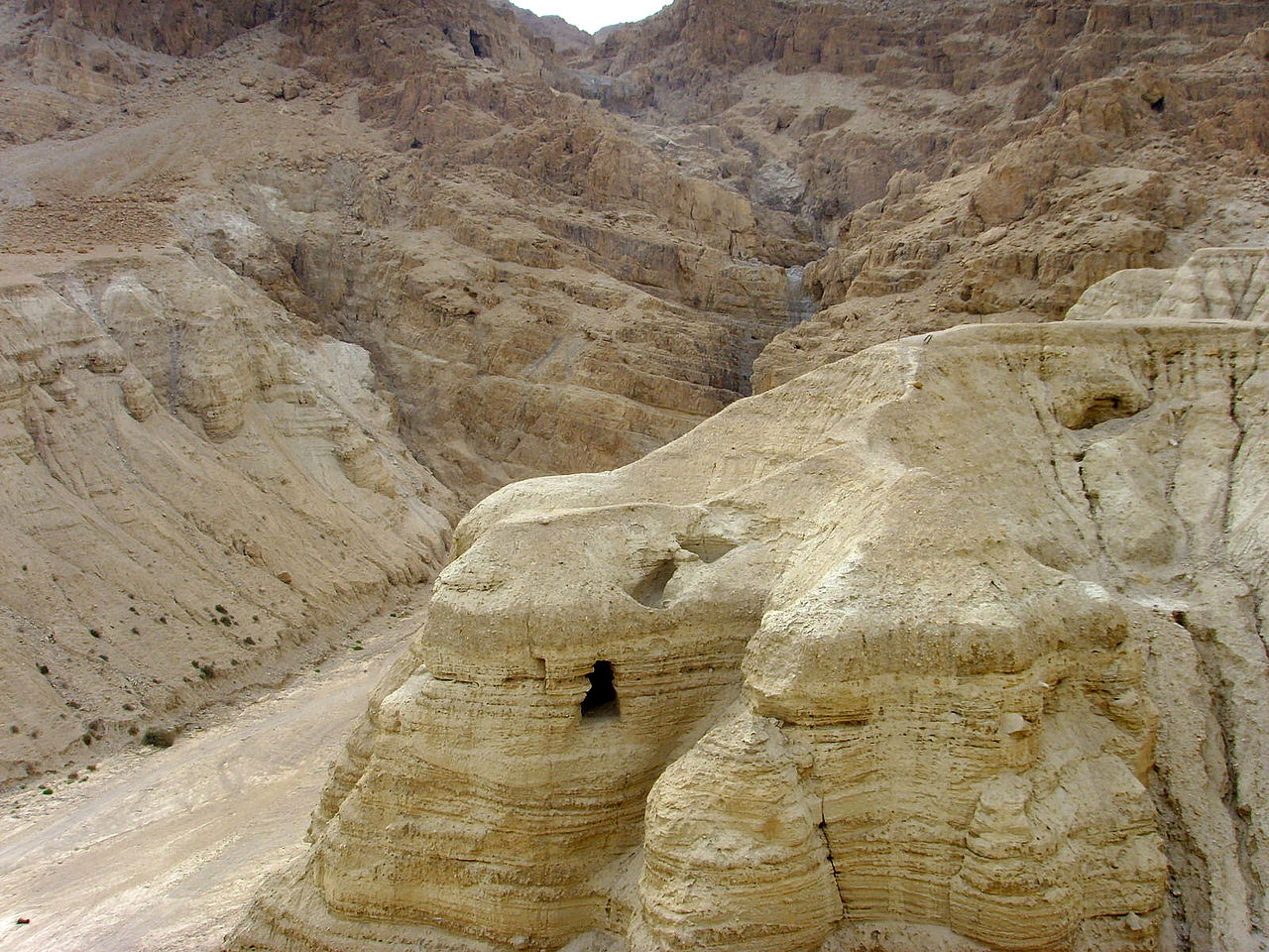
Luke 4:14-30
Qumran Cave 4Q

Slide 68
Luke 4:14-30
Qumran Cave 4Q

Slide 69
Luke 4:14-30

Slide 70
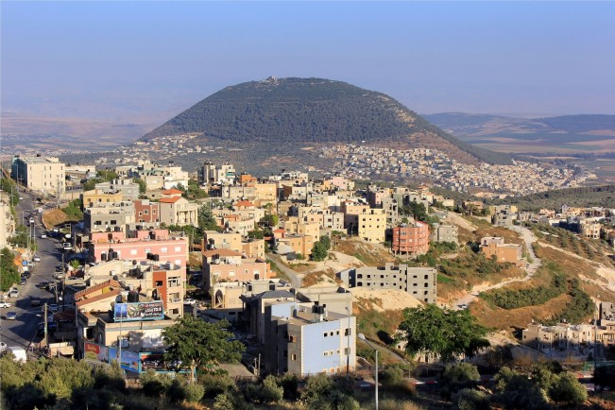
Luke 4:14-30
Mount Tabor And Nazareth today

Slide 71
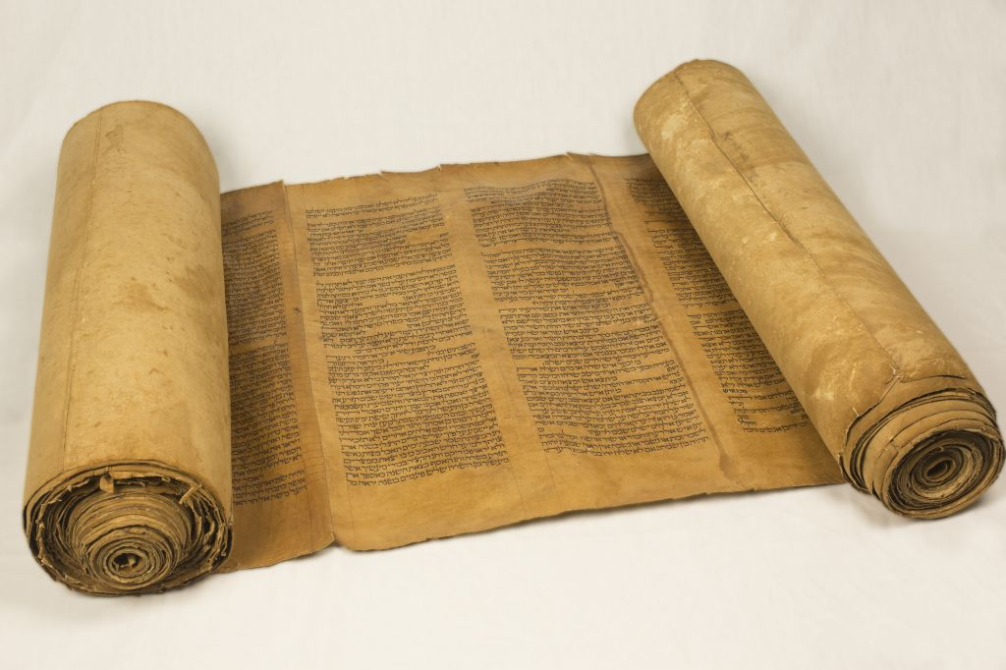
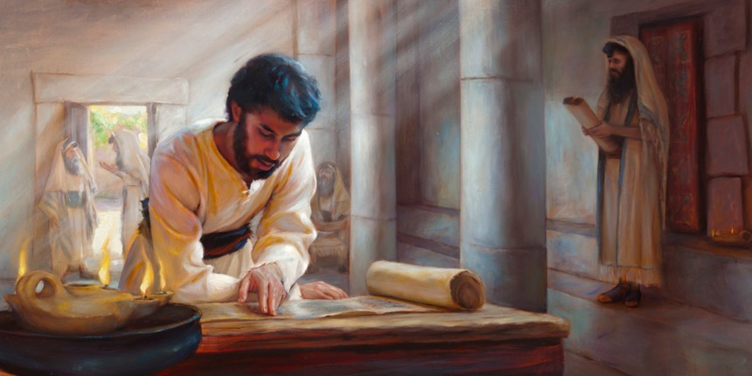
Luke 4:14-30
Synagogue Life

Slide 72
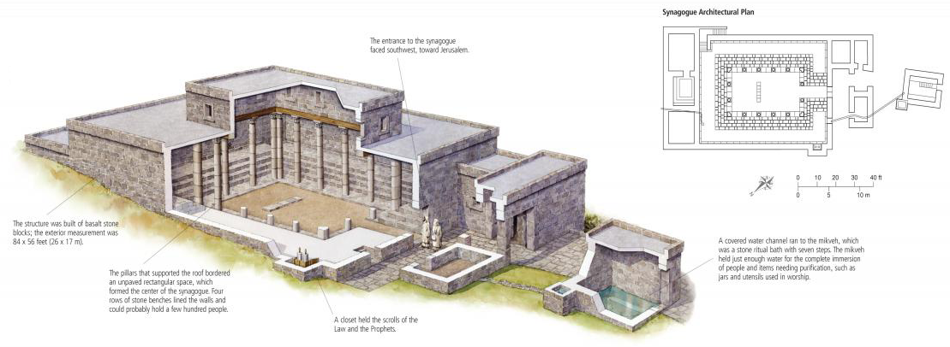
Luke 4:14-30
Synagogue Life
- The entrance would face towards Jerusalem

Slide 73
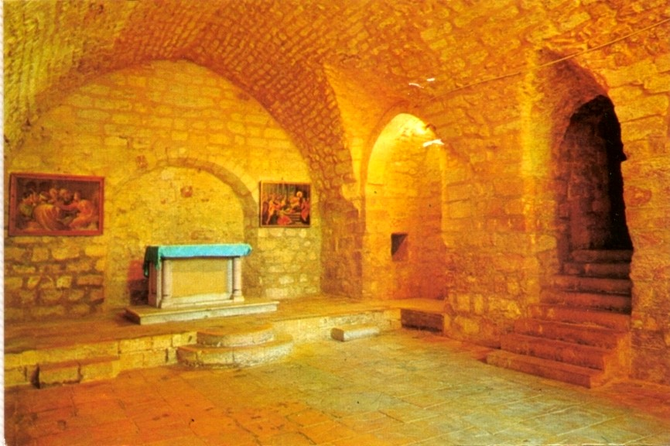
Luke 4:14-30
Synagogue Life

Slide 74
Luke 4:14-30
… and on the Sabbath day he went into the synagogue, as was his custom.
And he stood up to read.
The scroll of the prophet Isaiah was handed to him.
Unrolling it, he found the place where it is written:
"The Spirit of the Lord is on me, because he has anointed me
to preach good news to the poor. Preach
He has sent me to proclaim freedom for the prisoners Sent
and recovery of sight for the blind, SIGHT (Compassion)
to release (send) the oppressed, Send
to proclaim the year of the Lord’s favour.“ Proclaim
Then he rolled up
the scroll, gave it back to the
attendant and sat down.
The eyes of everyone in the synagogue were fastened
on him,

Slide 75
Jesus’ Inauguration
The stones into bread (4:1-4)
Use power to provide food for self? Jesus refuses.
The kingdoms of this world (4:5-8)
- Worship the devil and receive authority? Jesus refuses.
From the pinnacle of the temple (4:9-13)
Thrown yourself down – stones will not hurt you? Jesus refuses.
4. Jesus in Nazareth (4:16-28) – Mercy!
From the brow of the hill (4:29-30)
The people seek to thrown Him down. They cannot.
With authority and power, Jesus commands unclean spirits (4:31-41)
The demons submit and cry out
Jesus’ popularity grows
The miraculous catch of fish (5:1-11)
- Jesus uses His power to feed others

Slide 76
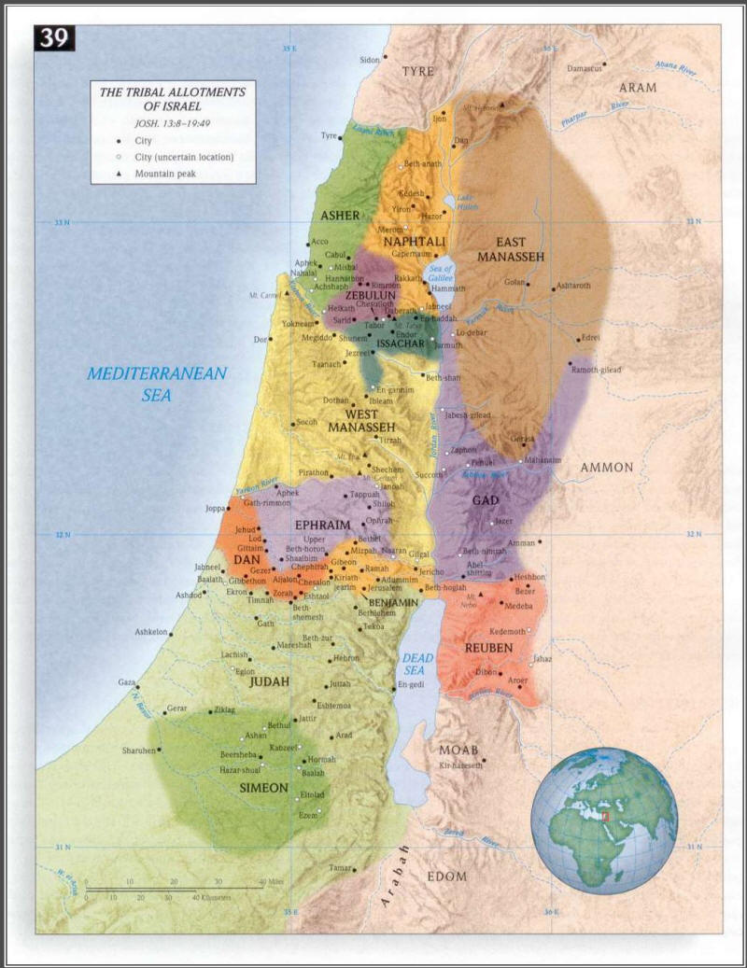
Matthew 4:15
"Land of Zebulun and land of Naphtali,
the way to the sea, along the Jordan,
Galilee of the Gentiles— the people
living in darkness have seen a great
light; on those living in the land
of the shadow of death a light
has dawned."

Slide 77
Luke 4:42

Slide 78
Luke 4:42

Slide 79
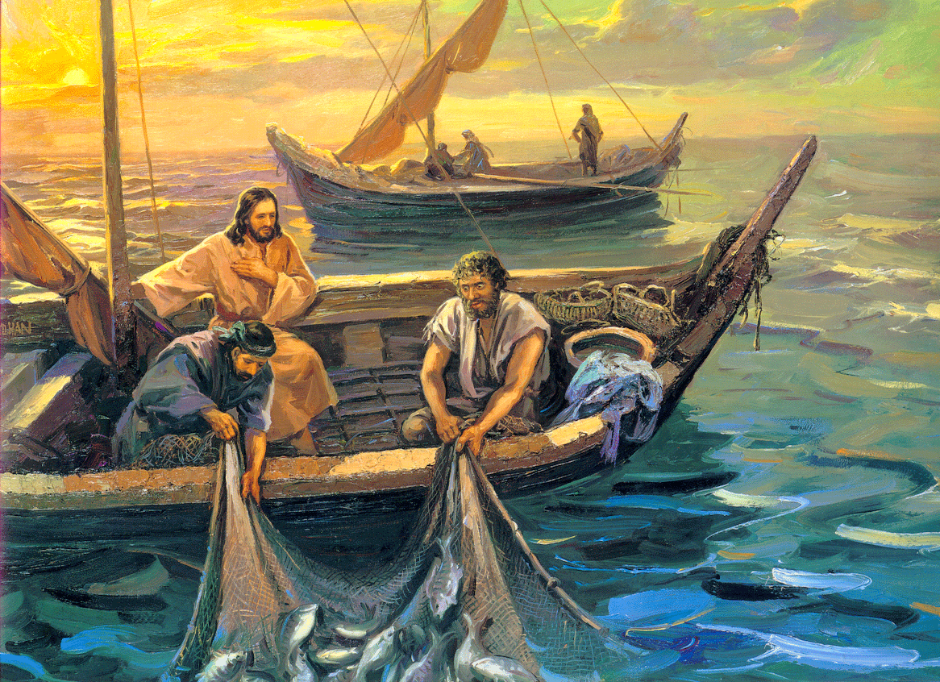
Luke 5:1-11
1. The boat goes out and Jesus teaches
2. Jesus instructs Peter to catch fish
3. Peter speaks to Jesus in an arrogant way
4. There is an incredible, supernatural catch of fish (esp. during the day!)
5. Peter responds to Jesus in repentance
6. Jesus instructs Peter to catch people, not fish .
7. The boat returns to shore and they follow Jesus.

Slide 80
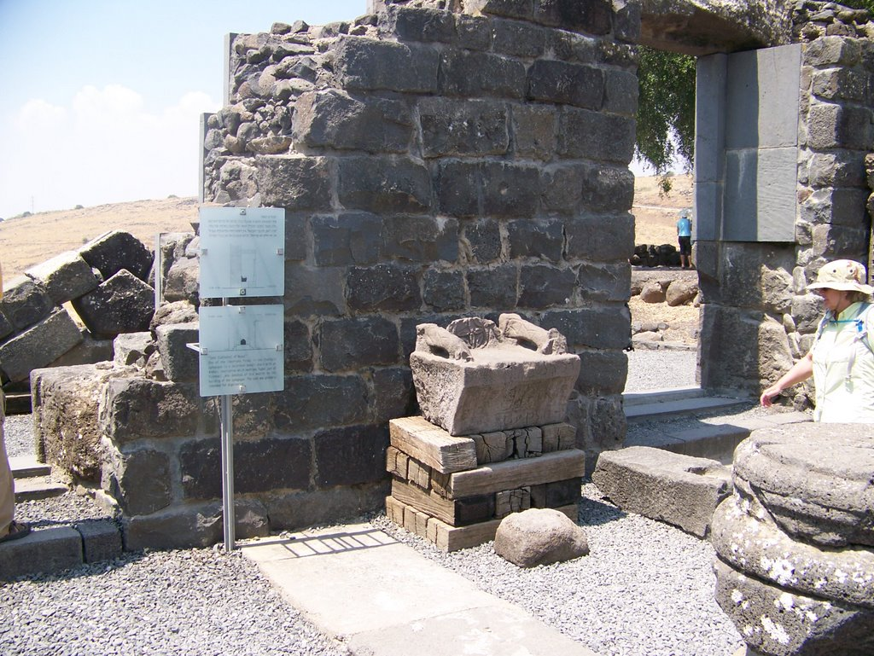
Luke 5:1-11
Moses Seat at Korazin (modern)

Slide 81
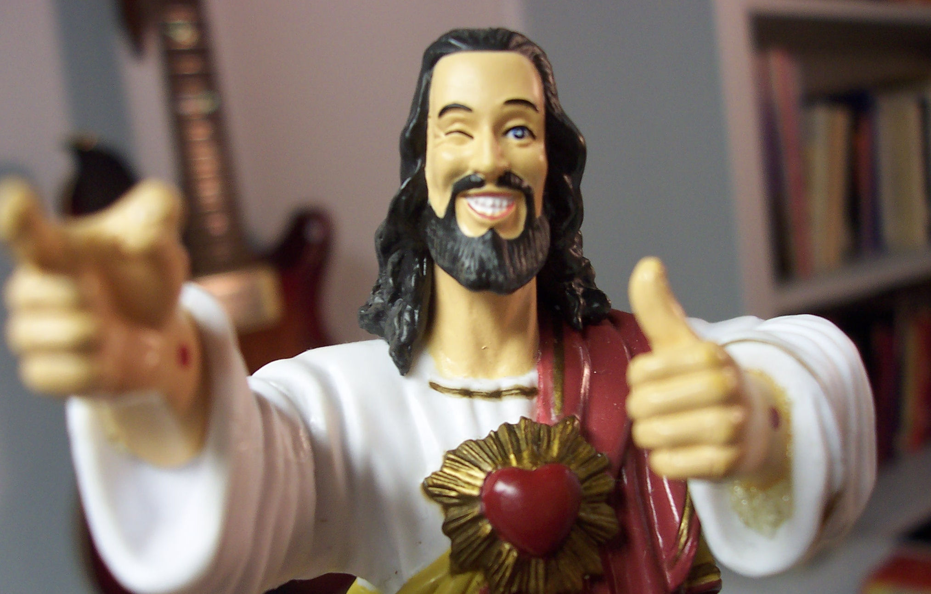
Luke 5:1-11
Does Jesus have a place in the corporate/business world today?
Can you bring Christ into your workplace?
Do I envision Jesus as a first century, anachronistic character?
Can Jesus work a computer?

Slide 82
Luke 5:1-11
Christ In The Workplace
C. Peter Wagner Offers The Following:
Transparency
Missionary
Adaptable
Are You Living a Transparent Life at Work?
Do you fake happiness even when you are sad about something?
Have you ever shared a personal concern with a co-worker?
Have you openly spoken about how God helped you during a tough time?
Do your actions at work reflect your Christian principles?
Are you pursing excellence, as working for the Lord, not for men?
Do you have a vision for your workplace?

Slide 83
Luke 5:12-15
Leprosy: Attacking skin and
underlying nerves

Slide 84
Luke 5:15

Slide 85
Luke 5:17-26
Jesus heals a paralytic

Slide 86
Luke 5:17-26
Jesus heals a paralytic

Slide 87
Luke 5:26
The ancient Jewish book of Sirach (200 BCE) 38:1 – 4:
Honor physicians for their services, for the Lord created them; for their gift of healing
comes from the Most High, and they are rewarded by the king. The skill of physicians
makes them distinguished, and in the presence of the great they are admired. The Lord
created medicines out of the earth, and the sensible will not despise them. (NRSV)
Yet later in the same chapter the text (vv. 9 – 15) brings in spiritual issues:
My child, when you are ill, do not delay, but pray to the Lord, and he will heal you.
Give up faults and direct your hands rightly, and
cleanse your heart from all sin. Offer a sweet
smelling sacrifice, and a memorial portion of
choice flour, and pour oil on your offering, as much
as you can afford. Then give the physician his place,
for the Lord created him; do not let him leave you,
for you need him. There may come a time when
recovery lies in the hands of physicians, for they too
pray to the Lord that he grants them success in diagnosis
and in healing, for the sake of preserving life. He who sins
against his Maker, will be defiant toward the physician. (NRSV)

Slide 88
Luke 5:26
Most Dangerous Paths

Slide 89
Luke 5:26
Most Dangerous Paths: Spain

Slide 90
Luke 5:31

Slide 91
Luke 5:31

Slide 92
Luke 5:39

Slide 93
Question: "What is Chrislam?"
Answer: Chrislam is an attempt to syncretize Christianity with Islam. While it began in
Nigeria in the 1980s, Chrislamic ideas have spread throughout much of the world.
The essential concept of Chrislam is that Christianity and Islam are compatible, that one
can be a Christian and a Muslim at the same time. Chrislam is not an actual religion of its
own, but a blurring of the differences and distinctions between Christianity and Islam.
Advocates of Chrislam point to facts such as Jesus being mentioned 25 times in the Qur’an,
or Christianity and Islam having similar teachings on morals and ethics, or the need for the
two largest monotheistic religions to unite to fight against the rise of atheism and alternative
spirituality. Chrislam is viewed by some as the solution for the ongoing conflict between
the Western world, which is predominantly Christian, and the Middle East, which is
predominantly Muslim.

Slide 94
Question: "What is Chrislam?"
While it is undeniable that there are many similarities between Christianity and
Islam (and Judaism, for that matter), Chrislam ultimately fails because Christianity and
Islam are diametrically opposed on the most important of issues – the identity of Jesus
Christ. True Christianity declares Jesus to be God incarnate. For Christians, the deity of
Christ is a non-negotiable, for without His deity, Jesus’ death on the cross would not have
been sufficient to be the atoning sacrifice for the sins of the entire world (1 John 2:2).
Islam adamantly rejects the deity of Christ. The Qur’an declares the idea
that Jesus is God to be blasphemy. Belief in the deity of Christ is considered
shirk (“filth”) to Muslims. Further, Islam denies the death of Christ on the cross.
The most crucial doctrine of the
Christian faith is rejected in Islam. As a result, the
two religions are absolutely not compatible,
making Chrislam a concept both Christians
and Muslims should reject.

Slide 95
Luke 6:5
Col 2:16 ¶ Therefore do not let anyone judge you by what you eat or drink, or with
regard to a religious festival, a New Moon celebration or a Sabbath day.
These are a shadow of the things that were to come; the reality, however, is
found in Christ.

Slide 96
Luke 6:5
How Do Christians Celebrate The Sabbath Today?
Remember that it is more about orientation than
it is about a series of rules (Col. 2:16-17)
b) It is given for our benefit (Matthew 12:12).
c) Rest is good (Hebrews 4:9-10)
The disciples at Troas “were gathered together”
[passive voice] upon “the first day of the week”
to break bread, i.e., to worship, (Acts 20:7). The
specific day of meeting was no accident. Though
Paul was anxious to get to Jerusalem (20:16), he
waited seven days for the opportunity to assemble
with the church.
The saints in Corinth were assembling, and
contributing into the church treasury, “every first
day of the week” (1 Cor. 16:2 — Greek text; cf. NASB).
The Didache (c. A.D. 120) declares that “every Lord’s day”
the Christians gather themselves together and “break bread” (ANF.VII.381).

Slide 97
Luke 6:11
Wallace Henley:
The chain of hatred moves from:
caricaturization to
marginalization to
vilification to
villainization to
criminalization to
elimination.

Slide 98
Luke 6:11
The chain of hatred moves from:
caricaturization to
marginalization to
vilification to
villainization to
criminalization to
elimination.

Slide 99
Luke 6:11
The chain of hatred moves from:
caricaturization to
marginalization to
vilification to
villainization to
criminalization to
elimination.

Slide 100
Luke 6:11
The chain of hatred moves from:
criminalization to
elimination.

Slide 101
We will not obey’: Christian leaders threaten civil disobedience if Supreme Court
legalizes gay marriage
We will not obey.”
That’s the blunt warning a group of prominent religious leaders is sending to the Supreme
Court of the United States as they consider same-sex marriage. “We respectfully warn the
Supreme Court not to cross that line,” read a document titled, Pledge in Solidarity to
Defend Marriage. “We stand united together in defense of marriage. Make no mistake
about our resolve.”
“While there are many things we can endure, redefining
marriage is so fundamental to the natural order and
the common good that this is the line we must draw
and one we cannot and will not cross,” the pledge
states.
The signees are a who’s who of religious leaders
including former Arkansas Gov. Mike Huckabee, former
U.S. Senator Rick Santorum, National Religious Broadcasters
president Jerry Johnson, Pastor John Hagee, and Franklin Graham,
president and CEO of the Billy Graham Evangelistic Association and Samaritan’s Purse.

Slide 102
The pledge was co-drafted by Deacon Keith Fournier, a Catholic deacon, and Mat Staver,
the founder of Liberty Counsel. Also involved in the document were Rick Scarborough, the
president of Vision America Action and James Dobson, the founder of Family Talk Radio.
“We’re sending a warning to the Supreme Court and frankly any court that crosses the line
on the issue of marriage,” Staver told me. He said that once same-sex marriage is elevated
to the level of protected status – it will transform the face of society and will result in
the “beginning of the end of Western Civilization.”
“You are essentially saying that boys and girls don’t need moms and dads – that moms
and dads are irrelevant,” Staver said. “Gender becomes pointless when government
adopts same-sex marriage. It creates a genderless relationship
out of a very gender-specific relationship. It says that it
doesn’t matter and that two moms or two dads are
absolutely equivalent to a mom and a dad.”
Dobson said the legalization of same-sex marriage
could fracture the nation. “The institution of marriage
is fundamental and it must be defended,” he told me.
“It’s the foundation for the entire culture. It’s been in
existence for 5,000 years. If you weaken it or if you undermine
it – the entire superstructure can come down. We see it as that important.”

Slide 103
And that means the possibility of Christians – people of faith – engaging in acts of civil
disobedience. “Yes, I’m talking about civil disobedience,” Staver said. “I’m talking about
resistance and I’m talking about peaceful resistance against unjust laws and unjust rulings.”
That’s quite a shocking statement. So I asked Mr. Staver to clarify his remarks. “I’m calling
for people to not recognize the legitimacy of that ruling because it’s not grounded in the
Rule of Law,” he told me. “They need to resist that ruling in every way possible. In a peaceful
way – they need to resist it as much as Martin Luther King, Jr. resisted unjust laws in his time.”
Scarborough said the pledge was meant to be forthright and clear.
We’re facing a real Constitutional crisis if the Supreme Court rules adversely
from our perspective on same-sex marriage,” he told
me. For me there’s no option. I’m going to choose to
serve the Lord. And I think that thousands of other
pastors will take that position and hundreds of
thousands – if not millions of Christians.”
Scarborough is urging pastors across the nation
to sign the pledge.

Slide 104
He referenced the “outrageous penalties” being assessed against people of faith simply
because they don’t want to participate in a same-sex union.
An Oregon bakery is facing a $135,000 fine for refusing to make a cake for a lesbian wedding
and a Washington State florist faces fines for refusing to participate in a gay wedding.
“Christians are being declared the lawbreakers when we are simply living by what we have
always believed, and by a set of laws that the culture historically has agreed to,” he said.
“Right now the courts are changing the playing field and declaring that what the natural
eye can see and natural law reveals is not truth. ... What will we do, and how will we
respond?”
Dobson said there’s no doubt that LGBT activists are targeting Christian business owners.
“For about 50 years the homosexual community has
had as its goal to change the culture, to change the
ideology and if necessary – to force people who don’t
agree by use of the courts,” Dobson told me. “I think
there’s a collision here and we can all see it and
where it’s going to go is anybody’s guess – but it is
serious.” To be clear – the men and women who
courageously signed this pledge did so knowing the hell
storm that is about to be unleashed on them – and their families.
“We have no choice,” Staver told me. “We cannot compromise our clear
biblical convictions, our religious convictions. Fox News …

Slide 105
Luke 6:12
- Jesus spends all night in prayer. Why? In the mountains … why?
- One will betray Him. Did Jesus choose wrong?
- Why choose 12? Does this choosing of new leaders mean that Jesus has rejected the
current spiritual leadership? Is there anything to be made of the fact that these men
were of no repute and lived far from Jerusalem?
- In all the lists of the Apostles, Peter is always first, the first four are always Peter, Andrew,
James and John. Bartholomew = Nathanael; Matthew = Levi; Judas son of James =
Thaddeus
- Why would Jesus choose a Zealot, who would have hated someone like Matthew?
- Leadership is never restricted to the chosen, gifted few!

Slide 106
Luke 6:22
Larry Richards …
Jesus’ Values Counter-values
Poor in spirit Self-confident, competent, self-reliant
Mourn Pleasure-seeking, hedonistic, “the beautiful people”
Meek Proud, powerful, important
Hunger and thirst Satisfied, “well adjusted,” practical
for righteousness
Merciful Self-righteous, “able to take care of themselves”
Pure in heart “Adult,” sophisticated, broad-minded
Peacemakers Competitive, aggressive
Persecuted because Adaptable, popular, “Don’t rock the boat”
of righteousness

Slide 107
Luke 6:39
Treatment Of Enemies …
Jean Valjean
Moral likeness proves parentage!

Slide 108
Luke 6:39
Joh 7:24 Stop judging by mere appearances, and make a right judgment."
Ro 14:4 Who are you to judge someone else’s servant? To his own master he stands or falls.
And he will stand, for the Lord is able to make him stand.
Ro 14:10 You, then, why do you judge your brother? Or why do you look down on your
brother? For we will all stand before God’s judgment seat.
1Co 4:3 I care very little if I am judged by you or by any human court; indeed, I do not even
judge myself.
1Co 4:5 Therefore judge nothing before the appointed time; wait till the Lord comes.
He will bring to light what is hidden in darkness and will expose the motives of
men’s hearts. At that time each will receive his praise from God.

Slide 109
Luke 6:39
1Co 5:12 What business is it of mine to judge those outside the church? Are you not to
judge those inside?
1Co 5:13 God will judge those outside. "Expel the wicked man from among you."
1Co 6:2 Do you not know that the saints will judge the world? And if you are to judge
the world, are you not competent to judge trivial cases?
1Co 6:3 Do you not know that we will judge angels? How much more the things of this life!

Slide 110
Luke 6:39
What Do We Do With All This?
1) No one wants to be told that what they do indicates a depraved heart.
2) By the definition of culture, to “judge” means to be told that what I am doing is wrong
3) We see this all the way back to the Garden story … “you will know good and evil”
4) The New Testament is filled with commands to us as believers to govern our actions.
A consistent violation of those commands indicates a problem and that problem must be
addressed.
5) We are specifically command to NOT judge “non-sin” issues that are hidden in the
heart or matters of Christian conscience. We may discuss and debate and disagree but
we are commanded to not break fellowship over them.
6) We are never to condemn (i.e. declare Hell bound, without redemptive hope), for that is
in the purview of God … not us. We are dispensers of grace and hope and truth. We do
not declare judgment upon the world now because that belongs to Christ.
7) As you study the Word, remember that the word “to judge” may have several different
shades of meaning depending upon the context:
To discern the truth or fairness of a legal or moral issue
To condemn to hell (or other punishment)
To be in leadership or authority over another.
8) Especially since the Enlightenment Period, humanity has continued down the path of
belief that there is no Absolute Truth and therefore no such thing as a morality.
Therefore to modern thinking, there is no such thing as right and wrong. Expect supreme
opposition here but do not fall into the trap of the world’s definitions and conclusions.

