Slide 1
Bible Plus Ideas For January 2019
1 & 2 Corinthians
Holy Spirit
Church History
Habakkuk, Zephaniah, Nahum, Micah (2)
Any book of the Bible not yet covered
Origins of the Universe/Humanity in light of
recent discovery / answers to scientific challenges (2)
Story of Joseph as a type of Jesus
Ecclesiastes
Helping people overcome fear
Return to the Old testament after
covering an Epistle
1Peter / Hosea
Feasts and their fulfillment in Christ
Qualifications for leadership
1Peter and 2Peter

Slide 2
Paul's Roman Excursion (Acts 21:17-28:31)

Slide 3
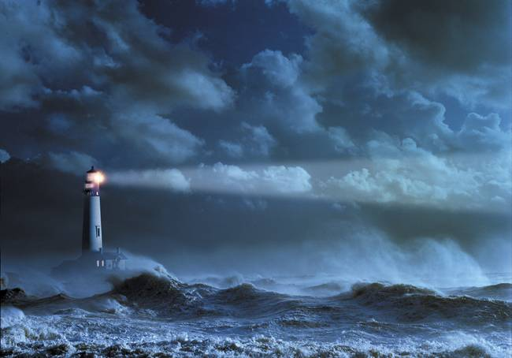
In the storm …
- Paul refuses to gloat! His first message is “Take Courage”. What message do people see in
us on a daily basis?
- His second message is “Stay together in unity”. Is unity in the church something to be
strived for? How would that be personally fleshed out by you?
- His third message is to “take food”. This is an incredibly practical advice. How practical are
Christians today in terms of what the world sees? What does the fact that Paul makes a
public show of his “prayer of thanksgiving” mean to you. What would an unsaved person
think if they heard you pray out loud?
- John Stott makes the statement that Paul
was a “... man of God and a man of action,
a man of the Spirit and of common sense”.
Do you agree? Does this make his witness
more attractive?
- Why would God spare all the prisoners
(man of which were going to Rome to die
in the Arena anyway)?

Slide 4
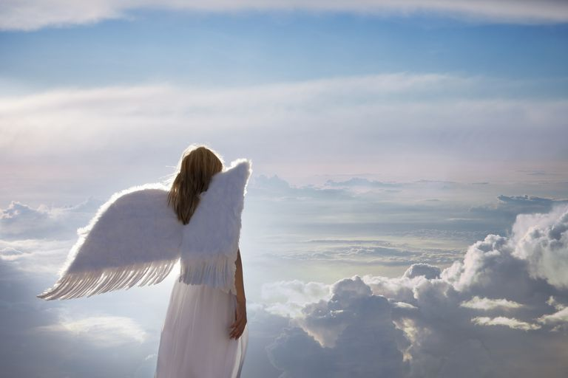
Angels With Us
- according to Hebrews 1:14, they minister to human beings by:
a) Giving instructions (Acts 8:26) ... ensure that these instructions are exactly in the will of
the Lord without contradicting His Word
b) Reveal God’s glory (Rev. 1:1-3)
c) To announce judgment (Daniel 5:25-27)
d) To strengthen (Matthew 4:11, Luke 22:42-43 - the word strengthen here, means to make
strong inwardly!)
e) Protection (2Kings 6:14-17)
f) By observing us and promoting the will of the Lord (1Corinthians 4:9)
Angels Are Tools Of Judgment
- see Hebrews 1:7
- they warn of Judgment in Genesis 18
- they bring judgment in 2Kings 19, 1 Chron. 21:16, Acts 12:22, Exodus 12:18-30 and Revelation
- The Lord will assign angels to separate the sheep from the goats (Matt. 25)
- note that Hell was created for the devil and his angels (Matthew 25:41)
- angels will be used to gather people (see Matthew 13:41-42, Matthew 24:40)
Angelic Power Over Us
- Give no opportunity to the devil (Ephesians 4:27)
- Be sober and vigilant (1 Peter 5:9)
- Resist (James 4:27)

Slide 5
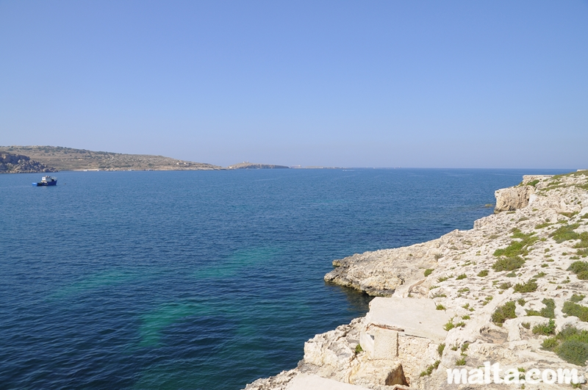
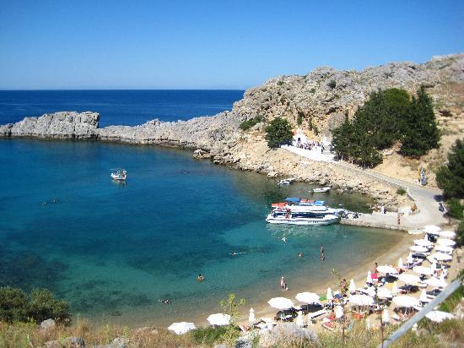
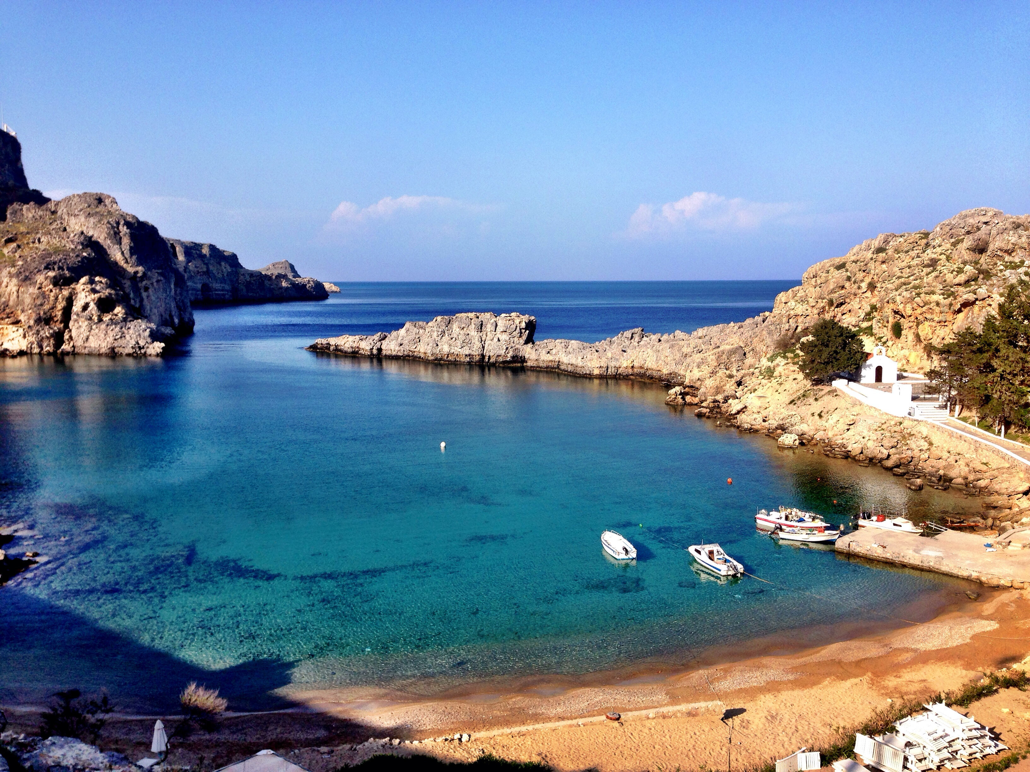
St. Paul's Bay … Malta
Two streams empty into this harbor,
producing a unique mud that would
hold a boat fast.

Slide 6
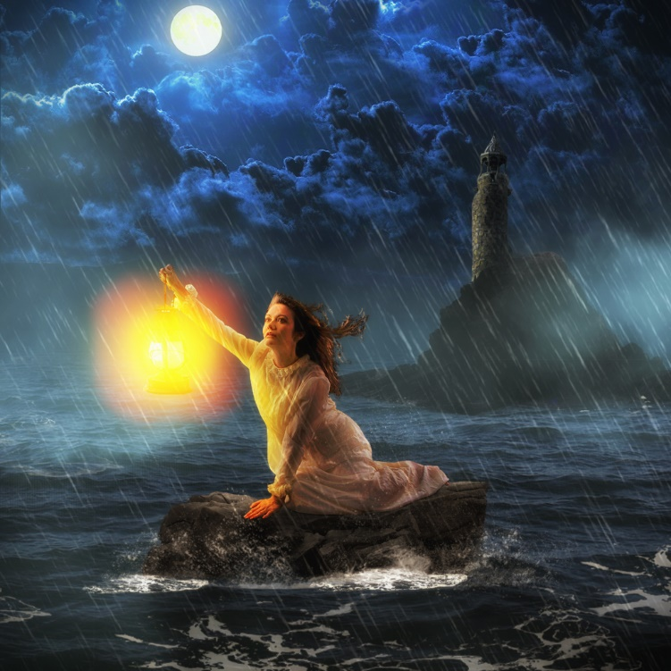
Lessons In The Storm
1. God is sovereign and will prepare and accomplish whatever is necessary.
Sometimes He calms the storms, sometimes He makes a path through it.
2. We may never know the reason for the storm, but be assured of the outcome.
3. Never stop being practical. Leadership surfaces in the storms.
4. God blesses those that reject Him for the sake of those who love Him.
5. My words and actions communicate
hope (See Jer. 32:6-16)
6. Do NOT discount human wisdom.
7. Present a clear testimony.
8. Note again Paul’s need for
encouragement as the church came to him.

Slide 7
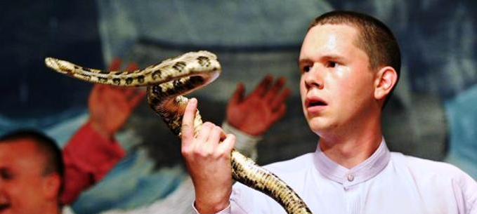
Snake Handling
Mark 16:17-18
Note that this passage is highly contested due to lack of attestation in multiple manuscript
What can be said of “signs” of personal holiness? Does this prove my salvation? What does?

Slide 8
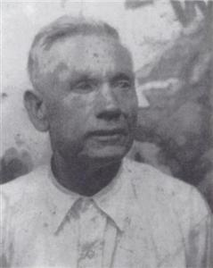
Snake Handling
George Went Hensley a short time before his death
Born May 2, 1881
Scott County, Virginia
Died July 25, 1955 (aged 74)
Calhoun County, Florida
Cause of Death: Snake Bite
Resting place Calhoun County, Florida
Occupation Evangelist
Organization Church of God with Signs Following
Spouse(s) Amanda Winniger
Irene Klunzinger
Inez Hutcheson
Sally Norman

Slide 9
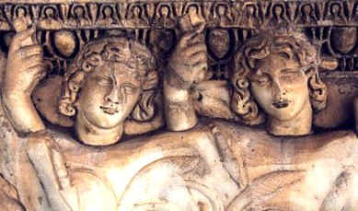
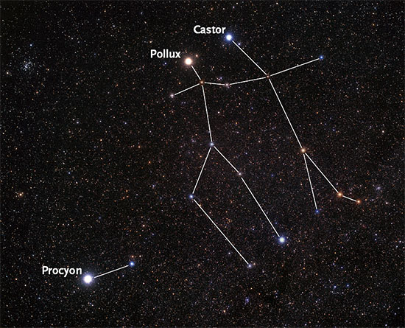
The Twins (Gemini) were
considered good fortune
for travelers.

Slide 10
What is the PURPOSE of the snake story?
(Hint … what door did it open?)
… once again, Paul leaves a community of gentiles in a better state than he found them. Is this a re-occurring theme in this book?

Slide 11
Again … the value of encouragement …
- Jeremiah 32

Slide 12
Acts 28: No Bitterness
In spite of who put Paul into such a difficult life situation, to whom
does Paull first go to in Rome? Why??

Slide 13
Final Reflections
What kind of man was Paul?
- impressive neither in speech nor appearance (2 Corinthian 10:10)
- some kind of debilitating physical illness (Galatians 4:13, 2Corinth. 12:7-10)
- a man of passion (either for Jewish things or Christian things)
- grammatically, his style is odd:
a) he often used a scribe to write his epistles (Amanuensis)
b) he often, in the midst of a thought, moves quickly down a sub thought,
never returning to his initial sentence - his writing is hard to follow at times
- he delighted in the fellowship of other Christians and he easily made friends
- his converts were his “pride and joy” ... mixing strong warnings with tender forgiveness
and encouragement
- he saw no limits to the transforming power of the Lord Jesus Christ
- he passionately “trained” his own body such that he might live what he believed
(1 Corinthians 9:19-27) ... and others would see it!

Slide 14
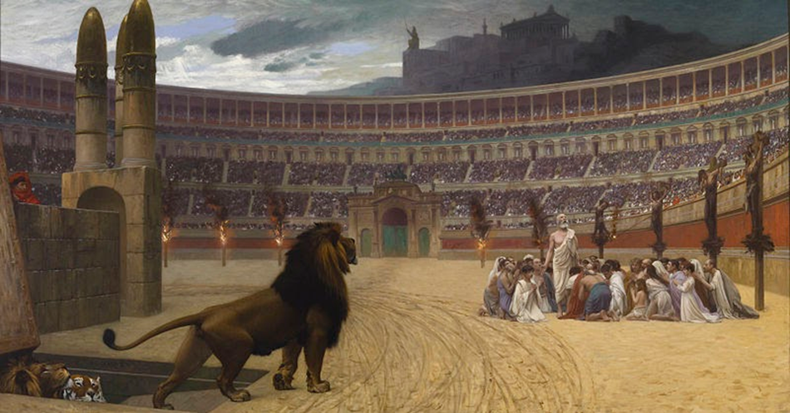
Satan's Attack | God's Response
1. Intimidation (Acts 4) | Courage, community, prayer
2. Internal lies (Acts 5) | God's power roots out the evil
3. Attack and jail leaders (Acts 5) | Courage, obedience, external help (Gamaliel)
4. Internal dissension (Acts 6) | Analyze, strategize, actions
5. Death of the first martyr (Acts 7) | Scatter, spread the Word (Samaritans)
6. Jail and kill believers (Acts 9) | Salvation of Saul
7. Prejudice (Acts 10) | Peter's vision and ministry
8. Attack leaders (James killed, Peter jailed) | Supernatural release of one.
9. Doctrinal problems (Acts 15) | Church council
10. The threat of the "unseen God" - where is He during trials? | Paul would die; The church would grow - Is God good??

