Slide 1
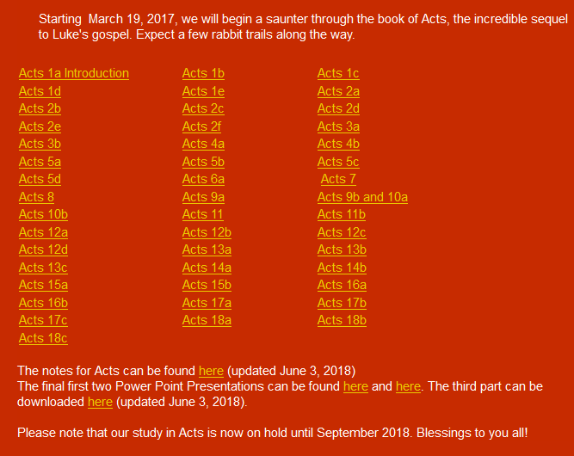
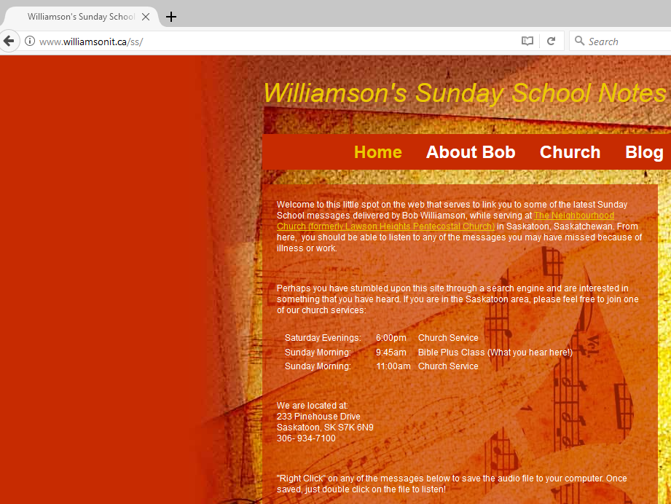
www.williamsonit.ca/ss

Slide 2
ACTS 1:1 - 8:1 THE BIRTH OF THE CHURCH
1:1 - 1:14 Introduction
1:15 - 26 A new apostle is chosen
2:1-13 The feast of Pentecost
2:14-47 Peter’s first sermon
3:1 - 4:31 Healing of a lame man
4:32 - 5:11 Ananias and Sapphira
5:12-42 The Apostles before the council
6 The first deacons appointed
7:1 - 8:1 Stephen’s defense and stoning
ACTS 8:1 - 11:18 PERSECUTION : SPREADS TO JUDEA AND SAMARIA
8:1 - 25 The Samaritans respond to the Gospel
8:26-40 Philip and the Ethiopian Treasurer
9:1-31 Saul is converted to Christianity
9:32-43 Peter at Lydda and Joppa
10 Peter and Cornelius
11:1-18 The Apostles approve Peter’s actions

Slide 3
ACTS 11:19 - 16:6 THE GOSPEL ADVANCES INTO SYRIA AND TURKEY
11:19-30 The first Gentile Church at Antioch
12 James is killed, Peter imprisoned
Further Study: Prayer
13, 14 Missionary Journey 1: Paul and Barnabas
- Cyprus, Perga, Pisidian Antioch,
Iconium, Lystra, Derbe
Further Study: Fasting
15:1-35 The Council at Jerusalem
ACTS 16:6 - 19:41 PAUL TAKES THE GOSPEL TO EUROPE
15:36 - 19:41 Missionary Journey 2 : Paul and Silas
- Philippi, Thyatira, Thessalonica, Beroea,
Athens, Corinth, Ephesus
Further Study: Gifts of the Spirit
What is spiritual warfare?
- Third missionary journey

Slide 4
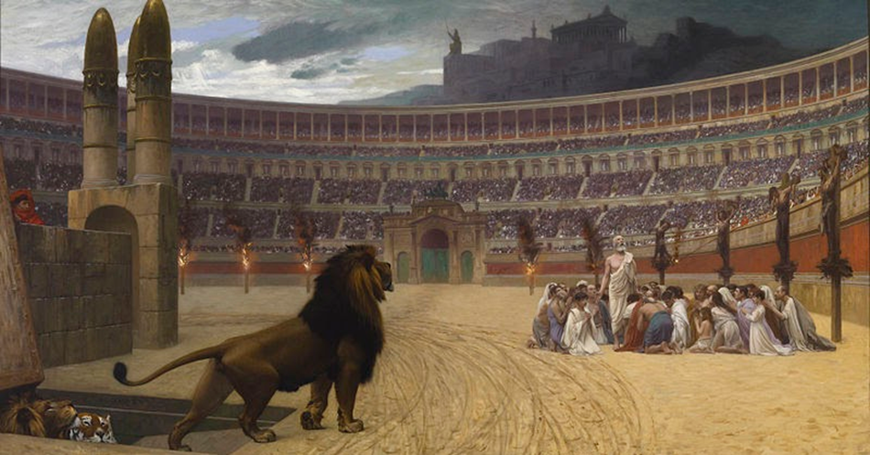
Satan's Attack | God's Response
1. Intimidation (Acts 4) | Courage, community, prayer
2. Internal lies (Acts 5) | God's power roots out the evil
3. Attack and jail leaders (Acts 5) | Courage, obedience, external help (Gamaliel)
4. Internal dissension (Acts 6) | Analyze, strategize, actions
5. Death of the first martyr (Acts 7) | Scatter, spread the Word (Samaritans)
6. Jail and kill believers (Acts 9) | Salvation of Saul
7. Prejudice (Acts 10) | Peter's vision and ministry
8. Attack leaders (James killed, Peter jailed) | Supernatural release of one.
9. Doctrinal problems (Acts 15) | Church council
10. The threat of the "unseen God" - where is He during trials? | Paul would die; The church would grow - Is God good??

Slide 5
Is God Good?

Slide 6
Is God Good?
He is all loving.
He is all powerful.
Evil exists. Bad things happen to good people.

Slide 7
Is God Good?
He is all loving.
He is all powerful.
Evil exists. Bad things happen to good people.
God is eternal.
God is all knowing.
God allows free will.
What does "good" mean?

Slide 8
ACTS 20 - 28 PAUL’S JOURNEY TO ROME
20: 1-16 Paul sets out for Jerusalem
20:17 - 21:14 Paul with the Ephesian Elders
21:15 - 23:35 Paul is arrested in Jerusalem
24 The defense before Felix
25:1-12 The defense before Festus
25:13 - 26:32 The defense before Agrippa
27, 28 Paul’s boat trip, shipwreck,
arrival at Rome
Further Study: Angelic realms

Slide 9
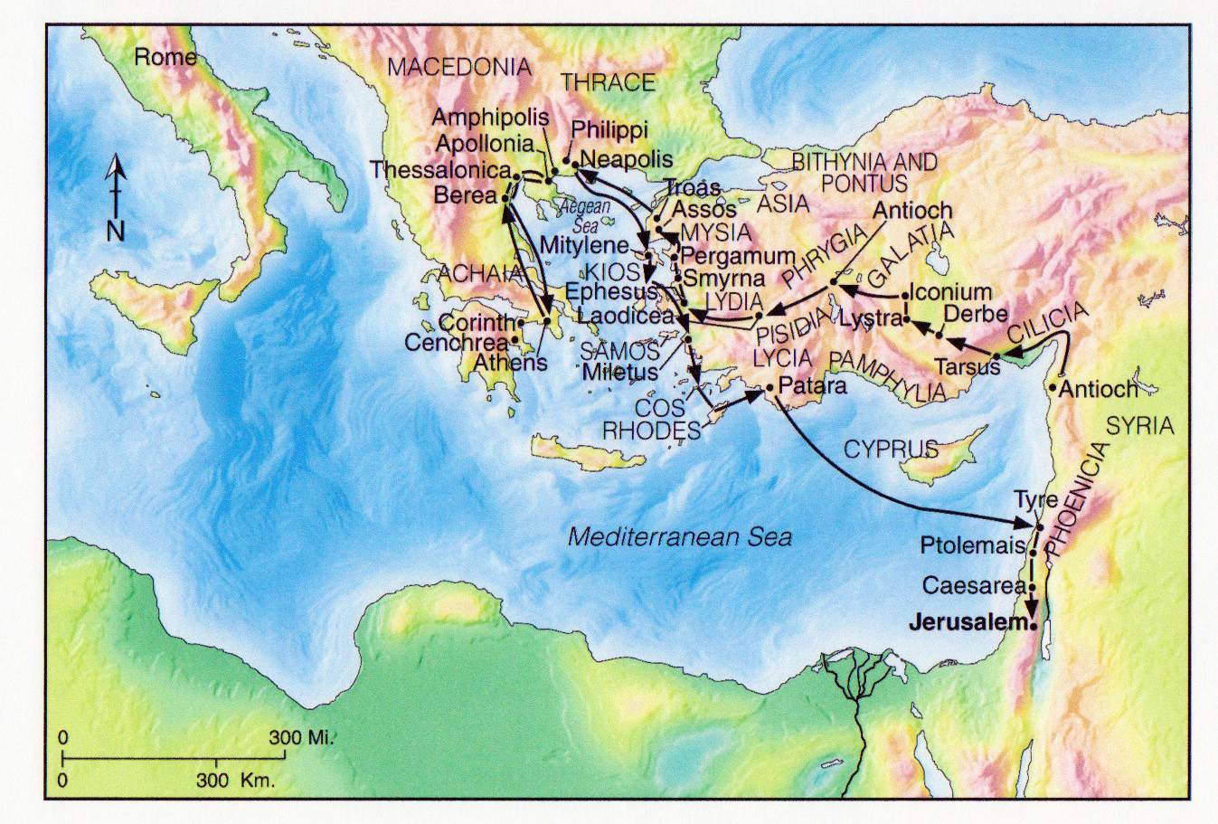
Paul's Third Missionary Journey (Acts 18:23-21:16)

Slide 10
Paul's Third Missionary Journey (Acts 18:23-21:16)
Themes of this journey: growth and encouragement!
- Paul leaves from Antioch ... But will never return.
God does not promise to leave us where He found us!
Note also … no peer companion this time
- Apollos .. The torch is passed to the next generation
- No new churches … but strengthening
- Those that needed to let go of Paul
- Paul himself, on his journey to Jerusalem
- this is not unlike that of Jesus
- Paul will send two of his disciples to prepare the way … like Christ
- He will receive prophecy that if he goes to Jerusalem … he will die.
- Teaching required:
- Apollos
- Disciples re: Holy Spirit
- Seven Sons of Sceva

Slide 11
Paul's Third Missionary Journey: Ephesus
(Acts 18:24-25)
What made Apollos such a great teacher?
He came … he was present
He was learned, well instructed
He was passionate
He presented Christ clearly (pedagogy)
What made your favourite
teachers special?

Slide 12
Paul's Third Missionary Journey: Ephesus
(Acts 18:24-25)
Apollos went to Achaia …
1 Corinthians 3:5 (NIV)
What, after all, is Apollos? And what is Paul? Only servants, through whom you came to believe—as the Lord has assigned
to each his task.
1 Corinthians 16:12 (NIV)
Now about our brother Apollos:
I strongly urged him to go to you
with the brothers. He was quite
unwilling to go now, but he will go
when he has the opportunity.

Slide 13
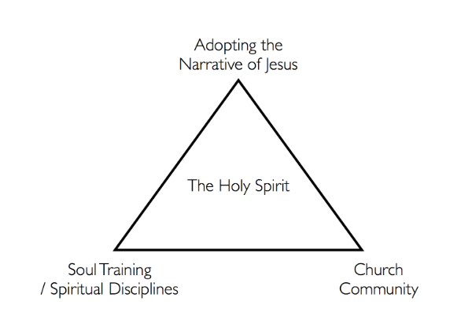
Real Change

Slide 14
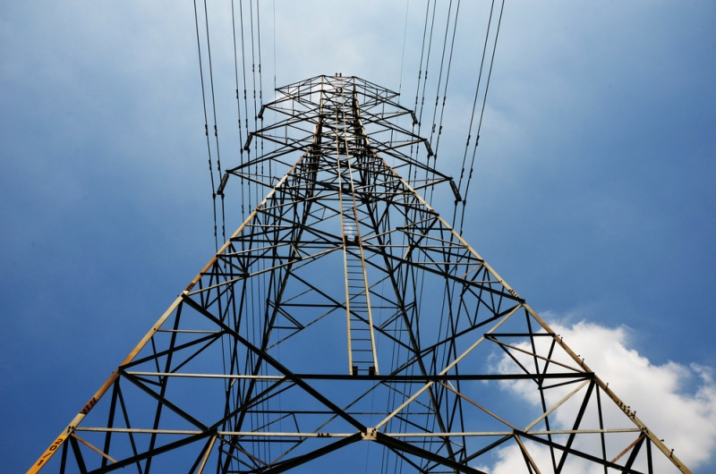
Power
1) Positional Power
- what formal positions of power that God has entrusted me with
- group leader, pastor etc.
2) Personal Power
- Education, experience, competencies, talents etc.
3) God Factor Power
- To what degree to people look to me as a representative of God
- Do they see me as a counselor? Spiritual wisdom?
4) Projected Power
- what unmet needs in people do they project onto me?
- who idealizes me from afar?
5) Relational Power
- people that I have in relationship with me
for a period of time; these I have some
sway over
6) Cultural Power
- age, race, gender, ethnicity or other
cultural effects

Slide 15
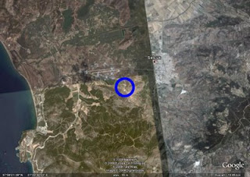
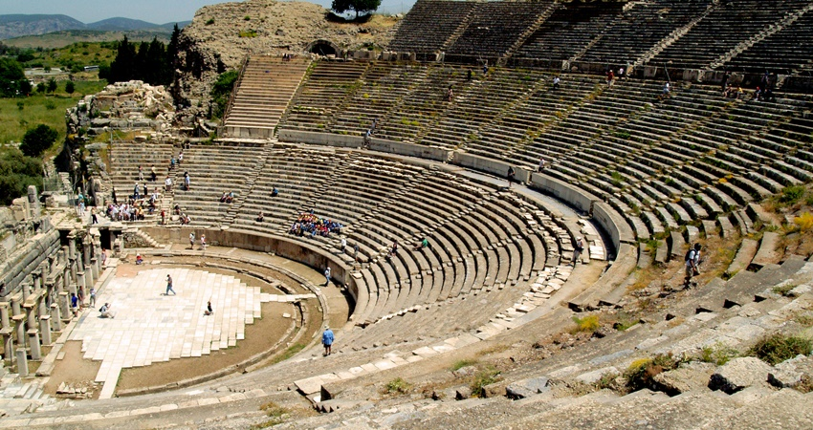
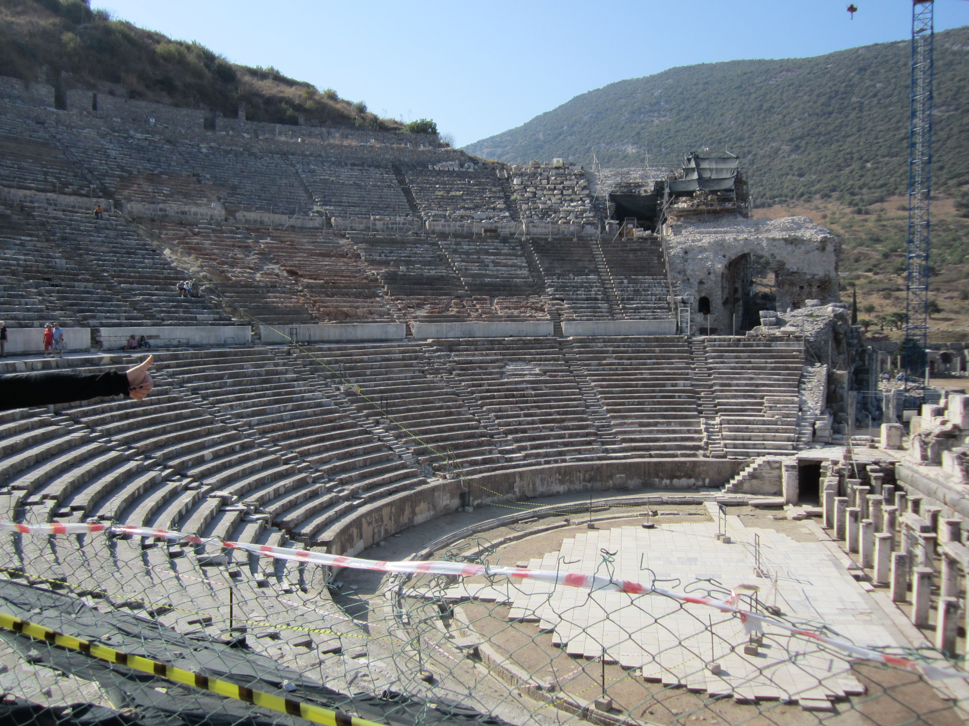
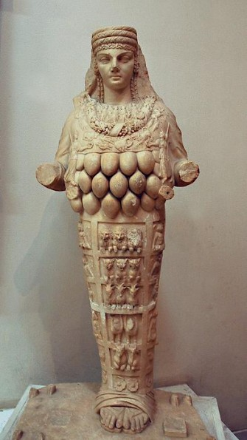
Paul's Third Missionary Journey: Ephesus

Slide 16
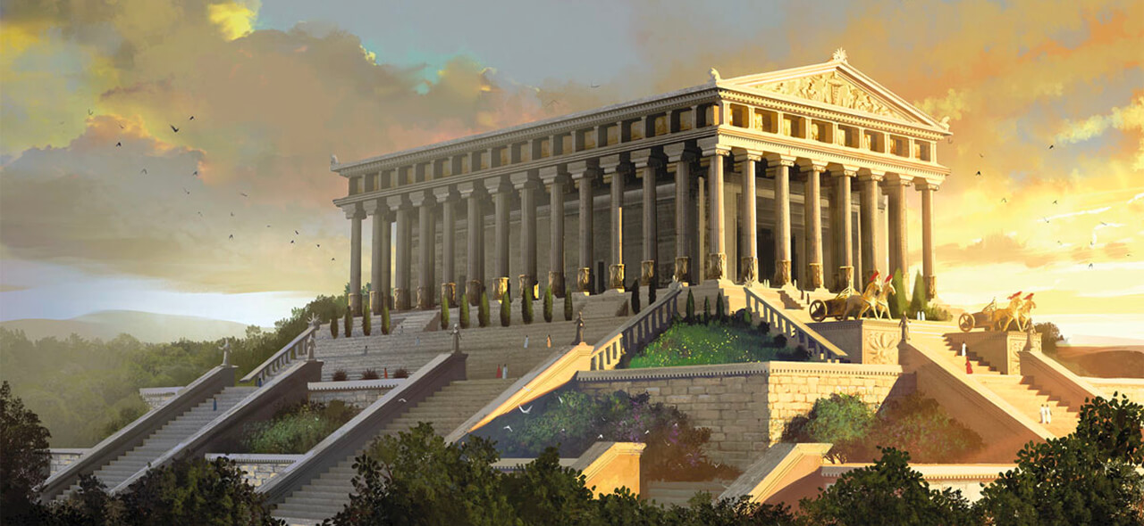
Paul's Third Missionary Journey: Ephesus
Temple of Artemis
The temple of Artemis was a key to the economic stability of Ephesus, for foreigners traveled there to
worship and deposited money in the temple.

Slide 17
Paul's Third Missionary Journey: Ephesus
It is interesting to note that Paul’s strongest admonishments regarding spiritual
warfare occur in the Letter to Ephesus. The Ephesians were known for their
Magical enchantments and spells.
During this time, it is likely that the seven churches of Revelation were founded.
Putting The Power Encounters Into Context:
a) The WORD of God should be paramount
b) Christians should neither be obsessed nor fearful of the occult
c) We do not seek for power encounters, but understand our authority
when they occur.
d) What might God have been trying to communicate using Paul’s sweat rags?
Note that there was a complete break
with the cultic practices previously enjoyed.
The Gospel invades ALL areas of our lives
- Where do Christians want to hold back?
- Why?

Slide 18
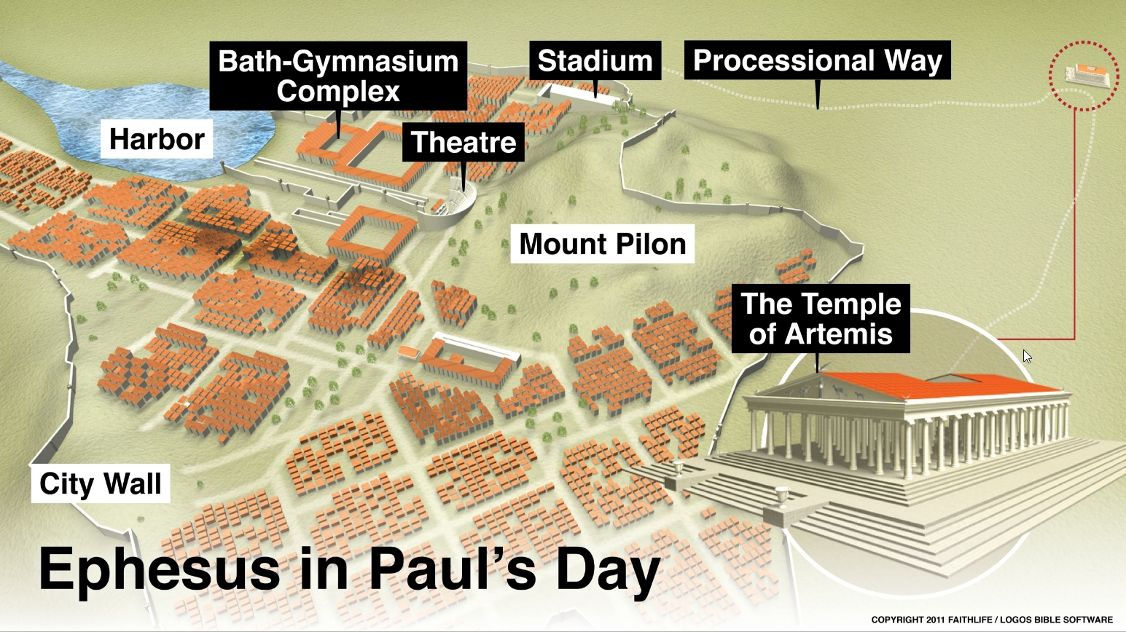
Paul's Third Missionary Journey: Ephesus

Slide 19
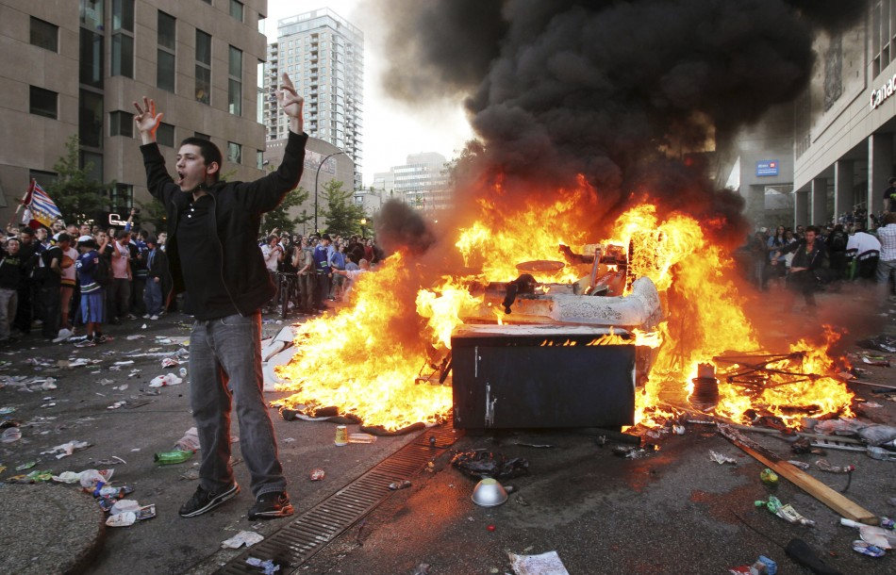
Paul's Third Missionary Journey: Ephesus
Lessons From A Riot …
1) People often riot without even knowing why! It is in our nature to be rebellious
2) The mob mentality is contagious
- Note the language of national pride
3) In this case … it was not religion that was the problem, but its effect
on money and control
4) Even Paul needed wise council from the godly and ungodly
5) Antisemitism is alive … even then
6) One does not need to show a ton of negativity towards ideas that are false
- Promote what is GOOD!

Slide 20
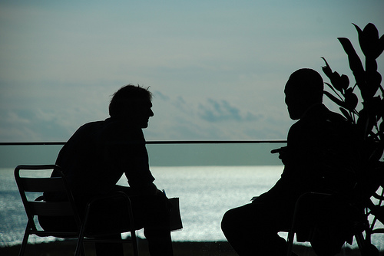
Paul's Third Missionary Journey: Ephesus
Should evangelism be needs based or truth based?
Needs:
1) To meet needs does demonstrate love.
2) We are commanded to do good.
3) Jesus did many good deeds and did not necessarily tie them to a truth claim
4) Yet, Christ came to bear witness to the truth (John 18:37)
5) Preaching is the common way people are saved.
6) Paul debates, attempts to convince, refutes ….
Truth:
1) Is faith without works dead?
2) Are words enough?
3) What happens when good works stop?

Slide 21
Paul's Third Missionary Journey (Acts 18:23-21:16)

Slide 22
Paul's Third Missionary Journey: Greece (20:1-12)
The Power Of Encouragement
Encouragement is like oxygen
to the human spirit.
Don't forget that you are
carrying someone else's air.
Encourage them.
Help them breathe!

Slide 23
Paul's Third Missionary Journey: Greece (20:1-12)
The Power Of Encouragement
Paul will write 2 Corinthians here
Note his traveling companions are
from many of the churches he
planted! Perhaps they represented
those churches that donated to the
saints of Jerusalem.
Note the new “we” section, starting
in 20:5. We have not heard this
since 16:16.

Slide 24
Paul's Third Missionary Journey: Greece (20:1-12)
The Power Of Encouragement
2Cor. 2:12-13
Now when I went to Troas to preach the
gospel of Christ and found that the Lord had
opened a door for me, I still had no peace of mind,
because I did not find my brother Titus there.
So I said goodbye to them and went on to
Macedonia.
2 Co 7:5–7
For when we came into Macedonia, we had no
rest, but we were harassed at every turn—conflicts
on the outside, fears within. But God, who comforts
the downcast, comforted us by the coming of
Titus, and not only by his coming but also by the
comfort you had given him. He told us about your
longing for me, your deep sorrow, your ardent
concern for me, so that my joy was greater than ever.

Slide 25
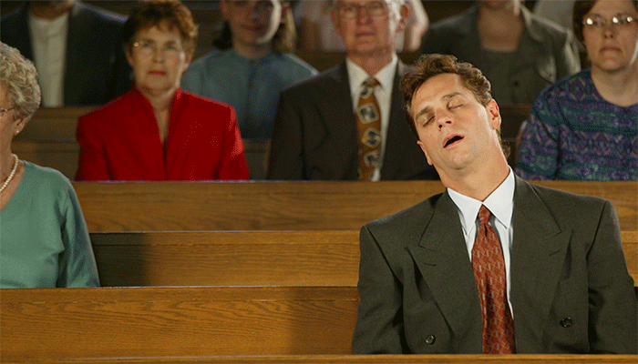
Paul's Third Missionary Journey: Eutychus (7-12)
Be careful where you sit. God’s protection is great, but foolishness still brings tragedy.
Eutychus was in the right place at the right time. We should not be hard on him.
God honored him in his healing.
Healing requires proximity … the elder to the younger (in this case)
At the beginning of Luke’s writing, we have the story of the shepherds who blessed
in their nighttime vigil,
as well as Anna.
At the end, we see the disciples
sleeping during Jesus’ prayer
vigil. Night does not always
bring bad things!

Slide 26
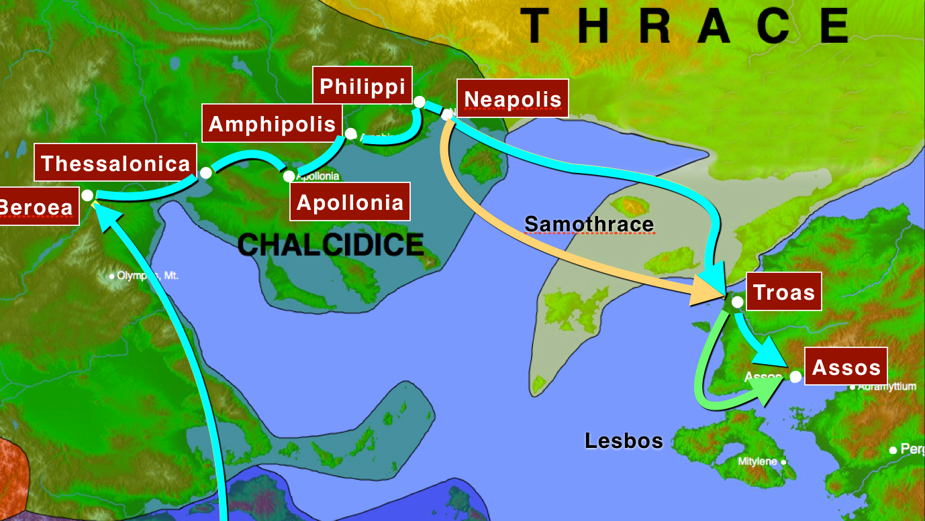
Paul's Third Missionary Journey: Greece (20:13-15)

Slide 27
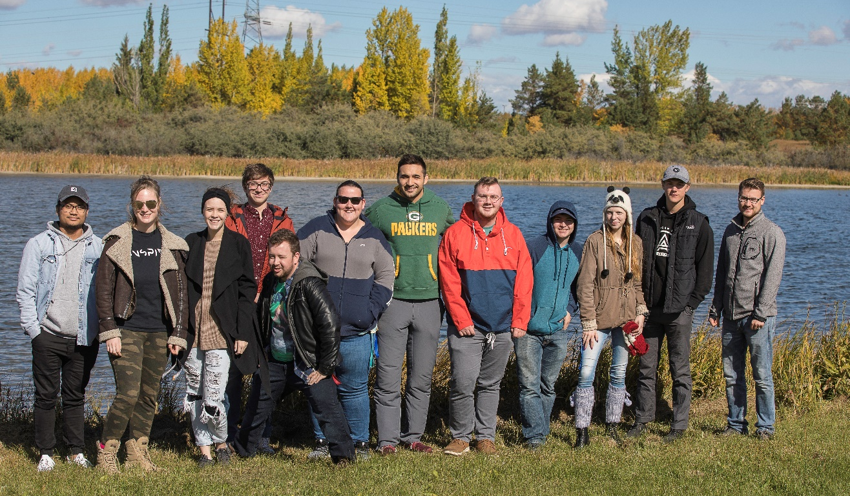
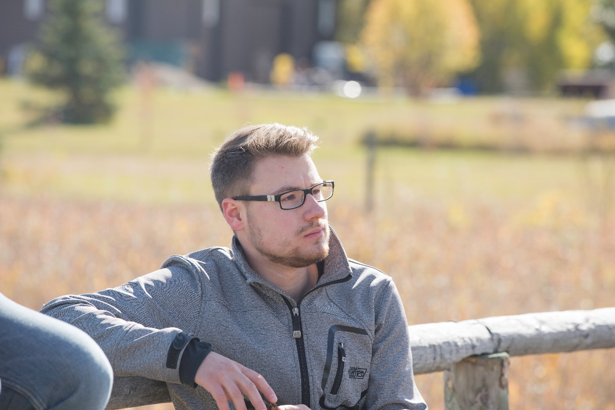
Paul's Third Missionary Journey: Greece (20:13-15)
Alone with God

Slide 28
Paul's Third Missionary Journey (Acts 18:23-21:16)

Slide 29
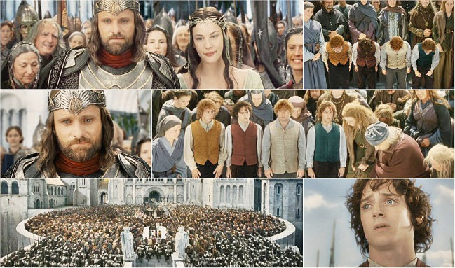
Paul's Third Missionary Journey: Elders (20:16-38)
To Identify with …

Slide 30
Paul's Third Missionary Journey: Elders (20:16-38)
Paul identified with the people,
living among them (v. 18),
serving God with humility and tears (v. 19)
going from house to house (v. 20).
This enabled him to know what they needed to hear, so that he was able to preach
everything that was helpful to them (v. 20a).
He obviously had what might be called an openhearted approach to ministry. This is
why he could spend a whole
night chatting with the
believers in Troas and this is
why he shed so many tears
among the Ephesians
(vv. 19, 31).
Kerygma

Slide 31
Paul's Third Missionary Journey: Elders (20:16-38)
Verses 20 -21 Repentance and faith
Actions and words are congruent!
Verses 22 -23 Led by the Spirit means walking into the unknown.
Committed to suffering if that is what it takes.
Verses 25-31 Personal responsibility to preach …
Personal responsibility to receive …
Kerygma

Slide 32
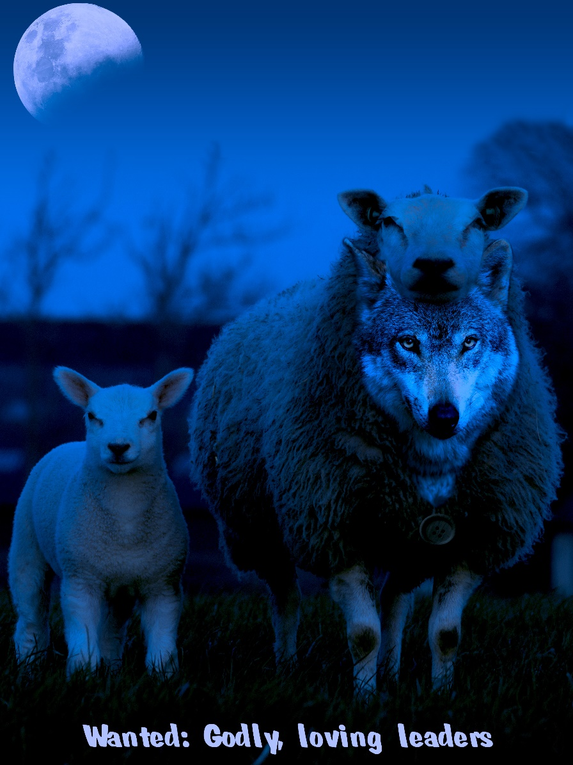
Paul's Third Missionary Journey: Elders (20:16-38)
Verses 32 – 38 Committed to the Lord
Paul calls them to live as he lives!
Kerygma
God’s representatives are often rejected by their own people.
This passage speaks a word of comfort and challenge to all
those who in obedience to God are living as pilgrims, are
paying the price of obedience, and are rejected by those who
should know better. Jesus “came to that which was his own,
but his own did not receive him” (John 1:11). We should not
expect anything different for ourselves. Jesus said, “ ‘No
servant is greater than his master.’ If they persecuted me, they
will persecute you also.” But Jesus said immediately
thereafter: “If they obeyed my teaching, they will obey yours
also” (John 15:20). Along with disappointments will be a few
successes that make the price paid worthwhile.

Slide 33
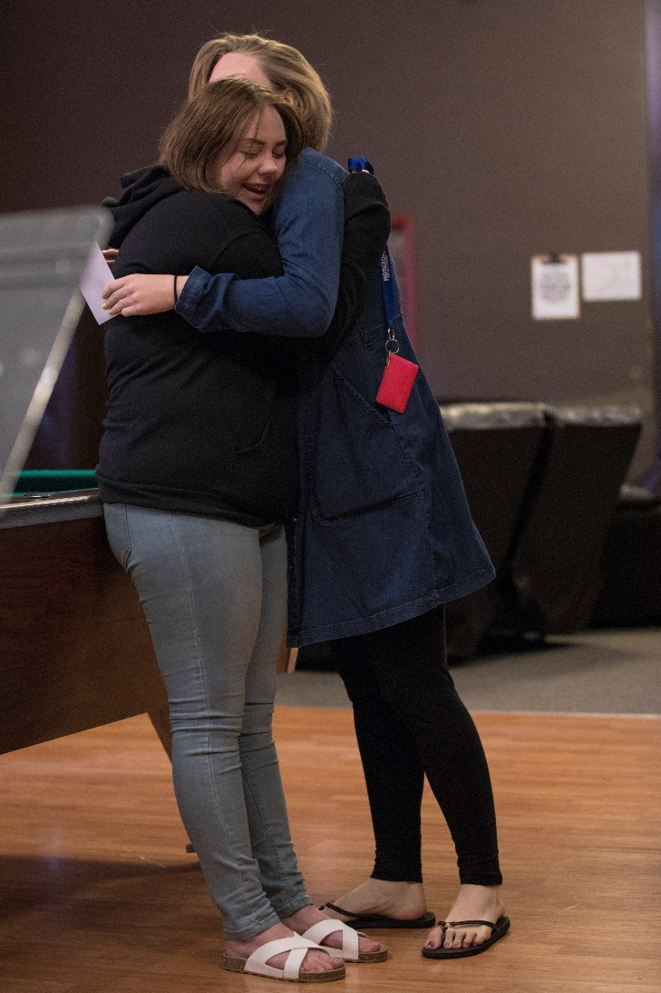
Paul's Third Missionary Journey: Elders (20:16-38)
Final thoughts on encouragement! How?
A) Through his presence … he encouraged … Paul WENT.
- Yes, this makes us vulnerable to being hurt!
B) Through his words …
- What he said, how he said it, when it said it.
C) Through his actions

Slide 34
Paul's Third Missionary Journey (Acts 18:23-21:16)

Slide 35
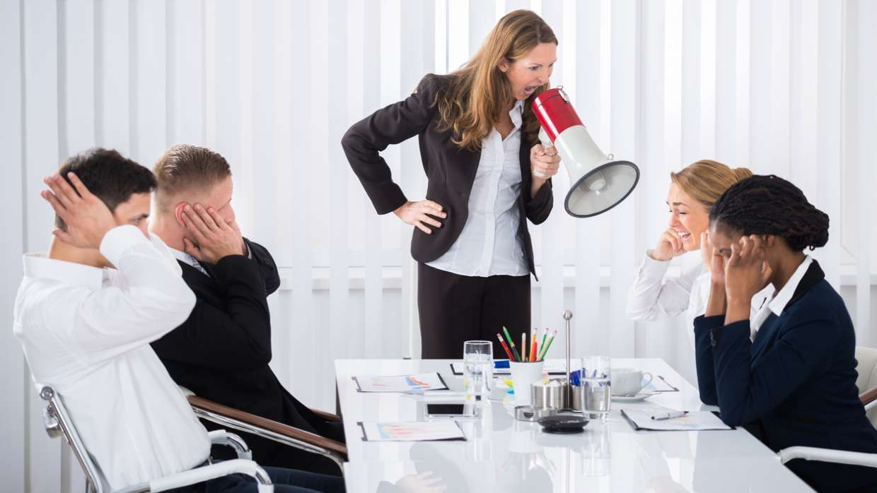
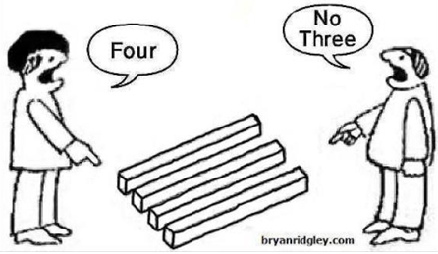
Paul's Third Missionary Journey (Acts 21:1-14)
Who is right?
1) The Spirit?
2) Paul??
3) The disciples???
Should Paul go
to Jerusalem?

Slide 36
Paul's Third Missionary Journey (Acts 21:1-14)
Discerning the future is hard.
- Why does God allow this confusion?
- Agabus was right in 11:28, but not quite in 21:11.
- How should we respond to personal, predictive prophecy?

Slide 37
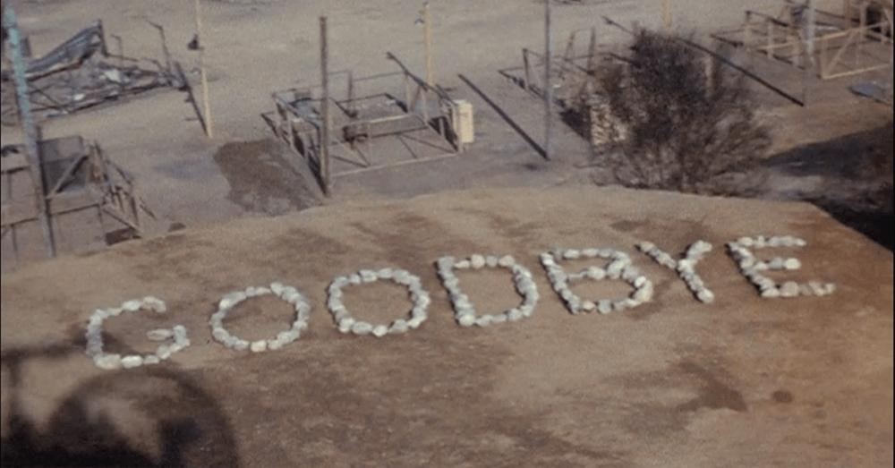
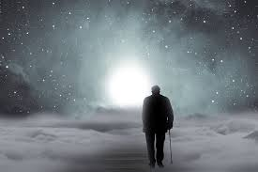
Paul's Third Missionary Journey (Acts 21:1-14)
Note the incredible, warm community life illustrated here
- Even new friends at Tyre were compassionate.
- In verse 12, even Paul’s companions were swayed.
- Note Paul’s response (13-14)
- It is raw, honest, open … requirement for true
community.
- When heroes do the work that MAKES them heroes, it often appears
as hard, radical, strange and unnecessary.

Slide 38
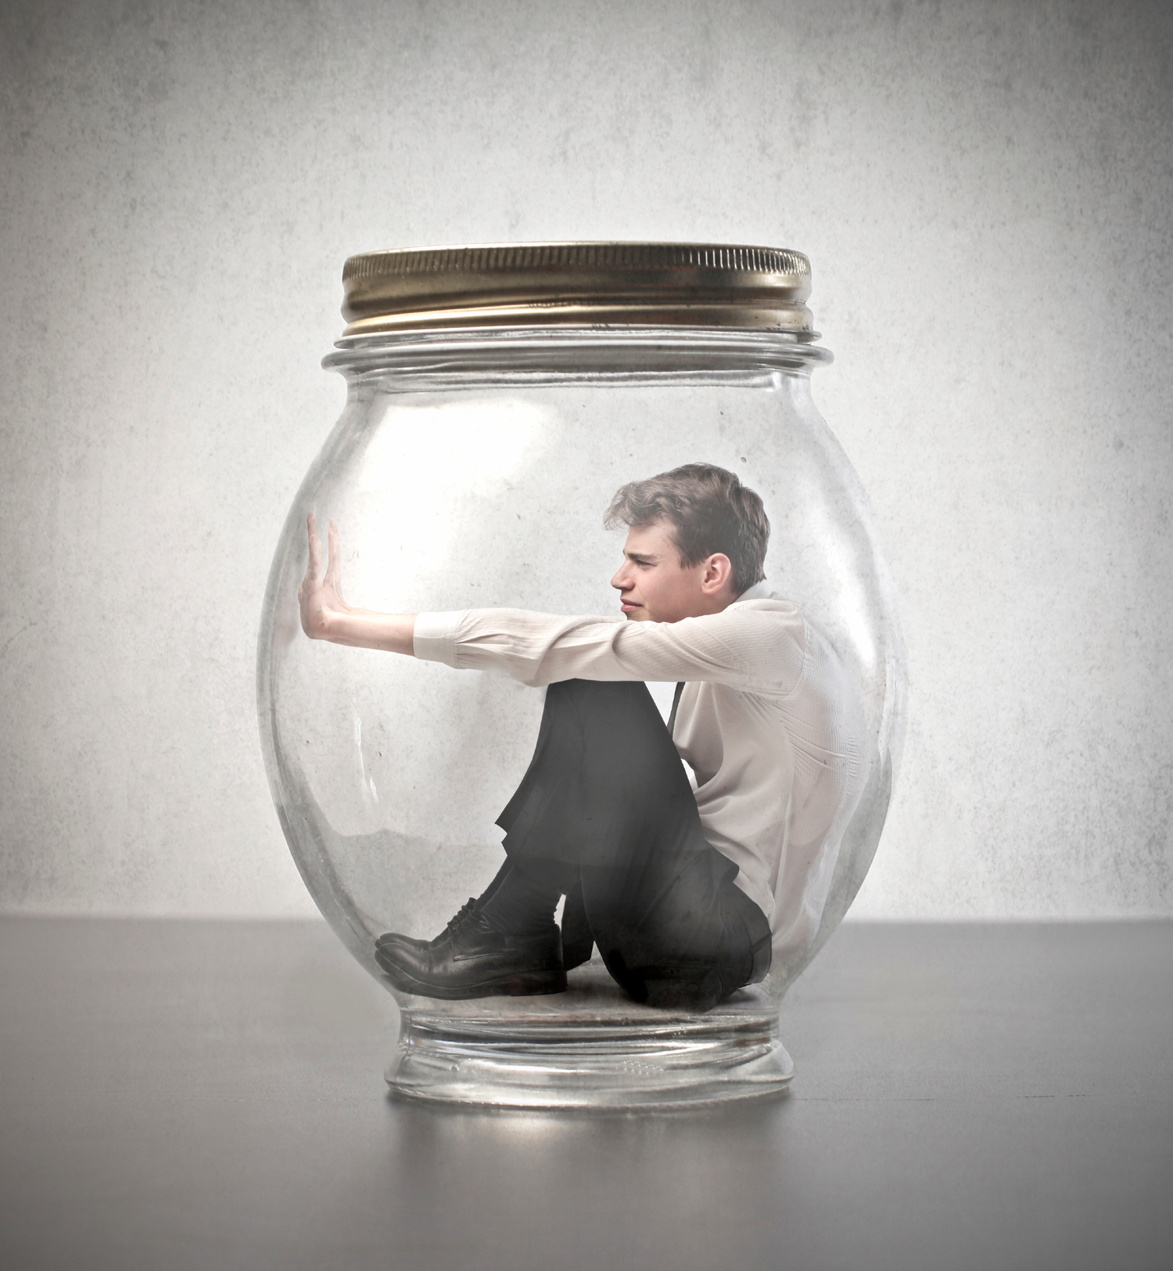
Paul's Third Missionary Journey (Acts 21:1-14)
- Is it possible to go overboard with the doctrine of “being all things to all
men” (1Corith. 9:22)
- Is it possible that the Apostles were having trouble discipling the Jewish converts (20-22)
- The four other men were completing a Nazirite vow.
- Do you think that Paul was in agreement with the plan?
- The fruit of this plan was the jailing of Paul. Did the Apostles miss the will of God here?
- Do you think that Paul held bitterness towards the church for the execution of this plan?
- According to William Barclay, “There is a time that compromise is a sign of
strength, not weakness”. Agree?

Slide 39
Paul's Third Missionary Journey (Acts 21:1-14)
Corinthians 9:20:
“To the Jews I became like a Jew, to win the Jews. To those under
the law I became like one under the law (though I myself am not
under the law), so as to win those under the law.”

Slide 40
Paul's Third Missionary Journey (Acts 21:1-14)
Why was Unity so important to Paul??? What is the cost of such unity?

Slide 41
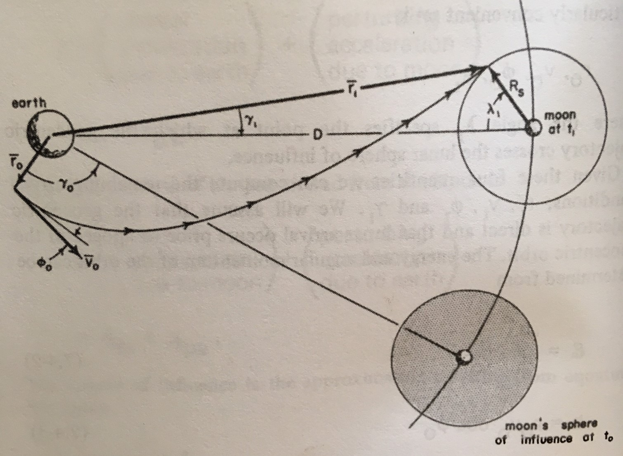
Paul In Jerusalem (Acts 22:1-30)
V. 17. Though Paul was perfectly
equipped to minister to the Jews, God had
other plans and sent him to the Gentiles.
Are we open to course corrections that the
Lord calls us to?

Slide 42
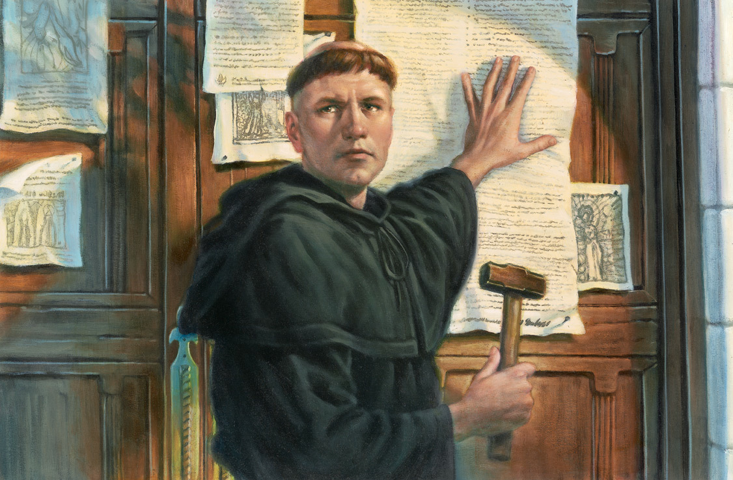
Paul In Jerusalem (Acts 22:18)
V. 18. There are truths that cannot be compromised!
At the Diet of Worms (1521), the Catholic scholar Johann Eck asked Luther whether he wished to retract what he had taught. Luther’s famous reply was as follows:
Since your serene majesty and your lordships seek a simple answer, I will give it in this manner, neither horned nor toothed: unless I am convinced by the testimony of the Scriptures or by clear reason … I am bound by the Scriptures I have quoted, and my conscience is captive to the
Word of God. I cannot and will not retract anything, since it is
neither safe nor right to go against conscience.

Slide 43
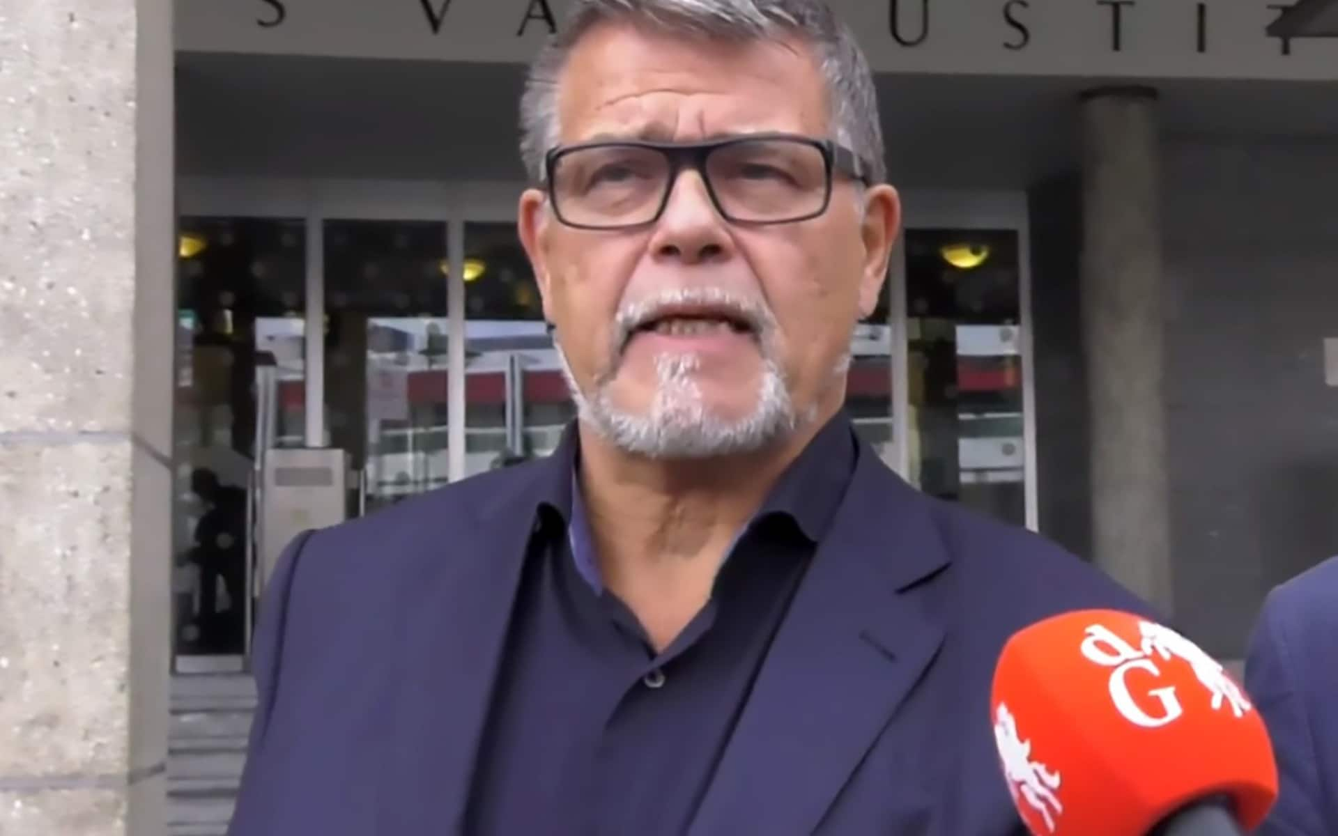
Paul In Jerusalem (Acts 22:18)
A pensioner has begun a legal battle to be recognized as being 20 years younger than his
actual age so he can go back to work and achieve greater success with women on Tinder.
Emile Ratelband, 69, argues that if transgender people are allowed to change sex, he should
be allowed to change his date of birth because doctors said he has the body of a 45-year-old.
Mr Ratelband was born on 11th March 1949, but says he feels at least 20 years younger and
wants to change his birth date to 11th March 1969. Mr Ratelband said: "I have done a
check-up and what does it show?
My biological age is 45 years.
"When I'm 69, I am limited. If I'm
49, then I can buy a new house,
drive a different car. I can take up
more work. "When I'm on Tinder
and it say I'm 69, I don't get an
answer. When I'm 49, with the
face I have, I will be in a luxurious
position. "Transgenders can now
have their gender changed on
their birth certificate, and in the
same spirit there should be room
for an age change."

Slide 44
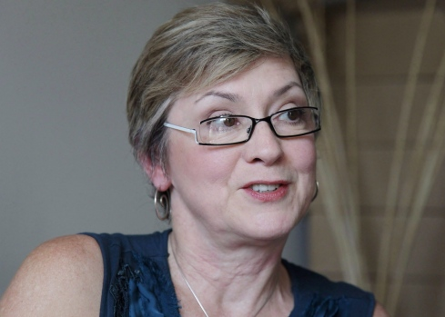
Paul In Jerusalem (Acts 22:18)
A United Church minister who had faced an unprecedented ecclesiastical court hearing over
her professed atheism is no longer in danger of a defrocking after the two sides reached an
agreement in the long-running case. In an unexpected development this week, Rev. Gretta
Vosper and the church settled ahead of what some had dubbed a "heresy trial," leaving her
free to minister to her east-end Toronto congregation. "It's going to be wonderful," Vosper
said in an interview Friday. "We'll be out from underneath that heavy cloud. Now we'll be able
to really fly.“
The Right Rev. Richard Bott, who was elected in July to lead the United Church in Canada,
said in a public message that he was pleased with the resolution. At the same time, Bott
acknowledged the controversy that has been swirling around Vosper and the church's
initiative to fire her. In a message to adherents, Bott
referenced the church's core values of faith in God
and inclusiveness.
"The dance between these core values, how they
interact with and inform each other, is one that we
continue to explore as followers of Jesus and children
of the creator," he said. "As a Christian church, we
continue to expect that ministers in the United Church
of Canada will offer their leadership in accordance
with our shared and agreed upon statements of faith."

Slide 45
Paul's Roman Excursion (Acts 21:17-28:31)

Slide 46
Acts 9 | Acts 22 | Acts 26
1 But Saul, still breathing threats and murder against the disciples of the Lord, went to the high priest 2 and asked him for letters to the synagogues at Damascus, so that if he found any belonging to the Way, men or women, he might bring them bound to Jerusalem. | 3 “I am a Jew, born in Tarsus in Cilicia, but brought up in this city, educated at the feet of Gamaliel according to the strict manner of the law of our fathers, being zealous for God as all of you are this day. 4 I persecuted this Way to the death, binding and delivering to prison both men and women, 5 as the high priest and the whole council of elders can bear me witness. From them I received letters to the brothers, and I journeyed toward Damascus to take those also who were there and bring them in bonds to Jerusalem to be punished. | 8 Why is it thought incredible by any of you that God raises the dead? 9 “I myself was convinced that I ought to do many things in opposing the name of Jesus of Nazareth. 10 And I did so in Jerusalem. I not only locked up many of the saints in prison after receiving authority from the chief priests, but when they were put to death I cast my vote against them. 11 And I punished them often in all the synagogues and tried to make them blaspheme, and in raging fury against them I persecuted them even to foreign cities. 12 “In this connection I journeyed to Damascus with the authority and commission of the chief priests.

Slide 47
Acts 9 | Acts 22 | Acts 26
3 Now as he went on his way, he approached Damascus, and suddenly a light from heaven flashed around him. 4 And falling to the ground he heard a voice saying to him, “Saul, Saul, why are you persecuting me?” 5 And he said, “Who are you, Lord?” And he said, “I am Jesus, whom you are persecuting. 6 But rise and enter the city, and you will be told what you are to do.” 7 The men who were traveling with him stood speechless, hearing the voice but seeing no one. 8 Saul rose from the ground, and although his eyes were opened, he saw nothing. So they led him by the hand and brought him into Damascus. | 6 “As I was on my way and drew near to Damascus, about noon a great light from heaven suddenly shone around me. 7 And I fell to the ground and heard a voice saying to me, ‘Saul, Saul, why are you persecuting me?’ 8 And I answered, ‘Who are you, Lord?’ And he said to me, ‘I am Jesus of Nazareth, whom you are persecuting.’ 9 Now those who were with me saw the light but did not understand the voice of the one who was speaking to me. 10 And I said, ‘What shall I do, Lord?’ And the Lord said to me, ‘Rise, and go into Damascus, and there you will be told all that is appointed for you to do.’ 11 And since I could not see because of the brightness of that light, I was led by the hand by those who were with me, and came into Damascus. | 13 At midday, O king, I saw on the way a light from heaven, brighter than the sun, that shone around me and those who journeyed with me. 14 And when we had all fallen to the ground, I heard a voice saying to me in the Hebrew language, ‘Saul, Saul, why are you persecuting me? It is hard for you to kick against the goads.’ 15 And I said, ‘Who are you, Lord?’ And the Lord said, ‘I am Jesus whom you are persecuting. 16 But rise and stand upon your feet, for I have appeared to you for this purpose, to appoint you as a servant and witness to the things in which you have seen me and to those in which I will appear to you,

Slide 48
Acts 9 | Acts 22 | Acts 26
9 And for three days he was without sight, and neither ate nor drank. 10 Now there was a disciple at Damascus named Ananias. The Lord said to him in a vision, “Ananias.” And he said, “Here I am, Lord.” 11 And the Lord said to him, “Rise and go to the street called Straight, and at the house of Judas look for a man of Tarsus named Saul, for behold, he is praying, 12 and he has seen in a vision a man named Ananias come in and lay his hands on him so that he might regain his sight.” 13 But Ananias answered, “Lord, I have heard from many about this man, how much evil he has done to your saints at Jerusalem. 14 And here he has authority from the chief priests to bind all who call on your name.” 15 But the Lord said to him, “Go, for he is a chosen instrument of mine to carry my name before the Gentiles and kings and the children of Israel. 16 For I will show him how much he must suffer for the sake of my name.” |  | 17 delivering you from your people and from the Gentiles—to whom I am sending you 18 to open their eyes, so that they may turn from darkness to light and from the power of Satan to God, that they may receive forgiveness of sins and a place among those who are sanctified by faith in me.’ 19 “Therefore, O King Agrippa, I was not disobedient to the heavenly vision.

Slide 49
Acts 9 | Acts 22 | Acts 26
17 So Ananias departed and entered the house. And laying his hands on him he said, “Brother Saul, the Lord Jesus who appeared to you on the road by which you came has sent me so that you may regain your sight and be filled with the Holy Spirit.” 18 And immediately something like scales fell from his eyes, and he regained his sight. Then he rose and was baptized; 19 and taking food, he was strengthened. For some days he was with the disciples at Damascus. | 12 “And one Ananias, a devout man according to the law, well spoken of by all the Jews who lived there, 13 came to me, and standing by me said to me, ‘Brother Saul, receive your sight.’ And at that very hour I received my sight and saw him. 14 And he said, ‘The God of our fathers appointed you to know his will, to see the Righteous One and to hear a voice from his mouth; 15 for you will be a witness for him to everyone of what you have seen and heard. 16 And now why do you wait? Rise and be baptized and wash away your sins, calling on his name.’

Slide 50
Comparing …
1) Paul received authority from the high priests to arrest Messianics at Damascus and bring them back to Jerusalem for trial and punishment.
2) All three mention the light (but one mentions the time of day).
3) Paul falls to the ground (ch. 26 mentions that they all fell).
4) All heard a sound … but only Paul was able to discern meaning to that voice.
5) Jesus personally identifies Himself.
6) Acts 26 alone mentions the commission.

Slide 51
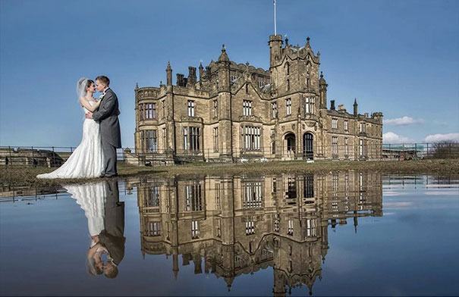
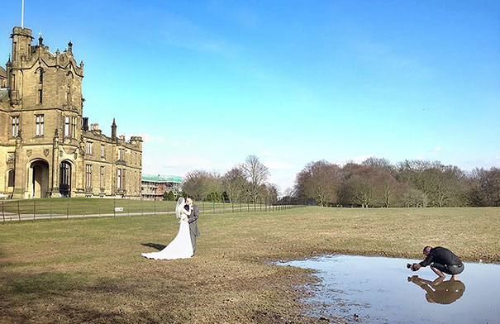
Remember … Context
1) Acts 9 deals with the details of the conversion story
2) Acts 22 is very Hebrew in nature … Paul attempts to show the Hebrew roots to the gospel and how he is a good Hebrew.
3) Acts 26 has an audience of Agrippa II, who was an expert in Hebrew culture.
The more you understand about the environment around you, the better you are equipped to speak to it with power.

Slide 52
Paul's Roman Excursion (Acts 21:17-28:31)
Should the gospel message be used to influence
political policy or individual hearts?

Slide 53
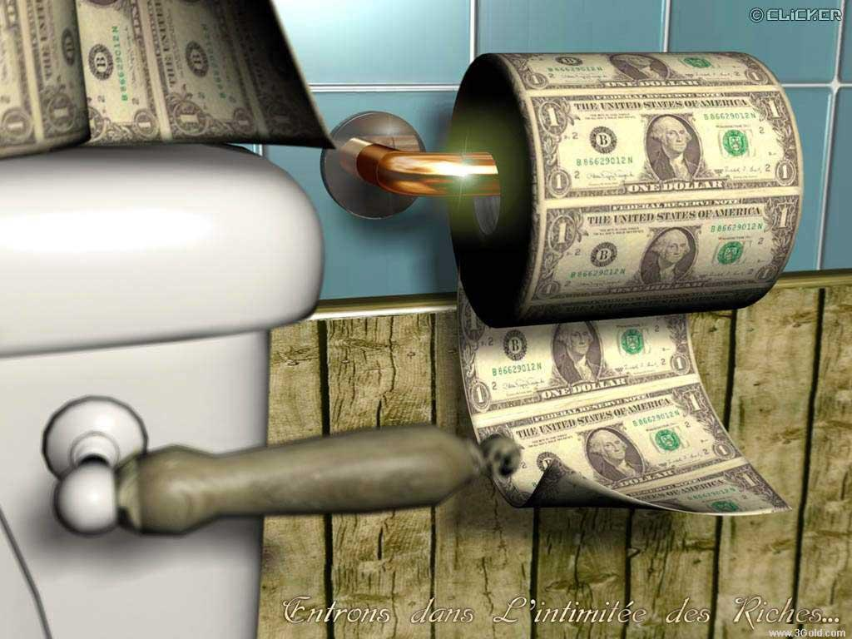
Paul's Roman Excursion (Acts 21:17-28:31)
Paul with Felix: How to mask the conviction of the Spirit
- Riches and power can dilute talk of righteousness,
self control and judgement.
1. They are able to camouflage their insecurity by pretending to
be in control of their lives
- Felix tries to control the timing of their meetings (v. 25a)
2. The rich and powerful are often
controlled by an insatiable greed, and
they usually find convenient ways to
express this. (v. 26)

Slide 54
Paul's Roman Excursion (Acts 21:17-28:31)
3. Those who are at the top feel that they have to please many
people if they want to stay in their position and thrive in society.
This may hinder them from doing what they know to be right.
(v. 27)

Slide 55
Paul's Roman Excursion (Acts 21:17-28:31)
All three trials found Paul innocent.
Yet no judge had the courage to act.

Slide 56
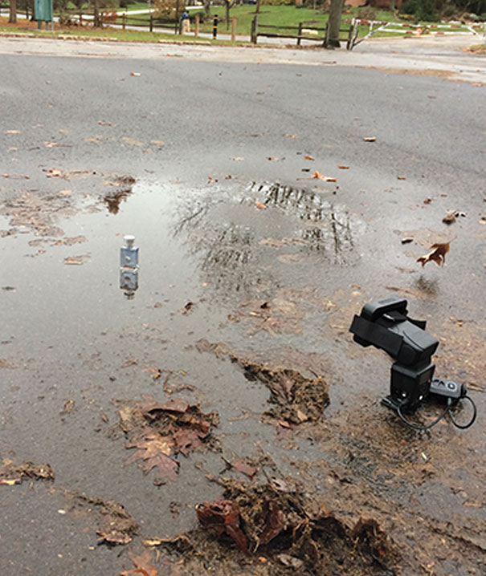
May I never hide behind
a title or a position.
In every trial. It was declared
that Paul was innocent.
No one had the courage
To LET HIM GO!

Slide 57
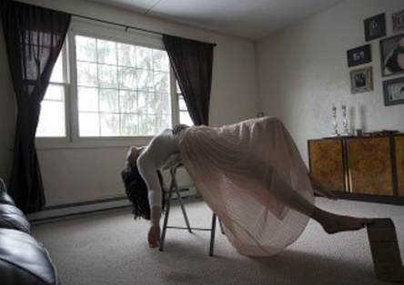

Slide 58
Excursus … Human Government
Gen. 9:6 “Whoever sheds human blood, by humans shall their blood be shed; for in the image of God has God made mankind.
A new institution is developed and empowered … civic government
Note that its purpose was to restrained violence … the original cause for the flood.

Slide 59
Paul's Roman Excursion (Acts 21:17-28:31)
Before Agrippa II
- This man was son to Agrippa I and great grandson to Herod The
Great. Bernice was his sister
Herod The Great ... slaughtered the babies in Bethlehem
Antipas (his son) ... Beheaded John the Baptist
Agrippa (grandson) ... killed James, the son of Zebedee by the sword

Slide 60
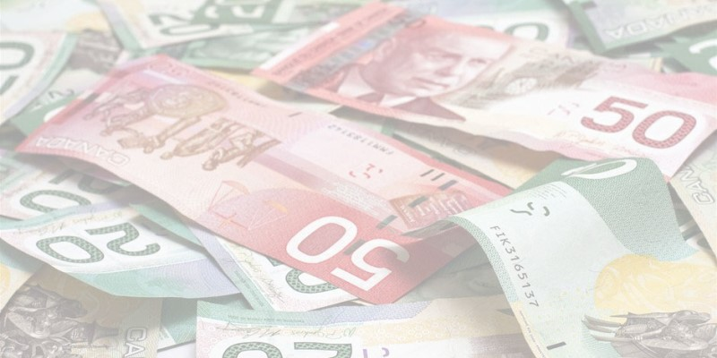
Excursus … Human Government
Gen. 10:8 Cush was the father of Nimrod, who became a mighty warrior on the earth. He was a mighty hunter before the LORD; that is why it is said, “Like Nimrod, a mighty hunter before the LORD.” The first centers of his kingdom were Babylon, Uruk, Akkad and Kalneh, and Shinar. From that land he went to Assyria where he built Nineveh, Rehoboth Ir, Calah and Resen, which is between Nineveh and Calah—which is the great city.
The first empire.
Nimrod drove the spirit of Babel
Why does Revelation end with the destruction of this city?

Slide 61
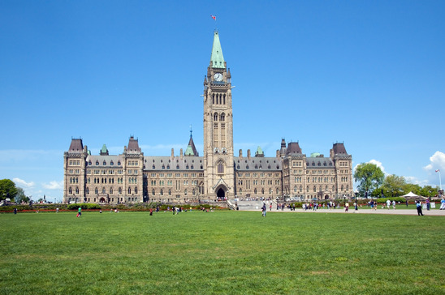
Excursus … Human Government
1 Samuel 8: 1-3 When Samuel grew old, he appointed his sons as Israel’s leaders. The name of his firstborn was Joel and the name of his second was Abijah, and they served at Beersheba. But his sons did not follow his ways. They turned aside after dishonest gain and accepted bribes and perverted justice.
Why did Samuel appoint these men? What is Nepotism?
Did this lead to the first government being formed in Israel?
Was God in this?
What should Samuel have learned from Eli’s sons?

Slide 62
Excursus … Human Government
Remember:
1) Israel’s kings did not make laws. The law of the land was already given by God.
2) Israel’s kings were to be subject to the same laws as the people.
3) Israel’s kings were supposed to listen to God’s prophets.
What was God’s purpose in human government?
Does the government have a moral responsibility? How do they determine what that
morality looks like?

Slide 63
Excursus … Human Government
6 But when they said, “Give us a king to lead us,” this displeased Samuel; so he prayed to the Lord. 7 And the Lord told him: “Listen to all that the people are saying to you; it is not you they have reject, but they have rejected me as their king. 8 As they have done from the day I brought them up out of Egypt until this day, forsaking me and serving other gods, so they are doing to you. 9 Now listen to them; but warn them solemnly and let them know what the king who will reign over them will claim as his rights.”
10 Samuel told all the words of the Lord to the people who were asking him for a king. 11 He said, “This is what the king who will reign over you will claim as his rights: He will take your sons and make them serve with his chariots and horses, and they will run in front of his chariots. 12 Some he will assign to be commanders of thousands and commanders of fifties, and others to plow his ground and reap his harvest, and still others to make weapons of war and equipment for his chariots. 13 He will take your daughters to be perfumers and cooks and bakers. 14 He will take the best of your fields and vineyards and olive groves and give them to his attendants. 15 He will take a tenth of your grain and of your vintage and give it to his officials and attendants. 16 Your male and female servants and the best of your cattle and donkeys he will take for his own use. 17 He will take a tenth of your flocks, and you yourselves will become his slaves. 18 When that day comes, you will cry out for relief from the king you have chosen, but the Lord will not answer you in that day.”
19 But the people refused to listen to Samuel. “No!” they said. “We want a king over us. 20 Then we will be like all the other nations, with a king to lead us and to go out before us and fight our battles.”

Slide 64
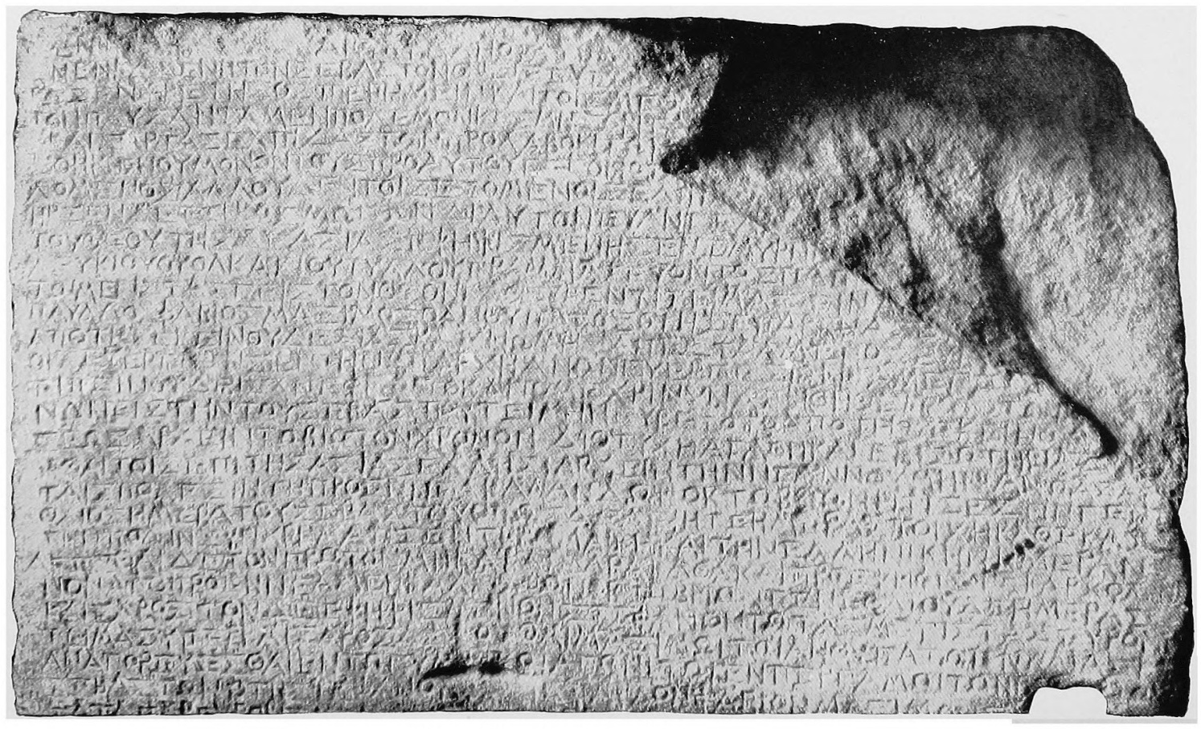
Augustus Caesar …
The Calendar Inscription of Priene (around 9BC):
Decree of the Greek Assembly in the province of Asia, on motion of the High Priest Apolionios, son of Menophilos, of Aizanoi whereas Providence that orders all our lives has in her display of concern and generosity in our behalf adorned our lives with the highest good: Augustus, whom she has filled with virtue for the benefit of humanity, and has in her beneficence granted us and those who will come after us a Saviourwho has made war to cease and who shall put everything [in peaceful] order; and whereas Caesar, transcended the expectations of [all who had anticipated the good news], not only by surpassing the benefits conferred by his predecessors but by leaving no expectation of surpassing him to those who would come after him, with the result that the birthday of our God signalled the beginning of Good News for the world because of him; ..... proconsul Paul Fabius Maximus] has discovered a way to honour Augustus that was hitherto unknown among the Greeks,
namely to reckon time from the date of his
nativity; therefore, with the blessings of Good
Fortune and for their own welfare, the Greeks
in Asia decreed that the New Year begin for all
the cities on September 23, which is the
birthday of Augustus; and, to ensure that the
dates coincide in every city, all documents are
to carry both the Roman and the Greek date,
and the first month shall, in accordance with
the decree, be observed as the Month of
Caesar, beginning with 23 September, the
birthday of Caesar."
How subversive was the Gospel?

Slide 65
Augustus Caesar …
The text calls Caesar ….
1) Savior because of the pax romana (Roman peace)
2) God, as he holds all things in his hands (even time!)
3) A gospel
4) Sent by Providence
5) Ender of war
How subversive was the Gospel?

Slide 66
Excursus … Human Government (NT)
Romans 13:4 Gov’t is designed to punish evildoers (to keep society in shalom).
Romans 12:17-19 We do not pay back evil for evil … authority structures do.
Romans 13:3 Do good … and the authorities are pleased.
1Peter 2:13-14 Note the theme of punishment and praise.
Matthew 22:20-22 Caesar may print the money … but we are not to give him
total allegiance.
John 19:11 Authority has been given from above for every leader.
1Timothy 2:1-2 Pray for those in positions of authority.

Slide 67
Excursus … Human Government
When Gov’t Goes Bad
Daniel What was his response to bad gov’t?
Rome What was the Christian response
Revelation What does this remind us?
Is faith tied to a political party?

Slide 68
Excursus … Human Government – Restorative Justice

Slide 69
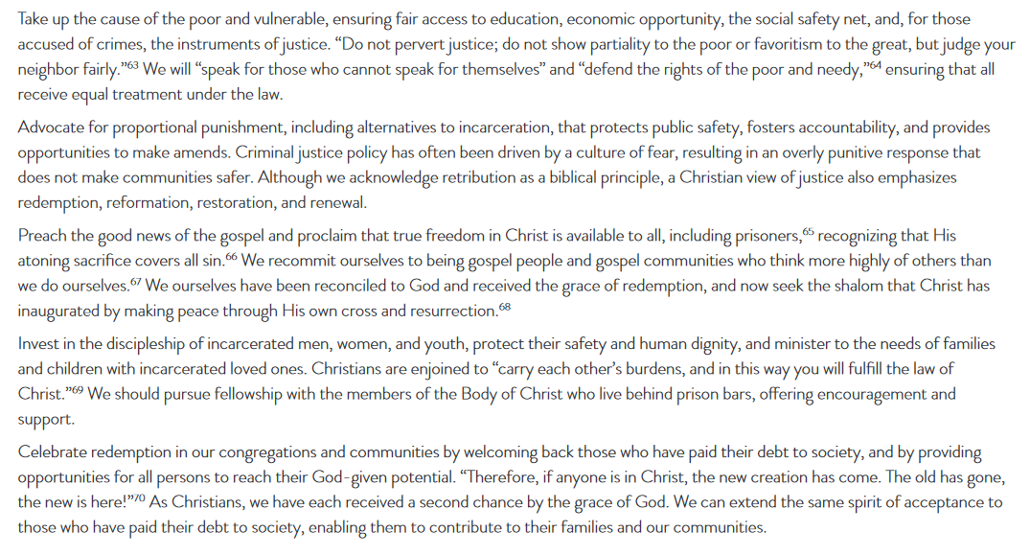
Excursus … Human Government – Restorative Justice

Slide 70
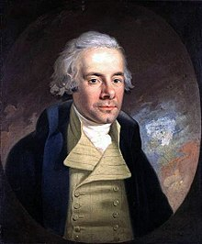
Excursus … Human Government – Practical
1. Pray (2Chronciles 7:14, 1Timothy 2:1)
2. Refuse the vitriol (Proverbs 19:13, 2Timothy 2:14, 23, Titus 3:9)
3. Vote (in an informed way … not based upon who puts most money in pockets)
4. Political parties are not equal to religious affiliations
5. Be involved (Daniel, Joseph, Nicodemus, Luke 8:3 etc.)
Wilberforce was convinced of the importance of religion, morality and education. He championed
causes and campaigns such as the Society for the Suppression of Vice, British missionary work in
India, the creation of a free colony in Sierra Leone, the foundation of the Church Mission Society,
and the Society for the Prevention of Cruelty to Animals. His underlying conservatism led him to
support politically and socially
controversial legislation, and
resulted in criticism that he was
ignoring injustices at home while
campaigning for the enslaved
abroad. In later years, Wilberforce
supported the campaign for the
complete abolition of slavery,
and continued his involvement
after 1826, when he resigned
from Parliament because of his
failing health. That campaign led to the Slavery Abolition
Act 1833, which abolished slavery in most of the British
Empire. Wilberforce died just three days after hearing that
the passage of the Act through Parliament was assured.

Slide 71
Excursus … Human Government – Practical
6. Most political positions are not matters of faith but of practical wisdom. Do
not confuse the two.
7. Reject the idea that you must agree with ALL of a politicians views to support
them on some.
8. We must work for and practice a radical justice.
9. Do not place ultimate allegiance in any political solution.
10. When resistance is necessary, it is always passive and accepting of punishment.

Slide 72
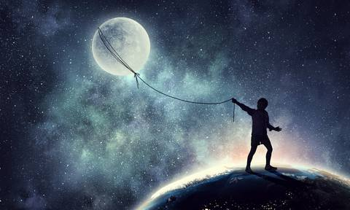
Paul’s dream was to come to Rome (see Romans 1:13)
Does God sometimes fulfill our dreams in ways that we do not expect?
Why does God devote such a large piece of Scripture to this event?
What transforms Paul the prisoner to Paul the leader? Paul is a leader
to the church AND to a group of prisoners! (v. 27:3)

Slide 73
What is Paul’s seek to making friendships so quickly? Were Luke and
Aristarchus traveling as Paul's slaves (Pliny writes of this 50 years later)
Why does the guard trust him so much in the story? As part of the Augustan Cohort, (troop of the Emperor), he was strong and loyal to Rome.
Several times, the entire group of prisoners will owe their live to Paul.
Could Christ have stilled this storm? Why didn’t He?

Slide 74
Paul's Roman Excursion (Acts 21:17-28:31)
130 miles
476 miles
67 miles

Slide 75
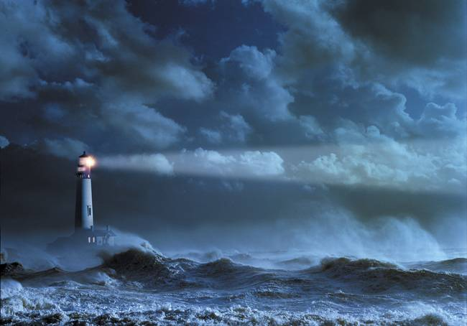
In the storm …
- Paul refuses to gloat! His first message is “Take Courage”. What message do people see in
us on a daily basis?
- His second message is “Stay together in unity”. Is unity in the church something to be
strived for? How would that be personally fleshed out by you?
- His third message is to “take food”. This is an incredibly practical advice. How practical are
Christians today in terms of what the world sees? What does the fact that Paul makes a
public show of his “prayer of thanksgiving” mean to you. What would an unsaved person
think if they heard you pray out loud?
- John Stott makes the statement that Paul
was a “... man of God and a man of action,
a man of the Spirit and of common sense”.
Do you agree? Does this make his witness
more attractive?
- Why would God spare all the prisoners
(man of which were going to Rome to die
in the Arena anyway)?

Slide 76
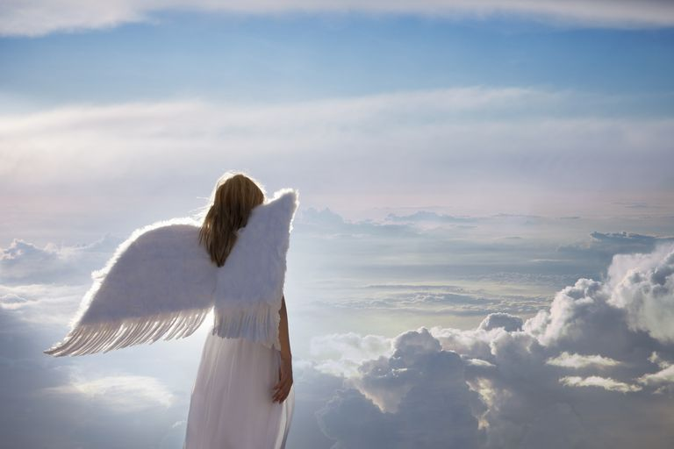
Angels With Us
- according to Hebrews 1:14, they minister to human beings by:
a) Giving instructions (Acts 8:26) ... ensure that these instructions are exactly in the will of
the Lord without contradicting His Word
b) Reveal God’s glory (Rev. 1:1-3)
c) To announce judgment (Daniel 5:25-27)
d) To strengthen (Matthew 4:11, Luke 22:42-43 - the word strengthen here, means to make
strong inwardly!)
e) Protection (2Kings 6:14-17)
f) By observing us and promoting the will of the Lord (1Corinthians 4:9)
Angels Are Tools Of Judgment
- see Hebrews 1:7
- they warn of Judgment in Genesis 18
- they bring judgment in 2Kings 19, 1 Chron. 21:16, Acts 12:22, Exodus 12:18-30 and Revelation
- The Lord will assign angels to separate the sheep from the goats (Matt. 25)
- note that Hell was created for the devil and his angels (Matthew 25:41)
- angels will be used to gather people (see Matthew 13:41-42, Matthew 24:40)
Angelic Power Over Us
- Give no opportunity to the devil (Ephesians 4:27)
- Be sober and vigilant (1 Peter 5:9)
- Resist (James 4:27)

Slide 77
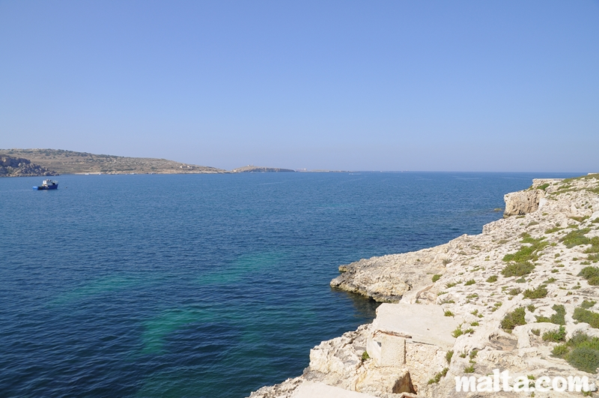
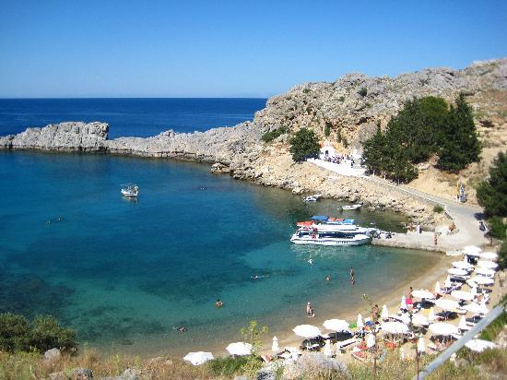
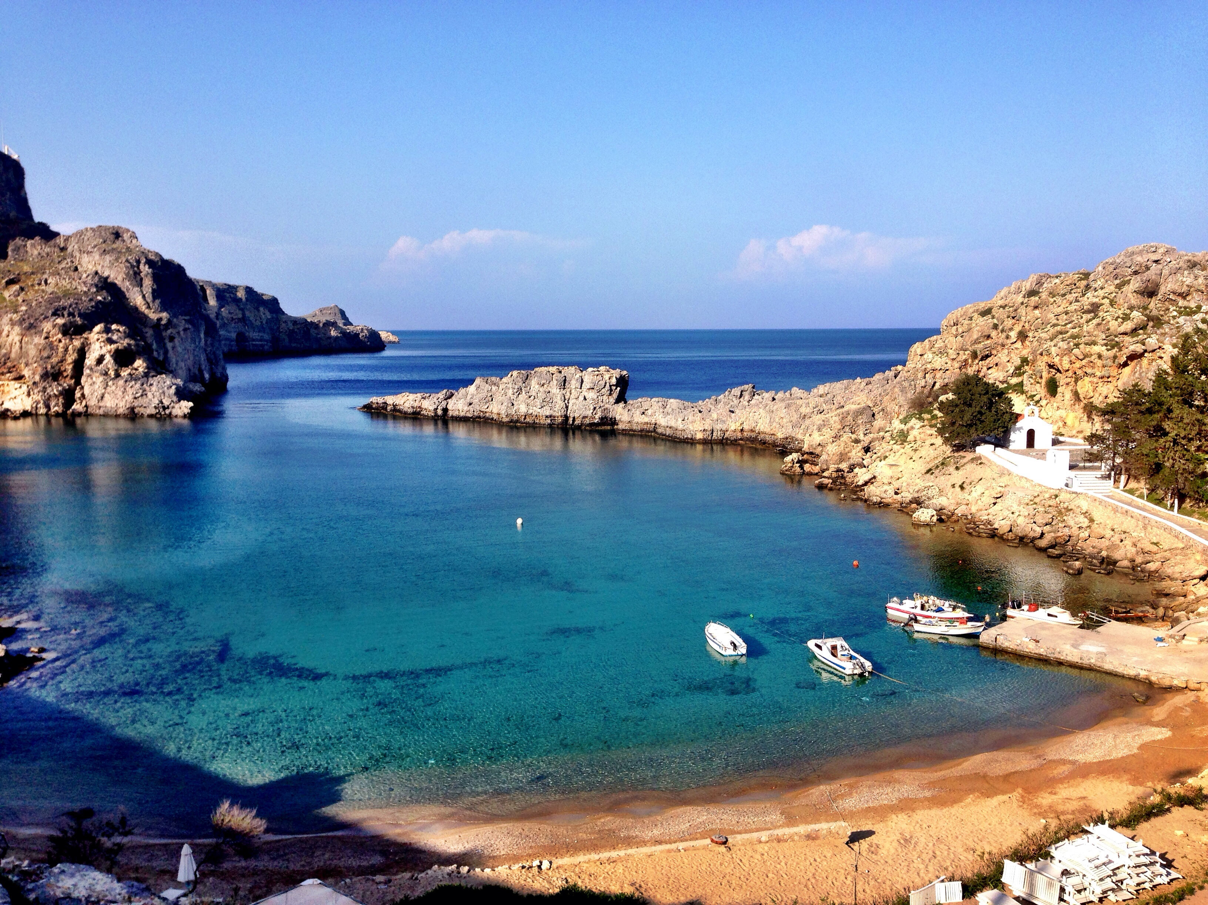
St. Paul's Bay … Malta
Two streams empty into this harbor,
producing a unique mud that would
hold a boat fast.

Slide 78
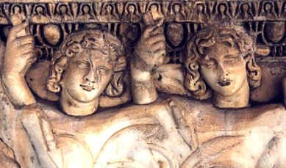
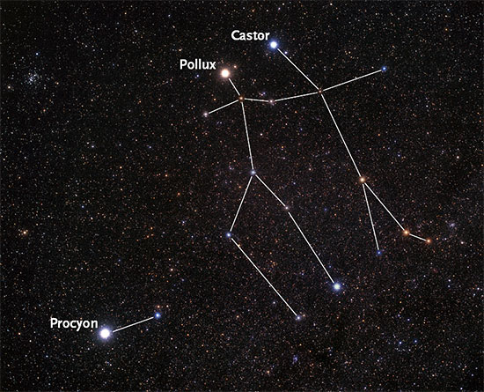
The Twins (Gemini) were
considered good fortune
for travelers.

Slide 79
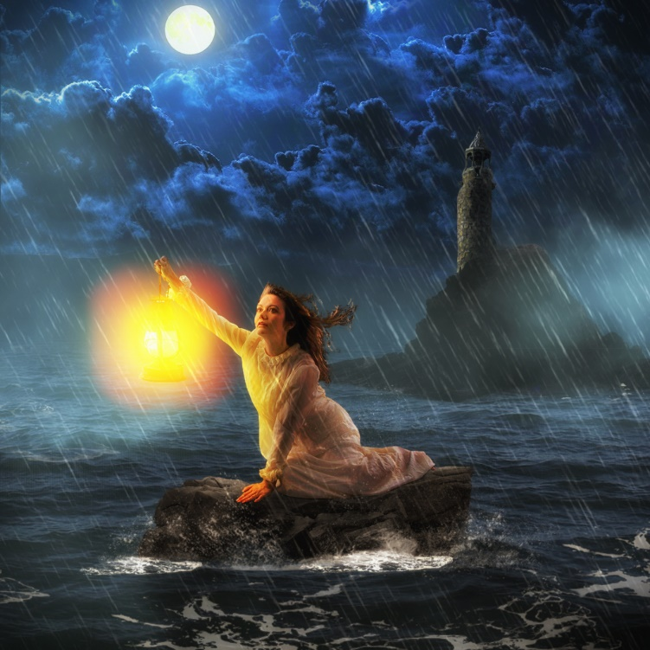
Lessons In The Storm
1. God is sovereign and will prepare and accomplish whatever is necessary.
Sometimes He calms the storms, sometimes He makes a path through it.
2. We may never know the reason for the storm, but be assured of the outcome.
3. Never stop being practical. Leadership surfaces in the storms.
4. God blesses those that reject Him for the sake of those who love Him.
5. My words and actions communicate
hope (See Jer. 32:6-16)
6. Do NOT discount human wisdom.
7. Present a clear testimony.
8. Note again Paul’s need for
encouragement as the church came to him.

Slide 80
Acts 28: No Bitterness
In spite of who put Paul into such a difficult life situation, to whom does Paull first go to
in Rome? Why??

