Slide 1
ACTS 1:1 - 8:1 THE BIRTH OF THE CHURCH
1:1 - 1:14 Introduction
1:15 - 26 A new apostle is chosen
2:1-13 The feast of Pentecost
2:14-47 Peter’s first sermon
3:1 - 4:31 Healing of a lame man
4:32 - 5:11 Ananias and Sapphira
5:12-42 The Apostles before the council
6 The first deacons appointed
7:1 - 8:1 Stephen’s defense and stoning
ACTS 8:1 - 11:18 PERSECUTION : SPREADS TO JUDEA AND SAMARIA
8:1 - 25 The Samaritans respond to the Gospel
8:26-40 Philip and the Ethiopian Treasurer
9:1-31 Saul is converted to Christianity
9:32-43 Peter at Lydda and Joppa
10 Peter and Cornelius
11:1-18 The Apostles approve Peter’s actions

Slide 2
ACTS 11:19 - 16:6 THE GOSPEL ADVANCES INTO SYRIA AND TURKEY
11:19-30 The first Gentile Church at Antioch
12 James is killed, Peter imprisoned
Further Study: Prayer
13, 14 Missionary Journey 1: Paul and Barnabas
- Cyprus, Perga, Pisidian Antioch,
Iconium, Lystra, Derbe
Further Study: Fasting
15:1-35 The Council at Jerusalem
ACTS 16:6 - 19:41 PAUL TAKES THE GOSPEL TO EUROPE
15:36 - 19:41 Missionary Journey 2 : Paul and Silas
- Philippi, Thyatira, Thessalonica, Beroea,
Athens, Corinth, Ephesus
Further Study: Gifts of the Spirit
What is spiritual warfare?
- Third missionary journey

Slide 3
ACTS 20 - 28 PAUL’S JOURNEY TO ROME
20: 1-16 Paul sets out for Jerusalem
20:17 - 21:14 Paul with the Ephesian Elders
21:15 - 23:35 Paul is arrested in Jerusalem
24 The defense before Felix
25:1-12 The defense before Festus
25:13 - 26:32 The defense before Agrippa
27, 28 Paul’s boat trip, shipwreck,
arrival at Rome
Further Study: Angelic realms

Slide 4
God's response to our questions …
Mark 10:35-40, 46-52
Our questions reveal much about our current condition of the heart.
Christ always draws truth out …. with questions.

Slide 5
Practicing Prayer
Some Thoughts On The Practical Side Of Prayer
- There are times of both corporate prayer and private prayer; both are necessary.
- Try to quiet your mind before rushing in!
- Do what it takes to eliminate the distractions.
- Try to create a “prayer closet”.
- Spend at least some time listening! Lectio Divina
- How often do we “Amen” and go, without tarrying a bit and waiting on the Lord?
- Try to set aside the same time each day for your devotional time: No guilt allowed.
- Don’t focus on the length of the prayer or the words spoken .
- Don’t allow yourself to fall into the trap of repeating the same phrase over and over.
- It is important to mean what you say and use the language that
you are used to (Psalm 62:8).
- Allow yourself the time to fully express your emotions to God.
- You can’t hide yourself ... so don’t try.
- Keep a prayer journal (if it works for you) ... but pray in a way that
you will know when God answers!
- Remember the balance of what is spoken:
A ... Adoration (worship to the Lord for who He is)
C ... Confessions (Lord ... forgive me)
T ... Thanksgiving (praising God for needs met)
S ... Supplication (asking for needs to be met)
- The focus must be on God ... not the mountains we are praying about!
- Some on-going questions for God:
1) What is the next step in my character development?
2) What is the next step with my family ?
3) What is the next step with my ministry?
4) What is the next step in my vocation ... dating ...
education ... giving ...
- Pray specifically

Slide 6
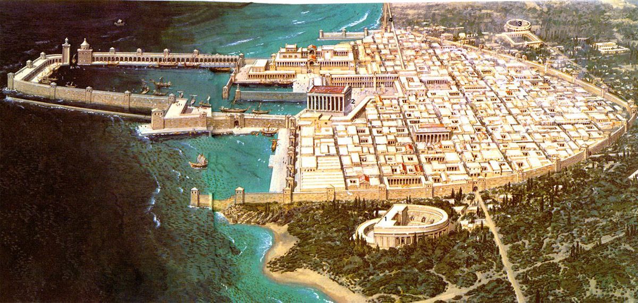
Caesarea
- a seaport city
- rebuilt by Herod the Great and named after Caesar Augustus
- there were more Gentiles living there than Jews, calling it the "Daughter of Edom"
- the city was meant to serve as a show piece to the Roman empire
- it was riots here in 66AD that sparked the Roman/Jewish wars
- Josephus claims that 20,000 Jews were massacred there in 66AD

Slide 7
Herod's Humiliation
What actions are we capable of when we feel humiliated?
- Herod killed guards
- He then fled to Caesarea
- He accepts worship as a god.

Slide 8
Herod's (Agrippa) Humiliation
• According to Luke, Herod was “wearing his royal robes” (v. 21); Josephus writes that
he wore a garment made wholly of silver, which shone in a surprising manner when the
rays of the sun touched it.
• Luke says that Herod’s punishment was because he did not praise God when the
flatterers shouted that his was the voice of a god (vv. 22 – 23). Josephus reports that
“the king did neither rebuke them, nor reject their impious flattery.”
• Josephus says that he had violent abdominal pains and died five days later, whereas
Luke says, “Immediately … an angel of the Lord struck him down, and he was eaten
by worms and died” (v. 23). This apparent discrepancy can be explained in that Luke
applied the “immediately” to the striking down with sickness (which took place
immediately), not to the dying (which took
place five days later).

Slide 9
Brene Brown on Shame …
Shame
Shame is the most powerful, master emotion. It’s the fear that we’re not good enough.
Shame, blame, disrespect, betrayal, and the withholding of affection damage the roots
from which love grows. Love can only survive these injuries if they are acknowledged,
healed and rare.
If we can share our story with someone who responds with empathy and understanding,
shame can’t survive.
Shame corrodes the very part of us that believes we are capable of change.
If we share our shame story with the wrong person, they can easily become one more
piece of flying debris in an already dangerous storm.

Slide 10
Brene Brown on Shame …
Courage
Owning our story can be hard but not nearly as difficult as spending our lives running
from it. Embracing our vulnerabilities is risky but not nearly as dangerous as giving up on
love and belonging and joy—the experiences that make us the most vulnerable. Only
when we are brave enough to explore the darkness will we discover the infinite power of
our light.
Courage starts with showing up and letting ourselves be seen.
As a shame researcher, I know that the very best thing to do in the midst of a shame
attack is totally counterintuitive: Practice courage and reach out!
The dark does not destroy the light; it defines it. It’s our fear of the dark that casts our joy
into the shadows.
If you trade your authenticity for safety, you may experience the following: anxiety,
depression, eating disorders, addiction, rage, blame, resentment, and inexplicable grief.

Slide 11
Paul's First Missionary Journey (Acts 13:1-14:28)

Slide 12
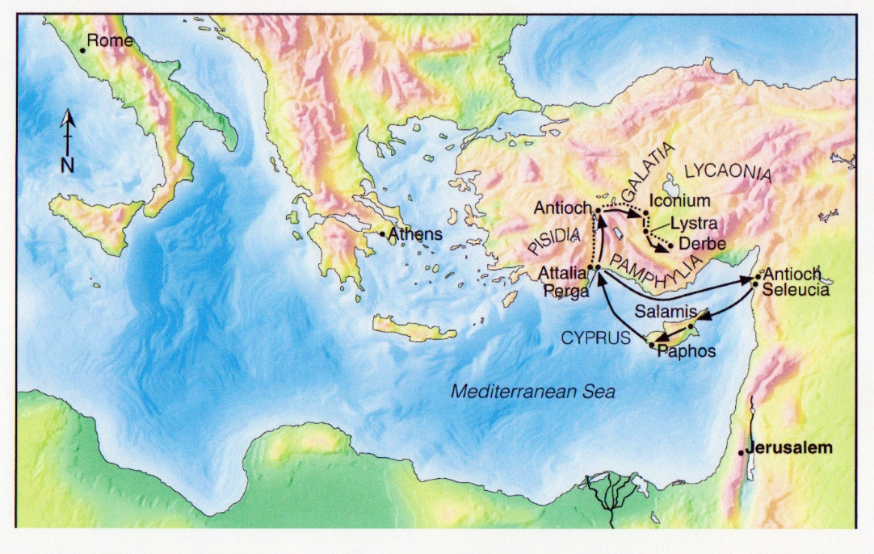
Paul's First Missionary Journey (Acts 13:1-14:28)
The Commission
- On or around this time, Paul had an unusual experience that he writes about in
2 Corinthians 12:2-10
- He describes that 12 years earlier (around 42 or 43 AD), he was caught up to
heaven
- He was then given a thorn in the flesh
- This would have happened either just before or during his call to evangelize
- WHY all of this, now? How does the reaction of Saul and Herod differ?
Is there a link between great
faith/abilities and the thorn
in the flesh we may be asked
to bear?

Slide 13
Paul's First Missionary Journey (Acts 13:1-14:28)
- Note the wide range of leaders at Antioch
Barnabas ... full of compassion and encouragement (a people person), also a
Levite from Cyprus (Acts 4:36)
Simeon called Niger (black) ... of dissimilar ethnic origin (possibly Simon of Cyrene)
Lucius ... from North Africa
Manaen ...rich and influential, well connected (this Herod [Antipas] was the one
who put John the Baptist to death ... see also Luke 8:3 for Joanna)
- Ironic … two friends … one beheads and one heads up …
Saul ... highly trained and intelligent
“we will probably have to pay a price for devoting
our lives to building the kingdom of God. Jesus did.” ― Bill Hybels, Courageous Leadership
“You're a leader. It's your job to keep your passion hot.
Do whatever you have to do, read whatever you have
to read, go wherever you have to go to stay fired up.
And don't apologize to anybody. ” ― Bill Hybels, Courageous Leadership

Slide 14
Paul's First Missionary Journey (Acts 13:1-14:28)
Some Questions About This Passage:
1) How do you think that the Spirit revealed it to the church?
2) What was the purpose of prayer and fasting?
3) Why did they fast and pray AGAIN after the call?
4) Why did they lay hands on these two?
5) Does it bother you that they went without clear directions
(not unlike Abraham)?
6) Is there a healthy balance with the Spirit direction individuals and
the church together?

Slide 15
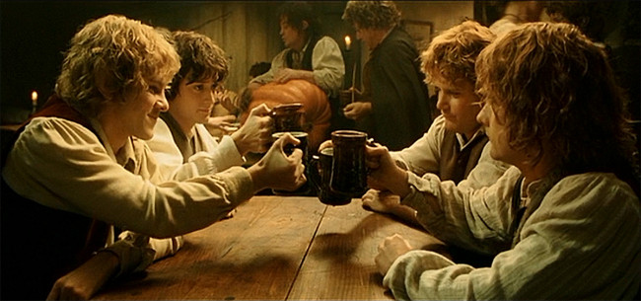
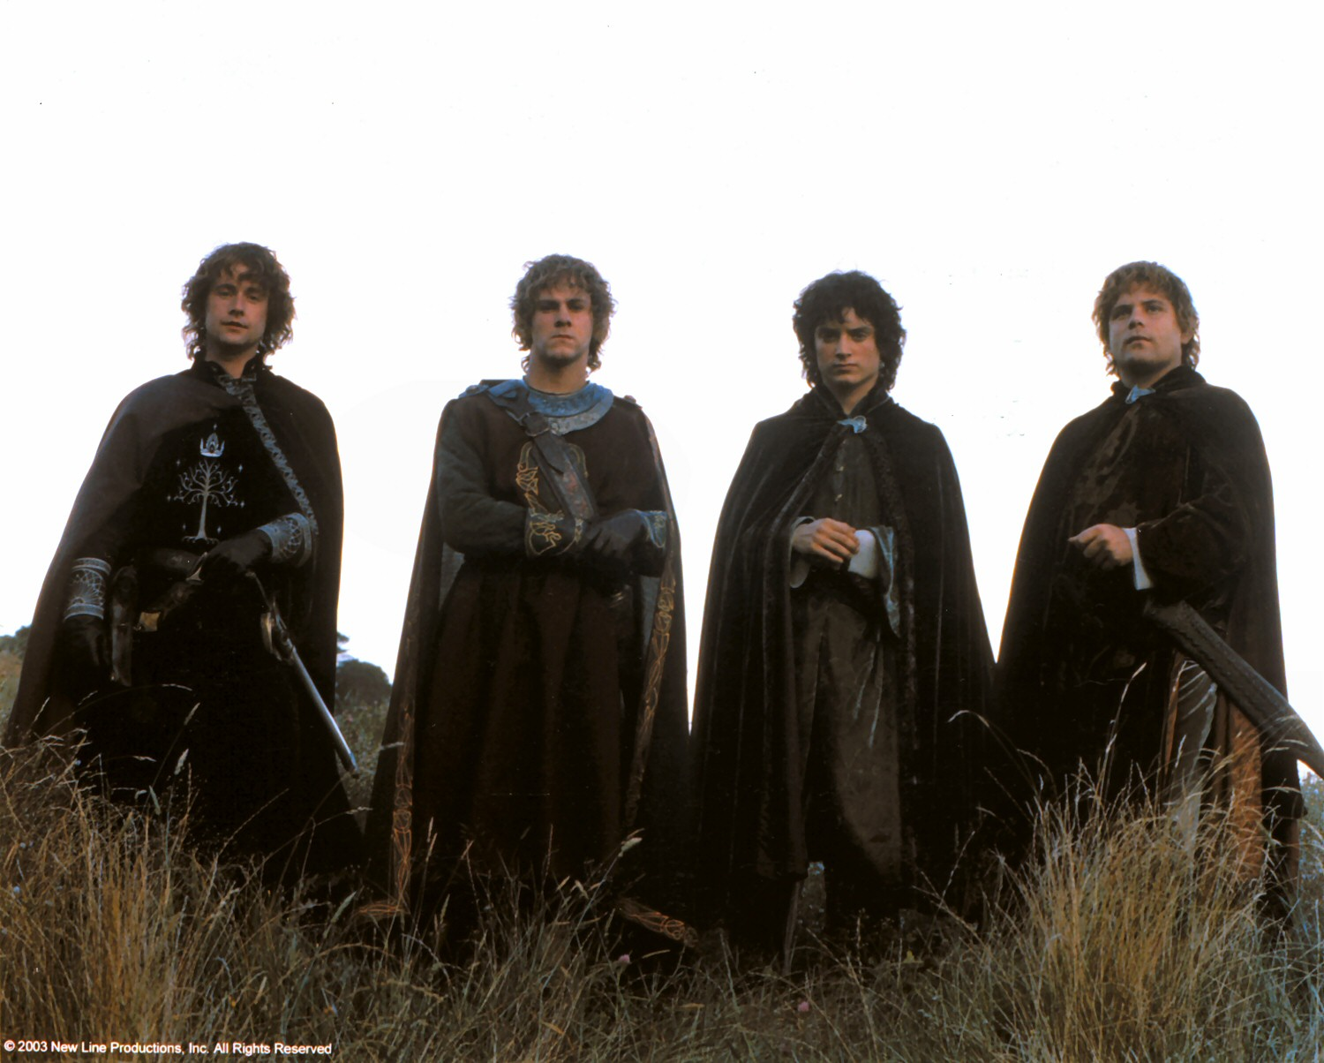
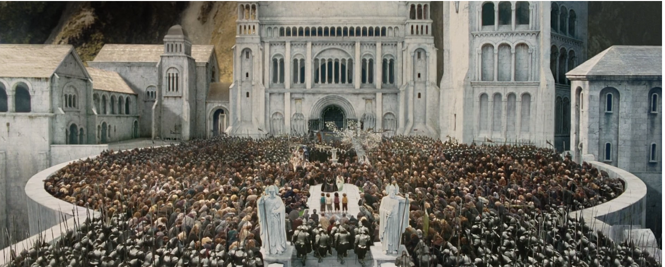
Paul's First Missionary Journey (Acts 13:1-14:28)
In Cyprus
- Why here? Perhaps because Barnabas was from this island?
- Why was John Mark such a valuable asset? Was he an eye witness to
Jesus?
- Was Paul in the right to use such strong language describing Elymas?
- Leaders are often admired from a distance. This is likely true of Paul.
Note in 2Timothy 4:16, all had abandoned him. When you serve, it may be alone,
but today Paul is recognized as one of the great leaders of the world.
In the messy middle of your story …. You will not likely see the hand of God
as clearly as you want to. It does not mean He is not there.

Slide 16
Paul's First Missionary Journey (Acts 13:1-14:28)
Paul too was blind for a season
- would it have the same effect on Elymas?
Why?

Slide 17
Paul's First Missionary Journey (Acts 13:13)
John Mark quits
- was this a good thing?
- When is it right to quit?
- Are some goals to be abandoned?
Jacob was blessed because he would not stop
wrestling with God (Genesis 32:26)
2Timothy 2:3 Endure hardship with us like a good soldier of Christ Jesus.
4 No-one serving as a soldier gets involved in civilian affairs—he wants to please his
commanding officer.
5 Similarly, if anyone competes as an athlete, he does not receive the victor’s crown
unless he competes according to the rules.
6 The hardworking farmer should be the first to receive a share of the crops.
7 Reflect on what I am saying, for the Lord will give you insight into all this.
Do I hold a grudge against
those who have quit on me?

Slide 18
Paul's First Missionary Journey (Acts 13:13)
Being Careful About Quitting
Some things need to be ended. How do you know which?
The people we admire most, all faced adversity.
Count the cost very carefully. What do you lose?
What do you gain? Short term vrs. long term?
Quitting does not often develop character.
It is not glamorous.
Satisfaction, advancement and fulfillment are seldom
achieved by simply starting over.
Quitting points are not as solid as they seem to be.
They are just painful.
Important vision has a high price tag. If God births it,
it is a valuable, holy experience. Keep your clarity.

Slide 19
Paul's First Missionary Journey (Acts 13:14-52)
- Note that Barnabas is not even mentioned in this passage. What does this communicate?
- Antioch was about 3600 feet above sea level. Quite a mountain climb!
- Sergius Paulus may have been the first of six successive senators named Lucius Sergius
Paullus, of Antioch, Pisidia.
Paul preaches here due to some form of illness (see Galatian 4:12-15)
ENCOURAGERS HAND OVER leadership. It must not have been easy for Barnabas to hand
leadership over to Paul. Paul was in some ways his trainee. Barnabas was probably physically
older than Paul — and certainly older spiritually. He was also probably more distinguished
looking, for later the people of Lystra called Barnabas Zeus, the chief Greek god, and Paul
Hermes, the spokesman of the god (14:12).

Slide 20
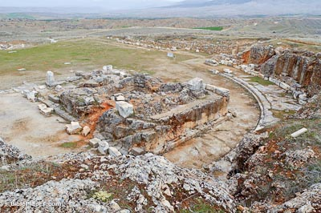
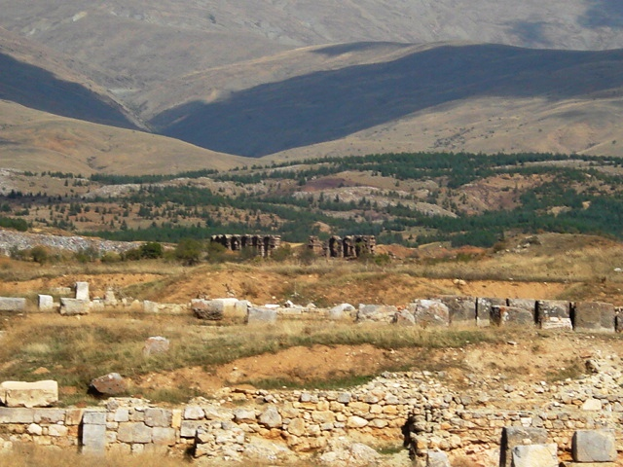
Paul's First Missionary Journey (Acts 13:14-52)
Temple of Augustus
As Augustus was regarded as the city’s founder,
this temple dedicated to him was built after
2 BC and became the focal point of the city.
This podium temple was constructed in front of
a two-story semi-circular portico and adjacent
to a large colonnaded courtyard
Ruins of Pisidian Antioch

Slide 21
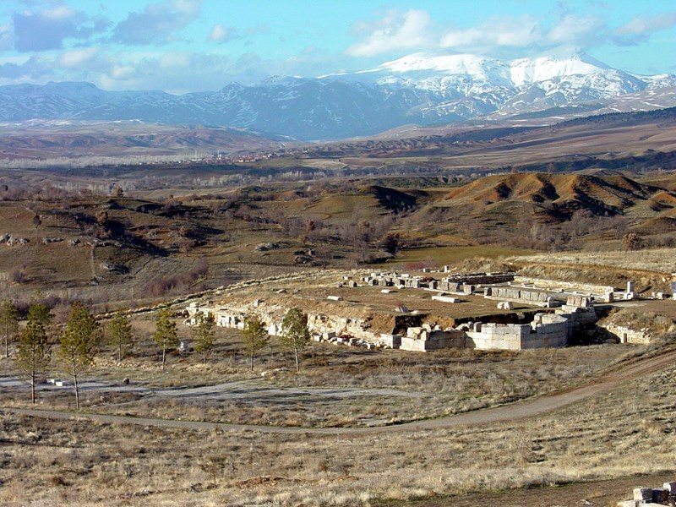
Paul's First Missionary Journey (Acts 13:14-52)
Church Of St. Paul
Possible location of the Jewish Synagogue …

Slide 22
Paul's First Missionary Journey (Acts 14:1-19)
Had a meeting with a former students this week. He had just gone through an in-depth study of Acts,
looking for times that Jesus is proclaimed as God during preaching. He is not. This was a second century
doctrine that was debated and discussed and finally agreed upon.
Does this bother you? What happens to you when your pre-conceived notions are challenged?

Slide 23
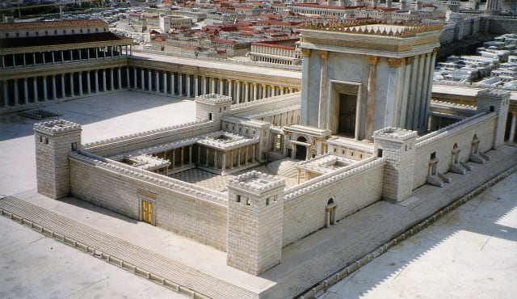
Paul's First Missionary Journey (Acts 14:1-19)
1 Peter …
1:1-2 We are strangers …. No land, no passport … no roots … we should expect to be outside
2:4-8 Our stone is rejected by people … as are we
We are living stones … the Spirit is in us. We are joined together into a temple , also
where the Spirit dwells. We are priests! We have a Law. We have a Promised Land.

Slide 24
Paul's First Missionary Journey (Acts 14:1-19)
An overarching theme of the book of Acts …
our message will be both received and rejected.
The presentation must be balanced between the revealed Truth
of the holiness of God and the incredible grace poured out on us.
The results must lie upon Him who has called us.
Note similarities here to Acts 3
- Both crippled from birth
- Apostles "looked" upon each
- Both had faith to be healed
- Both lept up
- Both messages gave glory to God

Slide 25
Paul's First Missionary Journey (Acts 14:1-19)
Does the Gospel of Christ always unite?
Does unity mean conformity?
Is there such a thing as an ungodly unity?
What was wrong with Babel?
Does unity come when forced?
What is the unifying impetus?
What should be given up for the sake of unity and what should not?

Slide 26
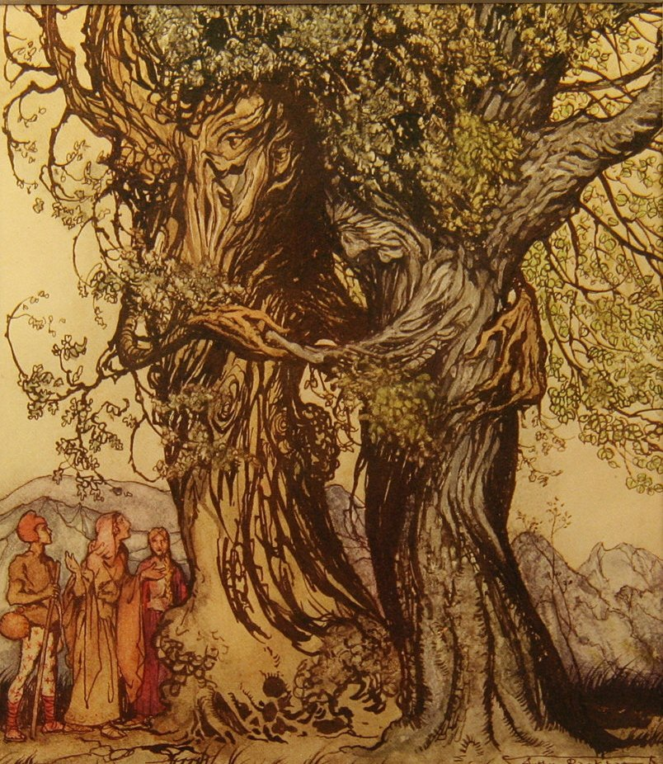
Paul's First Missionary Journey (Acts 14)
Zeus = the chief god
Hermas = the patron god of orators
Note the opposite reaction here
as opposed to that of Herod. Our
apostles refuse to take credit for
anything.
Are there pagan stories in our
culture that we believe strongly
enough to influence our reaction
to the Gospel?

Slide 27
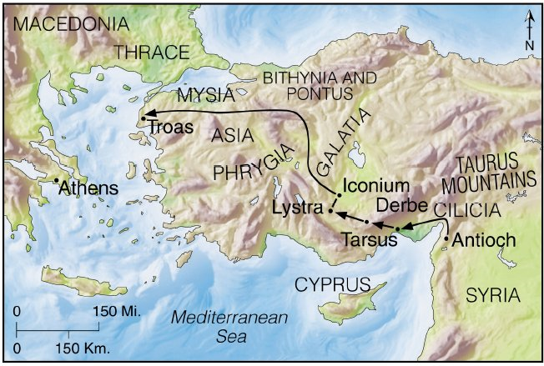
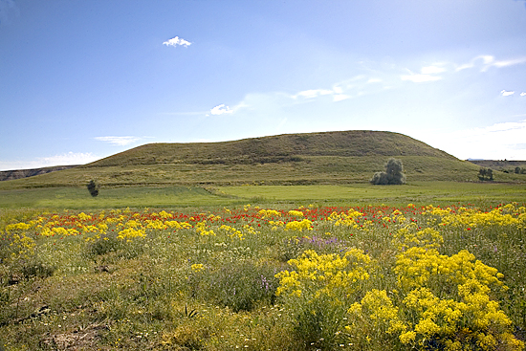
Lystra

Slide 28
Paul's First Missionary Journey (Acts 14:21-28)
Why did they retrace their route instead of carrying on
east and south?
Why the mention of hardship in verse 22? (Gr. pollon … quality or
kinds, not quantity)

Slide 29
Paul's First Missionary Journey (Acts 14:21-28)
What Strengthens?
1) Personal involvement
2) Perseverance in the faith … stay true
3) Proper understanding of trials
4) Well trained leadership

Slide 30
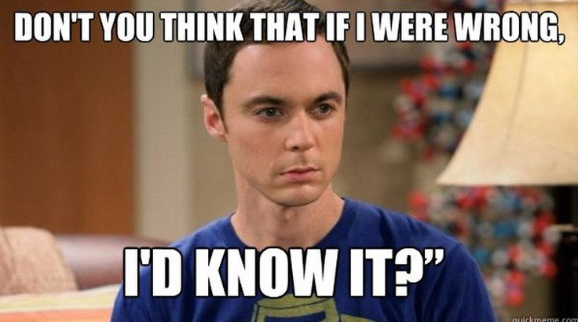
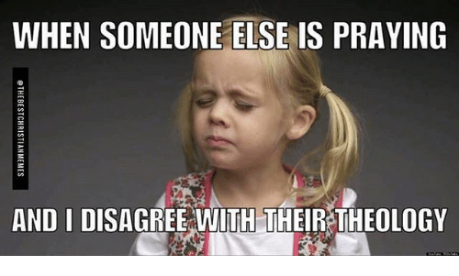
Acts 15: The Jerusalem Council
When the church is divided … when leaders disagree

Slide 31
Acts 15: The Jerusalem Council
The council took place around 49AD.
The church met to discuss this issue. It was not swept away!
Remember that Peter had earlier been rebuked by Paul. Now
He stands together with him. Huge growth for Peter!
- The salvation issues are dealt with AND THEN the fellowship issues!

Slide 32
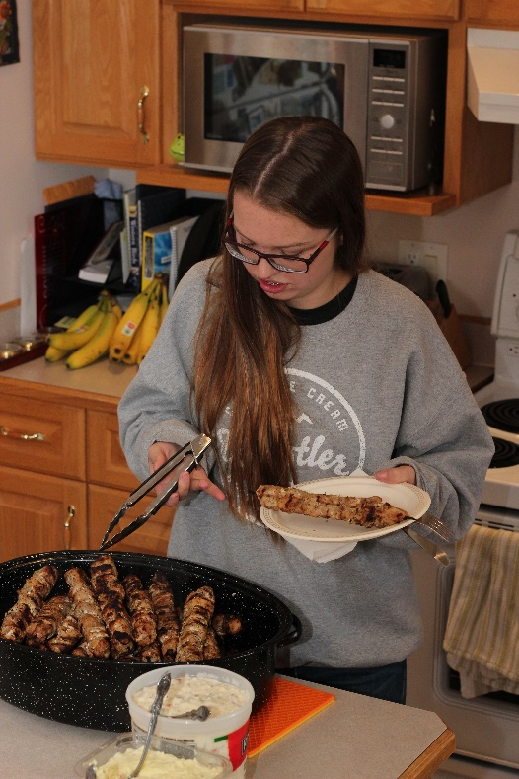
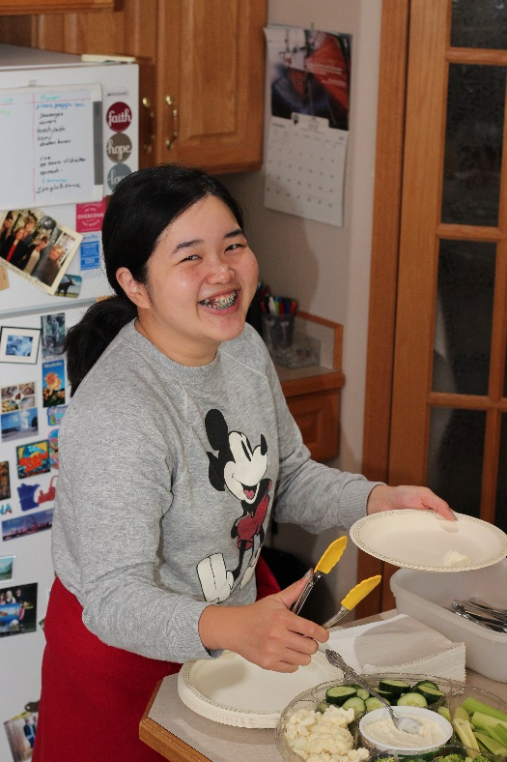
Acts 15: The Jerusalem Council
Table fellowship is an important component to Christian fellowship
To remain clean w.r.t. dietary laws was important to the Jewish believers
Should they fellowship together?
What about kosher foods?
Why no decree for Jewish Christians?
Abstain from foods offered to idols.
Abstain from sexual immorality.
Abstain from meat of strangled animals. (Deut. 14:21)?
Abstain from blood.
Cultic Defilement?

Slide 33
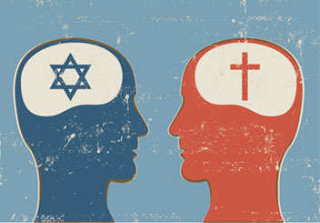
Acts 15: The Jerusalem Council
Gentiles without synagogue background were coming into the church. Their single greatest
instructional need would be to avoid paganism or syncretism.
The decree lists four things demonstrably associated with pagan cults as well as with Jewish
sensitivities. The words have other associations, too, but pagan cultic associations are a
viable option.
The decree is presented as easy to comply with, not a burden, something the gentiles may
have already been in compliance with.
James says the decree is needed because he did not want to hinder gentile conversions,
but he implied that synagogue preaching would. The decree is much less than synagogues
taught and much less than Pharisee Christians would observe.
The decree is given in answer to people who taught that gentiles had to keep the law of Moses.
This implies that the decree is not based on the law of Moses. It does not perpetuate
ritualistic laws for either Jews or gentiles.
This theory explains why all gentiles needed to comply with the decree, whether they lived
near Jews or not, and why there was no decree for Jewish Christians.

Slide 34
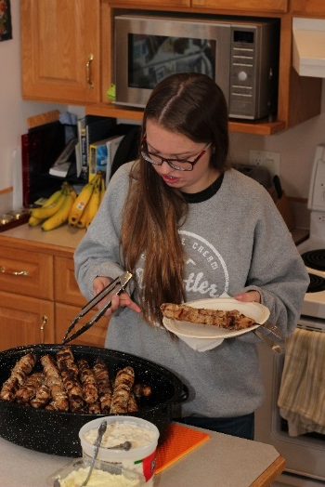
Acts 15: The Jerusalem Council
Why no decree for Jewish Christians?
Abstain from foods offered to idols.
Abstain from meat of strangled animals. (Deut. 14:21)?
Abstain from blood.
Abstain from sexual immorality.
Not Binding on Christians?
Different from the rest?
Binding on Christians?
The purpose of this decree seemed aimed at ensuring that Jewish Christians could partake in Christian feasts along side of
their Gentile brothers and sisters.
This may be a specific reference to Lev. 18 (marriages among relatives) [Bruce]
This may be a general reminder to Gentiles, in light of the lax views of sexuality
It may reference specific activities that took place in cultic religions around them.

Slide 35
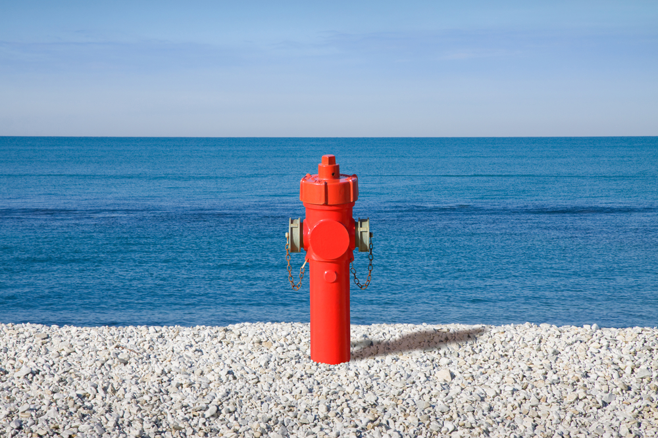
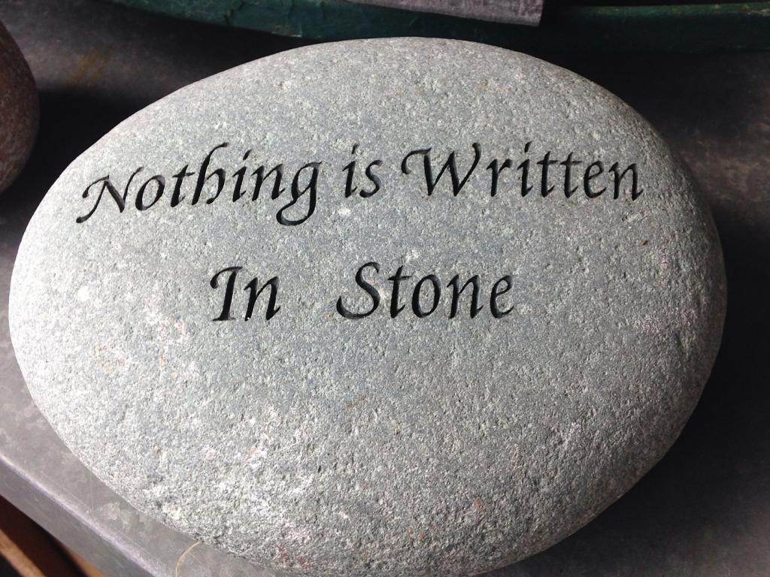
Acts 15: The Jerusalem Council
WHAT? 6-7 years later in 1Corinth. 8?
WHAT? 8 years later in Romans 14?
To cap this entire teaching, what does it say of Paul that when he met Timothy, he had him circumcised? (See Acts 16:3)
Only one of the four commands we just studied are mentioned by Paul in his epistles

Slide 36
Acts 15: Freedom To Self-Limit
Did Paul and James disagree? Not really.
With the list from Jerusalem, we must remember that …
James did not speak to soteriology … rather the practicality of living together.
Christian maturity recognizes that I have many freedoms in Christ. I am not bound by
the 613 laws of the Old Testament. I AM bound by the NT laws of Christ.
Only one of the four commands we just studied are mentioned by Paul in his epistles
When Paul spoke of salvific doctrines, he proclaimed loudly that we were NOT saved
by keeping the laws of the OT. He knew that the three dietary commands were NOT
salvific … rather they represented a
Christian’s willingness to self-regulate
their freedom for the sake of others.
See this in Romans 14:14, 1 Corinth. 8:4-13

Slide 37
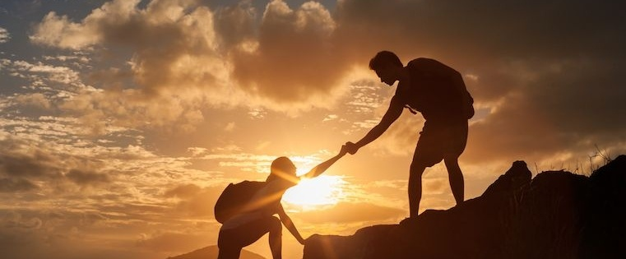
A Final Look At Barnabas …
Acts 4:36 Generous, caring, encourager
Acts 9:27 Trusting, willing to forgive, acting as a bridge (a priest!)
Acts 11:22 Willing to forgo centuries of tradition by welcoming the
Samaritans into the Church.
Acts 11:25 Willing to travel 100 miles to find Saul and bring him into ministry
Acts 11:30 A great reputation … trusted him with money
Acts 12:25 Willing to reach out to an untrusted nephew (Col. 4:10), give him a chance
Acts 13:1 Compare with 13:42 … willing to release the reigns of leadership to Saul
Gal. 2:13 Not above making a mistake!
Acts 15:37 Willing to stand with the underdog and give second chances
- Compare to 2Timothy 4:11

Slide 38
Paul's Second Missionary Journey (Acts 16:1-5)
Paul Selects His Disciple ... Timothy … what were the qualifications of this man?
a) The parental difference was NOT an issue
b) He was spoken well of by the brothers and sisters that knew him
c) Willing to go with Paul
d) Willing to suffer whatever (circumcision) it took for the Lord
- this in spite of the fact that it was a non-salvation issue!
- is it right to freely give up liberties for the Gospel?
- There is often pain when identifying with people.
- how have I taken a personal interest in discipling
- though Paul had a passion to develop churches, he was
also still a pastor!

Slide 39
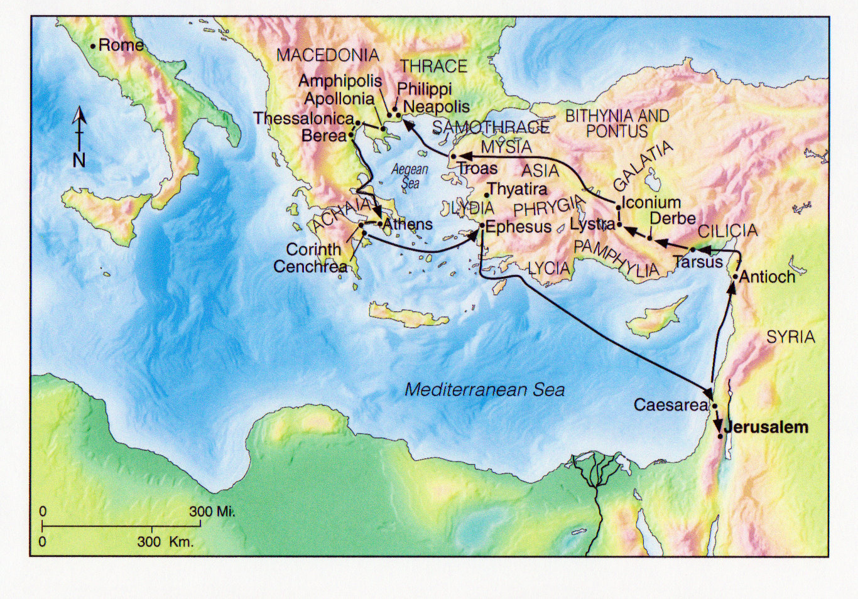
Paul's Second Missionary Journey (Acts 15:36-18:22)

Slide 40
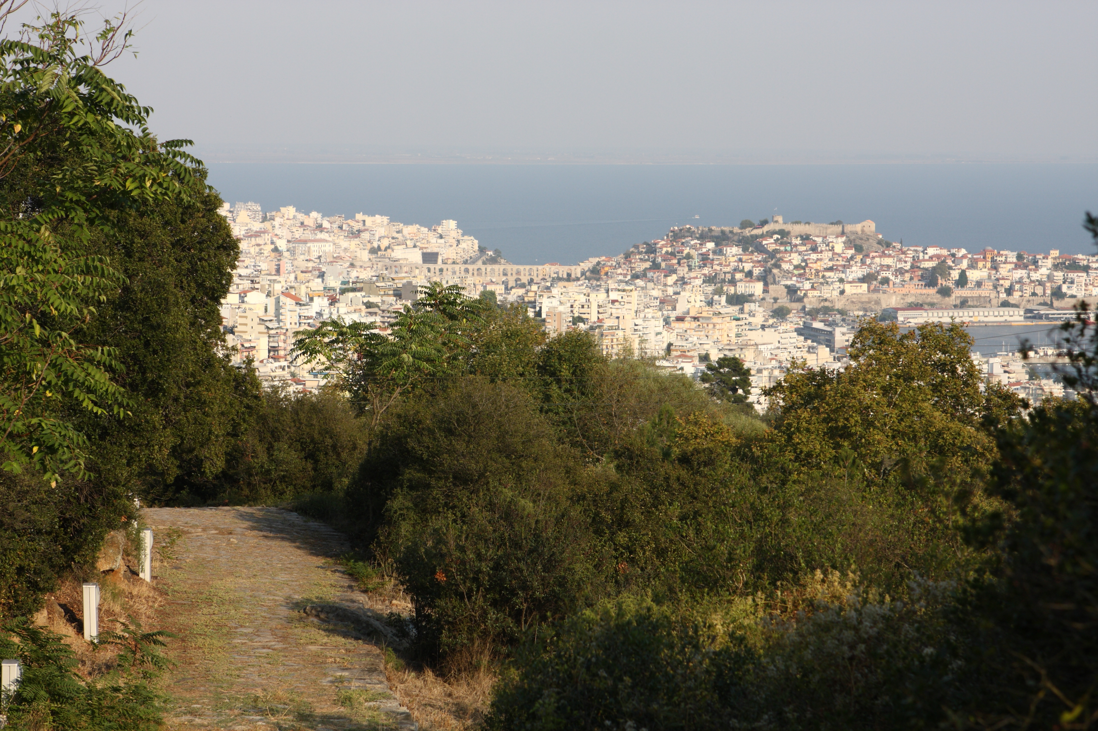
Neapolis with a portion of the Via Egnatia

Slide 41
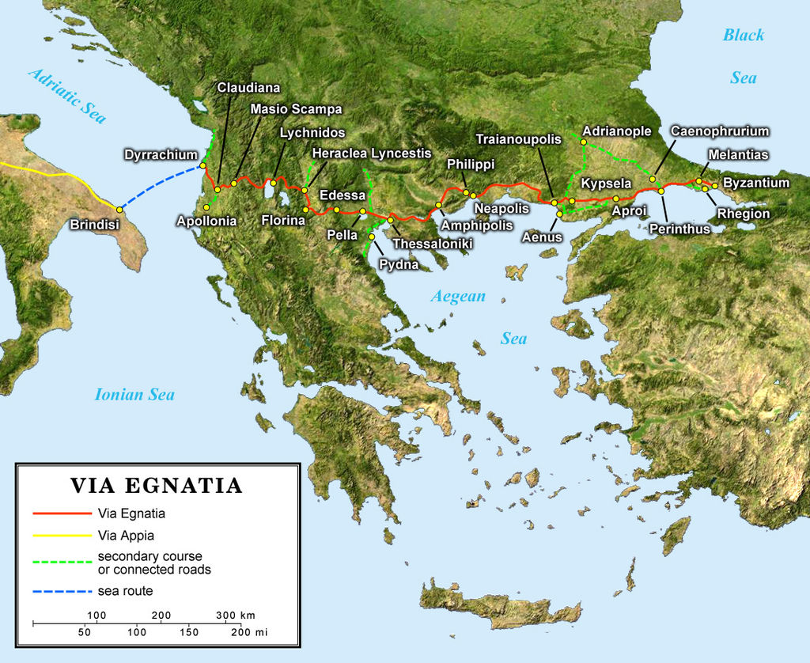
Paul's Second Missionary Journey (Acts 15:36-18:22)

Slide 42
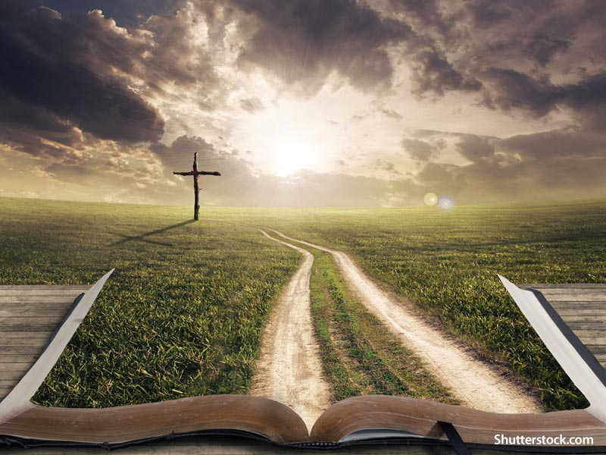
Paul's Second Missionary Journey (Acts 16:6-10)
Determining The Will Of The Lord
- God blocks the way ... south west (to Asia), north (Mysia), east (where they came from)
- they tried going as far west as they could (Troas) and waited!
a) In determining God’s will, don’t stop trying the logical paths!
b) Be willing to see and accept when God closes a door
c) If everything closes in front of you, wait and seek His face UNTIL He reveals
what He wants
- it is seldom difficult to discover God’s will (how many times in the Bible to people really wrestle with this?)
is there still a place for God speaking
through dreams today?
- Consider Joel 2:28, Acts 2:17
- What criteria do we use to determine if
a dream is of the Lord?
- Consider verse 10 (the word “concluding”
implies discussion, debate, CORPORATE
debate!)
!

Slide 43
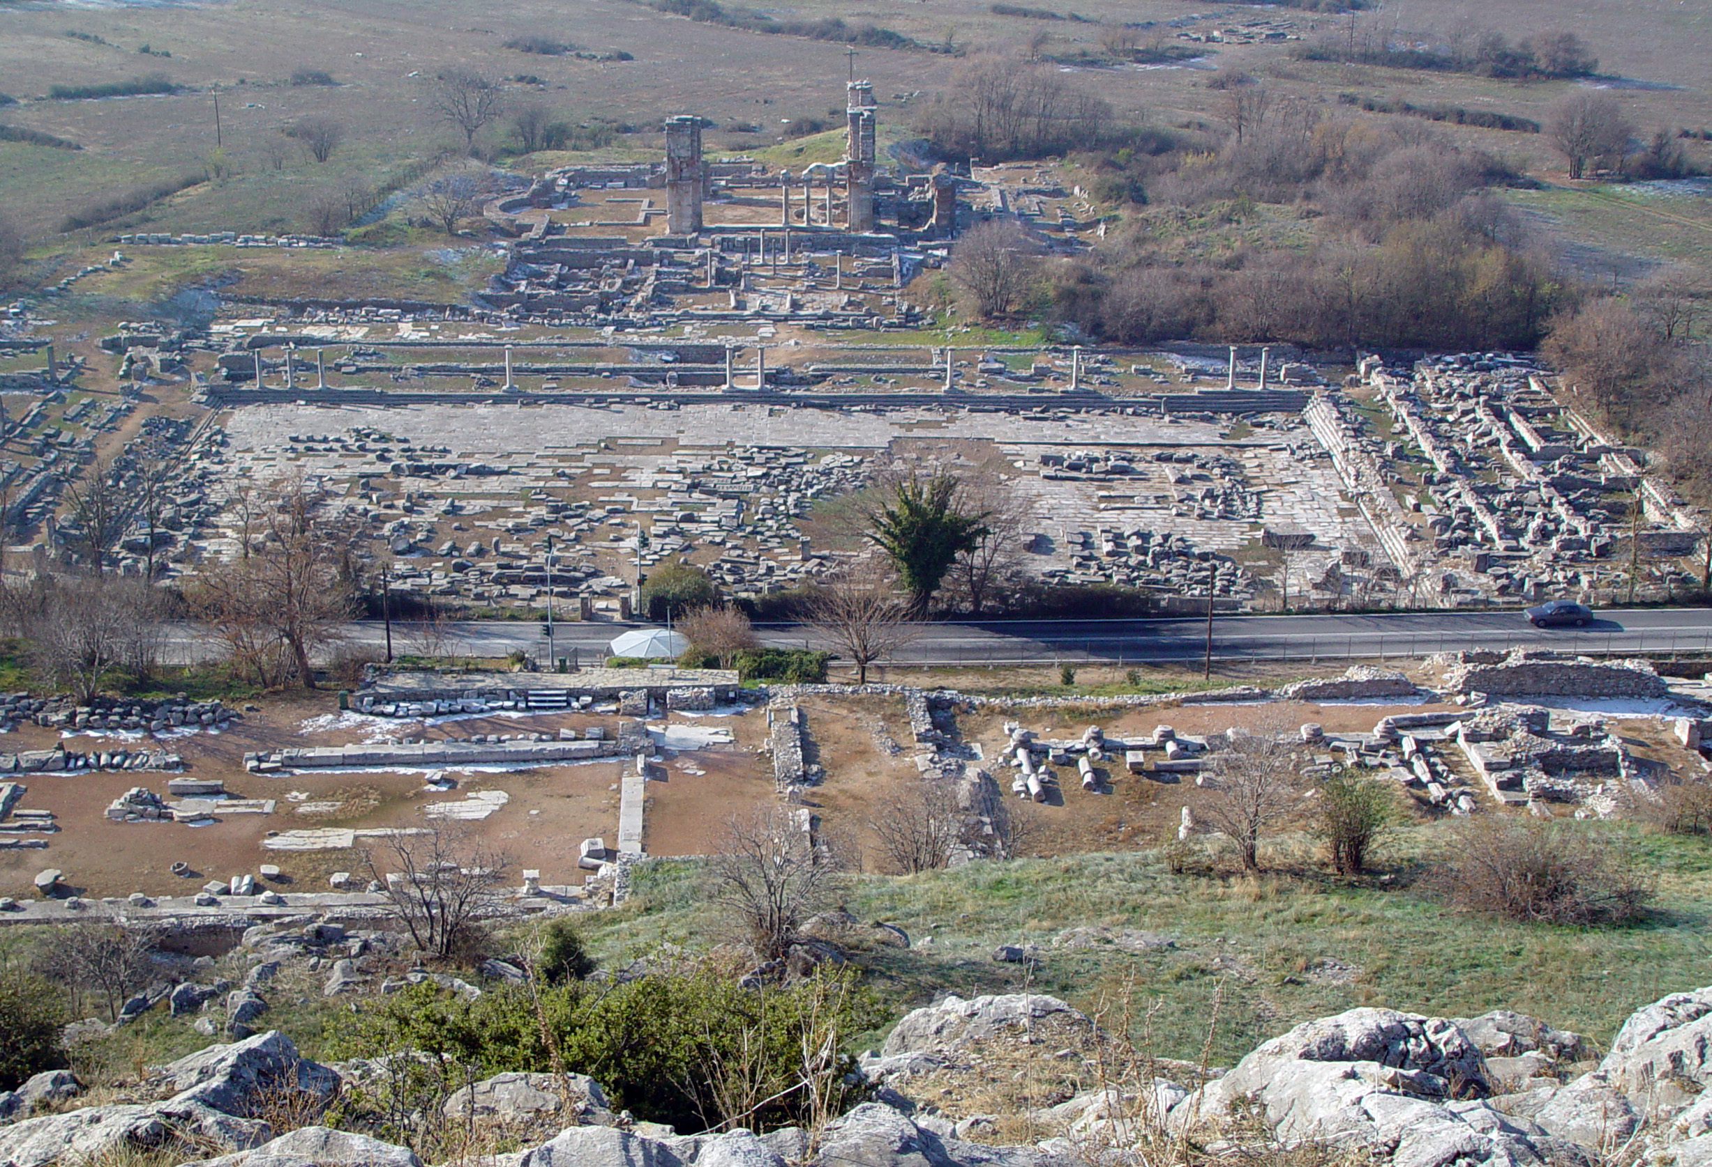
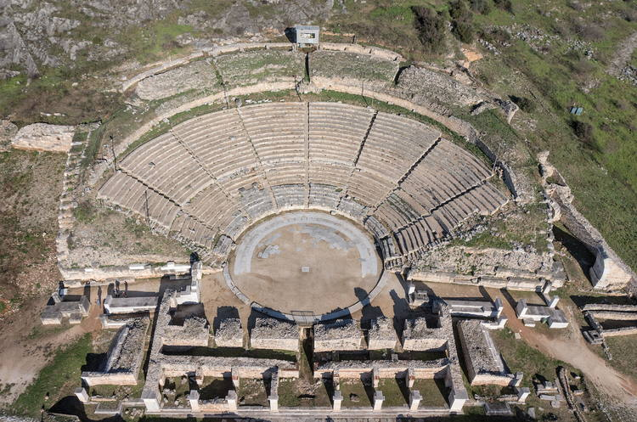
Questions In Philippi

Slide 44
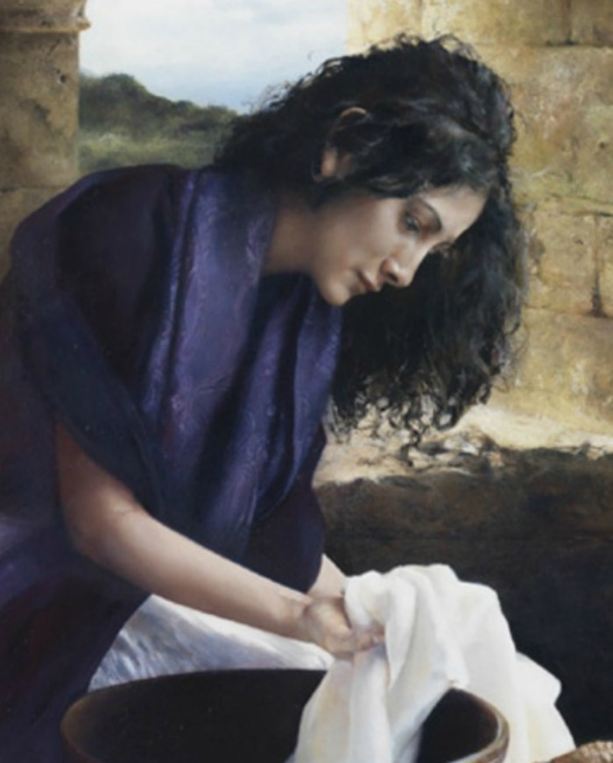
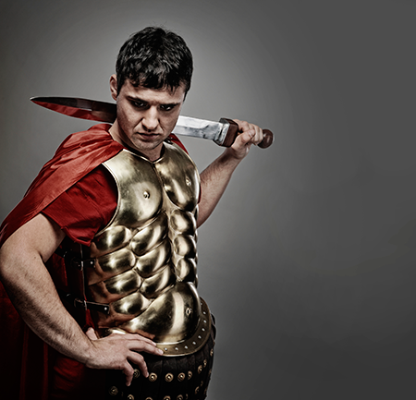
Questions In Philippi
- Why was Paul hesitant to visit Lydia’s home?
- Why did Paul wait so long before casting out the demon from the girl?
- Why did Paul not demand his Roman rights WHILE he was being beaten and humiliated?
- Why did NO OTHER prisoner run when the bonds were loosed?
- Did Paul and Silas go back to jail after the night was over?
!

Slide 45
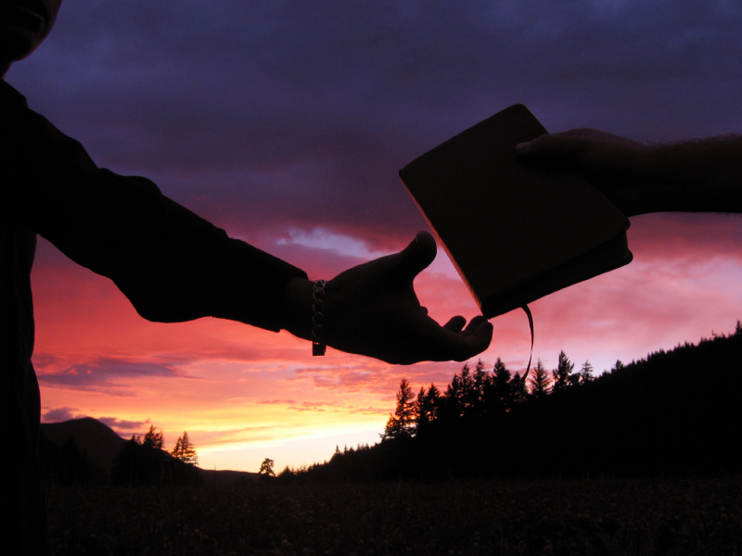
Paul's Second Missionary Journey (Acts 17:10-15)
Theology Of Evangelism …
Paul reasoned in the synagogue … (verse 2) … to discuss … to correct misunderstanding
about the Gospel.
2) … explain … (verse 3) … to open up ….
3) … prove … (verse 3) … carefully answered questions posed to him, responded to their objections, and demonstrated the validity of his claims.
4) … to proclaim … to give a clear understand of the Gospel message
5) … to persuade … “to convince someone
to believe something and to act
on the basis of what is
recommended.
6) … joined … attached themselves to the
apostles and accepted what
came after that.
Biblical evangelism has these components
at its root.
He was torn from them (1Thess 2:17)
!

Slide 46
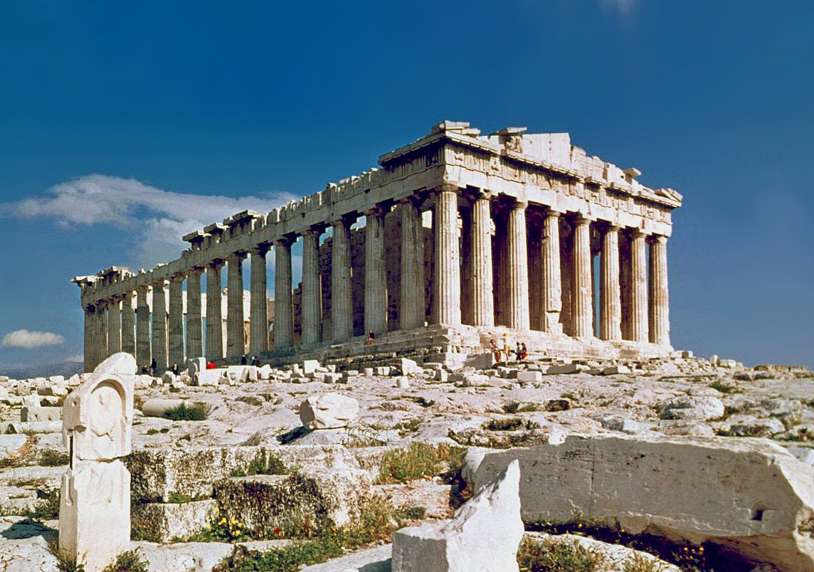
Paul's Second Missionary Journey (Acts 17)
In Athens …
The Epicurians were “a philosophical school that valued pleasure (the absence of pain and disturbance) and disbelieved in the gods of ancient myths.” “They were influential only in the educated upper classes, and their views about God were similar to deism (he was uninvolved in the universe and irrelevant).” Stoicism was “the most popular form of Greek philosophy in Paul’s day. Although most people were not Stoics, many Stoic ideas were widely disseminated.” Though they believed in a supreme God, it was in a pantheistic way.
The Stoics saw the world as determined by fate and advocated that “human beings must pursue their duty, resigning themselves to live in harmony with nature and reason, however painful this might be, and develop their own self-sufficiency.”
Parthenon
- Built 447 BC

Slide 47
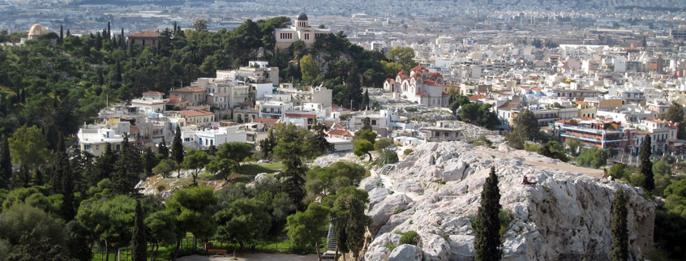
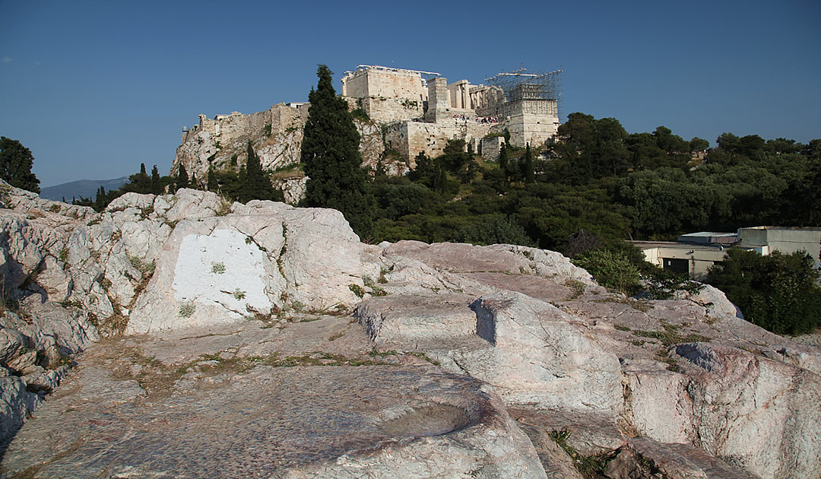
Paul's Second Missionary Journey (Acts 17)
Areopagus hill of Athens
Mars Hill

Slide 48
Paul's Second Missionary Journey (Acts 17)
How might the worship of an unknown god act as a safety precaution?
Is it possible that there are components of our faith today that operate
in the same way?
Note the start of Paul’s argument … that God IS. Ultimate beginnings
are unprovable by science.

Slide 49
Paul's Second Missionary Journey (Acts 17)
Paul’s Style Of Witnessing:
1) Build a bridge to where they are (“I notice the alter to the Unknown God”)
- note also the use of two quotes from pagan poetry
- though Paul was “enraged”, he showed great restraint
2) Leave the condemning words behind!
3) Note that there was no fear that the great “philosophies” would dominate his presentation of the
Gospel. The Truth will always stand up in argument.
4) He compliments these people in the largest way that he truthfully can
5) The message is specifically geared to the audience
6) No Old Testament prophecies are quoted (unknown to these men). Rather the quotes are from
pagan poets of his day.
7) The basic message is that God is a) Creator of all, b) Sustainer of all, c) Judge of all.
- Why does God not punish sin
immediately
- Note that other faith systems
may have some important truths,
the overall system is flawed.

Slide 50
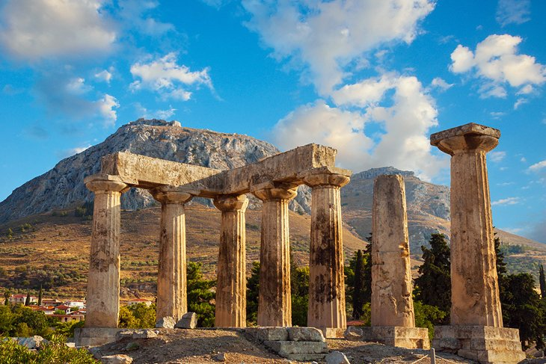
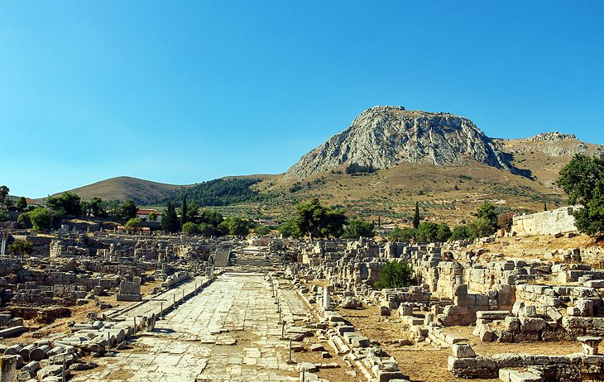
Paul's Second Missionary Journey (Acts 18:9)
1 Cor. 2:3 … he came in fear, weakness
2Cor. 1:9 … depression
1Thess 2:17 – 3-5 … waiting …
Corinth …
Temple Of Apollo

Slide 51
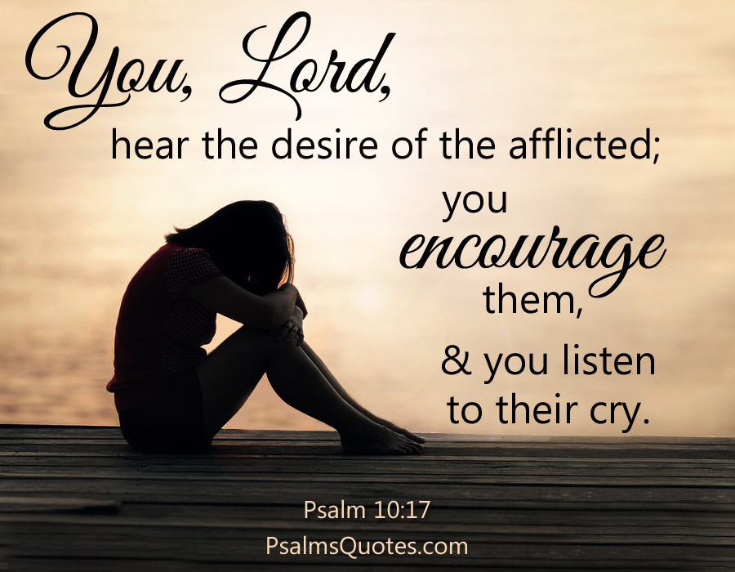
Paul's Second Missionary Journey (Acts 18:9)
Paul needed encouragement …
What encourages you?
When has the Lord brought a
powerful sense of
encouragement into your life?
What forms of encouragement
did Paul experience?
- Phil. 4:14

Slide 52
Paul's Second Missionary Journey (Acts 18:9)
Sabbath
If we stop working crazy hours, we will die. We are terrified.
Stopping requires us to look inside.
- Sabbath should have a regular rhythm
The four pillars of Sabbath: stop work, enjoy rest, practice delight, contemplate God.
What is the resistance to Sabbath? Shame. ; this intense, painful feeling of being
fundamentally flawed.. shame testifies
not to wrong doing but to flawed being.
It leaves me vulnerable.
God is not in a rush
I do nothing productive but am utterly loved
Can we wait, listen and honor our limits?

Slide 53
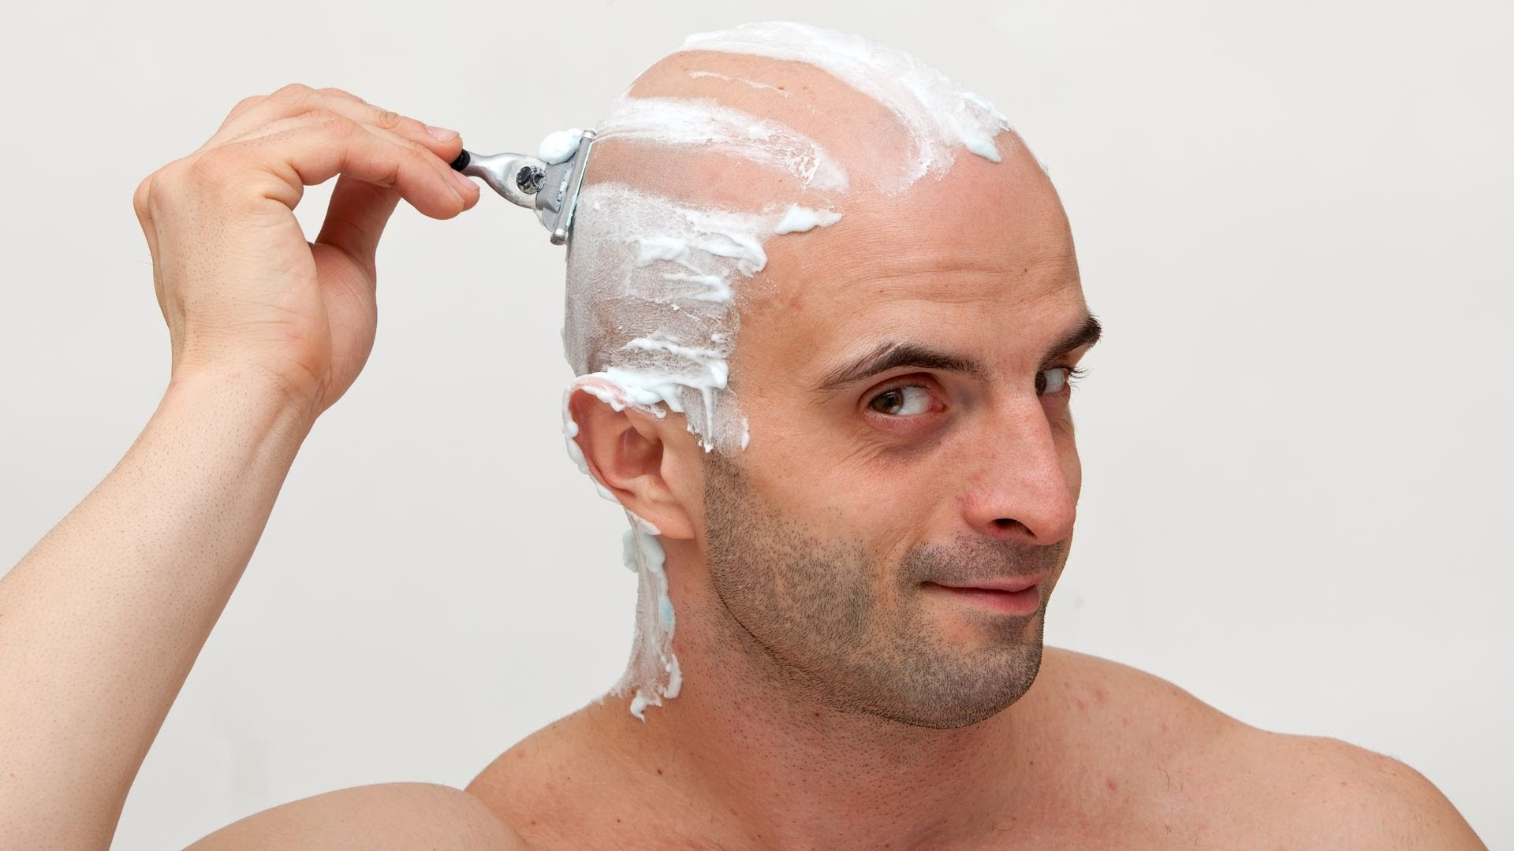
Paul's Second Missionary Journey (Acts 18:9)
Was Paul hypocritical for his Nazirite Vow?
- Why might he have performed this act?
- Is a vow a spiritual discipline?

Slide 54
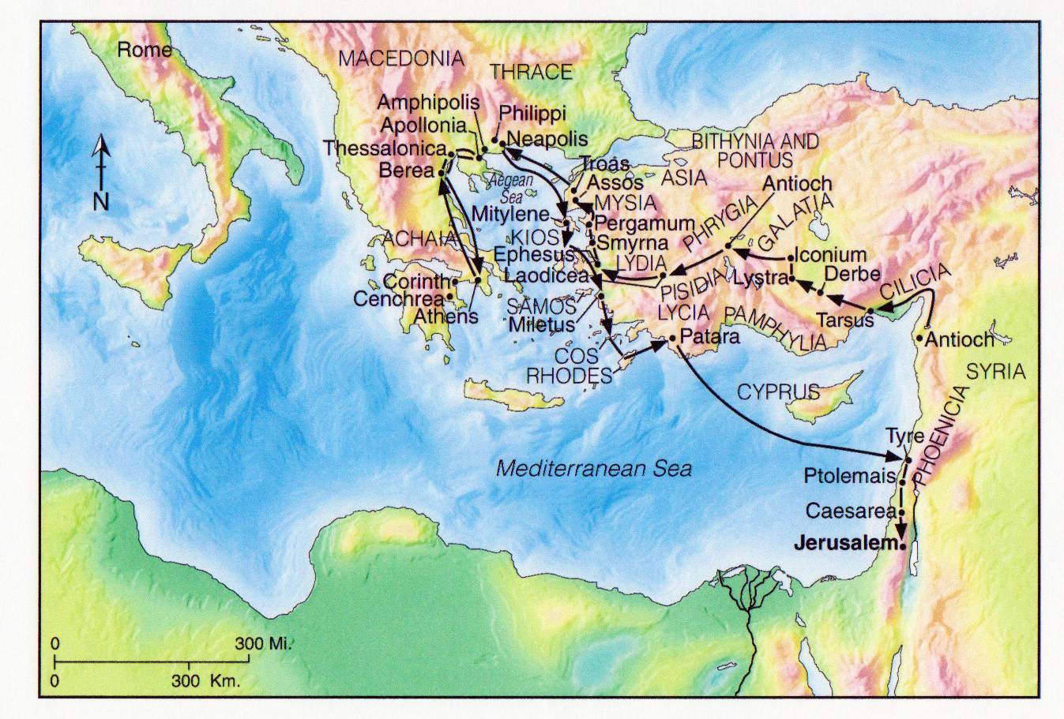
Paul's Third Missionary Journey (Acts 18:23-21:16)

Slide 55
Paul's Third Missionary Journey (Acts 18:23-21:16)
Theme of this journey is growth!
- Apollos
- Disciples at Ephesus
- Seven sons of Sceva
- Those that needed to let go of Paul
- Paul himself, on his journey to Jerusalem
- this is not unlike that of Jesus

Slide 56
Paul's Third Missionary Journey: Ephesus
(Acts 18:24-25)
What made Apollos such a great teacher?
He came … he was present
He was learned, well instructed
He was passionate
He presented Christ clearly (pedagogy)
What made your favourite
teachers special?

Slide 57
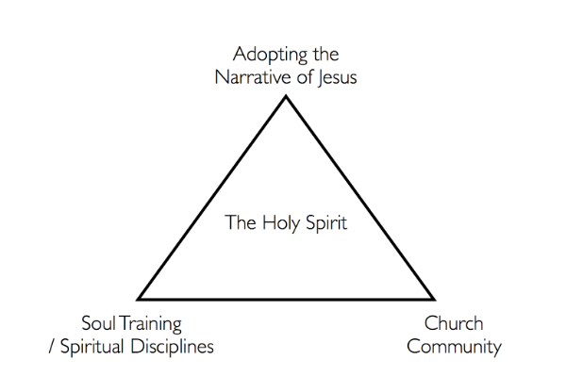
Real Change

Slide 58
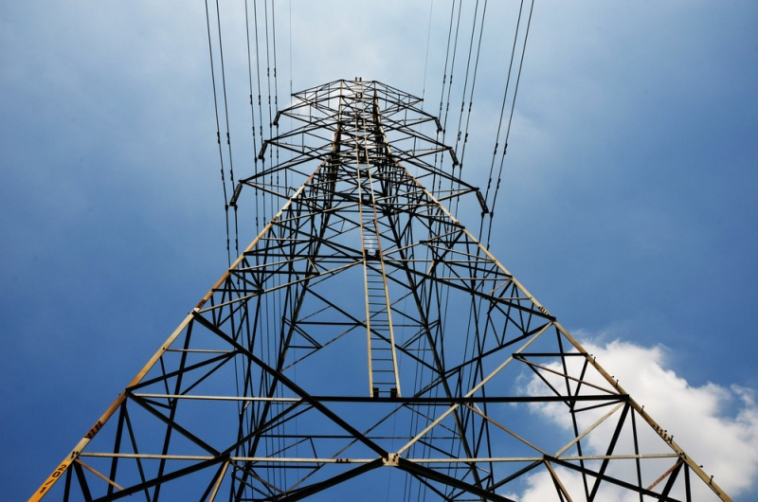
Power
1) Positional Power
- what formal positions of power that God has entrusted me with
- group leader, pastor etc.
2) Personal Power
- Education, experience, competencies, talents etc.
3) God Factor Power
- To what degree to people look to me as a representative of God
- Do they see me as a counselor? Spiritual wisdom?
4) Projected Power
- what unmet needs in people do they project onto me?
- who idealizes me from afar?
5) Relational Power
- people that I have in relationship with me
for a period of time; these I have some
sway over
6) Cultural Power
- age, race, gender, ethnicity or other
cultural effects

Slide 59
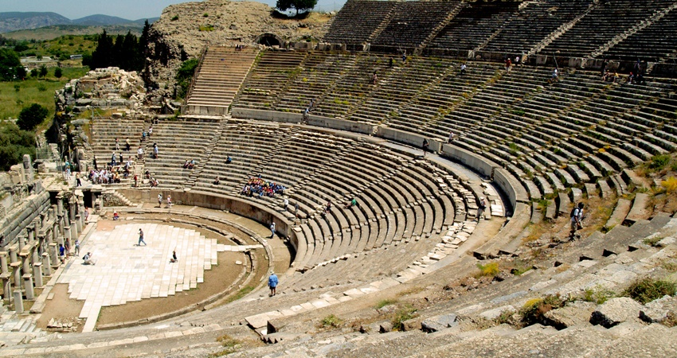
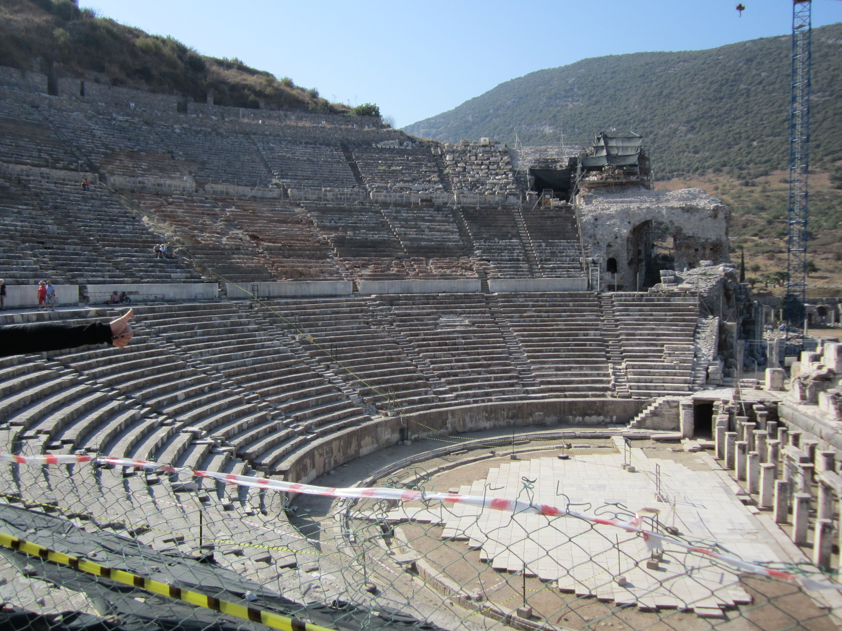
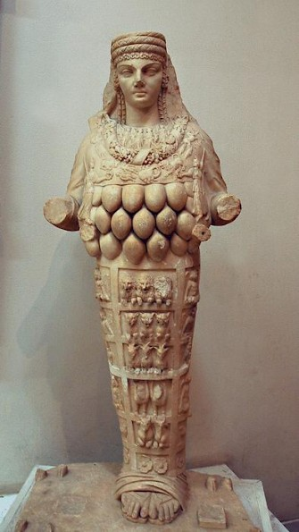
Paul's Third Missionary Journey: Ephesus

Slide 60
Paul's Roman Excursion (Acts 21:17-28:31)

