Slide 1
ACTS 1:1 - 8:1 THE BIRTH OF THE CHURCH
1:1 - 1:14 Introduction
1:15 - 26 A new apostle is chosen
2:1-13 The feast of Pentecost
2:14-47 Peter’s first sermon
3:1 - 4:31 Healing of a lame man
4:32 - 5:11 Ananias and Sapphira
5:12-42 The Apostles before the council
6 The first deacons appointed
7:1 - 8:1 Stephen’s defense and stoning
ACTS 8:1 - 11:18 PERSECUTION : SPREADS TO JUDEA AND SAMARIA
8:1 - 25 The Samaritans respond to the Gospel
8:26-40 Philip and the Ethiopian Treasurer
9:1-31 Saul is converted to Christianity
9:32-43 Peter at Lydda and Joppa
10 Peter and Cornelius
11:1-18 The Apostles approve Peter’s actions

Slide 2
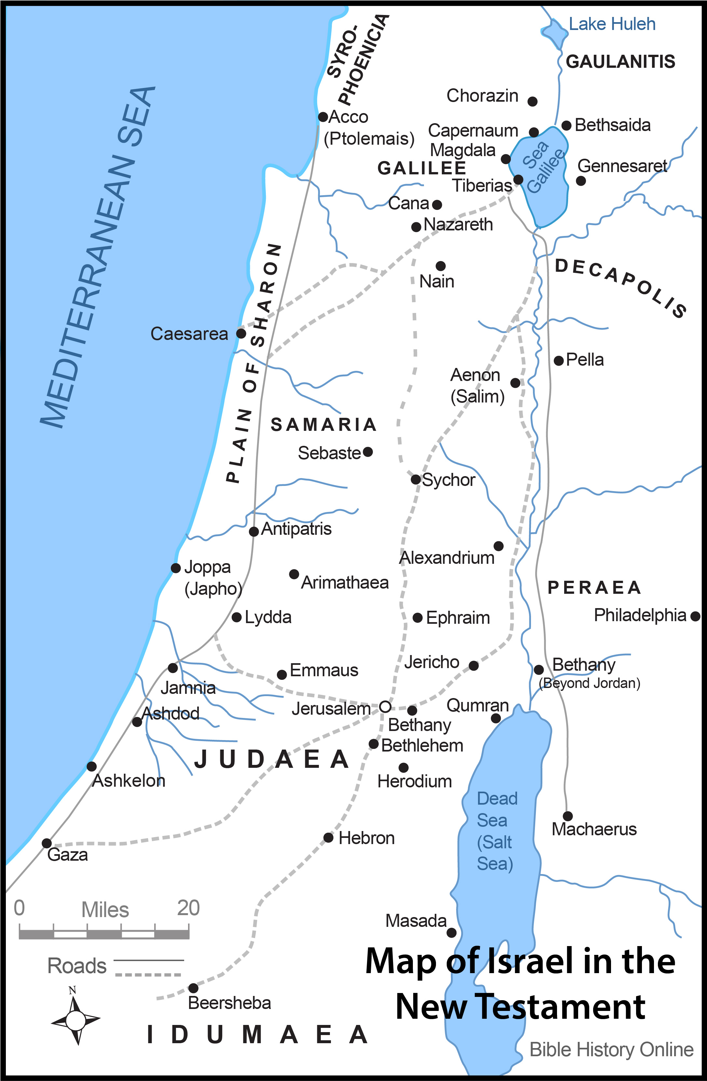
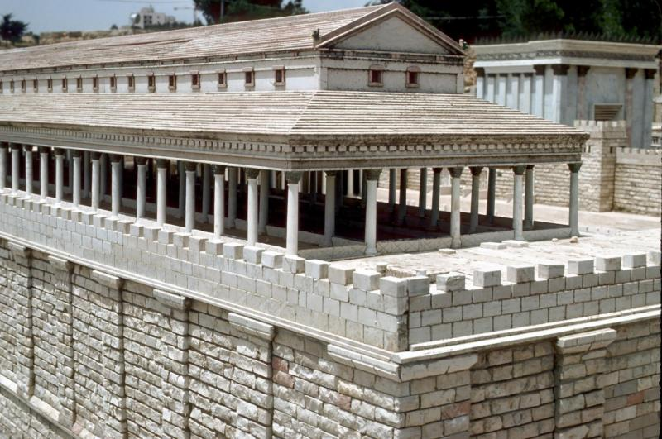
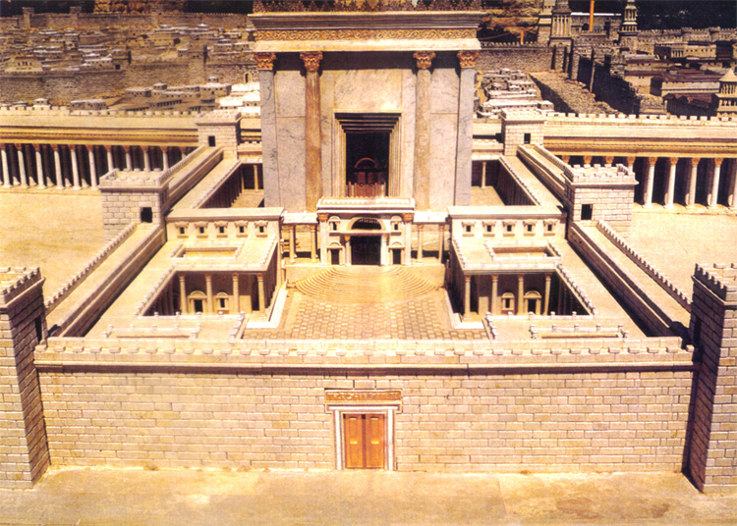

Slide 3
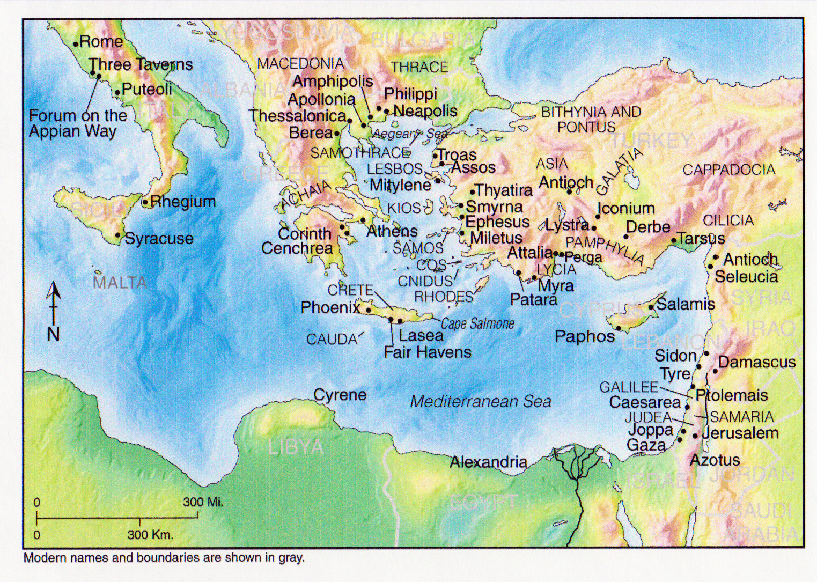

Slide 4
ACTS 11:19 - 16:6 THE GOSPEL ADVANCES INTO SYRIA AND TURKEY
11:19-30 The first Gentile Church at Antioch
12 James is killed, Peter imprisoned
Further Study: Prayer
13, 14 Missionary Journey 1: Paul and Barnabas
- Cyprus, Perga, Pisidian Antioch,
Iconium, Lystra, Derbe
Further Study: Fasting
15:1-35 The Council at Jerusalem
ACTS 16:6 - 19:41 PAUL TAKES THE GOSPEL TO EUROPE
15:36 - 19:41 Missionary Journey 2 : Paul and Silas
- Philippi, Thyatira, Thessalonica, Beroea,
Athens, Corinth, Ephesus
Further Study: Gifts of the Spirit
What is spiritual warfare?
- Third missionary journey

Slide 6
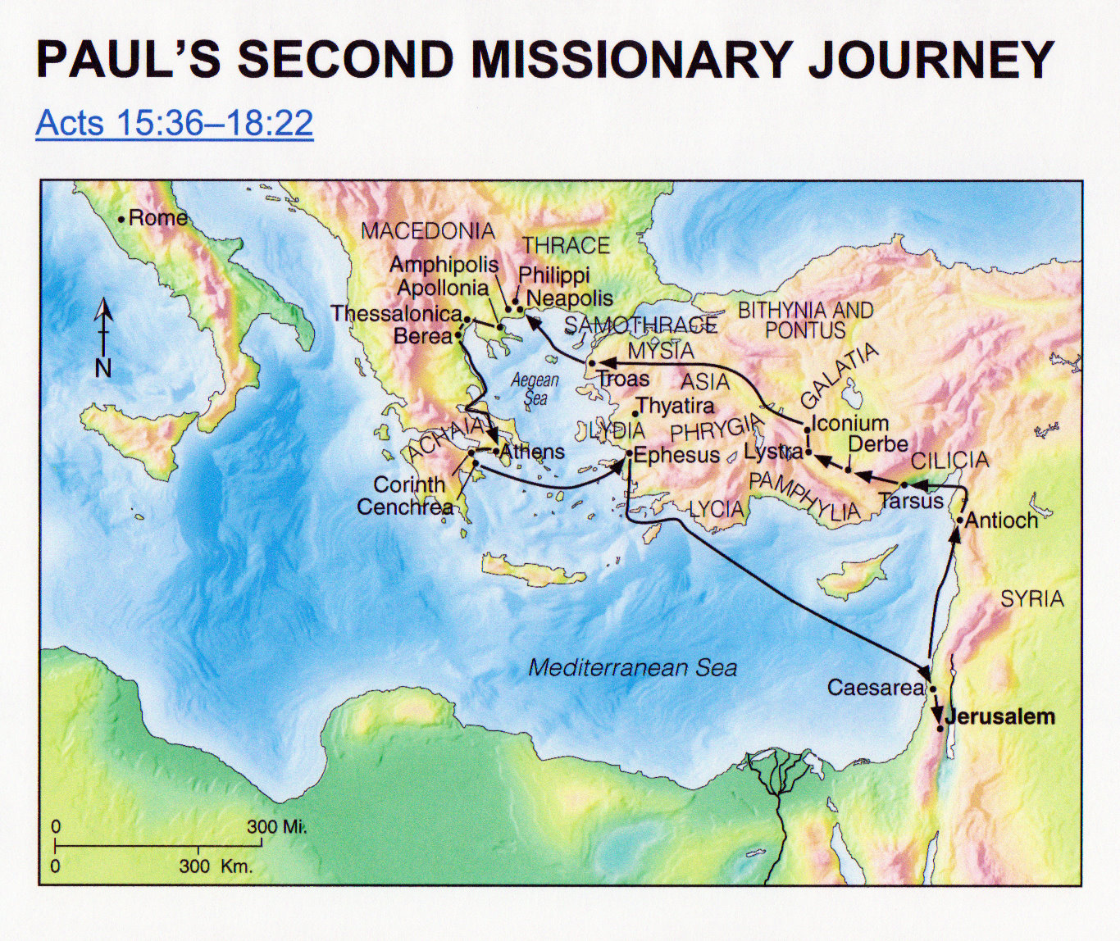

Slide 7
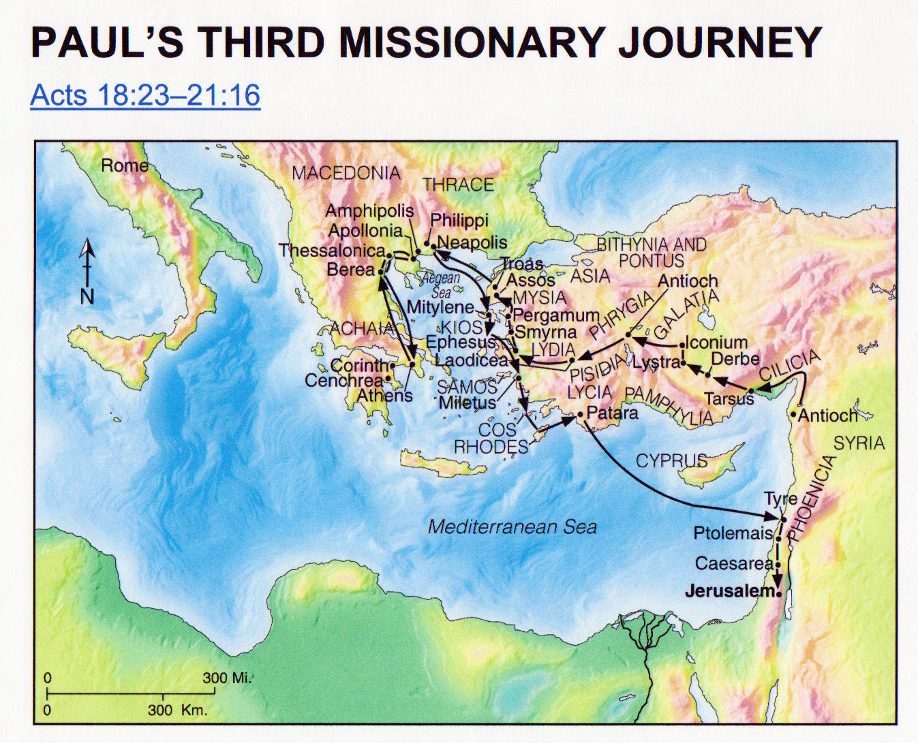

Slide 8
ACTS 20 - 28 PAUL’S JOURNEY TO ROME
20: 1-16 Paul sets out for Jerusalem
20:17 - 21:14 Paul with the Ephesian Elders
21:15 - 23:35 Paul is arrested in Jerusalem
24 The defense before Felix
25:1-12 The defense before Festus
25:13 - 26:32 The defense before Agrippa
27, 28 Paul’s boat trip, shipwreck,
arrival at Rome
Further Study: Angelic realms

Slide 10
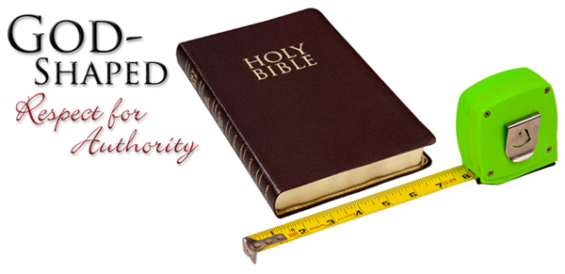
Authority
God uses those in authority over us to curb our characters
Proverb:29:1: He, that being often reproved hardeneth
his neck, shall suddenly be destroyed, and that
without remedy.

Slide 11
Authority
- the way that we respond to human authority is exactly the way we will respond to God’s
authority
- Some Things To Think About When Squeezed By Authority:
1) Are my attitudes of response mature, Christian responses
2) Do I really understand the basic intentions of those in authority above me?
3) Have I created alternatives
4) Have I waited for the changes to take place
- do I really believe that God will make even my enemies to be at peace
with me?

Slide 12
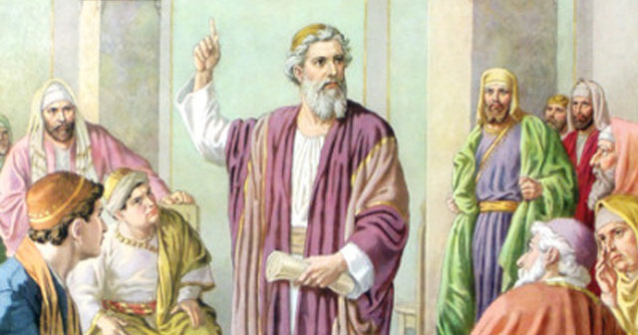
Gamaliel
- note also that it is at the intervention of the more tolerant Pharisee Gamaliel, that they
obtained their freedom. Gamaliel’s most famous student - Saul (see Acts 22:3)
- we see a leadership style here that is worth mentioning:
a) restrain anger: decisions can never be made emotionally
b) respond cautiously: Is this of God or not?
c) present facts
d) move ahead slowly: God’s timing is not always ours
e) understand that things we don’t necessarily see can still be of God
- Is Gamaliel’s principle (verse 38) an accurate one?
- The Apostles left the place with 39 lashes, yet rejoicing
- “the honour to be dishonoured ... the grace to be disgraced”

Slide 13
Under Nero (AD 54-68) Christians were imprisoned and executed, including probably Paul and Peter.
Domitian (AD 81-96) oppressed Christians who refused to pay him the divine honours he demanded; under him John was exiled to Patmos.
Marcus Aurelius (AD 161-180), believing that Christianity was dangerous and immoral, turned a blind eye to severe local outbreaks of mob violence.
Then in the third century what had so far been sporadic became systematic. Under Decius (AD 249-251) thousands died, including Fabian, Bishop of Rome, for refusing to sacrifice to the imperial name.
The last persecuting emperor before the conversion of Constantine was Diocletian (AD 284-305). He issued four edicts which were intended to stamp out Christianity altogether. He ordered churches to be burned, Scriptures to be confiscated, clergy to be tortured, and Christian civil servants to be deprived of their citizenship and, if stubbornly unrepentant, executed.
Tertullian, addressing the rulers of the Roman Empire, cried out: “Kill us, torture us, condemn us, grind us to dust.... The more you mow us down, the more we grow; the seed is the blood of Christians.”
Bishop Festo Kivengere said in February 1979, on the second anniversary of the martyrdom of Archbishop Janani Luwum of Uganda: 'Without bleeding the church fails to bless.' Persecution will refine the church, but not destroy it. If it leads to prayer and praise, to an acknowledgment of the sovereignty of God and of solidarity with Christ in his sufferings, then - however painful - it may even be welcome.

Slide 14
Service (Acts 6:1-7, Romans 12:6-8)
a) Don’t ignore the problem
b) Don’t be content to attack the complainers
c) Act as a group. Share the burden. Know your strengths.
d) Deal with the problem with sensitivity (Note all of the chosen men had Greek names!)
e) Don’t negate the physical over the spiritual
f) Secular giftings do not trump spiritual hearts. BOTH are required in the Church.

Slide 15
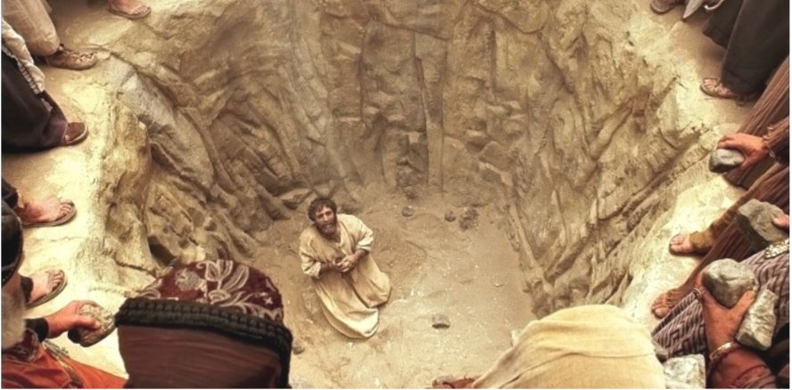
Stephen …
1. Full of faith (6:5)
2. Full of the Holy Spirit (6:5, 7:55)
3. Full of God's grace (6:8) (He was a gracious, winsome person)
4. Full of God's power (6:8)
5. Of Wisdom (6:10)
6. Of forgiveness (7:60)
7. His glowing countenance reminds us of what is said of Moses (6:15)

Slide 16
He preaches on three themes …
1. God does not move just in Israel … He is evident everywhere
- Where have you see God move?
2. Worship does not always happen at the temple
- What was the most unusual place you found yourself worshiping God?
3. People often ignore the voice of God through His prophets
- What is the most unusual voice used to speak the Word of God to you?

Slide 17
Christ and Moses are similar and complementary
a) An unusual birth (7:20)
b) Death of babies at both births (7:19)
c) Both children came out of Egypt (7:21)
d) Christ, like Moses, was rejected by His people (7:25, 35, 39)
e) Both were sent by the Father (7:35b)
f) Both did signs and wonders (7:36)
g) Moses prophesized regarding Jesus (7:37, Deut. 18:15, 18)

Slide 18
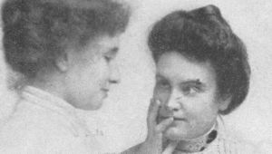
Four people are key for the explosive church growth:
1) Stephen the martyr (stirs up opposition within Jerusalem)
2) Philip the evangelist (the one who breaks the Jewish/Samaritan barrier)
3) Saul the convert (Apostle to the gentiles)
4) Cornelius (the one who calls for salvation from the gentile world)

Slide 19
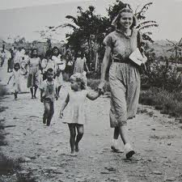
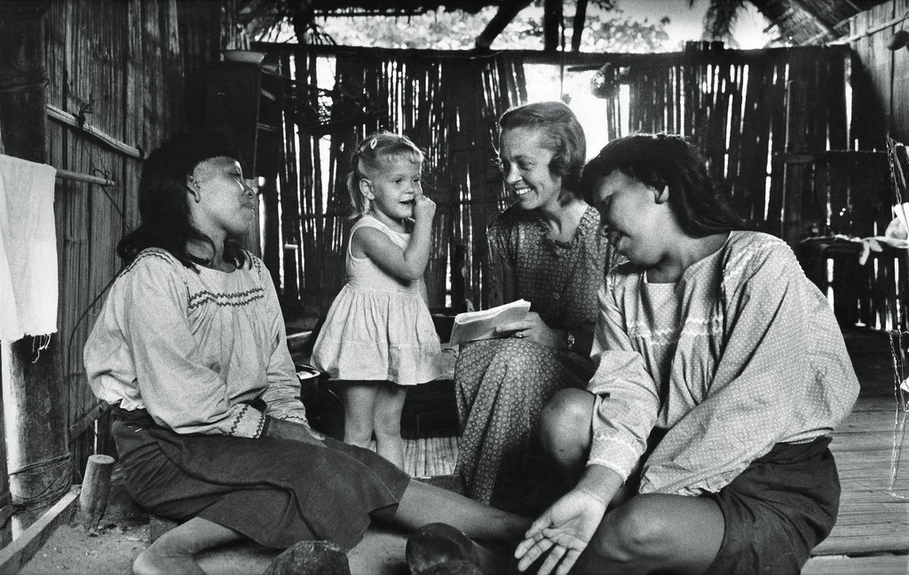
“The fact that I am a woman does not
make me a different kind of Christian,
but the fact that I am a Christian makes
me a different kind of woman.”
—Elisabeth Elliot

Slide 21
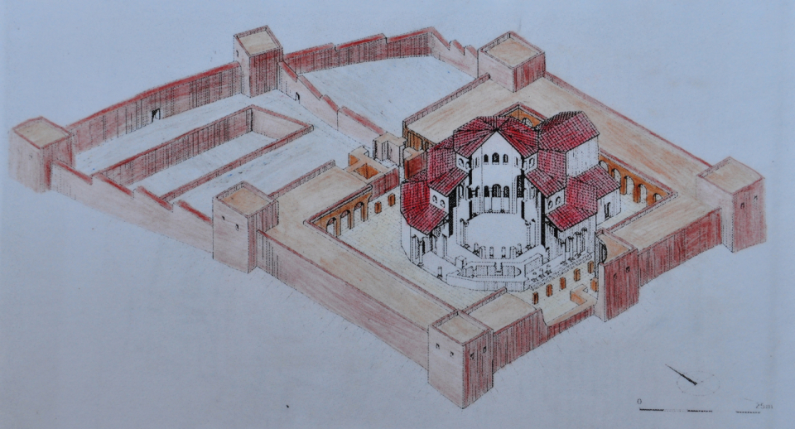
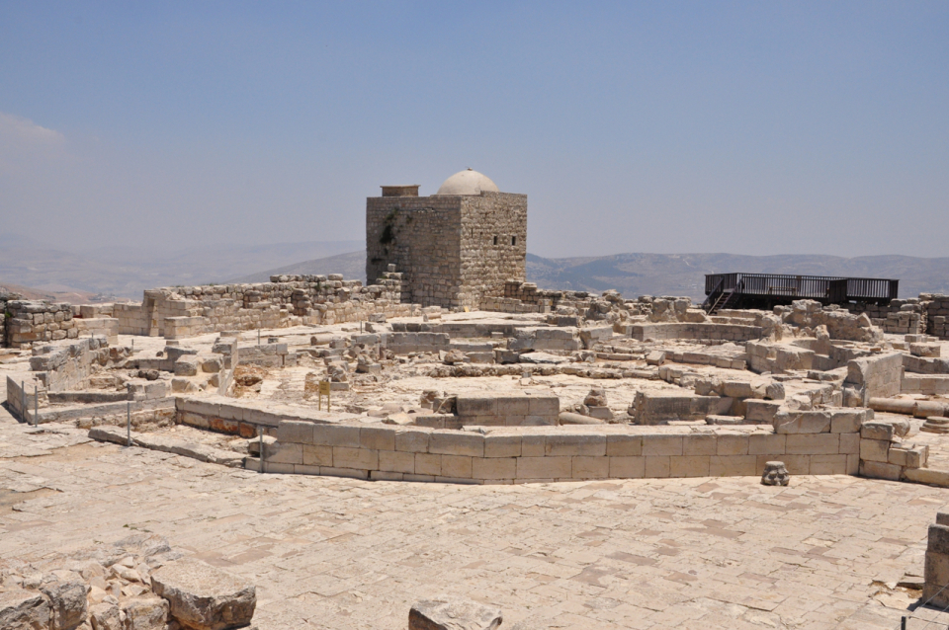
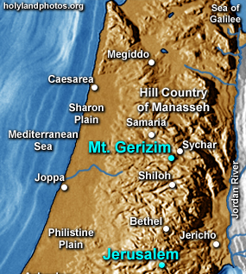
History Of The Relationship Between Jews and Samaritans ....
In Ezra 3:7 – 4:5, Samaritans were not allowed to help rebuild the temple. They built their
own on Mount Gerizim (near Shechem). In the following centuries, the Samaritans suffered
when Shechem was destroyed by Alexander the Great, while in 128 B.C. John Hyrcanus
(Judean leader) captured Shechem and destroyed the Samaritan temple. It remained in
ruins until the 2nd century A.D. when it was rebuilt by the Emperor Hadrian as a reward for
Samaritan help against the Jews during
the Bar Kokhba revolt (132-135 A.D.).

Slide 22
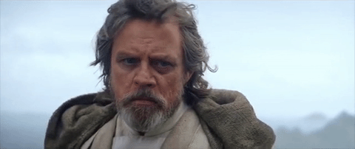
Passing The Torch …
The apostles move from initiators to verifiers here.
They were slow to respond … yet learned from the younger.
As I grow older, do I still have to the ability to …
a) Be flexible and malleable?
b) Hear and heed the younger generation
c) Bring the best of MY generation and deposit that in the newer …

Slide 23
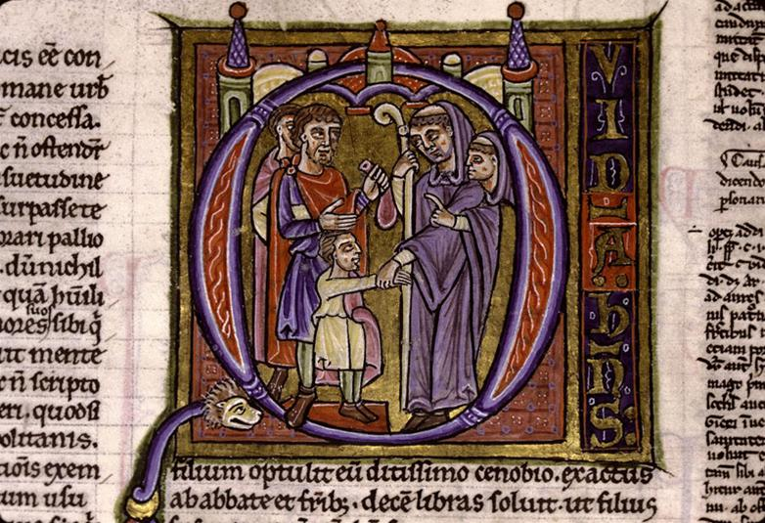
The word “simony” has entered the English language through this
incident; it refers “to the attempt to secure ecclesiastical office or
privilege through monetary means.” When money and power combine,
there are many pitfalls that can cause great damage in the lives of individuals
and in the church as a whole.
Can this exist in the church today?

Slide 24
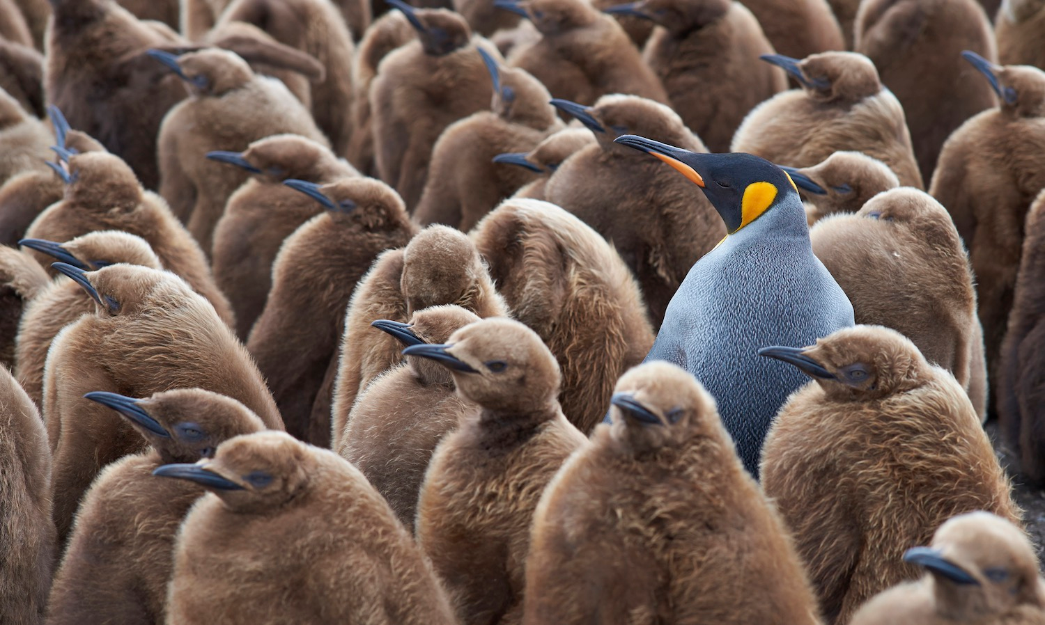
Evangelism Today
Evangelism as obedience!
Evangelism is cross cultural!
Evangelism because GOD prepares hearts!
Evangelism starts with their questions!
Evangelism is rooted in Scripture!
Evangelism is themed in Christ!
Evangelism seeks a response (Eventually)!

Slide 25
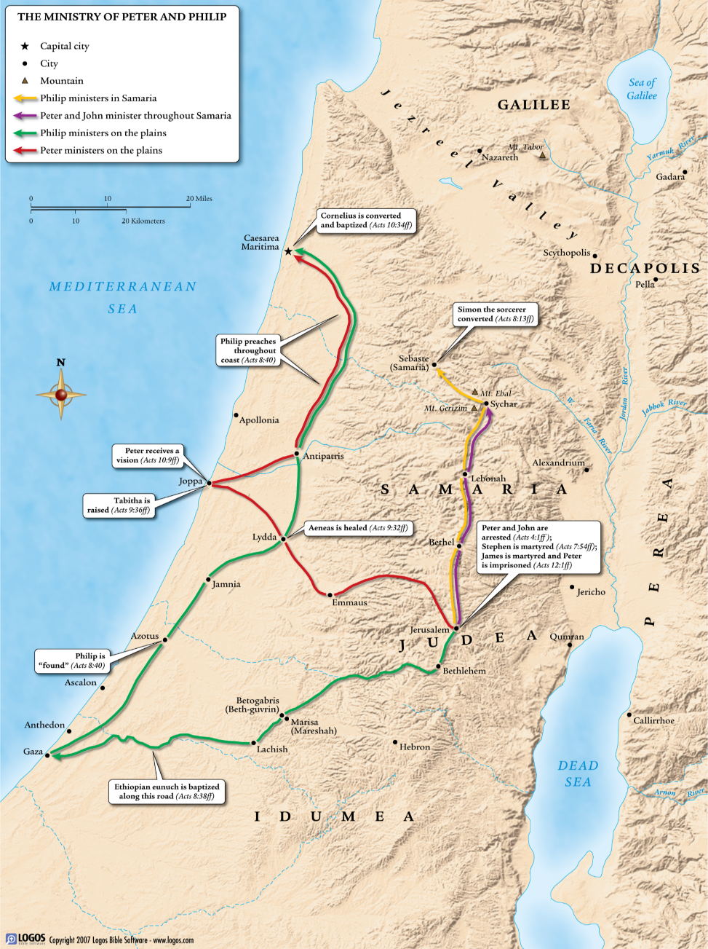

Slide 26
Call Narratives
Elements | Moses (Exodus) | Gideon (Judges) | Samuel (1 Samuel) | Isaiah (Isaiah) | Jeremiah (Jeremiah) | Ezekiel (Ezekiel)
Confrontation | 3:7-9 | 6:11-13 | 3:2-10 | 6:1-7 | [1:3] | 2:1-2, 3:12-15, 22-24
Commission | 3:10 | 6:14 | 3:11-14 | 6:8-13 | 1:4-5 | 2:3-8a, 3:4-11, 16-21, 25-27
Objections | 3:11,13, 4:1,10, 13 | 6:15 |  | 6:5 | 1:6
Assurance (I will be with you) | 3:12, 14-22, 4:2-9, 11-12, 14-17 | 6:16 |  | 6:7 | 1:7-10, 17-19
Sign | [4:2-9, 17] | 6:17-24 |  |  | 1:11-16 | 2:8b-3:3
Theophany | 3:2 | 6:11, 21-22 | 3:4, 6, 10 | 6:1-13 | 1:9 | 1:1-28
Results Expected | 3:8-10 | 6:12, 16 |  | 6:9-11 | 1:14-19 | 2:6-8

Slide 27
Saul's Call Narrative
Elements | Saul/Paul
Confrontation | Acts 9:1-5 He hears a voice, sees a light. No others can comprehend. The double vocative (Saul, Saul) is similar to other OT callings.
Commission | Acts 9:6, 15, Acts 22:15 Go … and you will be told what to do. Go to the Gentiles
Objections | Who are you? (Not unlike the question of Moses.)
Assurance (I will be with you) | Acts 18:9, for example.
Sign | Blinded for three days. Healed by his "enemy". He will suffer for Christ's name.
Theophany | Light and sound of Christ. Note that it the HUMAN name (Jesus) that is used. This speaks to Saul. The HUMAN is alive!
Results Expected | Acts 1:16

Slide 28
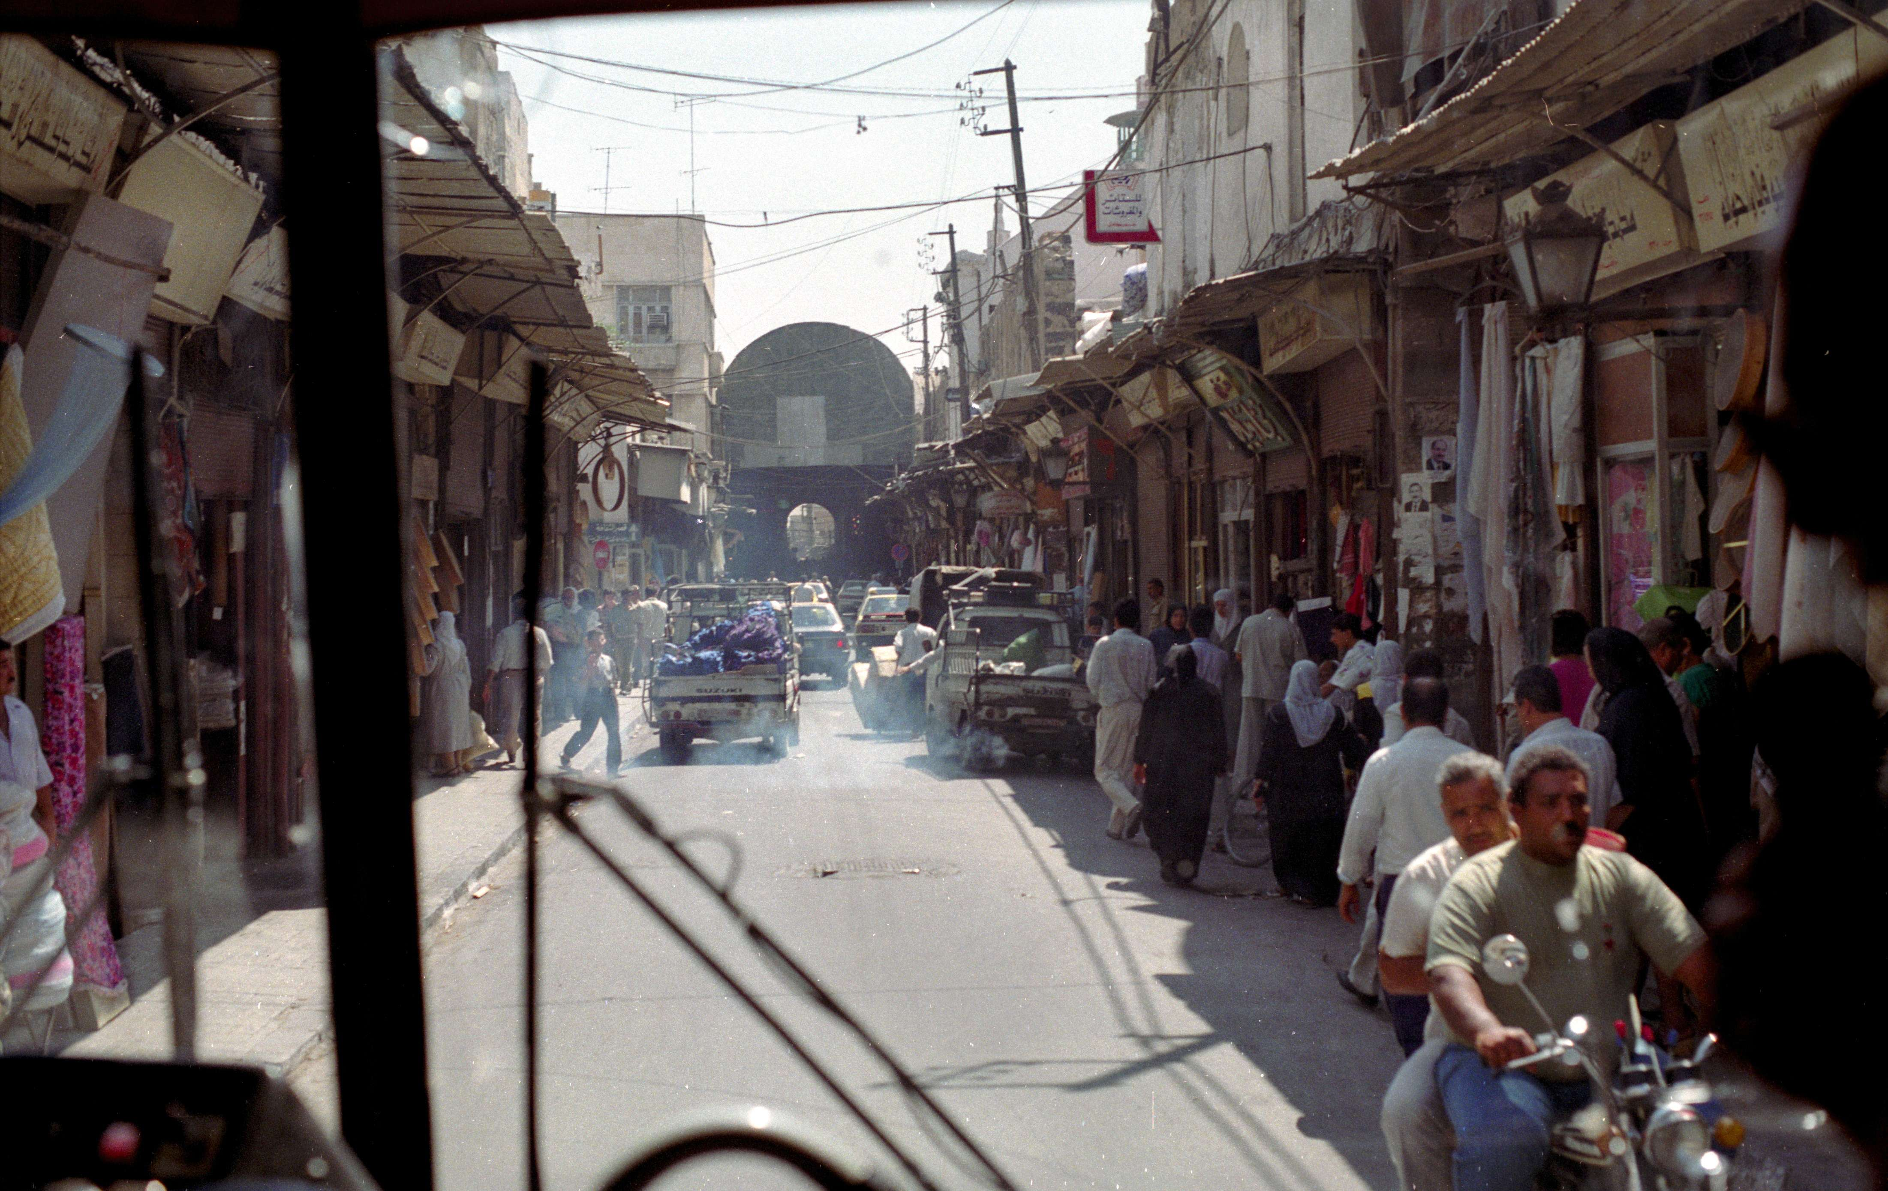
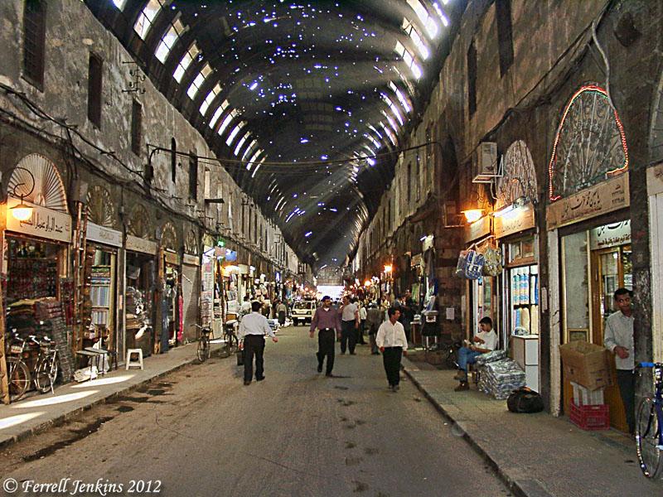
Damascus … Straight Street

Slide 29
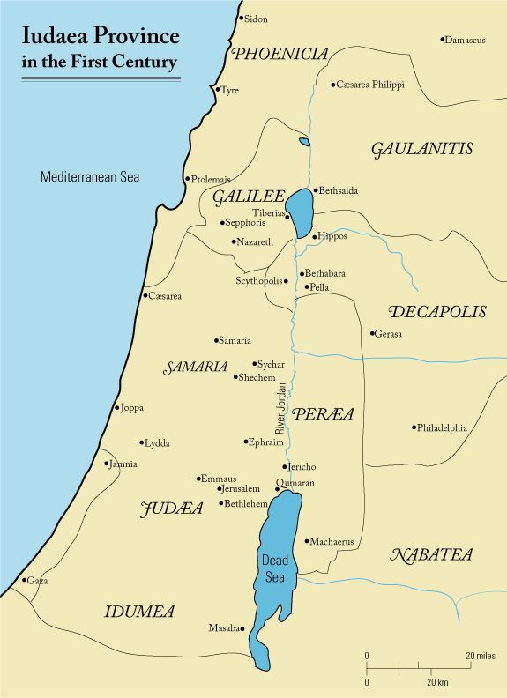
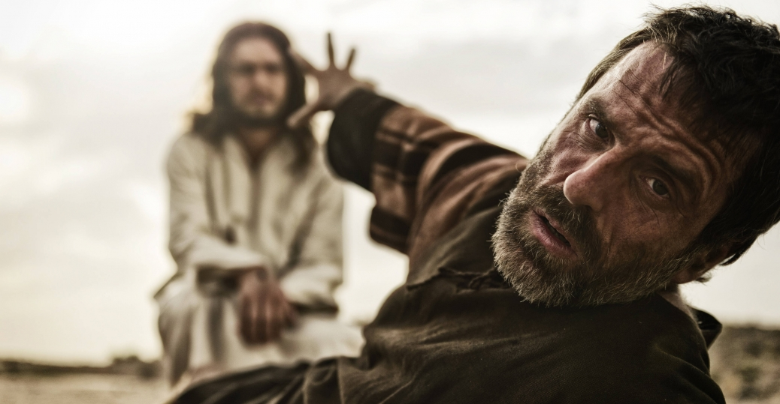
Saul's Early History
1. His salvation and calling (Acts 9:1-9)
2. To Damascus to meet with Ananias for several days (9:10-22)
3. He left for the Arabian desert for three years (Gal. 1:13-17)
4. He comes back to Damascus
5. The escape from the city (2Corinth. 11:32-33) (Arabs and Jews now angry with Saul)
6. To Jerusalem, where he meets with Peter and James
and is initially rejected. (Gal. 1:18-21)
7. He makes a retreat to Tarsus for the next several years.
(Acts 11:25)

Slide 30
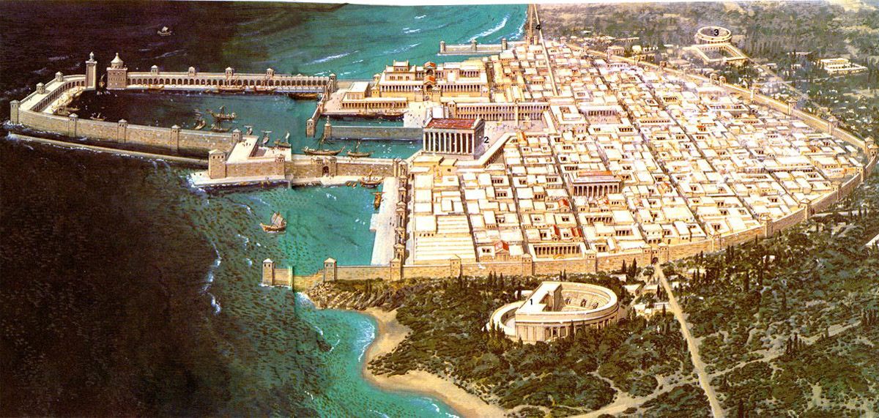
Caesarea
- a seaport city
- rebuilt by Herod the Great and named after Caesar Augustus
- there were more Gentiles living there than Jews, calling it the "Daughter of Edom"
- the city was meant to serve as a show piece to the Roman empire
- it was riots here in 66AD that sparked the Roman/Jewish wars
- Josephus claims that 20,000 Jews were massacred there in 66AD
- this is where Cornelius lived. He was attracted to the ethic of Judaism but was not a Jew.
- our story finds him praying at the traditional time of prayer for Jews (3:00pm)

Slide 31
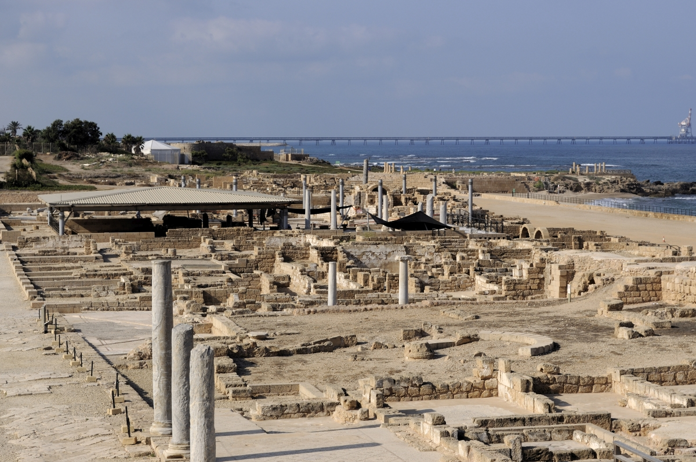
Caesarea

Slide 32
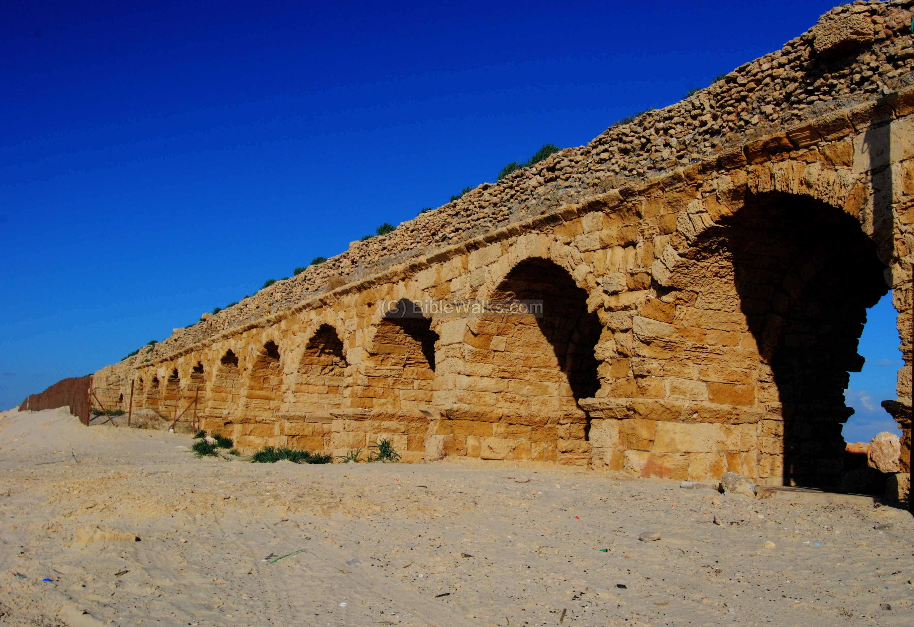
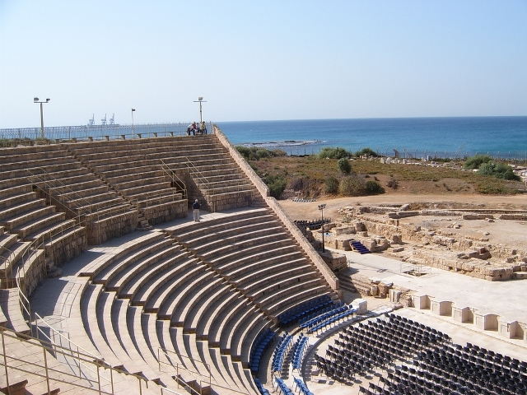
Caesarea

Slide 33
Jonah and Peter
Jonah | Peter
1. Sent to the Gentiles (Nineveh, the enemy). | 1. Sent to the Gentiles (Caesarea, the enemy).
2. Chose to move in the opposite direction. | 2. Chose to move in the correct direction.
3. Called from Joppa | 3. Called from Joppa.
4. Jonah's "no" was followed by action and anger. | 4. Peter's "no" was followed by reflection and response.
5. Jonah is convinced after 3 days in the fish. | 5. Peter is convinced after seeing a vision 3 times.
6. Commanded to arise and go. | 6. Commanded to arise and go.
7. Gentiles are saved. | 7. Gentiles are saved.
The word translated “thinking” (dienthymeomai),
which appears only here in the Bible, means “to think
about something thoroughly and/or seriously.” Louw
and Nida say it is used to indicate intensity of thought.

Slide 34
Division
What divisions still separate people today?

Slide 35
Gleanings From This Passage
1. God CALLS us to wrestle with that which makes us uncomfortable.
- Why didn't the angel just preach the gospel to Cornelius?
2. God speaks and acts through prayer.
3. Like Peter, when I am wrong, am I strong enough to admit it?
4. Hospitality is still a definitive gift!
5. God reveals Himself to sincere seekers … one way or another!
When has God broken
down a barrier in your
life?

Slide 36
Grace
Paul teaches that “there is no one who understands, no one who seeks God” (Rom. 3:11).
In their natural state people are incapable of seeking after God, because of the heart of
rebellion that sin has produced. To this is added the fact that “the god of this age has blinded
the minds of unbelievers, so that they cannot see the light of the gospel of the glory of Christ,
who is the image of God” (2 Cor. 4:4). Those who do seek after God, then, do not do so
entirely by their own efforts but by the enlightening of their minds and the energizing of their
wills by the Holy Spirit.
Even the Wesleyan tradition, where there is a
greater emphasis on the human involvement
in the process of salvation than in the Calvinistic
tradition, has the doctrine of prevenient grace.
Thomas Oden describes prevenient grace as
“the grace that begins to enable one to choose
further to cooperate with saving grace. By
offering the will the restored capacity to
respond to grace, the person then may freely
and increasingly become an active, willing
participant in receiving the conditions for
justification.”

Slide 37
Creativity
• When styles of music we are unfamiliar with are presented in church, many protest, saying
it is irreverent, without really trying hard to understand why the changes have been made.
- when Handel’s Messiah was first performed in England, it was dismissed
• William Booth, founder of the Salvation Army, broke new ground for the church by going
out to the poor, the alcoholics, and others considered
undesirables in society. But respected and devout leaders of
the church criticized him. Even the great evangelical politician
the Earl of Shaftesbury, who was himself a champion of the
rights of the poor, once announced that after much study he
was convinced that the Salvation Army was clearly the Antichrist.
• When missionaries like E. Stanley Jones in India expressed
solidarity with the Indian struggle for independence from Britain,
evangelicals accused them of liberalism.
• Many immediately branded the Pentecostal revival as
demonic because it did not square with their understanding of
the place of some gifts of the Spirit in this dispensation.

Slide 38
Contention (Acts 11:1-18)
God uses business meetings to further His cause!
We should not be afraid to give an account for what the Lord does through us
It is interesting that when an issue of contention arose, they were not afraid to let it be dealt
within a public setting!
It is good to see that Peter used wisdom in bringing witnesses with him to the event at Cornelius’ house. They could now testify on his behalf.
Peter was required to be bold and innovative - is this lacking in the Christian church today?
Note the charge (verse 2) ... had nothing to do with baptizing Cornelius (table fellowship)
- this was not a spiritual question at all!
- What can be said of Peter, who here fights so hard for the
Gentiles, and yet in Galatians (2:11- 12), he has forgotten
and slide back to the old way? What must we guard?
(This took place some 12 - 14 years later)
Their criticism ceased ... their worship began (F.F. Bruce)

Slide 39
Excursus … Christmas Time
What does the best scholarship teach us …

Slide 40
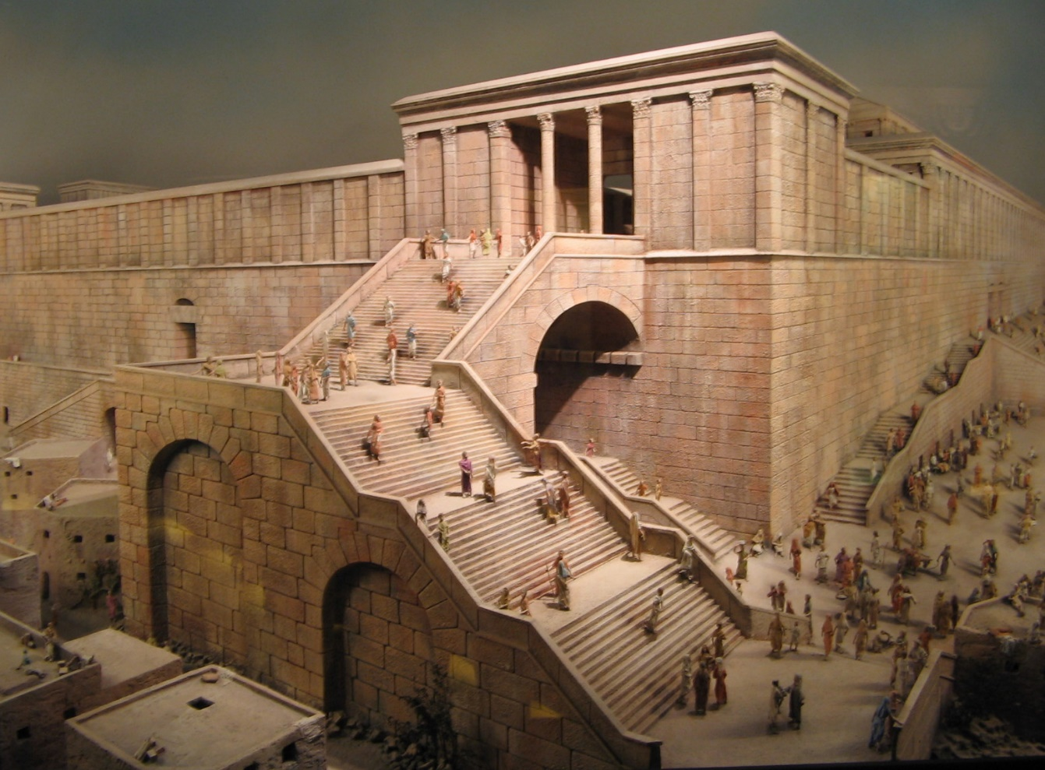
Priestly Order
There were 24 orders or courses of priests, who would minister 2 separate weeks each year.
A week would extend from Sabbath to Sabbath.
Incense was burned before the morning sacrifice and after the evening sacrifice.
Only those who had never done the job before were allowed to cast lots for the honor.
Afterwards, those involved in burning the incense would stand on the steps of the temple
and bless the people.

Slide 41
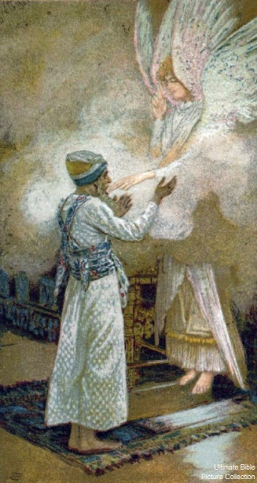
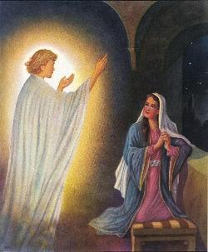
The Two Visits
Luke 1:11-20 | Luke 1:28-38
He was troubled (v12) | She was much troubled (v28)
The angel said to him (v13) | The angel said to her (v30)
Do not be afraid (v13) | Do not be afraid (v30)
Will bear you a son (v13) | You will … bear a son (v31)
And you will name him (v13) | And you will name him (v31)
He will be great (v15) | He will be great (v32)
Said to the angel (v18) | Said to the angel (v34)
And replying, the angel (v19) | And replying, the angel (v35)
Gabriel … God … sent (v19) | Gabriel … send … God (v26)
And now (v20) | And now (v36)

Slide 42
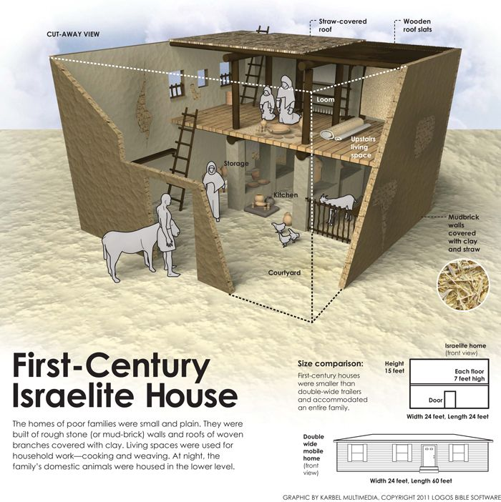
Jesus’ Birth (1:57-80)
First Century Jewish Homes

Slide 43
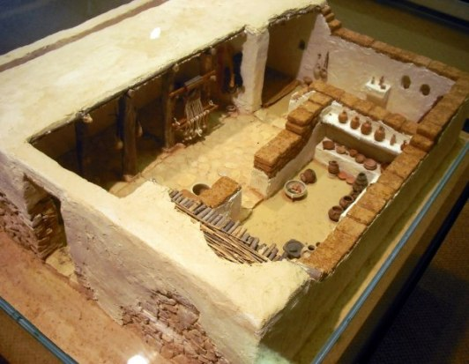
Jesus’ Birth (1:57-80)
First Century Jewish Homes

Slide 44
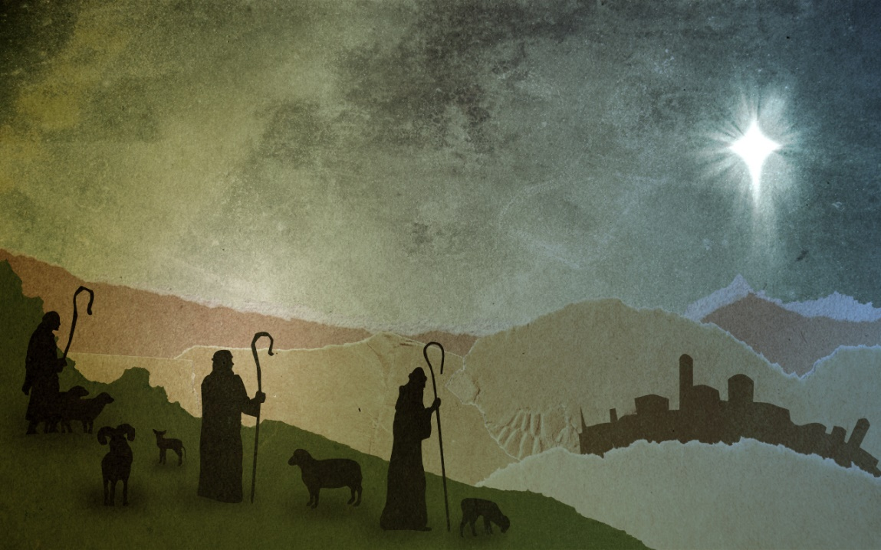
Jesus’ Birth (1:57-80)
It is interesting that these lowly citizens of the culture were among the
first to have this news revealed.
The sheep that these men watched over may indeed have been those
that were used in the priestly sacrifices in Jerusalem
These shepherds could hardly contain themselves once they understood
the good news.
The reception of the angel is the same as the last two times:
- The angel appears
- The angel proclaims to “Fear not”
- There is a birth announcement
- There is a sign
In the first two cases, the angel
makes his claims in the context of
a family. The shepherds are clearly
not family. Yet, Jesus would
enlarge the meaning of family to
include ALL who would come!

Slide 45
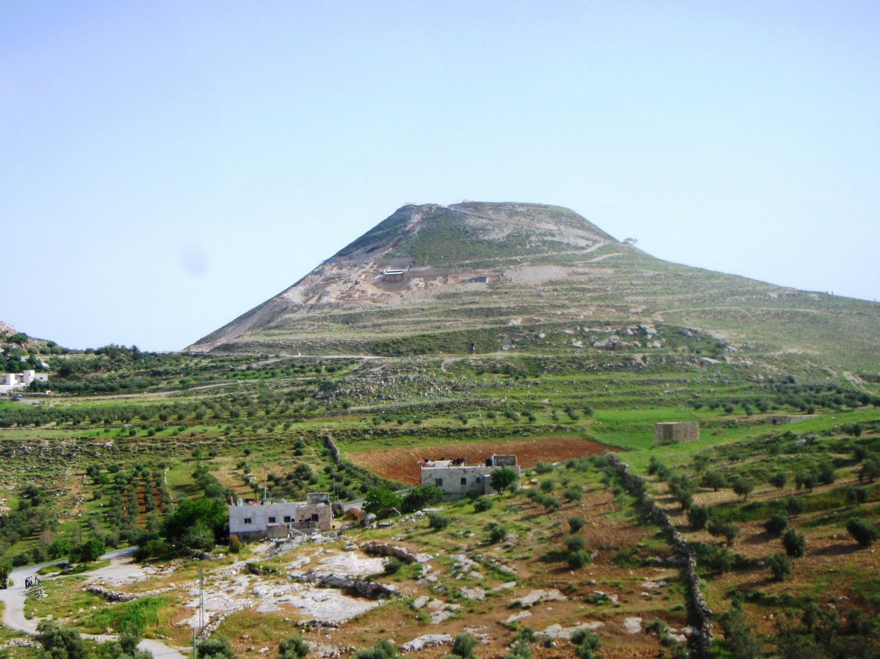
The Herodian

Slide 46
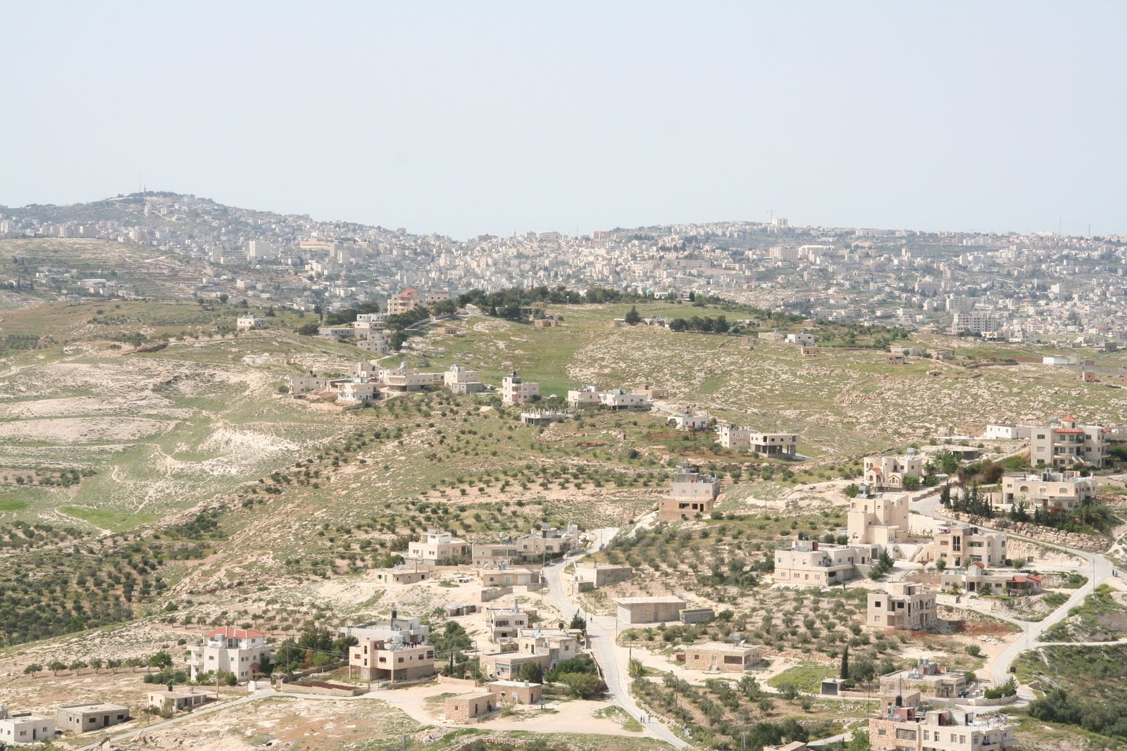
Bethlehem Viewed From The Herodian

Slide 47
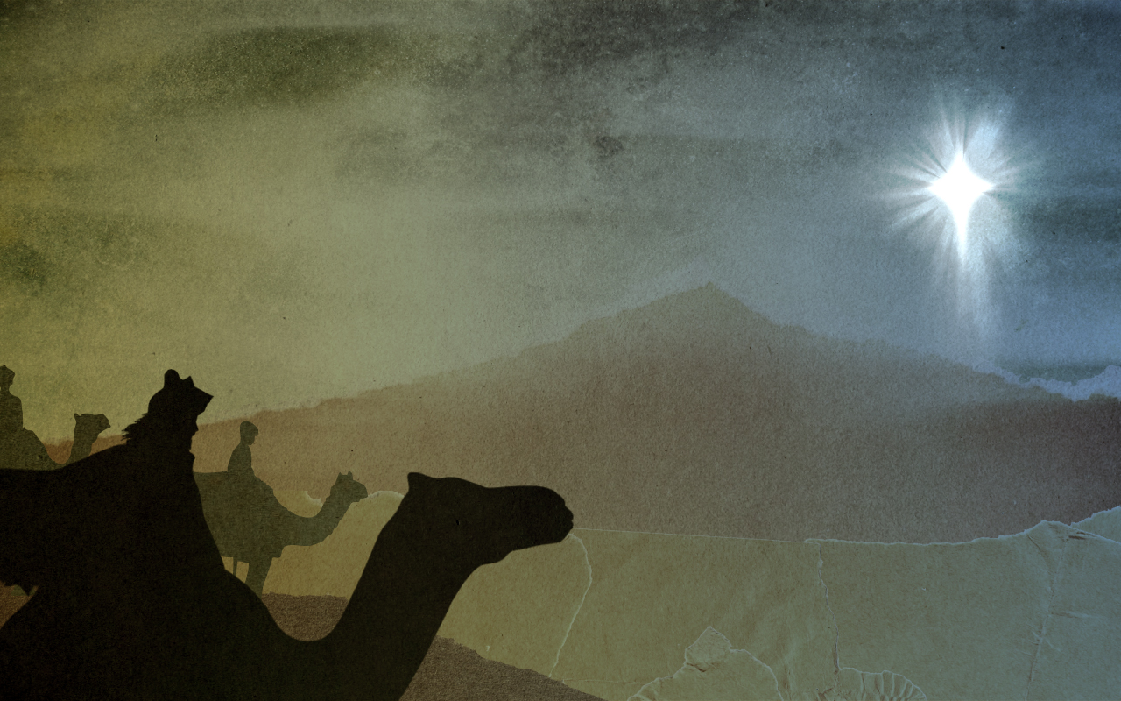

Slide 48
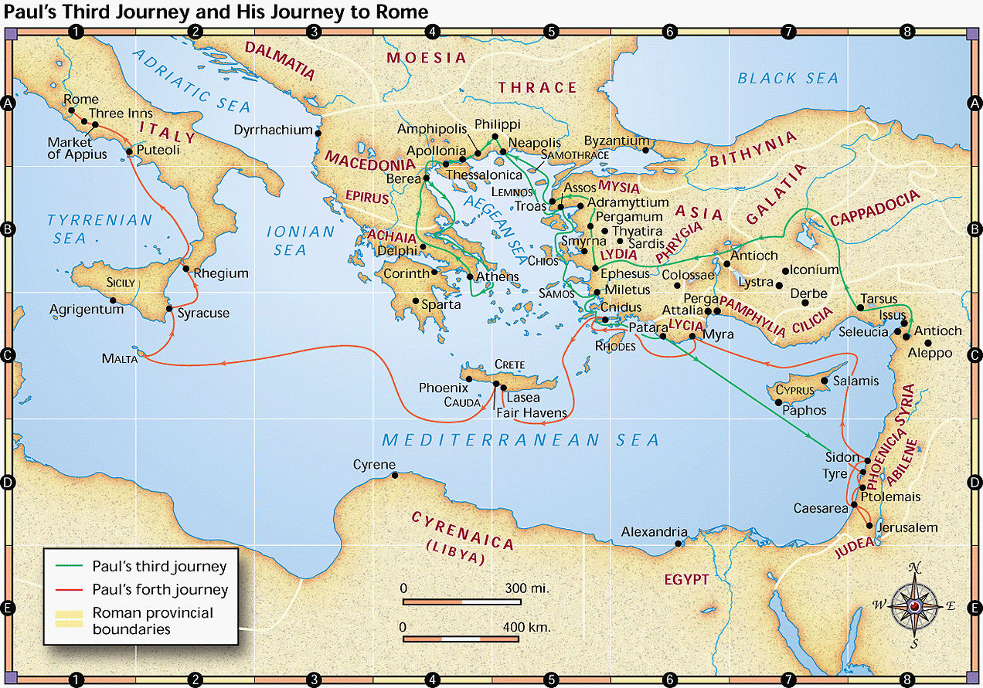
The Gospel Spreads

Slide 49
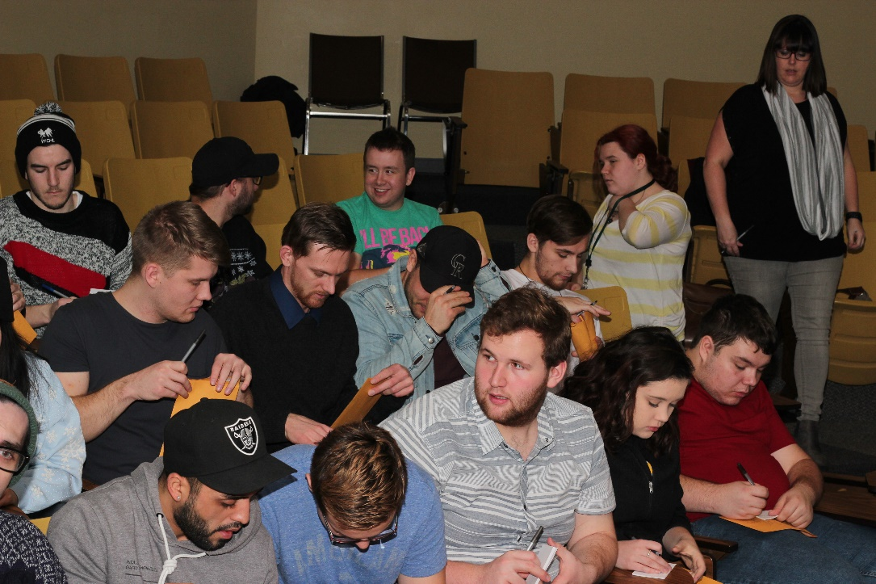
The Gospel Spreads
The value of the "unknown" servant!
Can we serve if no one ever finds out?
Significance and greatness cannot be equated to exposure

Slide 50
The Word Spreads To More Gentiles (11:19-30)
Why was Barnabas used so mightily of the Lord? What does it mean to be good?
a) He looked for evidence of God alive in these people
b) He was gladdened when he saw that evidence
c) He was encouraging to the people there
d) He recognized when he needed help
e) He stayed with the people a good length of time
f) He urged perseverance!
We do not have one recorded word spoken by Barnabas.
But most Christians today know of him. What does this say?
Good people refuse to
break principles to
achieve goals.
- No ulterior motive
- No hidden agenda
- They do not lie
- They do not crush others

Slide 51
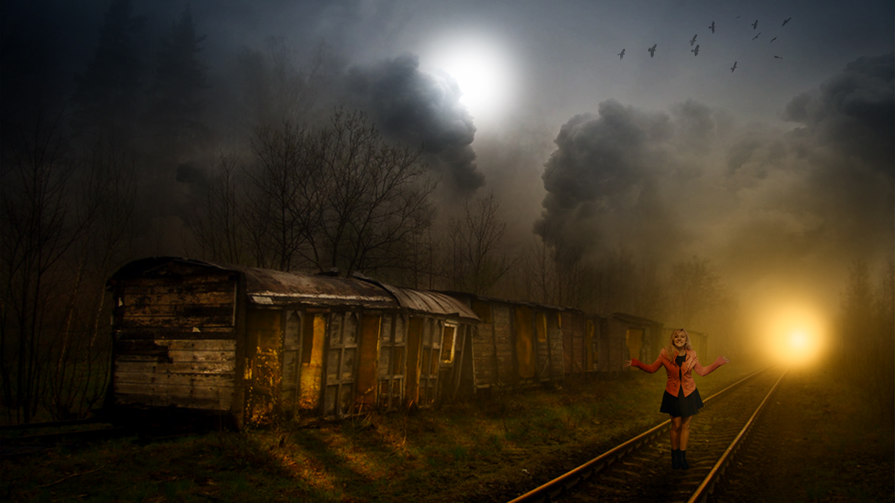
Decisions Today Affect Tomorrow!
Decisions do not always immediately manifest fruit.
Short term rewards are not always better than long term gains.
Being right is always better than being "happy" or appeased.
Almost all major decisions affect others as well as me.
If anyone seeks wisdom, let them ask ….

Slide 52
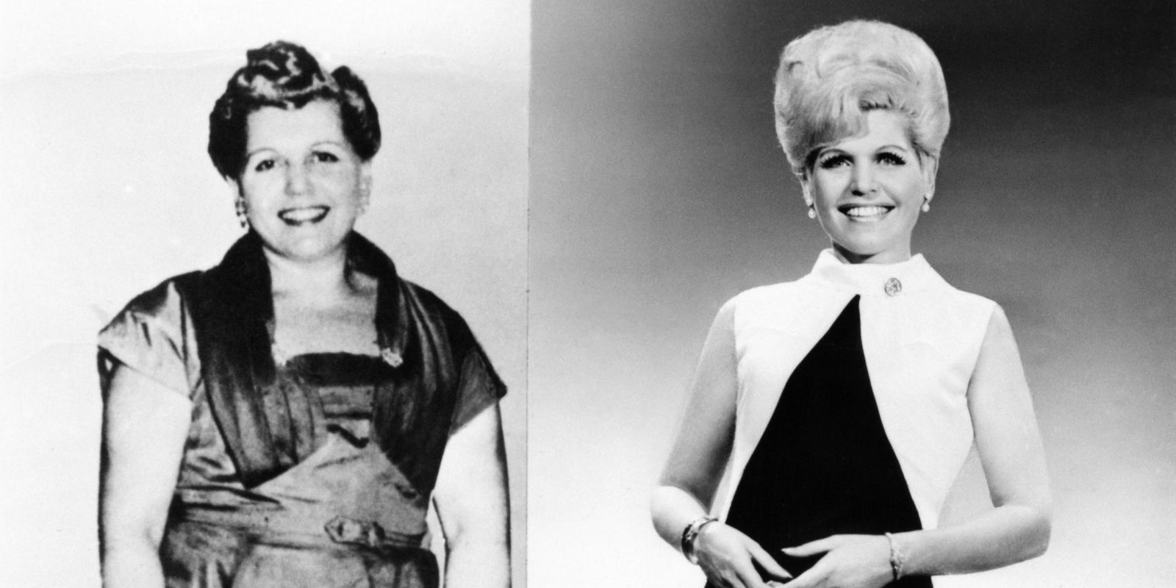
The Value Of A Push …
Decisions do not always immediately manifest fruit.
Short term rewards are not always better than long term gains.
Being right is always better than being "happy" or appeased.
Almost all major decisions affect others as well as me.
If anyone seeks wisdom, let them ask ….

Slide 53
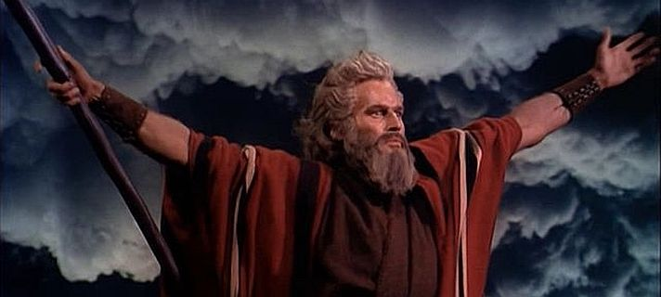
Does Prophecy Exist Today?
- 1Thess. 5:20-21
- John 4:1
The canon is closed. But does this mean that God does not have a Word for His people?
- Not every prophecy was meant to further the Canon (as here!).
Does the word agree with Scripture?
Does the lifestyle of the prophet seem to indicate spiritual growth and maturity?
Is the word that is proclaimed have confirmation?

Slide 54
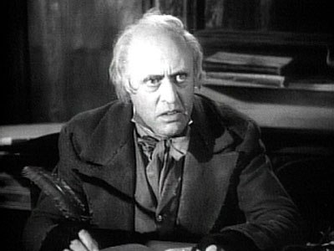
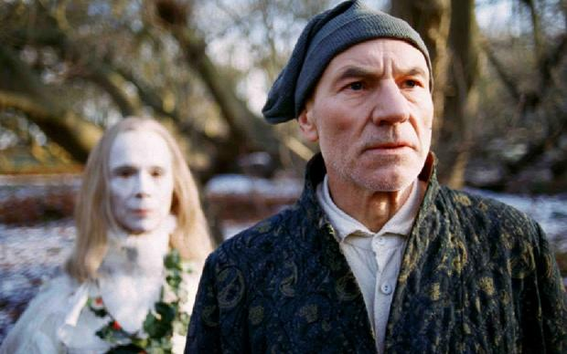
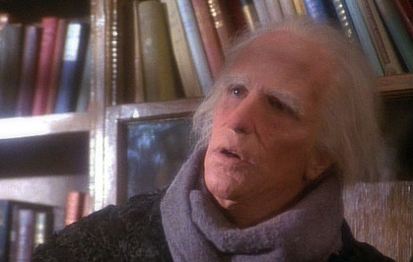
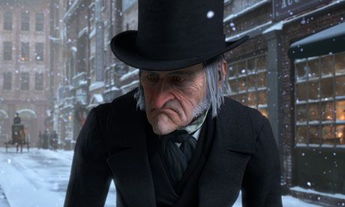
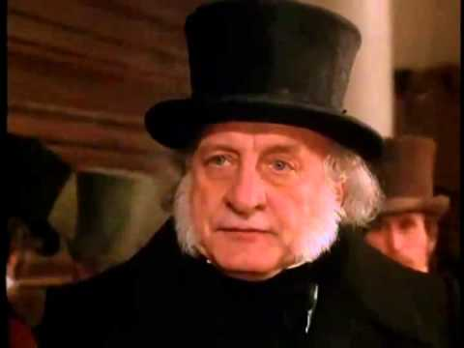
More On Giving
a) It was pro-active, not re-active (see verses 27-28)
b) It was according to means (verse 29)
c) There was financial accountability (verse 30)
d) Note that salvation always is accompanied by compassionate hearts
- What might be the significance of the term “brothers” in verse 29?

Slide 55
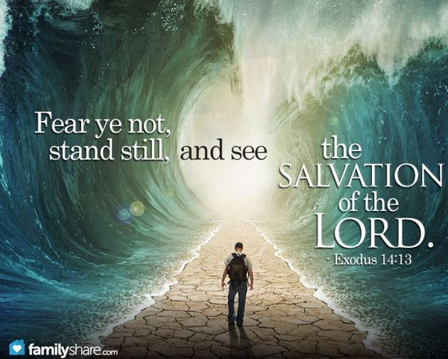
Deliverance
There are five possible responses to those that face difficult trials (like Peter)
1) A glorious, supernatural rescue by the Lord
2) No rescue comes, as does intense pain, but a radiant joy still prevails.
3) The faith of the person was shattered and they never recovered.
4) People will compromise their faith to relieve the pain.
5) Some, who did not know God, came to realize who He was and turned in faith.
WHAT MAKES THE DIFFERENCE?
Intensity is the law of prayer
"Give me Scotland or I die!"
John Knox

Slide 56
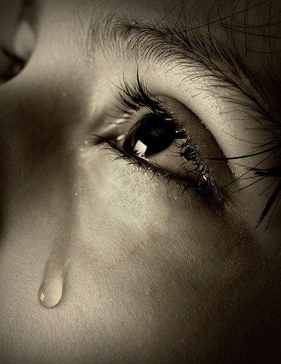
Intensely Painful Times
What To Do?
1. Talk to God … ask Him to reveal the WHY. Follow the example of the Psalmists, who
sometimes cry out to God as though taking Him to task for their problems, but who persist in
their conversation with Him; eventually [they received] an answer, reinforcing His faithfulness
to His servants."
Suffering produces intimacy with God (Job 42:5). Expect it.
Job, who endured unspeakable suffering, said, "My ears had heard of you but now my eyes have seen you."
Intimacy with God is often borne in the furnace of affliction.
There's an opening of the soul that happens during times of stress or duress. During times of suffering, we experience God at a deep, profound level.

Slide 57
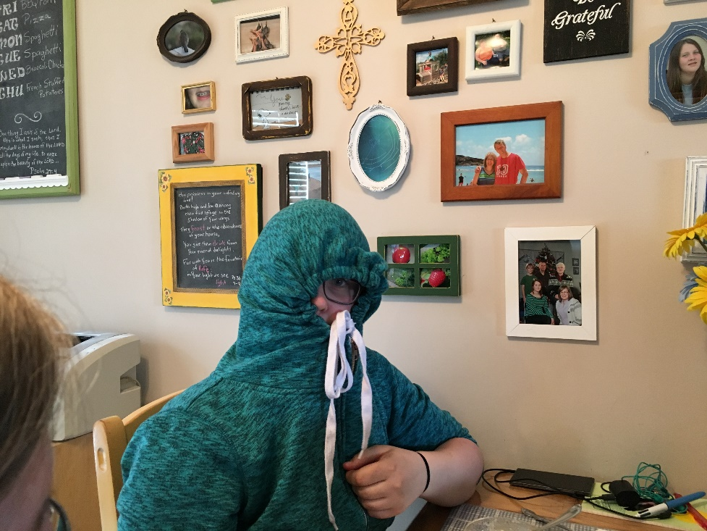
Intensely Painful Times
What To Do?
2. Resolve not to quit. Choose to walk with the Lord, no matter what … including your
responsibilities.
3. Fill your mind with truth whenever you have strength to.
4. Don't "turtle up". Talk about it. Defeat the lies.

Slide 58
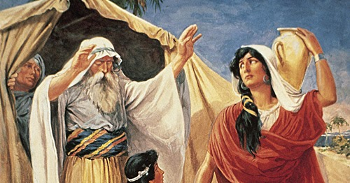
Intensely Painful Times
What To Do?
5. Be especially wary of your plans to alleviate your suffering. We are at our most vulnerable.

Slide 59
God's Will (Acts 12)
James (Half brother of Jesus)
James, Son Of Zebedee
Peter

Slide 60
God's Will (Acts 12)
There is absolutely nothing that happens in the universe that is outside of God’s
influence and authority. As King of kings and Lord of lords, God has no limitations.
Consider just a few of the claims the Bible makes about God:
God is above all things and before all things. He is the alpha and the omega, the
beginning and the end. He is immortal, and He is present everywhere so that
everyone can know Him (Revelation 21:6).
God created all things and holds all things together, both in heaven and on earth,
both visible and invisible (Colossians 1:16).
God knows all things past, present, and future.
There is no limit to His knowledge, for God knows
everything completely before it even happens
(Romans 11:33).

Slide 61
God's Will (Acts 12)
God can do all things and accomplish all things. Nothing is too difficult for Him,
and He orchestrates and determines everything that is going to happen in your life,
in my life, in Canada, and throughout the world. Whatever He wants to do in the
universe, He does, for nothing is impossible with Him (Jeremiah 32:17).
God is in control of all things and rules over all things. He has power and authority
over nature, earthly kings, history, angels, and demons. Even Satan himself has to
ask God’s permission before he can act (Psalm 103:19).
That’s what being sovereign means. It means being the ultimate source of all power,
authority, and everything that exists. Only God can make those claims; therefore, it’s
God’s sovereignty that makes
Him superior to all other gods.

Slide 62
Prayer
What Happens When We Pray:
a) God grants peace ... see Phil 4:6-7
b) We ultimately move the heart of God (Genesis 18:16-33, Isaiah 38 etc.)
c) Through prayer, we know God (Luke 22:39-45)
d) There is power that the Lord grants (Matthew 17:21, 21:22)
e) I recognize more clearly that these issues cannot be handled by me alone
(Phil. 1:19, James 5:15)
f) God often grants the requests of our hearts (Matt. 7:9-11)
g) What an encouragement to know others are truly praying for you!

Slide 63
Some Myths Regarding Prayer
a) God must do what I say (based on Luke 11:9, for example)
- this must be balanced against:
Matt 18:19 (why two or three??)
John 15:7 (what does it mean to abide?)
John 14:13 (who gets the glory when my request is granted?)
James 4:3-4 (what effect does motive have on answered prayer?)
1John 5:14 (whose will is important here?)
Matthew 21:21-22 (what element does faith play?)
James 5:16-17 (what place does righteousness (sin) and passion play?)

Slide 64
Some Myths Regarding Prayer
b) God really doesn’t have the power to do what He says
- has God done the miraculous in the past?
- we may truly doubt this
- is God immutable (unchanging)? (Mal. 3:6, Hebrews 13:8)
- Consider the prophecies of Scripture … how did they come to be?

Slide 65
Some Myths Regarding Prayer
c) God doesn’t have the desire to answer
- see Matthew 7:7-12
- what kind of father doesn’t desire to do the best for His people
- God still wants glory in this world - we are the vessels He chooses to manifest that.

Slide 66
Practicing Prayer
Some Thoughts On The Practical Side Of Prayer
- There are times of both corporate prayer and private prayer; both are necessary.
- Try to quiet your mind before rushing in!
- Do what it takes to eliminate the distractions.
- Try to create a “prayer closet”.
- Spend at least some time listening! Lectio Divina
- How often do we “Amen” and go, without tarrying a bit and waiting on the Lord?
- Try to set aside the same time each day for your devotional time: No guilt allowed.
- Don’t focus on the length of the prayer or the words spoken .
- Don’t allow yourself to fall into the trap of repeating the same phrase over and over.
- It is important to mean what you say and use the language that
you are used to (Psalm 62:8).
- Allow yourself the time to fully express your emotions to God.
- You can’t hide yourself ... so don’t try.
- Keep a prayer journal (if it works for you) ... but pray in a way that
you will know when God answers!
- Remember the balance of what is spoken:
A ... Adoration (worship to the Lord for who He is)
C ... Confessions (Lord ... forgive me)
T ... Thanksgiving (praising God for needs met)
S ... Supplication (asking for needs to be met)
- The focus must be on God ... not the mountains we are praying about!
- Some on-going questions for God:
1) What is the next step in my character development?
2) What is the next step with my family ?
3) What is the next step with my ministry?
4) What is the next step in my vocation ... dating ...
education ... giving ...
- Pray specifically

Slide 67
Caesarea
- a seaport city
- rebuilt by Herod the Great and named after Caesar Augustus
- there were more Gentiles living there than Jews, calling it the "Daughter of Edom"
- the city was meant to serve as a show piece to the Roman empire
- it was riots here in 66AD that sparked the Roman/Jewish wars
- Josephus claims that 20,000 Jews were massacred there in 66AD

Slide 68
Herod's Humiliation
What actions are we capable of when we feel humiliated?
- Herod killed guards
- He then fled to Caesarea
- He accepts worship as a god.

Slide 69
Herod's (Agrippa) Humiliation
• According to Luke, Herod was “wearing his royal robes” (v. 21); Josephus writes that
he wore a garment made wholly of silver, which shone in a surprising manner when the
rays of the sun touched it.
• Luke says that Herod’s punishment was because he did not praise God when the
flatterers shouted that his was the voice of a god (vv. 22 – 23). Josephus reports that
“the king did neither rebuke them, nor reject their impious flattery.”
• Josephus says that he had violent abdominal pains and died five days later, whereas
Luke says, “Immediately … an angel of the Lord struck him down, and he was eaten
by worms and died” (v. 23). This apparent discrepancy can be explained in that Luke
applied the “immediately” to the striking down with sickness (which took place
immediately), not to the dying (which took
place five days later).

Slide 70
Brene Brown on Shame …
Shame
Shame is the most powerful, master emotion. It’s the fear that we’re not good enough.
Shame, blame, disrespect, betrayal, and the withholding of affection damage the roots
from which love grows. Love can only survive these injuries if they are acknowledged,
healed and rare.
If we can share our story with someone who responds with empathy and understanding,
shame can’t survive.
Shame corrodes the very part of us that believes we are capable of change.
If we share our shame story with the wrong person, they can easily become one more
piece of flying debris in an already dangerous storm.

Slide 71
Brene Brown on Shame …
Courage
Owning our story can be hard but not nearly as difficult as spending our lives running
from it. Embracing our vulnerabilities is risky but not nearly as dangerous as giving up on
love and belonging and joy—the experiences that make us the most vulnerable. Only
when we are brave enough to explore the darkness will we discover the infinite power of
our light.
Courage starts with showing up and letting ourselves be seen.
As a shame researcher, I know that the very best thing to do in the midst of a shame
attack is totally counterintuitive: Practice courage and reach out!
The dark does not destroy the light; it defines it. It’s our fear of the dark that casts our joy
into the shadows.
If you trade your authenticity for safety, you may experience the following: anxiety,
depression, eating disorders, addiction, rage, blame, resentment, and inexplicable grief.

Slide 72
Paul's First Missionary Journey (Acts 13:1-14:28)
The Commission
- On or around this time, Paul had an unusual experience that he writes about in
2 Corinthians 12:2-10
- He describes that 12 years earlier (around 42 or 43 AD), he was caught up to
heaven
- He was then given a thorn in the flesh
- This would have happened either just before or during his call to evangelize
- WHY all of this, now? How does the reaction of Saul and Herod differ?

Slide 73
Paul's First Missionary Journey (Acts 13:1-14:28)
- Note the wide range of leaders at Antioch
Barnabas ... full of compassion and encouragement ( a people person), also a
Levite from Cyprus (Acts 4:36)
Simeon called Niger (black) ... of dissimilar ethnic origin (possibly Simon of Cyrene)
Lucius ... from North Africa
Manaen ...rich and influential, well connected (this Herod [Antipas] was the one
who put John the Baptist to death ... see also Luke 8:3 for Joanna)
- Ironic … two friends … one beheads and one heads up …
Saul ... highly trained and intelligent
“we will probably have to pay a price for devoting
our lives to building the kingdom of God. Jesus did.” ― Bill Hybels, Courageous Leadership
“You're a leader. It's your job to keep your passion hot.
Do whatever you have to do, read whatever you have
to read, go wherever you have to go to stay fired up.
And don't apologize to anybody. ” ― Bill Hybels, Courageous Leadership

Slide 74
Paul's First Missionary Journey (Acts 13:1-14:28)

Slide 75
Paul's First Missionary Journey (Acts 13:1-14:28)
Some Questions About This Passage:
1) How do you think that the Spirit revealed it to the church?
2) What was the purpose of prayer and fasting?
3) Why did they fast and pray AGAIN after the call?
4) Why did they lay hands on these two?
5) Does it bother you that they went without clear directions
(not unlike Abraham)?
6) Is there a healthy balance with the Spirit direction individuals and
the church together?

Slide 76
God's response to our questions …
Mark 10:35-40, 46-52
Our questions reveal much about our current condition of the heart.
Christ always draws truth out …. with questions.

Slide 77
Paul's First Missionary Journey (Acts 13:1-14:28)
In Cyprus
- Why here? Perhaps because Barnabas was from this island?
- Why was John Mark such a valuable asset? Was he an eye witness to Jesus?
- Was Paul in the right to use such strong language describing Elymas?
- Leaders are often admired from a distance. This is likely true of Paul.
Note in 2Timothy 4:16, all had abandoned him. When you serve, it may be alone,
but today Paul is recognized as one of the great leaders of the world.

Slide 78
Paul's First Missionary Journey (Acts 13:1-14:28)
Paul too was blind for a season
- would it have the same effect on Elymas?
Why?

Slide 80
Paul's Second Missionary Journey (Acts 15:36-18:22)

Slide 81
Paul's Third Missionary Journey (Acts 18:23-21:16)

Slide 82
Paul's Roman Excursion (Acts 21:17-28:31)

