Slide 1
ACTS 1:1 - 8:1 THE BIRTH OF THE CHURCH
1:1 - 1:14 Introduction
1:15 - 26 A new apostle is chosen
2:1-13 The feast of Pentecost
2:14-47 Peter’s first sermon
3:1 - 4:31 Healing of a lame man
4:32 - 5:11 Ananias and Sapphira
5:12-42 The Apostles before the council
6 The first deacons appointed
7:1 - 8:1 Stephen’s defense and stoning
ACTS 8:1 - 11:18 PERSECUTION : SPREADS TO JUDEA AND SAMARIA
8:1 - 25 The Samaritans respond to the Gospel
8:26-40 Philip and the Ethiopian Treasurer
9:1-31 Saul is converted to Christianity
9:32-43 Peter at Lydda and Joppa
10 Peter and Cornelius
11:1-18 The Apostles approve Peter’s actions

Slide 2
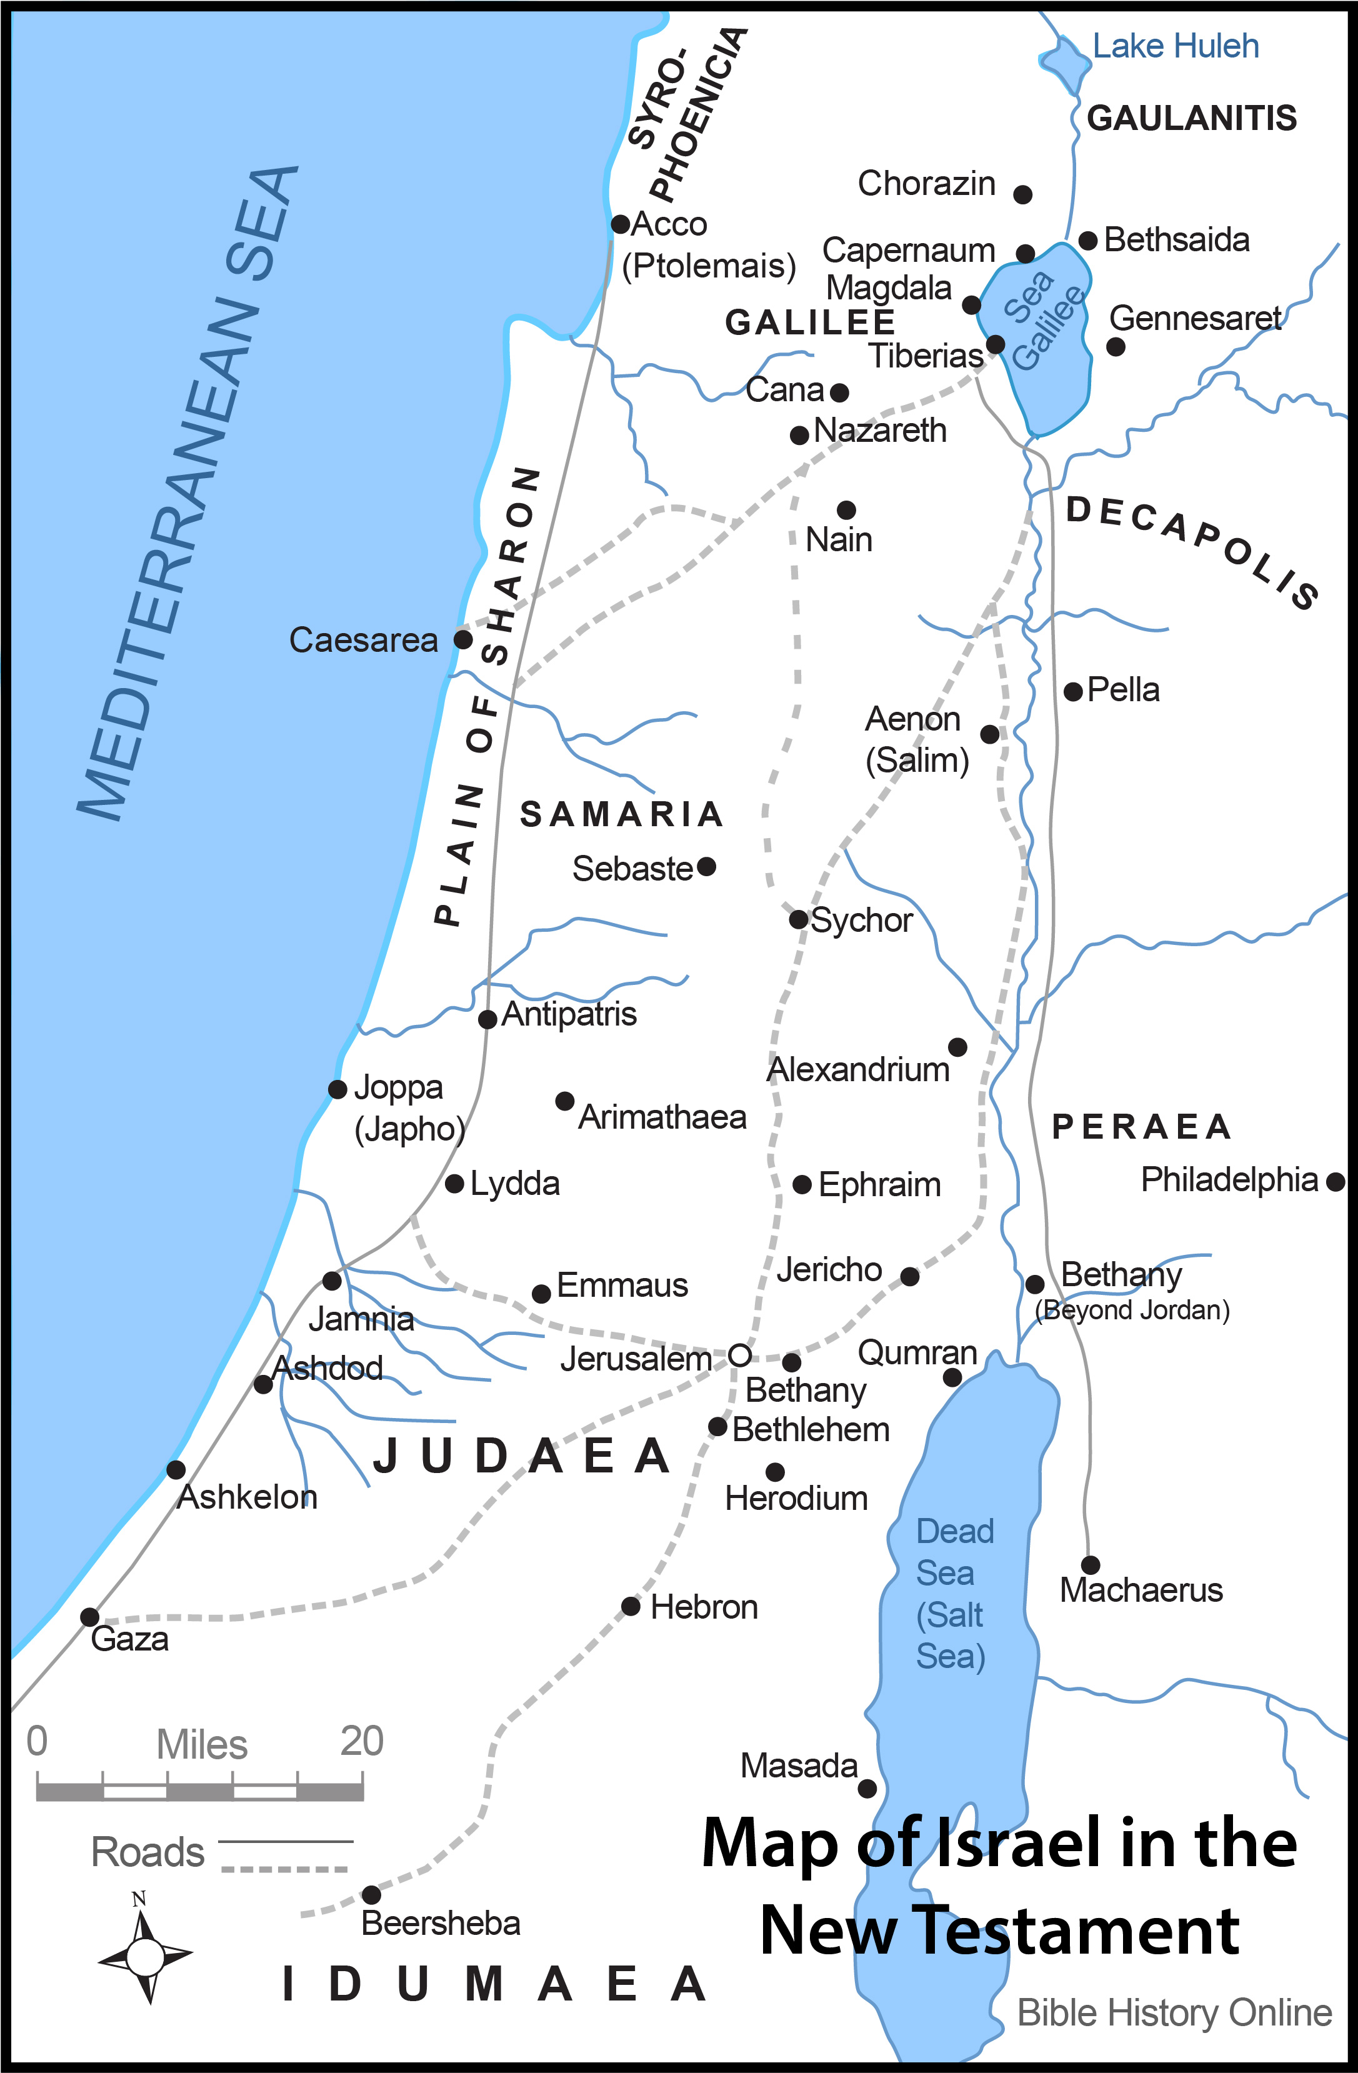
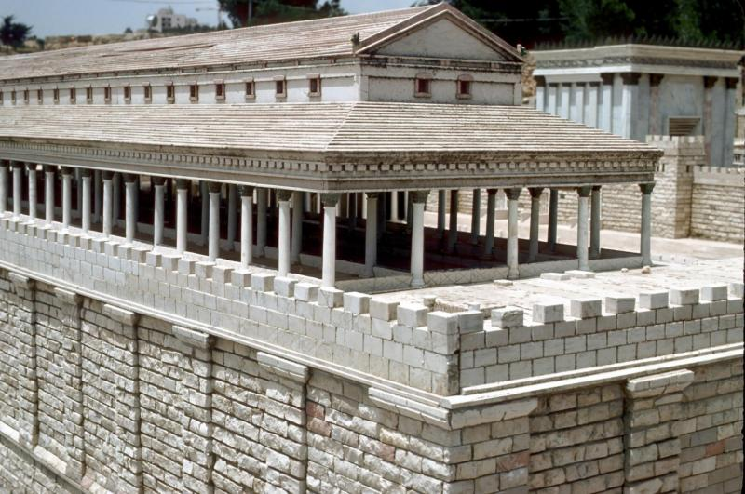
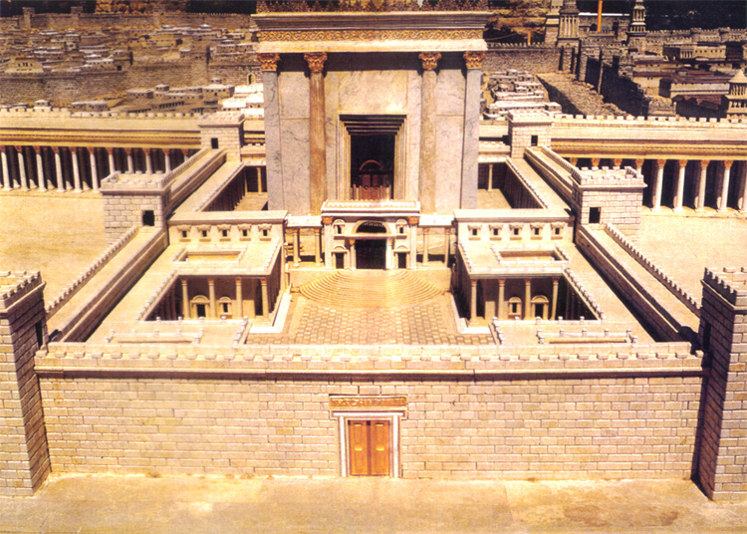

Slide 3
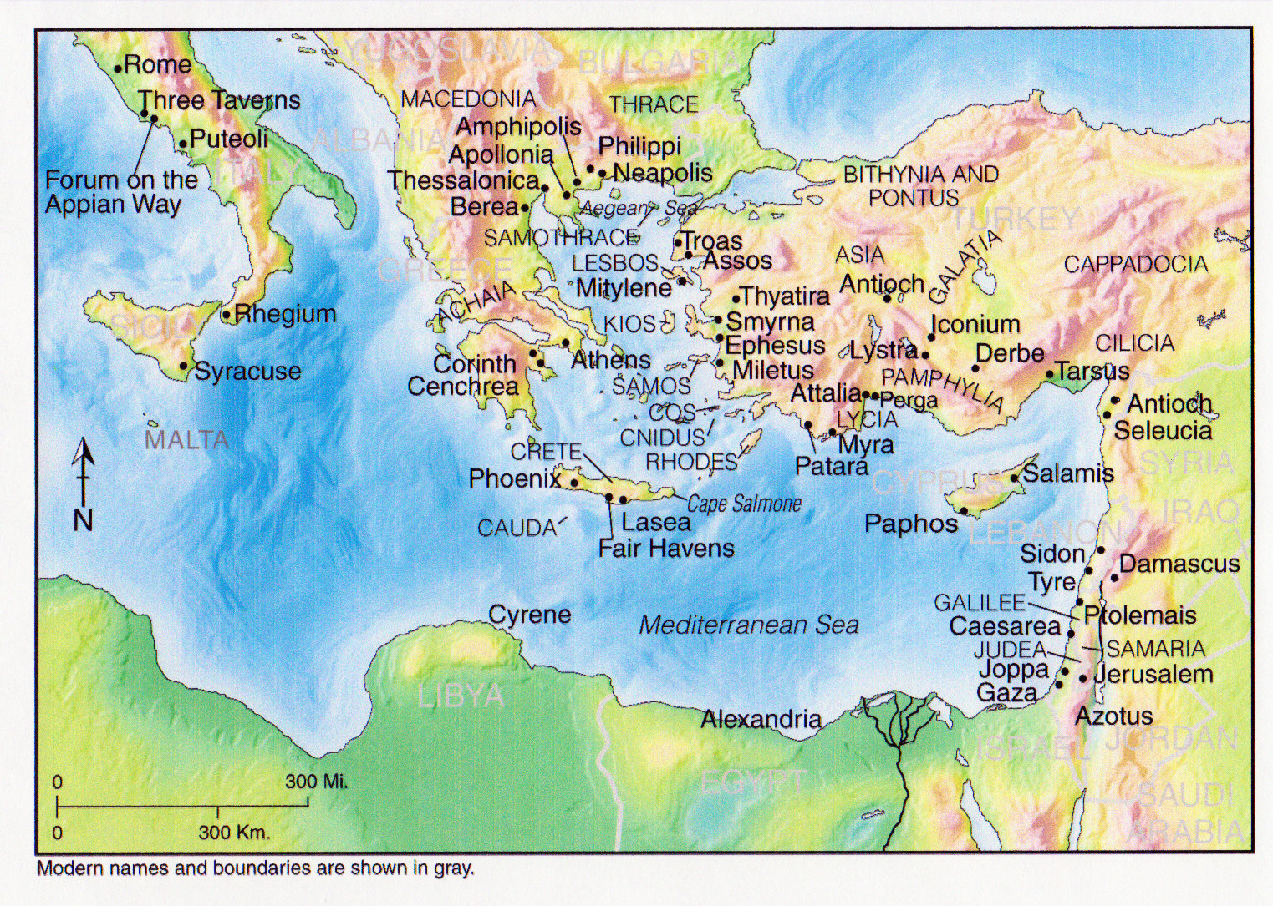

Slide 4
ACTS 11:19 - 16:6 THE GOSPEL ADVANCES INTO SYRIA AND TURKEY
11:19-30 The first Gentile Church at Antioch
12 James is killed, Peter imprisoned
Further Study: Prayer
13, 14 Missionary Journey 1: Paul and Barnabas
- Cyprus, Perga, Pisidian Antioch,
Iconium, Lystra, Derbe
Further Study: Fasting
15:1-35 The Council at Jerusalem
ACTS 16:6 - 19:41 PAUL TAKES THE GOSPEL TO EUROPE
15:36 - 19:41 Missionary Journey 2 : Paul and Silas
- Philippi, Thyatira, Thessalonica, Beroea,
Athens, Corinth, Ephesus
Further Study: Gifts of the Spirit
What is spiritual warfare?
- Third missionary journey

Slide 6
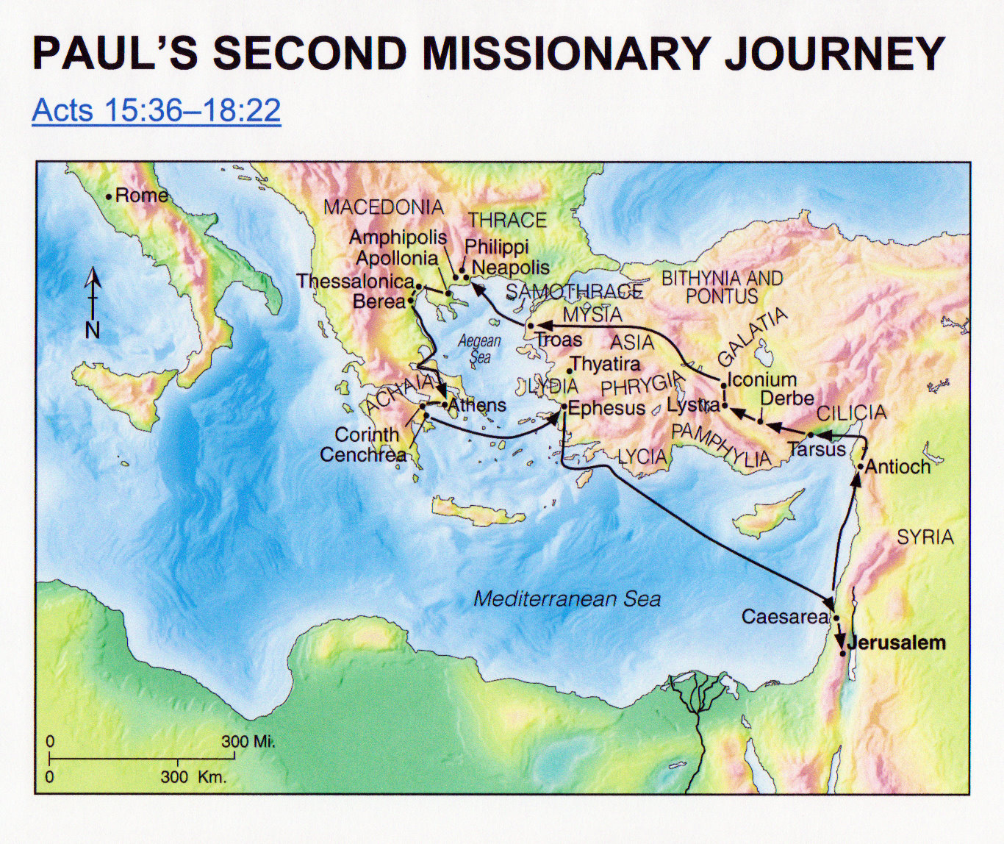

Slide 7
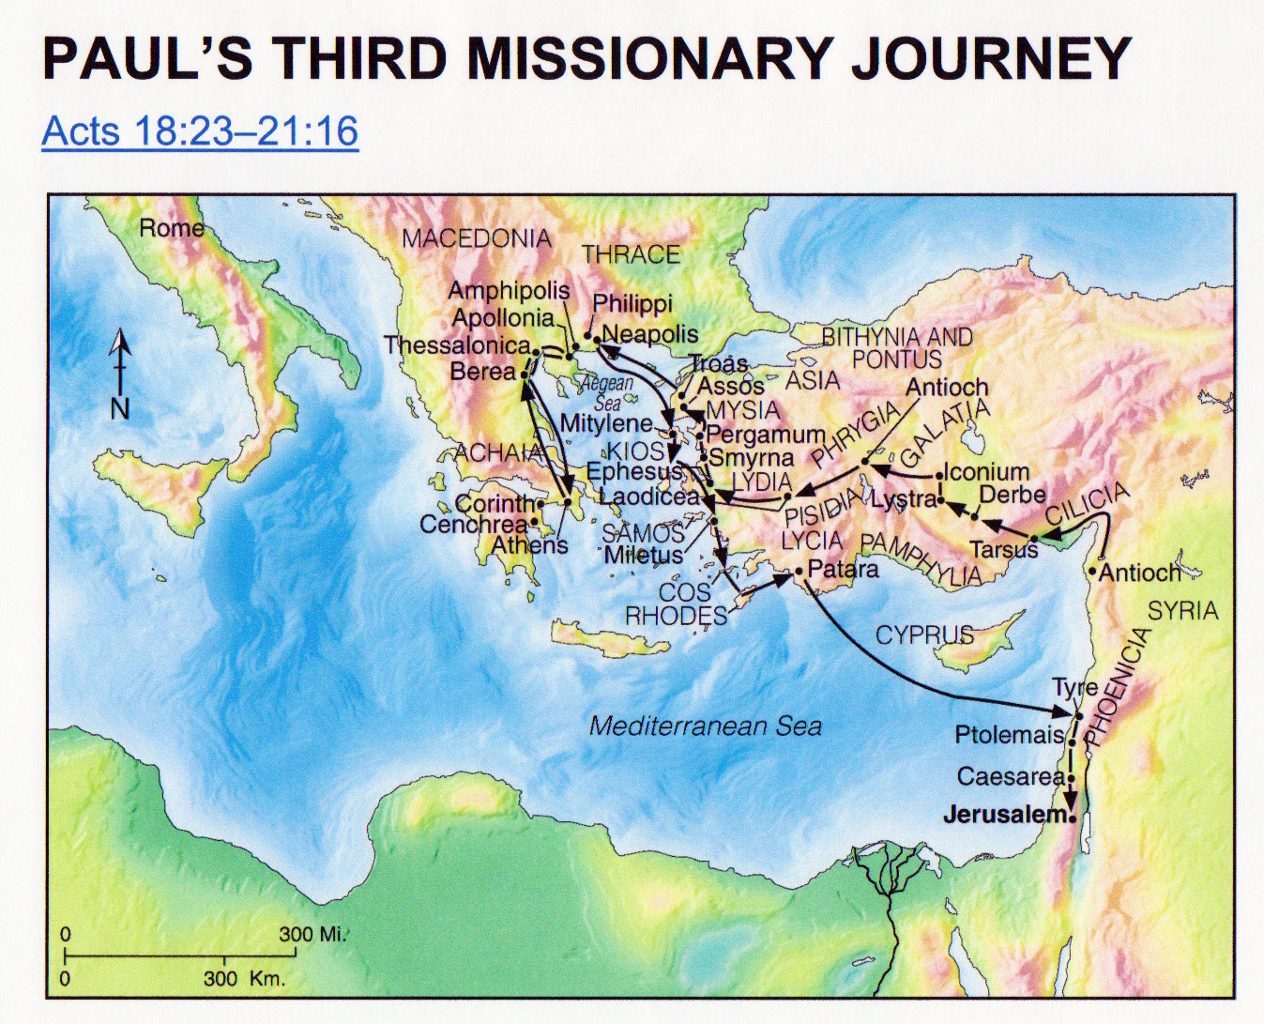

Slide 8
ACTS 20 - 28 PAUL’S JOURNEY TO ROME
20: 1-16 Paul sets out for Jerusalem
20:17 - 21:14 Paul with the Ephesian Elders
21:15 - 23:35 Paul is arrested in Jerusalem
24 The defense before Felix
25:1-12 The defense before Festus
25:13 - 26:32 The defense before Agrippa
27, 28 Paul’s boat trip, shipwreck,
arrival at Rome
Further Study: Angelic realms

Slide 10
Some of the overarching themes in this book include:
a) Evangelism is everyone’s business, not just a select few.
b) The content that we share is critically important. We will see that the message is
rooted in Scripture.
c) The timeless, unchanging message must always be contextualized. Paul will show us this.
d) Paul will operate within the context of the law as much as possible, but will always
bow to the Lord’s law as supreme. We use what we have to promote and live our
faith and suffer the slings and arrows of this world system when we cannot.
e) There will ALWAYS be opposition between the kingdoms of the world and the
Kingdome of our God.
f) The Holy Spirit is the source of power in this
Christian walk.
g) Prayer, God's sovereignty, suffering

Slide 11
As a radical challenge to todays, culture …
• To a society where individualism reigns and where the church also seems to have
adopted a style of community life that “guards the privacy of the individual,” the early
church presents a radical community where the members held all things in common.
• To a society where selfishness is sometimes admired and each one is left to fend for
himself or herself, Acts presents a group of Christians who were so committed to Christ
and the cause of the gospel that they were willing to sacrifice their desires for the good
of others.
• To a society where pluralism defines truth as something subjective and personal, Acts
presents a church that based its life on certain objective facts about God and Christ — facts
that were not only personally true but also universally
valid and therefore had to be presented to the entire
world.

Slide 12
As a radical challenge to todays, culture …
• To a society that denies absolute truth and therefore shuns apologetics and persuasion in
evangelism in favor of dialogue, Acts presents a church that persuaded people until they were
convinced of the truth of the gospel. Instead of aiming at mutual enrichment as the main
aim of interreligious encounter, as many do today, the early church proclaimed Christ as
supreme Lord with conversion in view.
• In an age where specialization has hit evangelism so much that we rarely find churches
that emphasize healing also emphasizing apologetics, Acts presents a church where the
same individuals performed healings and preached highly reasoned, apologetic messages.
• In an age when many churches spend so much time, money, and energy on
self-preservation and improvement, Acts presents
churches that released their most capable people
for reaching the lost.

Slide 13
As a radical challenge to todays, culture …
• In an age where many churches look to excellence in techniques to bring success, Acts
presents a church that depended on the Holy Spirit and gave top priority to prayer and
moral purity.
• In an age when many avenues are available to avoid suffering and therefore many
Christians have left out suffering from their understanding of the Christian life, Acts
presents a church that took on suffering for the cause of Christ and considered it a basic
ingredient of discipleship.

Slide 14
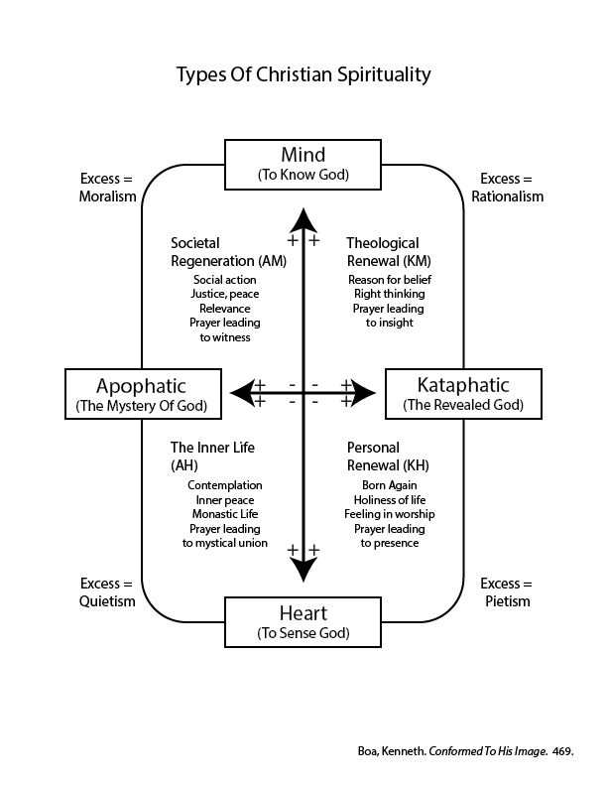
How do you view your experience with God?
Re: The Baptism In The Spirit:
A Second Definite work of grace?
The Wesleyan holiness movement has
emphasized holiness of heart and life, or
entire sanctification, as resulting from
this baptism. The Charismatics and
Pentecostals have emphasized the
power for witness and the sign gifts,
such as tongues. Evangelicals like
D. L. Moody and R. A. Torrey emphasized
power for service, especially for witness,
as the result of this baptism. Martyn
Lloyd-Jones wrote that while the baptism
with the Holy Spirit may take place at
conversion, it usually takes place later
and lifts a person to a higher level of
spiritual experience.

Slide 15
Deceptive Ads … Feel Good "Truth"

Slide 16
Deceptive Ads … Feel Good "Truth"

Slide 17
Deceptive Ads … Feel Good "Truth"
The apparent message in this photo is "invisalign
looks better on your teeth than conventional
braces." The unspoken, subtle and manipulative
implication is "invisalign users have better,
smoother skin with no wrinkles or visible pores,
their lips are full and glossy pink, and their noses
are tinier with smaller nostrils."

Slide 18
Timing
Feast Of Passover Crucifixion The Death Angel
Feast Of Unleavened Bread In the tomb Leave Egypt
Feast Of First Fruits Resurrection Possible Dead Sea
Feast Of Pentecost Giving Of The Spirit Giving Of The Law

Slide 19
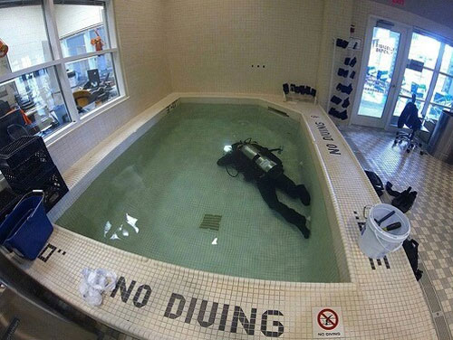
Acts 1:6
Note at least three errors in the apostles question:
A) restore ... a political kingdom was coming
B) Israel ... an Israelite kingdom was coming; no place for spiritual prejudice
C) at this time ... it was coming now!

Slide 20
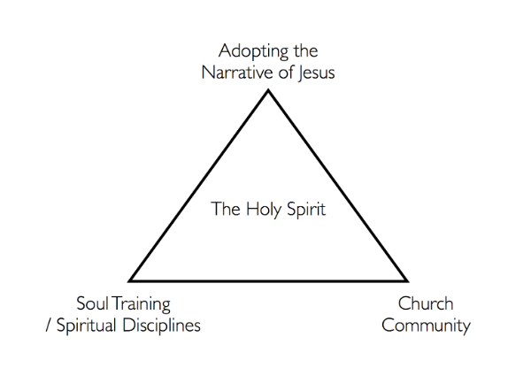
Real Change

Slide 21
Discipline Of Submission
Key Verses: Psalm 40:6-9; Micah 6:6-8; Matthew 16: 21-28; John 14:15-21;
Ephesians 5:21; Philippians 2:1-8; James 4:1-12; 1 Peter 1:13-16; 2: 13-18; 3:1
- the willingness to voluntarily submit to Christ and also to others in authority.
- choosing to yield our will, mind, and body for God's purposes so we can better hear,
receive, and obey His Word.
- When we are submitting to others, we are also submitting and serving Christ as
Lord (Col. 3:23-24)!
- it does not go beyond the bounds of respect into sinful or immoral behavior.
- is more about our interpersonal relationships and how we humbly reverence God
- when we are under the leadership of those who are more mature and respect others'
leadership, we will learn and grow more.
- this will also affect our home life and relationships as we will show love and respect thus
creating harmony and contentment.

Slide 22
Discipline Of Submission
- is not is a loss of our identity or personality; rather, we are freed and enhanced to be
better and more content with God and others.
- Submission is not about hating ourselves; rather, it means to have a right respect and
relationship with God.
- When I am self-sufficient or self-indulgent, I not only fail to see my need for redemption,
but also fail to see my need for growth in spiritual matters.
- This is not being "weak;" rather, it is being "meek," as Christ exemplified and called us to
be. Meekness is showing humbleness and gentleness toward God and others
(Ex. 32:19-20; 30-34; Num 12:1-3; Psalm 37:11; Prov. 3:5; Matt. 5: 3-12; 11:29). Meekness
causes us to seek to please God and submit our will and aspirations to His will and what is
best. This will enable us to endure being personally attacked as we keep our focus on Christ
and humility.

Slide 23
Practicing Submission
1) When you know you are wrong, admit it and give up the fight.
2) Refuse the best parking spot. Let someone else have it.
3) Let someone into your lane on the road this week.
4) Someone butts into line in front of you? Let it go.
5) The next time you read Scripture, watch for those spots where you spirit instantly
rebels. Stop and ask yourself why.
What are your suggestions?

Slide 24
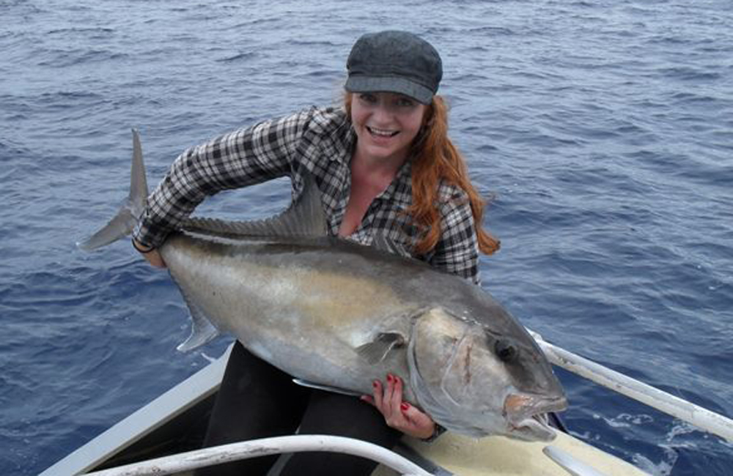
Acts 1:8
Why is POWER more valuable than dates?

Slide 25
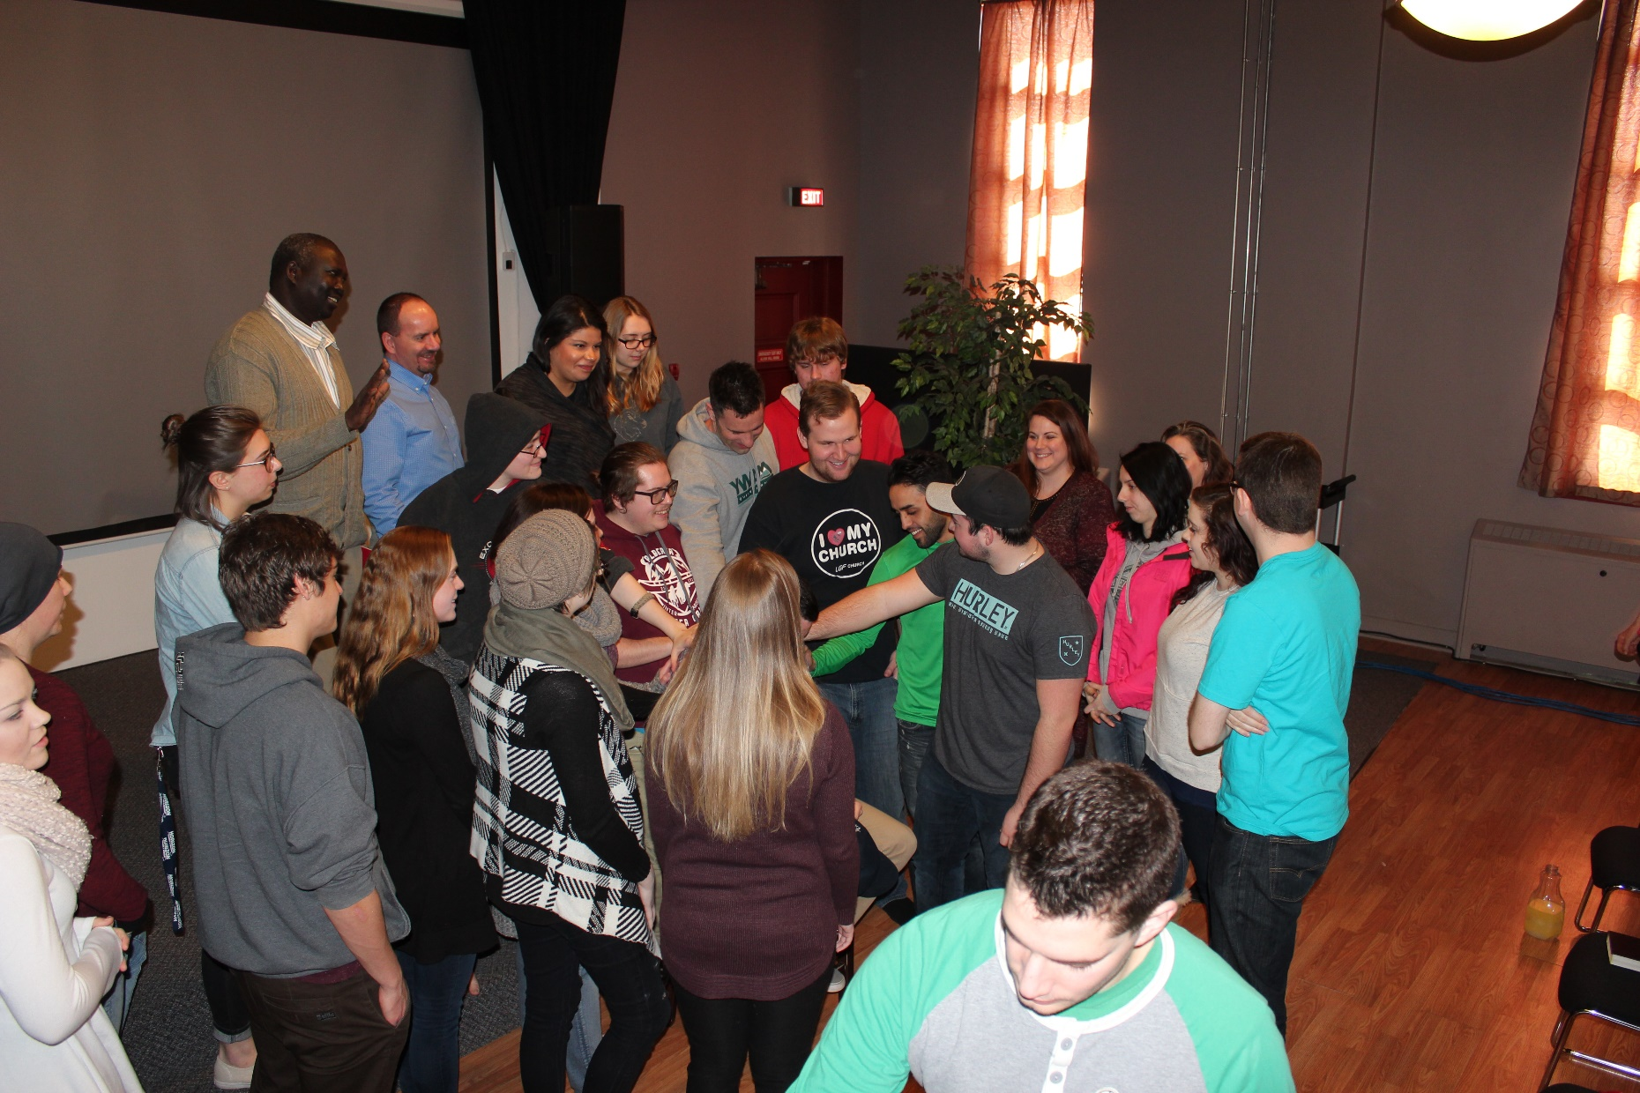
Acts 1:13
Praying together …

Slide 26
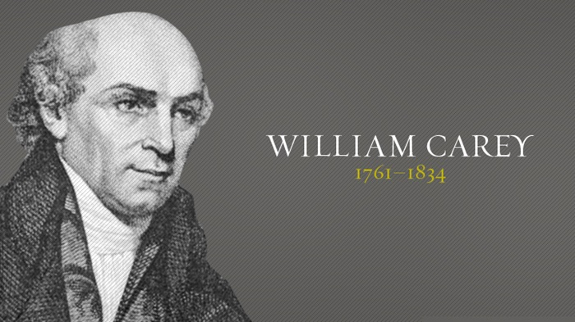
Acts 1:13
Prayer: secret, fervent, believing prayer – lies
at the root of all personal godliness.

Slide 27
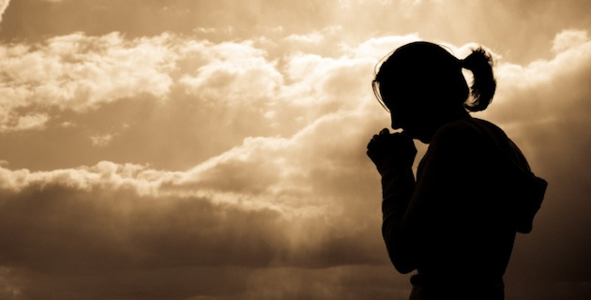
Acts 1:13
Some Essentials Of Prayer
1) Unified
- it required 120 Jewish people in a community
to establish a council
- note that Peter and John are listed first
(up and coming leaders) and James and John are now
separated in the list (hinting at a new, stronger
brotherhood)
2) Persevering (see verse 14) ... see also Romans 12:12, Col. 4:2

Slide 28
Acts 1:13
Ro 12:12 Be joyful in hope, patient in affliction, faithful in prayer.
Col 4:2 Devote yourselves to prayer, being watchful and thankful.
1Thess. 5:17 Pray without ceasing.

Slide 29
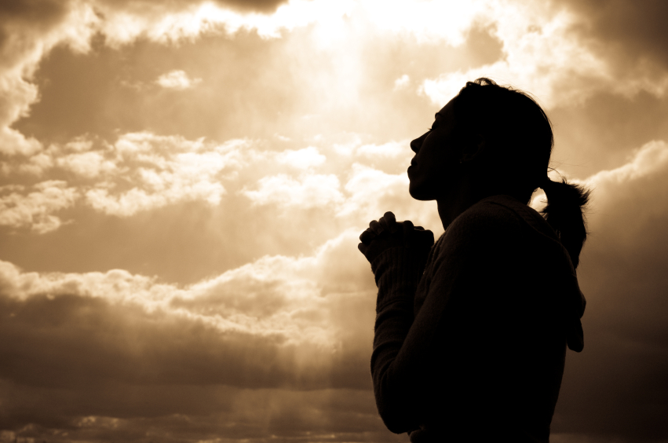
Acts 1:13
Prayer in the Bible always seems to have:
a) Utter belief that what was prayed for would come to pass.
Hebrews 11:6 And without faith it is impossible to please God, because anyone who comes
to him must believe that he exists and that he rewards those who earnestly seek him.
b) Prayer must also be listening as well as talking.
- Is my heart quiet enough to hear?
c) Keep it simple
- The reason God responds to our cries is because His children ask Him

Slide 30
Acts 1:13
d) When answers do not come, seek the why?
- Is God really saying, “no”? Am I asking amiss? Is there sin in my life? Is God
saying, “Wait”? Am I really listening?
- Is this something that the Lord is asking ME to do?
- To that end, will I spend time in meditation towards the Lord?
e) Protection from worry is a power product of prayer (Matthew 6:25)
- Worry is the disproportionate level of concern based on an inappropriate
measure of fear.
- The false lie: Worry helps us. If I worry, something good will come of it.
- Note that in the upper room, they were no longer concerned that Jesus was
not with them.
- Read and contemplate Phil 4:6-7. Prayer
and worry are on opposite ends of the
spectrum.

Slide 31
Acts 1:13
A Guide:
1) Each morning, set aside 10 minutes.
2) Think about what you are anxious for right now.
3) Write them down in your journal.
4) Ask the Lord what you can do to help in these areas.
5) As anything is revealed, write it down.
6) Turn the rest over to God. Write your request to Him and be specific.
- Don’t let your prayer be vague.
7) Journal your successes.

Slide 32
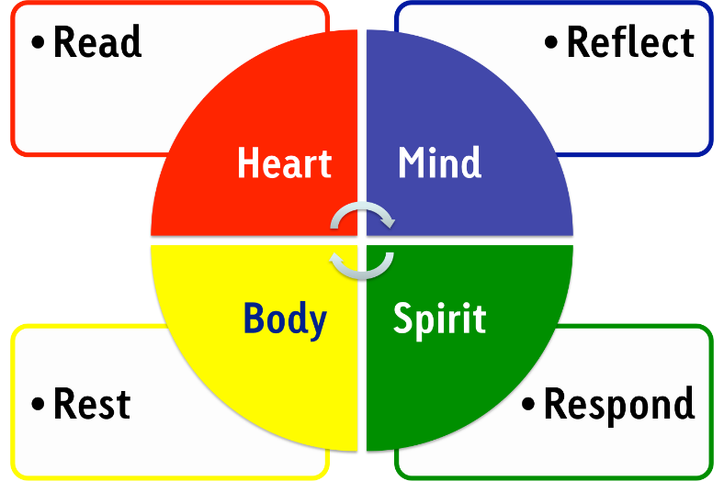
Lectio Divina
1. Pick a few verses … usually no more than 5 or so.
2. Spend a moment relaxing, just breathing, calming down.
3. Read the verses slowly, pause between each clause
4. Be silent for a moment or two
5. Read it again, taking even longer pauses between the clauses. Pay attention to words that seem
to catch your eye. Write those special words down.
6. Re-read the passage again, stopping at those key words. Repeat them to yourself.
7. Ponder and reflect. Why are those words standing out? Repeat the phrase a few more times.
What might God be saying to you?
8. Pray for the wisdom and Spirit of the Lord to reveal. Listen. Write down what God is saying.
9. Rest for a few moments.
10. Based on what was revealed, ask yourself … “What am I being called to do now?”

Slide 33
Acts 1:20-26
Note the discernment of God’s will:
1) Search the Scriptures
2) Prayer
3) Common sense and unity
4) Trusting God to speak through circumstances
5) Note that the two names came out the community, and
were confirmed by the leadership
- when the Spirit came, the need to cast lots was
replaced by His leading
- How do we make decisions today?

Slide 34
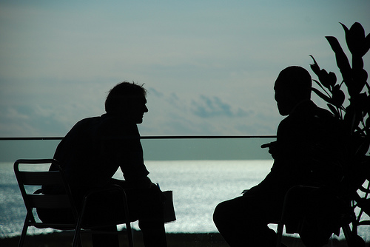
Acts 2
Acts chapter 2 introduces the three most important characteristics
of the early church: Spirit empowerment, evangelism throughout
the world and deeply committed community.

Slide 35
Acts 2
Re: The Baptism In The Spirit:
A Second Definite work of grace?
The Wesleyan holiness movement has
emphasized holiness of heart and life, or
entire sanctification, as resulting from
this baptism. The Charismatics and
Pentecostals have emphasized the
power for witness and the sign gifts,
such as tongues. Evangelicals like
D. L. Moody and R. A. Torrey emphasized
power for service, especially for witness,
as the result of this baptism. Martyn
Lloyd-Jones wrote that while the baptism
with the Holy Spirit may take place at
conversion, it usually takes place later
and lifts a person to a higher level of
spiritual experience.

Slide 36
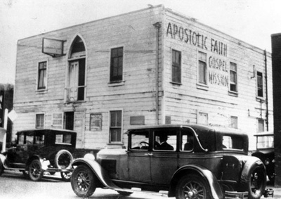
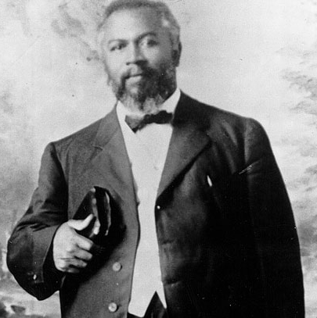
Acts 2
- The wind and fire that accompanied the gift
of the Spirit (vv. 2 – 3) are common biblical
symbols for the activity of the Spirit. The Greek
and Hebrew words for “Spirit” can also mean
“wind” and “breath.”
- In the valley of dry bones, wind and breath
come and give life to dried-up bones. After
that the Lord said, “I will put my Spirit in you
and you will live” (Ezek. 37:1 – 14).
Azusa Street
William J Seymour

Slide 37
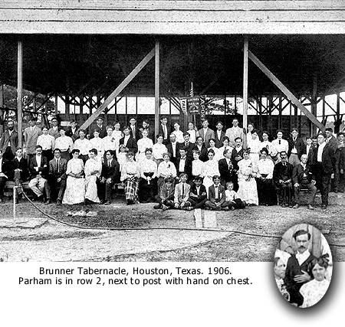
Acts 2
- According to Jesus, the blowing of the wind “illustrates the mysterious operation of the Spirit in effecting new birth” (John 3:7 – 8). In both cases the wind was a symbol of regeneration.
- In the prediction of baptism with the Holy Spirit by John the Baptist, the wind (by implication) blows the chaff away (Luke 3:16 – 17). This is a symbol of judgment. Similarly, fire in this same prediction, which burns up the chaff, is a symbol of judgment. In other words, like the coming of the gospel message (2 Cor. 2:15 – 16), the coming of Spirit means life to some and judgment to others (as we will see with Ananias and Sapphira, Acts 5:3, 9).

Slide 38
Acts 2
- Moreover, fire is also a symbol of the powerful presence of God, as both the fire at the burning bush (Ex. 3:2 – 5) and the pillar of fire at night (Ex. 13:21 – 22) indicate.
Other Ideas Associated With The Feast of Pentecost
- it was considered 50 days after crossing the Red Sea to the giving of the Law.
- The Law was given to Moses on this day.
- The 6th Day Of Sivan
- Exodus 19:19 says that the voice of the Lord was like a trumpet
- Rabbi Yohanan ben Zakkai claimed, in the Midrash, that “God’s voice, as it was uttered, split into 70 voices so that all the nations should understand”

Slide 39
Acts 2
- Further, Rabbi Moshe Weissman claimed that the people actually saw the voice waves emanate from the mouth of God (the trumpet) as fiery breathes (Exodus 20:18 … the people perceived the thunders)
- Wind, fire … different languages … sound familiar?
- Typically, the Book of Ruth is read at Pentecost each year (our Redeemer!)
- According to Jewish legend, Enoch was raptured on this day, as well
- Note that Jesus taught His disciples during this time (Acts 1:3)
- See Jeremiah 31:31-33 … where God promises to write His laws in our hearts by His Spirit
- Pentecost can be seen as an overcoming of the curse of the Tower Of Babel.

Slide 40
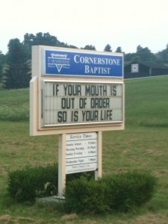
Acts 2
What Exactly Is Speaking In Tongues?
- It is a form of prayer life in which the Christian yields him or herself to the Spirit and receives from the Spirit a supernatural (or un-learned human language) language in which to praise (and pray to) the Lord. It is miraculous but combines both human and divine elements.
Common Arguments By Non-Pentecostals:
1) Tongues is out-or-order in a church service
- a careful study of 1 Corinth. 14 will indicate that
when the time of teaching has come, a message in tongues is
out of order. Paul’s main focus in the chapter is that order be
maintained such that teaching
is not disturbed.

Slide 41
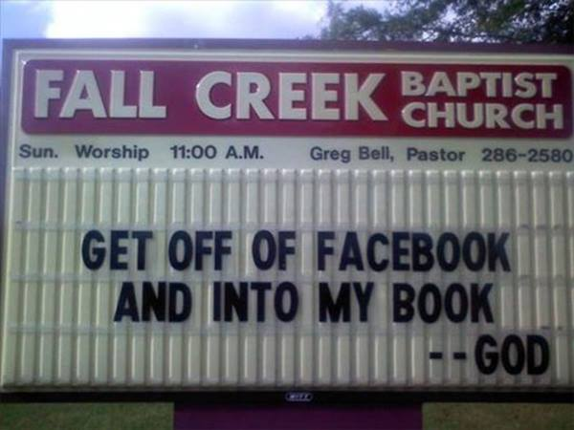
Acts 2
2) The gifts of the Spirit ended with the Apostles
- see 1Corinth. 13:8-10, 2Tim. 4:20
- Anecdotal evidence throughout history confirms miracles have not ceased
- no mention is made of the “laying on of hands” in Acts 10:44
- the church is built on the foundation of the Apostles (Eph. 2:20)
- why is there so much of the New Testament devoted to this teaching if the
gifts were to cease?
- Also see 1Corinth. 13:8-10 and ask yourself, what was the “Perfect” that was
spoken of?
3) Now that we have the Word of God, we don’t need messages from God
- 1Cor. 14:3 gives the purposes of the prophetic gifts. Has their need ended?

Slide 42
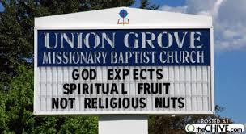
Acts 2
4) Tongues were only a sign to validate the preaching of Apostles in the Book Of Acts
- why does Paul command that we not let them cease in the church (1Cor. 14:39)
5) Everything God has to offer me was appropriated at my salvation.
- The issue here is whether or not the Apostles were “saved” when Jesus was taken into Heaven. In other words, was the Day Of Pentecost a second encounter with God (i.e. the first being salvation) or were they saved and baptized all the same time. It seems clear that the Apostles were baptized themselves before this day (John 3:22, 26 and 4:2). Acts 2:38 seems to indicate a distinction between the two. There is no question that we are complete in Christ Jesus (Col. 2:10), but God still grants gifts and fruit to us as we grow. For example, the disciples could not cast out the demon in Mark 9, but with prayer and fasting (29). Christians grow in the Lord and as such, He grants new power and responsibility.

Slide 43
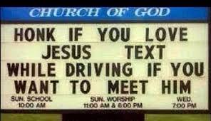
Acts 2
6) Only some are to receive the gift of tongues (see 1Corinth. 12)
- a distinction is made between the general operation of tongues and the Gift of Tongues and Interpretation. Paul claims to speak in an unknown tongue more than any (1Corinth. 14:18) but in the church setting where there are those to be taught, he would rather use the language that is understood (1Corinth. 14:14-17) or follow the tongue with an interpretation. (See all verse 5).
7) If we are still in the age of miracles, why can’t we empty the hospitals?
- remember that there is no promise in Scripture of everyone being healed and God’s ultimate will is still in effect! Also, remember that God’s promises are conditional ... upon faith. We find few promises of God leveled at the unbeliever. (See Matthew 13:58)

Slide 44
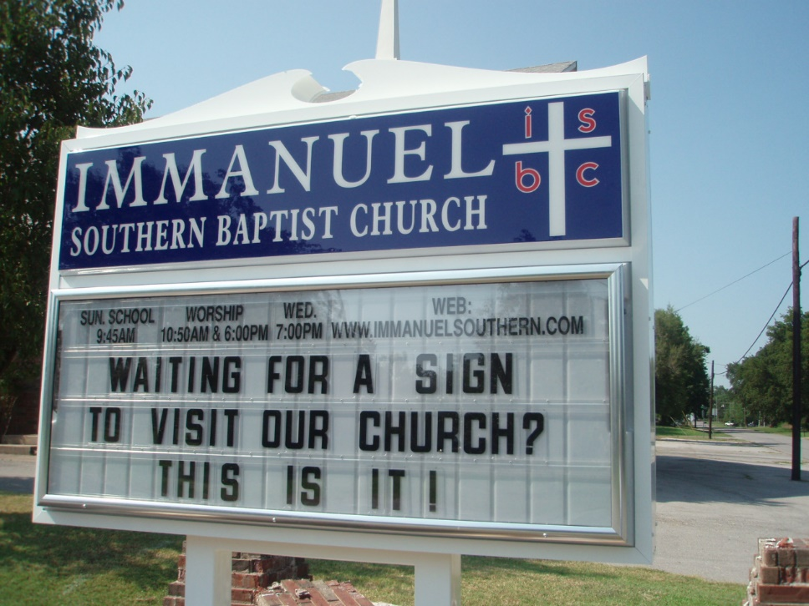
Acts 2
8) I know of those that have never spoken in tongues performing miracles.
- There is no question as to this fact. Christ granted to his Apostles (and later the 70) the power to work miraculous wonders, yet still insisted that they wait in the upper room for this coming. (Matt 10, Luke 10)
9) What does this experience do for me?
- If truly it is of God, would you not want everything that the Lord has for you?
- There is a deepening of prayer life (See Romans 8:26-27)
- There is a deepening of assurance in my heart (see Romans 8:15-16, 1John 4:13)
- There is a deepening understanding of the Scripture (1John 2:26-27,
John 16:12-13)
- There is a more definitive sense of the
leading of the Lord (Act 16:6-8)
- Power (Acts 4:31)

Slide 45
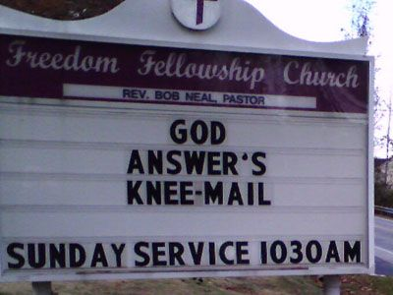
Acts 2
10) God’s revelation to mankind ended with the Scriptures and there is no more revealed truth to come.
-either speaking in an unknown tongue or having a message in tongues and interpretation has never constituted new revealed truth. Nothing can and will ever be revealed as “more of the Bible”. However, Paul gives the purposes of these words in 1Corinth. 14:3.
11) Not all will speak in tongues (based on 1Cor. 12:30).
- we must draw a distinction between the Gift of Tongues (1 Corin. 12) and the ability to praise God in tongues. In passages like Acts 2, Acts 10, Acts 19 it is evident that all could pray in tongues, but there was NO
interpretation required. In 1 Corinth. 12 - 14,
Paul speaks of edifying the church using the Gift
Of Tongues combined with
the Gift Of Interpretation.

Slide 46
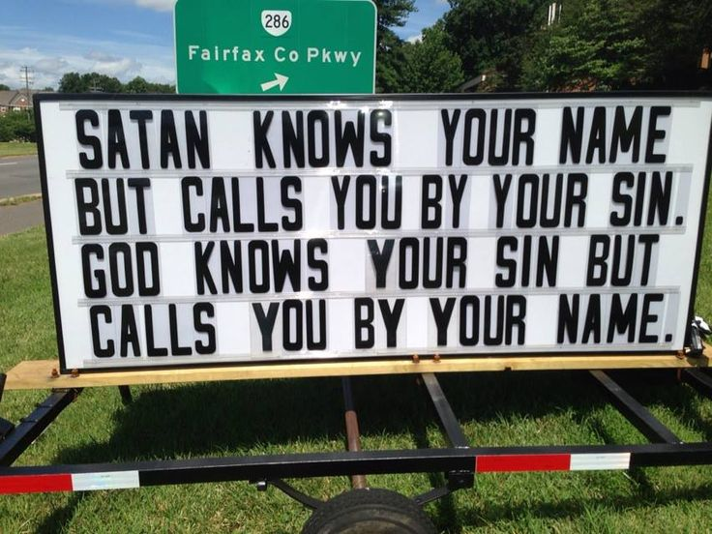
Acts 2
12) When Acts 2 occurred, they were speaking in only known languages.
- perhaps, but there are three things to consider:
a) Why were they accused of being drunk? If all they were doing was praying God in a known language, the charge makes little sense
b) During Acts 10:47, the Spirit fell on Gentile believers. They spoke in other tongues. Nowhere does it indicate that they spoke in a known language. Yet, Peter recognizes instantly the super natural event as he says that it “happened to them like it happened to us”
c) What are tongues of angels and men (1Corinth 13:1)
13) It is all too emotional for me.
-perhaps this is true, but it is the worst of all reasons to deny this doctrine completely. Can anyone argue that the Bible is filled with illustrations of praise to God that is anything but emotional? Singing, shouting, clapping, playing music, dancing etc. are all pretty emotional events. Based on 1 Corinth. 14:32, the prophet
(being used in a gift) is
always in control.

Slide 47
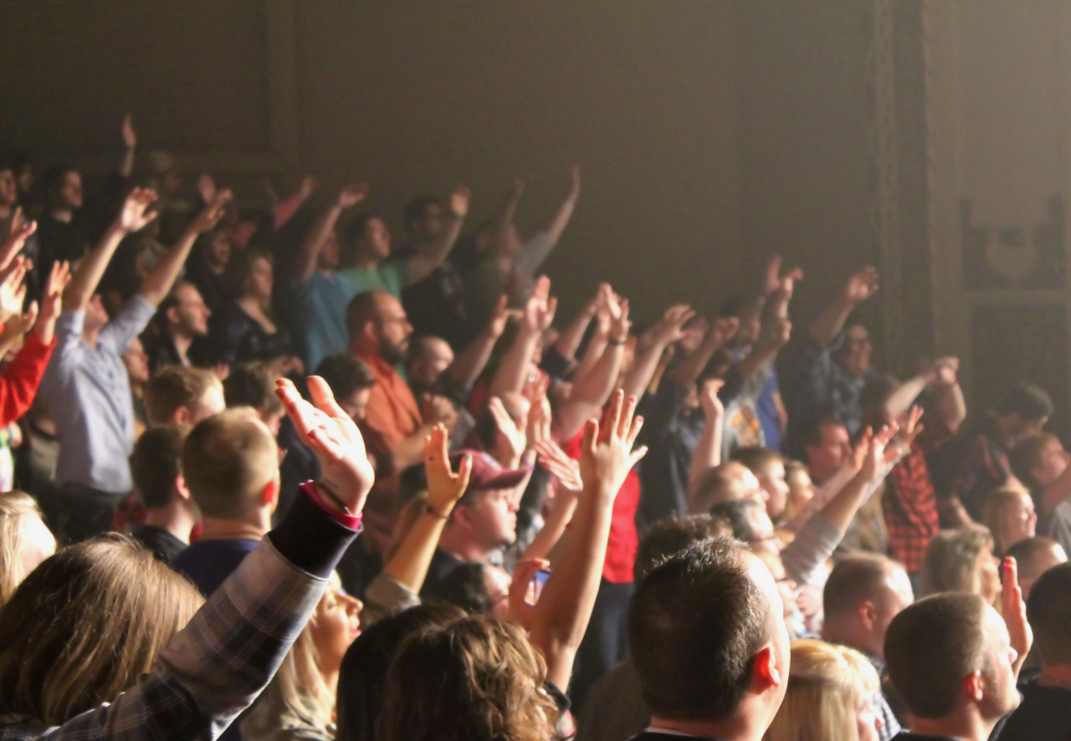
Acts 2
Issues To Consider:
1) No one can “teach” you how to speak in tongues
2) Tongues is an evidence of the experience and is NOT to be sought after
- see Mark 16:17-18
3) God times this gift - no human being can say that you “should have” received or you are in sin because you did not receive. This is utter “spiritual pride”
4) Your salvation is complete in the work of Christ on the Cross
5) Don’t confuse the Gifts of the Spirit with the Fruit of the Spirit. In other words, even people who speak in tongues do foolish and hurtful things! (Not perfection … see Acts 21:10)

Slide 48
Acts 2:14-41
The ancient Christian kerygma as summarized by C.H. Dodd from Peter's speeches in the New Testament Book of Acts was:
1) The Age of Fulfillment has dawned, the "latter days" foretold by the prophets. (Joel 2,3)
2)This has taken place through the birth, life, ministry, death and resurrection of Jesus
Christ.
3) By virtue of the resurrection, Jesus has been exalted at the right hand of God as
Messianic head of the new Israel. (Psalm 110:1-2)
4) The Holy Spirit in the church is the sign of Christ's present power and glory.
5) The Messianic Age will reach its consummation in the return of Christ.
6) An appeal is made for repentance with the offer of forgiveness, the Holy Spirit, and
salvation.

Slide 49
Acts 2:14-41
Why Does Evangelism Get A Bad Wrap?

Slide 50
Acts 2:14-41
Why Does Evangelism Get A Bad Wrap?
1. Clearly identify yourself as a Christian.
2. Let the relationship grow naturally. You do not need to force it.
3. Relationships should be valued for what they are without agendas!
4. Witness comes through passion and love, not intellect.
- Don’t be afraid of the probing questions.
5. Tell your story.
6. You don't need to answer every question immediately.
7. Don't minimize your own struggles and issues. We all have them.
8. Don't minimize the supernatural.
9. Embrace the risk.
Kerygma
IS
Christ

Slide 51
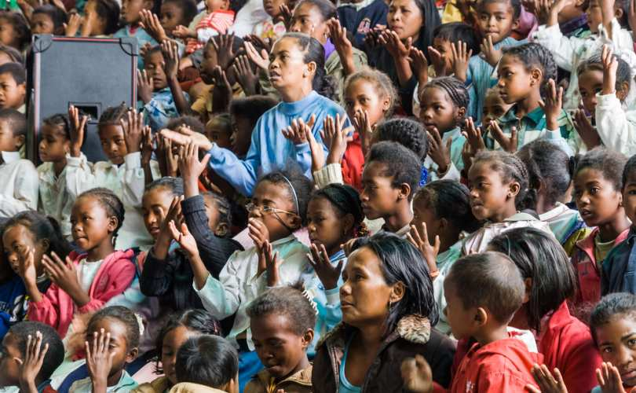
Acts 2:14-41
The Signs Of A Growing Church
a) A learning church (2:42)
b) A loving church (verse 42, 44)
c) A fellowshipping church (2:42)
d) A worshiping church
e) An evangelistic church (2:47)
- to fellowship ... koinonia ... to have something in common ... to share together.
- note that the sharing of goods was always voluntary.
- fellowship was both formal and informal (in homes and the in temple).
- Is going it alone truly a sign of strength? Does it make life easier?

Slide 52
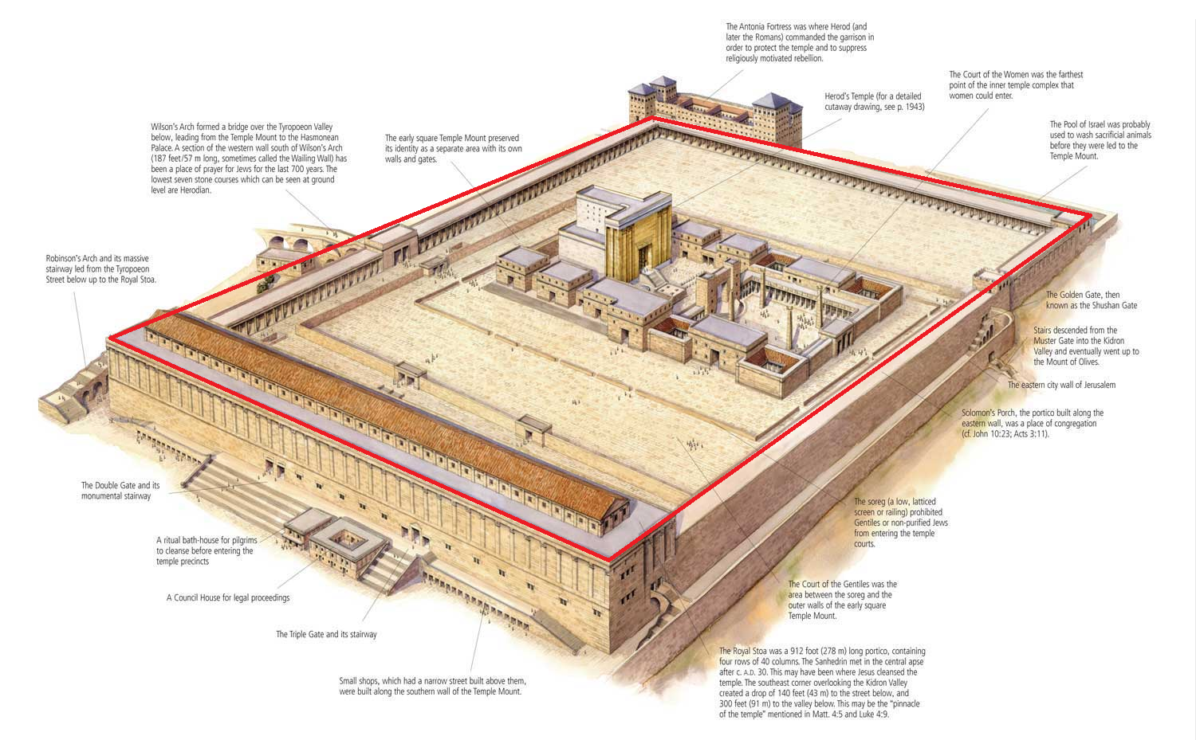
Acts 2:46

Slide 53
The Purpose Of The Church …
W (Worship)
I (Instruction)
F (fellowship)
E (Expression)

Slide 54
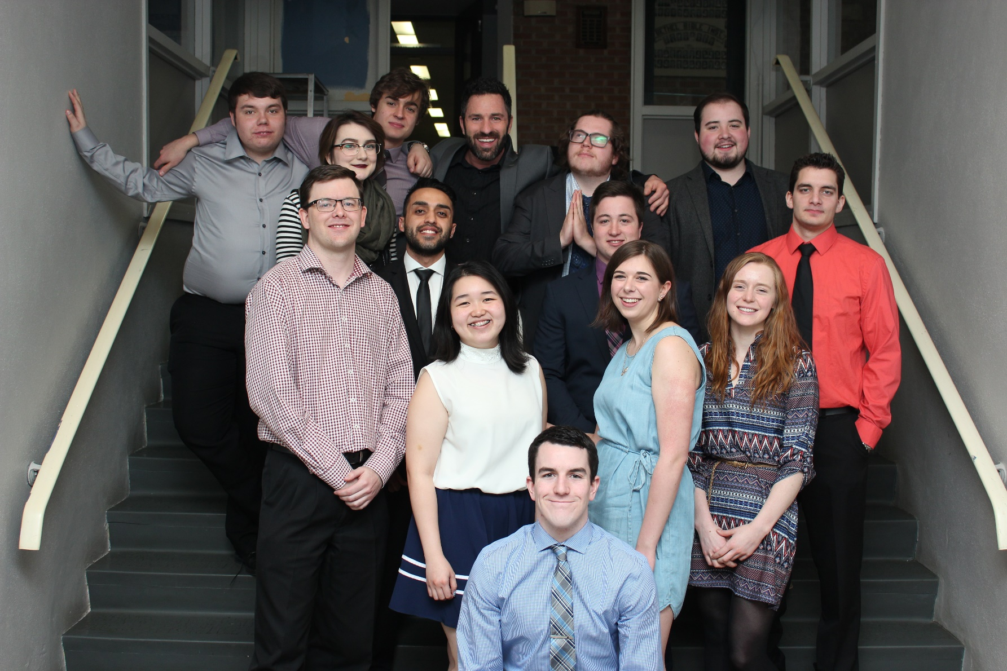
Acts 2:14-41
Fellowship or koinonia, defined as: Love and Acceptance, Care and Compassion, Support and Forgiveness, Encouragement & Availability, Informality and Flexibility, Honesty and Humility

Slide 55
Why is house evangelism difficult?
Many Christians are reluctant to host others in their homes.
Donald Bubna, surveyed Christians to find reasons for this reluctance. The two main reasons he found were:
(1) having guests frightens some prospective hosts
(2) some felt their home furnishings were too modest or inadequate. Others said they were too busy, the expense of showing hospitality was too great, and the tension and exhaustion from getting the house cleaned and the food prepared was too much for them.

Slide 56
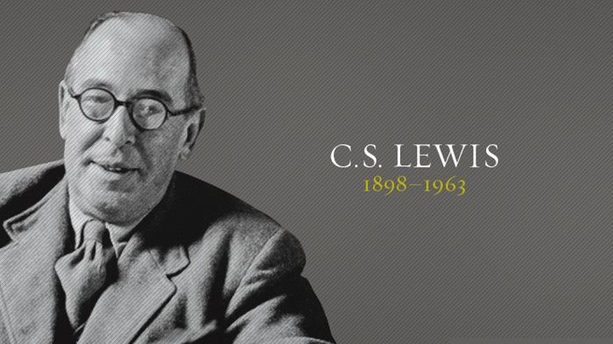
Agape … the basis for all things
There is no safe investment. To love at all is to be vulnerable. Love anything and your heart will certainly be wrung and possibly broken. If you want to make sure of keeping it intact, you must give your heart to no one, not even an animal. Wrap it carefully with hobbies and little luxuries; avoid all entanglements. Lock it up safe in the casket or coffin of your selfishness. But in that casket, safe, dark, motionless, airless - it will change. It will not be broken, but it will become unbreakable, impenetrable, irredeemable. The alternative to tragedy or the risk of tragedy is damnation. The only place you can be perfectly safe from all the dangers of love is hell.
The Four Loves
(New York, Harcourt, 1960)

Slide 57
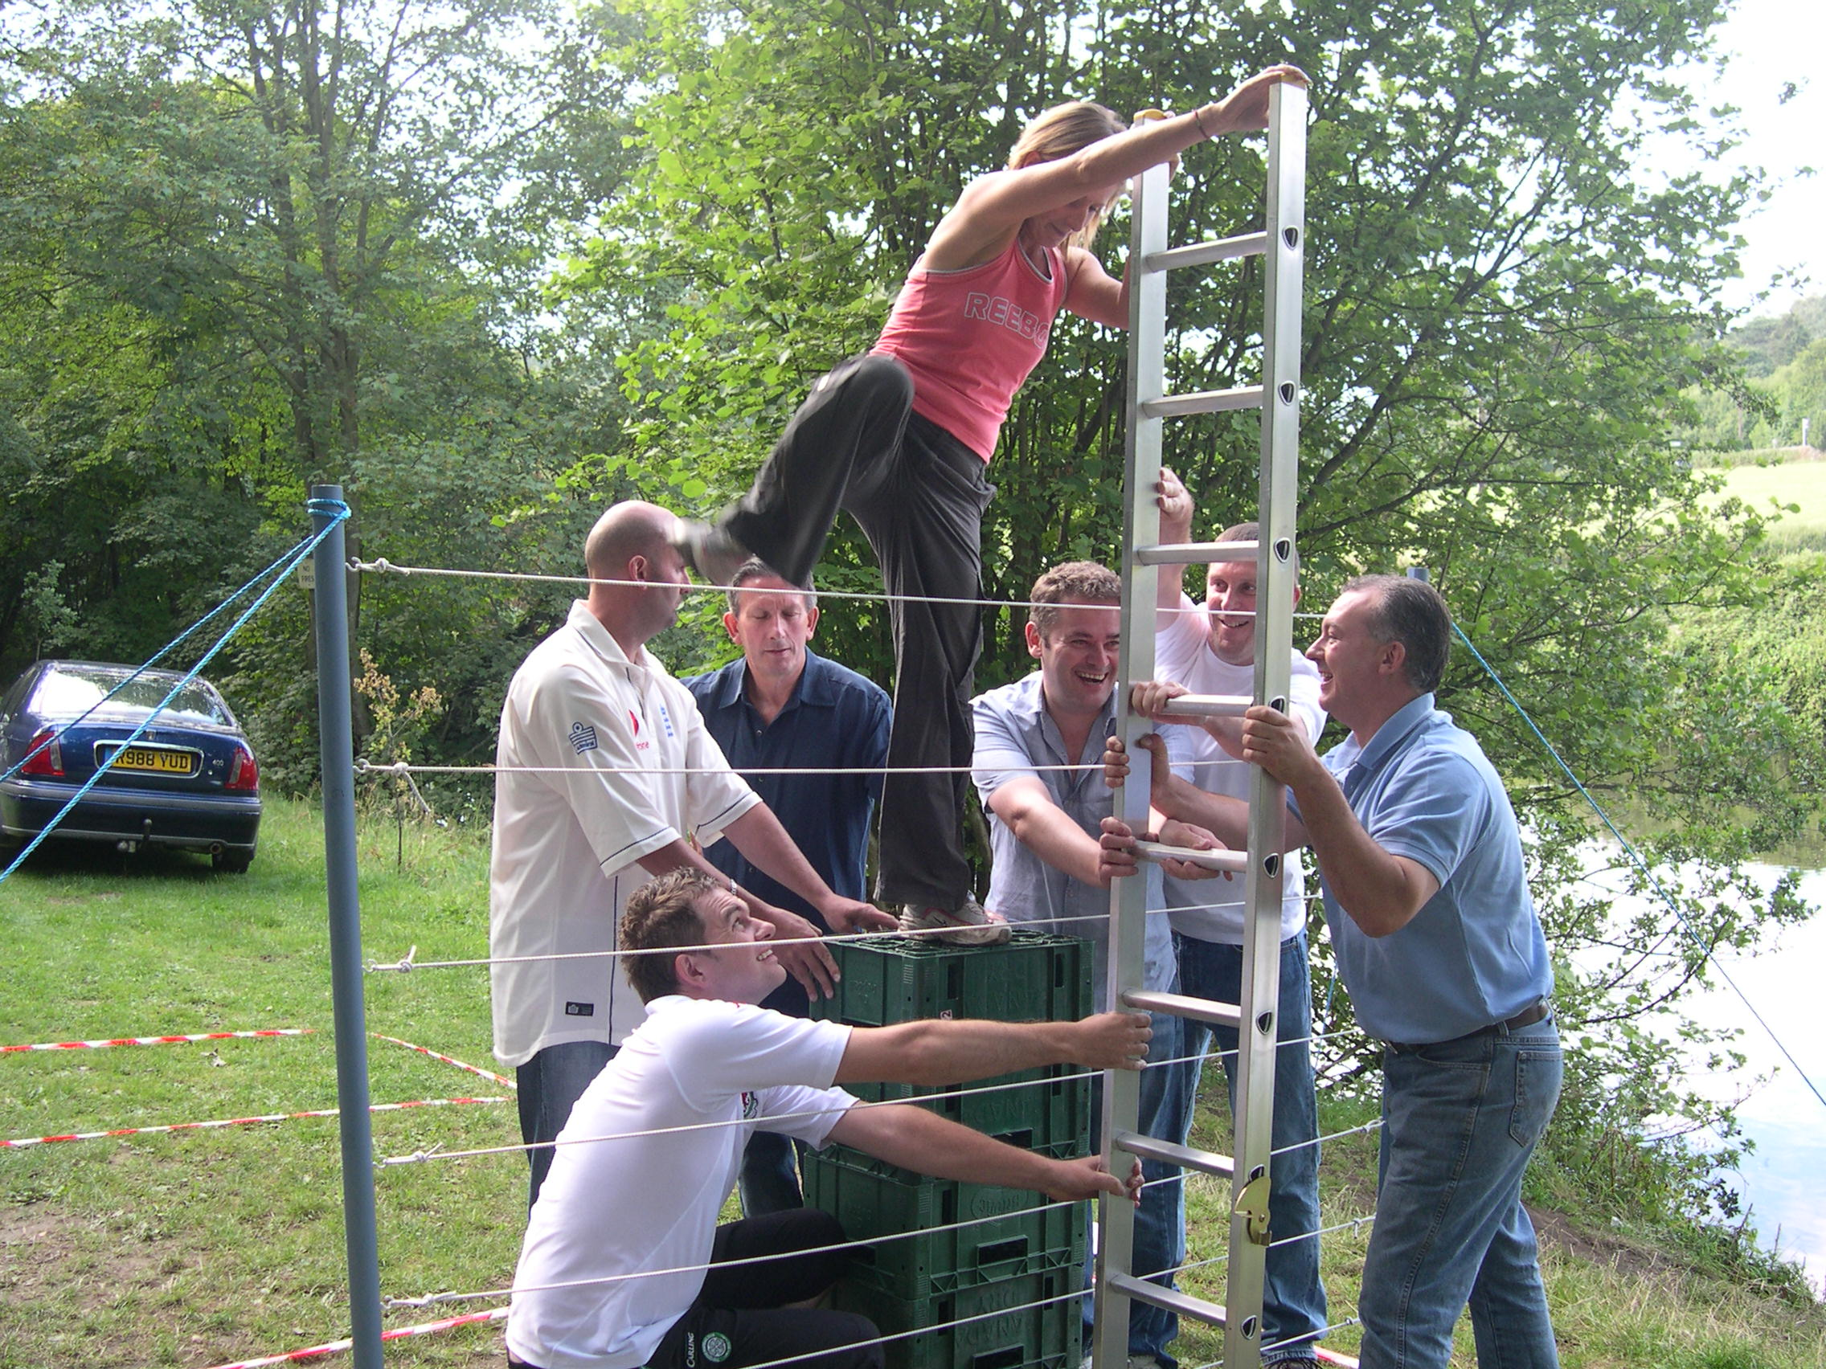
Team Ministry (see Ecc. 4:9-12)
The value of team ministry today cannot be overstressed.
• Greater fruitfulness: “Two are better than one, because they have a good
return for their work.”
• Help in times of personal failure: “If one falls down, his friend can help him up.
But pity the man who falls and has no one to help him up!”
• Warmth of affirmation in times of need: “Also, if two lie down together, they
will keep warm. But how can one keep warm alone?”
• Strength to face attacks: “Though one may be overpowered, two can defend
themselves. A cord of three strands is not quickly broken.”

Slide 58
Choosing To Make An Impact
a) continue “in the temple” i.e. fellowship with believers (3:1)
- what does the Lord desire to teach me through other people?
- when I analyze why I don’t like someone, what do I learn about myself?
b) willing to take time to minster (3:1)
- Note that this was the 9th hour … the same hour that Jesus was crucified.
c) make personal identification with the sick and needy (3: 4) (Look at me)
d) be willing to humble ourselves in their sight (3:4-5)
e) understand the true value of what we have to offer (3:6)
f) TAKE them to the temple (3:8)
g) don’t let them go until they are ready to stand on their own (3:11)
h) be ready to give the Lord glory (3:12)

Slide 59
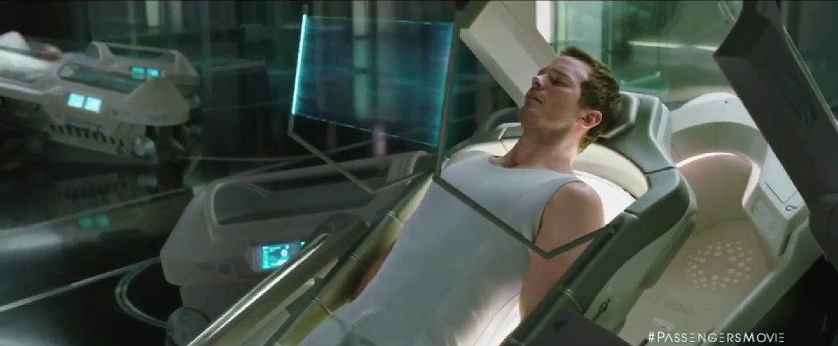
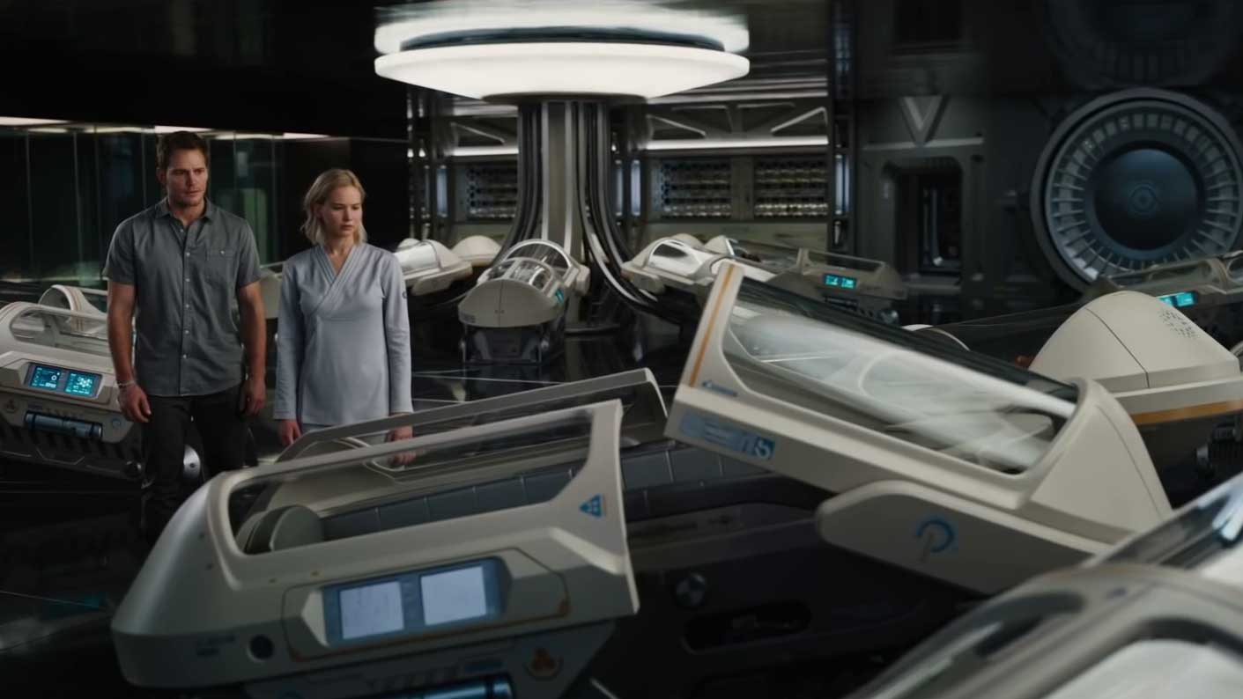
Learning From One Another

Slide 60
What I Learn From You
That people make terrible choices but there is joy in forgiveness.
That God's path for you looks different than mine.
That it is not my job to make you look like me.
That together, we are stronger.
That your gifts are not my gifts.
That you and I both stand and fall to the Lord.
That sin for you MAY not be sin for me.
That differences in theology are not always so bad.
What else … ?

Slide 61
Choosing To Make An Impact
a) continue “in the temple” i.e. fellowship with believers (3:1)
- what does the Lord desire to teach me through other people?
- when I analyze why I don’t like someone, what do I learn about myself?
b) willing to take time to minster (3:1)
- Note that this was the 9th hour … the same hour that Jesus was crucified.
c) make personal identification with the sick and needy (3: 4) (Look at me)
d) be willing to humble ourselves in their sight (3:4-5)
e) understand the true value of what we have to offer (3:6)
f) TAKE them to the temple (3:8)
g) don’t let them go until they are ready to stand on their own (3:11)
h) be ready to give the Lord glory (3:12)

Slide 62
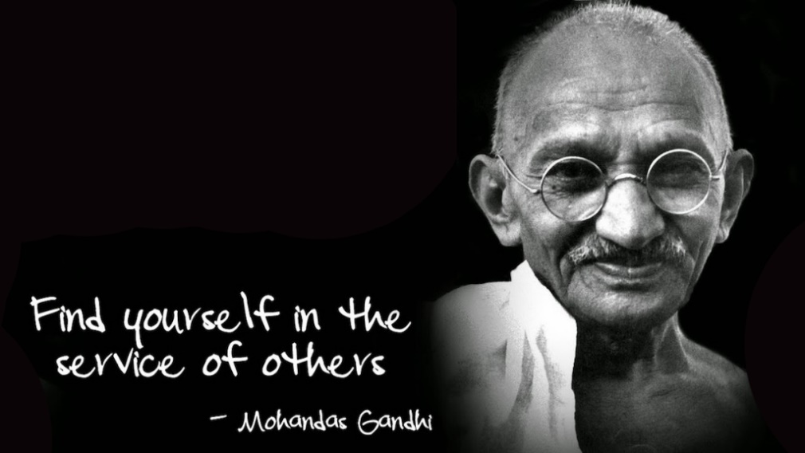
Significant Service
• An anointing with the fullness of the Spirit (v. 8).
• Courage (v. 13).
- The death and resurrection of Christ and his uniqueness as the source of
salvation were offensive to the Jews, but the early Christians had the inner
motivation to persist in this work. In today’s society we need a similar courage
as we face similar challenges.
• The desire to use every opportunity to share the message of the gospel.
- it was not their aim to get off the hook. They used the opportunity to declare
the gospel.
• The nearness and similarity to Christ that Peter and John exhibited
• Loyalty to God.
- Peter and John chose to obey God even if it meant incurring the wrath
of the most powerful people of the time (vv. 19 – 20).
• Confidence over the gospel.
- Peter and John said that they had no choice but to share what they
had “heard and seen” (v. 20) — the facts about the life, death,
resurrection, ascension, and teaching of Christ (see 3:14 – 15).

Slide 63
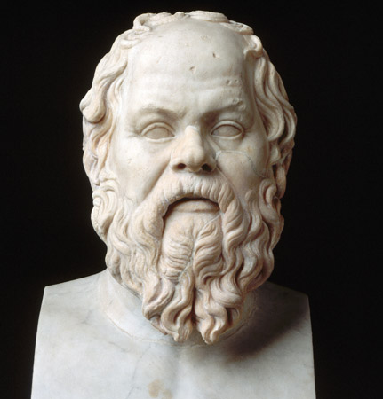
The Words Of God
The apostles likely had never studied Socrates, but quote him almost verbatim in Acts 4:19
… Men of Athens, I honor and love you; but I shall obey God rather than you, and while
I have life and strength I shall never cease from the practice and teaching of philosophy …
Apology Of Socrates
A truism for any principled person!
Socrates (470 - 399BC)

Slide 64
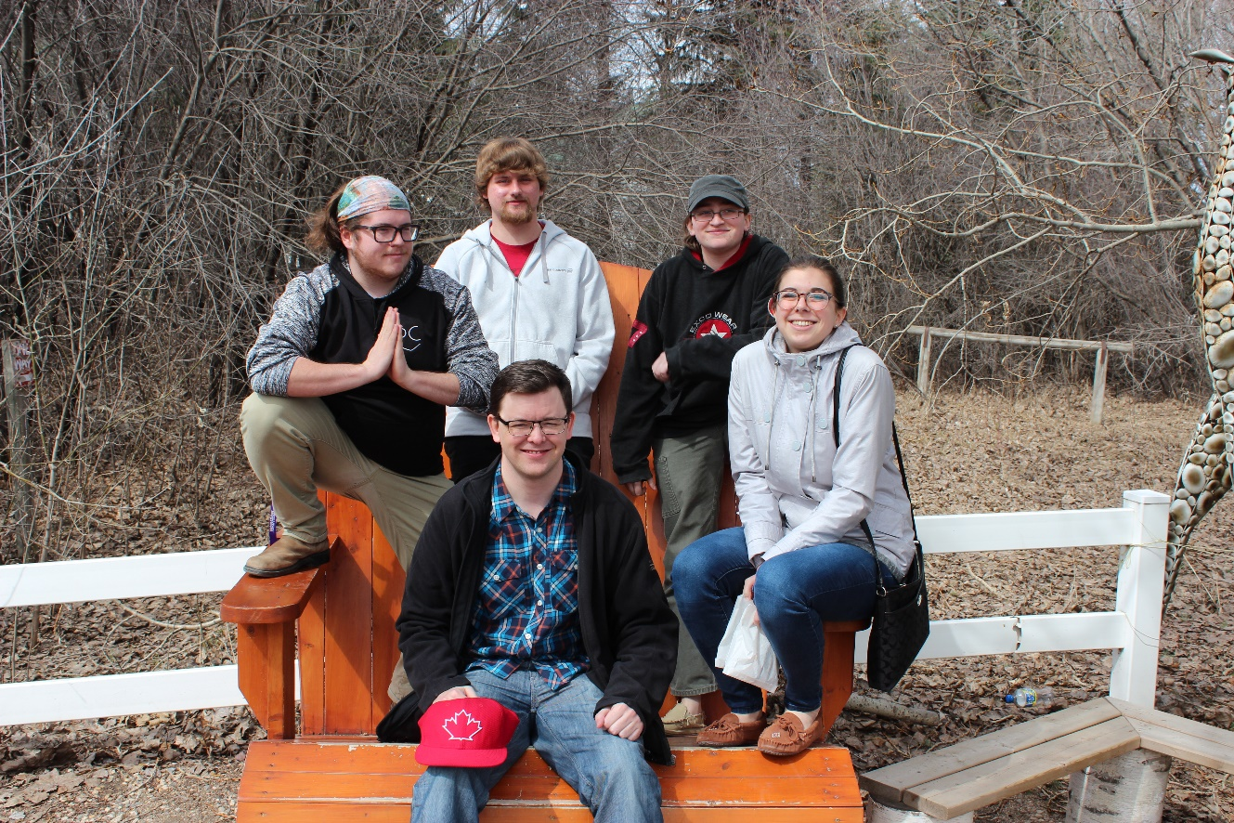
Why Are Bible Colleges Needed Today?
1. Jesus spent three years teaching His disciples.
2. Bad preaching makes bad churches.
3. Sermons that will impact will always be bathed in a good understanding of the Word.
4. Cults are born out of bad theology.
5. Bible colleges teach more than Bible. They teach character.
6. Christian disciplines are often learned first in Bible college.
7. There is no other institution left that teaches or announces a foundation for morality.

Slide 65
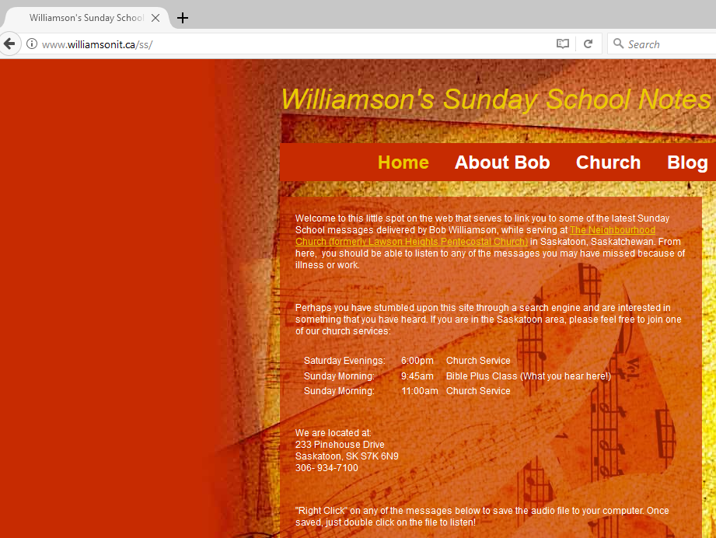
www.williamsonit.ca/ss

Slide 66
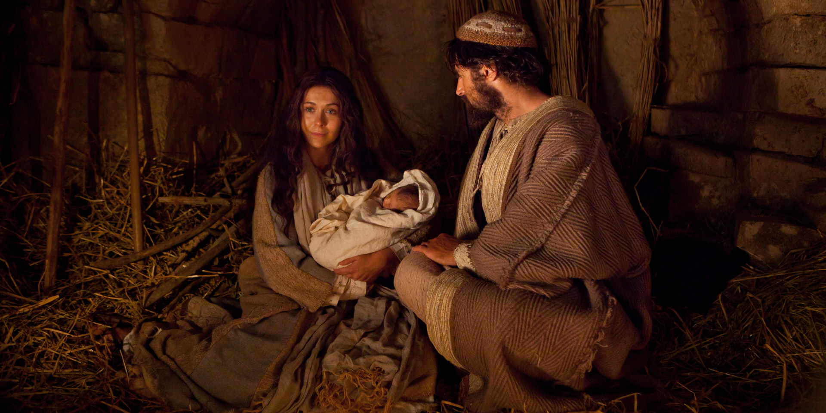
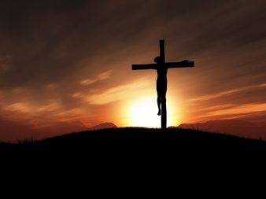
Exclusivity Of Christ (4:12)
Jesus is the Only Savior
1. Christ alone was conceived by the Holy Spirit and born of a virgin
(Isaiah 7:14; Matthew 1:18; Luke 1:26), and as such, he alone qualifies to be Savior.
Only as the Holy Spirit takes the place of the human father in Jesus' conception can it be true
that the one conceived is both fully God and fully man.
2. Christ alone is God incarnate (John 1:1; Hebrews 1:1; Philippians 2:5; 1 Timothy 2:5), and as
such, he alone qualifies to be Savior. As Anselm argued in the 11th century, our Savior must be
fully human in order to take the place of humanity and die in their stead, and he must be fully
God in order for the value of his sacrificial payment to satisfy the demands of our infinitely
holy God.

Slide 67
Exclusivity Of Christ (4:12)
Jesus is the Only Savior
3. Christ alone lived a sinless life (2 Corinthians 2:21; Hebrews 4:15; Hebrews 7:23;
Hebrews 9:13; 1 Peter 2:21), and as such, he alone qualifies to be Savior.
4. Christ alone died a penal, substitutionary death (Isaiah 53:4; Romans 3:21;
2 Corinthians 2:21; Galatians 3:10), and as such, he alone qualifies to be Savior.
The wages of sin is death (Romans 6:23). And because Christ lived a sinless life, he did not
deserve to die. Rather, the cause of his death was owing to the fact that the Father
imputed to him our sin. The death that he died was in our place.

Slide 68
Exclusivity Of Christ (4:12)
Jesus is the Only Savior
5. Christ alone rose from the dead triumphant over sin (Acts 2:22; Romans 4:25;
1 Corinthians 15:3, 1 Corinthians 15:16), and as such, he alone qualifies to be Savior.
The Bible indicates that a few people, other than Christ, have been raised from the dead
(1 Kings 17:17; John 11:38), but only Christ has been raised from the dead never to die again.
Conclusion: Christ alone qualifies as Savior, and Christ alone is Savior. Jesus' own words could
not be clearer: "I am the way, and the truth, and the life. No one comes to the Father except
through me" (John 14:6). And the Apostle Peter confirms this here.

Slide 69
Exclusivity Of Christ (4:12)
Faith In Christ Is Needed To Be Saved
1. Jesus' own teaching shows that the nations need to hear and repent to be saved
(Luke 24:44). Jesus commands that "repentance and forgiveness of sin should be proclaimed
in his name to all the nations, beginning from Jerusalem" (Luke 24:47). The people Jesus
here describes are currently both unrepentant and unforgiven. To be forgiven they must
repent. But to repent they must hear the proclamation of Christ's work in his name.
And this is true for all the nations, including Jews who haven't trusted Christ.
Jesus does not envision the "nations" as already having saving revelation available to them.
2. Paul teaches that even pious Jews, and everyone else, must hear and believe in Christ to
be saved (Romans 10:1). Paul's heart's desire and
prayer is for the salvation of his fellow Jews. Even
though they have a zeal for God, they do not know
that God's righteousness comes only through faith in
Christ. So these Jews, even though pious, are not saved.

Slide 70
Exclusivity Of Christ (4:12)
Faith In Christ Is Needed To Be Saved
3. Cornelius's story demonstrates that even pious Gentiles must hear and believe in Christ
to be saved (Acts 10:1, Acts 10:38; Acts 11:13; Acts 15:7). Far from being saved before Peter
came to him, as some think, Cornelius was a pious (Acts 10:2) Gentile who needed to hear
of Christ, and believe in Christ, to be saved.
Conclusion: Jesus is the only Savior, and people must know and believe in Christ to be saved.
May we honor Christ and the gospel, and manifest our faithfulness to God's word, by
upholding these twin truths and living in a manner that demonstrates our commitment to
them.

Slide 71
What To Pray For … And NOT … ?
Acts 4:29-30
Lord we remember … you are sovereign and this does not take you by surprise
Lord grant us … enable powerful and bold preaching
Lord may we see … signs and wonders
No mention of …
- deliverance
- favour with authorities
- wisdom

Slide 72
Land For Sale (Acts 4:32-37)
- Note that in this passage, land is mentioned twice. Why?
- 1Timothy 6:10 reminds us what wealth can produce. But not here!
- The term "heart and mind" implies a deep sense of unity.
- How do you view the subject of personal ownership (or private property)?

Slide 73
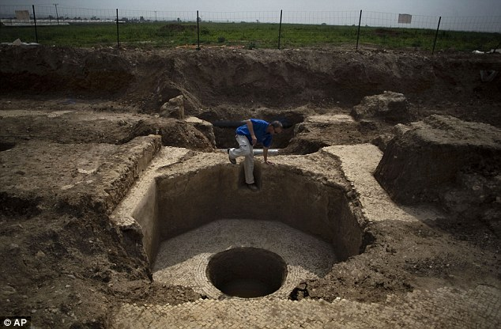
The Power Of One (Acts 4:36)
- Note the power of an individual. These verses deal with God's response to the problem
of the leader's threats. Part of the solution? Barnabas. Why? Because he would disciple
a man named Saul … Paul
How often does God's Word detail the power and effectiveness of One?
Why?
1) Often the majority do not listen
2) It is rare to find the required courage
3) God's power is manifested
- not my gifts but availability
4) One's effects are multipliable
Remember … Gideon

Slide 74
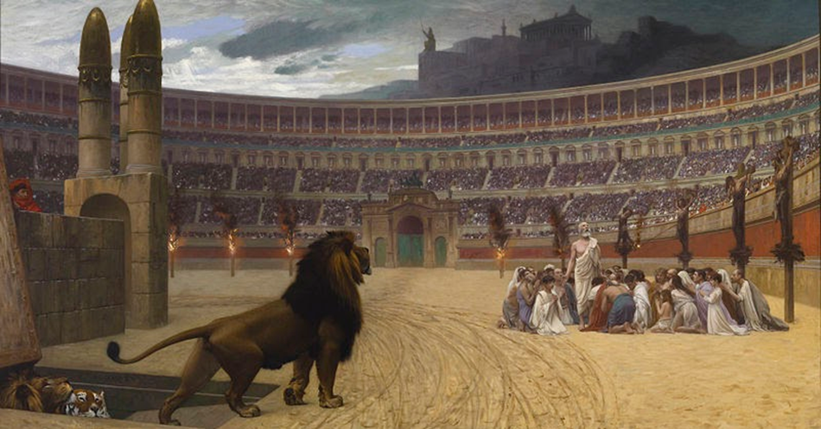
Satan's Attack | God's Response
1. Intimidation (Acts 4) | Courage, community, prayer
2. Internal lies (Acts 5) | God's power roots out the evil
3. Attack and jail leaders (Acts 5) | Courage, obedience, external help (Gamaliel)
4. Internal dissension (Acts 6) | Analyze, strategize, actions
5. Death of the first martyr (Acts 7) | Scatter, spread the Word (Samaritans)
6. Jail and kill believers (Acts 9) | Salvation of Saul
7. Prejudice (Acts 10) | Peter's vision and ministry
8. Attack leaders (James killed, Peter jailed) | Supernatural release of one.
9. Doctrinal problems (Acts 15) | Church council
10. The threat of the "unseen God" - where is He during trials? | Paul would die; The church would grow - Is God good??

Slide 75
Is God Good?

Slide 76
Is God Good?
He is all loving.
He is all powerful.
Evil exists. Bad things happen to good people.

Slide 77
Is God Good?
He is all loving.
He is all powerful.
Evil exists. Bad things happen to good people.
God is eternal.
God is all knowing.
God allows free will.
What does "good" mean?

Slide 78
Moral Corruption (Acts 5:1-10)
Some clear facts …
1) Satanic influence is real.
2) Satanic influence does not let Ananias off the hook.
3) Lying to the Spirit is both a "thing" and a grievous thing!
4) Lying to the church is lying to the Spirit.
5) There was a strong motive here for Ananias to claim a reputation that was not theirs!
6) The Acts church was not a perfect church.
7) Husbands and wives are held mutually accountable

Slide 79
Moral Corruption (Acts 5:1-10)
Barnabas | Ananias
Sold some land | Sold some property
Put the money at the apostles feet | Put (some) money at the apostles feet
Kept back nothing | Kept back part
Note the apostles renamed Joseph (may Jehovah give increase) to Barnabas (Encourager) | Ananias (God is gracious) seeks to make a name for himself

Slide 80
Moral Corruption (Acts 5:1-10)
Achan | Ananias
Stole some property | Sold some property
Hid the robe, silver and gold in his tent | Put (some) money at the apostles feet
Achan stole and lied (Josh. 7:11) | Ananias stole and lied
Joshua confronts him | Peter confronts him
He and his family died (no wife mentioned) | He and his wife died (Wife is a free moral agent!)
Was at the beginning of God's work | Was at the beginning of God's work
Judgement was severe and quick | Judgement was severe and quick
Achan and his family were piled under stones in a field (Josh. 7:28) | Both are buried
The people of Israel witnessed it | The Church witnessed it
A great move of God followed | A great move of God followed
Before this judgement, the community was fractured and powerless | Power returns to the Church after this event

Slide 81
Moral Corruption (Acts 5:1-10)
Some Questions From This Tale:
1) Why is it better to give anonymously?
2) When I sin, do I really believe that I sin against God?
3) Will we ever have a pure church?
4) How important is a pure conscience? (See Acts 24:16, 1John 1:7)
- Is God concerned when a grab at a reputation to which I do not deserve?
5) How important is church discipline today?
6) Is there a relationship between this act and the great powerful miracles that
occur in the next section of our study (5:12-16)

Slide 82
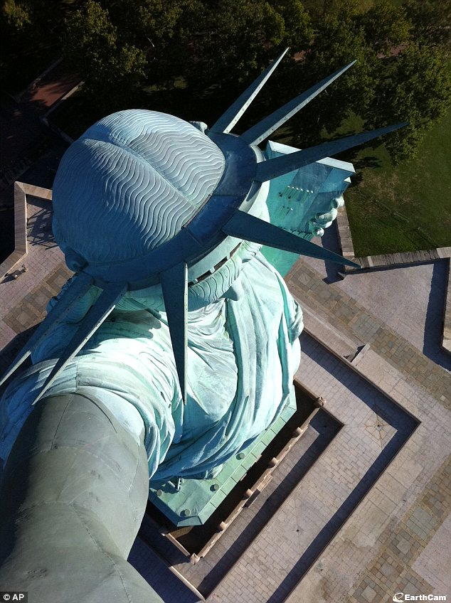
A. Be committed to honesty within
yourself.
1) Be committed to the truth
regardless of how much it hurts.
2) Hate all that is phony or false.
B. Be committed to honesty with God.
1) Make an in‑depth assessment
of your spiritual strengths and
weaknesses.
2) Don't take God's forgiveness
lightly.
a) Don't admit how weak you
are ‑ and then do nothing
about getting stronger.
b) Work on those areas where
you are weakest.
3) Do everything as
"unto the Lord."

Slide 84
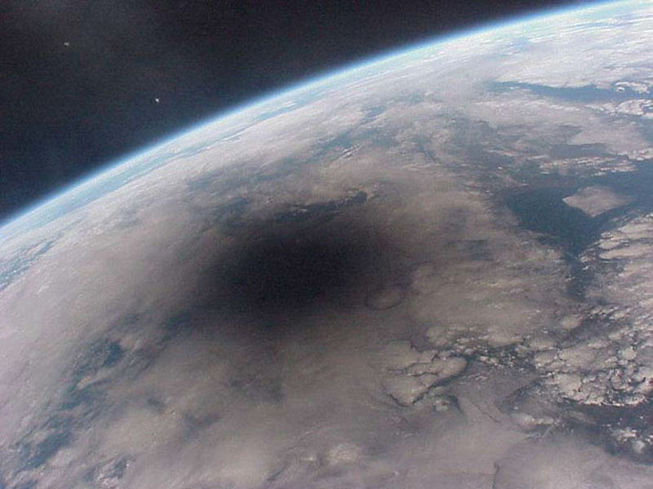
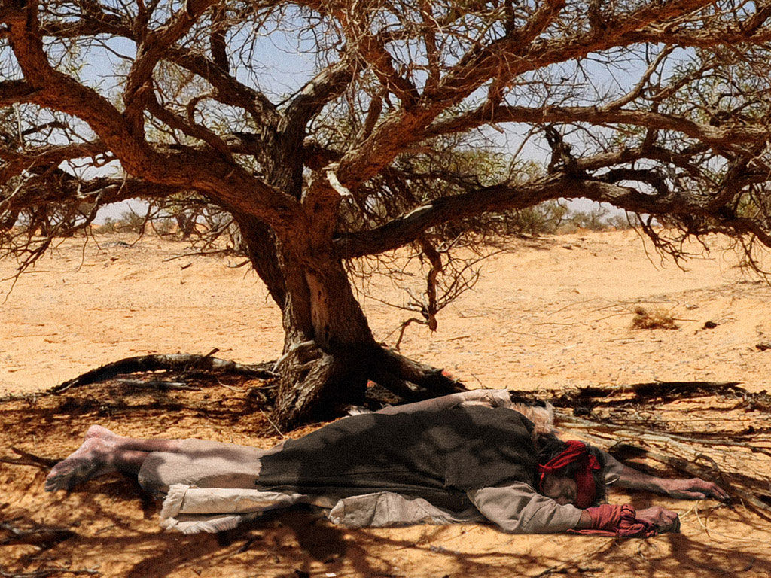
Shadows …
Ps 17:8 Keep me as the apple of your eye; hide me in the shadow of your wings
Isa 32:2 Each man will be like a shelter from the wind and a refuge from the storm, like streams of water in the desert and the shadow of a great rock in a thirsty land.
1Ki 19:4 while he himself went a day’s journey into the desert. He came to a broom tree, sat down under it and prayed that he might die. "I have had enough, LORD," he said. "Take my life; I am no better than my ancestors."

Slide 85
Cursed is Anyone Hung on a Tree
22"If a man has committed a sin worthy of death and he is put to
death, and you hang him on a tree, 23his corpse shall not hang all
night on the tree, but you shall surely bury him on the same day
(for he who is hanged is accursed of God), so that you do not defile
your land which the LORD your God gives you as an inheritance.
New American Standard Bible
Who his own self bare our sins in his own body on the tree, that we,
being dead to sins, should live unto righteousness: by whose stripes ye
were healed.
1Peter 2:24
Christ redeemed us from the curse of
the Law, having become a curse for us–
for it is written, "CURSED IS EVERYONE
WHO HANGS ON A TREE "— Galatian 3:13

Slide 86
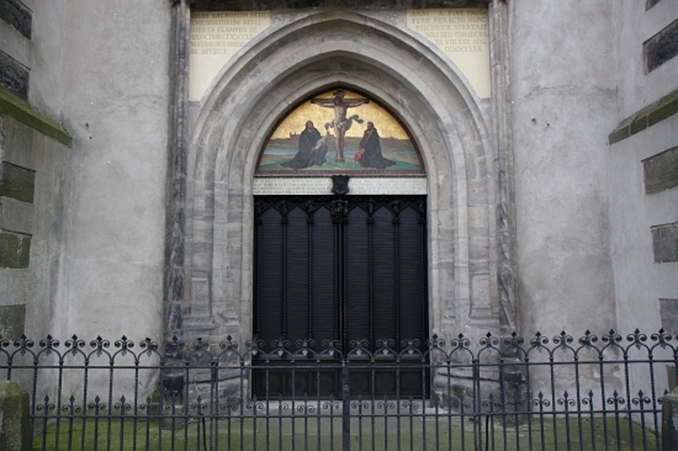
Four basic authority structures:
Parents over children
Employers over employees
Government over people
Submitting to the teaching of the Word through the Church.
Purposes?
1) To grow in wisdom and character (as Jesus did in Luke 3 - His childhood)
2) To gain protection from destructive temptations
- God grants us the ability to learn from those over us!
3) Clear direction for life decisions
- Matthew 8:10 great faith from centurion?
God uses those in authority over us to
curb our characters
Church At Wittenberg
October 31, 1517

Slide 87
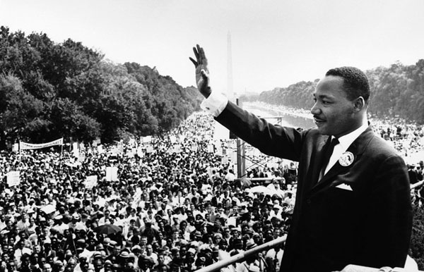
D. J. E. Attwood presents two situations that might warrant civil
disobedience:
1. when believers are required to deny their faith in Christ, or explicitly disown their Lord
2. when the state has required Christians to take part in an action which is in clear conflict
with their Christianly informed conscience.”

Slide 88
When Is Civil Disobedience Appropriate?
1. All democratic and constitutional means must genuinely be exhausted. It is far preferable
to persuade people by democratic argument. [That is what the great apologists of the
early church did.]
2. Civil disobedience should be open and public. It should be submissive to arrest and
punishment, ready to take responsibility for its illegal actions.
3. It should strongly prefer non-violent methods, some would say it must insist on
non-violence.
4. Actions of civil disobedience should display a good knowledge of the law, and a full
respect for it.
5. Actions should be appropriate to the cause.
6. Civil disobedience should have a specific
and realistic end in view. It should not be
designed or undertaken in ways that are
politically counter-productive

Slide 89
When Is Civil Disobedience Appropriate?
1. All democratic and constitutional means must genuinely be exhausted. It is far preferable
to persuade people by democratic argument. [That is what the great apologists of the
early church did.]
2. Civil disobedience should be open and public. It should be submissive to arrest and
punishment, ready to take responsibility for its illegal actions.
3. It should strongly prefer non-violent methods, some would say it must insist on
non-violence.
4. Actions of civil disobedience should display a good knowledge of the law, and a full
respect for it.
5. Actions should be appropriate to the cause.
6. Civil disobedience should have a specific
and realistic end in view. It should not be
designed or undertaken in ways that are
politically counter-productive

Slide 90
Being A Christian In A Secular Workplace
(http://jesusalive.cc/ques324.htm)
1. Know the law and know what it means
- Dissemination and harassment is wrong no matter who you are (Acts 16:37-38)
2. Bless and do not curse (Matthew 5:44, Acts 7)
- Be very careful of your heart and attitude
- Only three men in Scripture are ever described as meek (power under control)
1) Christ (Matt. 11:29)
2) Paul (2Cor. 10:1)
3) Moses (Numbers 12:3)
3. Some verses to consider: (Rom 12:21) says, "Do not be overcome by evil, but overcome
evil with good."
(1 Pet 3:8-9) says, "To sum up, all of you be
harmonious, sympathetic, brotherly,
kindhearted, and humble in spirit; (9) not
returning evil for evil or insult for insult, but
giving a blessing instead; for you were
called for the very purpose that you might
inherit a blessing."

Slide 91
Being A Christian In A Secular Workplace
(1 Pet 3:17)(NLT) says, "Remember, it is better to suffer for doing good, if that is what God
wants, than to suffer for doing wrong!"
(Titus 2:9-10)(NIV) in speaking to Christian slaves, God says, "Teach slaves to be subject to
their masters in everything, to try to please them, not to talk back to them, (10) and not
to steal from them, but to show that they can be fully trusted, so that in every way they
will make the teaching about God our Savior attractive.
(Gal 6:9) says, "And let us not be weary in well doing: for in due season we shall reap, if we
faint not."
(James 1:2-4) says, "Consider it all joy, my
brethren, when you encounter various
trials, (3) knowing that the testing of your
faith produces endurance. (4) And let
endurance have its perfect result, so that
you may be perfect and complete, lacking
in nothing."

Slide 92
Being A Christian In A Secular Workplace
(1 Pet 3:17)(NLT) says, "Remember, it is better to suffer for doing good, if that is what God
wants, than to suffer for doing wrong!"
(Titus 2:9-10)(NIV) in speaking to Christian slaves, God says, "Teach slaves to be subject to
their masters in everything, to try to please them, not to talk back to them, (10) and not
to steal from them, but to show that they can be fully trusted, so that in every way they
will make the teaching about God our Savior attractive.
(Gal 6:9) says, "And let us not be weary in well doing: for in due season we shall reap, if we
faint not."
(James 1:2-4) says, "Consider it all joy, my
brethren, when you encounter various
trials, (3) knowing that the testing of your
faith produces endurance. (4) And let
endurance have its perfect result, so that
you may be perfect and complete, lacking
in nothing."

Slide 93
Being A Christian In A Secular Workplace
When required to confront …
First, we need to pray. Pray about if you should confront whoever is treating you unfairly.
If you feel lead to do so, pray about what to say. Pray for God to search your heart and show
you if you are doing anything wrong (Ps 139:23-24). If so, you may need to apologize. Then,
we should keep the following verses in mind as we confront:
Remember to approach it with "meekness" and "humility".
Do it without "selfishness or empty conceit," "not merely looking out for your own personal
interests, but also the interests of (the one you are speaking to) others" (Phil 2:3-4).
Do it with "love" (1 Cor 16:14)(1 Jn 4:7-8),
and "grace" (Col 4:6), remembering to
"love your neighbor as yourself"
(Mt 19:19)(Mt 22:39)(Mk 12:31).
Do it without "complaining or arguing"
(Phil 2:14), or anger (Eph 4:31)(Col 3:8).
Speak to the person in private (not in front of others) (Mt 18:15). (This was meant for Christians speaking to Christians, but I still think it applies.)
In confronting, I find it useful to ask questions, and find out where people are coming from.
*** Note: It is interesting to note that when Jesus was attacked by people, nearly every time He confronted them with a question in response: (Attacked Mt 9:3 - Question Mt 9:4)(Attacked Mt 12:2 - Question Mt 12:3-4) (Mt 12:10/Mt 12:11-12) (Mt 12:24/Mt 12:26-27) and more.
Perhaps ask questions such as:
Have I done something to make you upset? (As opposed to: I don't like being picked on!)
Am I doing something wrong that I can do better? (As opposed to: I don't deserve this kind of treatment!)
I have not gotten a raise in two years, is there some reason why? (As opposed to: I have been here 2 years and haven't gotten a raise, and I deserve one!)
I have been here for 5 years, and others who have been here less time are being promoted instead of me, is there something I have done wrong? (As opposed to: I have been here for 5 years and IT ISN'T FAIR that I haven't been promoted!)

Slide 94
Being A Christian In A Secular Workplace
When required to confront …
Speak to the person in private (not in front of others) (Mt 18:15).
In confronting, I find it useful to ask questions, and find out where people are coming from.
*** Note: It is interesting to note that when Jesus was attacked by people, nearly every
time He confronted them with a question in response: (Attacked Mt 9:3 - Question Mt 9:4)
(Attacked Mt 12:2 - Question Mt 12:3-4) (Mt 12:10/Mt 12:11-12) (Mt 12:24/Mt 12:26-27)
and more.
Perhaps ask questions such as:
Have I done something to make you upset?
(As opposed to: I don't like being picked on!)
Am I doing something wrong that I can do
better? (As opposed to: I don't deserve
this kind of treatment!)

Slide 95
Being A Christian In A Secular Workplace
When required to confront …
I have not gotten a raise in two years, is there some reason why?
(As opposed to: I have been here 2 years and haven't gotten a raise, and I deserve one!)
I have been here for 5 years, and others who have been here less time are being
promoted instead of me, is there something I have done wrong? (As opposed to:
I have been here for 5 years and IT ISN'T FAIR that I haven't been promoted!)

Slide 96
Being A Christian In A Secular Workplace
When asked to do something unethical at work … what should I do?
Should Christians be forced to attend diversity training?
- How might the story of Daniel help us answer this question?
- Daniel 1:4-5, 17)
Should Christians be required to work on Sunday? (see Romans 13)
TRUTH: Opposition to our way of life, to our faith, is a certainty, a little-quoted promise
of Jesus. The courts can not be trusted to protect us. We have had it fairly easy from
Constantine onwards (Edict of Milan, 313AD). No longer. There may be a time
that we are required to quit a beloved job.
a) Determine to exit with dignity and honor
b) Did you give your employer a chance?
c) Are you honoring your commitments
even to the end?
d) Make sure you are not conspiring with
others.

Slide 97
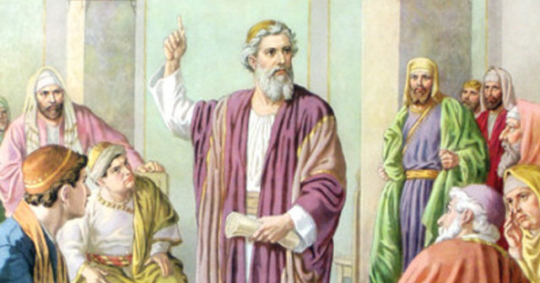
Gamaliel
- note also that it is at the intervention of the more tolerant Pharisee Gamaliel, that they
obtained their freedom. Gamaliel’s most famous student - Saul (see Acts 22:3)
- we see a leadership style here that is worth mentioning:
a) restrain anger: decisions can never be made emotionally
b) respond cautiously: Is this of God or not?
c) present facts
d) move ahead slowly: God’s timing is not always ours
e) understand that things we don’t necessarily see can still be of God
- Is Gamaliel’s principle (verse 38) an accurate one?
- The Apostles left the place with 39 lashes, yet rejoicing
- “the honour to be dishonoured ... the grace to be disgraced”

Slide 98
Under Nero (AD 54-68) Christians were imprisoned and executed, including probably Paul and Peter.
Domitian (AD 81-96) oppressed Christians who refused to pay him the divine honours he demanded; under him John was exiled to Patmos.
Marcus Aurelius (AD 161-180), believing that Christianity was dangerous and immoral, turned a blind eye to severe local outbreaks of mob violence.
Then in the third century what had so far been sporadic became systematic. Under Decius (AD 249-251) thousands died, including Fabian, Bishop of Rome, for refusing to sacrifice to the imperial name.
The last persecuting emperor before the conversion of Constantine was Diocletian (AD 284-305). He issued four edicts which were intended to stamp out Christianity altogether. He ordered churches to be burned, Scriptures to be confiscated, clergy to be tortured, and Christian civil servants to be deprived of their citizenship and, if stubbornly unrepentant, executed.
Tertullian, addressing the rulers of the Roman Empire, cried out: “Kill us, torture us, condemn us, grind us to dust.... The more you mow us down, the more we grow; the seed is the blood of Christians.”
Bishop Festo Kivengere said in February 1979, on the second anniversary of the martyrdom of Archbishop Janani Luwum of Uganda: 'Without bleeding the church fails to bless.' Persecution will refine the church, but not destroy it. If it leads to prayer and praise, to an acknowledgment of the sovereignty of God and of solidarity with Christ in his sufferings, then - however painful - it may even be welcome.

Slide 99
Service (Acts 6:1-7, Romans 12:6-8)
a) Don’t ignore the problem
b) Don’t be content to attack the complainers
c) Act as a group. Share the burden. Know your strengths.
d) Deal with the problem with sensitivity (Note all of the chosen men had Greek names!)
e) Don’t negate the physical over the spiritual
f) Secular giftings do not trump spiritual hearts. BOTH are required in the Church.

Slide 100
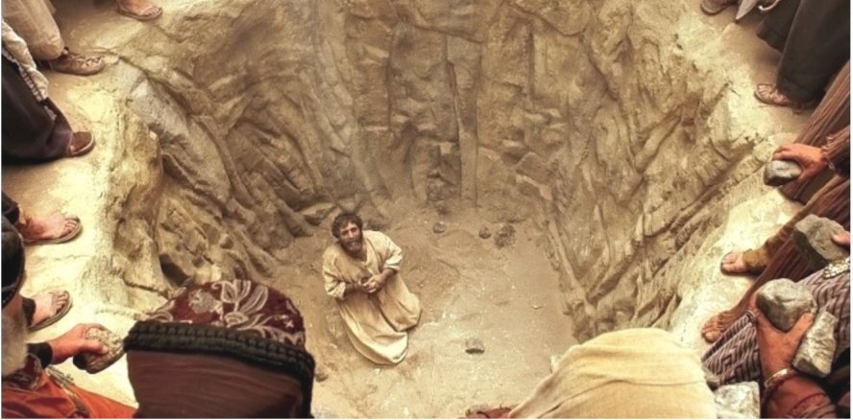
Stephen …
1. Full of faith (6:5)
2. Full of the Holy Spirit (6:5, 7:55)
3. Full of God's grace (6:8) (He was a gracious, winsome person)
4. Full of God's power (6:8)
5. Of Wisdom (6:10)
6. Of forgiveness (7:60)
7. His glowing countenance reminds us of what is said of Moses (6:15)

Slide 101
He preaches on three themes …
1. God does not move just in Israel … He is evident everywhere
- Where have you see God move?
2. Worship does not always happen at the temple
- What was the most unusual place you found yourself worshiping God?
3. People often ignore the voice of God through His prophets
- What is the most unusual voice used to speak the Word of God to you?

Slide 102
Christ and Moses are similar and complementary
a) An unusual birth (7:20)
b) Death of babies at both births (7:19)
c) Both children came out of Egypt (7:21)
d) Christ, like Moses, was rejected by His people (7:25, 35, 39)
e) Both were sent by the Father (7:35b)
f) Both did signs and wonders (7:36)
g) Moses prophesized regarding Jesus {7:37, Deut. 18:15, 18})

