Slide 1

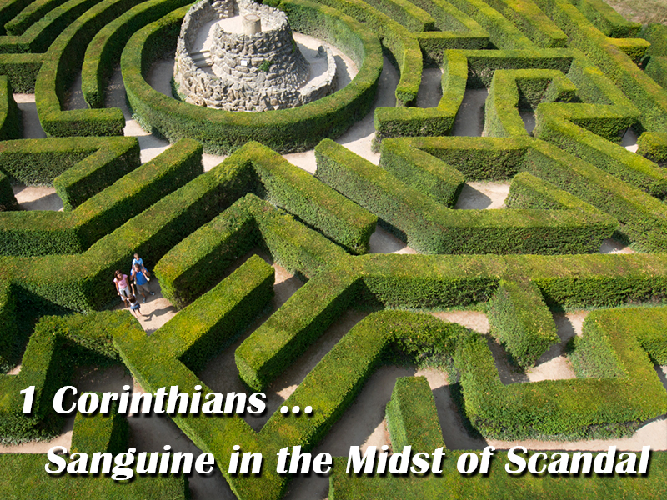

Slide 2
Parallelism
Isaiah 55:6-7 New International Version (NIV)
A. Seek the Lord while he may be found; SEEK the Lord
A. call on him while he is near. Call on Him
B. Let the wicked forsake their ways HIS WAYS
B. and the unrighteous their thoughts. His thoughts
C. Let them turn to the Lord, and he will have TO THE LORD - MERCY
C. mercy on them, and to our God, for he will To God - Pardon
C. freely pardon.

Slide 3
Chiasm (or Inverted Parallelism or Ring Composition)
Isaiah 55:8-9 New International Version (NIV)
A. “For my thoughts are not your thoughts, THOUGHTS
B. neither are your ways my ways,” Ways
declares the Lord.
C. “As the heavens are higher than the earth, Parable
B. so are my ways higher than your ways Ways
A. and my thoughts than your thoughts. THOUGHTS

Slide 4
Step Parallelism
Isaiah 55:10-11 New International Version (NIV)
As the rain and the snow come down from heaven, THE RAIN
and do not return to it without watering the earth Not return
and making it bud and flourish, Results
so that it yields seed for the sower and bread for
the eater,
so is my word that goes out from my mouth: GOD’s WORD
It will not return to me empty, Not return
but will accomplish what I desire Results
and achieve the purpose for which I sent it.
Note how the rain does not return void
and so does God’s word!

Slide 5
Revelation: Chiasm
Prologue (Rev 1:1-8)
Seven Churches (1:10-3:22)
Seven Seals (4:1 – 8:1)
Seven Trumpets (8:2 – 11:18)
Satan attacks (11:19-14:20)
Fall Of Babylon (17:1-19:10)
Bowl Judgments 15:1 – 16:21
Millennium (19:11 – 21:8)
New Jerusalem (21:9 – 22:9)
Epilogue (Rev 22:8-17)

Slide 6
Revelation: Chiasm
Introduction
Testimony of Jesus (1:2)
Blessed is he who reads (1:3)
Behold He is coming (1:7)
I am the Alpha and the Omega (1:8)
Prologue Rev 1:1-8
I, Jesus, sent this testimony (22:16)
Blessed is he who keeps (22:7)
Behold I come soon (22:12, 20)
I am the Alpha and the Omega (22:13)
Epilogue Rev 22:8-17

Slide 7
Revelation: Chiasm
Christ walks among the 7 lamps (2:1)
Tree Of Life (2:1)
Open Door (3:8)
Christ sits on the Father’s throne (3:21)
New Jerusalem comes down from heaven (3:12)
I am coming soon (3:11)
Seven Churches (1:10-3:22)
Christ is the eternal lamp (21:23)
Tree Of Life (22:2)
Gates never close (21:25)
Throne of God and the Lamb (22:1,3)
New Jerusalem comes down from heaven (21:10)
I am coming soon (22:7)
New Jerusalem (21:9 – 22:9)

Slide 8
Revelation: Chiasm
Heaven opens (4:1)
Riders on colored horses (6:2-8)
Souls of martyrs under alter ask for judgment (6:9-10)
White robes (6:11, 7:9-14)
Kings ask to be killed (6:15-16)
Seven Seals (4:1 – 8:1)
Heaven opens (19:11)
Rider on white horse and others (19:11-16)
Souls of martyrs resurrected and made judges (20:4-6)
White robes (19:14)
Kings are killed (19:17-21)
Millennium (19:11 – 21:8)

Slide 9
Revelation: Chiasm
Earth (8:7)
Sea (8:8-9)
Rivers and fountains (8:10-11_
Sun, moon and stars (8:12)
Darkness, bottomless pit, locusts (9:1-11)
River Euphrates (9:13-21)
Loud voices: The Kingdom is Christ’s (11:15-18)
Seven Trumpets (8:2 – 11:18)
Earth (16:2)
Sea (16:3)
Rivers and fountains (16:4)
Sun (16:8-9)
Darkness on the throne of the Beast (16:10-11)
River Euphrates (16:12, 16)
A loud voice … It is done! (16:17-21)
Seven Bowl Judgments
(15:1-16:21)

Slide 10
Revelation: Chiasm
True mother dressed in white (12:1-2)
Her child keeps the commandments (12:17)
Woman in the wilderness (12:14)
Beast with 7 heads and 10 horns (12:3, 13:1)
Fallen is Babylon (14:8)
Testimony of Jesus (12:17)
Satan attacks (11:19-14:20)
False mother, dressed in purple (17:4)
Her children are harlots (17:5)
Woman in the wilderness (17:3)
Beast with 7 heads and 10 horns (17:3)
Fallen is Babylon (18:2)
Testimony of Jesus (19:10)
Fall Of Babylon (17:1-19:10)

Slide 11
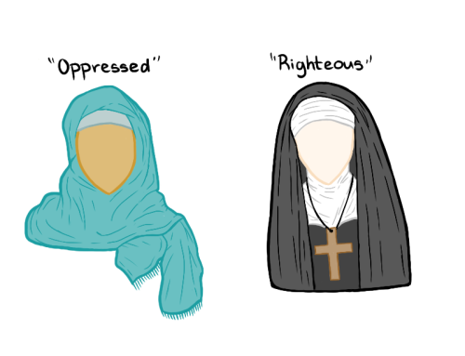
Some Concerns …
Ethnocentrism …

Slide 12
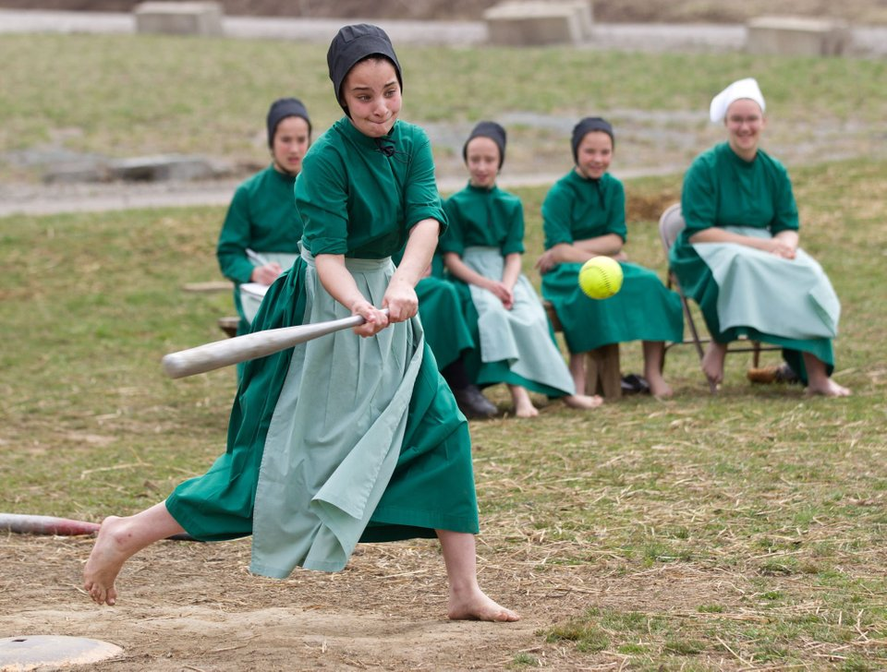
Canonizing of culture …

Slide 13
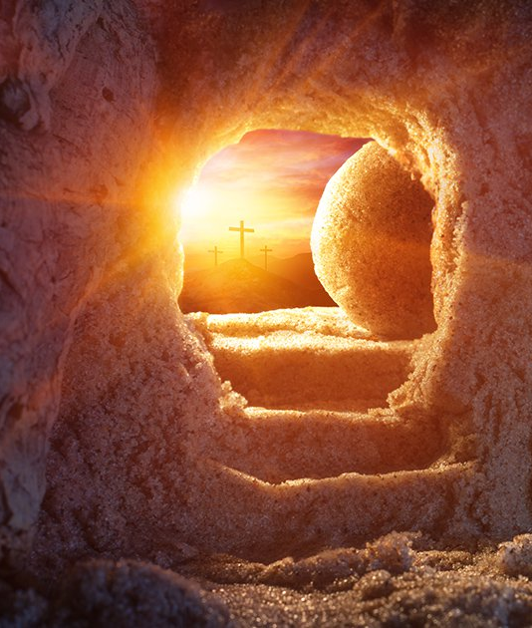


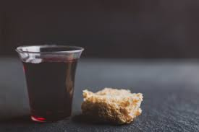
Themes
1) Christian unity and why it is important
2) How should Christians really view the cross
3) Sexual practices for Christians
4) Living the life God called us to in a hostile world
5) Marriage
6) Communion
7) The place of men and women in spiritual leadership
8) Spiritual gifts
9) Love
10) Understanding the resurrection

Slide 14
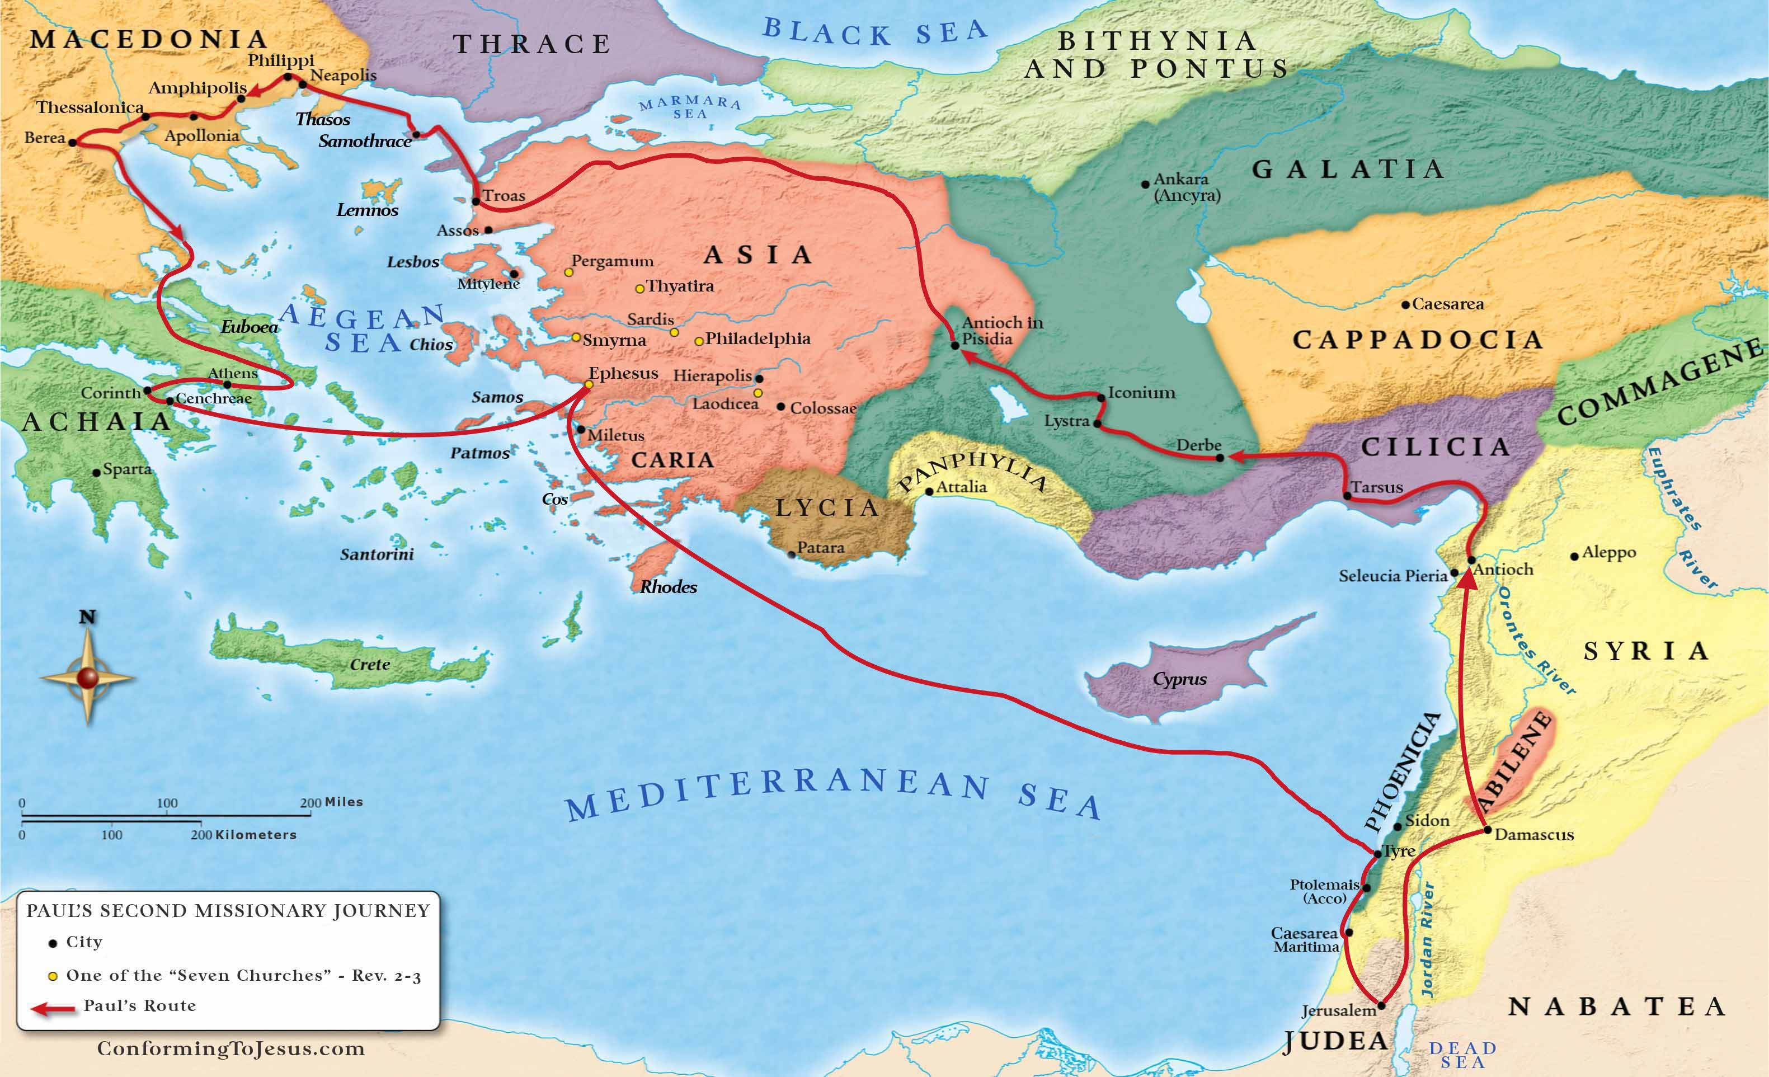
Corinth

Slide 15
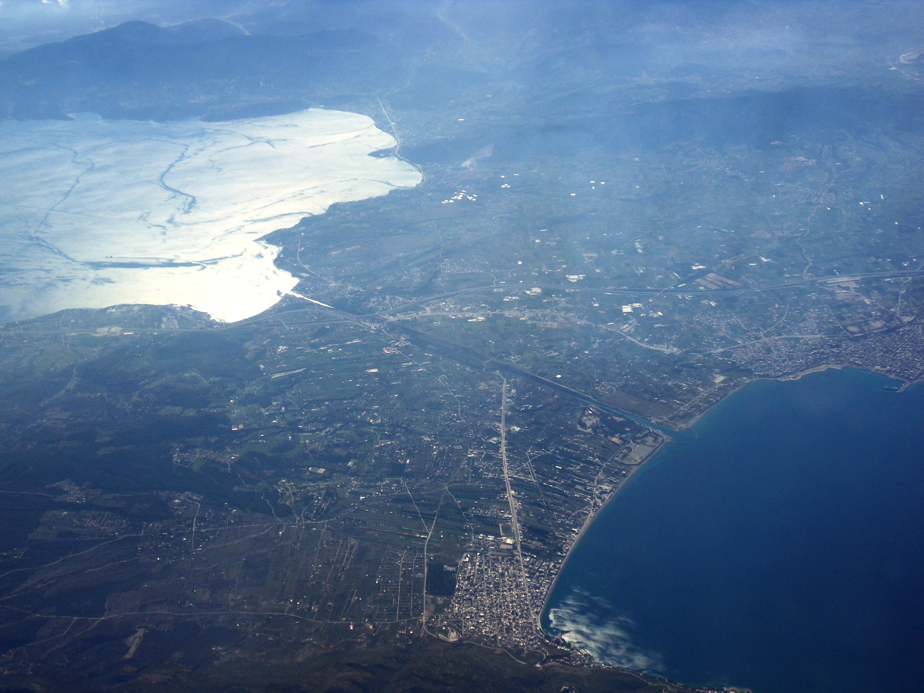
Modern Corinth

Slide 16
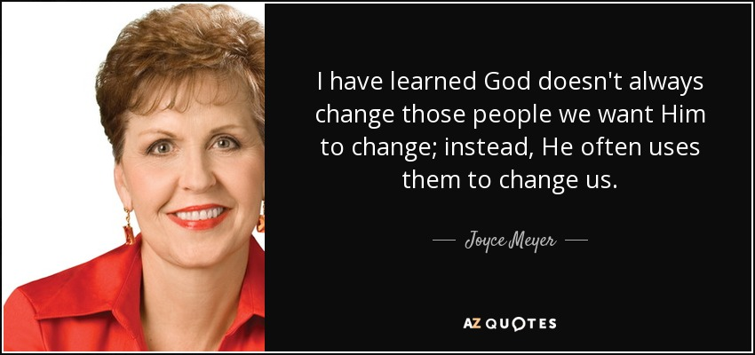
1Corinthains 1:2
Do people change?
What is the catalyst?

Slide 17
1Corinthains 1:2
Some factors that cause people to change:
1) A life altering event
- Salvation, death, love, loss, failure, disappoint,
catastrophe, breakup
2) Stories we read or see
- We identify with the characters and what happens to
them feels like has happened to us.
- strong emotions cement memories
3) People that believe in us
- also, the environment we
surround ourselves with.
4) Goals and grit
- a strong desire to change
- dreams, betterment etc.

Slide 18
1Corinthains 1:10-4:16 Christian Unity
I appeal to you, brothers and sisters, Jesus is our Lord
in the name of our Lord Jesus Christ, NAME … of Jesus
that all of you agree with one another Divisions
in what you say and that there be no
divisions among you,
but that you be perfectly united in Must unite
mind and thought.
My brothers and sisters, some from Chloe’s Not Fight
household have informed me that there are
quarrels among you.
What I mean is this: One of you says, “I follow Divisions
Paul”; another, “I follow Apollos”; another,
“I follow Cephas[b]”; still another, “I follow Christ.”
Is Christ divided?
Was Paul crucified for you? Were you baptized Jesus died for you
in the name of Paul? NAME … of Paul?

Slide 19

1Corinthains 1:10-4:16 Christian Unity
Divisions … like torn tent cloth that leaks …

Slide 20
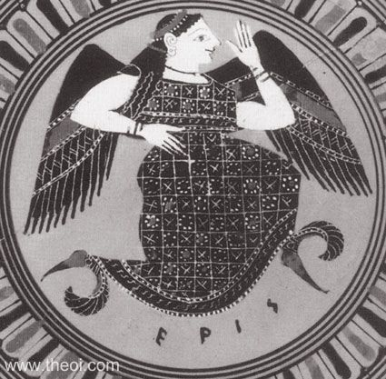
1Corinthains 1:11
ERIS was the goddess or personified spirit of strife, discord, contention and rivalry. She was often portrayed, more specifically, as the spirit of the strife of war, haunting the battlefield and delighting in human bloodshed.
Because of Eris' disagreeable nature she was the
only goddess not to be invited to the wedding of
Peleus and Thetis. When she turned up anyway
and was refused admittance, she raged and
threw a golden apple amongst the goddesses
inscribed "To the fairest." Three laid claim to
it--Hera, Aphrodite and Athena--and in their
rivalry brought about the events leading
up to the Trojan War.

Slide 21
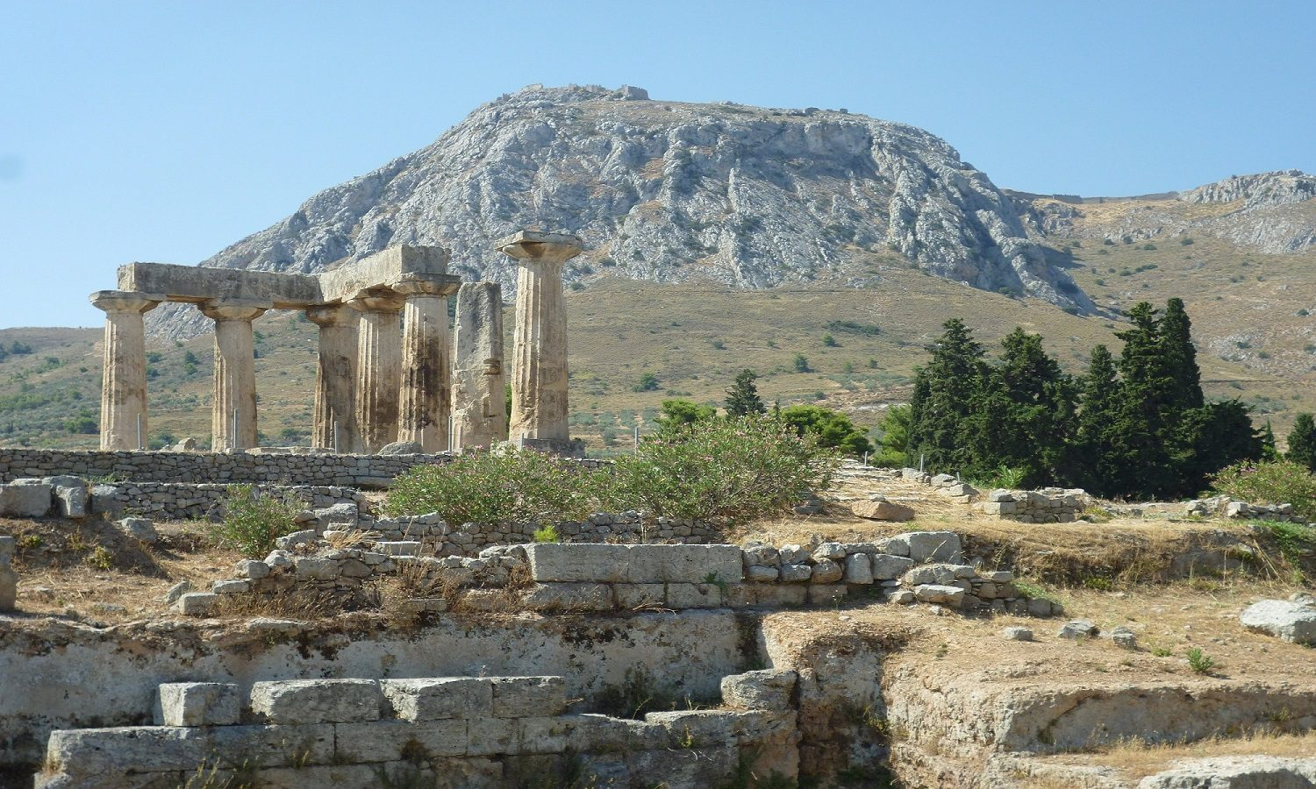
1Corinthains 1:11
I follow Paul: Paul was viewed as a Roman Citizen
I follow Apollos Apollos (Greek named)
I follow Cephas Cephas is Peter’s Jewish name
I follow Jesus Implies that everyone else isn’t; Just us.
Corinth was a city in Greece, which was destroyed by the Romans in 146 B.C. and then rebuilt by them in 44BC.
Racial tensions ran high.

Slide 22

Gleanings
1. There is no place in the Body for racial segregation or separation.
2. Leaders should not be that which separates.
3. We are called by Christ (1:2). THAT is our unity
4. Baptism and the cross unite us.
5. The real question is, Who died for me … not … Who is my leader.

Slide 23

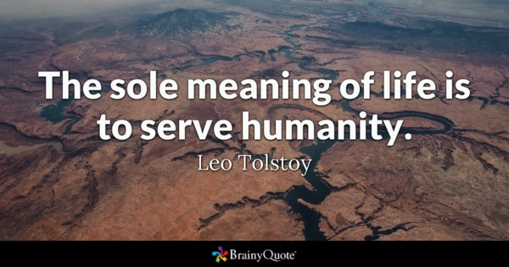
1:17-2:2
Three Themes:
- Wise words and wise people are inadequate
- The power of God lies in the Cross
- Wise words and wise power are inadequate

Slide 24
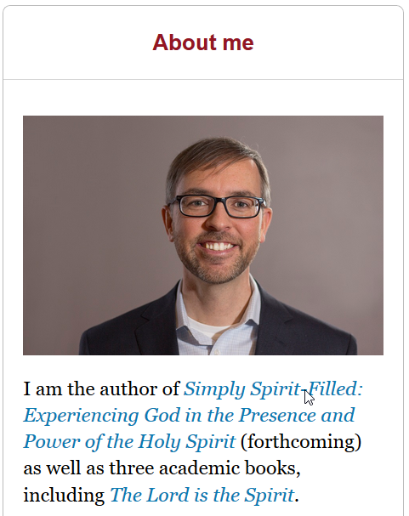
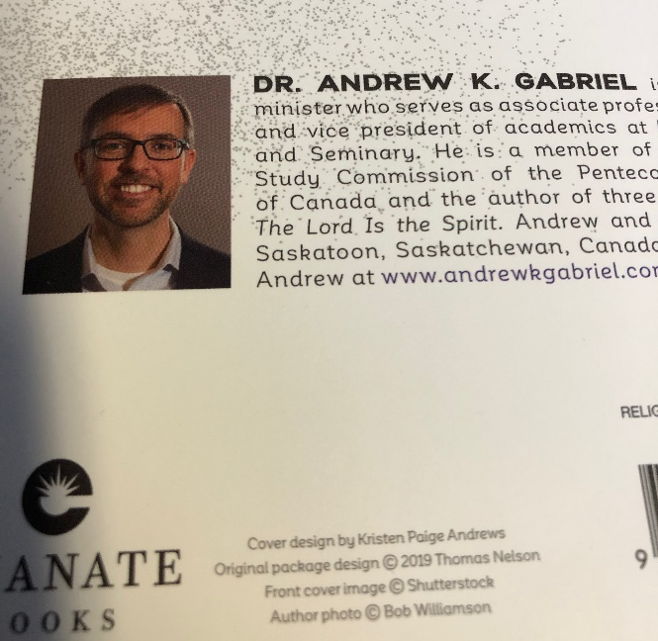

1:17-2:2
Why human wisdom fails:
1) It does not adequately describe reality
- I must understand what is broken and how to fix it
2) Sooner or later, what it demands for my happiness will
impinge upon your happiness
3) It never answers the question of significance
- It leads to a crisis of helplessness
- Solomon discovered this in Eccles. 2
4) God’s way is to find my purpose in life by following Him … giving myself.

Slide 25
1Corinthains 1:10-4:16 Outer Block: The “Wise”
17For Christ did not send me to baptize, but to preach the gospel—not with
wisdom and eloquence, lest the cross of Christ be emptied of its power.
For the message of the cross is foolishness to those who are perishing, but to us who
are being saved it is the power of God, For it is written: “I will destroy the wisdom
of the wise; the intelligence of the intelligent I will frustrate.”
20 Where is the wise person? Where is the teacher of the law? Where is the philosopher
of this age? Has not God made foolish the wisdom of the world? (skip 21-25)
Paul Sent
Preach Gospel
Not Wise Words
The Cross
Perishing
The Power Of God
Scripture: Destroy
Jewish Scholar
Greek Scholar
Jewish Scholar
Greek Scholar
Isa. 29:14
26Not many of you were wise by human standards;
not many were influential; not many were of noble birth. (also … think Jesus here)
An Example: But God chose the foolish things of the world to shame the wise; God chose the weak things of the world to shame the strong. God chose the lowly things of this world and the despised things—and the things that are not—to nullify the things that are,
so that no one may boast before him. It is because of him that you are in Christ Jesus,
who has become for us wisdom from God—that is, our righteousness, holiness and
redemption. Therefore, as it is written: “Let the one who boasts boast in the Lord.”
And so it was with me, brothers and sisters. When I came to you, I did not come with
eloquence or human wisdom as I proclaimed to you the testimony about God. (2:2) For
I resolved to know nothing while I was with you except Jesus Christ and him crucified.
Boasting
Wisdom Of God
I Paul Came
No Wise Words
Proclaiming
Jer. 9:23-24
Wisdom
Strength
Riches

Slide 26
1Corinthains 1:10-4:16 Inner Block: “The Cross”
21For since in the wisdom of God the world Wisdom of God
through its wisdom did not know him, World Ignorant
God was pleased through the foolishness Kerygma
of what was preached to save those who believe. Believers
Jews demand signs and Jews
Greeks look for wisdom, Greeks
but we preach We Preach
Christ crucified: The Cross
a stumbling block to Jews and Jews
foolishness to Gentiles, Greeks
but to those whom God has called, Those Called
both Jews and Greeks, Christ the Christ: Power and Wisdom
power of God and the wisdom of God.
25For the foolishness of God is wiser than human God is Wise, Strong
wisdom, and the weakness of God is stronger Humans are Weak/Foolish
than human strength.
An Example: Brothers and sisters, think of what you were when you were called.

Slide 27
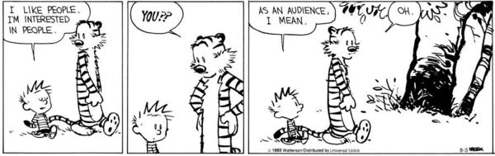
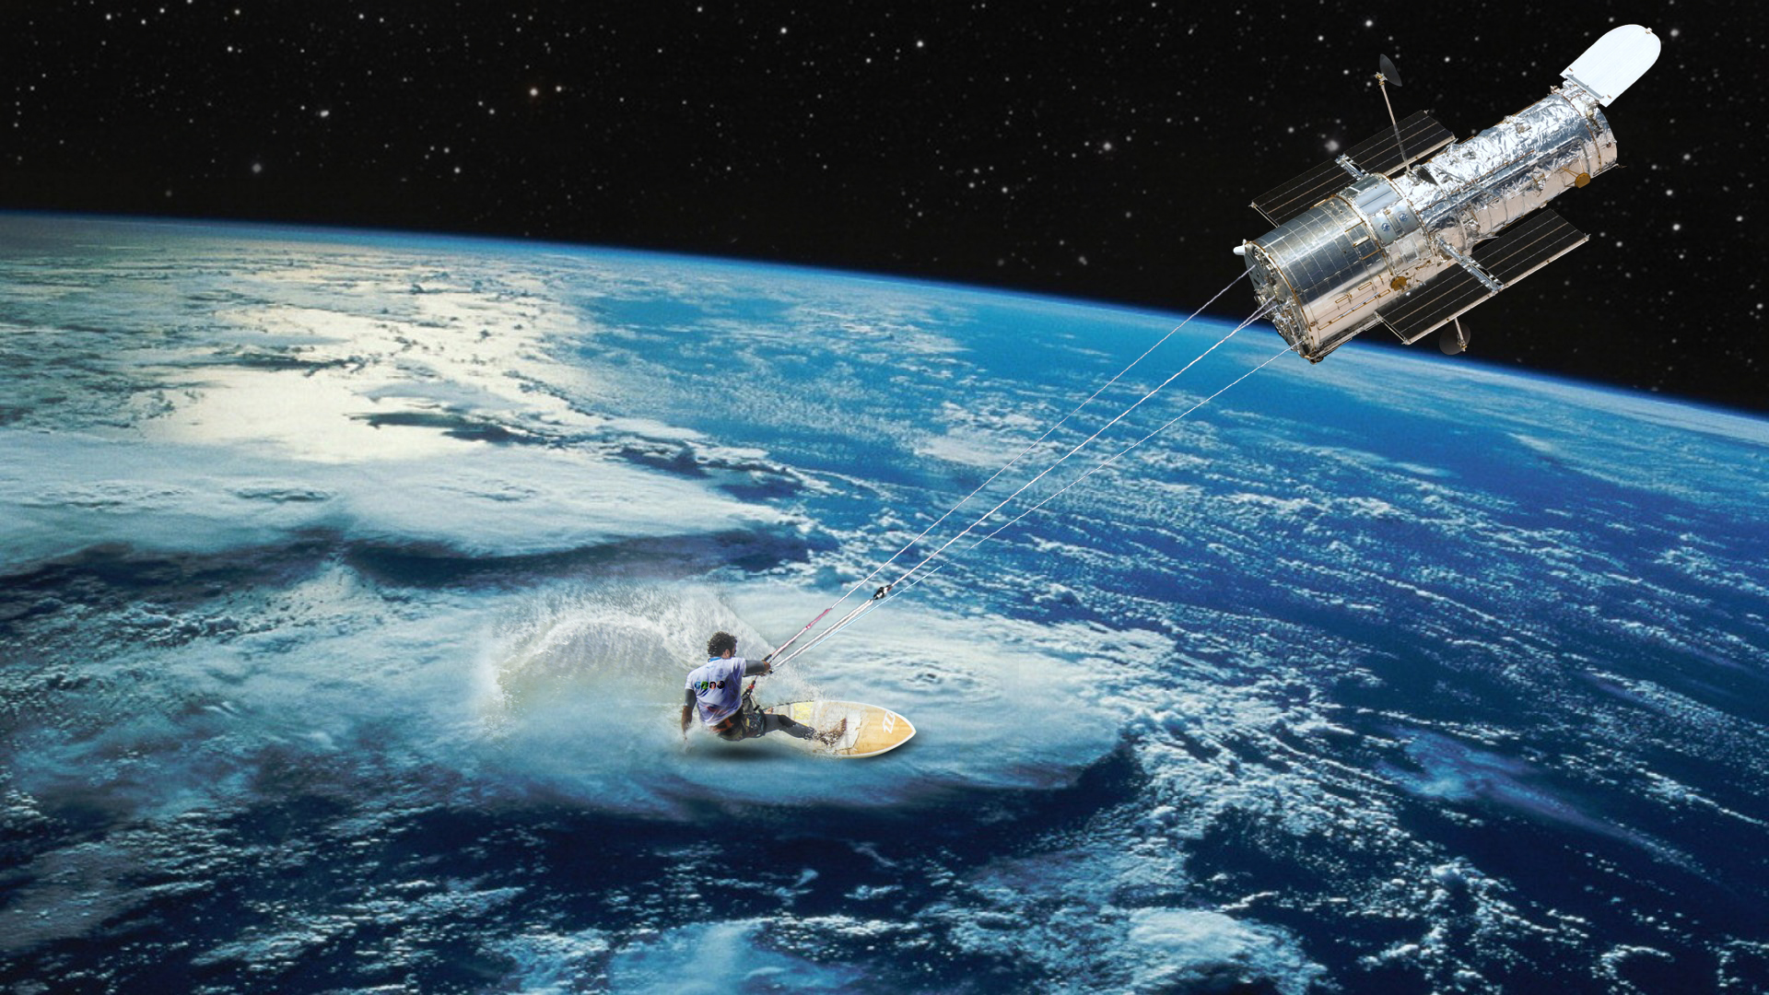
1Corinthains 1:10-4:16 Boasting

Slide 28

1Corinthains 1:10-4:16 What is Paul NOT Saying?
1) That study is wrong
- Paul was a scholar himself who wrote difficult theology!
2) That wisdom cannot be found
- It can, but must be viewed in the PROPER context of God
- Galileo
3) That the gospel makes no sense
- It does, but requires a divine POV.
4) God only saves the simple.
- Simply not true!
- A child-like faith is not
a childish faith. (Heb. 6:1-3)
5) That we should mimic the world to win the
world.

Slide 29

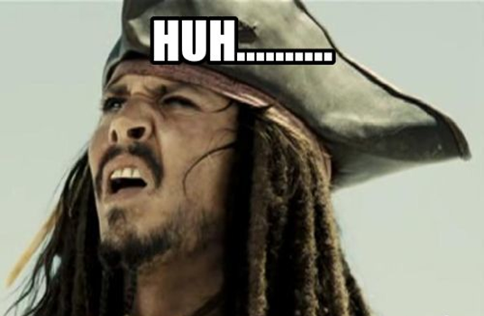
1Corinthains 1:10-4:16
Moralistic therapeutic deism (MTD) is a term that was first introduced in the book Soul Searching: The Religious and Spiritual Lives of American Teenagers (2005) by sociologists Christian Smith and Melinda Lundquist Denton.
The term is used to describe what they consider to be the common beliefs among American youth. The book is the result of the research project the "National Study of Youth and Religion".
The author's study found that many young people believe in several moral statutes not exclusive to any of the major world religions. It is not a new religion or theology as such, but identified as a set of commonly-held spiritual beliefs. It is this combination of beliefs that they label Moralistic Therapeutic Deism:
1) A god exists who created and ordered the world and watches over human life on earth.
2) God wants people to be good, nice, and fair to each other, as taught in the Bible and by most world religions.
3) The central goal of life is to be happy and to feel good about
oneself.
4) God does not need to be particularly involved in one's life
except when God is needed to resolve a problem.
5) Good people go to heaven when they die.

Slide 30

1Corinthains 1:10-4:16 What is Cross Centred Preaching?
1. My need for Christ’s substitutionary death (1Corinthians 15:1-4)
2. Preaching the life and message of Christ (Acts 8:35)
- Note that Paul uses Christ’s name 17 times in chapter 1
3. Preaching a message of identification with Christ (Romans 6)
4. Preaching the Church (Ephesians 2:15-16)
5. Preaching in spite of the existence of evil
- the cross was evil. Christ submits to it.
- We serve God in spite of the evil we see around us.

Slide 31
1Corinthains 2:3-10
Subversive!
3 I came to you in weakness with great fear and trembling.
4 My message and my preaching were not with wise and
persuasive words, but with a demonstration of the
Spirit’s power,
5 so that your faith might not rest on human wisdom,
but on God’s power.
6 We do, however, speak a message of wisdom among
the mature, but not the wisdom of this age or of the
rulers of this age, who are coming to nothing.
7 No, we declare God’s wisdom, a mystery that has been
hidden
and that God destined for our glory before time began.
8 None of the rulers of this age understood it,
For if they had, they would not have crucified the
Lord of glory.
9 However, as it is written: “What no eye has seen,
what no ear has heard, and what no human mind
has conceived”—
the things God has prepared for those who love him—
10 these are the things God has revealed to us by his Spirit.
PAUL:
Fear and trembling
HIS MESSAGE:
Spirit and Power
YOUR FAITH:
In the power of God
FOR THE MATURE
Wisdom
This age cannot understand
God’s wisdom: Hidden in a mystery
God’s decree: For our glory
Not understood by the people
THE CROSS!
Not understood by the people
God prepared: For us who loved Him
God’s wisdom: Revealed through the Spirit
Isa. 52:15

Slide 32
1Corinthains 2:3-10 The Trinity
The doctrine of the Trinity emerges from the depth Grammar of the Holy Scriptures and Christian worship. Bringing this ‘depth grammar’ to light should make apparent the logic and necessity of the Christian doctrine of the Trinity.
1. There is only one God.
2. His name is YHWH (tetragrammaton)
3. The LORD brought the people of Israel up out of slavery in
Egypt. Therefore they shall have no other gods.
4. The LORD will not share his glory with another.
5. The LORD is the incomparable Creator of heaven and earth.
Dr. Robert J. Dean

Slide 33
1Corinthains 2:3-10 The Trinity
1. Jesus refers to the God of Israel as his Father. (Math. 7:21, 10:32 etc.)
2. Jesus identifies Himself with the God of Israel in word and deed. (Matt. 8:27, John 5:16-18, John 5:36)
3. Jesus claims that he and the Father are one. (John 10:30, John 14:10-11)
4. Jesus’ followers worship him as God. (Matt. 16:16, 14:33, John 9:38, John 20:28)
5. Jesus shares the divine name of the LORD. (John 8:58, 20:28, Rev. 1:18)
Possible Options for Understanding the relationship between Jesus and the God of Israel:
1. Jesus is a second god
- There is only one God
2. Jesus became God at some point
- Because God is eternal, either one is God or is not God, one does not
‘become’ God
3. Jesus must share in the identity of the God of Israel
Dr. Robert J. Dean

Slide 34
1Corinthains 2:3-10 The Trinity
1. The Spirit is closely associated with both Jesus and the Father (Matt. 28:19)
2. The Spirit is portrayed in personal terms and not simply as an abstract power
a) Lie against the Spirit (Acts 5:3)
b) Grieve the Spirit (Eph. 4:30)
3. The Spirit does divine things (John 14:16)
a) Teaches (John 14:26)
b) Guides in truth (John 16:13)
c) Gives life (John 6:63, Romans 8:11)
d) Sanctifies and Justifies (1 Corinth. 6:11)
Therefore, the Spirit, like the Son, must also be understood to participate in the identity of the God of Israel.
The Cappadocians (4th C A.D.) innovatively deployed the
Greek terms:
◦ ousia (‘being’ or ‘essence’)
◦ hypostasis (concrete particularity in which
ousia exists) = Person
Dr. Robert J. Dean

Slide 35
1Corinthains 2:3-10 The Trinity
Dr. Robert J. Dean
Trinitarian Heresies:
1. Tritheism
- Preserves the Threeness of God at the expense of the Oneness of God
2. Adoptionism
- Christ was once human but because He did not sin, the Father adopted Him
- For us to worship him would make us idolatrous
- A creature cannot save us
3. Modalism
- Preserves the Oneness of God at the expense of the Threeness
- However, does this mean that God puts on a mask and the true God
is really unknown to us?
- How could the Son pray to the Father?
- What about Jesus’ baptism?
4. Arianism
- Christ was a creature made by God
- Then there was a time that God was not
Father
- Christ was homoiousios (of like essence)
- pronounced home-oy-ooh-see-os
- But Jesus does “God things”

Slide 36

Nicene Creed … 325AD
We believe in one God, the Father almighty, maker of heaven and earth, of all things visible and invisible.
And in one Lord Jesus Christ, the only Son of God, begotten from the Father before all ages,
God from God, Light from Light, true God from true God, begotten,
not made, of the same essence as the Father.
Through him all things were made. For us and for our salvation he came down from heaven;
he became incarnate by the Holy Spirit and the virgin Mary, and was made human.
He was crucified for us under Pontius Pilate; he suffered and was buried.
The third day he rose again, according to the Scriptures.
He ascended to heaven, and is seated at the right hand of the Father.
He will come again with glory to judge the living and the dead. His kingdom will never end.
And we believe in the Holy Spirit, the Lord, the giver of life. He proceeds from the Father and the Son,
and with the Father and the Son is worshiped and glorified. He spoke through the prophets.
We believe in one holy catholic and apostolic church. We affirm one baptism for the forgiveness of sins.
We look forward to the resurrection of the dead, and to life in the world to come.
Amen.

Slide 37
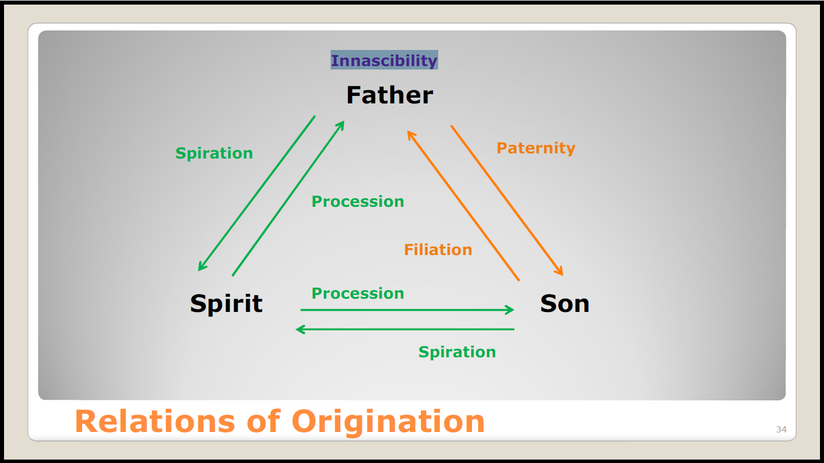
1Corinthains 2:3-10 The Trinity
Dr. Robert J. Dean

Slide 38
1Corinthains 2:3-10 The Trinity
When we speak of relations, we think of relations between already existing persons
◦ Eg. – My wife and I both existed prior to entering into the relationship of marriage
This will not do when it comes to divine persons
◦ If the Father exists before begetting the Son, then there is something beyond their
relationship that distinguishes them
In other words, the Son would not be God in the same sense that the Father is God
◦ If the Father, Son, and Spirit exist prior to entering into relationship with one
another we have three different gods
Dr. Robert J. Dean

Slide 39
1Corinthains 2:3-10 The Trinity
Any attempt to make the gospel
palatable by bringing it into line
with the tastes of those to whom
it is preached distorts it, because
in this case the criterion is made
the expectations of fallen
humanity.
In so doing, it loses its power.
The Trinity is a divine mystery.
Dr. Robert J. Dean

Slide 40

1Corinthains 2:3-10 The Trinity: So What?
What does the Trinity teach us about …
1) Unity?
2) Community?
3) Roles?
4) Love?
5) Worship?

Slide 41
1Corinthains 2:10-15
A man, his thoughts, his spirit!
¹⁰ these are the things God has revealed to us by his
Spirit. The Spirit searches all things, even the deep
things of God. ¹¹ For who knows a person’s thoughts
except their own spirit within them? In the same way
no one knows the thoughts of God except the Spirit of God.
¹² What we have received is
not the spirit of the world, but the Spirit who is from
God, so that we may understand what God has freely
given us.
¹³ This is what we speak, not in words taught us by
human wisdom but in words taught by the Spirit,
explaining spiritual realities with Spirit-taught words.
¹⁴ The person without the Spirit does not accept
the things that come from the Spirit of God but
considers them foolishness, and cannot understand
them because they are discerned only through the Spirit.
¹⁵ The person with the Spirit makes judgments about
all things, but such a person is not subject to merely
human judgments, ¹⁶ for,“ Who has known the mind
of the Lord so as to instruct him? ”But we have the
mind of Christ.
Spirit … Deep Thing of God
PARABLE OF:
Humanity: Thoughts and Spirit
God: Thoughts and Spirit (Trinity)
We Receive:
Spirit
Understanding
Grace
We Impart
- Teachings of the Spirit
- To spiritual people
Natural Man NOT Receive:
- Spiritual gifts
- Understanding
The Spiritual One Discerns All
Mind Of Christ (Trinity)
Isa. 40:13

Slide 42
1Corinthains 2:10-15: The Trinity
 | Spirit | Christ | God
1. | The Spirit (searches all) | Deep things | Of God
2 | The Spirit (knows) | The thoughts | Of man
3. | The Spirit (knows) | The thoughts | Of God
4. | From the Spirit | Things graced upon us | From God
5. | The Spirit | The things | Of God
6. | The Spiritual One | The mind of Christ | Mind of Yahweh

Slide 43

It is impossible for a natural person to receive God’s truth. So ….
1. How does ANYONE get saved? (Prevenient Grace?)
2. Why do we expect that people will “clean up” before coming
to Christ (or to church)?

Slide 44
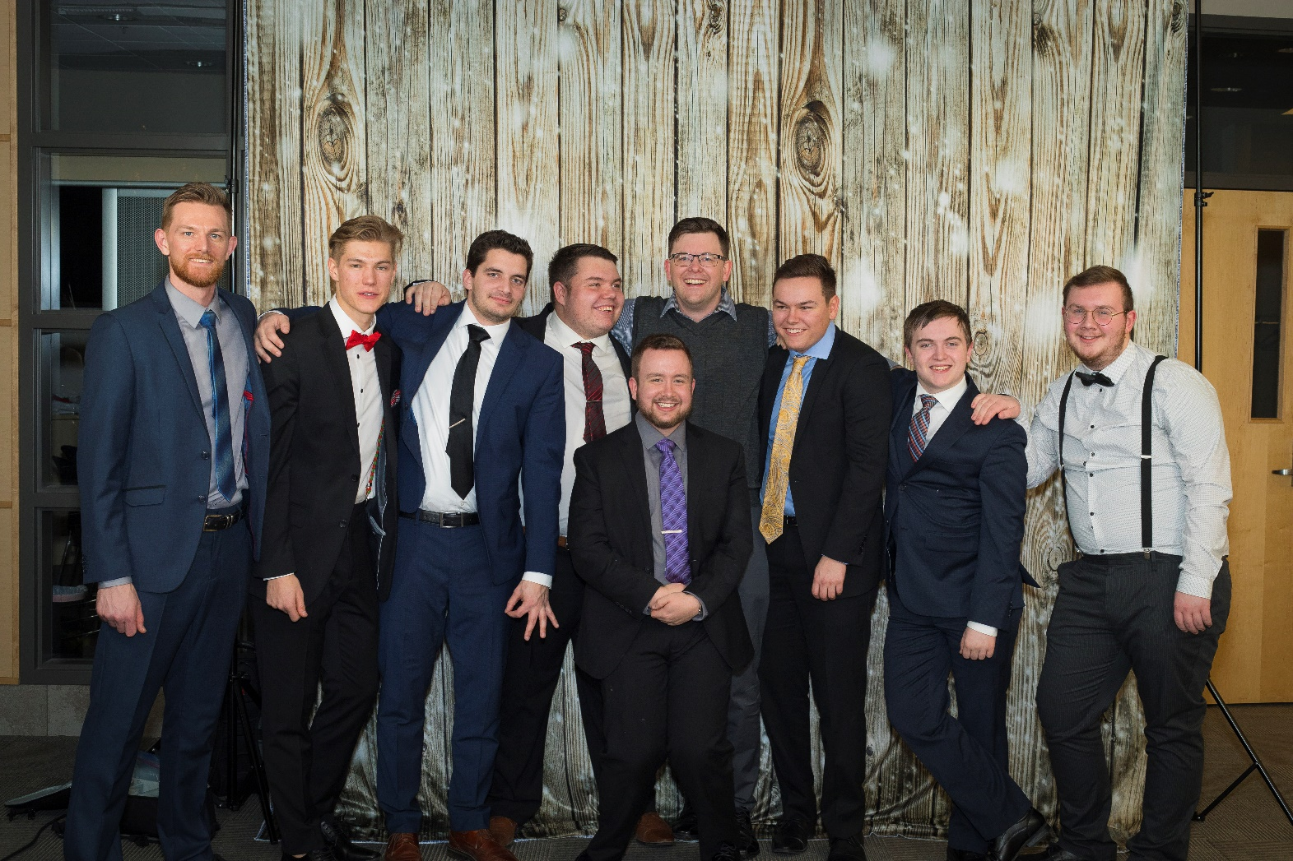
What Is YOUR
Mission?

Slide 45
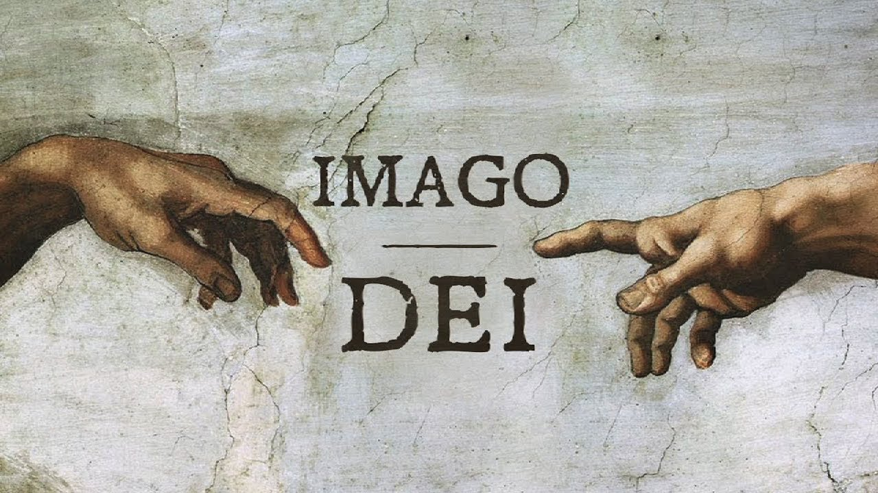
1Corinthains 3:1-4:16 Christian Unity
Thus far … Problem: Division
The Wisdom and Power of God: The Cross
The Wisdom and Power of God: The Spirit
Solution: Paul, Apollos, Cephas are one

Slide 46
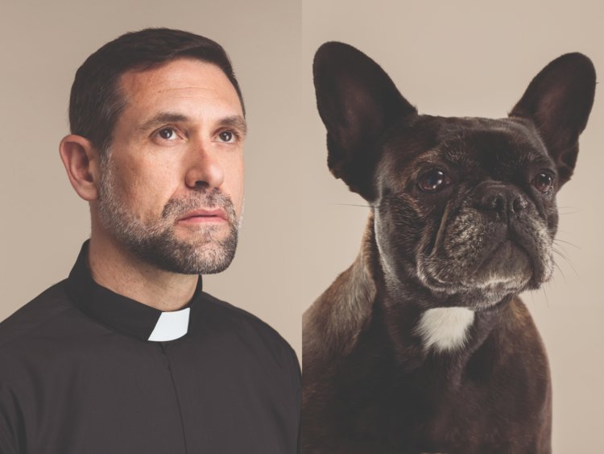

1Corinthains 3:1-4:16 Christian Unity
God remains faithful to Himself and promises a new redeemed people who will bear His image.
The true redeemer and deliverer is none other than Christ Jesus. His baptism and temptation is a
recapitulation of Israel’s exodus, this time without failure. He does what the Father does, performing
the deeds mirrored in the creation and exodus. He is true imago Dei; exalted and Giver of the Spirit,
calling those who recognize Him as king to share in a final resurrected destiny, living as true humans
along with their sisters and brothers.
This eschatological restoration of the image of God is both personal and communal. We are called to
live in love bearing the image of God; empowered by His Spirit and acting well towards one another.
As eschatological people, our lives have been reconstituted in every way and the expectation is that
all of creation will be restored as the new dwelling place of God.

